Slide 1
Data-Driven Structure Preservation for Scientific Machine Learning
SAND2023-04587C
Jonas A. Actor, Nat Trask, Andy Huang
Postdoctoral Appointee
Computational Mathematics - 01442
Sandia National Laboratories
jaactor@sandia.gov
This paper describes objective technical results and analysis. Any subjective views or opinions that might be expressed in the paper do not necessarily represent the views of the U.S. Department of Energy or the United States Government.

Slide 2
Setup: Inverse Problems and Surrogate Models
high-fidelity model
expensive
compute-intensive
observational
Given: data capturing physics laws
Goal: recover model that describes data while
preserving underlying physics laws

Slide 3
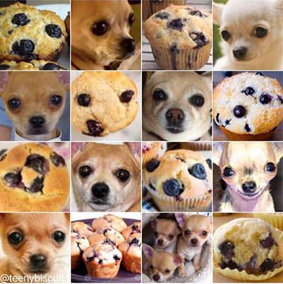
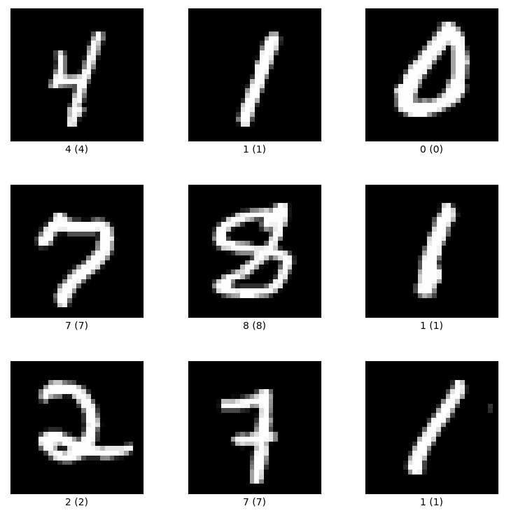
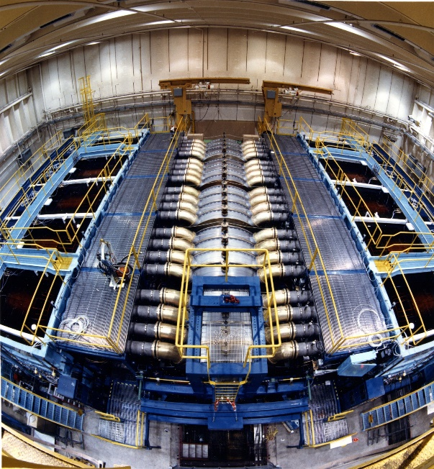
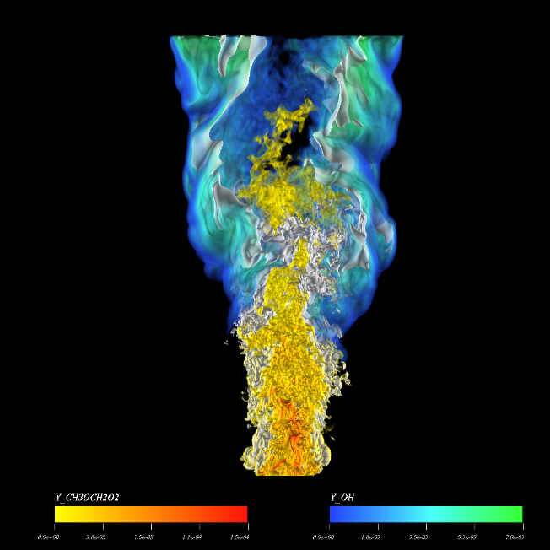
Why Structure-Preserving ML?
Traditional ML
Lots of data
Structured data: images, text, video
Model invariant to translation, noise
Goal is accuracy
Classification, correlation, segmentation
Scientific ML
Small amounts of data
Unstructured data
Model invariants of conservation laws
Goal is accuracy, UQ, V+V
Simulation for multiscale/multiphysics
Images: freeCodeCamp, TensorFlow, SNL (CSandia/EIMS), SNL (CSandia/EIMS)

Slide 4
Preserving Physics in Machine Learning Models
“Learn from data”
Black Box NN learn model through data exclusively
$$\min_{ξ}{{\left\|NN_{ξ}−u_{data}\right\|}_{2}^{2}}$$
Physics-Informed NN learn model close to physics through penalty
$$\min_{ξ}{{\left\|NN_{ξ}−u_{data}\right\|}_{2}^{2}} + λ ‖L\left[NN_{ξ}\right]−f{\left.​\right\|}_{2}^{2}$$
Structure-Preserving NN learn model that preserves physics exactly
$$\min_{ξ}{{\left\|NN_{ξ}−u_{data}\right\|}_{2}^{2}} such that L\left[{NN}_{ξ}\right]=f$$
“Solve from physics”

Slide 5
Avoiding Model Error is Necessary!
A generic NN is doomed to fail to model electromagnetism if the underlying physics invariants – such as Gauss’s Law – are not obeyed exactly…
$$∯{B⋅dS}=0 ⟺ ∇⋅B=0$$
You cannot see the physics from the data alone!

Slide 6
Why Learn a Chain Complex?
Guarantee physics constraints
Divergence-free, gauge-free constraints appear naturally in homology of chain complex
Learn new metrics
Chain complexes can be built for any manifold, with bespoke metric information
Build with mesh-free construction
Build k-forms using Whitney Forms
Construct with exact integration
Avoid variational crimes due to collocation, quadrature, etc.

Slide 7
Examples of Physics Relationships
0-forms (“points”)
temperature, electric potential
1-forms (“curves”)
electric field, magnetic field
2-forms (“areas”)
heat flux, magnetic flux
3-forms (“volumes”)
charge density, mass density
grad $∇$
curl $∇×$
div $∇⋅$
div*
curl*
grad*
Stokes’ Theorem
Exact Sequence Property
$$\int_{Ω}{ ∇⋅u}=\int_{∂Ω}{u⋅\overset{⃑}{n} }$$
$$∇×\left(∇u\right)=0$$

Slide 8
Example of a Chain Complex
The de Rham complex encodes how exterior calculus relates volumes to boundary fluxes.
Stokes’ Theorem
Exact Sequence Property
$$\int_{Ω}{ ∇⋅u}=\int_{∂Ω}{u⋅\overset{⃑}{n} }$$
$$∇×\left(∇u\right)=0$$

Slide 9
Example of a Chain Complex
The de Rham complex encodes how exterior calculus relates volumes to boundary fluxes.
Stokes’ Theorem
Exact Sequence Property
$$\int_{Ω}{ δ_{0}^{∗}u}=\int_{∂Ω}{u⋅\overset{⃑}{n} }$$
$$δ_{1}∘δ_{0}=0$$

Slide 10
Examples of k-Forms
0-forms
temperature, electric potential
1-forms
electric field, magnetic field
2-forms
heat flux, magnetic flux
3-forms
charge density, mass density
Good reference: Arnold, D. “50 years of Whitney elements”, talk, slides available at www-users.cse.umn.edu/~arnold/talks/whitney-print.pdf

Slide 11
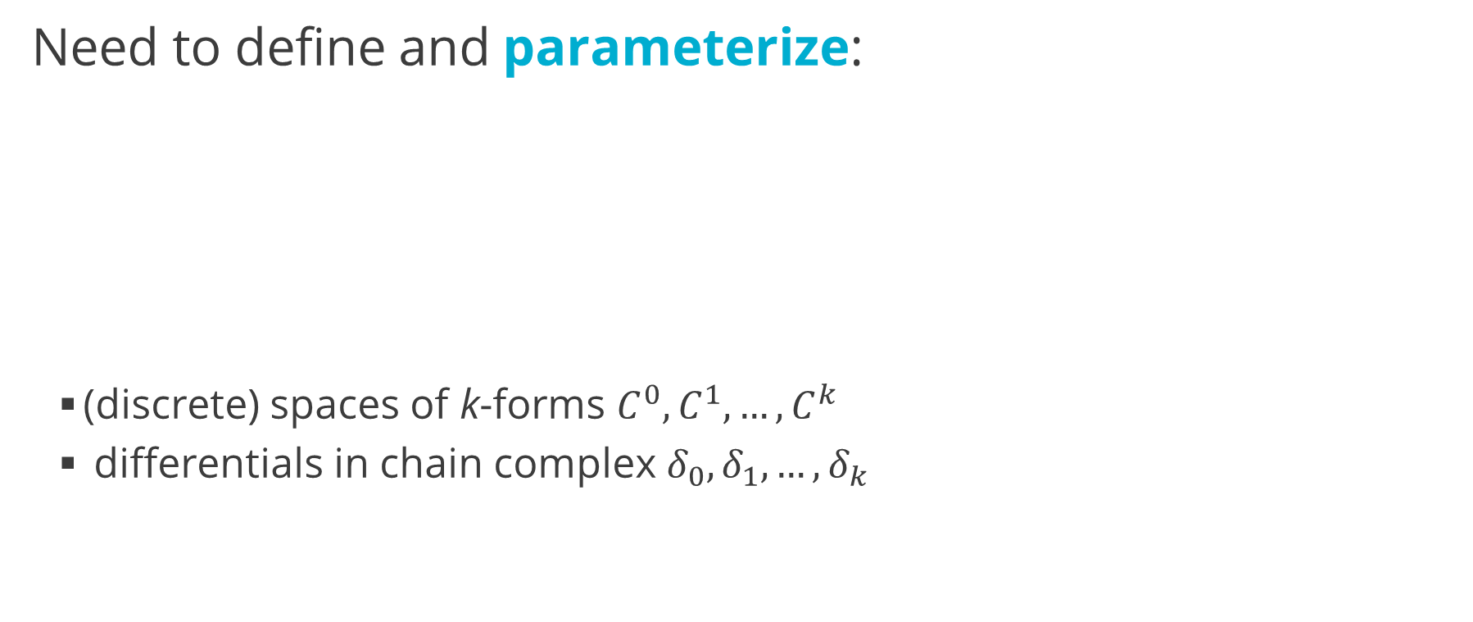
Example of a Chain Complex
Need to define and parameterize:
(discrete) spaces of k-forms $C^{0},C^{1},…, C^{k}$
differentials in chain complex $δ_{0},δ_{1},…, δ_{k}$

Slide 12
Defining k-forms
Build a partition of unity ${\left\{ψ_{i}\right\}}_{i=1,…,N}$ parameterized by trainable parameters ${\left\{θ_{j}\right\}}_{j=1,…,M}$
A partition of unity (POU) maintains the following characteristics:
$0≤ψ_{i}\left(x\right)≤1$ for every point $x∈Ω$
$\sum_{i}{ψ_{i}}=1$
Examples: softmax, probability distributions, B-splines
“Fuzzy Control Volumes”

Slide 13
Defining our Partition of Unity
1. Define fine-scale trainable spline knots ${\left\{t_{k}\right\}}_{k=1,…,K}$
2. Define B1-splines $\hat{ψ_{k}}\left(x\right)= \left\{\begin{aligned} \frac{x − t_{k−1} }{t_{k } − t_{k−1}} if x∈[t_{k−1}, t_{k}] \\ 1 − \frac{{x − t}_{k}}{t_{k+1} −{ t}_{k}} if x∈[t_{k}, t_{k+1}] \\ 0 else \end{aligned}\right.$
3. Define trainable convex combination matrix $W∈ℝ^{K×N}$, constrained so that
$${0≤W}_{k,n}≤1 ∀ k,n \\ \sum_{n}{W_{k,n}=1} ∀ k$$
4. Define POU functions $ψ_{i}\left(x\right)=\sum_{k}{W_{k,i} }\hat{ψ_{k}}\left(x\right)$

Slide 14
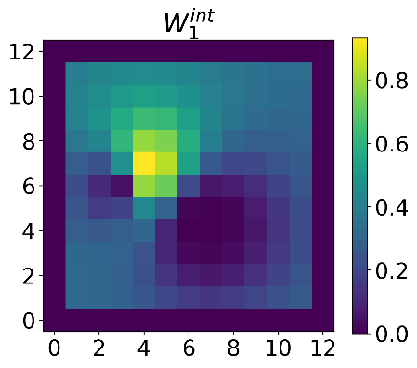
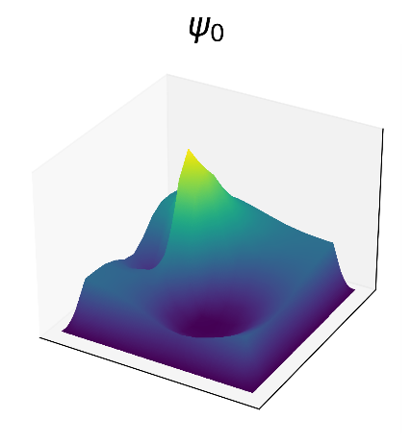
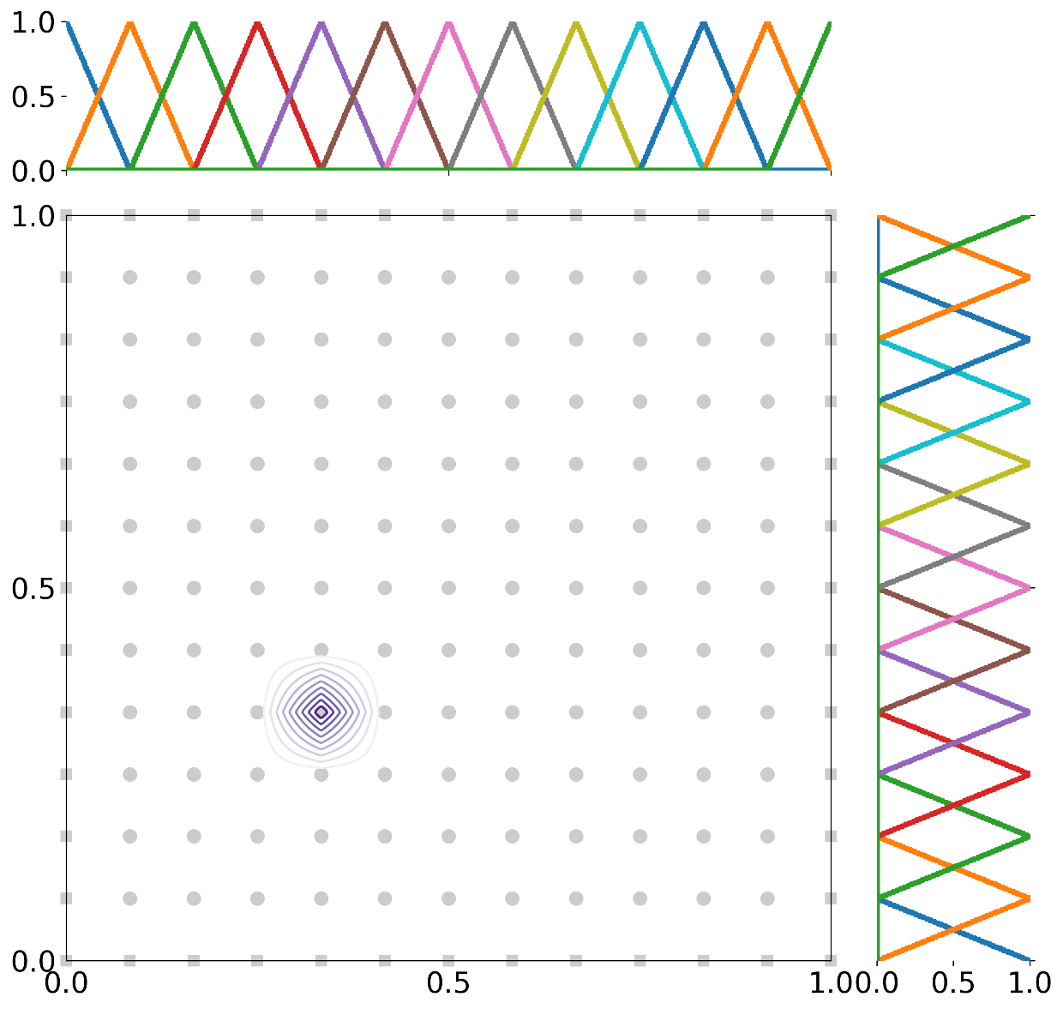
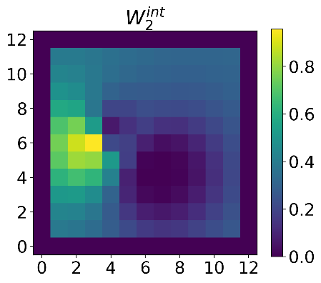
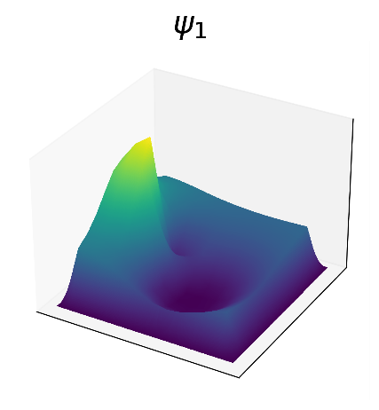
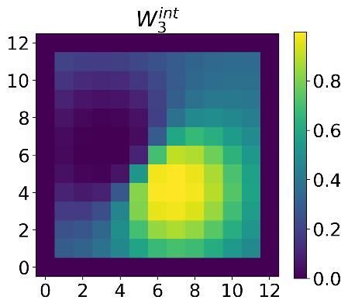
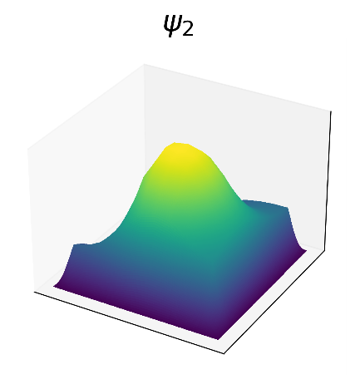
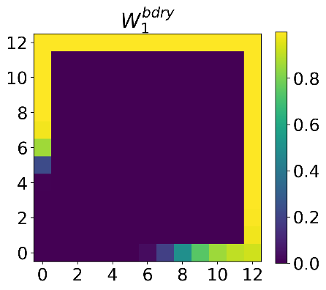
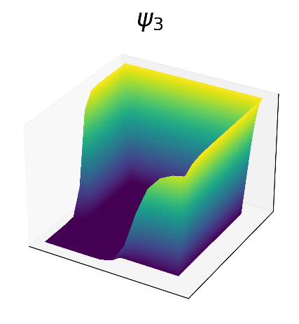
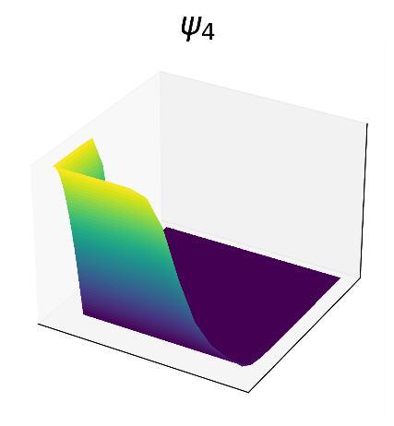
An Illustration
$$V_{D}^{0}$$
$$V^{0}$$

Slide 15
Defining Whitney k-forms
Define each space of k-forms $C^{k}$:
POUs $={C^{0}=span \left\{ψ_{i}\right\}}_{i=1,…,N}$
Fluxes between POUs $={C^{1}=span \left\{ψ_{ij}= ψ_{i}∇ψ_{j}−ψ_{j}∇ψ_{i}\right\}}_{i,j=1,…,N}$
Higher order relationships ${=C^{k}=span \left\{ψ_{j_{0},j_{1},…,j_{k}}^{k}\right\}}_{j_{0},j_{1},…,j_{k}=1,…,N}$
$$ψ_{j_{0},j_{1},…,j_{k}}^{k}=k!\sum_{i=0}^{k}{{\left(−1\right)}^{i}{ ψ}_{j_{i} } dψ_{j_{0}}∧…∧dψ_{j_{i−1}}∧dψ_{j_{i+1}}∧…∧dψ_{j_{k}}}$$

Slide 16
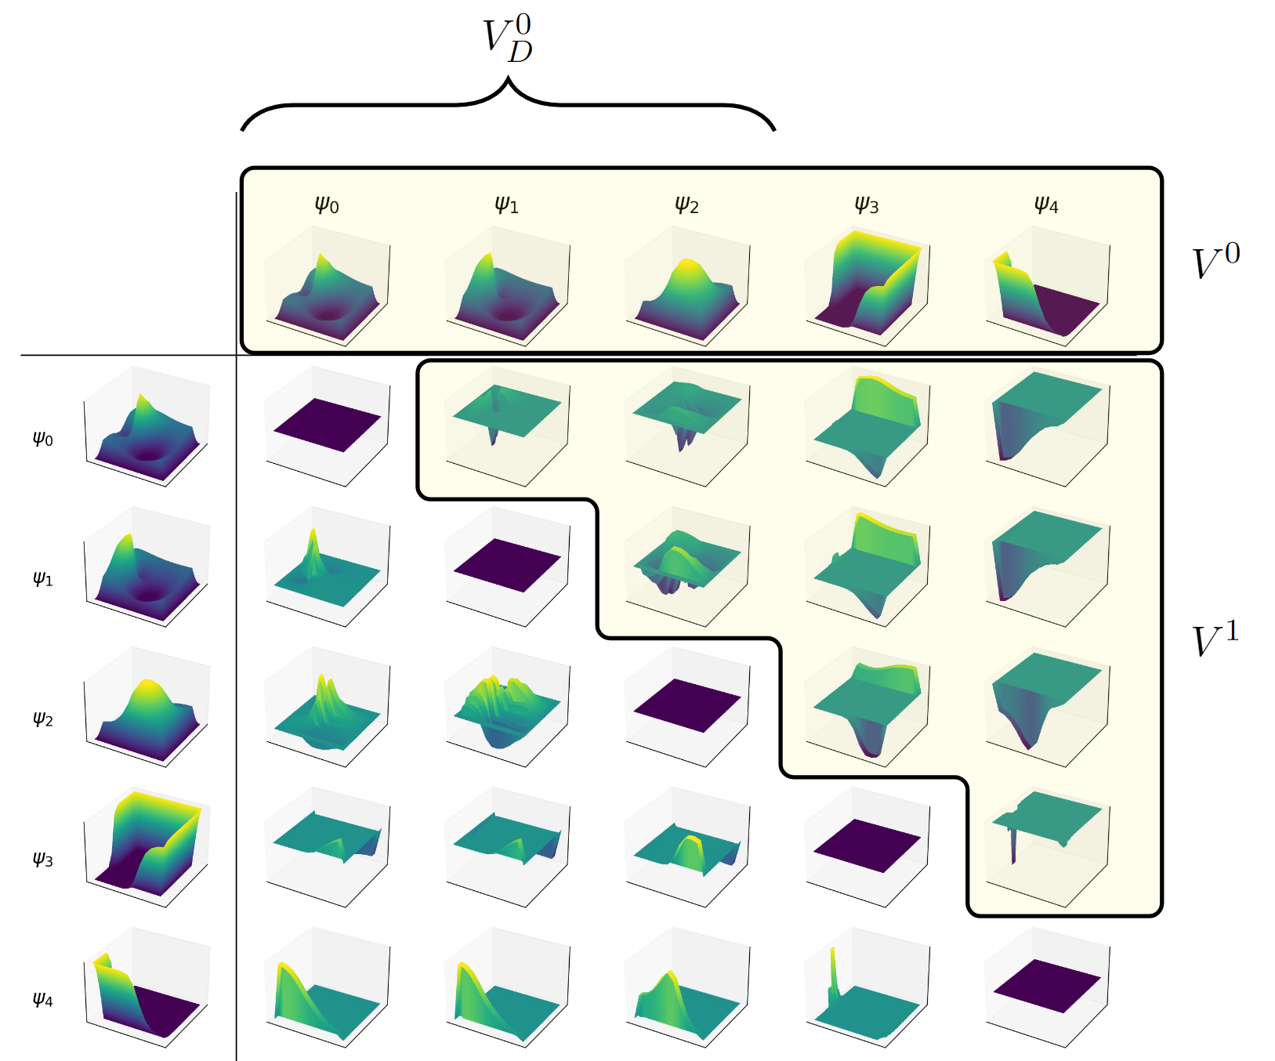
An Illustration
Using 0-forms from earlier,
$$ψ_{ij}= ψ_{i}∇ψ_{j}−ψ_{j}∇ψ_{i}$$

Slide 17
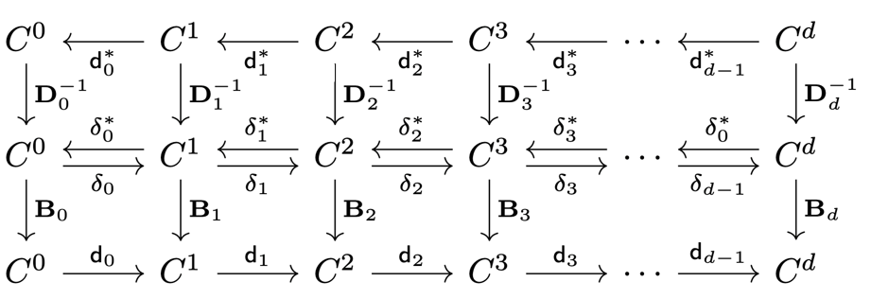
Defining Metricized Exterior Derivatives
Initial $δ_{k}$ is the corresponding discrete exterior calculus operator on a complete graph
$$DIV ψ_{ij}= δ_{0}^{∗}ψ_{ij}=ψ_{j}−ψ_{i}$$
New $δ_{k}$ warps DEC operator by multiplying on left and right with positive diagonal trainable metric tensors $B_{k},D_{k}$:
“Assign mass, area to POUs”

Slide 18
Building Exact Physics FEEC System
Strong form
Find $\left(p,F\right)∈C^{0}×C^{1}$ such that
$${ F − ∇p \atop ∇⋅F} {= \atop =} { 0 in Ω \atop f in Ω} \\ F⋅\overset{⃑}{n }=g_{N} on Γ_{N} \\ p=g_{D} on Γ_{D}$$
Discrete System
Solve the linear system
Learnable system
Solve the new linear system

Slide 19
Building Exact Physics FEEC System
Discrete System
Solve the linear system or equivalent system
Introduce metrics
Change metrics for exterior derivatives
Learnable system
Solve the new linear system

Slide 20
Building Exact Physics FEEC System
Machine learning FEEC problem
Solve the optimization problem
$$\min_{\begin{aligned}POU parameters θ, \\ metrics D_{0},D_{1},B_{0},B_{1}\end{aligned} }{ \left\| p_{data}−\sum_{i}{p_{i}ψ_{i }}\right\|}_{2}^{2}+ {\left\| F_{data}−\sum_{ij}{F_{ij}ψ_{ij}} \right\|}_{2}^{2}$$
$$such that$$
Structure-Preserving NN learn model that preserves physics exactly
$$\min_{ξ}{{\left\|NN_{ξ}−u_{data}\right\|}_{2}^{2}} such that L\left[{NN}_{ξ}\right]=f$$

Slide 21
Examples

Slide 22
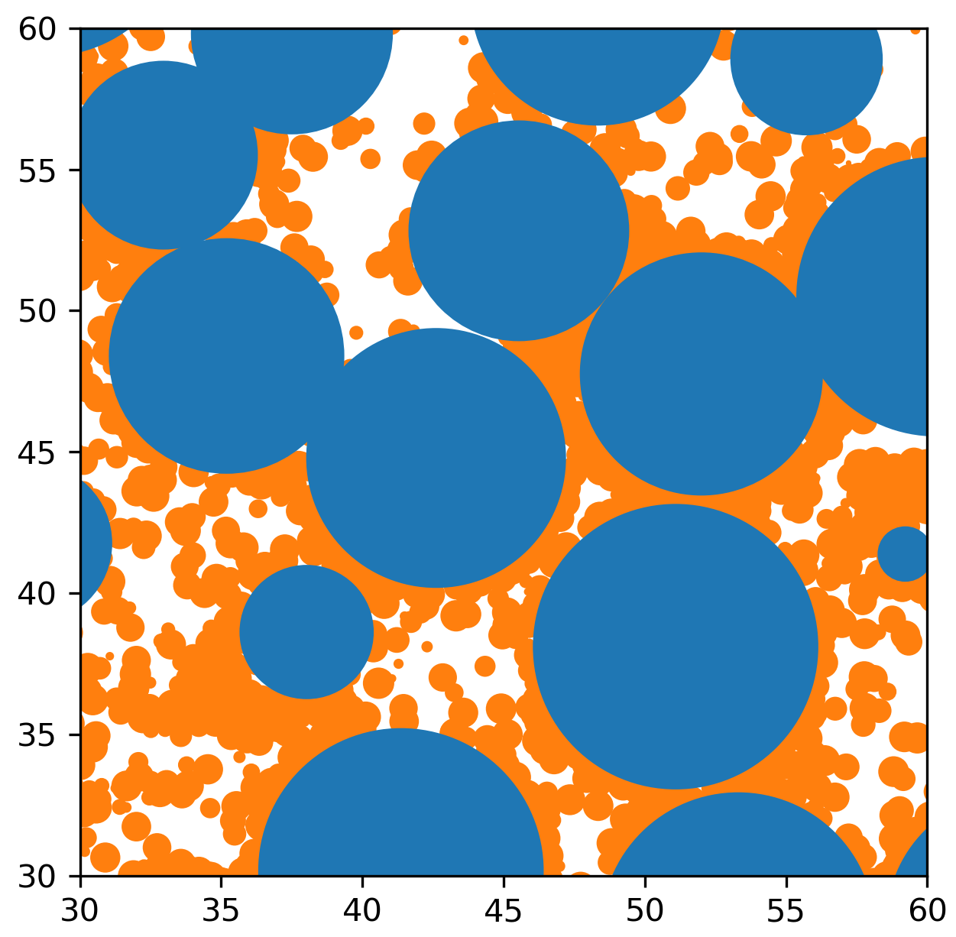
Examples 1&2: Mixed-Formulation Poisson Problems
Problem 1
Five Strip Problem
$$f=0 \\ Γ_{N}=∂Ω \\ g_{N}= \left\{\begin{aligned}−1 x=0 \\ 1 x=1 \\ 0 y=0,1\end{aligned}\right.$$
Problem 2
Battery Problem
$$f=0 \\ Γ_{D}=∂Ω \\ g_{D}=1−x$$
Problem Statement
Find $\left(p,F\right)∈C^{0}×C^{1}$ such that
$${ F − ∇p \atop ∇⋅(κ F)} {= \atop =} { 0 in Ω \atop f in Ω}$$
$$\begin{matrix}F⋅\overset{⃑}{n} \\ p\end{matrix} \begin{matrix}= \\ =\end{matrix} \begin{matrix}g_{N} on Γ_{N} \\ g_{D} on Γ_{D}\end{matrix}$$
Battery data courtesy of Scott Roberts, 01513

Slide 23
Example 1: Five Strip Problem
True Solution
$p\left(x,y\right)=β_{i} x$ for each strip $i$ $$F\left(x,y\right)=\left[\begin{matrix}1 \\ 0\end{matrix}\right]$$
Generate $p_{data}, F_{data}$ from true solution

Slide 24
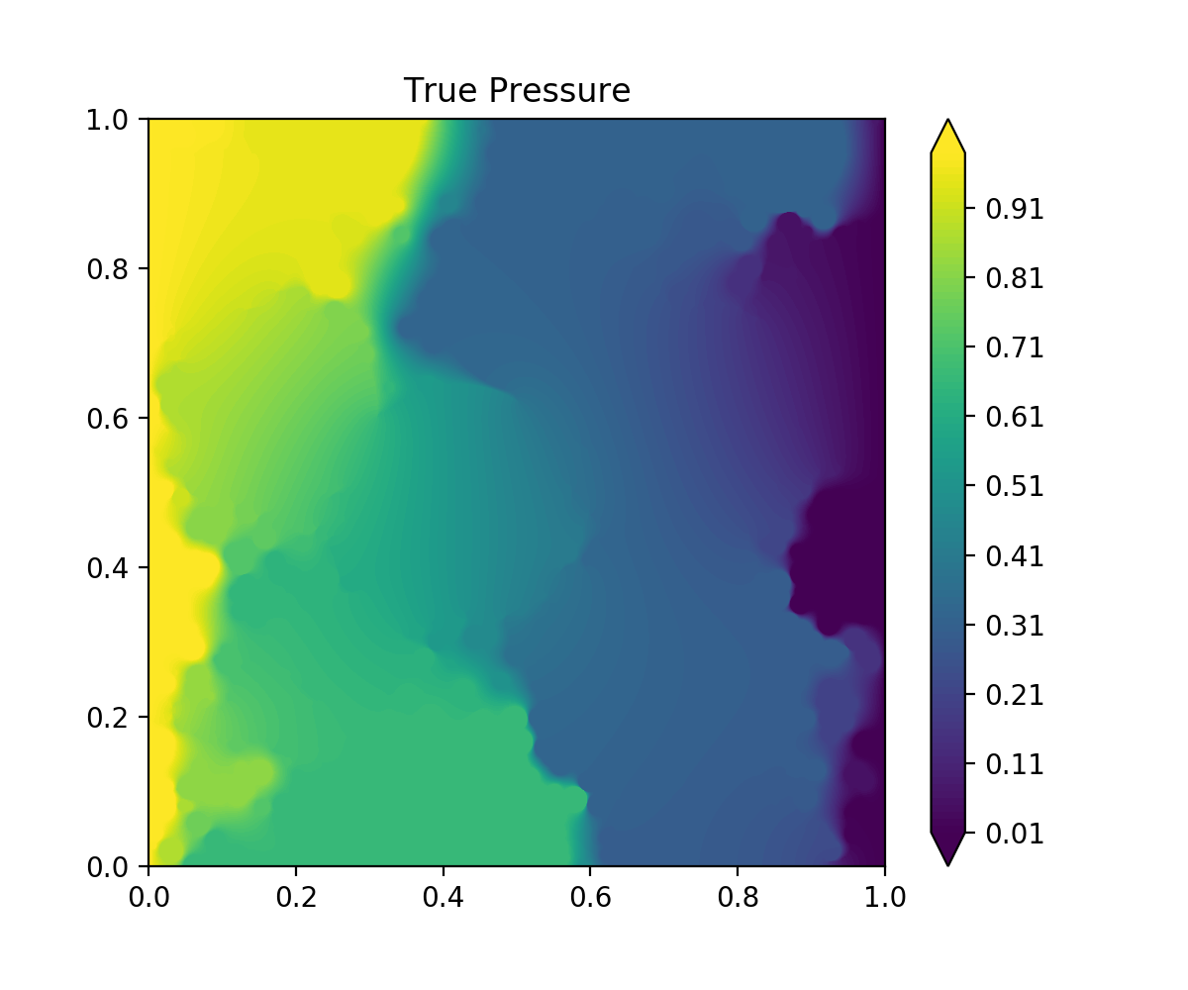
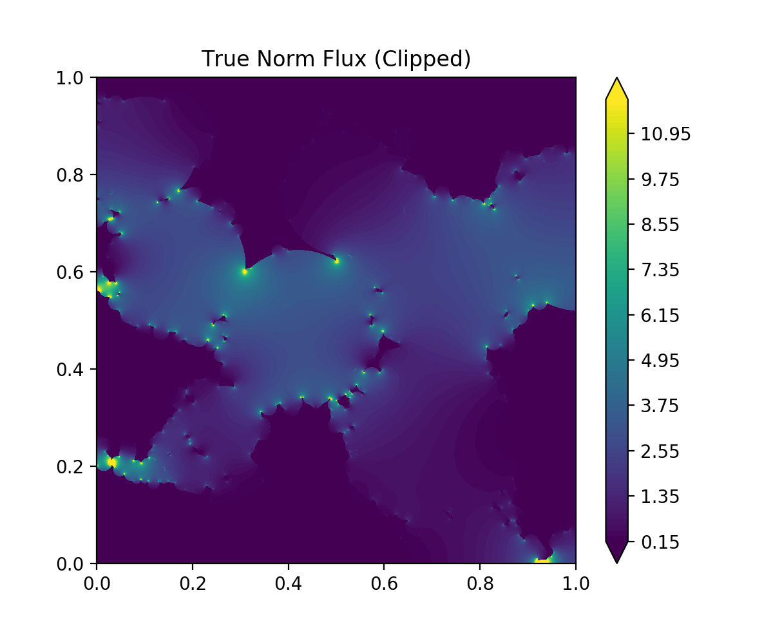
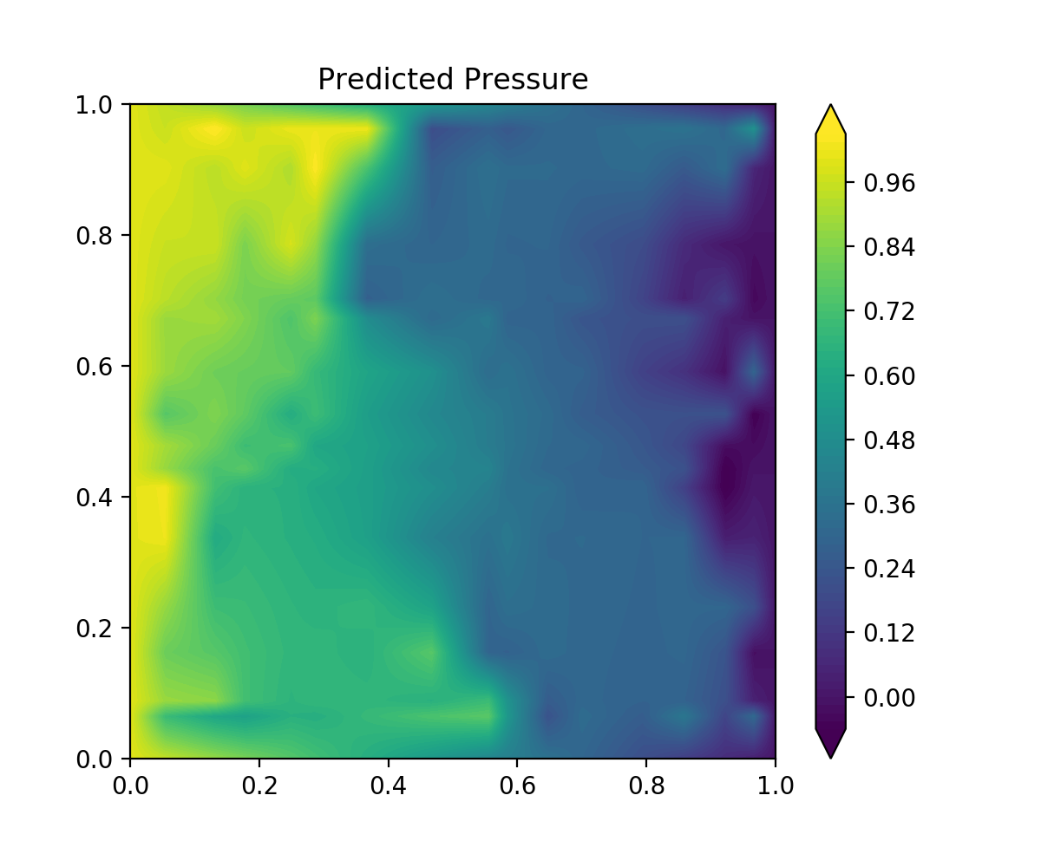
Example 2: Battery Problem
FEM simulation with ARIA
Mesh: 5.89 M nodes
11.8 M elements
Solve: 5.89 M DoF
ML chain complex model
POUs: 8 interior POUs
8 boundary POUs
Solve: 264 DoF

Slide 25
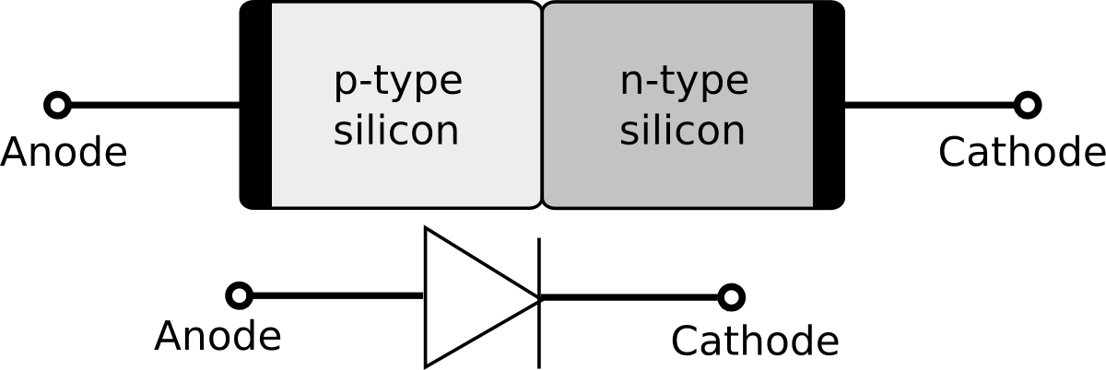
Example 3: Drift-Diffusion Equations
Problem Statement
Find $\left(φ, n, p, { J}_{φ}, J_{n}, J_{p}\right)∈{\left(C^{0}\right)}^{3}×{\left(C^{1}\right)}^{3}$
such that
$$\begin{matrix}{ J}_{φ} −∇φ & =0 & in Ω \\ J_{n}+∇n −n J_{φ} & =0 & in Ω \\ J_{p}+∇p+p J_{φ} & =0 & in Ω\end{matrix}$$
$$\begin{matrix}{− ∇⋅J}_{φ}+n−p & =f_{φ} & in Ω \\ − ∇⋅J_{n}+R(n,p) & =0 & in Ω \\ {− ∇⋅J}_{p}−R(n,p) & =0 & in Ω\end{matrix}$$
where $R\left(n,p\right)=\frac{np − α_{0} }{β_{0}\left(n+p\right)+β_{1}}$

Slide 26
ML Formulation
Machine learning FEEC problem
Solve the nonlinear-constrained optimization problem
$\min_{\begin{aligned}POU parameters θ, \\ metrics Ds, Bs \end{aligned} }{ \left\| φ_{data}−\sum_{i}{φ_{i}ψ_{i }}\right\|}_{2}^{2}+{ \left\| n_{data}−\sum_{i}{n_{i}ψ_{i }}\right\|}_{2}^{2}+{ \left\| p_{data}−\sum_{i}{p_{i}ψ_{i }}\right\|}_{2}^{2}+ {\left\| {J_{φ}}_{data}−\sum_{ij}{{J_{φ}}_{ij}ψ_{ij}} \right\|}_{2}^{2}+{\left\| {J_{n}}_{data}−\sum_{ij}{{J_{n}}_{ij}ψ_{ij}} \right\|}_{2}^{2}$ + ${\left\| {J_{p}}_{data}−\sum_{ij}{{J_{p}}_{ij}ψ_{ij}} \right\|}_{2}^{2}$
$$such that$$
$$F\left(φ, n, p, J_{φ}, J_{n}, J_{p}\right)=0$$

Slide 27
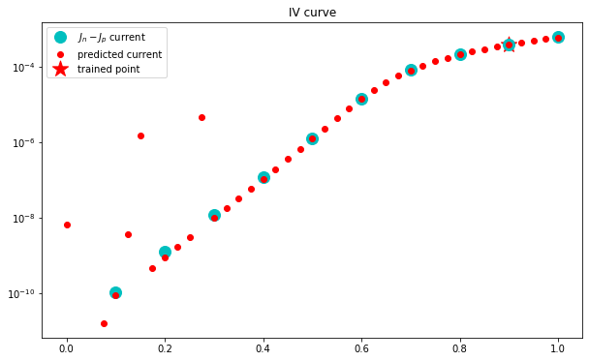
Example 3: Drift-Diffusion Equations
Solution changes nonlinearly as we vary $f_{φ}$ voltage across the transistor
Measure current
($J_{n}−J_{p})⋅ \overset{⃑}{n}$ at boundary
Because model captures the nonlinearity exactly, we can extrapolate across a range of voltages!
current
Trained to fit $f_{φ}=0.9$
Extrapolates for
$$0.2< f_{φ }<1.0$$
$$f_{φ}$$

Slide 28
Conclusion: Structure Preservation By Construction
Structure-preserving ML by learning a chain complex preserves physics invariants while learning parameters, coefficients, metric information.
Learning a chain complex guarantees:
Generalized Stokes’s Theorem
Compatibility: $δ_{k+1}ψ_{i}∈C^{k+1}$
Exactness of the chain complex: $δ_{k+1}∘δ_{k}=0$
Our POU construction guarantees:
Exact integration: no quadrature necessary, avoid variational crimes
Adaptive parameterization: training focuses on areas that need refinement within data

Slide 29
References and Further Reading
References
Actor, JA., et al. “Data-Driven Whitney Forms for Structure-Preserving Control Volume Analysis.” Journal of Computational Physics, in revision.
Trask, N., Huang, A., Hu, X. "Enforcing exact physics in scientific machine learning: a data-driven exterior calculus on graphs." Journal of Computational Physics: 110969, 2022.
Actor, JA., Huang, A., Trask, N. "Polynomial-Spline Neural Networks with Exact Integrals.“ 2022 IEEE SSCI, 2022.
Huang, A., et al. "Greedy Fiedler Spectral Partitioning for Data-driven Discrete Exterior Calculus." Proceedings of the AAAI 2021 Spring Symposium on Combining Artificial Intelligence and Machine Learning with Physical Sciences. AAAI, 2021.
Further Reading
Adler, JH., et al. "A finite-element framework for a mimetic finite-difference discretization of Maxwell's equations." SISC 43.4: A2638-A2659, 2021.
Arnold, D., Falk, RS., Winther, R. “Finite element exterior calculus, homological techniques, and applications”, Acta Numerica: 1-155, 2006.

Slide 30
Extra Slides

Slide 31
What is a Chain Complex?
“A chain complex is an algebraic structure that consists of a sequence of (graded) abelian groups (or modules), accompanied by a sequence of homomorphisms between groups, called differentials, so that the image of each homomorphism is included in the kernel of the next homomorphism.”
“A chain complex’s homology describes how the images of each homomorphism is included in the kernel of the next homomorphism.”
Source: Bott, R., Tu, LW. Differential Forms in Algebraic Topology, New York: Springer-Verlag, 1982.

Slide 32
Related Concept: FEEC and Mixed FEM Spaces
Popular mixed FEM spaces are examples of Whitney Form discretizations of chain complexes on meshes!
Examples:
Raviart-Thomas Elements for H(div)
BDM Elements for H(div)
Nedelec Elements for H(curl)
RT
BDM
Good reference: Arnold, D., Falk, RS., Winther, R. Finite element exterior calculus, homological techniques, and applications, Acta Numerica, 1-155, 2006.
Nedelec
Figures: Kirby, RC., et al. "Common and unusual finite elements." Automated Solution of Differential Equations by the Finite Element Method. Springer, Berlin, Heidelberg, 95-119, 2012.

Slide 33
Computational Notes
Implementation in TensorFlow 2.2.0
Careful: need to keep spline knots in order
Learn the distance between spline knots, not their positions
Use softmax of the distances to scale knots back into [0,1]
All integrals are exact since we know our spline knots
Train with favorite 1st order optimizer (we use Adam) + LSGD for linear system
Computation is memory-limited due to assembly of fine-scale spline integrals

Slide 34
Computational Notes
Nonlinear constraint (forward problem) solved by Newton’s Method with line search, with closed-form expressions for Jacobians of nonlinear terms
Nonlinear solver embedded within a TensorFlow Model to use autograd on chain complex DoF → backpropagation through a Newton solve
Initial Newton Method iterate given by solution to unconstrained problem
During training, Newton Method initial iterate is the solution at previous timestep
Only need 1-2 Newton steps to reach solution tolerance
Trainable free-spline knots mitigate the need for stabilization/upwinding despite high Peclet numbers and spurious oscillations

Slide 35
Moving Forward: Exemplars
Currently using for Darcy’s Equations and Drift-Diffusion, but other exemplars include:
Subsurface flow
Electromagnetism
Maxwell’s Equations
Magnetostatics
MHD
Elasticity
Plasma physics
But, not all problems are perturbed Hodge Laplacians…

