Slide 1
Leveraging 3D Game Engines for High-Quality Synthetic Data in Object Detection Applications
Lucas Zhou, 6614
MLDL 2023

Slide 2
Introduction

Slide 3
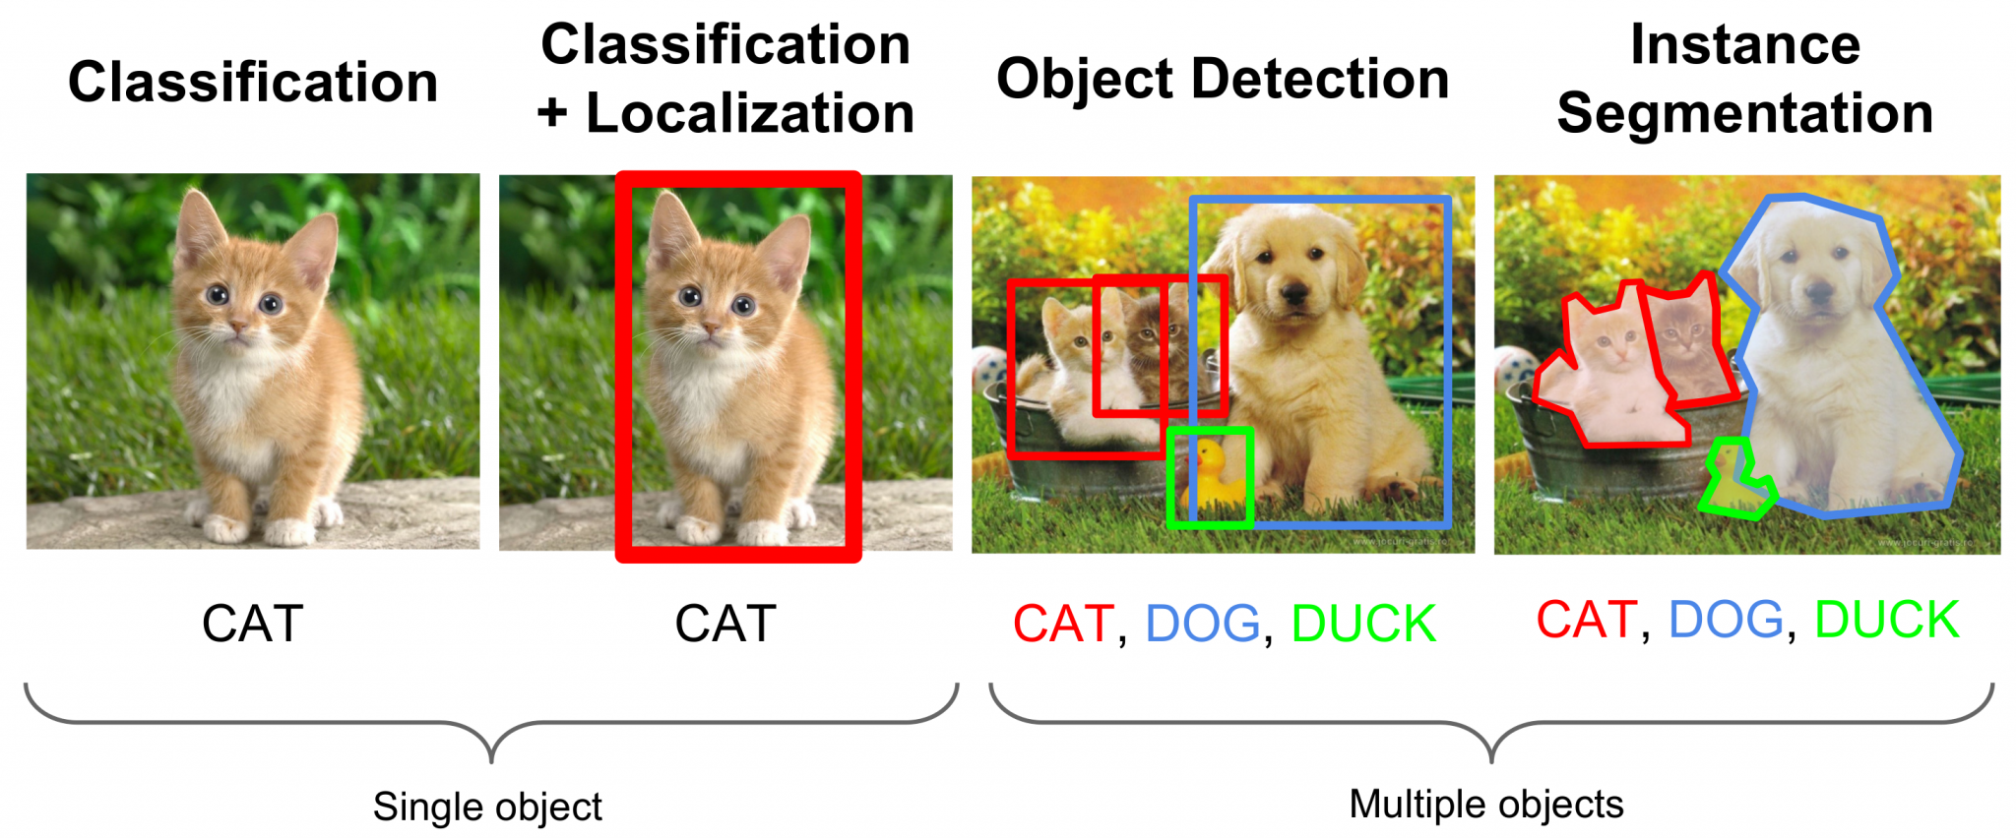
Computer Vision
“Field of artificial intelligence (AI) that enables computers and systems to derive meaningful information from digital images, videos and other visual inputs”
Ex: Image Classification, Object Detection
https://kajabi-storefronts-production.kajabi-cdn.com/kajabi-storefronts-production/file-uploads/blogs/22606/images/d21f3-f1c8-6261-c78d-22f64828fda_localizationVsDetection.png

Slide 4
Synthetic Data Pros
Data Quality
Scalability
Self labeling and annotating
Save time, money, effort
Increased specificity of dataset
Prevents data privacy issues

Slide 5
Synthetic Data Cons
May not cover edge cases
Data dependent on model quality
Data generation requires time and effort
Requires output control
Can include bias

Slide 6
Unity Perception Package

Slide 7
Unity Perception
2D/3D Bounding Boxes
Instance Segmentation
Semantic Segmentation
Labeling – Ground Truth
Dataset Capturing
Synthetic Humans

Slide 8
Unity Perception Realistic Data Generation
https://github.com/Unity-Technologies/com.unity.perception

Slide 9
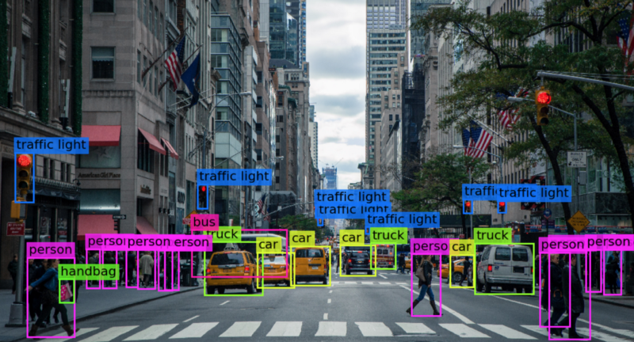
Unity Perception

Slide 10
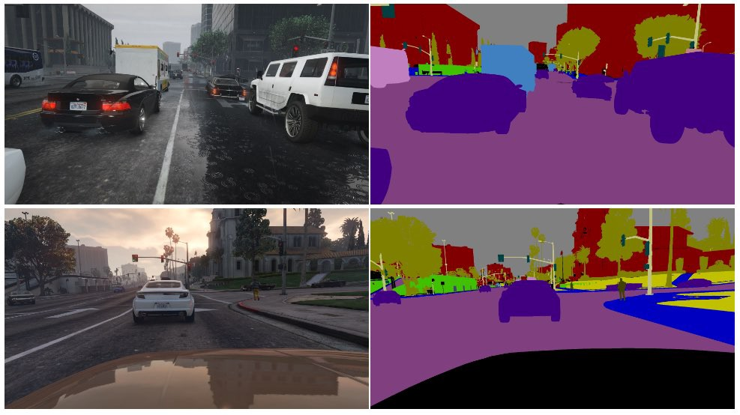
Unity Perception

Slide 11
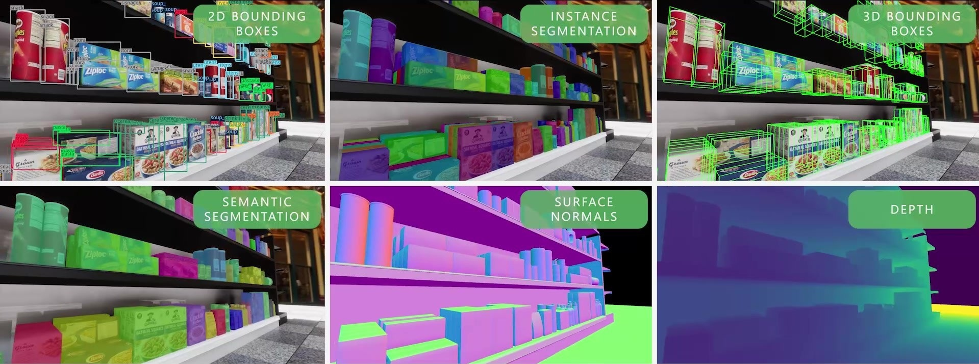
Unity Perception
https://github.com/Unity-Technologies/com.unity.perception

Slide 12
Unity Perception
https://github.com/Unity-Technologies/com.unity.perception
https://github.com/Unity-Technologies/com.unity.perception
https://github.com/Unity-Technologies/com.unity.perception

Slide 13
Unity Perception
https://github.com/Unity-Technologies/com.unity.perception

Slide 14
Case Study
https://unity.com/case-study/neural-pocket

Slide 15
Objective
Neural Pocket
11 Engineer Team in Tokyo, Japan
Generate large amounts of data quickly
Have perfect annotations

Slide 16
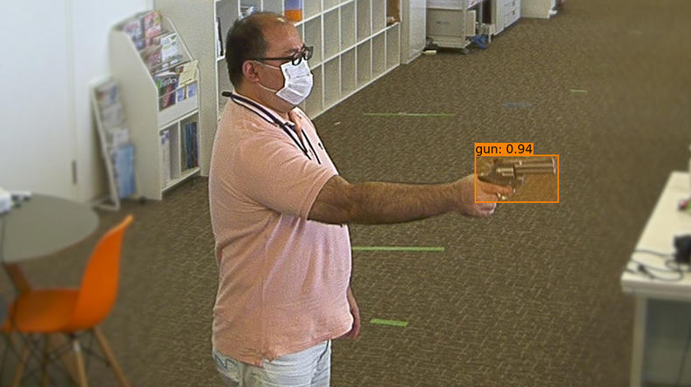
Methods
Object Detection for Weapons
Real data – video shoot with participants carrying weapons
Knives, bats, guns
Manual annotation

Slide 17
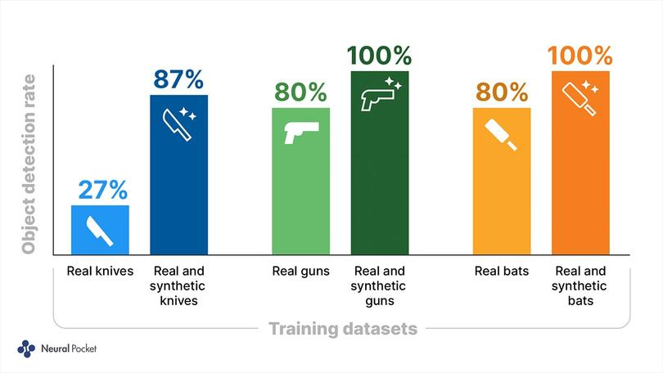
Methods

Slide 18
Results
95% reduction in training cycles
1 week vs 6 months on average
95% reduction in costs for data
Collection, annotation, training
Improved model performance

Slide 19
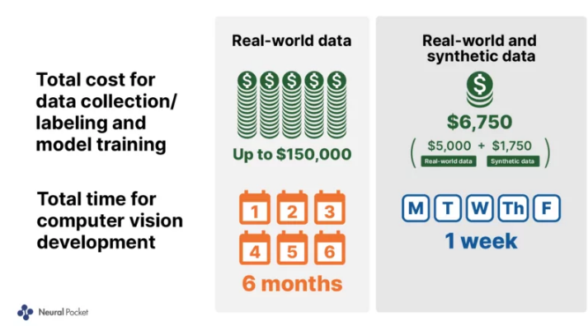
Results
https://research.aimultiple.com/synthetic-data-computer-vision/

Slide 20
Our Work

Slide 21
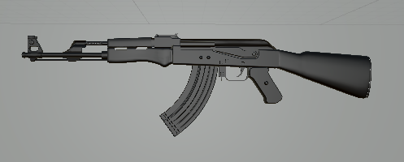
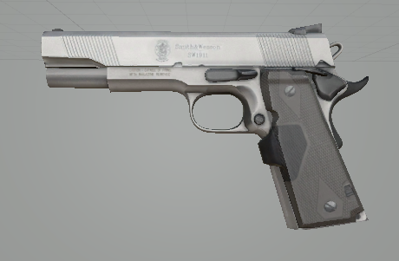
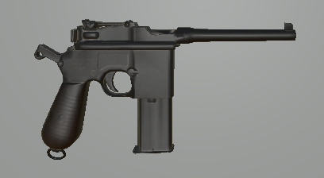
Objective
Gun detection
3D FBX models

Slide 22
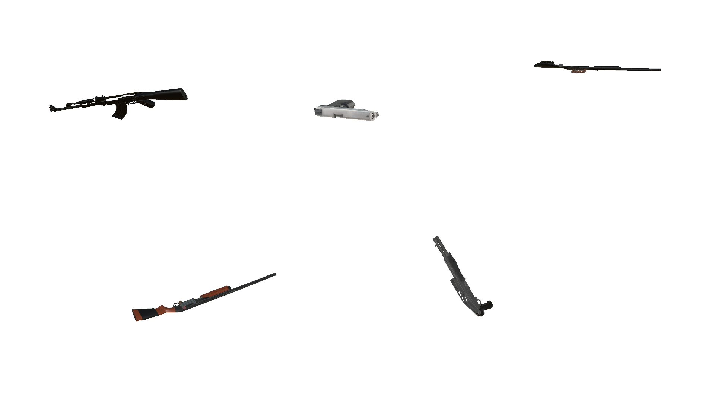
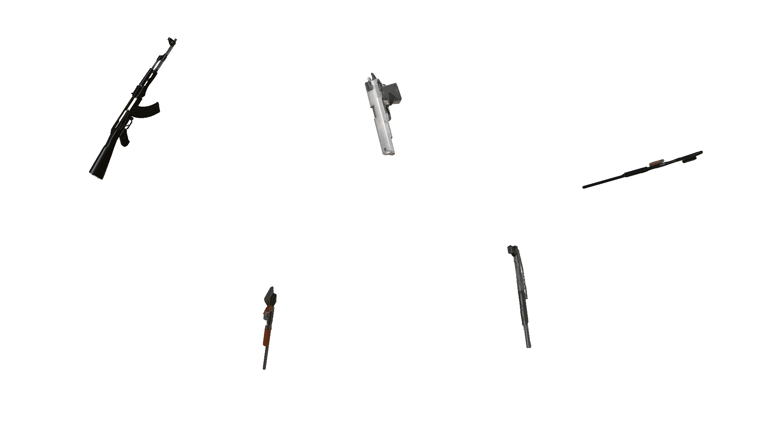
Methods/Results
Random rotation
Plain background
Generated 250k+ images

Slide 23
Conclusion

Slide 24
Summary
Powerful for computer vision applications
Useful for niche scenarios
Can reduce time and cost for training
Improve performance
Mitigate privacy/security risks

Slide 25
Future
Refine synthetic data pipeline
Continue training/testing
If you have any additional inquires or want to collaborate, feel free to reach out!
Email: lzhou@sandia.gov

Slide 26
Thank You!

