Slide 1


Artificial Intelligence and Machine Learning Support for Probabilistic Fracture Mechanics Analysis
SAND2023-06170PE
Sandia National Laboratories
U.S. Nuclear Regulatory Commission
Stephen J. Verzi, Joseph P. Lubars,
Satyanadh Gundimada, Michael J. Starr
Matthew Homiack, Raj Iyengar
Machine Learning / Deep Learning Workshop July 17-20, 2023
This presentation was prepared as an account of work sponsored by an agency of the U.S. Government. Neither the U.S. Government nor any agency thereof, nor any of their employees, makes any warranty, expressed or implied, or assumes any legal liability or responsibility for any third party’s use, or the results of such use, of any information, apparatus, product, or process disclosed in this report, or represents that its use by such third party would not infringe privately owned rights. The views expressed in this presentation are not necessarily those of the U.S. Nuclear Regulatory Commission.

Slide 2
Abstract
  In this research, artificial intelligence and machine learning (ML) methods are used to search an uncertain parameter space more efficiently for the most important inputs with respect to response sensitivities and then to construct, train, and test low-fidelity surrogate models. These methods are applied to the Extremely Low Probability of Rupture (xLPR) probabilistic fracture mechanics code used at the U.S. Nuclear Regulatory Commission in support of nuclear regulatory research. This presentation will show two separate but related efforts: 1) ranking important uncertain input features with respect to target outputs as determined by convergence in the confidence intervals for increasing sample sizes using simple random sampling; and 2) implementation of a reduced-order surrogate model for fast, approximate sample generation. Unoptimized, readily available off-the-shelf ML models were used in both efforts.
  The results show that ML models can assist analysts in conducting sensitivity and uncertainty analyses with respect to typical xLPR use cases. The ML models help to reduce the number of random realizations needed in the xLPR simulation by focusing on the most important input parameters (as part of the first effort) and augment xLPR output generation by providing quick approximate time-series simulation (as part of the second effort). This research involved several different kinds of ML models, including linear, random forest, gradient boosting, and multi-layer perceptron regression techniques. Even though not all models perform well in each task or scenario, especially when data is scarce (i.e., low probabilities of leak and rupture), the results show that there are cases where each ML model can perform well. Future efforts can focus on hyperparameter optimization, when appropriate. Both efforts were intended to augment xLPR simulations, which is what the results show.

Slide 3
Outline
  Problem Space
    Probabilistic Fracture Mechanics (PFM)
    Extremely Low Probability of Rupture (xLPR) Code
  Solution Space
    Artificial Intelligence (AI) and Machine Learning (ML)
      Sensitivity Analysis with xLPR
        Importance Sampling
        Determining Appropriate Sample Size
      Surrogate Model for xLPR Quantities of Interest (QoIs)
        Time of 1st Leak, if any
        Crack Propagation via Normalized Depth
  Results
  Potential Future Work
  Acknowledgments and Contacts

Slide 4
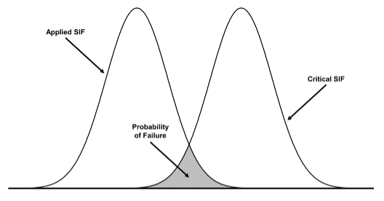
Problem Space – Probabilistic Fracture Mechanics (PFM)
  Analysis
This figure illustrates a simplistic PFM analysis. The curve on the left represents the distribution of crack driving force or applied stress intensity factor (SIF), which depends on the uncertainties in stress and crack size. The curve on the right represents the toughness distribution or critical (i.e., allowable) SIF of the material. When the two distributions overlap, there is a finite probability of failure, which is indicated by the shaded area. Time dependent crack growth, such as from fatigue or stress-corrosion cracking or both, can be considered by applying the appropriate growth laws to the crack distribution. Crack growth can cause the applied SIF distribution to shift to the right with time, thereby increasing the probability of failure.
Figure from U.S. NRC Technical Letter Report, TRL-RES/DE/REB-2022-13.

Slide 5
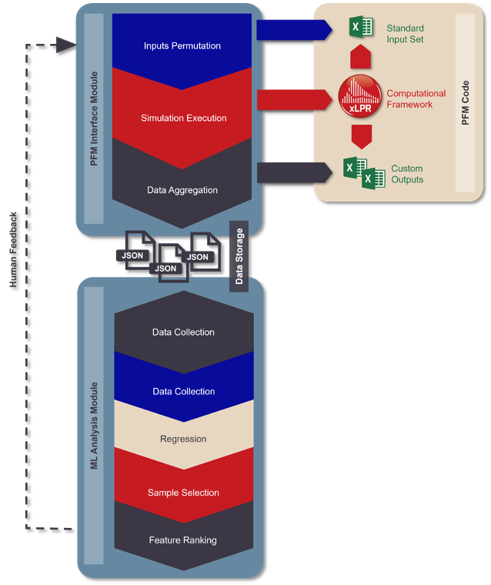
Problem Space – Extremely Low Probability of Rupture (xLPR) Code
  Analysis Architecture
Figure from U.S. NRC Technical Letter Report, TRL-RES/DE/REB-2022-13.

Slide 6
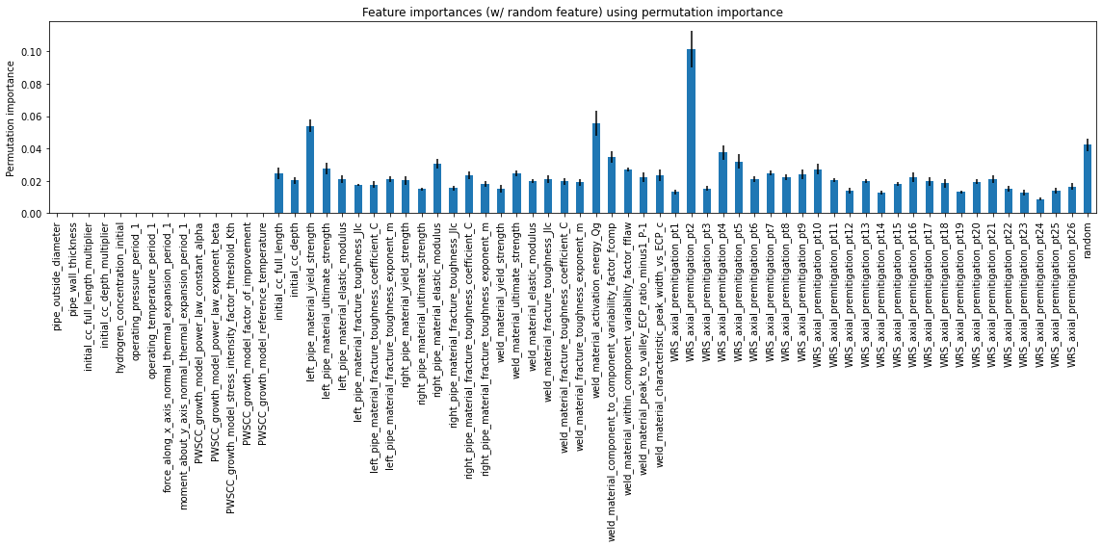
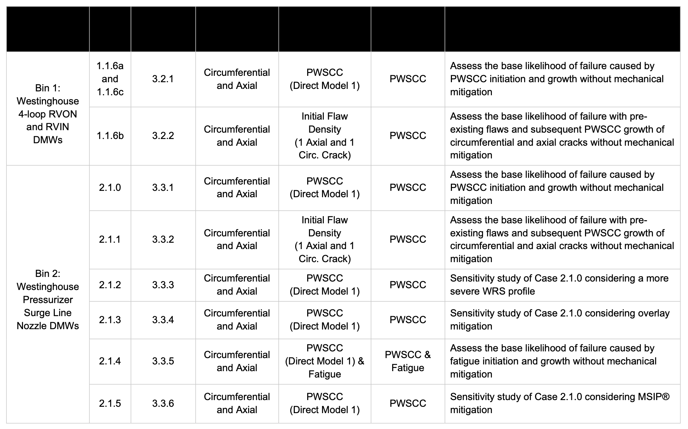
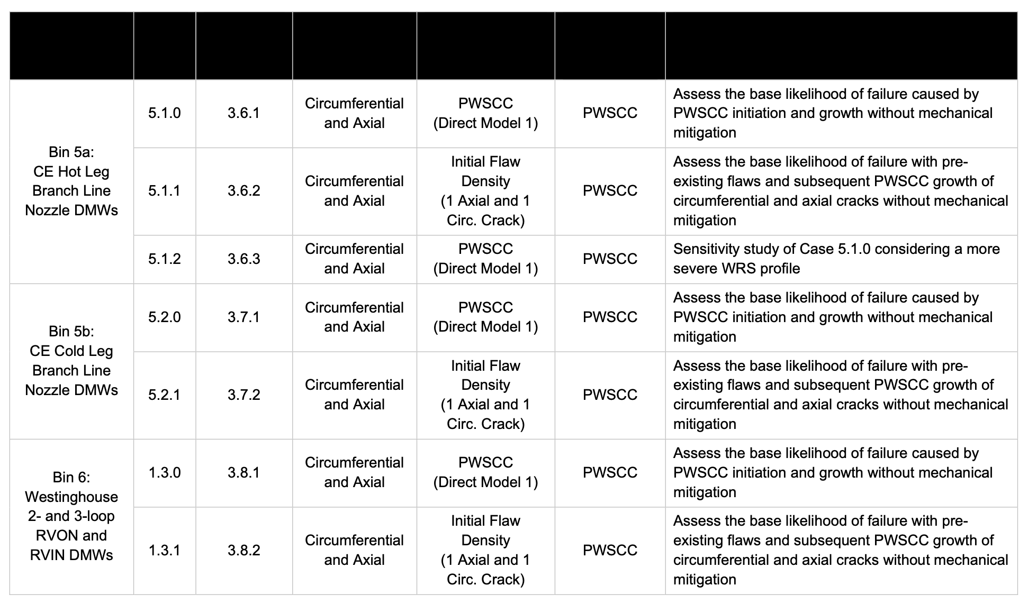
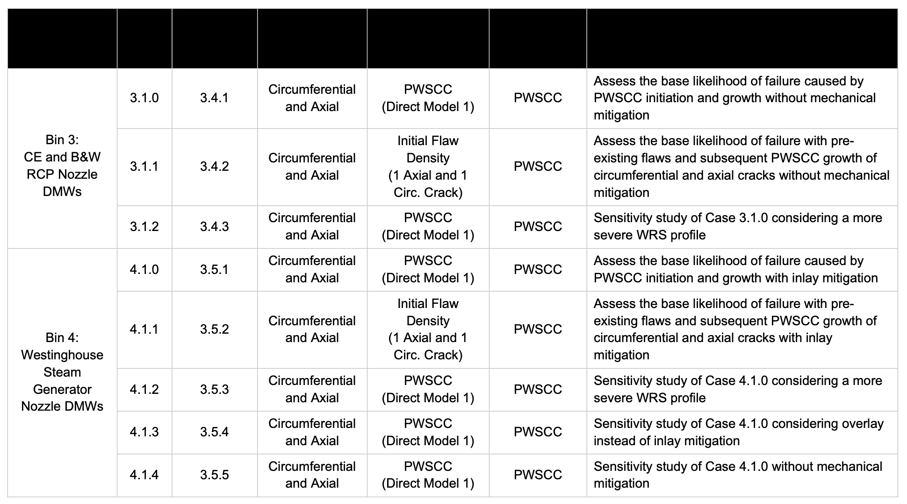
Sensitivity Analysis with xLPR
  Given input (uncertain parameter) distributions and associated Monte Carlo outputs
    Can we use AI/ML models to determine/rank importance of inputs while finding proper sample size with respect to output set?
…
inputs
ranked features
NRC, Technical Letter Report TLR-RES/DE/REB-2021-14-R1, "Probabilistic Leak-Before-Break Evaluations of Pressurized-Water Reactor Piping Systems using the Extremely Low Probability of Rupture Code," April 2022, ADAMS Accession No. ML22088A006

Slide 7
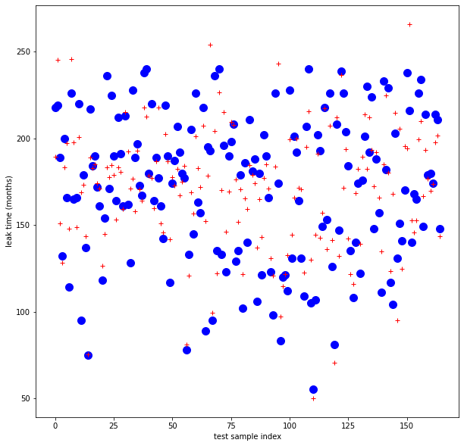
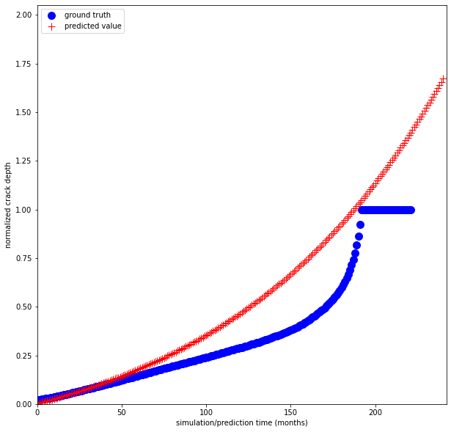
Surrogate Modeling using ML for xLPR
  Given input (uncertain parameter) distributions and associated Monte Carlo outputs
    Can we use AI/ML models to train surrogate model with respect to output set?
Outputs or Quantities of Interest (QoIs)
cc_depth_normalized
cc_ID_length_normalized
cc_OD_length_normalized
is_leaking
is_ruptured
total_leak_rate
492 of 2000 samples
240 * 2000 samples
leak time
normalized crack depth
sample index
simulation time
outputs
potential surrogate models

Slide 8
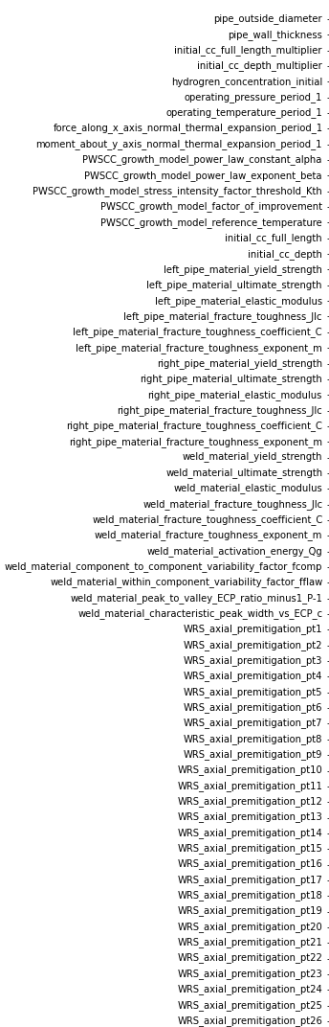
Results
  Using random forest regressor (scikit-learn)
    Mean decrease in impurity (MDI)
    Permutation importance values
  Using linear regression (scikit-learn)
inputs
Outputs or Quantities of Interest (QoIs)
cc_depth_normalized
cc_ID_length_normalized
cc_OD_length_normalized
is_leaking
is_ruptured
total_leak_rate
Scikit-learn: Machine Learning in Python, Pedregosa et al., JMLR 12, pp. 2825-2830, 2011. https://dl.acm.org/doi/abs/10.5555/1953048.2078195

Slide 9
Results – Using Random Forest Regressor
  Multi-variate output set (6) given input set (65) w/ 200 samples
Input Variable | Permutation Importance
WRS_axial_premitigation_pt01 | 0.5973
WRS_axial_premitigation_pt26 | 0.0680
WRS_axial_premitigation_pt24 | 0.0545
WRS_axial_premitigation_pt22 | 0.0501
WRS_axial_premitigation_pt05 | 0.0351
weld_material_PWSCC_growth_component_to_component_variability_factor_fcomp | 0.0280
WRS_axial_premitigation_pt21 | 0.0255
weld_material_PWSCC_growth_activation_energy_Qg | 0.0202
WRS_axial_premitigation_pt02 | 0.0158
WRS_axial_premitigation_pt07 | 0.0133
WRS_axial_premitigation_pt17 | 0.0107
Ranked permutation importance for those inputs with values greater than random feature mean + 2 * standard deviation.

Slide 10
Results – Using Random Forest Regressor
  Multi-variate output set (6) given input set (65) w/ 2000 samples
Input Variable | Permutation Importance
WRS_axial_premitigation_pt01 | 0.9740
weld_material_PWSCC_growth_component_to_component_variability_factor_fcomp | 0.2029
weld_material_PWSCC_growth_within_component_variability_factor_fflaw | 0.1503
WRS_axial_premitigation_pt14 | 0.0301
WRS_axial_premitigation_pt26 | 0.0268
WRS_axial_premitigation_pt22 | 0.0230
WRS_axial_premitigation_pt02 | 0.0176
WRS_axial_premitigation_pt23 | 0.0163
WRS_axial_premitigation_pt24 | 0.0162
WRS_axial_premitigation_pt07 | 0.0158
Ranked permutation importance for those inputs with values greater than random feature mean + 2 * standard deviation.

Slide 11
Results – Using Random Forest Regressor
  Multi-variate output set (6) given input set (65) w/ 20000 samples
Input Variable | Permutation Importance
WRS_axial_premitigation_pt01 | 1.2146
weld_material_PWSCC_growth_component_to_component_variability_factor_fcomp | 0.3489
weld_material_PWSCC_growth_within_component_variability_factor_fflaw | 0.2416
WRS_axial_premitigation_pt02 | 0.1115
initial_cc_full_length | 0.0323
WRS_axial_premitigation_pt25 | 0.0226
weld_material_PWSCC_growth_activation_energy_Qg | 0.0205
WRS_axial_premitigation_pt26 | 0.0177
WRS_axial_premitigation_pt24 | 0.0162
left_pipe_material_yield_strength | 0.0155
Ranked permutation importance for those inputs with values greater than random feature mean + 2 * standard deviation.

Slide 12
Results – Using Random Forest Regressor
  Determining appropriate sample size (all 6 QoIs) – Confidence intervals for 200, 2000 and 20000 samples
2000 Samples are sufficient

Slide 13
Results – Surrogate Model
  Can we predict time of first leak?
492 out of 2000 samples result in leak

Slide 14
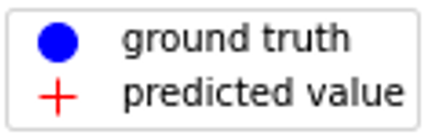
Results – Using Linear Regression
  492 (out of 2000) samples – 75/25 % training/testing split
Predicted leak time (in months) for test set by sample index
Seems like we do not have enough training data
leak time (months)
mse = 662.7
test sample index

Slide 15
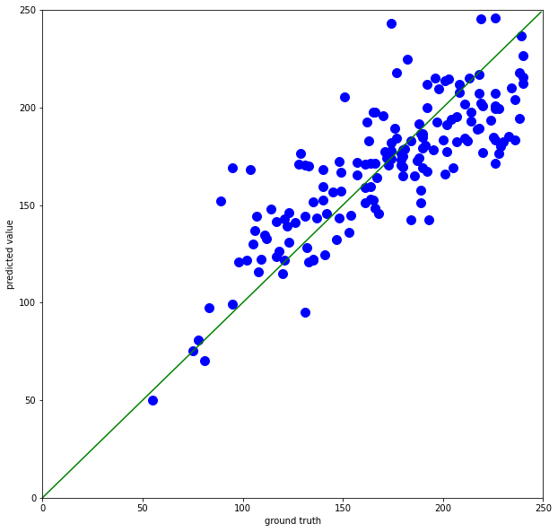
Results – Using Linear Regression
  492 (out of 2000) samples – 75/25 % training/testing split
Ground truth versus predicted for test set by sample
Seems like we do not have enough training data
Predicted leak time
mse = 662.7
ground truth

Slide 16
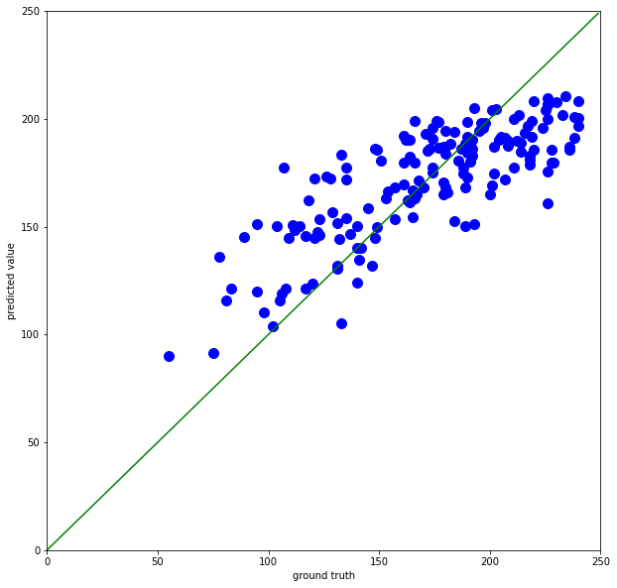
Results – Using Random Forest Regression
  492 (out of 2000) samples – 75/25 % training/testing split
Ground truth versus predicted for test set by sample
Seems to miss both high and low values (we probably do not have enough training data)
Predicted leak time
mse = 707.5
ground truth

Slide 17
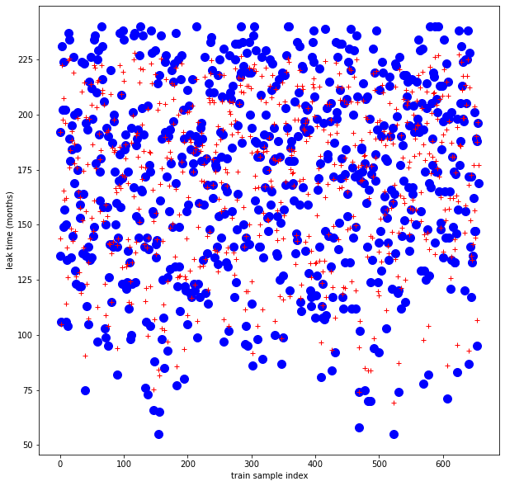
Results – Using Random Forest Regression
  492 (out of 2000) samples – 100/0 % training/testing split
Predicted leak time (in months) for train set by sample index
Significant drop in mse
leak time (months)
mse = 108.6
test sample index

Slide 18
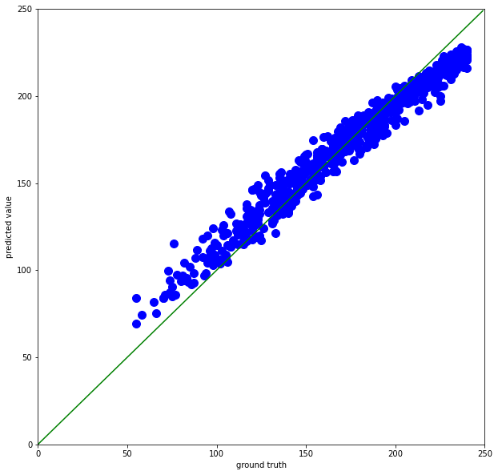
Results – Using Random Forest Regression
  492 (out of 2000) samples – 100/0 % training/testing split
Ground truth versus predicted for train set by sample
Significant drop in mse – but model still not capturing high and low ends well
Predicted leak time
mse = 108.6
ground truth

Slide 19
Results – Surrogate Model
  Can we predict normalized crack depth at next time step – Use Case: Leak occurs (when normalized crack depth is 1.0)?
2000 samples with 240 time steps each

Slide 20
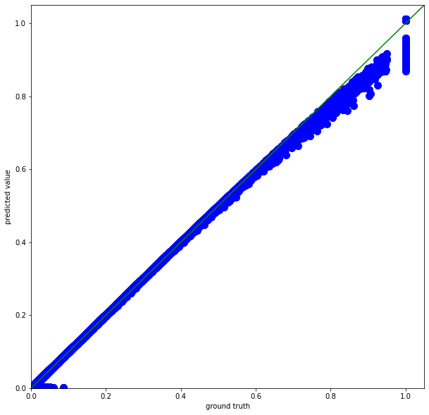
Results – Using Linear Regression
  2000 samples – 75/25 % training/testing split
xLPR depth versus predicted for test set by sample
Seems to lose performance for larger normalized crack depth values
Predicted leak time
mse = 2.7e-5
xLPR depth

Slide 21
Results – Using Linear Regression
  2000 samples – 75/25 % training/testing split
xLPR depth versus predicted time-series for single sample initial conditions
Attempts to extrapolate beyond unit normalized crack depth
Predicted depth
xLPR depth

Slide 22
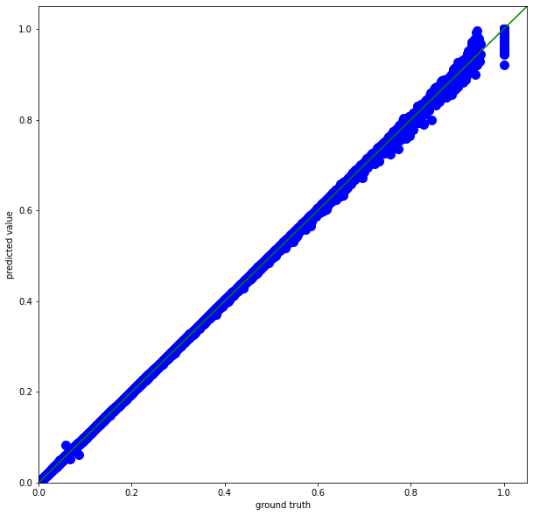
Results – Using Random Forest Regression
  2000 samples – 75/25 % training/testing split
xLPR depth versus predicted for test set by sample
Captures larger normalized crack depth values and more of curvature
Predicted leak time
mse = 2.0e-6
xLPR depth

Slide 23
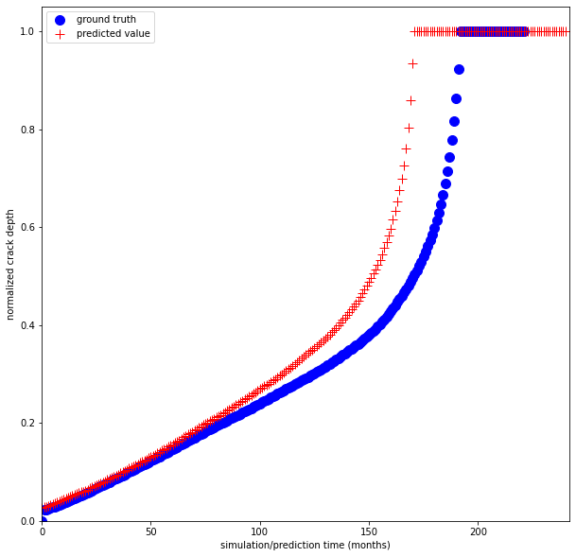
Results – Using Random Forest Regression
  2000 samples – 75/25 % training/testing split
xLPR depth versus predicted time-series for single sample initial conditions
Captures similar curvature, but predicts leak sooner than xLPR
Predicted depth
xLPR depth

Slide 24
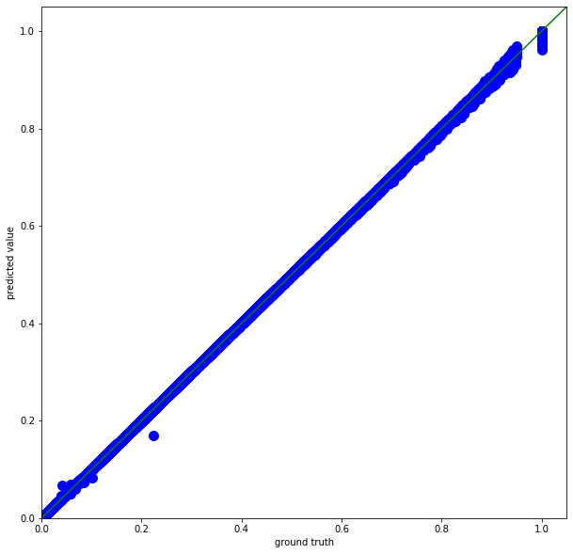
Results – Using Random Forest Regression
  2000 samples – train and test on 100% of data
xLPR depth versus predicted for train set by sample
Captures larger normalized crack depth, but with increased uncertainty
Predicted leak time
mse = 2.5e-7
xLPR depth

Slide 25
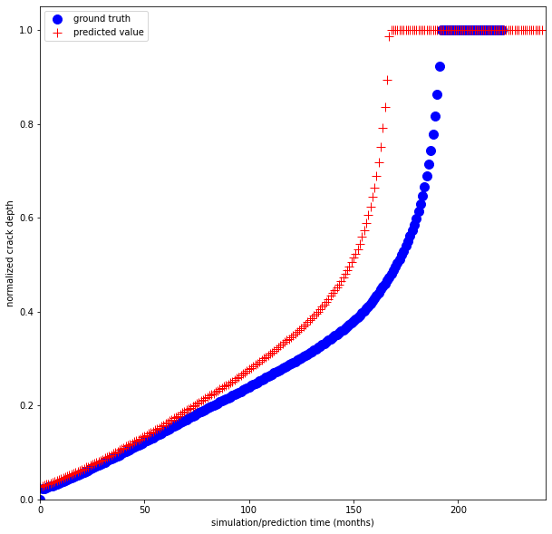
Results – Using Random Forest Regression
  2000 samples – train and test on 100% of data
xLPR depth versus predicted time-series for single sample initial conditions
Captures similar curvature, but predicts leak “even” sooner than xLPR or 75% training data – indicates overtraining
Predicted depth
xLPR depth

Slide 26
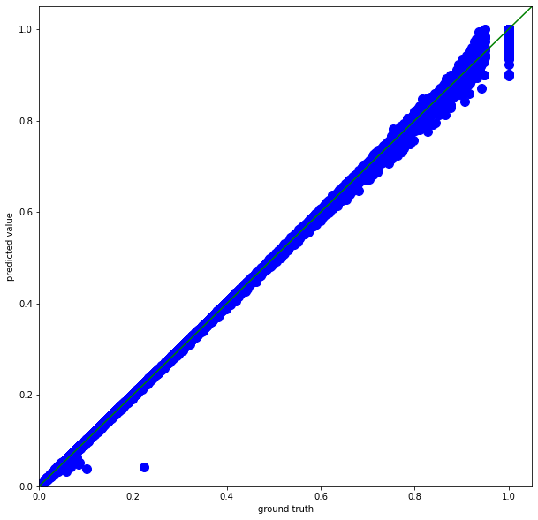
Results – Using Random Forest Regression
  2000 samples – 25/75 % training/testing split
xLPR depth versus predicted for test set by sample
Captures larger normalized crack depth values but with increased uncertainty
Predicted leak time
mse = 2.7e-6
xLPR depth

Slide 27
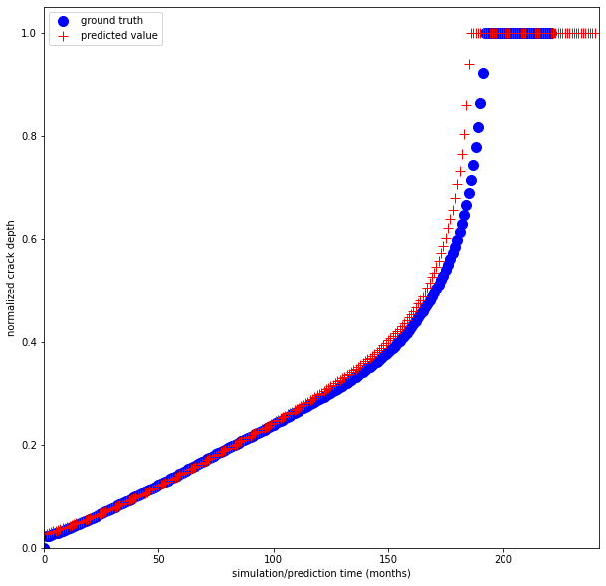
Results – Using Random Forest Regression
  2000 samples – 25/75 % training/testing split
xLPR depth versus predicted time-series for single sample initial conditions
Captures similar curvature, but predicts leak sooner than xLPR – not as overtrained
Predicted depth
xLPR depth

Slide 28
Potential Future Work
Efficiently identify response sensitivities from an uncertain input parameter space
  Sensitivity analysis
  Sensitivity studies
  Uncertainty analysis
Identify methods of creating tiered surrogate models (machine-learning/data-driven) with comparable accuracy to the physics-based xLPR model, including characterization of the increased computational efficiency of the potential surrogate models
  Start with one output and use neural network to predict
  Determine level of effort needed

Slide 29
Our Team – Sandia
  Sandia
  Michael Starr (PI)
  Stephen Verzi (staff, ML)
  Joseph Lubars (staff, ML/RL & statistics)
  Satyanadh Gundimada (staff, ML/DL)
  U.S. Nuclear Regulatory Commission
  Matthew Homiack
  Raj Iyengar
Sandia National Laboratories is a multimission laboratory managed and operated by National Technology and Engineering Solutions of Sandia LLC, a wholly owned subsidiary of Honeywell International Inc. for the U.S. Department of Energy’s National Nuclear Security Administration under contract DE-NA0003525.
This presentation was prepared as an account of work sponsored by an agency of the U.S. Government. Neither the U.S. Government nor any agency thereof, nor any of their employees, makes any warranty, expressed or implied, or assumes any legal liability or responsibility for any third party’s use, or the results of such use, of any information, apparatus, product, or process disclosed in this report, or represents that its use by such third party would not infringe privately owned rights. The views expressed in this presentation are not necessarily those of the U.S. Nuclear Regulatory Commission.

Slide 30
Thank You
  Questions?

