Slide 1
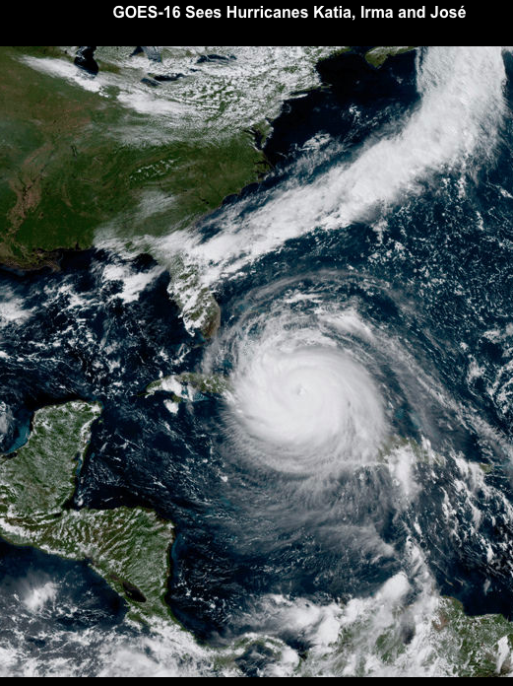
Selected Machine Learning Applications
in
Weather and Climate
Paul J. Roebber
UWM Distinguished Professor
University of Wisconsin at Milwaukee
July 18, 2023

Slide 2
Notes:
How are factors combined to produce evac decision?
Protective Action Decision Model
Describe Process
Walk through example
Ability to model
There’s a baseline understanding to be able to model the human system elements of hurricane evacuations. Rebecca’s work proves it.

Slide 3
Data Science = mapping inputs to outputs
Model
Input 1
Input 2
Input N
•••
Model
Multiple linear regression (MLR)
Multiple logistic regression (MLoR)
Decision trees, random forests
Neural Networks (hidden layer MLPs)
Agent-based modeling (ABM)
CNNs (Deep Learning)
Output

Slide 4
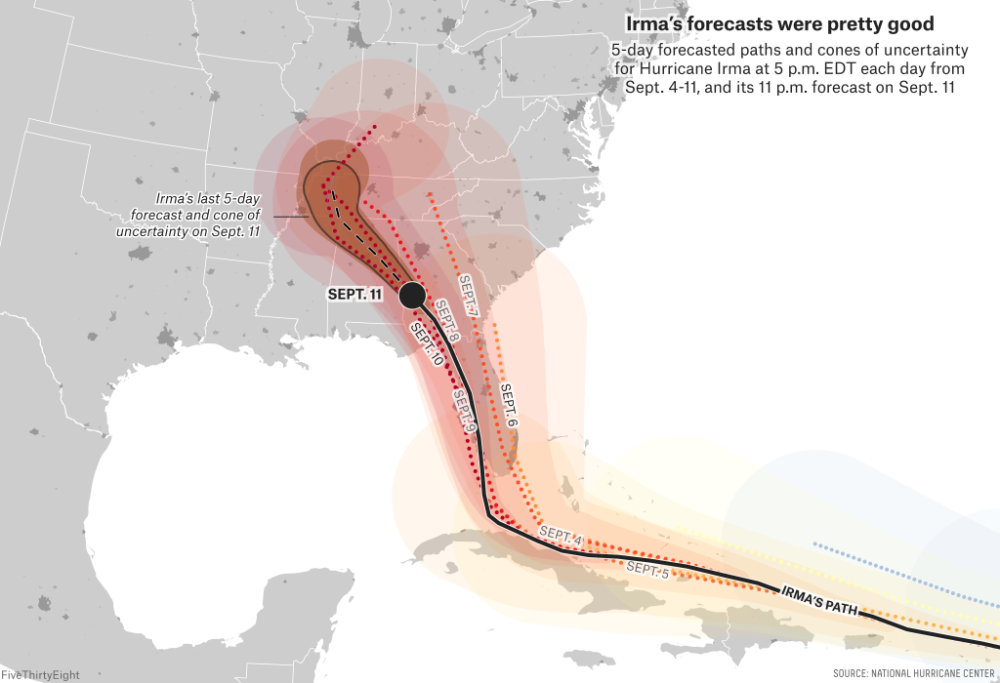
High Impact Events

Slide 5
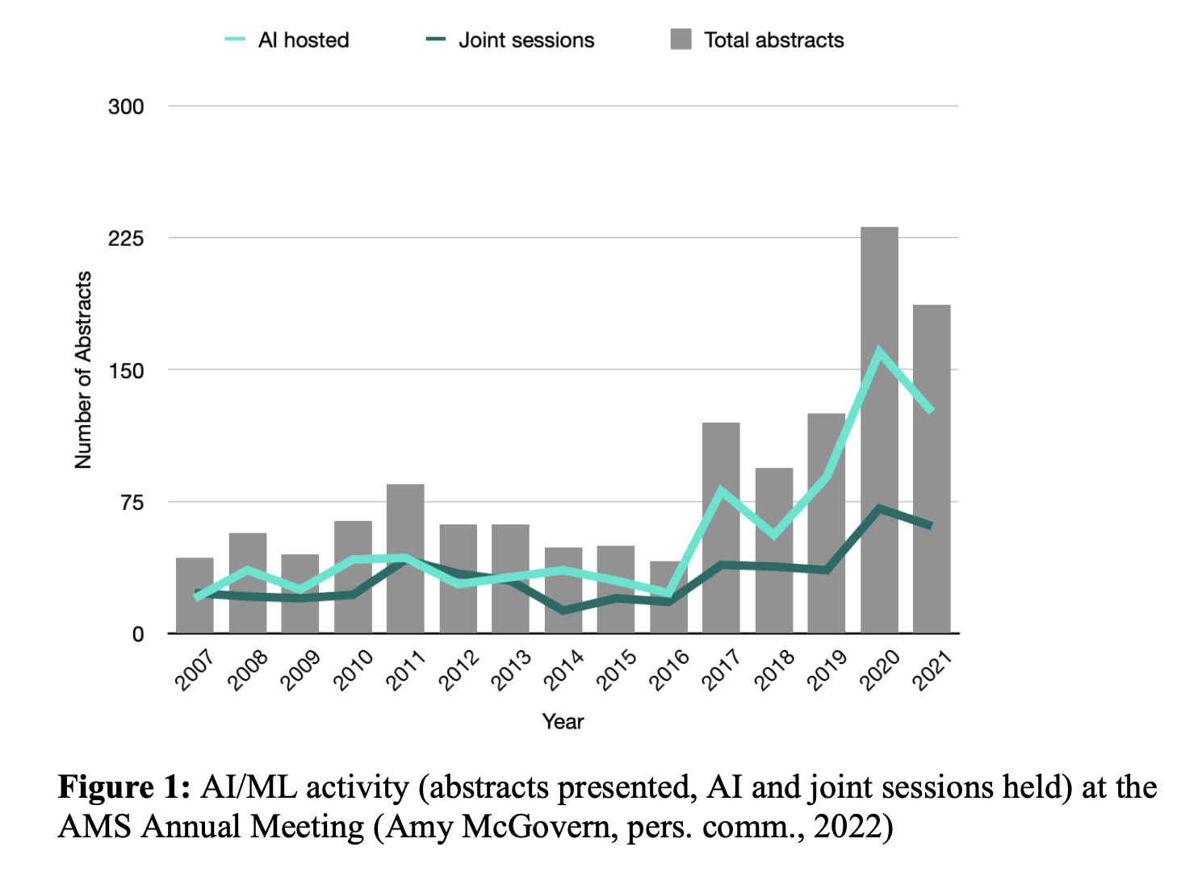

Slide 6
Powerful tools! User beware!

Slide 7
Notes:
How are factors combined to produce evac decision?
Protective Action Decision Model
Describe Process
Walk through example
Ability to model
There’s a baseline understanding to be able to model the human system elements of hurricane evacuations. Rebecca’s work proves it.

Slide 8
Guidance

Slide 10
Some examples
• Clustering (Weather Prediction Center)
• Heavy Rainfall using Random Forests (Severe Storms Lab)
• Quantile Mapping in NBM (Meteor. Development Lab)
• Snow Ratio using ANN (Weather Prediction Center, Env. Modeling Center)
• Adaptive Postprocessor using ABM/EP/ANN (Meteor. Development Lab)
• Tropical Storm Evacuations using ABM (U Milwaukee, NCAR)
• Simulated NWP using CNN (U Washington)
Notes:
How are factors combined to produce evac decision?
Protective Action Decision Model
Describe Process
Walk through example
Ability to model
There’s a baseline understanding to be able to model the human system elements of hurricane evacuations. Rebecca’s work proves it.

Slide 11
Some examples
• Clustering (Weather Prediction Center)
• Heavy Rainfall using Random Forests (Severe Storms Lab)
• Quantile Mapping in NBM (Meteor. Development Lab)
• Snow Ratio using ANN (Weather Prediction Center, Env. Modeling Center)
• Adaptive Postprocessor using ABM/EP/ANN (Meteor. Development Lab)
• Tropical Storm Evacuations using ABM (U Milwaukee, NCAR)
• Simulated NWP using CNN (U Washington)
Notes:
How are factors combined to produce evac decision?
Protective Action Decision Model
Describe Process
Walk through example
Ability to model
There’s a baseline understanding to be able to model the human system elements of hurricane evacuations. Rebecca’s work proves it.

Slide 12
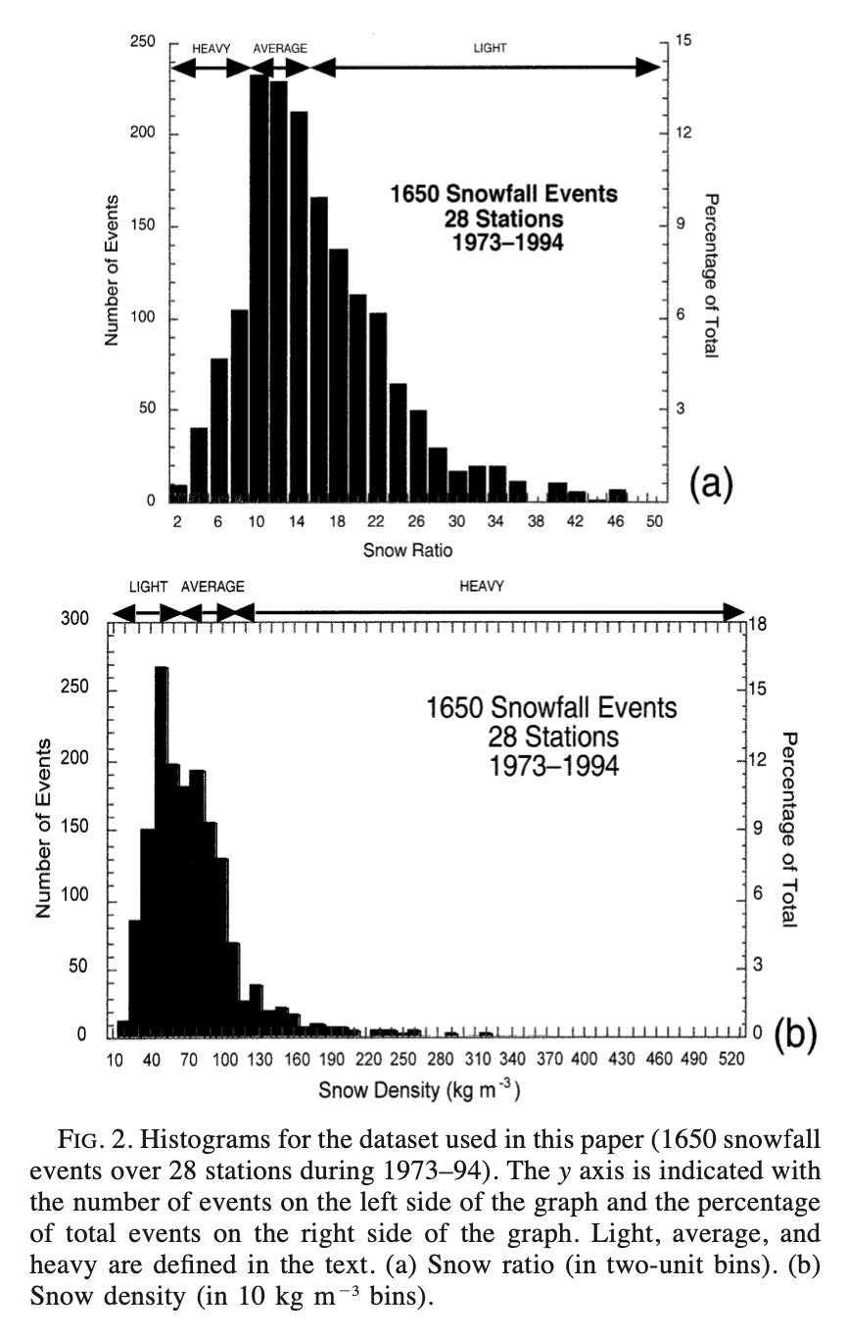
Snow-to-liquid water ratio

Slide 13
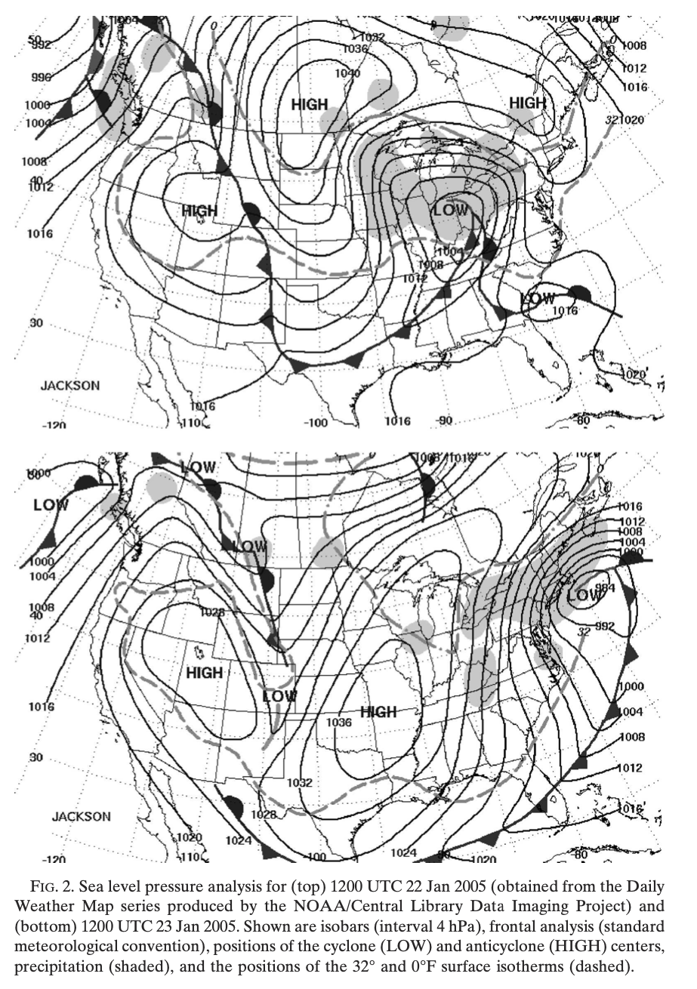
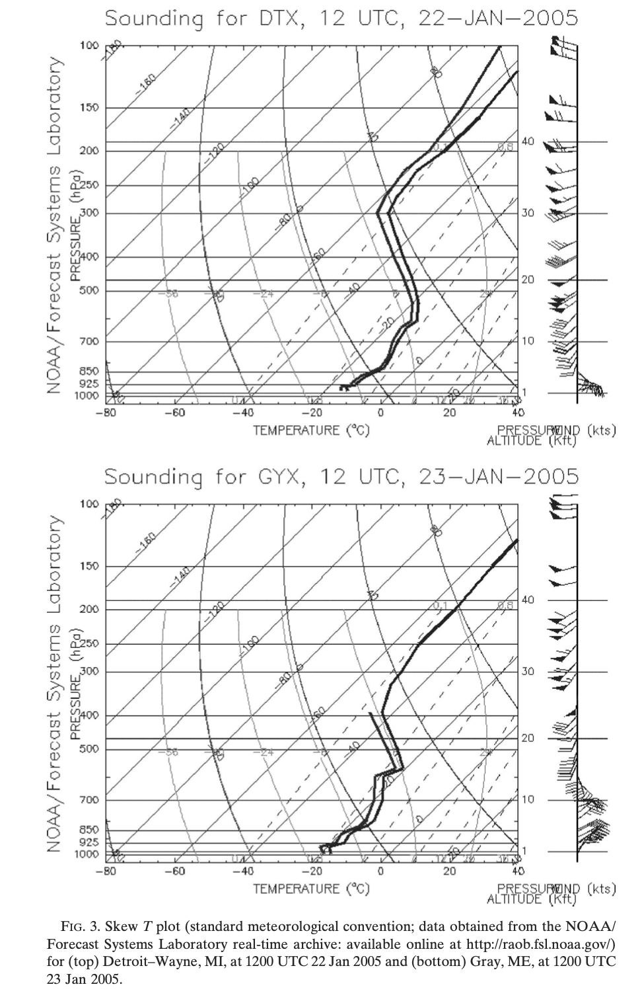
“Blizzard of 2005”

Slide 15
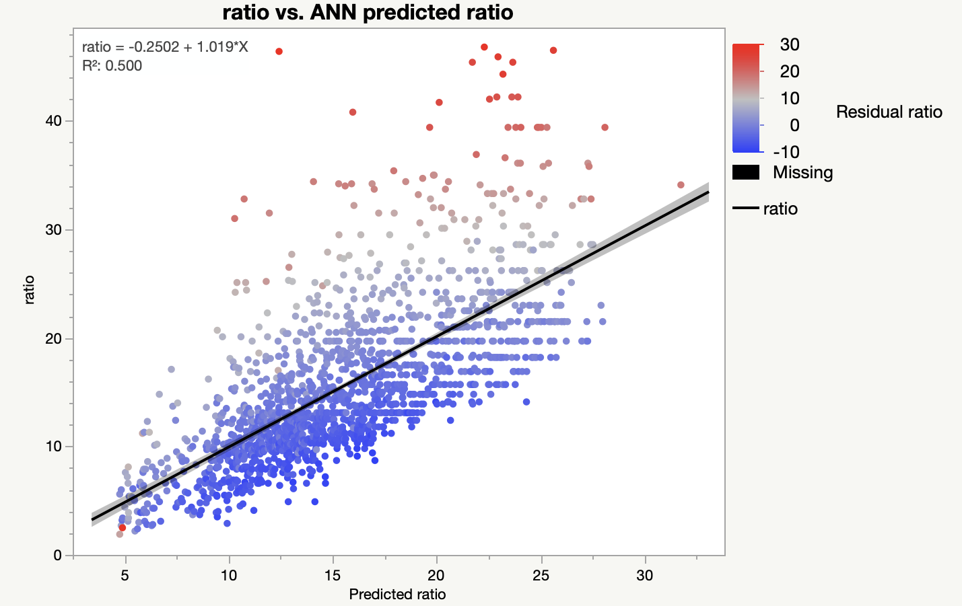
“wild snow”
Notes:
How are factors combined to produce evac decision?
Protective Action Decision Model
Describe Process
Walk through example
Ability to model
There’s a baseline understanding to be able to model the human system elements of hurricane evacuations. Rebecca’s work proves it.

Slide 16
Agent Based Models
KEY FEATURES
system is governed by the interaction of individual “agents” which follow a set of “local” rules
behavior of the system (e.g. traffic flow) emerges from the collective behavior of the individual agents (e.g. vehicles)
bottom-up interaction of multiple systems at multiple scales, with concomitant emergent properties, can allow for a deeper understanding of complex systems
Such models have a natural connection to human decision-making and the social sciences and can represent the interactions and feedbacks between natural and human systems
Great potential application to NWS IDSS

Slide 17
Where has this been applied?
In biology
In epidemiology
In business (e.g. organizational theory)
In economics and social sciences
In water management

Slide 18
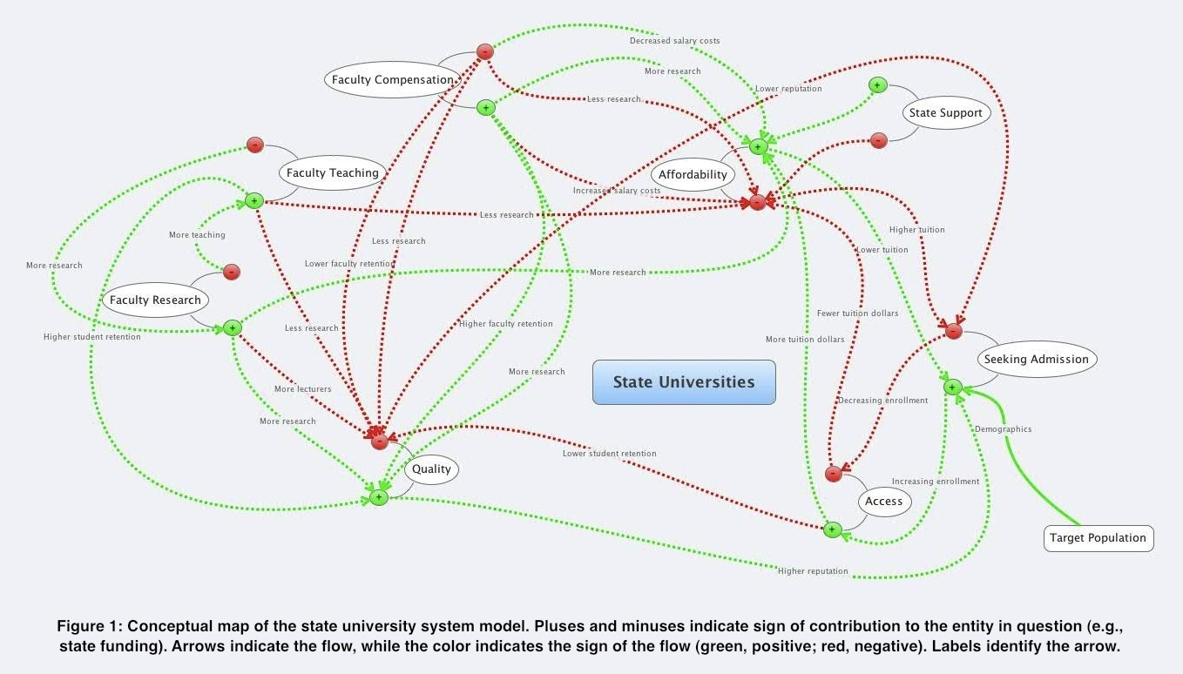
Testing scenarios

Slide 20
1. Impose interpretable algo structure 2. Initialize random structure 3. Measure “success” or “fitness” 4. Produce next generation (w/ mutations) based on “fitness” 5. Repeat #3-4* *Searching some small subset of the library of all possible solutions!
Evolutionary
Programming
Using the principles of evolution to produce skillful NWP postprocessors
MUTATIONS

Slide 21
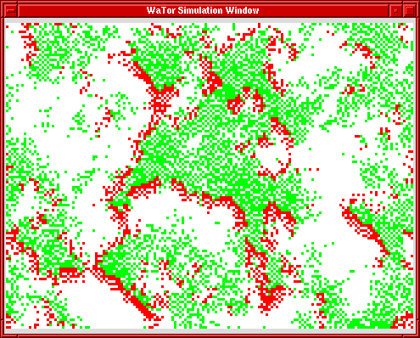
Predator-prey leads to clustering and thus might produce more genetic diversity over the domain (Dewdney 1984).
Roebber & Crockett (2019) showed that it improves both deterministic and probabilistic performance.

Slide 22
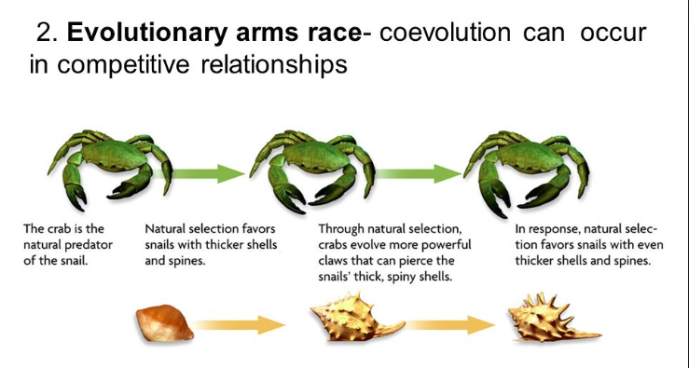

Slide 23
Initialize
Algorithms
(Pred, Prey)
Evaluate
Algorithms
Prey
Seek
Food
Update
Top 100
Pred
Seek
Prey
Algos
Reproduce
Prey
Eaten
Prey
Age
Prey
Starve
Pred
Age
Pred
Starve

Slide 25
Cycles as with the
Lotka-Volterra
equations …

Slide 26
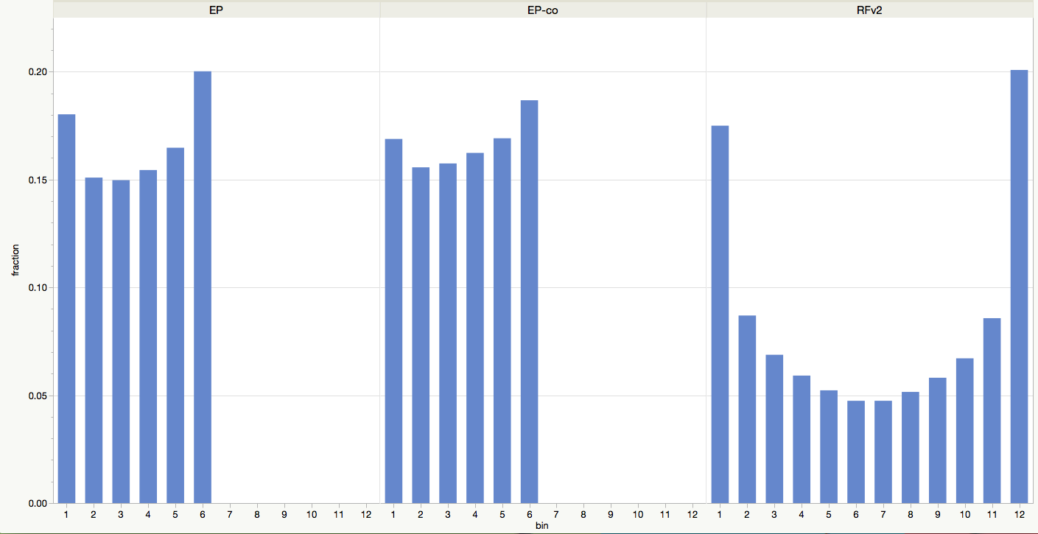
Impact of Co-evolution (reliability)
4.7%
Excessive Outliers
2.2%
Excessive Outliers
21.0%
Excessive Outliers
• Deterministic 72h T forecasts
Improves RMSE to 2.95°F
- over standard EP by 3.0% (averaged by grid)
- over RFv2 by 11.4% (averaged by grid)
• Probabilistic 72h T forecasts
Improves Ranked Probability Score
- over standard EP by 3.6%
- over RFv2 by 6.4 %

Slide 27
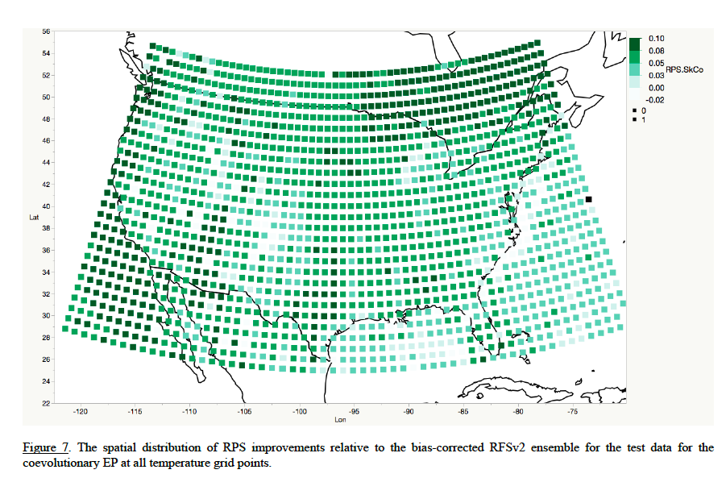

Slide 28
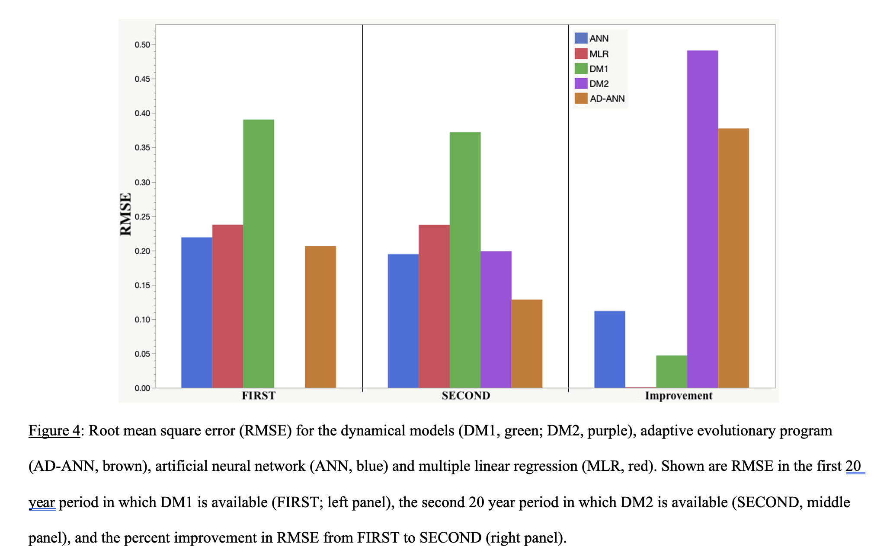
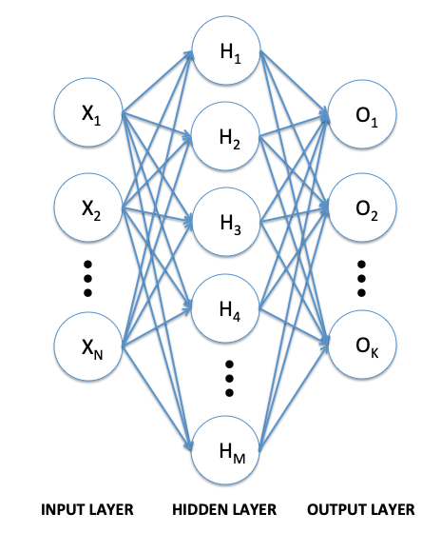
Adaptive Agent-based ANN model

Slide 29
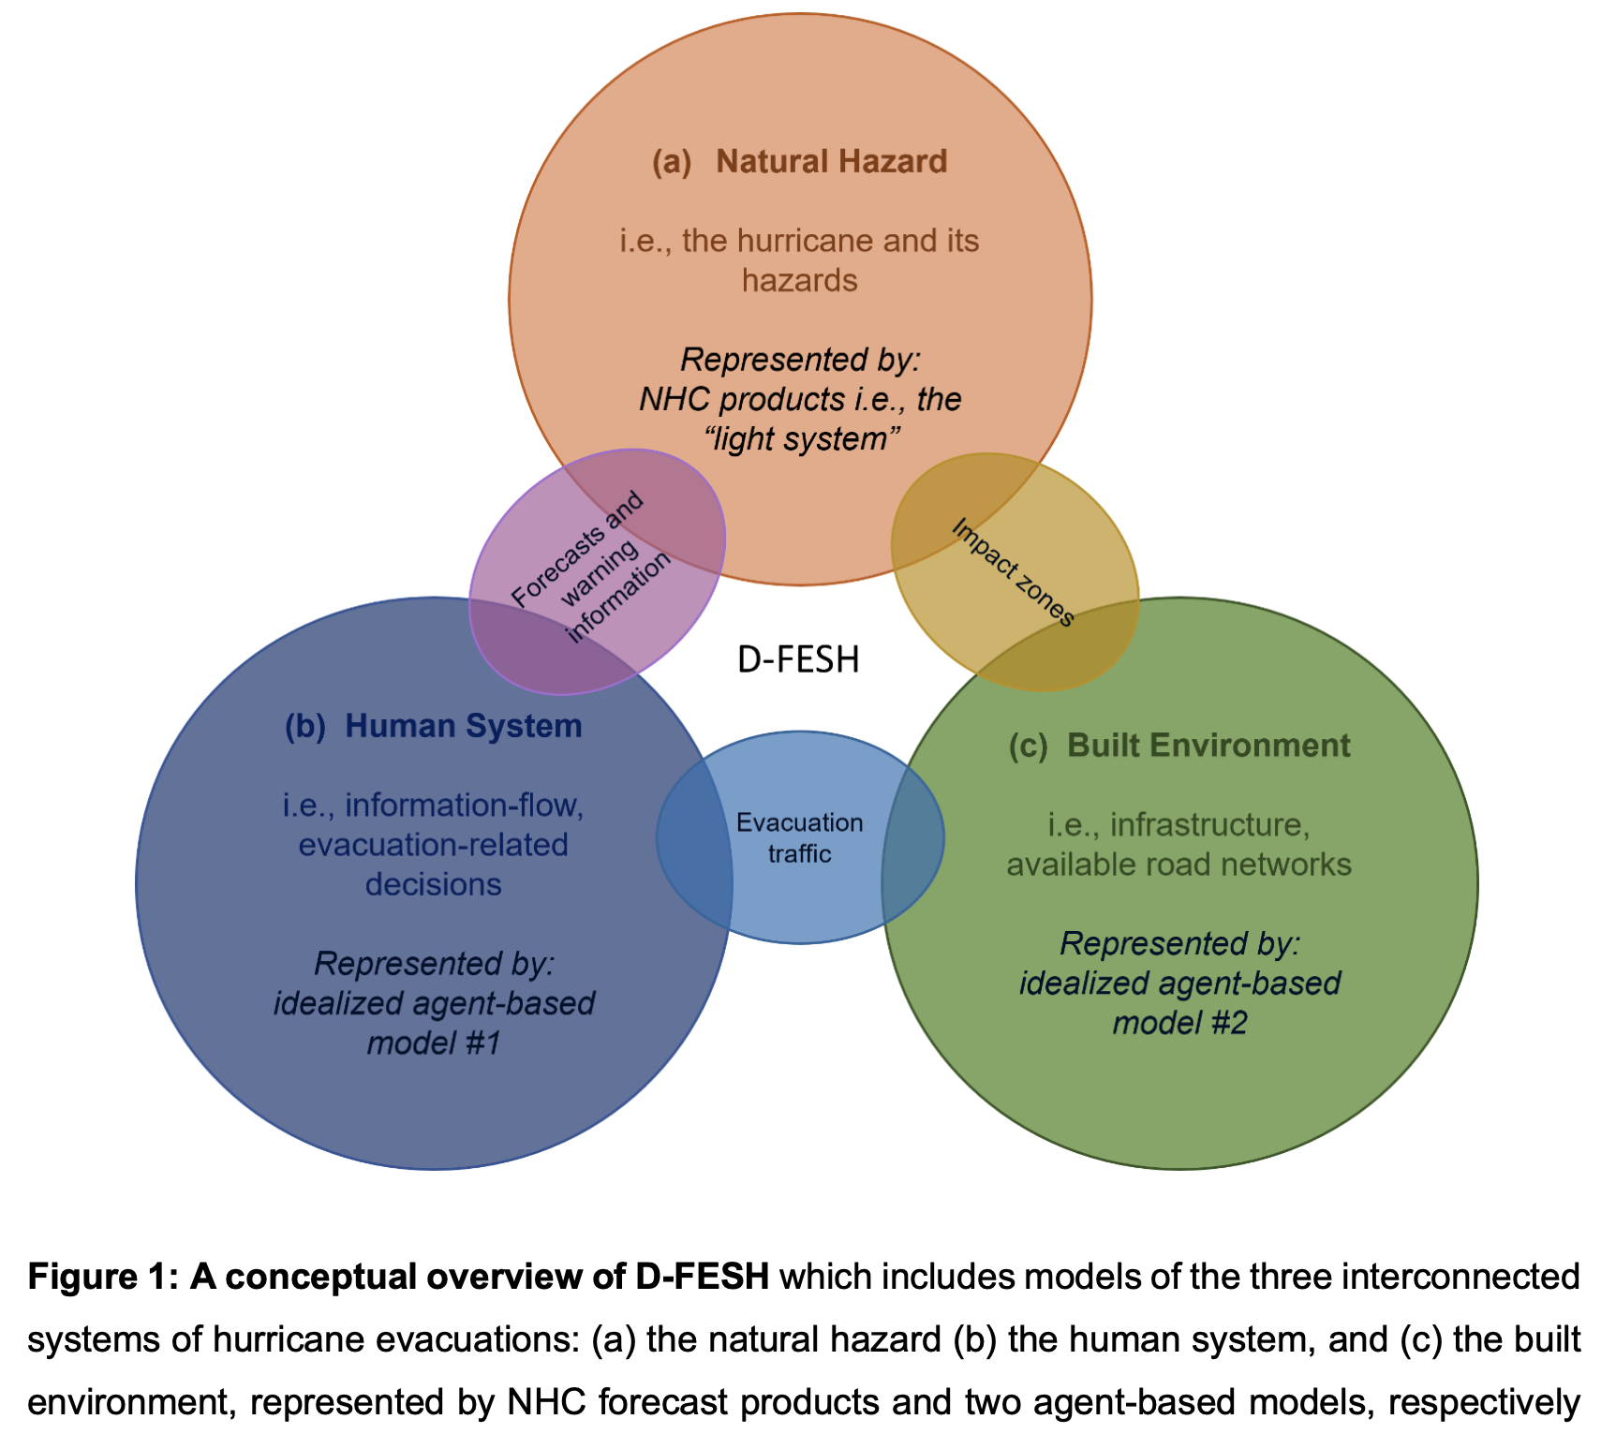
Coupled Human and Natural Systems

Slide 30
Key Evacuation Factors
Decision-making Process
The Human System
The literature has a pretty good handle on the “important” factors determining evacuations:
Huang et al (2016) – Meta-analysis of 36 studies on important evacuation factors
1. Personal risk perception: If one perceives serious risk to life and property, evacuation is likely. This perception results from many social, personality, and environmental factors.
4. Official warnings: When told to evacuate directly by trusted officials or news media, residents often decide to evacuate.
2. Storm factors: If residents perceive the storm to be weak or that most of the storm is likely to miss their area, they will not evacuate.
5. Mobile home residency: These groups are significantly more likely to evacuate due to the vulnerability of their residence.
6. Private-automobile use: There is strong evidence that residents rely on private automobiles to evacuate. In the US, carless individuals are primarily the elderly, disabled, and the poor who are disproportionately people of color.
3. Quality of sheltering options: Individuals who do not identify safe destinations prior to landfall are less inclined to evacuate. Public shelters as the only option negatively influences evacuation behavior.
Notes:
2nd thing to discuss
Factors most important to hurricane evacuations
Plenty of research
Huang et al (2016) meta-analysis of 36 hurricane evacuation studies.
Identify six key factors.
Read off slides
What now?
How are these factors combined / weighted by an individual to produce a decision whether or not to evacuate?????

Slide 31
Our version of the Protective Action Decision Model (PADM)
Key Evacuation Factors
Decision-making Process
1. Official evacuation orders?
Threat Perceptions
Personal risk = 1 + 2 + 3 + 4 + 5
(weighted appropriately)
Evacuation Impediments?
Car owner-ship and socio-economic barriers
Evacuation Decision
2. Light system of hazard risk
3. Social Cues
The process captures the known drivers of evacuation in Irma-specific + meta analysis
The threat perception is dynamic – it increases as uncertainty decreases / more of your neighbors evacuate
4. Age (past experience)
5. Mobile home ownership
Notes:
How are factors combined to produce evac decision?
Protective Action Decision Model
Describe Process
Walk through example
Ability to model
There’s a baseline understanding to be able to model the human system elements of hurricane evacuations. Rebecca’s work proves it.

Slide 32
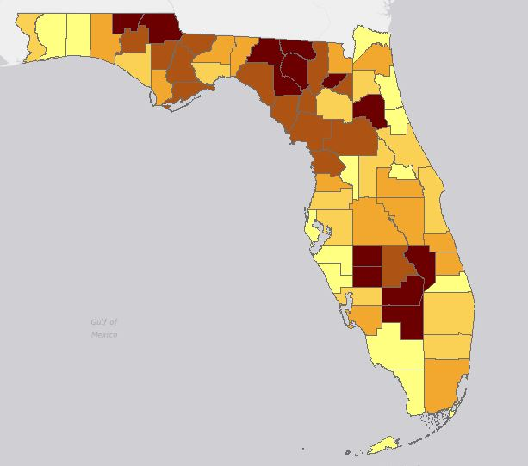
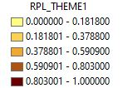
% ranking of socioeconomic status
Idealized ABM
5 | 4 | 4 | 3
5 | 4 | 4 | 1
4 | 4 | 2 | 1
4 | 4 | 3 | 2
3 | 1 | 3 | 2
2 | 3 | 3 | 3
1 | 5 | 5 | 3
3 | 5 | 5 | 1
1 | 2 | 2 | 2
1 | 1 | 3 | 3
Data taken from the CDC’s social vulnerability index.
Socio-economic data by county accounts for % below poverty, unemployed, income, education
We translated the county SVI information (right) into our Idealized ABM grid (left)

Slide 33
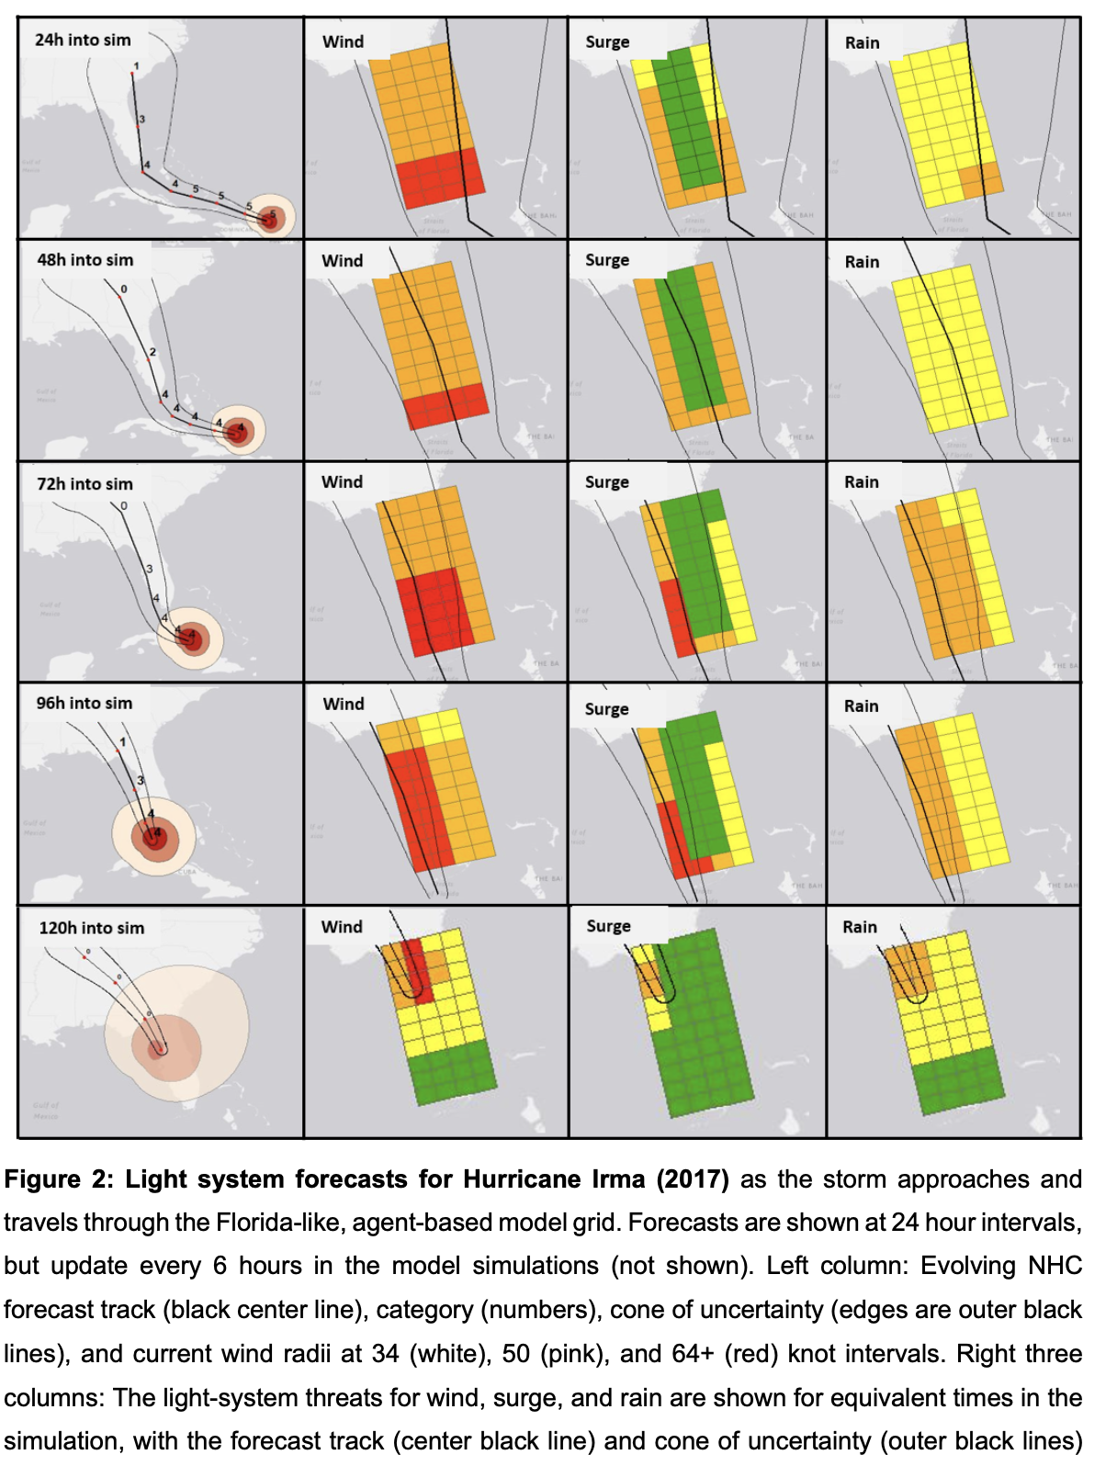
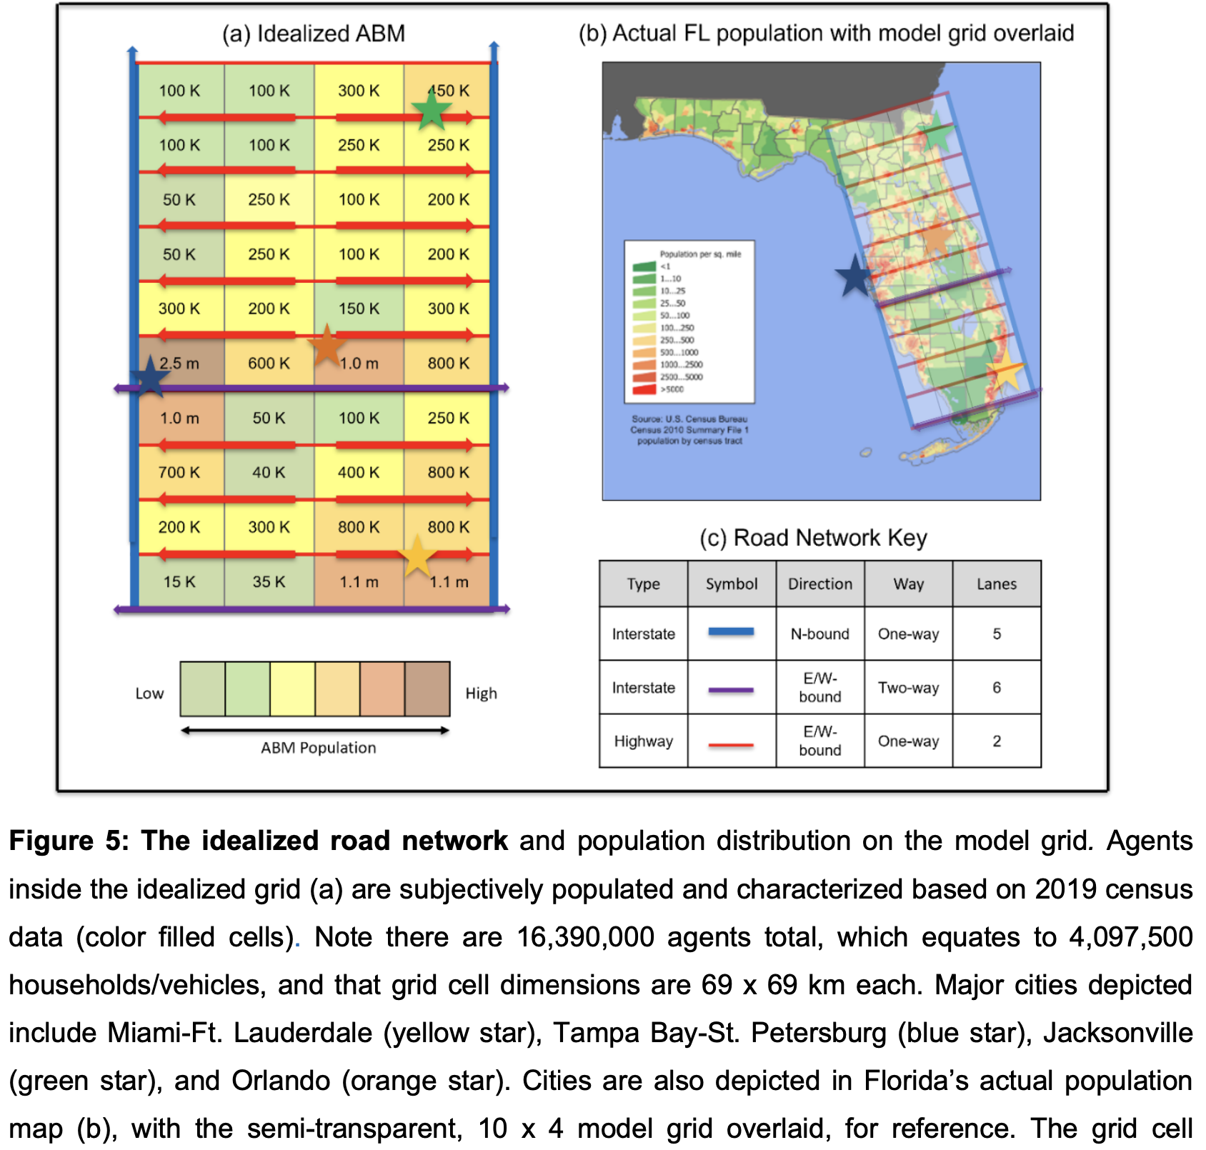

Slide 34
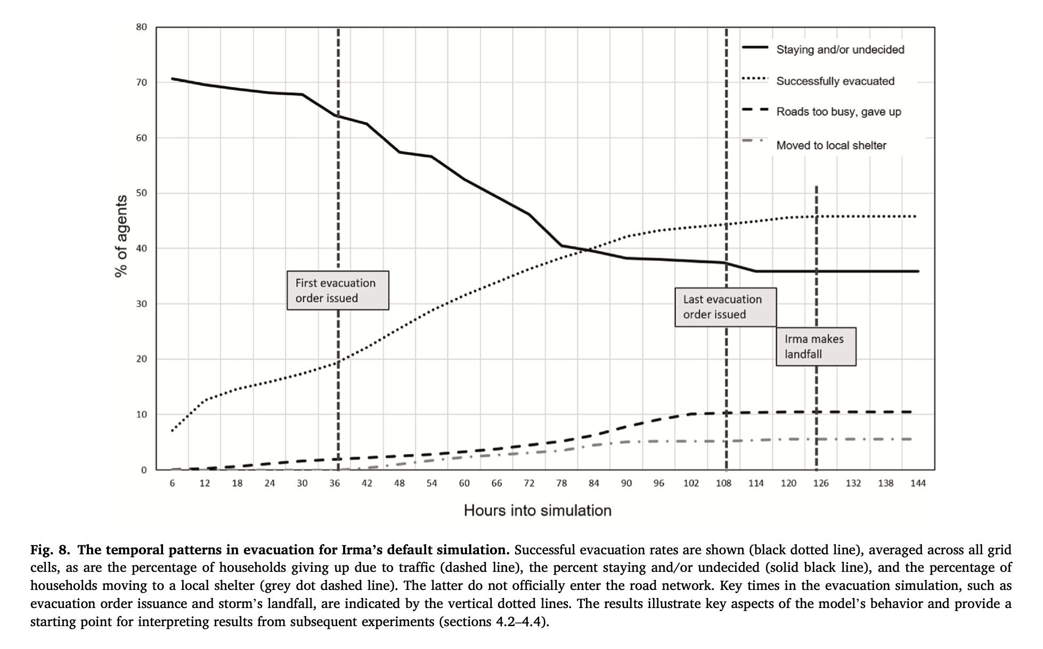

Slide 35
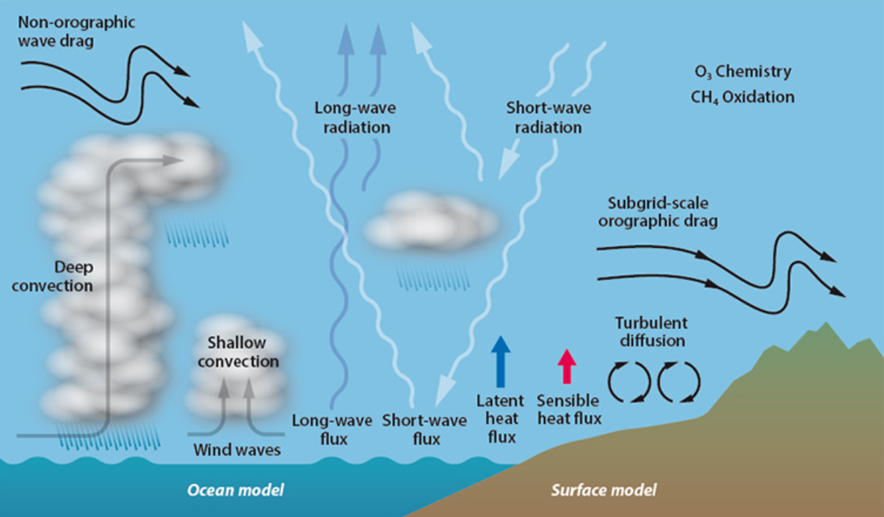

Slide 36
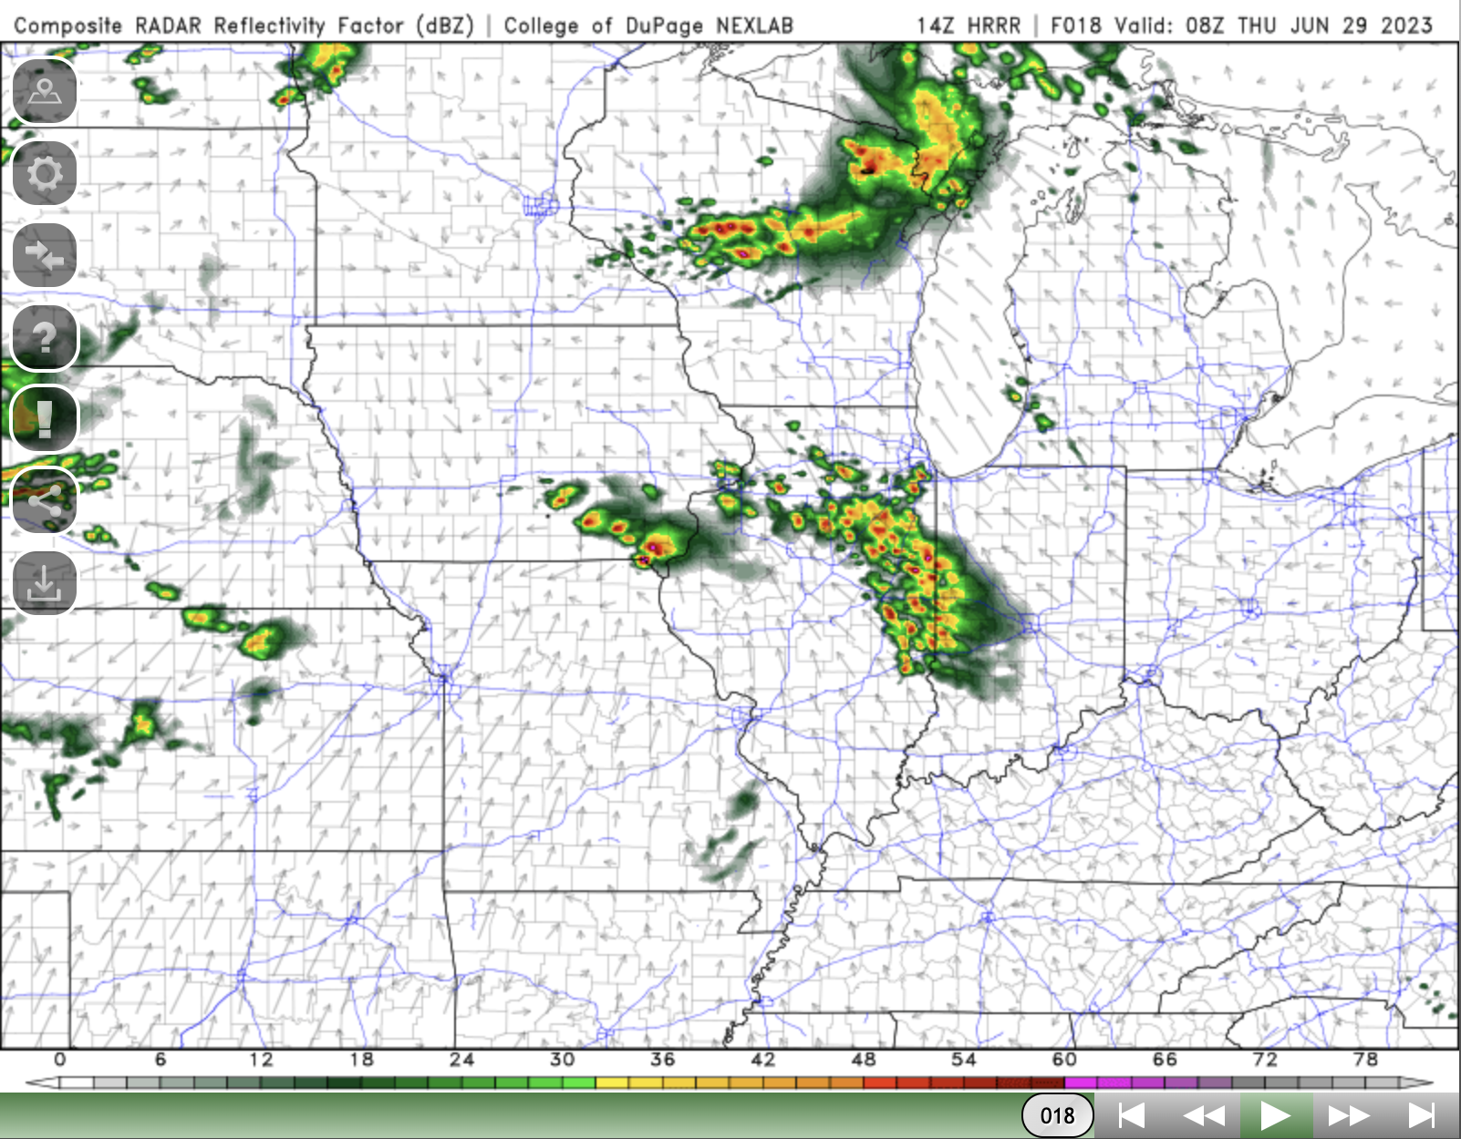

Slide 38
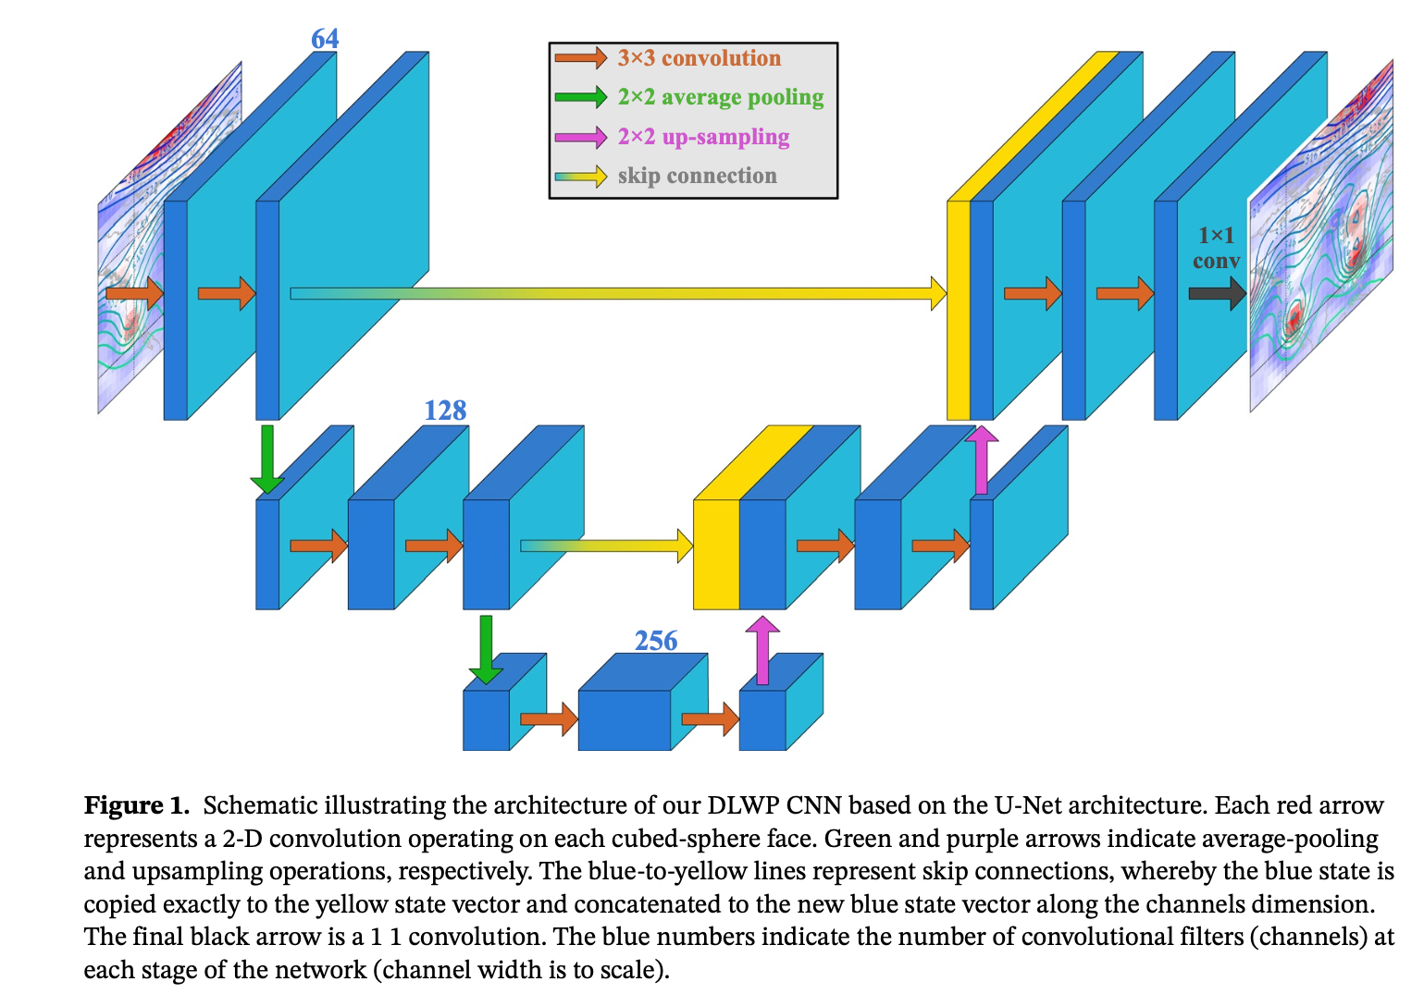

Slide 39
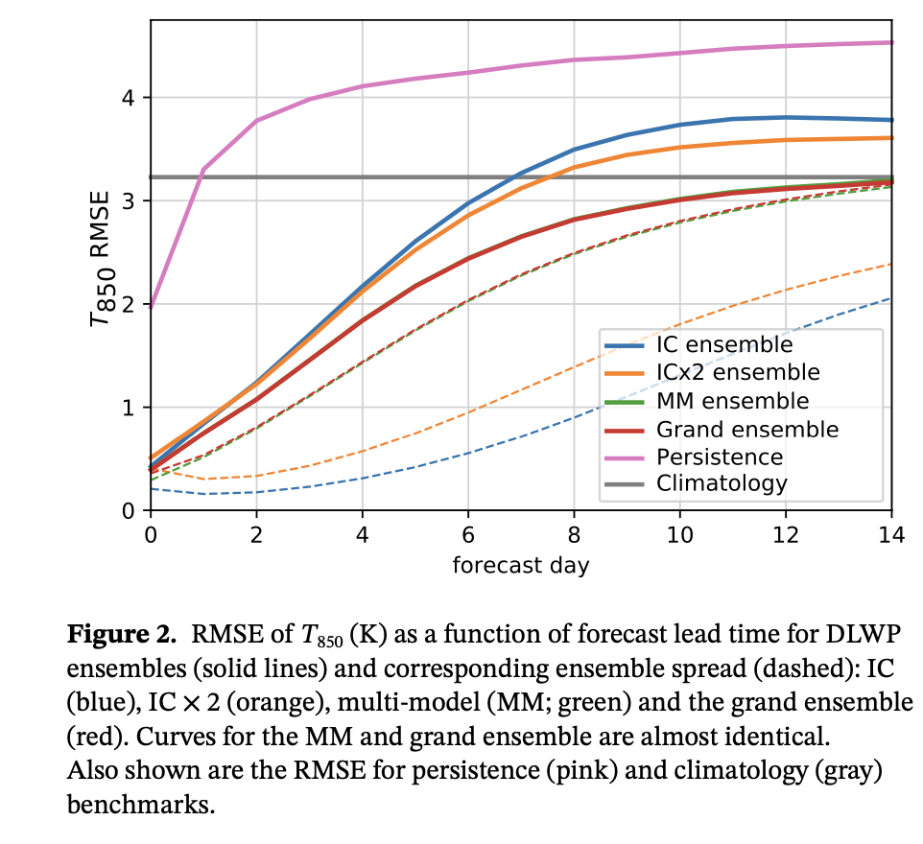

Slide 40
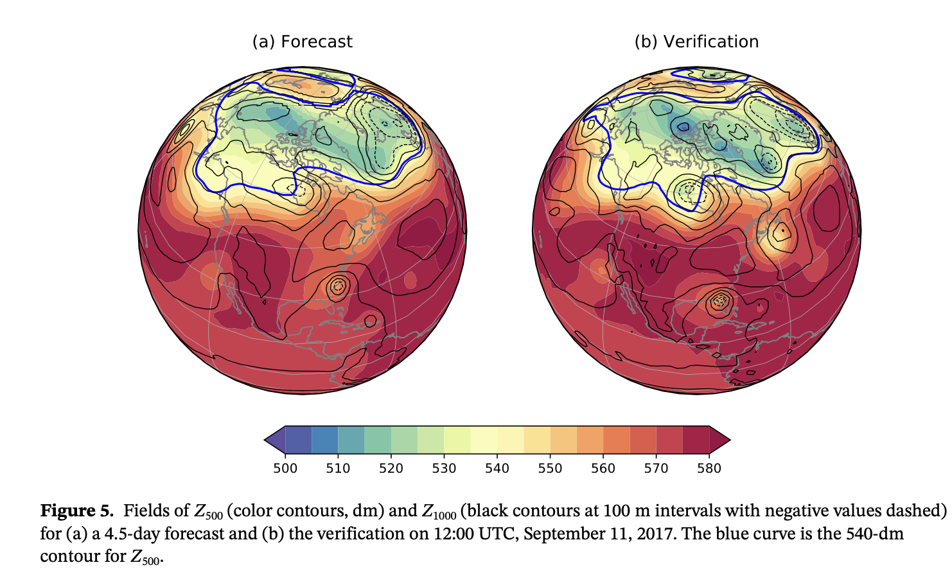

Slide 41
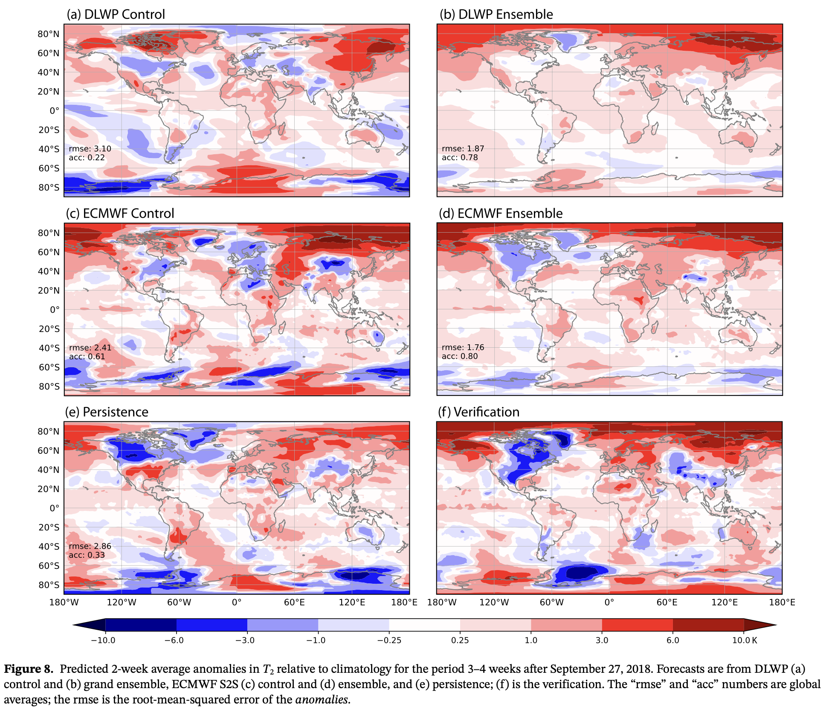

Slide 42
Questions/Discussion?
Notes:
How are factors combined to produce evac decision?
Protective Action Decision Model
Describe Process
Walk through example
Ability to model
There’s a baseline understanding to be able to model the human system elements of hurricane evacuations. Rebecca’s work proves it.

