Slide 1
Block Dynamic Mode Decomposition: Domain-Aware Machine Learning for Climate Modelling and Feedback Analysis
Craig Bakker
Adam Rupe, Parvathi Kooloth,
Derek DeSantis (LANL), Jian Lu
Notes:
Stock image of cloud formations

Slide 2
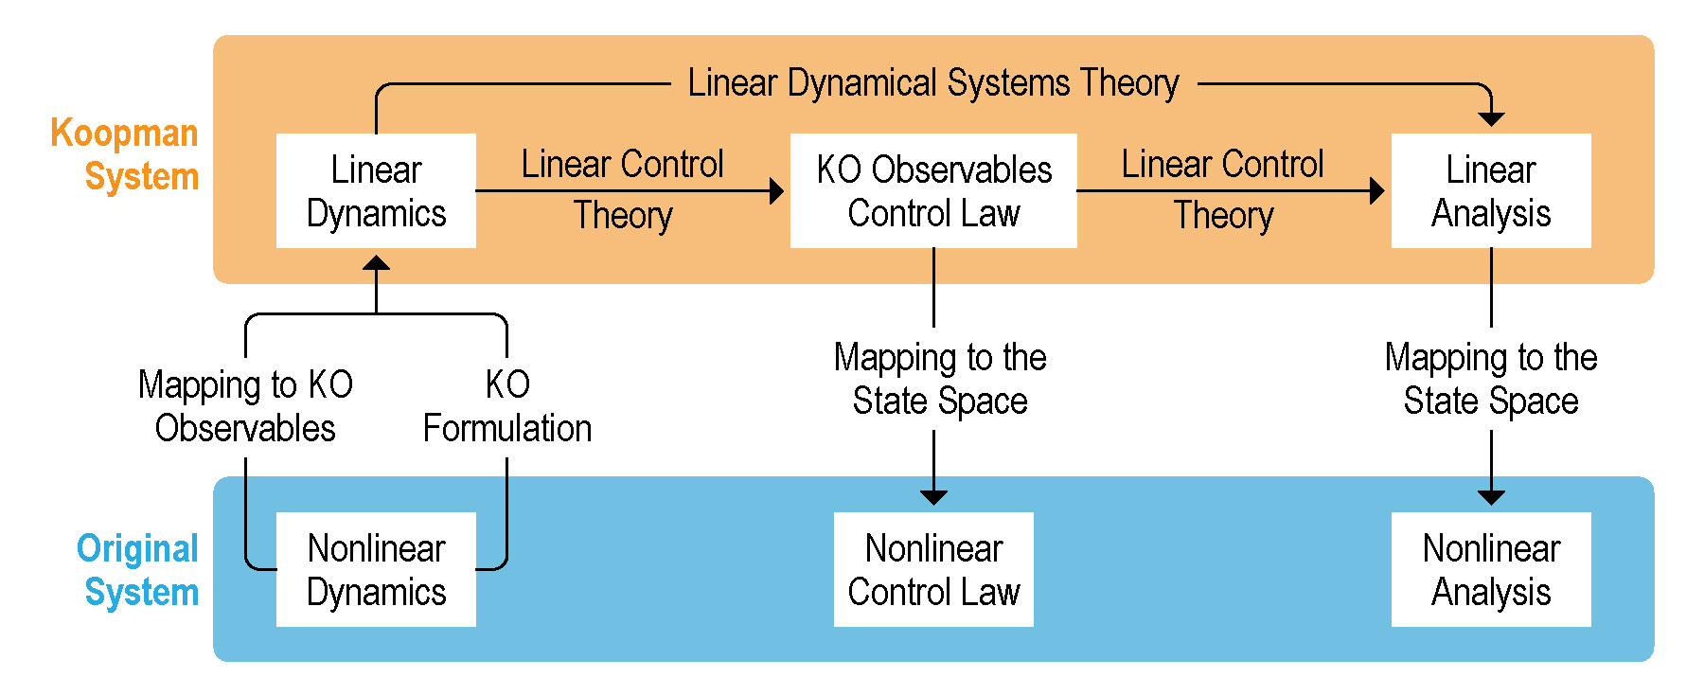
Fundamental Koopman Operator Concepts
$$\dot{ψ}=Lψ$$
$$ψ=ψ\left(x\right)$$
$$ψ_{t+τ}=K^{τ}ψ_{t}=e^{Lτ}ψ_{t}$$
$$\dot{x}=f\left(x\right)$$
The Koopman operator turns nonlinear state dynamics into linear observable dynamics

Slide 3
Calculating the Koopman Operator
$${\dot{x}}_{1}=μx_{1}$$
Analytical Example
Numerical Procedures
$$ψ\left(x\right)=\left\{\begin{matrix}x_{1} \\ x_{2} \\ x_{1}^{n}\end{matrix}\right\}$$
$${\dot{x}}_{2}=λ\left(x_{2}−x_{1}^{n}\right)$$
$$\frac{d}{dt}\left(ψ_{1}\left(x\right)\right)=μx_{1}=μψ_{1}\left(x\right)$$
$$\frac{d}{dt}\left(ψ_{2}\left(x\right)\right)=λ\left(x_{2}−x_{1}^{n}\right)=λ\left(ψ_{2}\left(x\right)−ψ_{3}\left(x\right)\right)$$
$$x_{t+1}=f\left(x_{t}\right)$$
$$\frac{d}{dt}\left(ψ_{3}\left(x\right)\right)=nx_{1}^{n−1}{\dot{x}}_{1}=μnx_{1}^{n}=μnψ_{3}\left(x\right)$$
$$\min{\sum_{t}{{\left\|ψ\left(x_{t+1}\right)−Kψ\left(x_{t}\right)\right\|}^{2}}}$$
$$\frac{d}{dt}\left(ψ\left(x\right)\right)=\left[\begin{matrix}μ & 0 & 0 \\ 0 & λ & −λ \\ 0 & 0 & μn\end{matrix}\right]ψ\left(x\right)$$

Slide 4
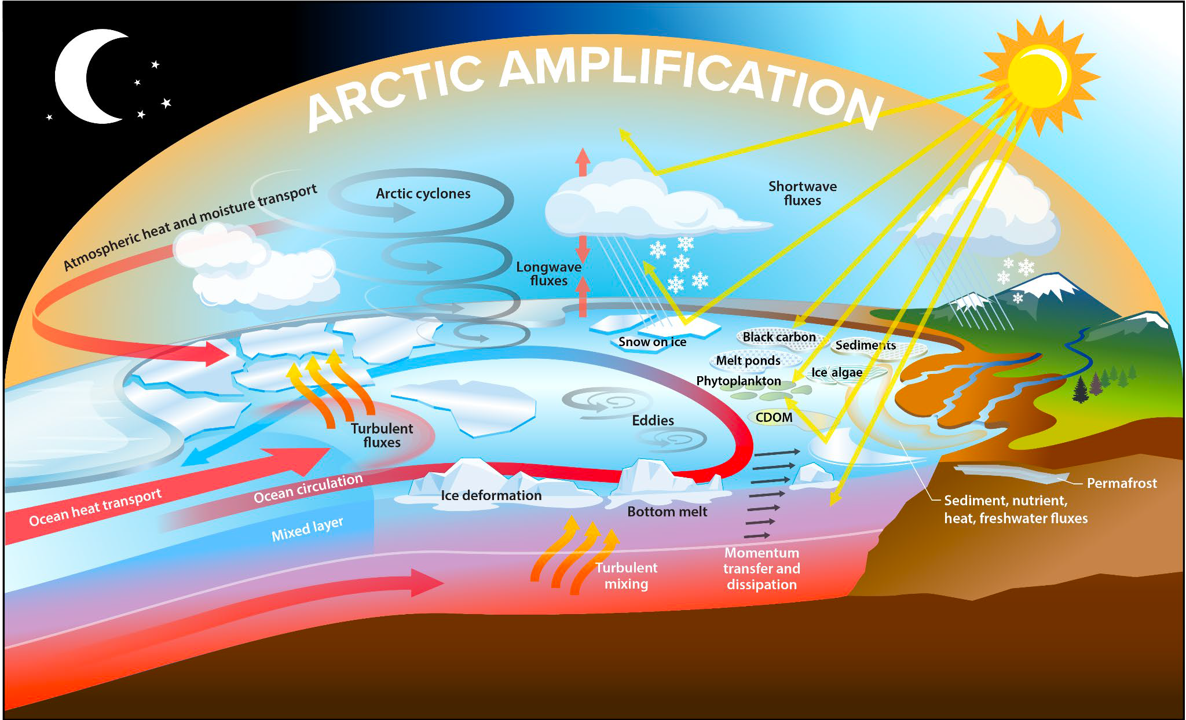
Climate Feedbacks

Slide 5
Block Dynamic Mode Decomposition
Formulation
Mathematical Characterization and Convergence
Eigendecompositions and Analysis
Domain Knowledge Incorporation
$$\left\{\begin{matrix}ψ_{x}\left(x_{t+1}\right) \\ ψ_{y}\left(y_{t+1}\right)\end{matrix}\right\}=K\left\{\begin{matrix}ψ_{x}\left(x_{t}\right) \\ ψ_{y}\left(y_{t}\right)\end{matrix}\right\}=\left[\begin{matrix}K_{11} & K_{12} \\ K_{21} & K_{22}\end{matrix}\right]\left\{\begin{matrix}ψ_{x}\left(x_{t}\right) \\ ψ_{y}\left(y_{t}\right)\end{matrix}\right\}$$

Slide 6
Feedback Analyses
Granger Causality
Controllability
Maximum Perturbation Analysis
Linear Feedback Quantification
$$\left\{\begin{matrix}x_{t+1} \\ y_{t+1}\end{matrix}\right\}=\left[\begin{matrix}K_{11} & K_{12} \\ K_{21} & K_{22}\end{matrix}\right]\left\{\begin{matrix}x_{t} \\ y_{t}\end{matrix}\right\}$$
$$\left\{\begin{matrix}x^{∗} \\ y^{∗}\end{matrix}\right\}=\left[\begin{matrix}K_{11} & K_{12} \\ K_{21} & K_{22}\end{matrix}\right]\left\{\begin{matrix}x^{∗} \\ y^{∗}\end{matrix}\right\}$$
$$K_{11}G_{12}K_{11}^{T} −G_{12}=−K_{12}K_{12}^{T}$$
$$\max_{Δy}\left\|Δx^{∗}\right\|$$
$$\frac{∂x_{t+2}}{∂y_{t+1}}\frac{∂y_{t+1}}{∂x_{t}}=K_{12}K_{21}$$
$$Δx^{∗}=K_{11}Δx^{∗}+K_{12}Δy$$
$$\left\|Δy\right\|≤ε$$

Slide 7
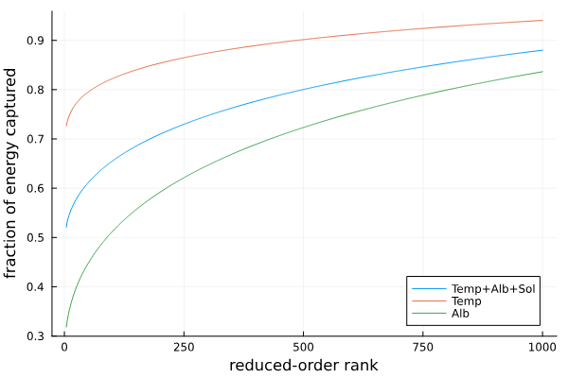
Data Generation and Training
Surface Temperature and Albedo
Rank Reduction
Eigenmode Analysis
$$ψ\left(x_{t+1},y_{t+1}\right)=Kψ\left(x_{t},y_{t}\right)+K_{u}ψ_{u}\left(u_{t}\right)$$

Slide 8
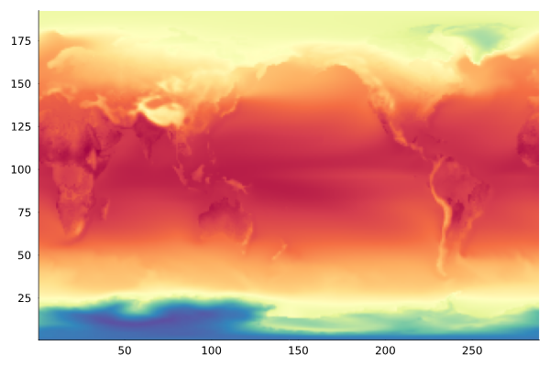
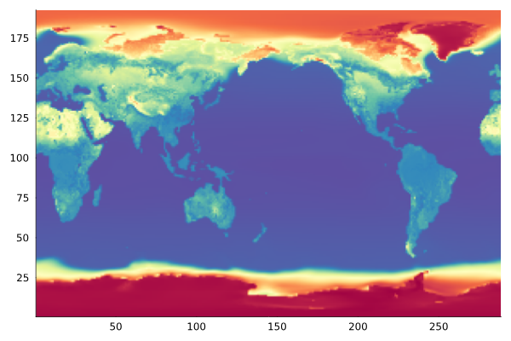
Eigenmodes – Mean State
Temperature
Albedo

Slide 9
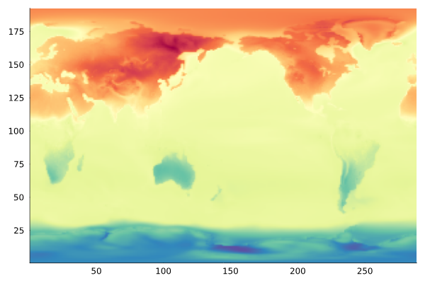
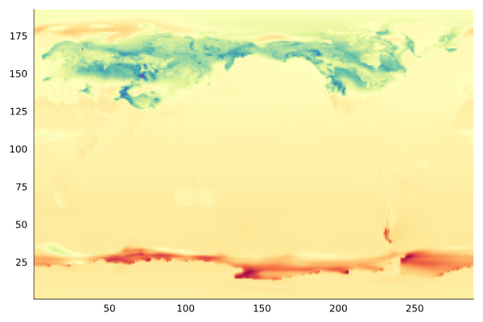
Eigenmodes – Seasonal Cycle, Real
period = 12.001 months
norm = 0.999
Temperature
Albedo

Slide 10
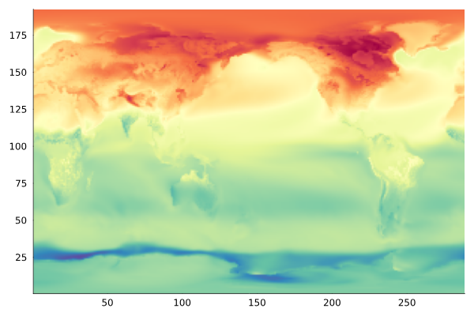
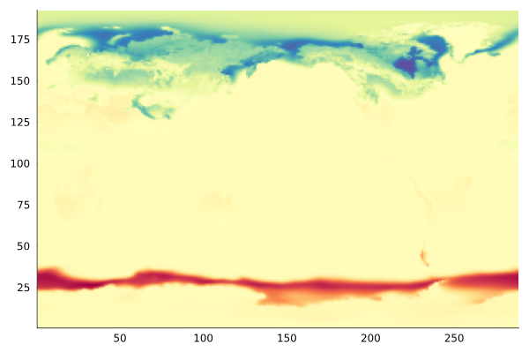
Eigenmodes – Seasonal Cycle, Imaginary
period = 12.001 months
norm = 0.999
Temperature
Albedo

Slide 11
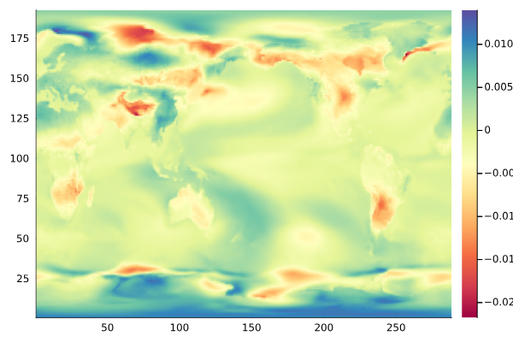
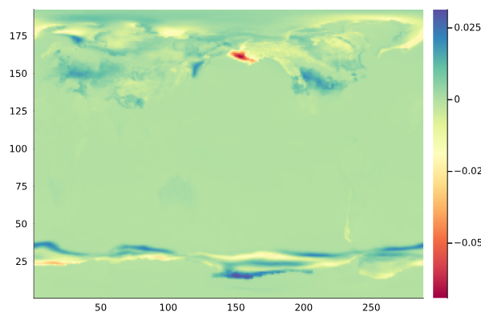
Results – Maximum Perturbation
$$\max_{Δy}\left\|Δx^{∗}\right\|$$
Albedo ($Δy$) on Temperature ($Δx^{∗}$)
$$\left\|Δx^{∗}\right\|=764.6$$
Temperature ($Δy$) on Albedo ($Δx^{∗}$)
$$\left\|Δx^{∗}\right\|=23.51$$

Slide 12
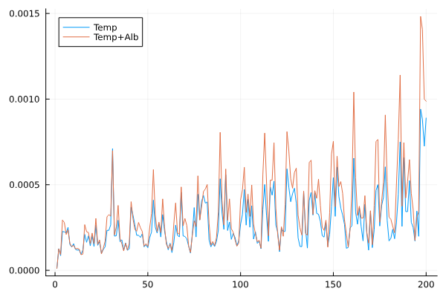
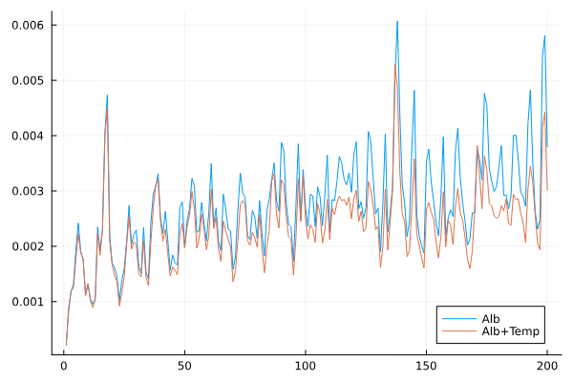
Results – Granger Causality
Mean squared error over time: single-variable DMD vs block DMD

Slide 13
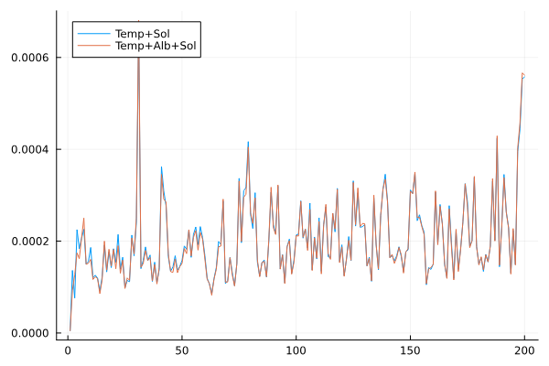
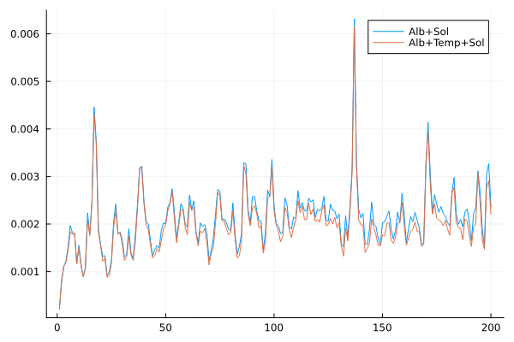
Results – Granger Causality (with Solar Forcing)
Temperature
Albedo

Slide 14
Discussion and Summary
Block-DMD and Feedback Analyses
ResDMD and Pseudospectra

Slide 15
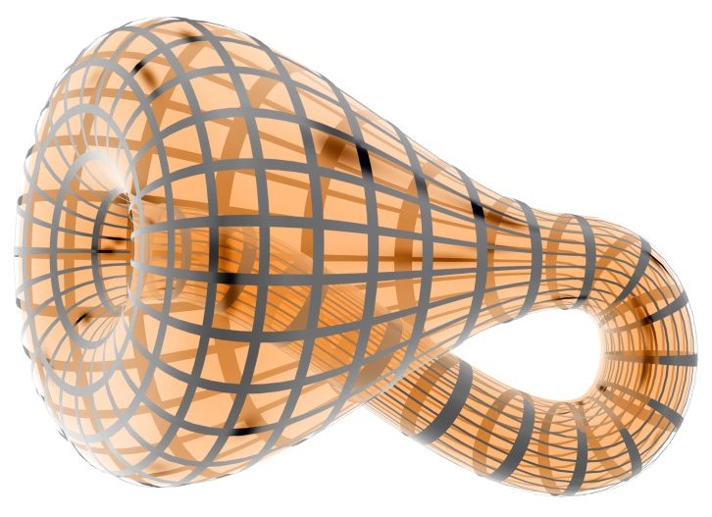
Questions
Banchoff, T., Beall, J.: kbc1.jpg. URL http://alem3d.obidos.org/en/struik/kbottle/

