Slide 1
Digital Provenance for Machine Learning Reproducibility and Trustworthiness
UUR
Samuel Grayson (1424, UIUC), Reed Milewicz (1424), Michael Darling (8732)

Slide 2
Has this ever happened to you?
Paper has software artifact! But not sure how to run...
Results look good, but I forgot what hyperparams were used

Slide 3
Problem
Reproducibility and documentation:
  Important
  Hard
  Often last priority

Slide 4
Sketch of solution
Bookkeeping should be done by the computer not the human
For every file, record the process that created it
  Provenance
Query graph database to view the (indirect) inputs for any file
No additional effort required

Slide 5
How?
Application
(Python, R, Java)
Monitor
Library interposition
Linux kernel and disk
libc

Slide 6
Tensorflow v2.19
Python 3.12
preprocessing.py
data-acquisition.py
training.py
train.csv
Raw_data.csv
Model weights.pkl

Slide 7
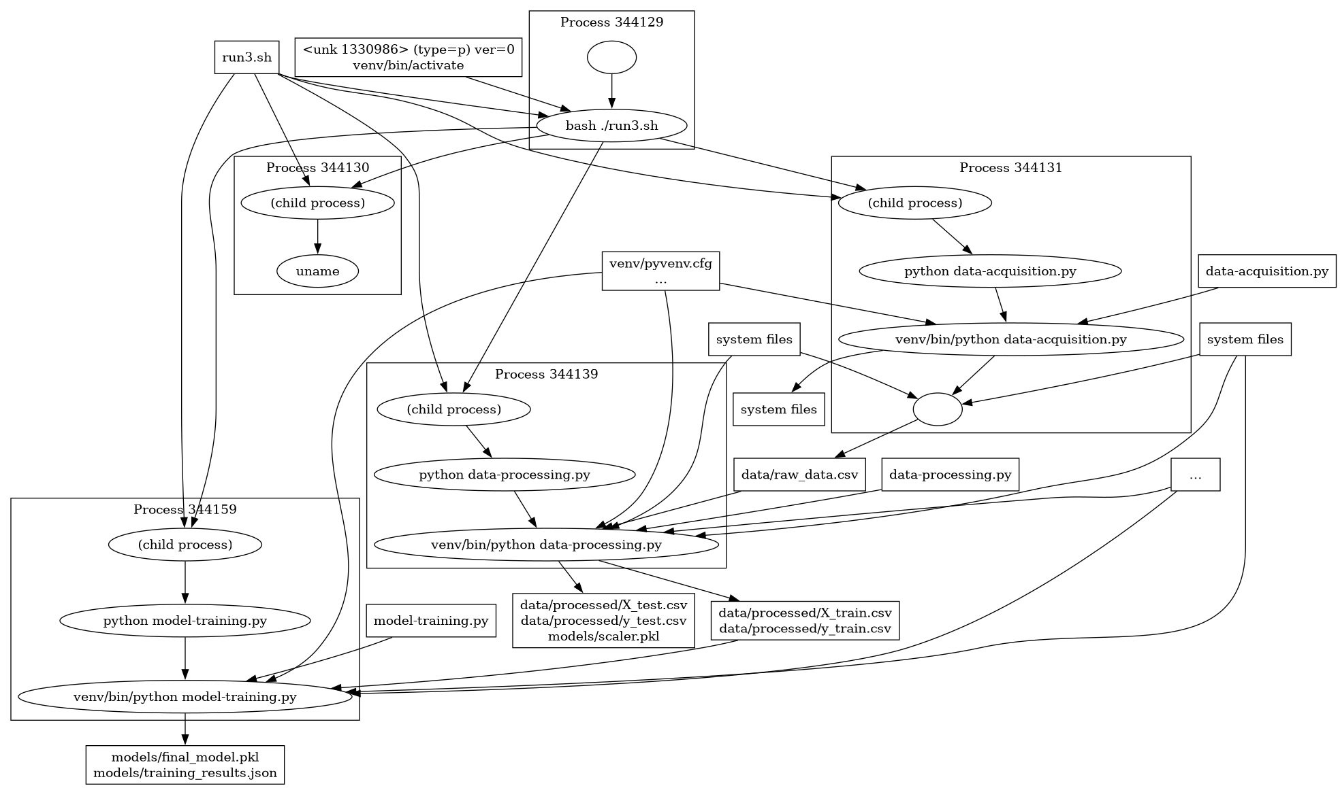

Slide 8
ML Engineer user experience
Code like normal
Instead of running ./script.py, run probe record ./script.py
  Creates .provenance/ in repository
Attach manual metadata (business purpose, etc.)
Push .provenance/ project's repo, versioned with the code
From .provenance/, anyone can see the graph of commands

Slide 9
benefits
Reproducibility for free
Bookkeeping trials "what parameters for that output?"
Provenance can be "baked in" to some data formats
  Parquet, SafeTensors, JSON, GGUF, ONNX
  Could be combined with other tools

Slide 10
Trusted AI Tools are Grounded in Trustworthy Evidence, Rooted in a
Credible Technical Bases
Trust: defines the state of the decision maker.
  Decision maker integrates model inference and/or predictions into their decision-making process.
Trustworthy
Trust
Trustworthy: defines the state of the model.
  Red team tested for security.
  Bias is known and accounted for.
Credibility
Credibility: defines the technical basis of the model.
  Verification, validation, UQ
  Data and Geometric Representations.
Copied from "Towards Certifying Machine Learning Models" Darling et al.

Slide 11
How does provenance help credibility?
Is the model training on the data you expect?
  Not using forbidden data
Does the process use any known-buggy data or libraries?
Do we "leak" testing data during trianing?

Slide 12
How does provenance help trustworthiness?
Is training process understandable?
Is model reproducible?
Are all contributors (code, data, libraries) trustworthy?

Slide 13
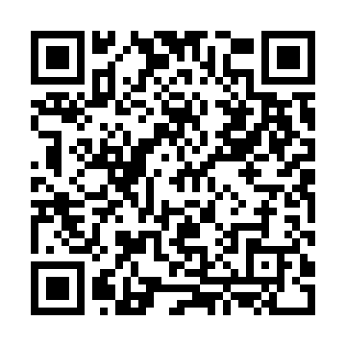
Soliciting users and feedback
Sagrays@sandia.gov
https://github.com/charmoniumq/PROBE

