Slide 1
Augmenting VR with Governed Agents
project_blackbox: a deterministic framework for autonomous, governed vulnerability research
Jackson Stephens

Slide 2
◈ BACKGROUND
Background
Jackson Stephens · M.S. AI Engineering for Information Security · Carnegie Mellon University
Background: Cybersecurity in the college of electrical and computer engineering at BYU, into a master's of AI engineering for information security at Carnegie Mellon. Year-round intern in the TITANS/Center for Cyber Defenders. Personal project.
Last year I was introduced to AI and machine learning through my internship at Sandia. I’ve been hooked ever since. This talk will go over the history of my journey in AI augmented cyber-ops, leading to the methodology that brought me my first 0day… That I can’t talk about…
MLDL 2026
2

Slide 3
◈ PART 01
01
How I got here
From cyber defense to governed vulnerability-research agents.

Slide 4
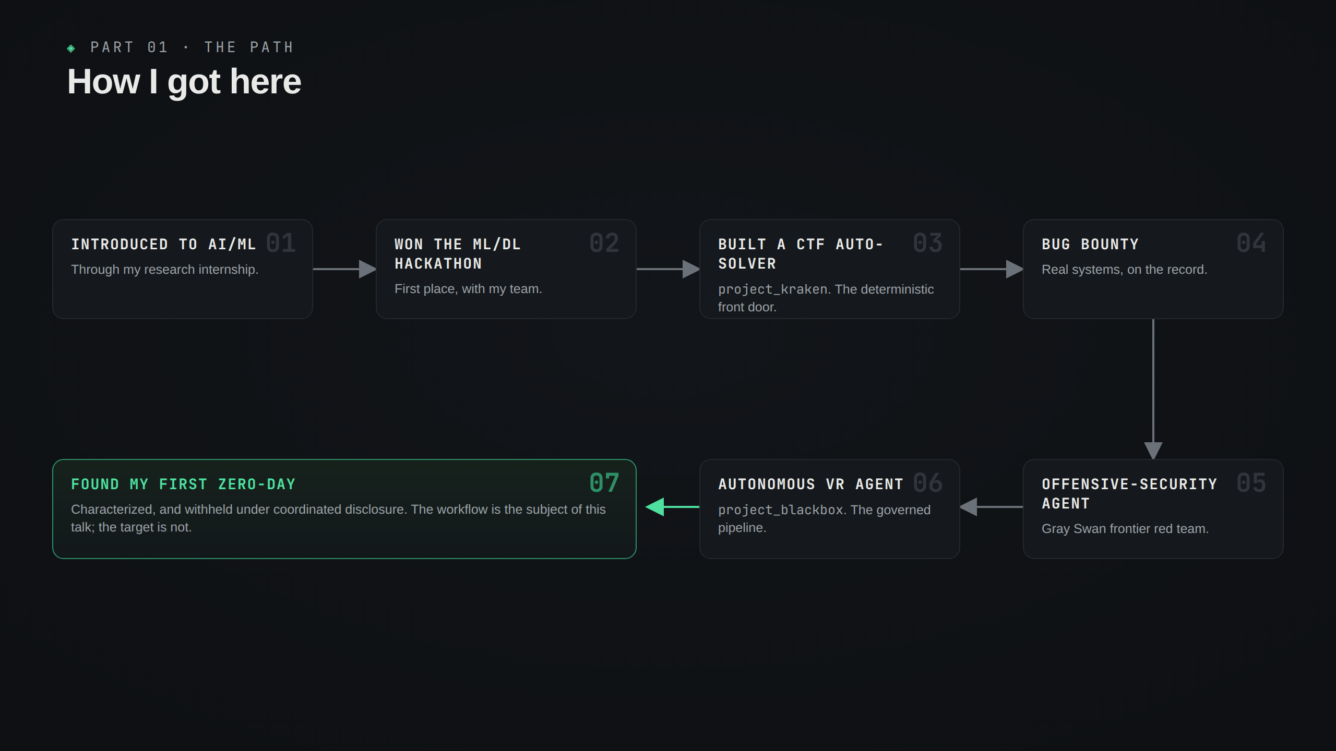

Slide 5
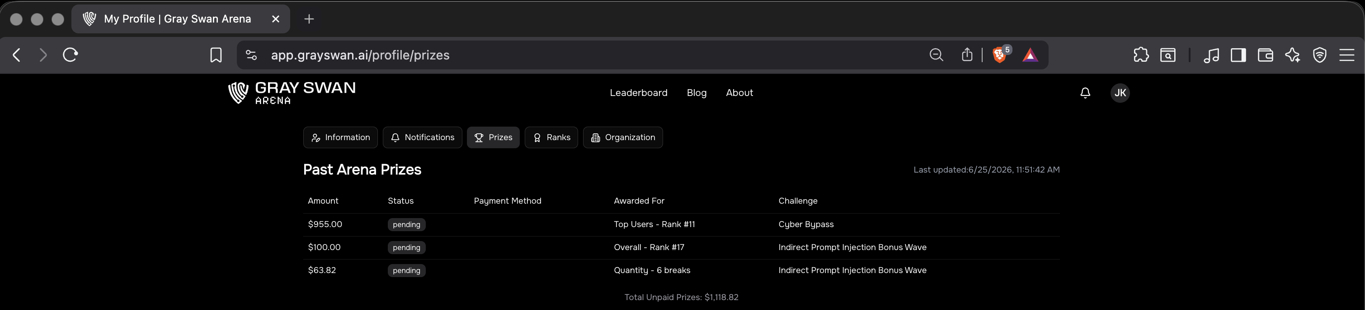
◈ PROOF · FRONTIER RED TEAM
Don't just take my word for it
I break these models too, which is a great value proposition as to why governance matters.
#11
GRAY SWAN · CYBER BYPASS
$1,118
ARENA PRIZES
6
CONFIRMED BREAKS
The methodology I’m about to share applies to every agentic development domain but tailored for VR. For example, I’ve used this to build out tooling for Gray Swan Arena competitions, landing me a spot on their frontier red team, running model safeguard and security assessments before they drop (like Fable & Mythos 5).
Throughout my experience in this, I’ve watched language models do genuinely impressive offensive work, once they’re aligned, but I’ve similarly watched the same models confidently make things up. So how can you feel confident in your agents doing serious security work?
MLDL 2026
5

Slide 6
◈ PART 02
02
The question
How do you trust agentic outputs and effectively direct intelligence?

Slide 7
◈ THE THESIS · DIRECTIONAL INTELLIGENCE
Direction matters more than intelligence
The interesting problem is not "can an agent find a bug." It is a systems-engineering question: how do you build a governed system that reliably creates value for an expert researcher?
The model is fungible. The scaffold is not.
THE MODEL DOES WELL
Recall at scale. Mechanical state-space search. Drafting. Pattern-matching a corpus. Tireless long campaigns.
THE OPERATOR DOES WELL
Goal-setting. Knowing when to switch. Catching silent failures. Taste: telling good from AI-shaped.
EMERGES FROM THE PAIR
Audit before build. Adversarial second opinion. Many short trajectories over one long one. Frozen cores, hot-pluggable edges.
MLDL 2026
7

Slide 8
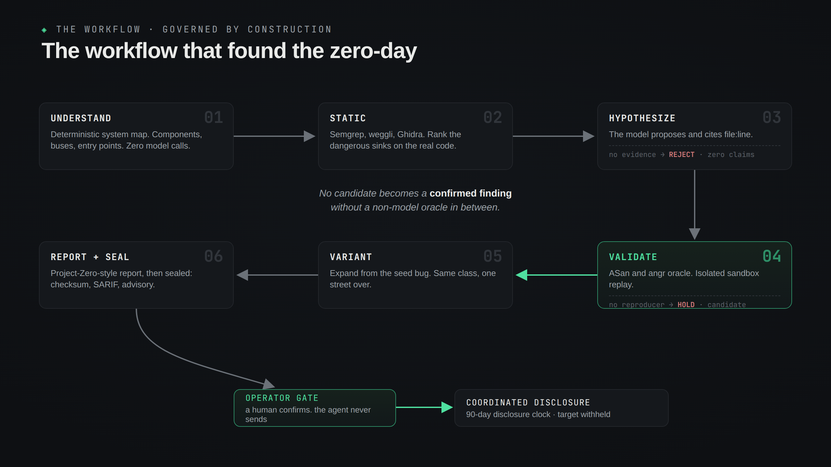

Slide 9
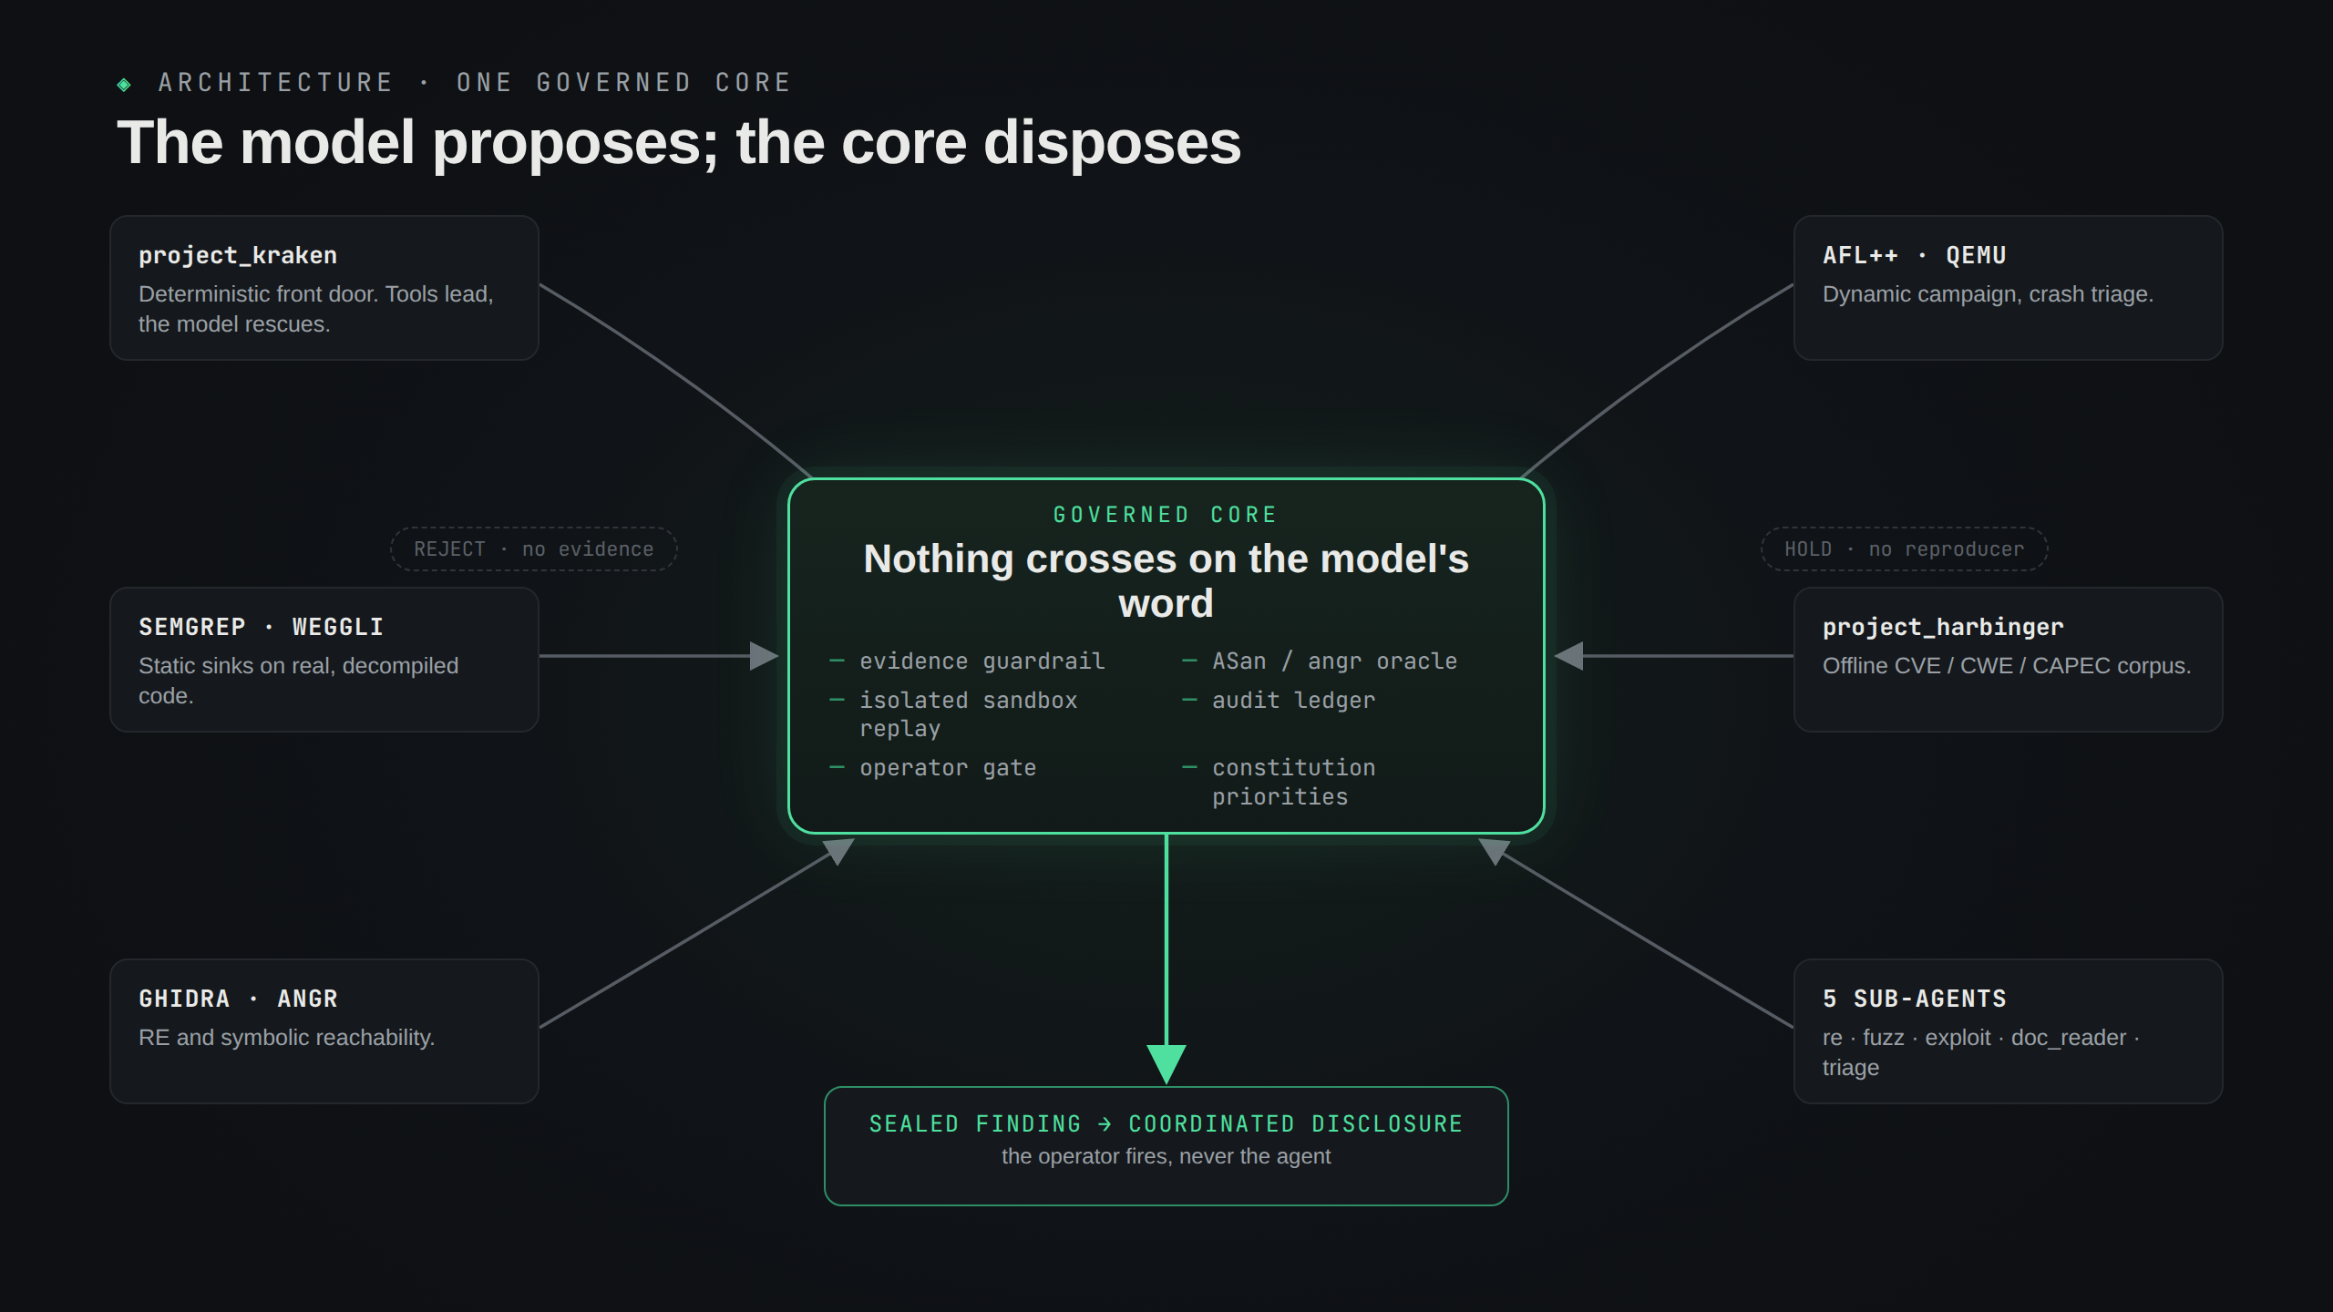

Slide 10
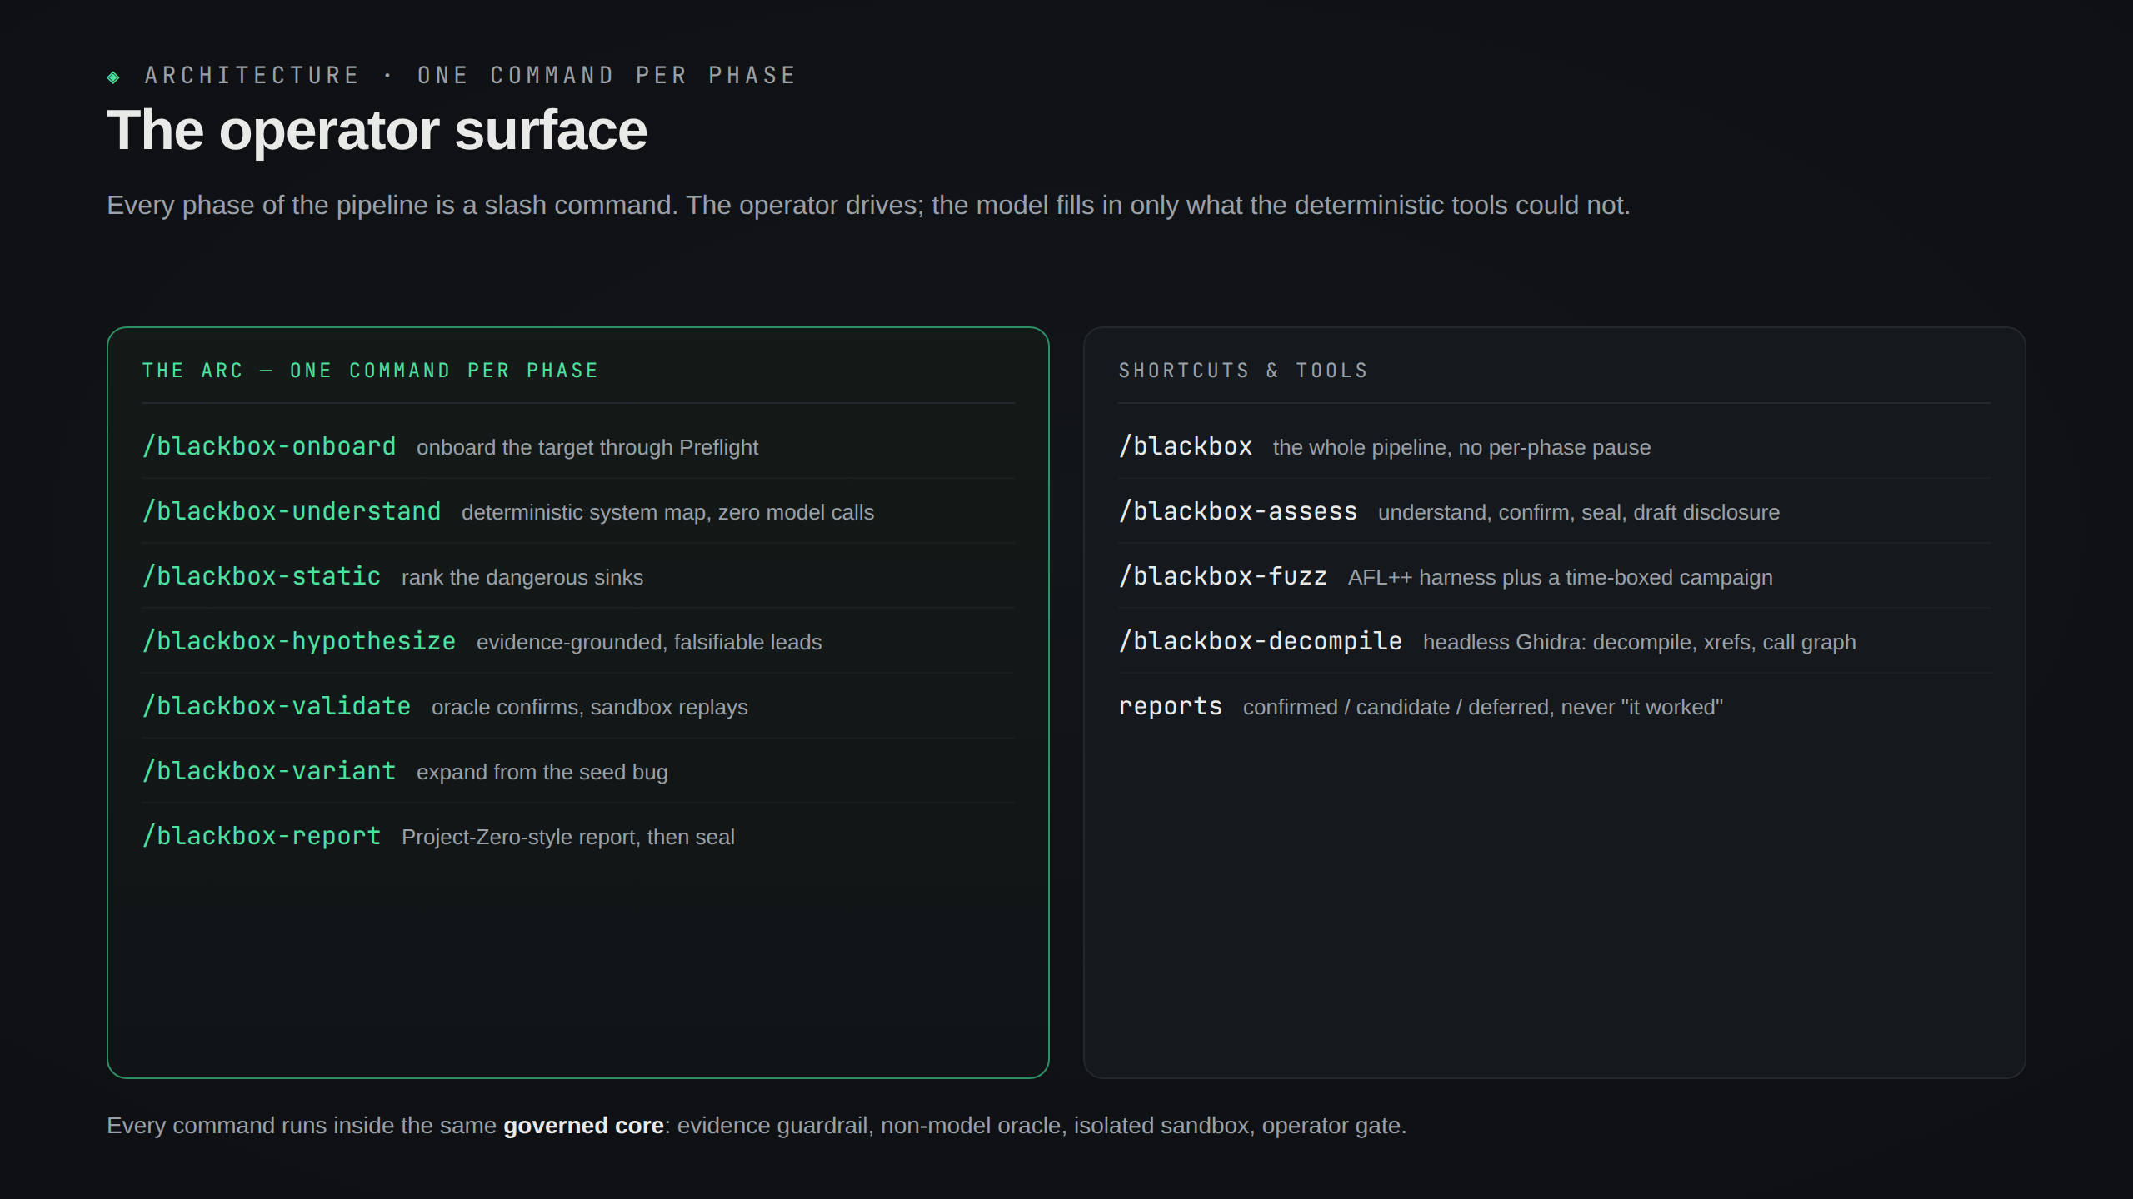

Slide 11
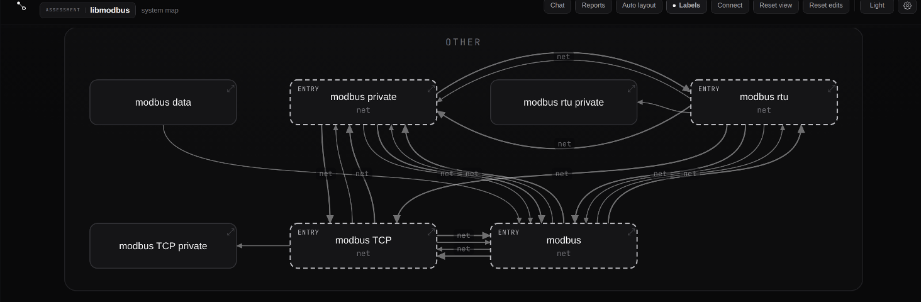
◈ THE UNDERSTANDING LAYER · DETERMINISTIC, MODEL-OPTIONAL
It reads the system before it touches a model
A real map, generated from a public target (libmodbus), with zero model calls: components, entry points, and data flow, straight from the source. The model narrates this map; it does not invent it. Great for determinism. Not ideal for system and component understanding.
MLDL 2026
11

Slide 12
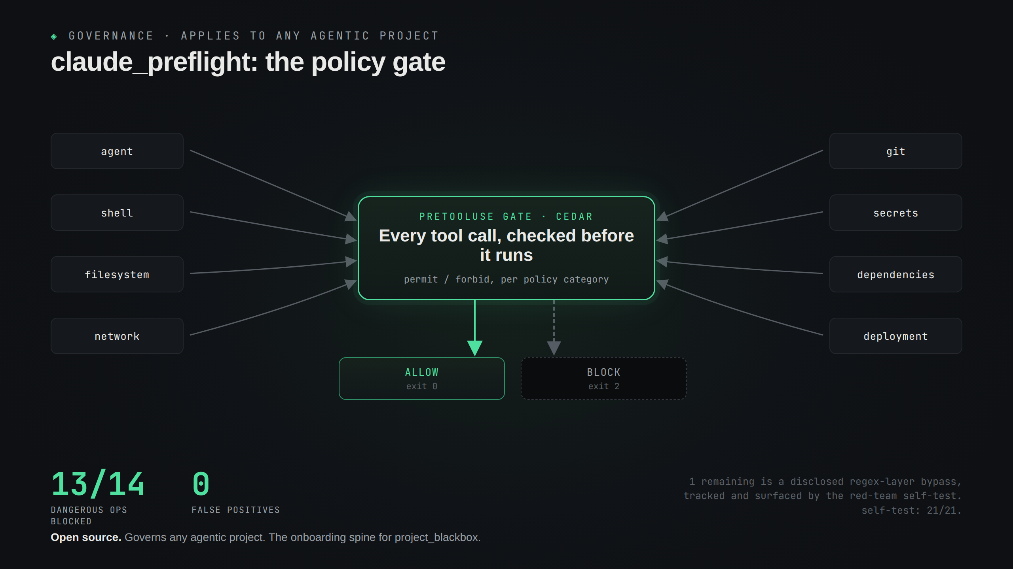

Slide 13
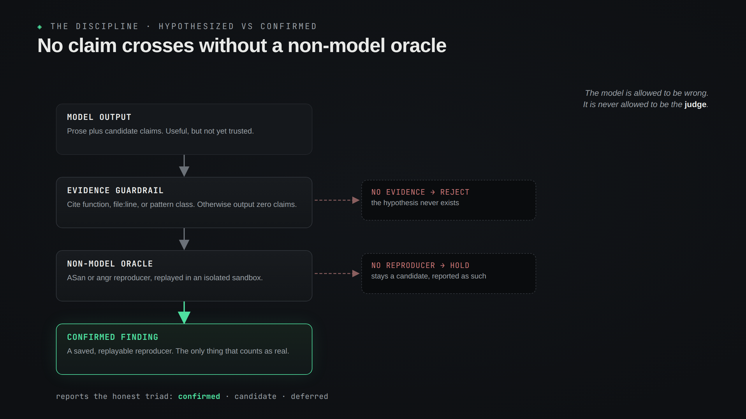

Slide 14
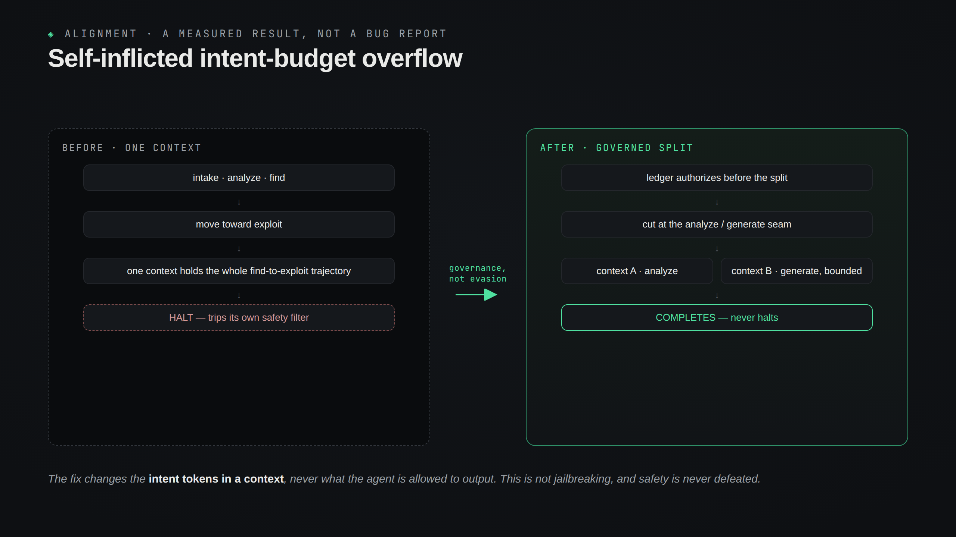

Slide 15
◈ DOES IT WORK · AN HONEST DEMO
A public demo, an honest scorecard
The real finding is withheld, so the demo runs on Magma, a benchmark that plants known memory-safety bugs into real open-source code, here libpng. Fully public: no redaction, no withheld frames.
16/16
ARC STAGES RAN · NONE HALTED
6/7
CANARIES REACHED · 0 FALSE POSITIVES
The governed arc drives to PNG003, a PLTE palette-length overflow in png_handle_PLTE, confirmed under AddressSanitizer. The bug-trigger runs operator-side, outside the agent. Honest by construction: a stage that lacks an optional tool degrades and says so, and disclosure stops at the operator gate. The bottleneck is research hours, not code.
MLDL 2026
15

Slide 16
◈ THE DIRECTION
Capability and alignment rise together
when governance is built into every step.
The value is not the CVE. It is a governed agent that raises the floor of every research session: understanding, environment, planning, evidence, reporting, clean handoffs. A faithful map of a system you would otherwise spend weeks learning, delivered every run, bug or no bug. Provide value at every run.
The model is fungible. The scaffold is not.
MLDL 2026
16

Slide 17
◈ RESOURCES
Run it yourself
Nothing here asks for trust on faith. The two pieces you can run today:
github.com/JKSNS/project_kraken | CTF-autosolver
github.com/JKSNS/claude_preflight | Policy + governance + token savings
jackson.stephens.sh | Blog, process write-ups, white-paper series
project_kraken is benchmarked against the external CSAW baseline, the Squid Agent (spl.team/blog/squid-agent-csaw). Trust framing draws on the Trust Calibration Maturity Model (Steinmetz et al., 2025) and Jacovi et al. (2021).
MLDL 2026
17

