Slide 1



TRIM: AI Guided Random Number Generation for Resource-Constrained IoT Systems
Presented by Tasneem Farhana Suha
Ph.D. Student
University of Maine

Slide 2
Outlines
Background & Motivation
Problem Statement
Methodology
Experimental Setup
Experimental Results
Conclusion

Slide 3

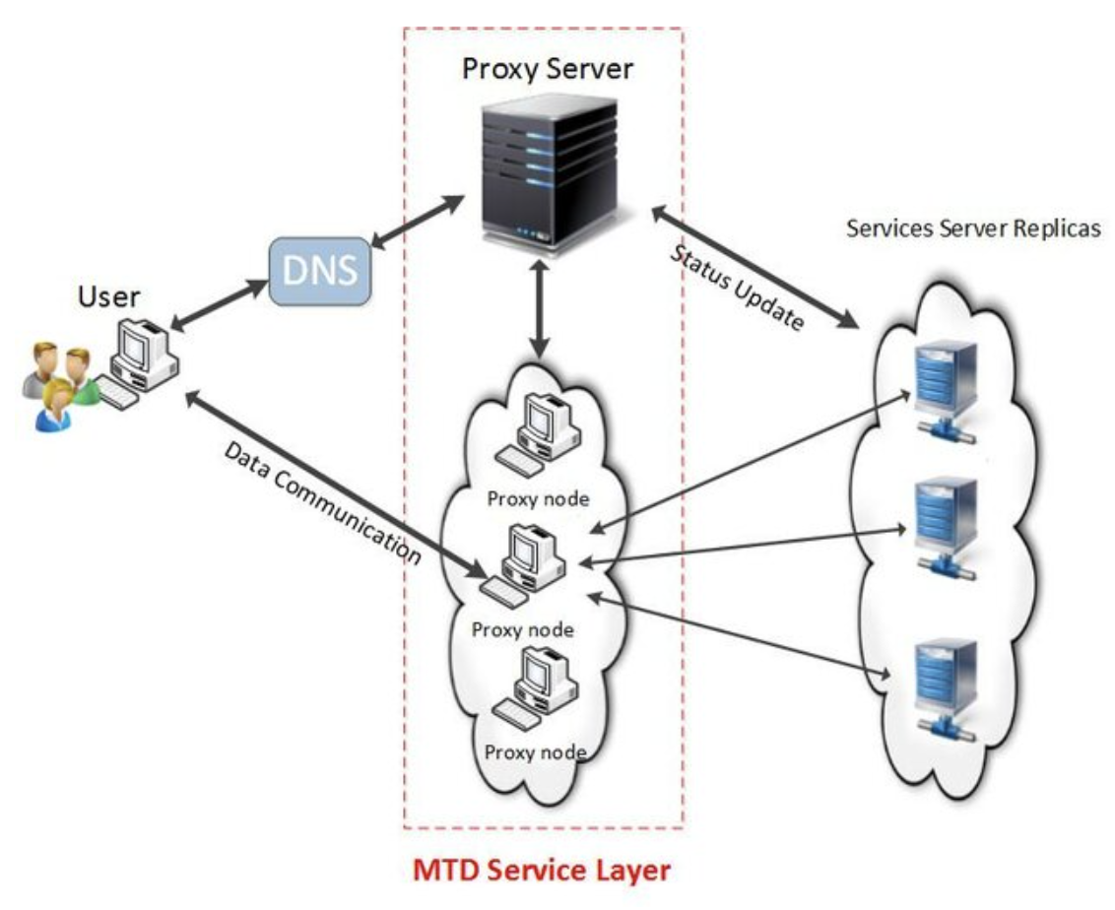
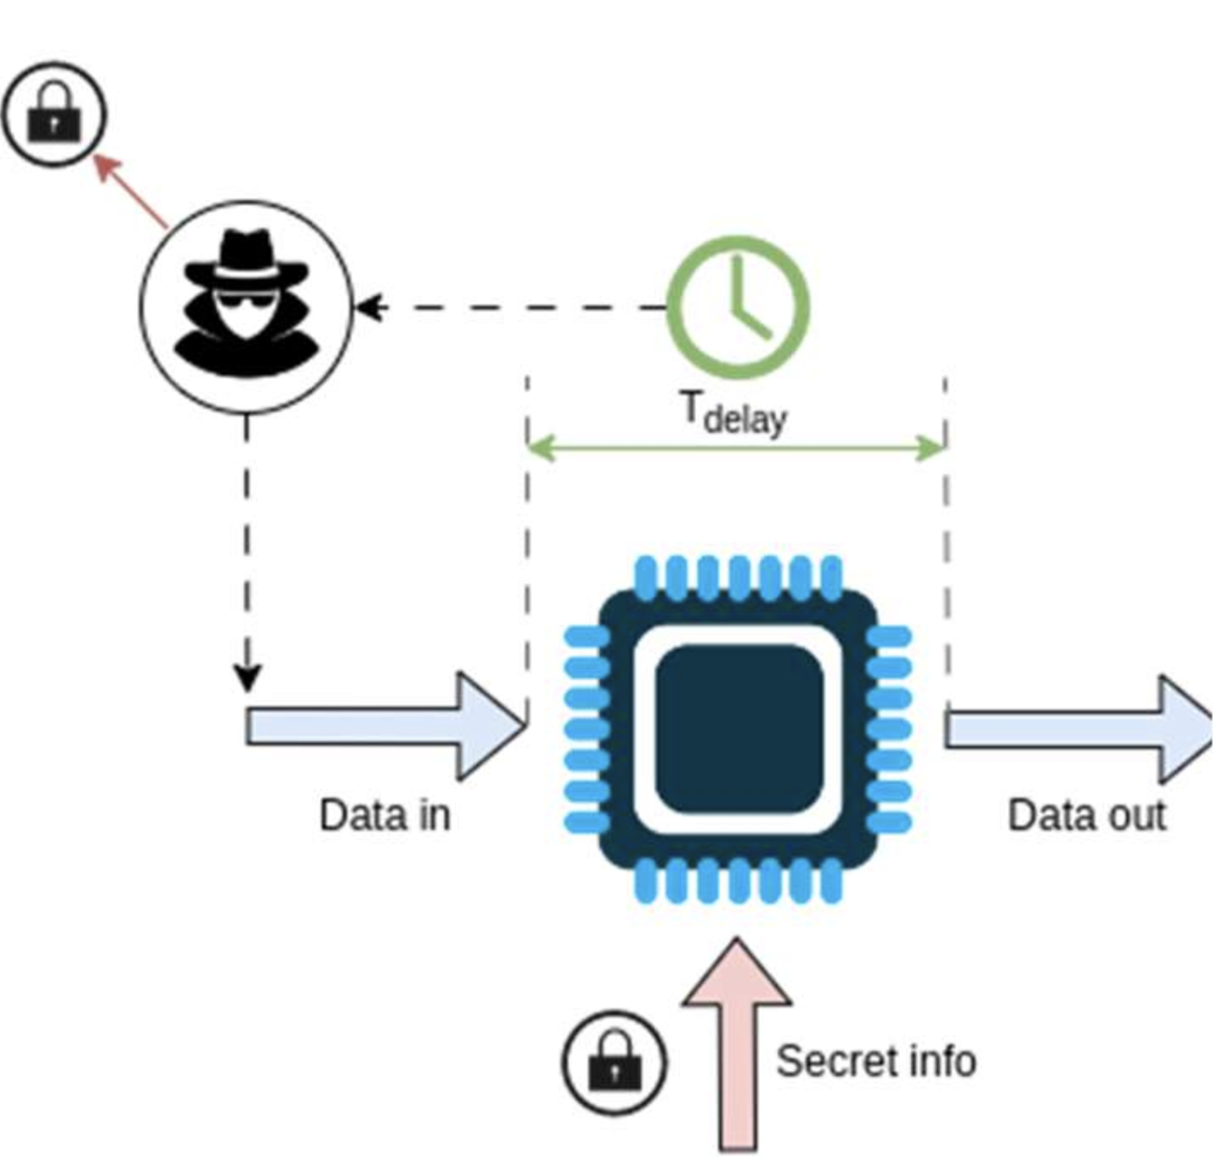
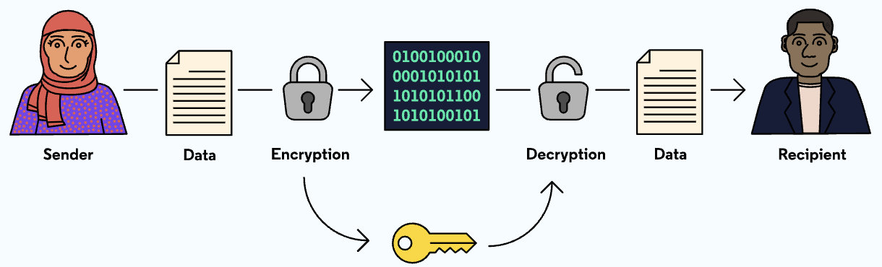
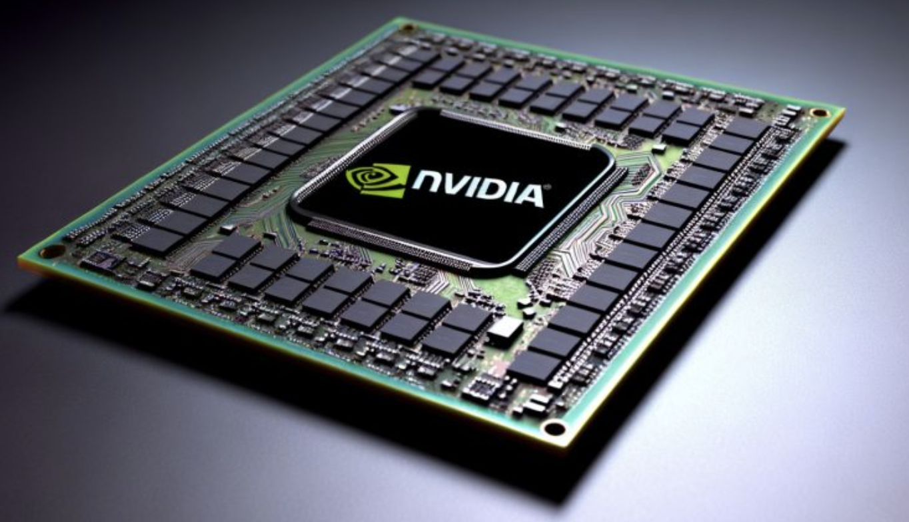
Why Randomness Matters?
Random numbers are widely used in cryptographic systems and for ensuring security of cyber systems
Encryption & Authentication
AI models in Industrial IoT
Hardware
Application
Moving Target Domain
Side Channel Analysis
Generate secure key
Embed random numbers
Insert random noise
Address-space randomization
Building "randomized"
deep learning models
https://www.codecademy.com/article , https://en.idei.club, https://dig.watch/updates/nvidia-ai-chip-release-could-be-postponed,
https://labs.dese.iisc.ac.in/embeddedlab/wp-content/uploads/sites/24/2023/06/16.png,,
https://www.researchgate.net/publication/271427773_Toward_Effectiveness_and_Agility_of_Network_Security_Situational_Awareness_Using_Moving_Target_Defense_MTD/figures?lo=1
Notes:
Random numbers are considered as the backbone of many security solutions in diverse domains, They are widely use to ensure the security of the cyber system. For example, They are used to generate secure keys for encrypt messages, it also used for authentication (OTP) – 6 digit code you get when logging into a secure app.That number must be different every time and unpredictable. Imagine a factory full of smart machines. These machines are connected through the internet and sometimes they get attacked by cybercriminals. So researcher used random numbers to build a randomize deep learning model , these models can easily spot the suspiciaous or unusual behavior like cyber attacks. In hardware (like the chip inside your phone), random numbers are embedded to protect it from being copied or hacked. Moving Target Defense (MTD) is a security strategy that keeps changing the system’s internal settings (like memory addresses, communication routes, or code structure) to make it harder for attackers to strike.

Slide 4

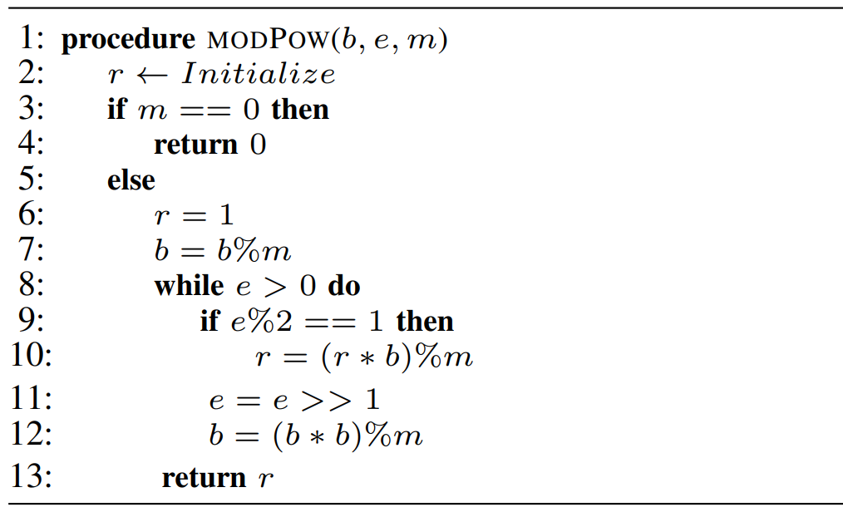
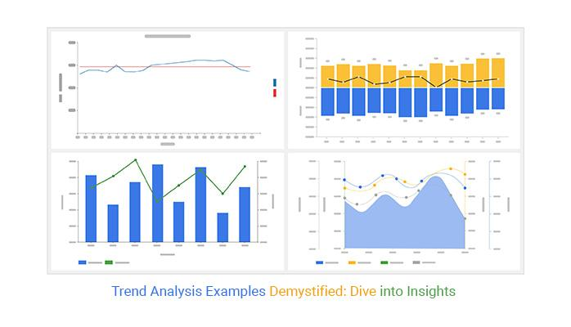
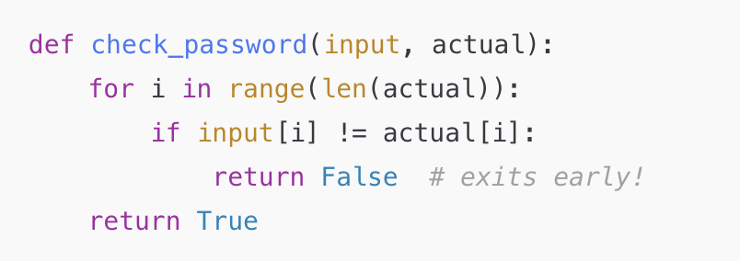
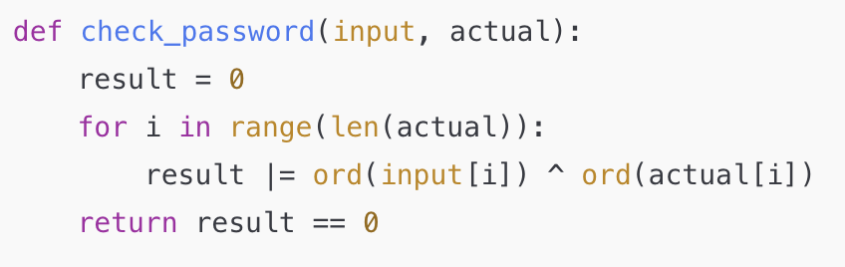
Background
RSA Moduler Exponentiation
Intruder
Code block
Timing analysis
1. Vulnerable code.
2. Branch based on e%2,
where “e” is the secret key.
3. Creating timing discrepancies.
Possible Solution:
Insert random noise inside the code
Constant time programming
Limitations of
Constant Time programming
Checking if two passwords match:
❌ NOT constant-time
✅ Constant-time version
Hard to do it right
Slower performance
Platform dependent
Hard to test

Slide 5
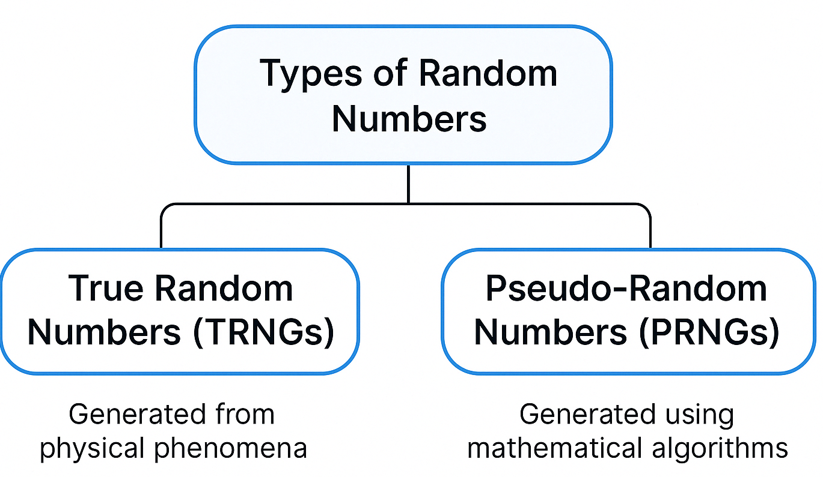
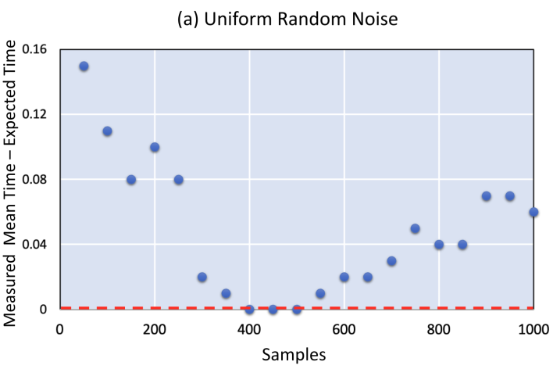
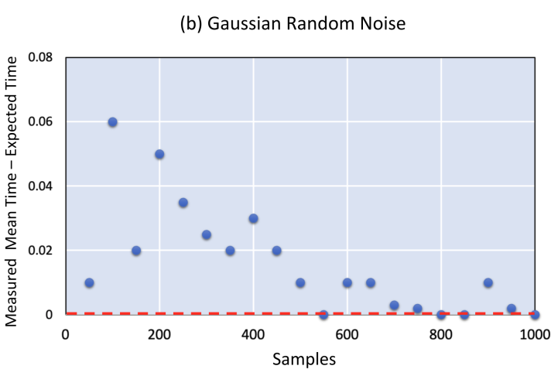
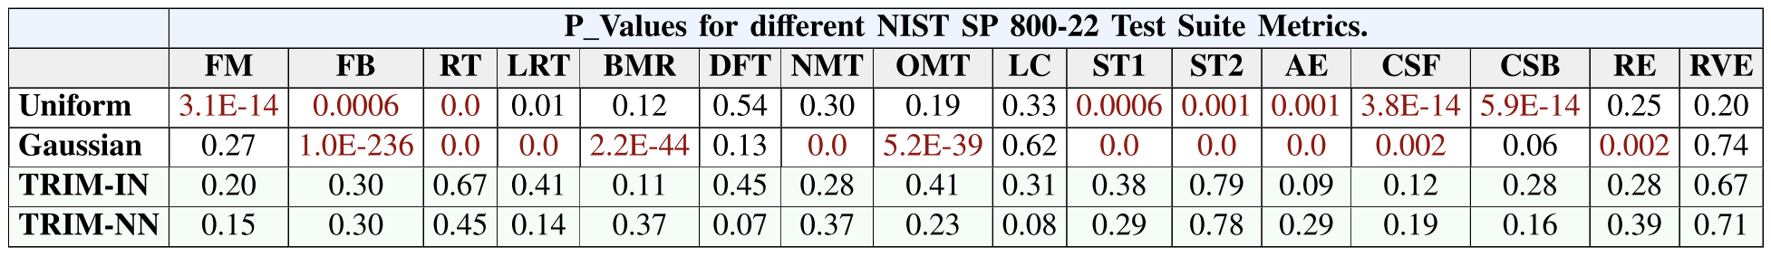
Background
RSA Moduler Exponentiation
Original time
Algorithm-based randomness
A PRNG starts from a seed value
Fast and efficient
Speed matters more than unpredictability.
Not suitable for high-security tasks
Disadvantages:
Predictable.
Follows specific patterns.
Correlation among successive values.
Poor dimensional distribution.
Original time

Slide 6
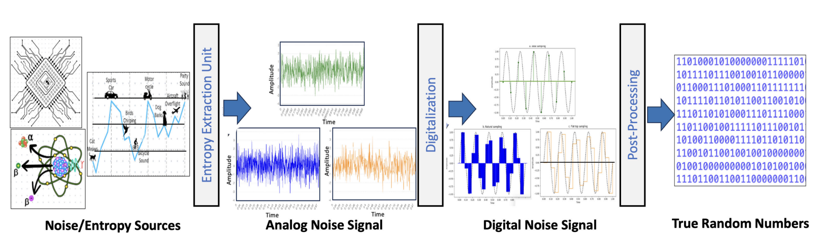
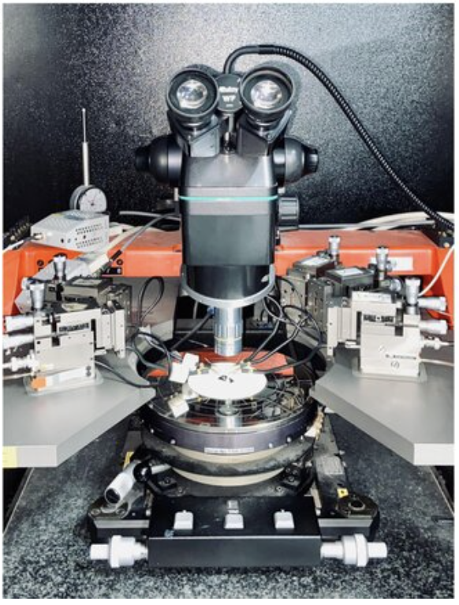
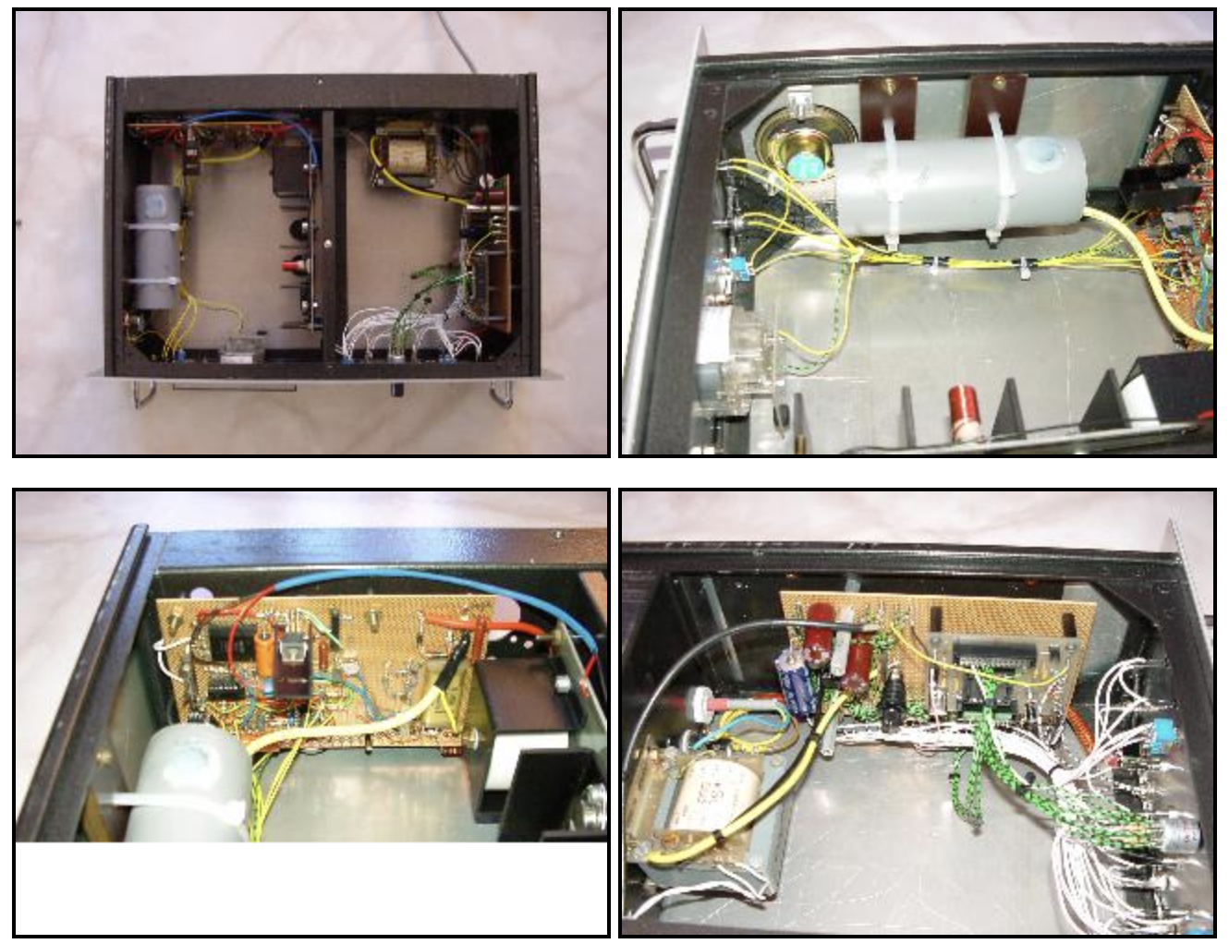
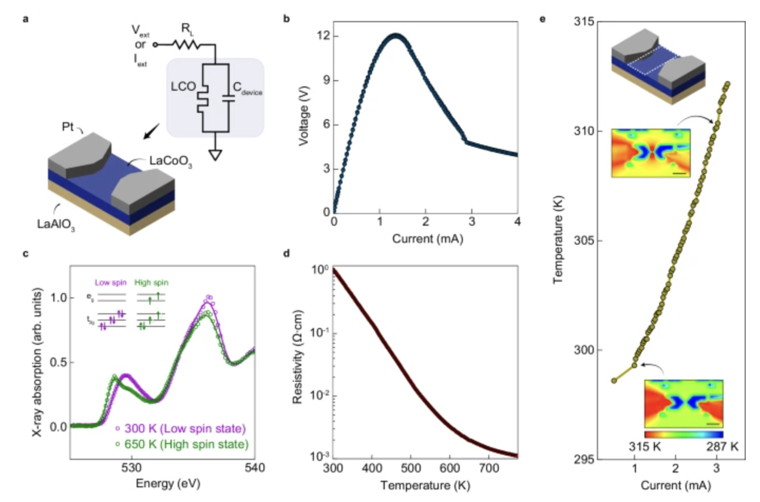
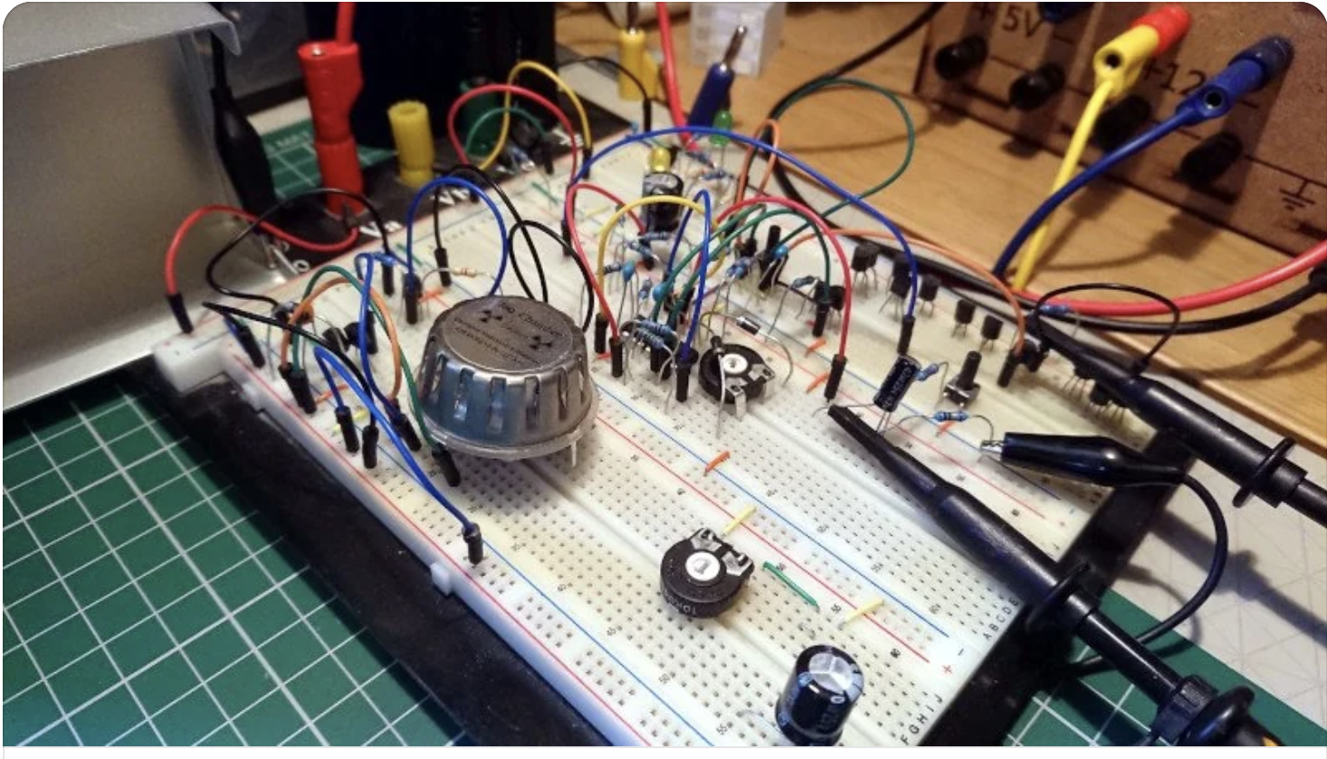
Background
Limited Portability
Complexity
Sensetive to environmental factors
Requires expertise monitoring
https://www.reddit.com/r/diyelectronics/comments/vpcutp/radioactive_random_number_generator_what_do_you/?rdt=37925 ,
http://www.vaxman.de/projects/rng/rng.html, https://www.nature.com/articles/s41467-024-49149-5,

Slide 7
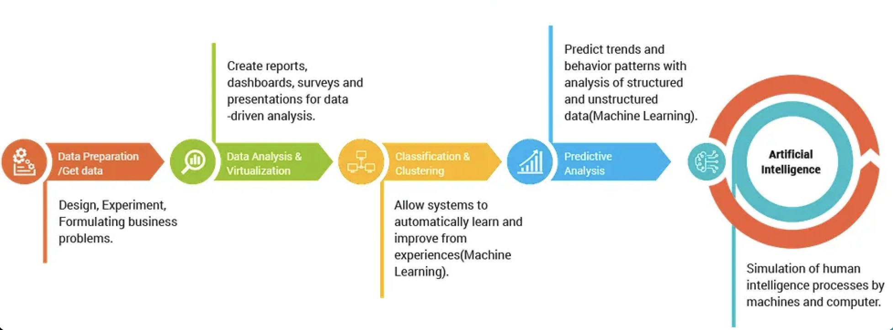
Problem Statements
Is there any inexpensive, less complex solutions to generate the near true random values?
Can AI act as an approximate TRNG ?
TRNG by AI:
Human can produce true random numbers
AI system influenced by human cognative process
AI can replicate natural sounds (music, speech)
It is plusible that AI can mimic true random numbers
Takeways:
Cost effective
Portable
Less biasness than Pseudorandom Numbers
Can be used in various security applications easily
Picture source: https://medium.com/@securechainai/a-beginners-guide-and-resources-for-ai-development-9b8c1766af01

Slide 8
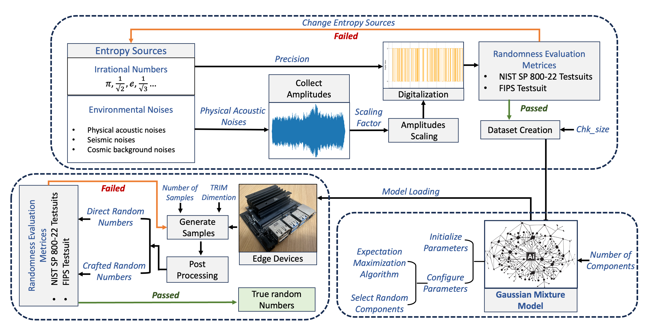
Main Contributions
First AI-driven RNG that consistently passes both NIST SP 800-22 and FIPS 140-1 on edge devices
Configurable framework that adapts TRIM to different security and throughput requirements
High throughput on edge platforms (Example: Raspberry Pi, Jetson Nano/Orin/Xavier)
Robustness against several attacks (inference, model access, distillation, diffusion), showing strong security properties.
7/24/25
8

Slide 9
Methodology
User Inputs
chk_size (bits per sample)
min_p_value (randomness threshold)
Run the Randomness_Test()
Slice the validated binary stream into chk_size bit
Irrational Number:
Provide precision (how many decimal places you want)
Transform that decimal representation into a binary string
Natural Noises:
Capture the amplitudes
Scalled the amplitudes(MinMaxScalling)
Convert them into binary
Merge all the binary bits
Data Preprocessing:
Entropy source-
Irrational Number
Natural Noise

Slide 10
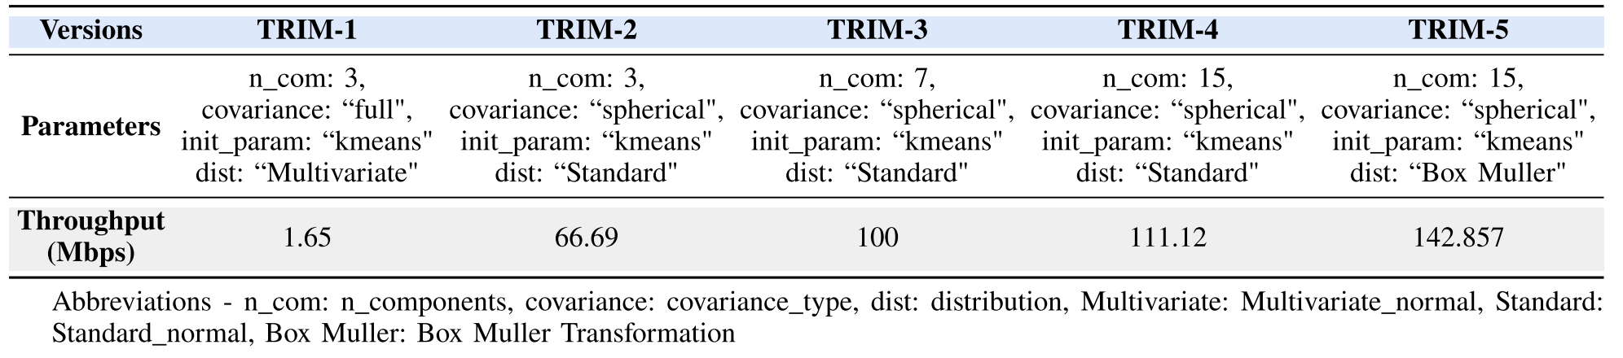
Methodology
AI Model:
Using a GMM model to mimic the TRNG
Expectation–Maximization (EM) refines
weights/means/covariances
→ Pick a component by its weight
→ draw a value from its Gaussian
→ quantize to 0/1 bits Sample generation
Efficiency Tweaks:
Pre-allocated arrays
Box–Muller sampling for diagonal covariances
tuned covariance types for edge-device speed
Trained Model
Generated Dataset

Slide 11
Methodology
Set Output Specs
Decide bitstream length (e.g., 1 Mb)
chunk size (e.g., 1024 bits)
minimum P‑value threshold (e.g., 0.01)
Sample from GMM
Convert to Bits
Apply the model’s thresholding
rule to map sampled values → {0,1}
→ Direct Random Numbers
Crafted Random Numbers:
Slice the stream into fixed-size chunks
→ Small random numbers
Append to the final result until you reach the target length
→ Large random numbers
Post-Check:
Run randomness tests (NIST/FIPS) on the output to ensure quality hasn’t drifted
Deliver & Store:
Save bitstreams in the required format (binary/hex) for downstream crypto or masking tasks
Trained Model

Slide 12
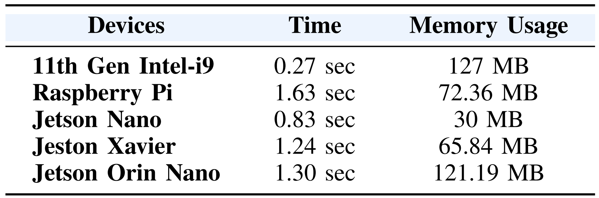
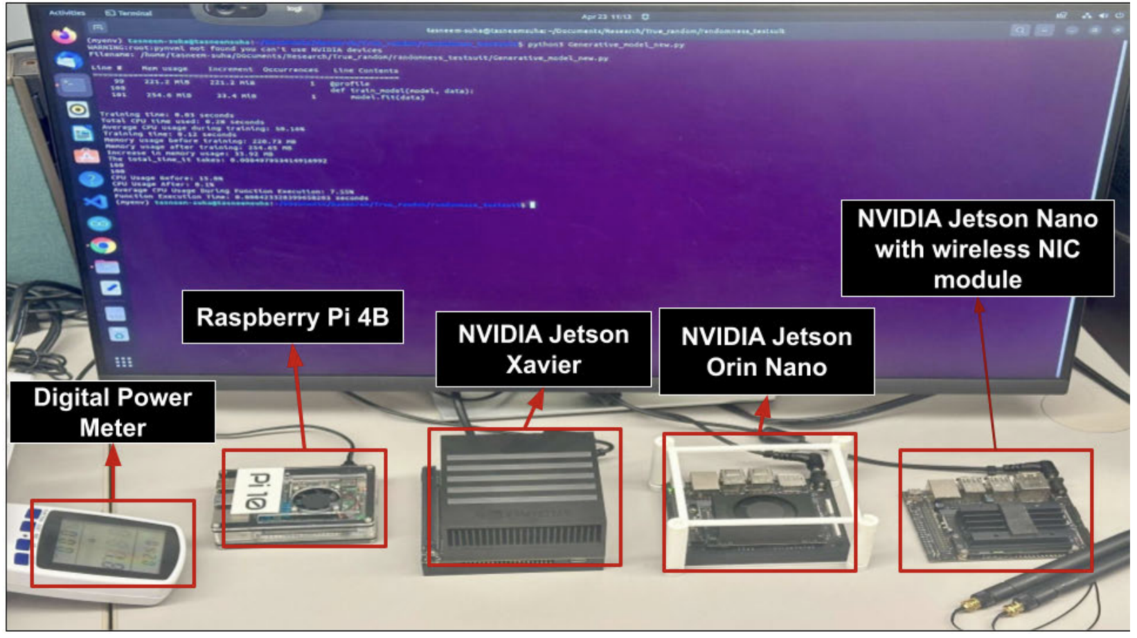
Experimental Setup
Hardware Platforms
Intel i9 workstation (training & bulk tests)
Edge devices (Raspberry Pi 4, Jetson Nano/Orin/Xavier) → verify portability, throughput, and energy/bit
Goodness of the true random numbers are tested by two test suits
NIST SP 800-22 statistical testsuite
FIPS-140-1 testsuite
Two distinct noise sources has been used
Irrational number π in binary format
Natural noise source generated from isolated urban noise
The audio dataset has two folders containing 393 .wav files
event: 231 files, background: 162 files
Bitstream Targets
Multiple output sizes (e.g., 1,250 bits → 1 Mb → up to 1B bits)

Slide 13
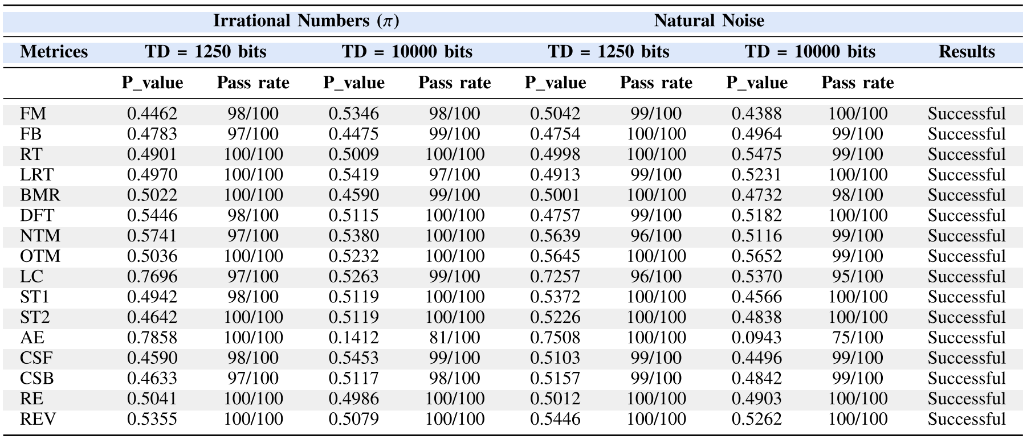
Experimental Results
Direct TRNG from TRIM model:
Chunk size for direct TRIM model are 1250, 10000
Then these 2 datasets are used to train 2 different TRIM models
NIST SP 800-22 metrics for TRIM models (trained on π dataset and natural noise dataset) in different settings. Here, TD = ES.

Slide 14
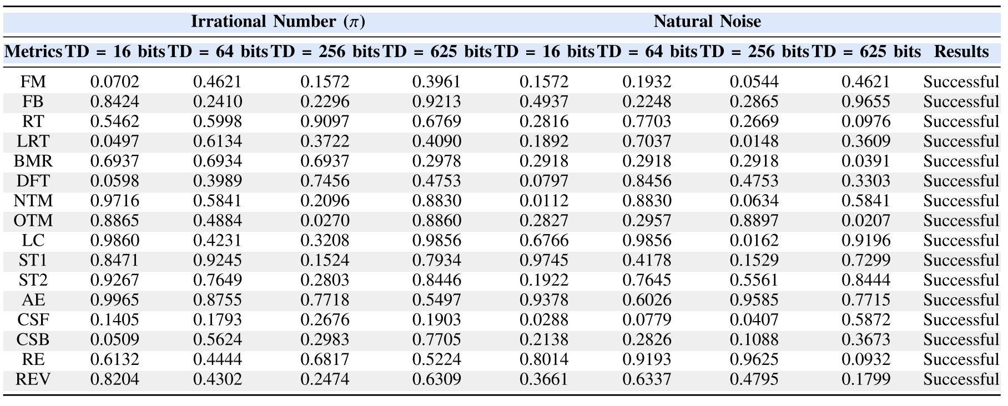
Experimental Results
Very Small Numbers from TRIM models:
Chunk size for small TRIM models are 16, 64, 256, 625
We generate N =100 samples
We merge these samples and then turn them into chunks of 1250 bits
NIST SP 800-22 metrics for TRIM models for generating smaller random numbers (trained on π dataset and natural noise dataset [52]). ES = 1250 bits.

Slide 15
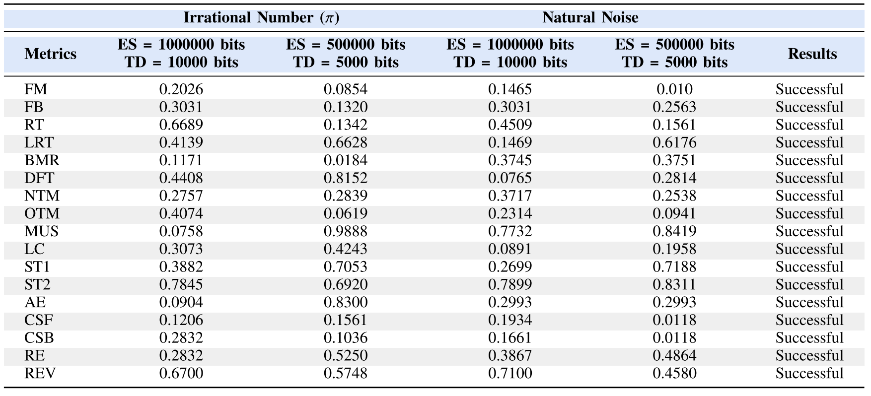
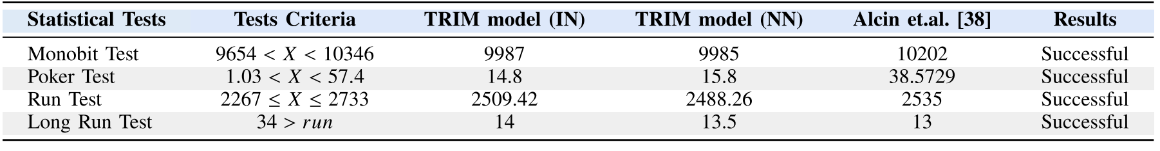
Experimental Results
Large Numbers From TRIM:
Chunk size for large TRIM models are 5000, and 10000
We merge these samples to generate of bit length 500000, and 1000000
Efficacy of using TRIM models (trained on π dataset and natural noise dataset) to generate large numbers.
FIPS-140-1 test: 1M bits are chunked into 20000 bits for this test
Evaluation using FIPS-140-1 metrics. Comparing TRIM Models with state-of-the-art. TD = ES = 20000 bits.

Slide 16
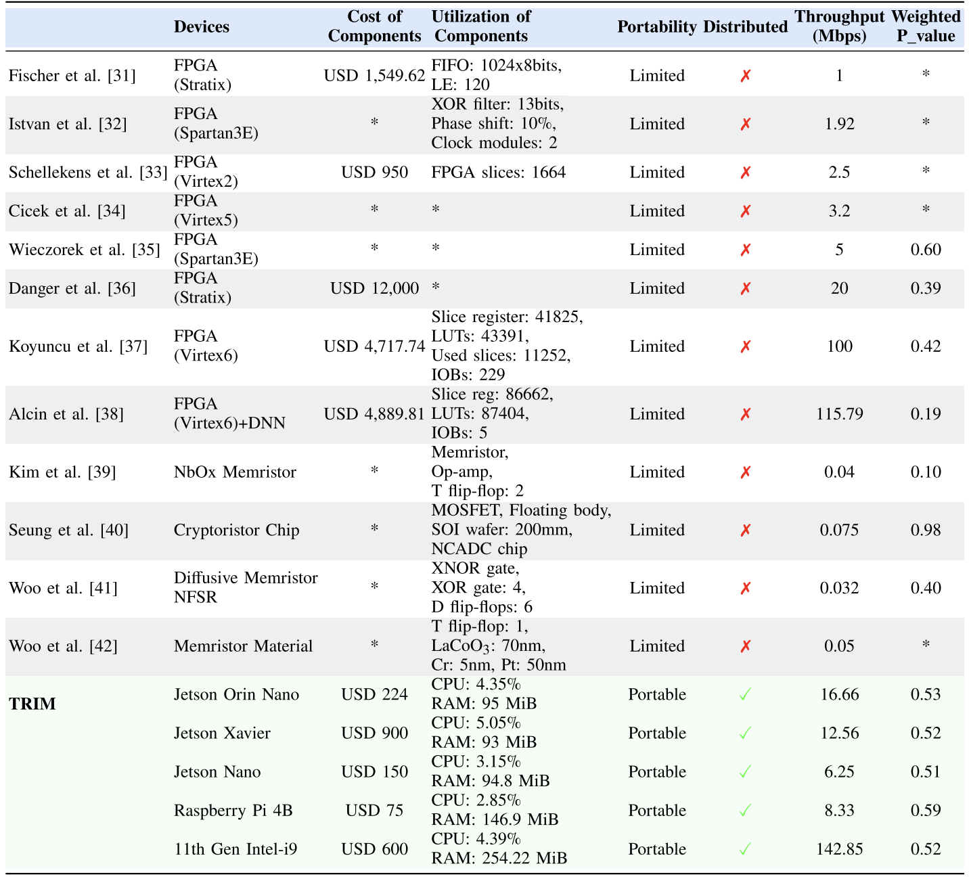
Experimental Results
TRIM is propossing a new high speed (142.55 Mbps)
TRIM models outperforms standard random number
Portability
Scalability
Speed
Resource utilization
Distributed Generation:
Horizontally Scalable
TRIM sampling is parallel spin up many cheap nodes (e.g., Raspberry Pis) and aggregate output
Iso-Cost Comparison
Alcin et al.’s TRNG hardware ≈ USD 4,889.81 vs.
USD 75 for one Raspberry Pi
Scale-Out Strategy
Deploy >65 Raspberry Pis (4,889.81 / 75 ≈ 65.2) to generate random numbers in parallel
Resulting Throughput:
Aggregate rate ≈ 543.09 Mbps at iso-cost
comparable or superior to expensive TRNG
Comparison with state-of-the-art true random number generator (TRNG) frameworks.

Slide 17
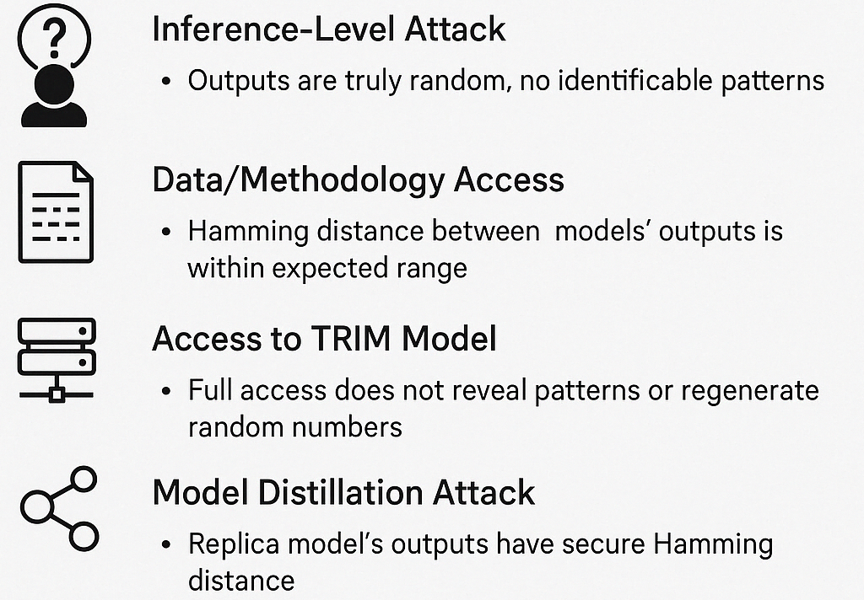
Security of TRIM
Inference-Level Attack
Attacker only sees outputs for known inputs
TRIM resists pattern recognition
Outputs are truly random and statistically secure
Data/Methodology Access
Attacker knows model and training data
Two TRIM models (G1, G2) trained identically
Hamming Distance (R1 vs R2): 499,558
Falls within secure range → no information leakage
Full Access to TRIM Model
Attacker can generate outputs using TRIM
Same model generates R1 and R2
Hamming Distance: 500,187
Within expected range → no pattern reuse or predictability
Model Distillation Attack
Attacker creates perfect replica of TRIM (G2 ≈ G1)
Generates new R1, R2 from same model
Hamming Distance: 499,558 → secure
TRIM remains robust even under worst-case cloning

Slide 18
Conclusion
TRIM: Novel technique for near-true random number generation using Generative AI
Formal algorithms built from diverse randomness sources
Evaluated across multiple scenarios and edge devices
Metrics: NIST SP 800-22, FIPS 140-1
Outperforms traditional RNGs in:
Quality
Throughput
Feature richness
Proven robust against various adversarial attacks
Future Work: Extend to more edge devices and explore new noise sources

Slide 19


