Slide 1

Accelerating CAD Modeling and Meshing Through Generative AI Agents
Nathan K. Brown, Steve Owen, Roshan Quadros, Scott Mitchell, Benjamin Greene
MLDL Workshop 2025
SAND2025-09140C

Slide 2
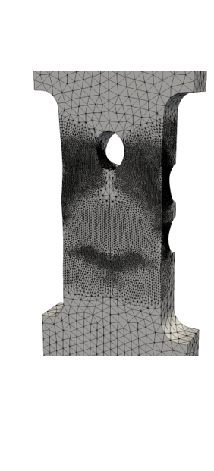
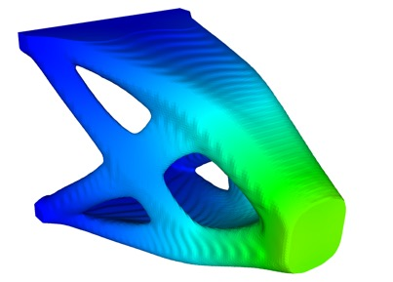
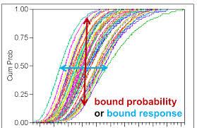
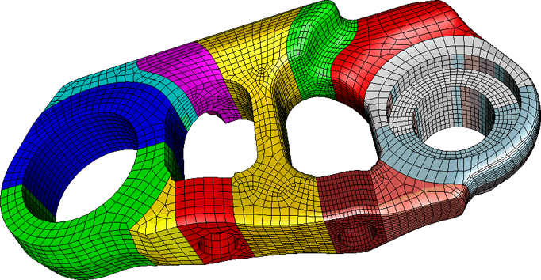
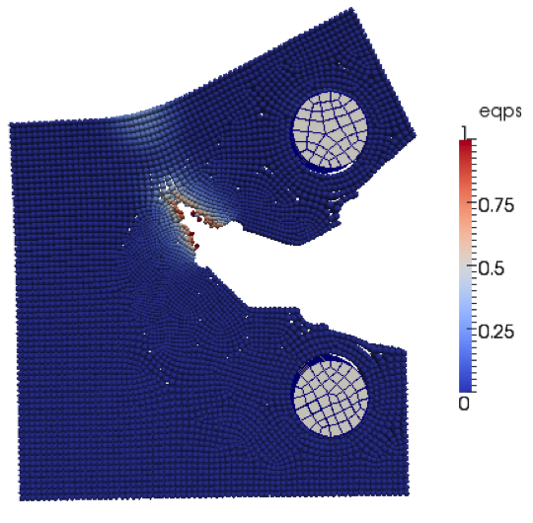
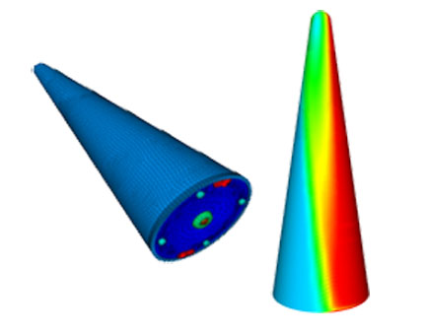
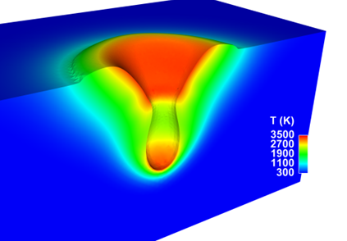
The Computational Design Enterprise
Sandia relies on a suite of powerful design, meshing, simulation, and optimization software tools to producing high performing design solutions across the enterprise
But they are not without shortcomings:
  Time-intensive
  Highly manual and repetitive
  Steep learning curve
Can we leverage Generative AI to improve the efficiency and efficacy of Sandia’s CompSim tools??
CUBIT
SIERRA
PLATO
DAKOTA
(Modeling and Meshing)
(Solid Mechanics, Structural Dynamics, radiation, fluid dynamics, etc.)
(Topology Optimization)
(Optimization and UQ)
…
Might as well start at the beginning of the design process with Cubit…

Slide 3

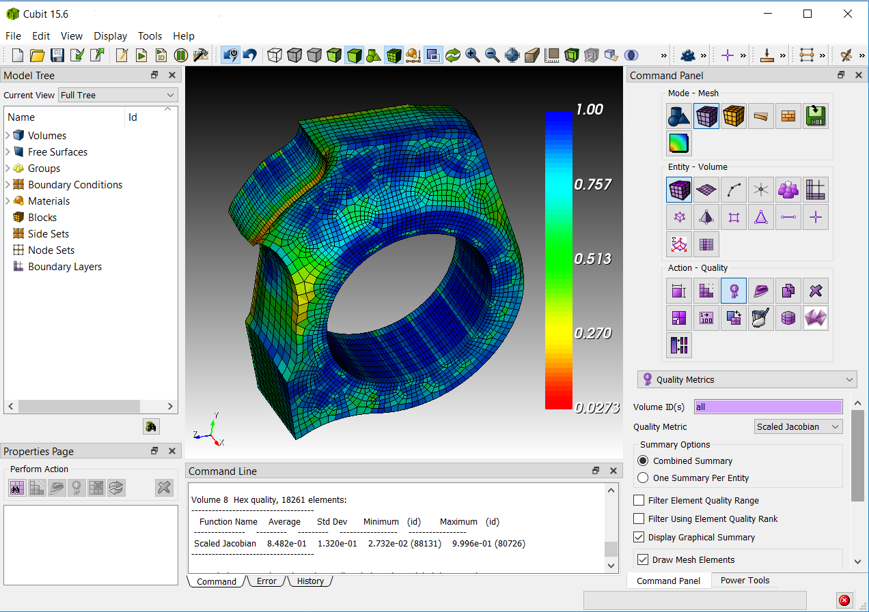

How do we currently use cubit?
Cubit is used to model, defeature, decomposition, and mesh geometries….prep a model for simulations
User can interact with the GUI or manually generate scripts to carry out a sequence of functions
Can we leverage Generative AI to automatically generate Cubit journal files using natural language??
Journal Scripts
Graphic User Interface
#Example 1
Reset
brick x 10
cylinder radius 2 z 12
Move vol 1 x 2
subtract vol 2 from vol 1
vol 1 size .5
vol 1 scheme auto
mesh vol 1
draw surf in vert 1
draw hex in node in surf 11
#Example 1-Accurate Coordinates
Reset
create vertex 0 0 0
- Very tedious
- Syntax/Semantics
- Visualization
…
- Very tedious
- Highly repetitive
- Interface interactions

Slide 4


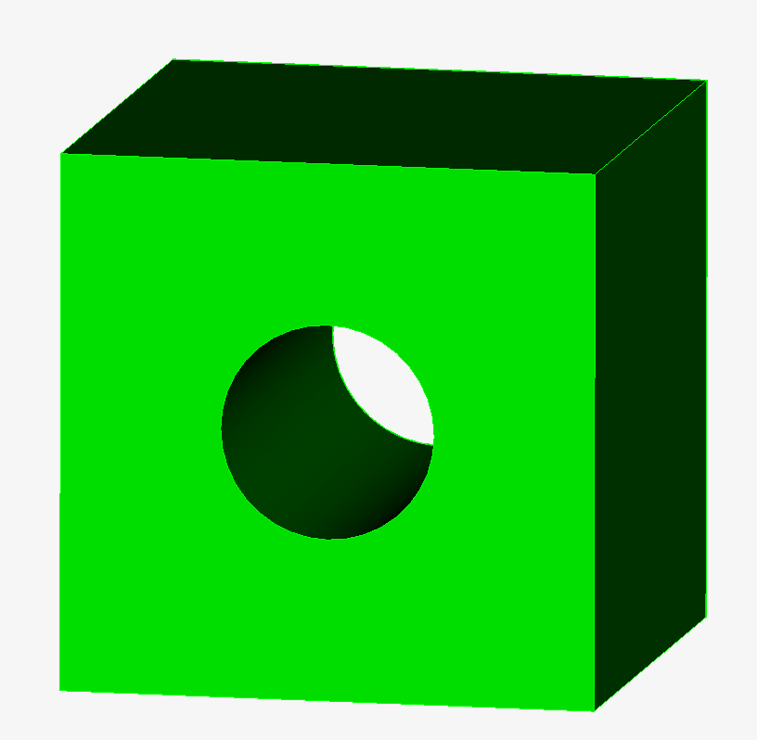

Introducing mada’s geometry agent
MADA: Multi-Agent Design Assistant → Tri-Lab effort targeting collaborative suite of AI agents used to improve the engineering design, simulation, and optimization framework using only natural language prompts
Geometry Agent: An AI agent used to translate plain-text CAD descriptions into the appropriate Cubit journal files
reset: Clears the current model to start…
brick x 1: Creates a brick aligned along the…
How do we help the LLM produce real Cubit functions and limit hallucinations?
cylinder radius 0.3 z 1:Creates a cylinder…
Cubit Docs
…
Resulting CAD
Retrieval Augmented Generation
User Prompt
LLM Output
“Create a cube with dimensions 5x5x5 then cut a cylinder hole with radius 1 unit out of the front surface.”
Cubit.cmd(‘brick x 5 y 5 z 5’)
Cubit.cmd(‘cylinder height 5 radius 1’)
Cubit.cmd(‘subtract body 2 from body 1’)
Eval()
Large Language Model

Slide 5
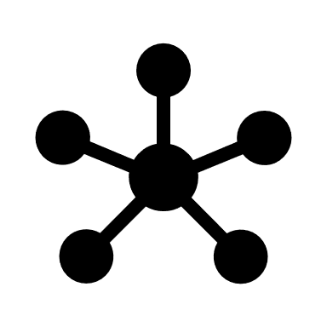


Using RAG for Cubit function extraction
RAG enables the geometry agent LLM to reference relevant Cubit functions and examples prior to generating the desired journal file
1
2b
3
User Prompt
Cubit Manual & Examples
“Create a cube with dimensions 5x5x5 then cut a cylinder hole with radius 1 unit out of the front surface.”
Geometry Agent
Embedding + Similarity Model
2a
5
Relevant Text
4
Resulting CAD
LLM Output
# To complete your request, you must subtract a cylindrical volume from a 5 unit cube
cubit.cmd(‘brick x 5 y 5 z 5’)
cubit.cmd(‘cylinder height 5 radius 1’)
cubit.cmd(‘subtract body 2 from body 1’)
Eval()
6

Slide 6
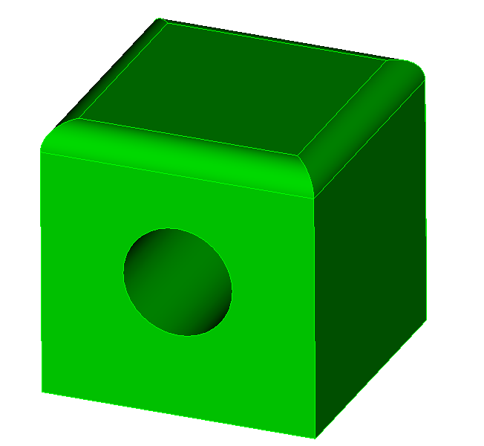
Introducing mada’s geometry agent
MADA: Multi-Agent Design Assistant → Tri-Lab effort targeting collaborative suite of AI agents used to improve the engineering design, simulation, and optimization framework using only natural language prompts
Geometry Agent: An AI agent used to translate plain-text CAD descriptions into the appropriate Cubit journal files
Current Geometry
Graph of Surfaces/Edges/Vertices
reset: Clears the current model to start…
brick x 1: Creates a brick aligned along the…
Does the LLM have any understanding of the current model?
cylinder radius 0.3 z 1:Creates a cylinder…
Cubit Docs
…
Text of Spatial Info
Resulting CAD
RAG
User Prompt
LLM Output
“Apply a fillet of size 0.5 to all edges on the top surface.”
Cubit.cmd(‘modify curve 2 8 11 12… blend radius 0.5’)
Eval()
Geometry Agent

Slide 7

Using graphs to give the llm spatial info
Provides model connectivity and geometric attributes (via graph to text) to the AI agent to provide “spatial awareness” of the current model
CAD Graph
(Geometric Attributes and connectivity)
Surface ID: 1 area: 3.3906 Centroid: [0.9809,0.0,0] block_id: 2
Surface ID: 5 area: 9.253 Centroid: [4.828,0.0,0] block_id: 3
…
Surface 2 has Curves 10, 49, 50, 28, 26.
Surface 3 has Curves 9, 48, 27, 18, 31.
…
Spatial_Info()
Curve ID: 11 length: 0.866 Centroid: [0.0,0.433,0] Vertices: 1 2
Curve ID: 12 length: 0.866 Centroid: [0.0,-0.433,0] Vertices: 1 10
User Input
…
“What is the largest edge length of the largest surface of this model?”
Vertex ID: 1 Coordinates: [0.0,0.0,0]
Vertex ID: 2 Coordinates: [0.0,0.866,0]
Call tool
Model Spatial Info
…
LLM Output
“The largest edge length of Surface 5 (with an area of 9.253) is 5.185 associated with Curve 19”
Current Model
Geometry Agent

Slide 8

Introducing mada’s geometry agent
MADA: Multi-Agent Design Assistant → Tri-Lab effort targeting collaborative suite of AI agents used to improve the engineering design, simulation, and optimization framework using only natural language prompts
Geometry Agent: An AI agent used to translate plain-text CAD descriptions into the appropriate Cubit journal files
Current Geometry
Graph of Surfaces/Edges/Vertices
reset: Clears the current model to start…
brick x 1: Creates a brick aligned along the…
cylinder radius 0.3 z 1:Creates a cylinder…
Cubit Docs
Tool Calling
Shaped Charge Design Instructions
Defeaturing Capabilities
Understanding mesh quality
…
…
Text of Spatial Info
RAG
What happens if the user asks for very specific/complex requests?
User Prompt
“Design a 2D shaped charge with a single material liner”
Geometry Agent

Slide 9
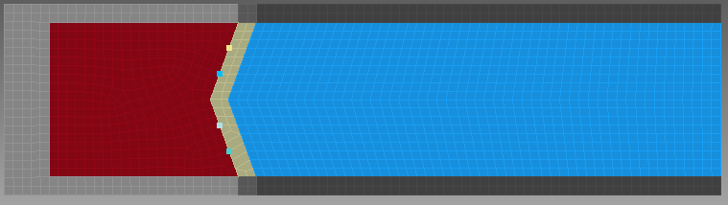
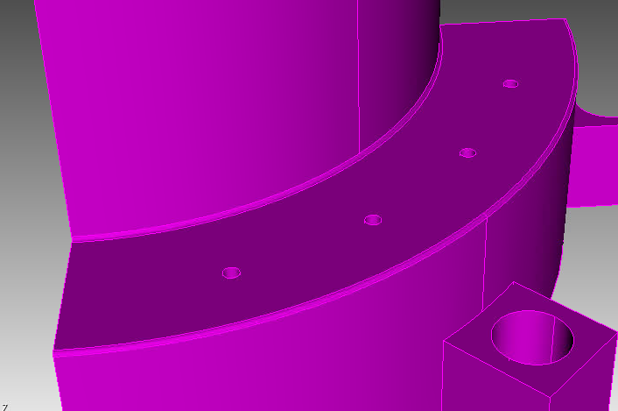
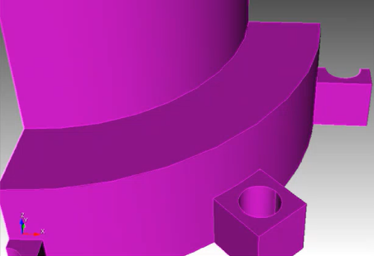
Agentic tool calling
Agentic Tool Calling: Enable an AI model to interact with external tools/resources/functions
Designing Shaped Charges Tool
Design_Shaped_Charge()
User Prompt
Call a tool
Steps to design shaped charges
Resulting CAD
“Please design a linear shaped charge with a single material liner. Use the following parameters: shaped charge tube radius=0.866, Top shell thickness=0.2, Tube length=7.5, Back shell thickness=0.5, initial liner distance=2, liner angle =70, liner thickness=0.2.”
LLM Output
Shell
Highly Explosive
Liner
Air
Geometry Agent
Defeaturing Tool
User Prompt
Call a tool
Cubit Power Tools
“Remove all holes and fillets with radius less than 0.4 mm”
Geometry Agent

Slide 10
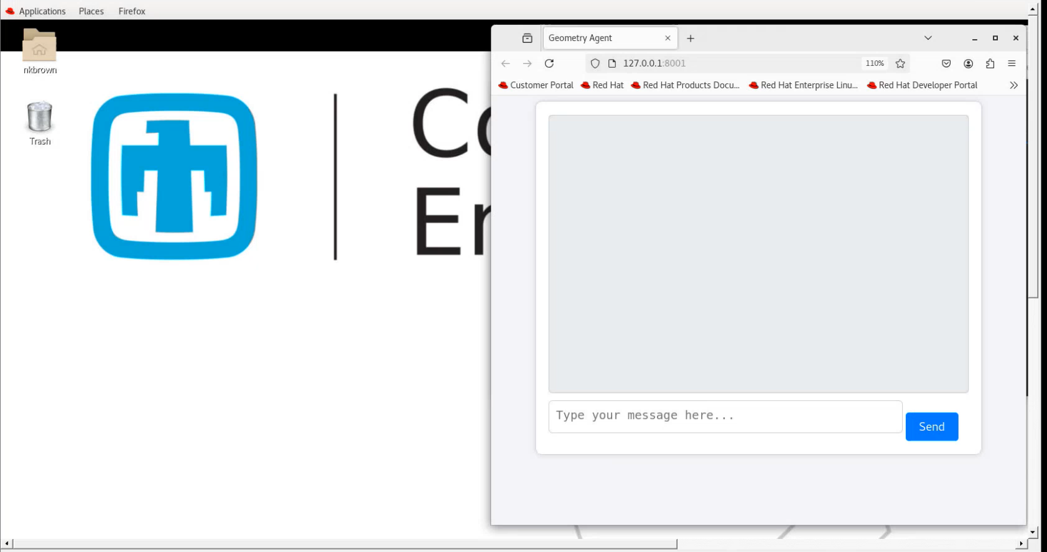
MADA Demo 1
The demo shows the Geometry Agent completing generic CAD tasks, using spatial information, and design shaped charges

Slide 11

MADA Demo 2
This demo specifically demonstrates the rapid defeaturing capabilities of the Geometry Agent

Slide 12
Expectations Setting
Naturally LLMs are bound to be better at certain tasks over others
STRONG
FINE
WEAK
Generating appropriate functions for most 1-3 step requests
Following and modifying design instructions, scripts, outlines, templates, etc.
Leveraging pre-existing tools within Cubit (e.g. Power Tools)
Functions not readily available within its RAG documentation
Making multi-step assessments of CAD connectivity
Meshing commands broadly
Carrying out long, multi-step reasoning tasks
Providing analytically grounded design/meshing recommendations
Multi-component alignment and engagement
Translating generic design requests into viable CAD (e.g. “Design a model car”)

Slide 13
Thank you!!
I look forward to your questions
Nathan Brown (nkbrown@sandia.gov)

