Slide 1
JustMigrate
Developing LLM-based tools to assist in the software lifecycle
Org. 9762
Ben Willhite and Ben Miller
16 July, 2025
SAND2025-09070C

Slide 2

Ben Miller
9762 – Technical Year-Round Intern
UNM ‘27 CS & Mathematics
Interests in Software Development and ML

Slide 3

Ben Willhite
9762 – Technical Year-Round Intern
Harvard ‘26 AB Economics, minor in CS
Interests in Software Development and ML

Slide 4




Production tools
Team that created and maintains several in-house applications across SNL
ick, DiGS, CSSR, NWIS LOFT, Network Disconnect, WebCARS
Built on top of the NWIS database
Applications are cornerstones of Sandia’s online environment and infrastructure
Authorization
Cyber Security
License Management/Billing
Reporting
Auditing

Slide 5
What's at stake
Testing projects are heavily dependent on moq library
Critical vulnerability in past moq update
Collects and stores user data without consent
Inability to opt out of collection
Loss of trust in author, presents our motivation in refactoring code
More broadly, highlighted the challenges in quickly migrating away from external dependencies

Slide 6
Leveraging new tools to balance workload
Network Disconnect — .NET application used to enforce network security policies
Over 300,000 lines of code
13,569 Unit Tests
3,700+ use moq
Cost efficiency
Estimated 8 minutes per test
452 hours for a developer to refactor Network Disconnect alone
Cost avoidance of almost $30,000 (entry level developer)

Slide 7
Introducing JustMigrate
Revision of testing project to use Telerik JustMock library instead of moq
Immediately improving security
Demonstrating versatility for future obstacles
Maintaining test quality and logic

Slide 8


Sandia’s Atlas and Shirty Services
Internally-hosted and maintained instances of AI models (LLMs, TTS, Image generation)
Allow users to handle potentially sensitive code or information in restricted environments
Leveraging best open-weight LLMs to improve efficiency

Slide 9
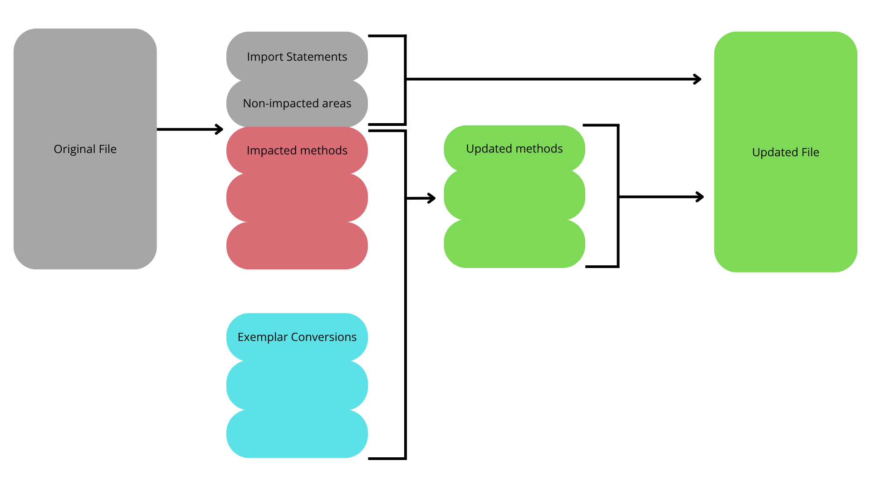
Anatomy of justmigrate's conversion method

Slide 10
Example conversion
Original Code
Updated Code
using Moq;
using Moq.AutoMock;
using System.Threading.Tasks;
using Xunit;
public class DemoServiceTests
{
[Fact]
public async Task TestMethod()
{
// Arrange
var value = "Test String";
var user = "Test User";
var autoMocker = new AutoMocker();
var mockTestService = autoMocker.GetMock<ITestPermissionService>();
mockTestService
.Setup(m =>
m.IsValueAnyProduct(It.Is<Product>(p =>
p == (Product.foo | Product.bar | Product.foobar)
)
)
)
.Returns(true);
var manager = autoMocker.CreateInstance<DemoService>();
var verifyCustomer = new VerifyCustomer(user);
// Act
await manager.HandleAsync(verifyCustomer);
// Assert
autoMocker.VerifyAll();
Assert.True(verifyCustomer.IsSuccessful);
}
}
using Telerik.JustMock;
using Telerik.JustMock.AutoMock;
using System.Threading.Tasks;
using Xunit;
public class DemoServiceTests
{
[Fact]
public async Task TestMethod()
{
// Arrange
var value = "Test String";
var user = "Test User";
var mockingContainer = new MockingContainer<DemoService>();
mockingContainer
.Arrange<ITestPermissionService>(m =>
m.IsValueAnyProduct(Arg.Is<Product>(p =>
p == (Product.foo | Product.bar | Product.foobar)
)
)
)
.Returns(true);
var manager = mockingContainer.Instance;
var verifyCustomer = new VerifyCustomer(user);
// Act
await manager.HandleAsync(verifyCustomer);
// Assert
Mock.AssertAll();
Asssert.True(verifyCustomer.IsSuccessful);
}
}

Slide 11
Challenges
New to Repositories
Learning C#
Variability of the tests
Models' absence of training on Telerik.JustMock

Slide 12
Progress
51 files converted
70.6% of converted files were approved without revision
Weekly pull request batches
Generalizing structure to agnostic frameworks

Slide 13
Future deployment and use-cases
Upon the completion of updates in Network Disconnect, we will move to other impacted projects
Upgraded capabilities from MVP
Analyzing, updating, testing, and revising files under one program
Potential integration into Git environment
As LLMs improve, the potential scope of usage broadens
Initial testing covered only test files, but applications extend into other areas of software development

Slide 14
So what?
Project-level consistency
Cost avoidance and efficient use of developer time
Quick response to malicious actors
Application maintenance

Slide 15
Justmigrate
Thank you

