Slide 1
BANYAN-INGEST
Challenges of Processing Documents for LLMs
Presented by Yang Ho
Chinmay Sahasrabudhe, Nick Winovich
Acknowledgement: Sandia National Laboratories is a multi-mission laboratory managed and operated by National Technology & Engineering Solutions of Sandia, LLC (NTESS), a wholly owned subsidiary of Honeywell International Inc., for the U.S. Department of Energy’s National Nuclear Security Administration (DOE/NNSA) under contract DE-NA0003525. This written work is authored by an employee of NTESS. The employee, not NTESS, owns the right, title and interest in and to the written work and is responsible for its contents. Any subjective views or opinions that might be expressed in the written work do not necessarily represent the views of the U.S. Government. The publisher acknowledges that the U.S. Government retains a non-exclusive, paid-up, irrevocable, world-wide license to publish or reproduce the published form of this written work or allow others to do so, for U.S. Government purposes. The DOE will provide public access to results of federally sponsored research in accordance with the DOE Public Access Plan.
SAND2025-09041C
Notes:
Hi everyone my name is Yang Ho and today I will talk about BANYAN-Ingest: Challenges of Processing Documents for LLMs

Slide 2

Background
Banyan-ingest is the document processing tool/R&D thrust of the BANYAN GenAI Institute @ Sandia
The goal of banyan-ingest is to investigate document processing techniques for training large scale and multi-modal models for science
Notes:
BANYAN-Ingest is the document processing tool and thrust of the BANYAN GenAI Institute at Sandia
The goal of BANYAN-Ingest is to investigate document processing methods for training large, multi-modal models for science

Slide 3
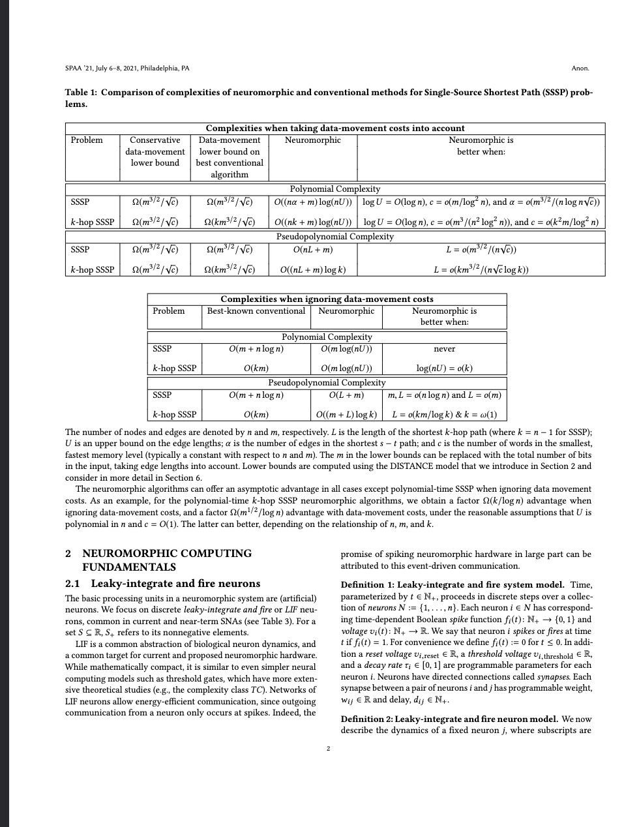
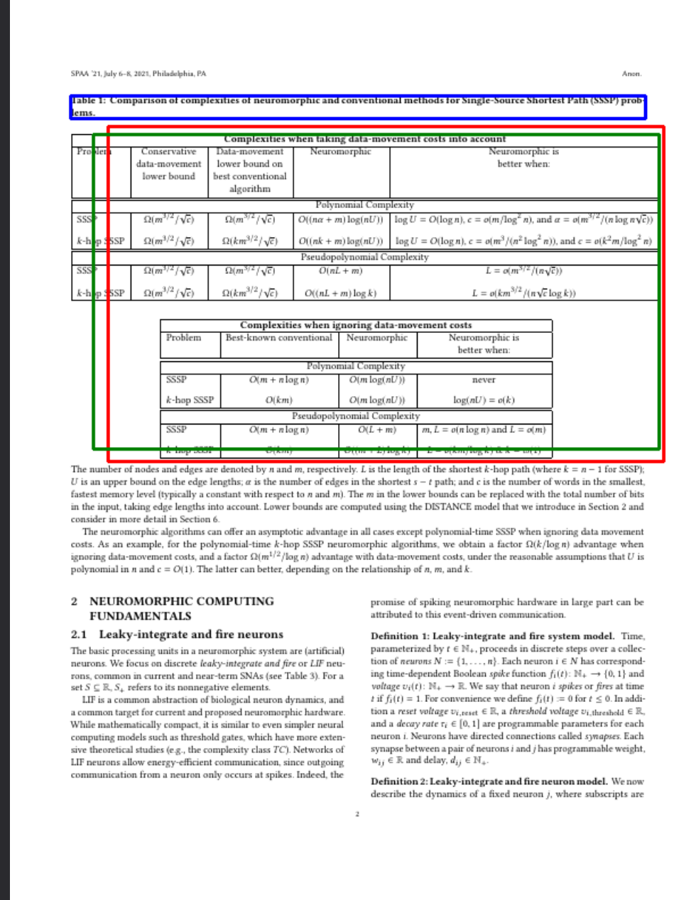
Introduction
Dataset
Extraction (OCR)
Model training
A typical workflow for training an LLM on scientific data. Properly extracted and tokenizable data is necessary for training LLMs.
Notes:
The typical workflow for this kind of training involves taking a dataset (in our case, scientific papers); extracting tokens; and feeding the tokens to the models.
Given the nature of scientific documents, we need to ensure that our extraction methods create high-quality tokens

Slide 4
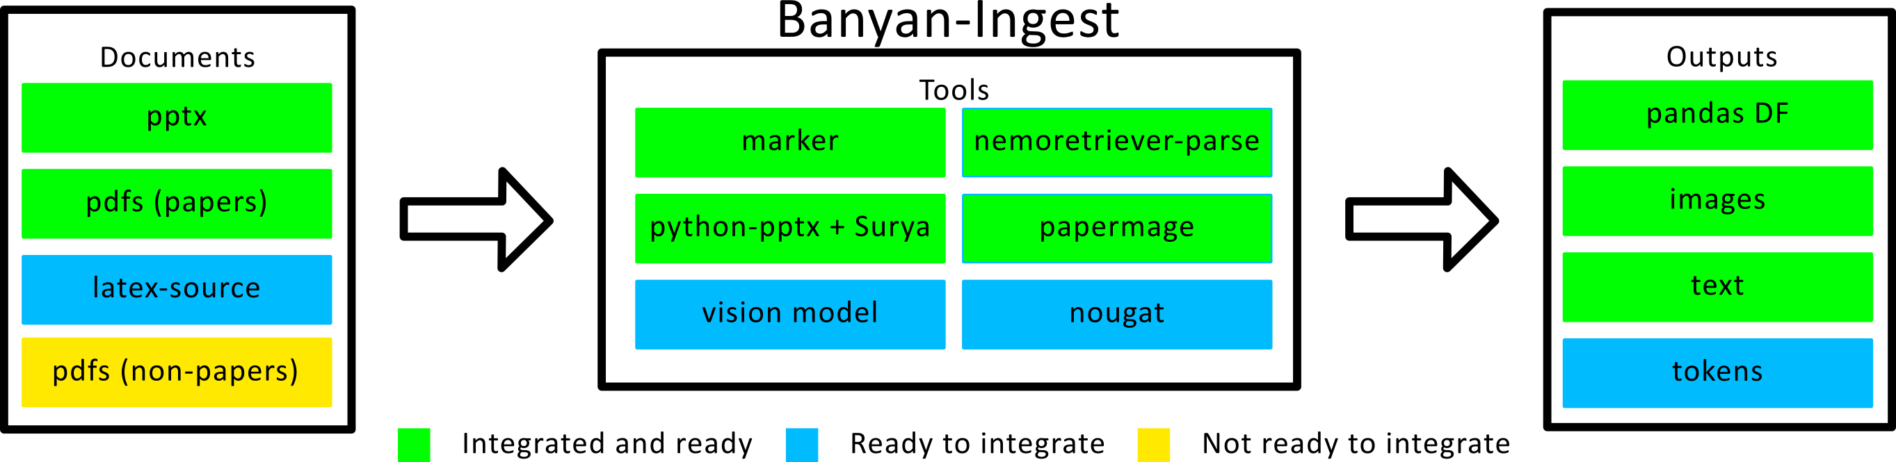
Banyan-ingest (Tool) Overview
Main goal: Extract information rich content
LaTeX syntax for math, figures, tables, pseudocode/code, etc.
Uses a toolbox of tools
Continuously looking for and evaluating potential tools
Supports multiple document types
Notes:
Our approach to the extraction of scientific content is BANYAN-Ingest
BANYAN-Ingest is a python module that is a toolbox of tools for document processing and extraction
We are continuously looking for and evaluating different tools to incorporate and provide support
In addition to the software engineering effort, we are also looking at ways of evaluating the outputs of the various tools as well as investigating strategies of improving extraction results.

Slide 5
Evaluation
Notes:
Now I want to discuss some of our evaluation methods as well as highlight some challenges we’ve noticed.

Slide 6
Document Datasets
Curated datasets of relevant scientific documents:
Pages from digitally born scientific papers/reports
Pages from scanned scientific papers/reports
Slides from presentations (pdf versions, NOT pptx files)
Posters from conferences/workshops etc.
More to come!
Notes:
To start, we’ve curated different datasets of different kinds of scientific documents. Each datasets contains individual pages/slides from scientific documents.
The first dataset contains digitially born scientific papers and reports
The second contains scanned scientific papers and reports
The third contains slides
And we are working on curating a dataset that contains posters
Note that all the documents are PDFs (although down the line, we will look at other document formats)

Slide 7
Tools Evaluated
Marker*
Nemoretreiver-parse*
Nougat
Papermage*
Deep figures
Docling
Vision models
Many more!
* Denotes support in banyan-ingest
Notes:
We’ve already looked at a number of different tools for our particular use-case and have also incorporated support in Banyan-ingest for a number of them

Slide 8
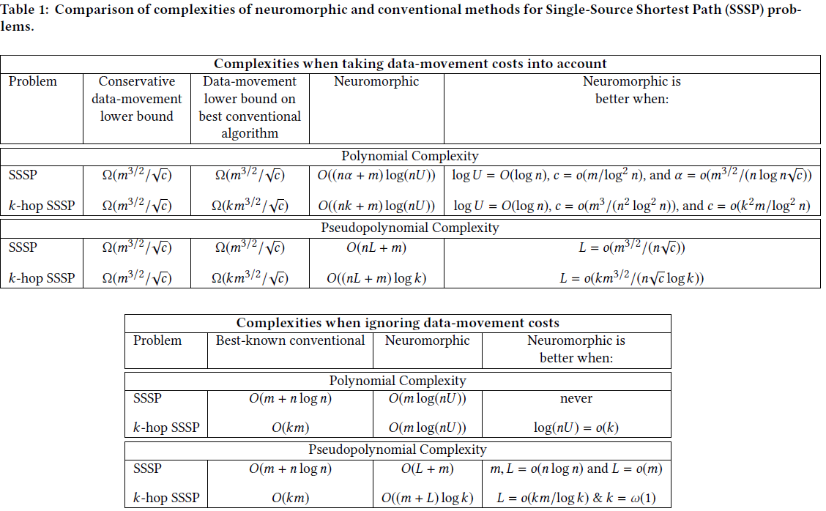

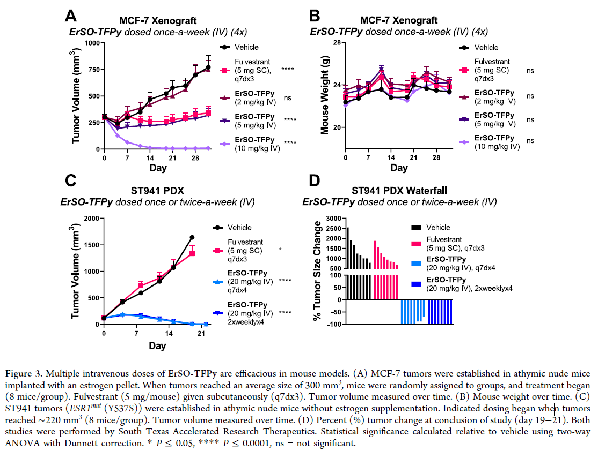
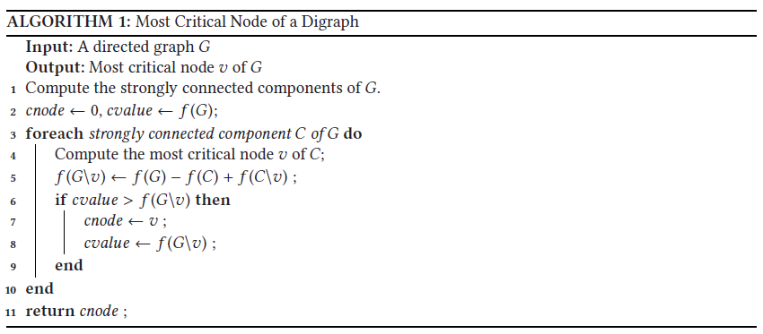
Criteria
In addition to the text: looking to extract relevant scientific and technical information:
Tables
Equations
Figures
Algorithms
Notes:
For our work, we are looking for tools that are good at extracting text, tables, algorithms, equations, and figures since these are all elements that convey important information in scientific documents.

Slide 9
Results
Notes:
Now I will talk about some of our preliminary findings on how well some tools extract scientific content

Slide 10
Preliminary Results: Digital Born Documents
HP4AIS workshop presentation (original author: Chinmay Sahasrabudhe)*
Evaluated marker, nougat, deep figures, and papermage on digitally born dataset
3 people scored the outputs 1-4 based on the “overall quality”
* C. Sahasrabudhe, Y. Ho, N. Winovich, S. Rajamanickam, "Imperfect Recognition: A Study of OCR Limitations in the Context of Scientific Documents," 2025 IEEE IPDPSW, Milan, Italy, 2025
Notes:
These results came from a previous conference presentation
We evaluated marker, nougat, deep figures, and papermage on the digitally born dataset
We used a 1-4 score based system to grade the extracted outputs based on “overall quality”

Slide 11
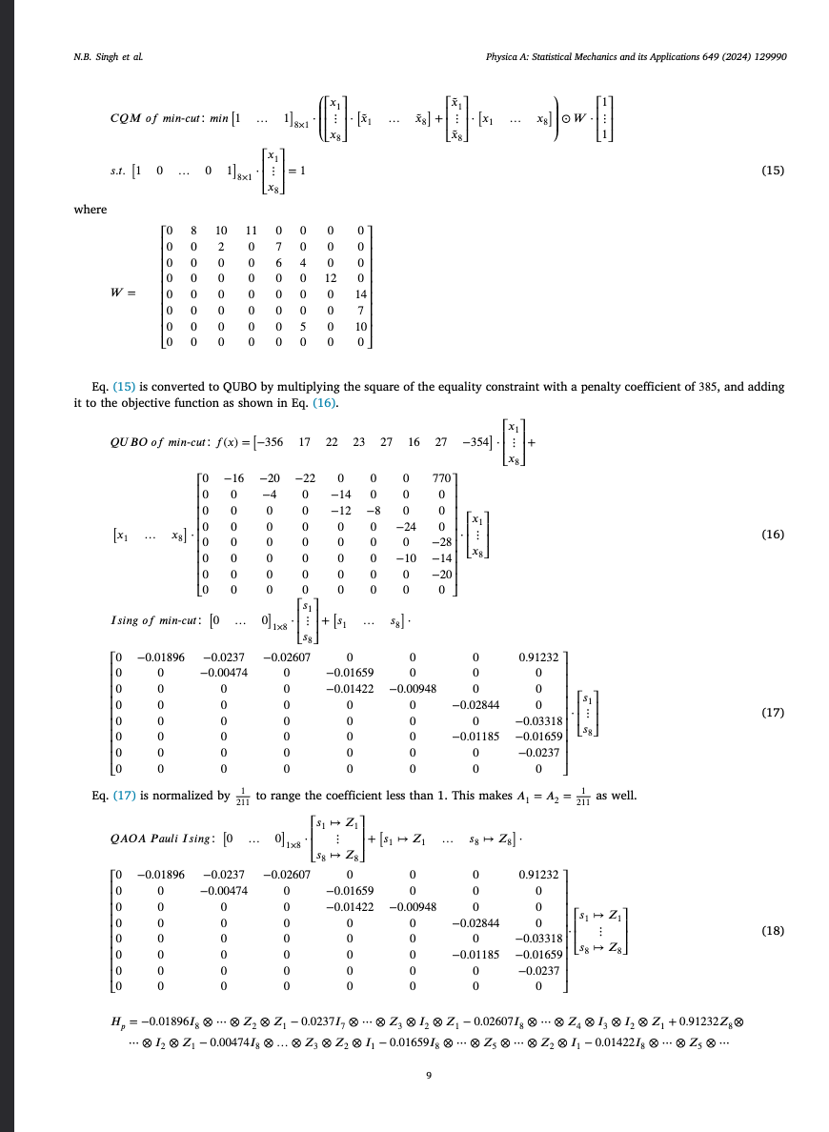
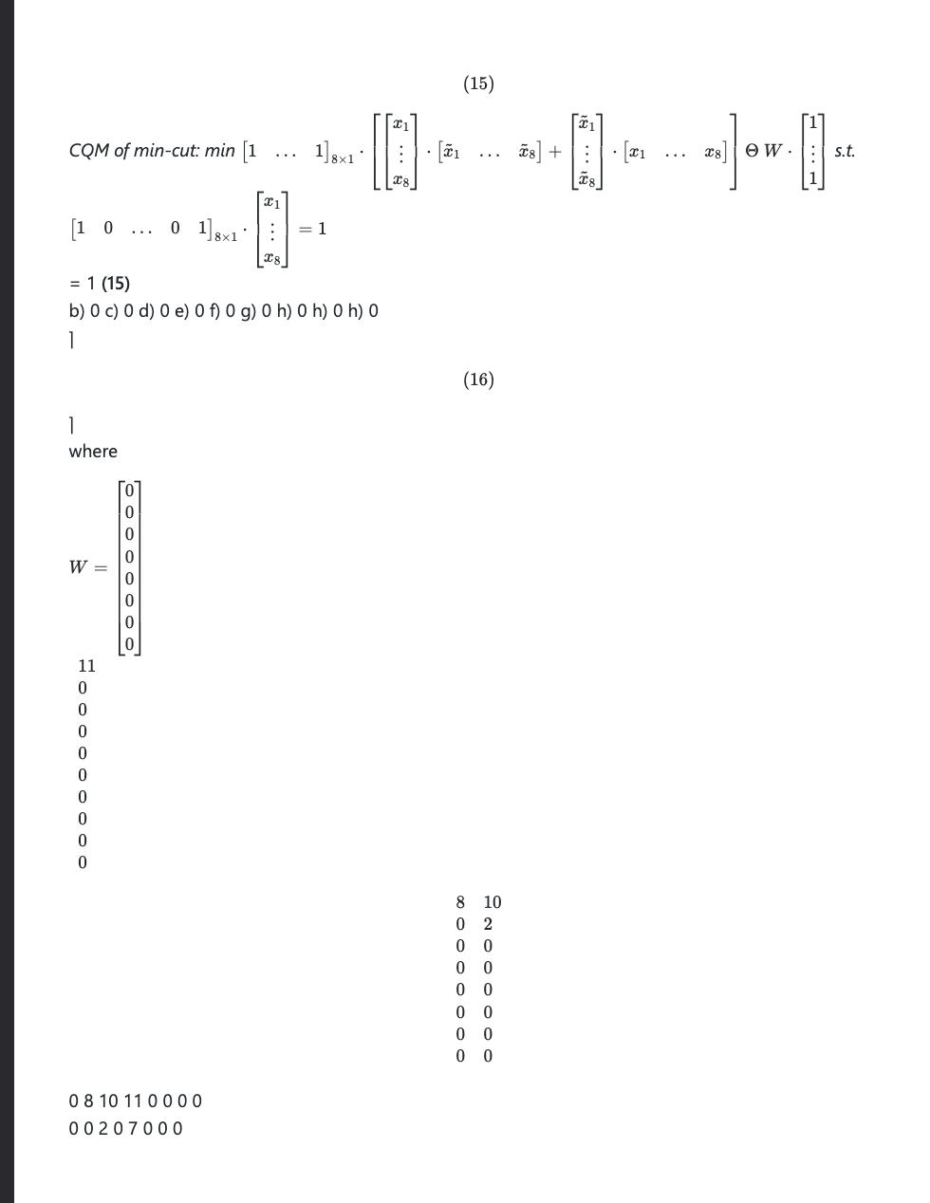
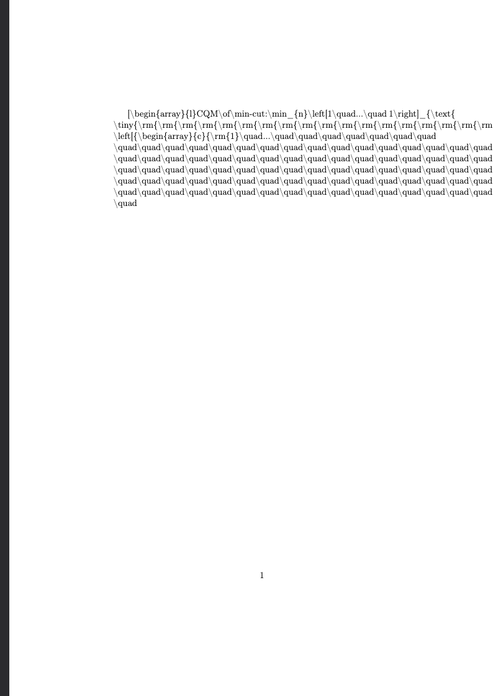
Evaluation Criteria: Example of Lowest score
Original
Marker
Nougat
Notes:
Here is an example where the tools received the lowest score.
The original document on the left contains a lot of complex equations, matricies, and in general is very hard to parse (even for a human)
Both marker and nougat were unsuccessful at recreating the same content and as a result, the underlying information is lost

Slide 12
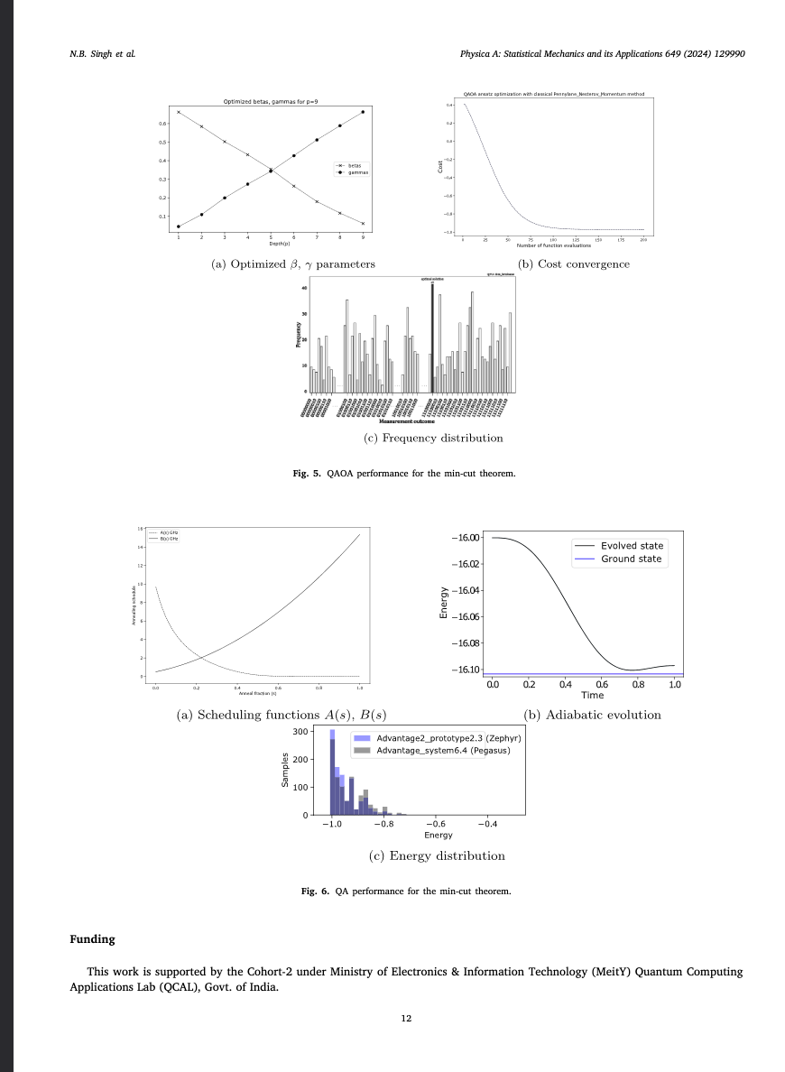
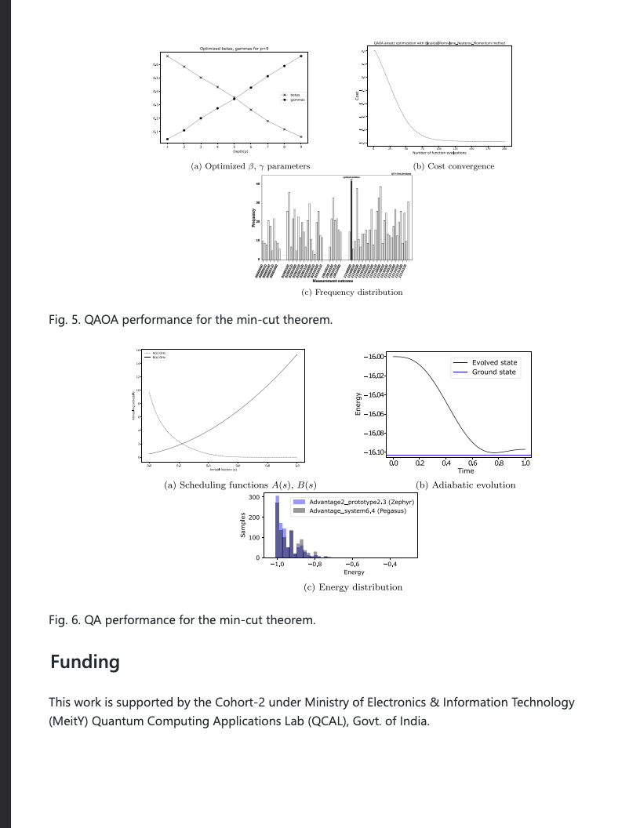
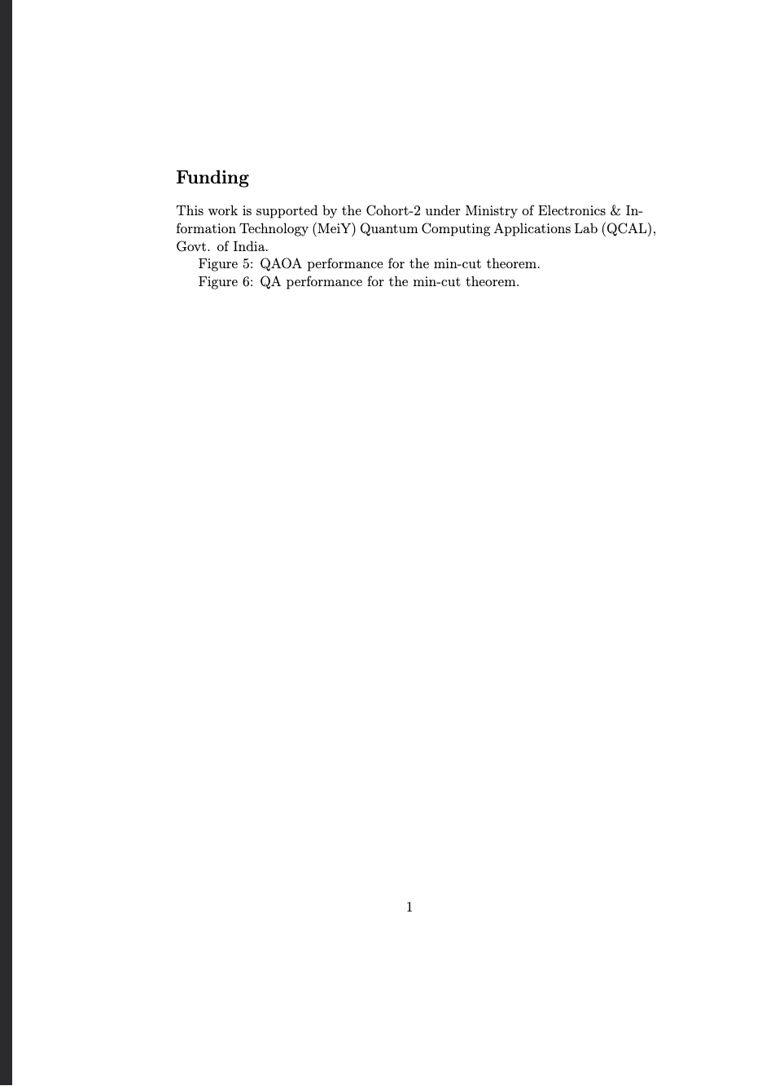
Evaluation Criteria: Example of highest score
Original
Marker
Nougat
Notes:
This slide contains examples of when the tools produce high quality outputs:
The original document contains several figures and marker is able to essentially recreate the exact page (minus a few minor formatting differences)
Note that Nougat, does not do figure extraction, and as a result, we do not unfairly penalize Nougat for this page (provided it extracted the text correctly)

Slide 13
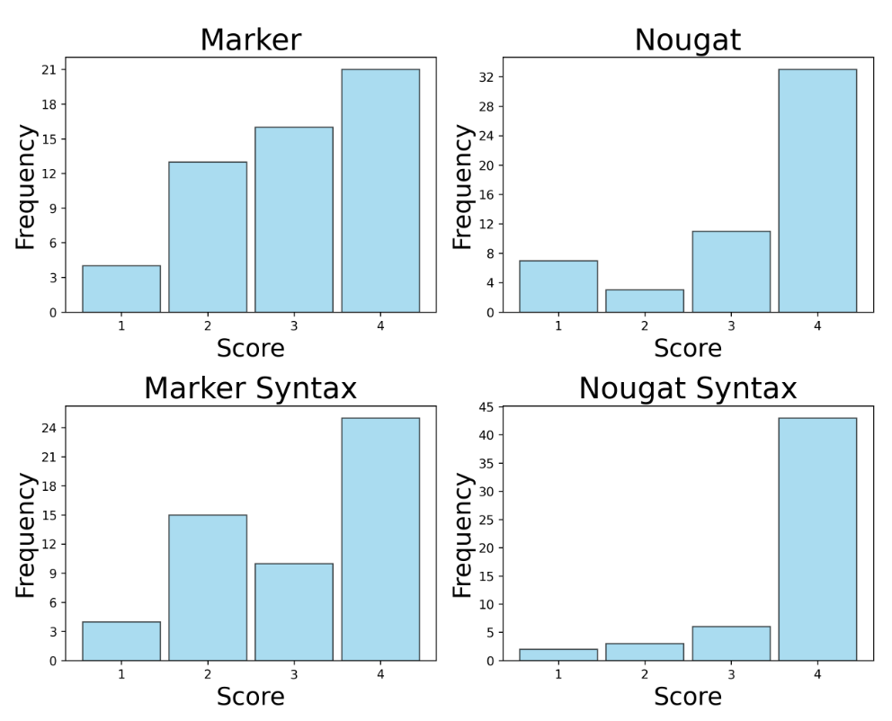
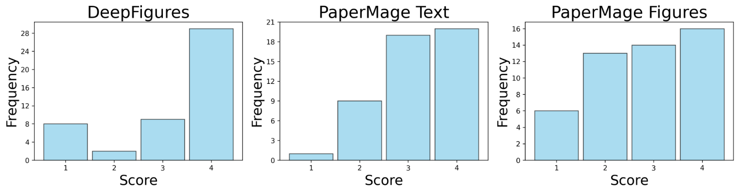
Scoring Results
Tools are overall pretty robust but there are many areas of improvement!
Notes:
Here is a summary of the results. The dataset contains around 50 pages and one of the main takeaways is that the tools overall do quite well (we can see that each tool get’s mostly 3’s and 4’s).
However, it is also important to note, that each tool also had a non-trivial amount of 1’s and 2’s and so every tool has room for improvement

Slide 14
Common Issues
Notes:
Now I want to shift to talk about some of the common issues we’ve found using our dataset

Slide 15
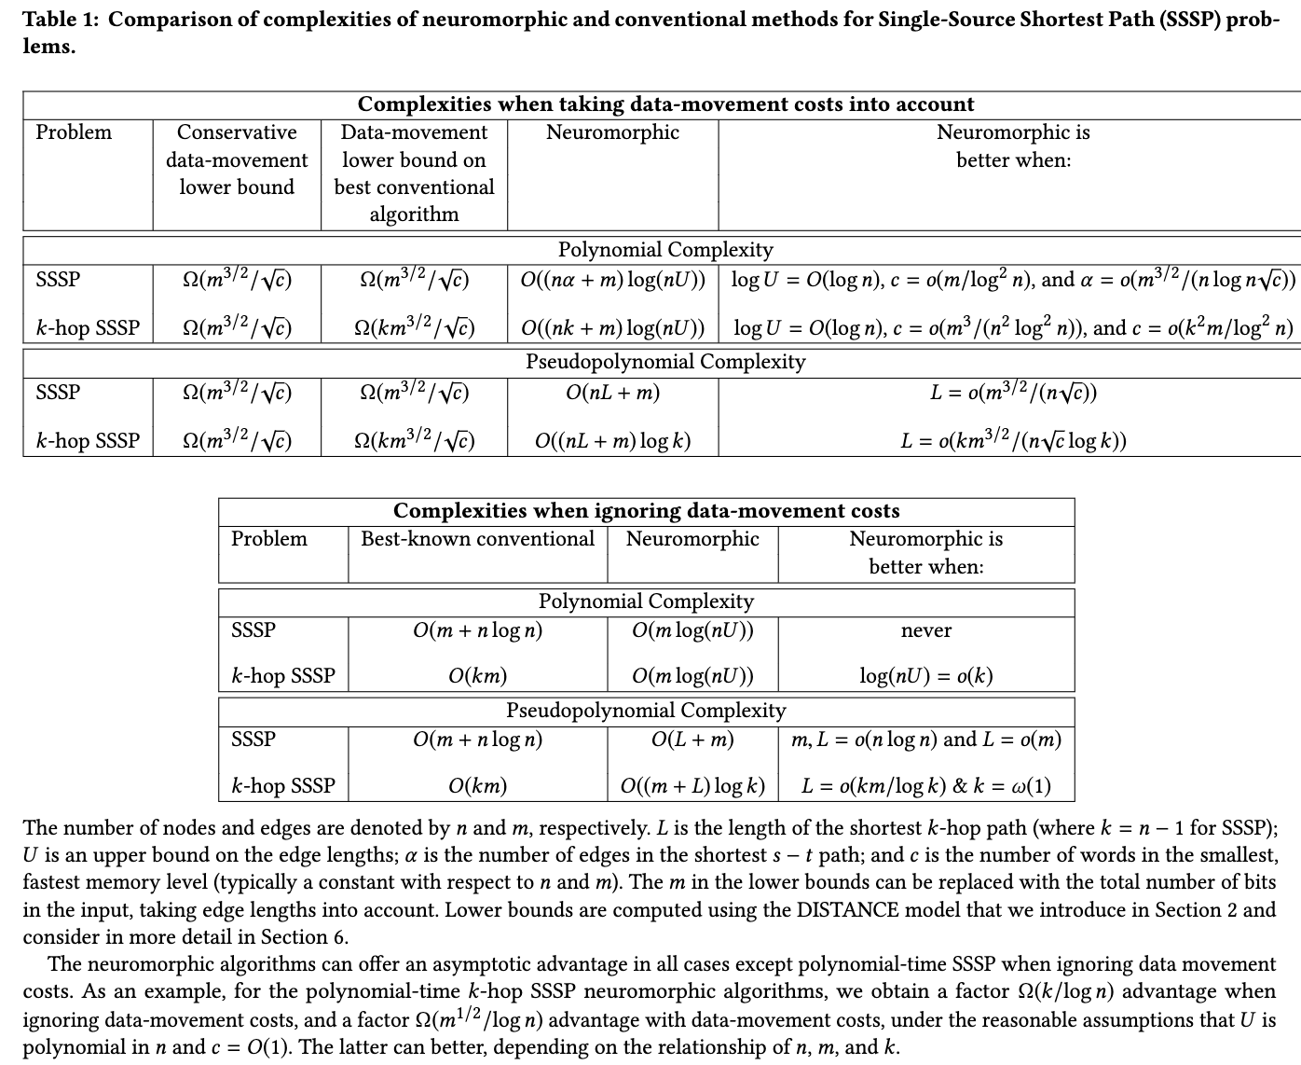
Adjacent Tables and Figures
Observed common portions of documents where tools extracted data incorrectly
Adjacent tables and figures
Nearby tables and figures can cause tools to crop or overestimate bounding boxes
Complex tables and figures
Models struggled with tables containing sub-tables with distinct headers and tables containing LaTeX-formatted equations
Also struggled on cases where the distinction between a figure and a table was not clear
Original contains two adjacent complex tables
Notes:
The first common issue we’ve notice is adjacent tables and figures as well as tables and figures that have complex data or structure
For example, the original page on the right has two tables right next to each other and each table contains complex equations/notation

Slide 16
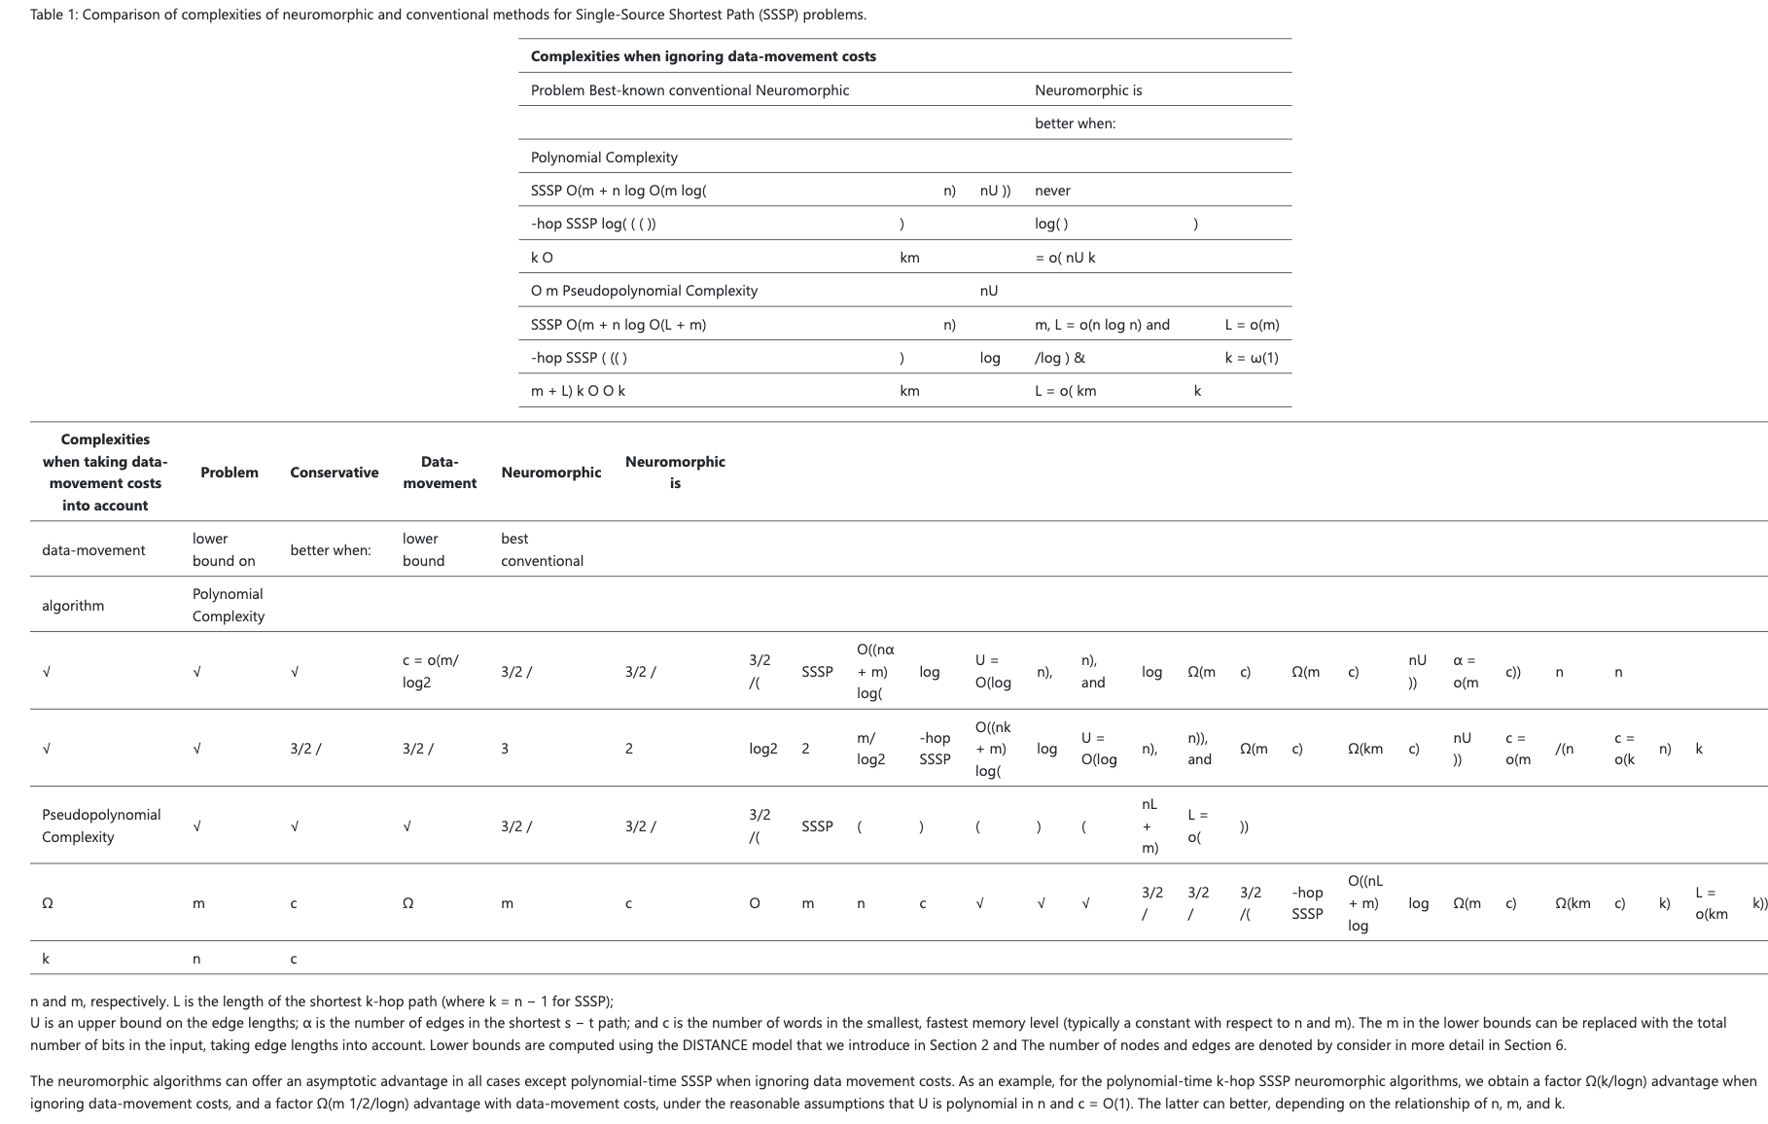
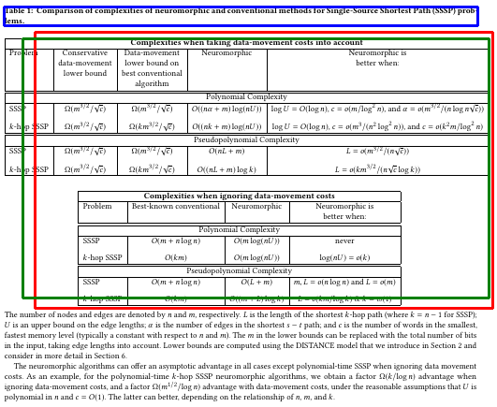
Adjacent Tables and Figures
Bounding boxes:
Figure
Table
Caption
Marker fails to extract both tables properly, as well as the text directly underneath.
PaperMage fails to differentiate between two tables, and incorrectly classifies them as a single figure.
Notes:
Here we see how marker and PaperMage struggle to properly extract the tables.
Marker is able to identify the tables as separate entities, but struggles with the actual content in the table
Papermage on the otherhand, is very confused about how the tables are organized.

Slide 17
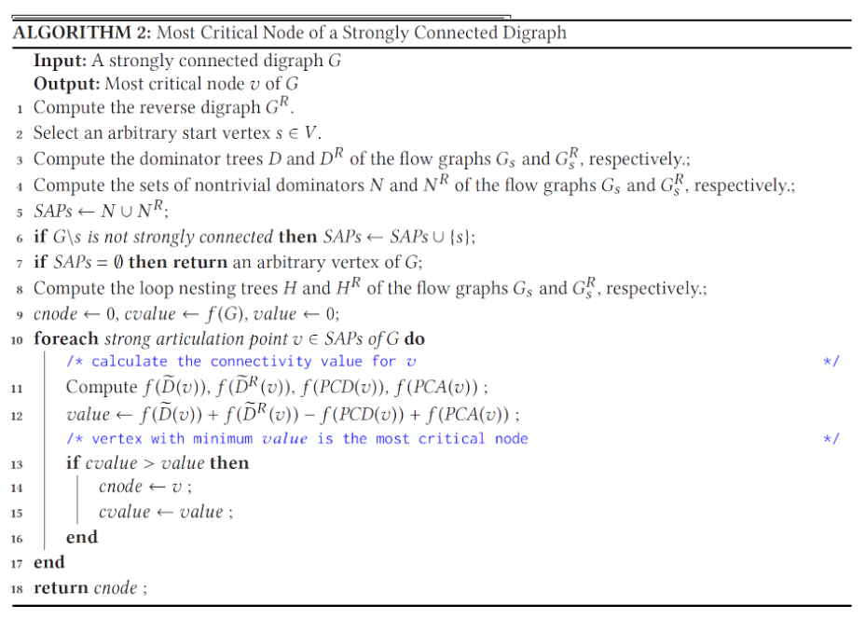
Algorithms and Pseudocode
Algorithms and pseudocode
Algorithms are often formatted as a captioned block of text and line numbers that is separated from the main text body
Classification is ambiguous unless the model is explicitly trained to detect algorithms as a different object class
Original contains multi-line, indented algorithm with math symbols
Notes:
Another type of entity that these tools tend to struggle on consistently extracting is algorithms and pseudocode
For example, on the right contains a multi-line, indented algorithm block that contains notation and a lot of mathematical symbols

Slide 18
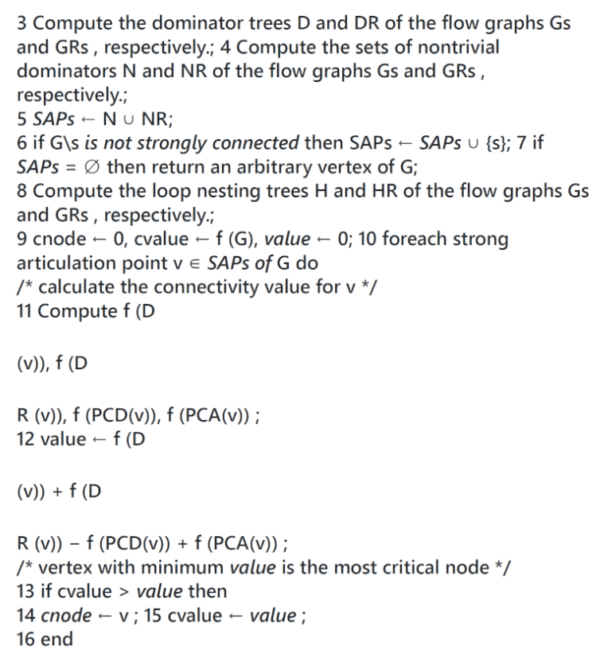
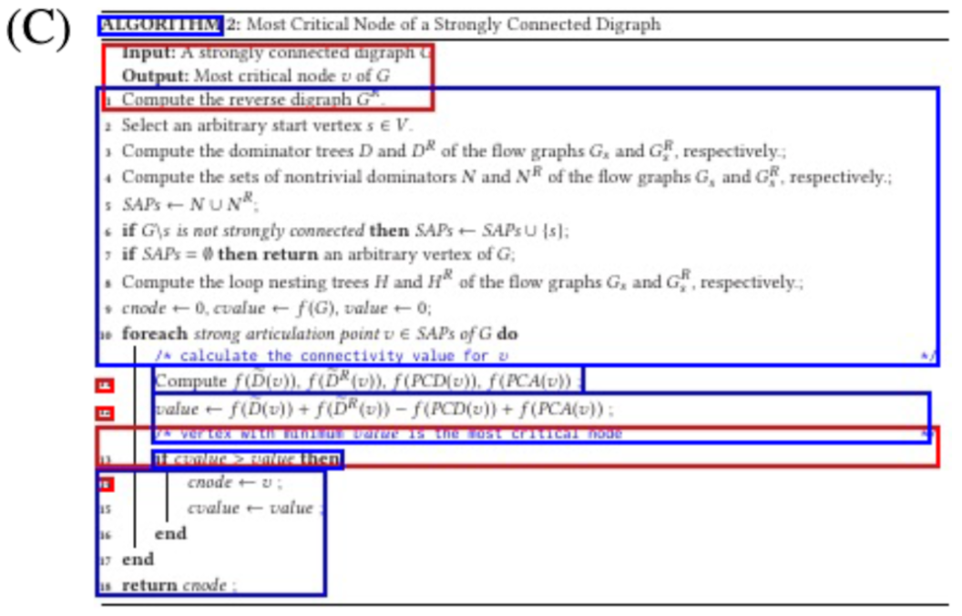
Algorithms and Pseudocode
Bounding boxes:
Paragraph
Equation
Algorithm
PaperMage overlaps boxes for paragraphs and algorithms, and does not detect the whole algorithm.
Marker fails to extract the correct structure of the algorithm.
Notes:
Here, marker is unable to detect that this should be a code block and fails extract the formatting of the algorithm
And again, paper mage tries its best but is ultimately unsuccessful

Slide 19
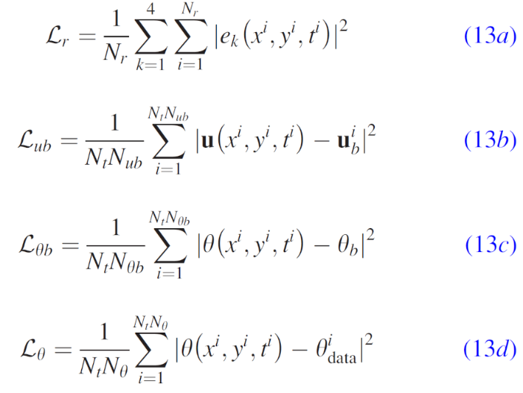
Multi-Line Equations
Complex, multi-line math formatting
Equations that consist of multiple lines, or contain other non-trivial formatting, can lead to incorrectly extracted and garbled text
Multi-line derivations and matrices typically arise in distinct blocks separated from the main text body
Original contains equations on multiple lines with with special characters
Notes:
Another feature we noticed that tends to give these tools some difficulty are mutli-line equations

Slide 20
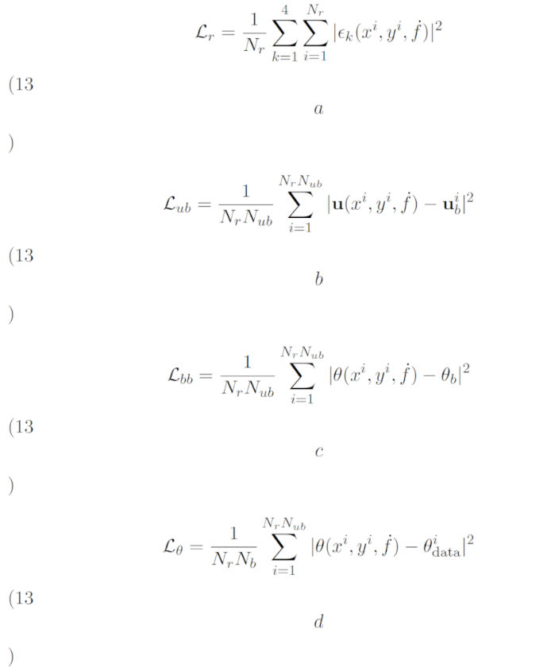
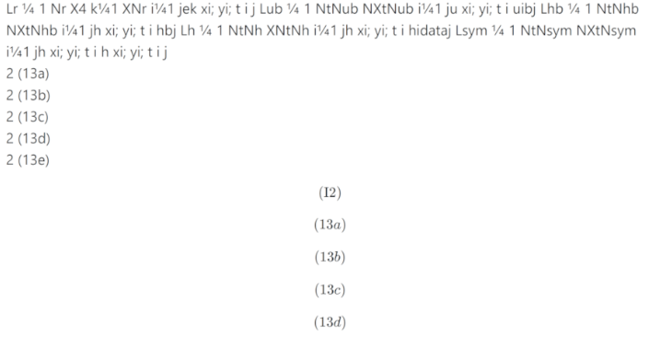
Multi-Line Equations
Marker fails to extract equations and line numbers correctly
Nougat extracts equations correctly, but garbles equation numbers
Notes:
Nougat is able to correctly parse and extract the equations (but garbles equation numbers)
While marker just completely fails in this particular example

Slide 21
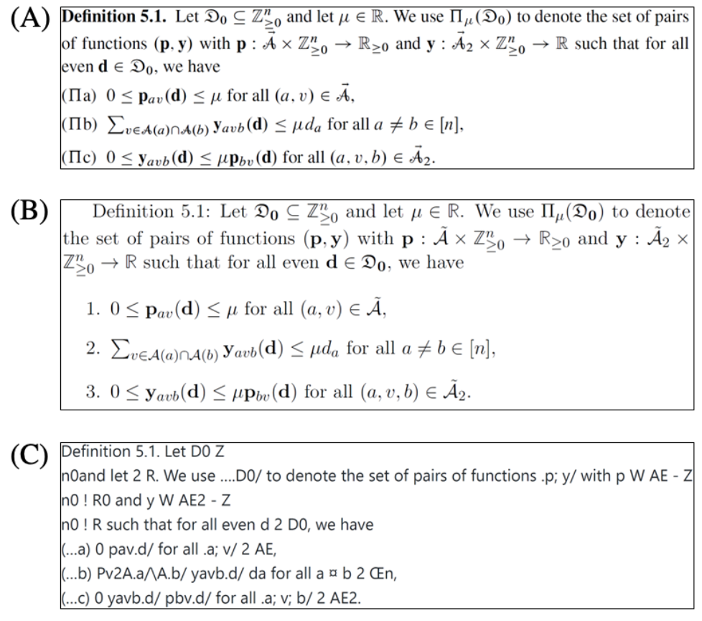
Use of Unicode
Unicode output
Generally fails to accurately represent mathematical equations
Lacks the expressiveness necessary to adequately represent the meaning of mathematical symbols
LaTeX provides a robust format to represent relationships between mathematical symbols
A – Original; B – Nougat; C – Marker
Notes:
And lastly, one of the biggest issue is the usage of unicode for syntax and equations.
This is problem because unicode lacks the expressiveness necessary to adequately represent the meaning behind the symbols.

Slide 22
Other Issues
Notes:
Now all the issues highlighted were commonly found in digitally born documents.
Now I want to highlight some of the common issues found in scanned documents

Slide 23
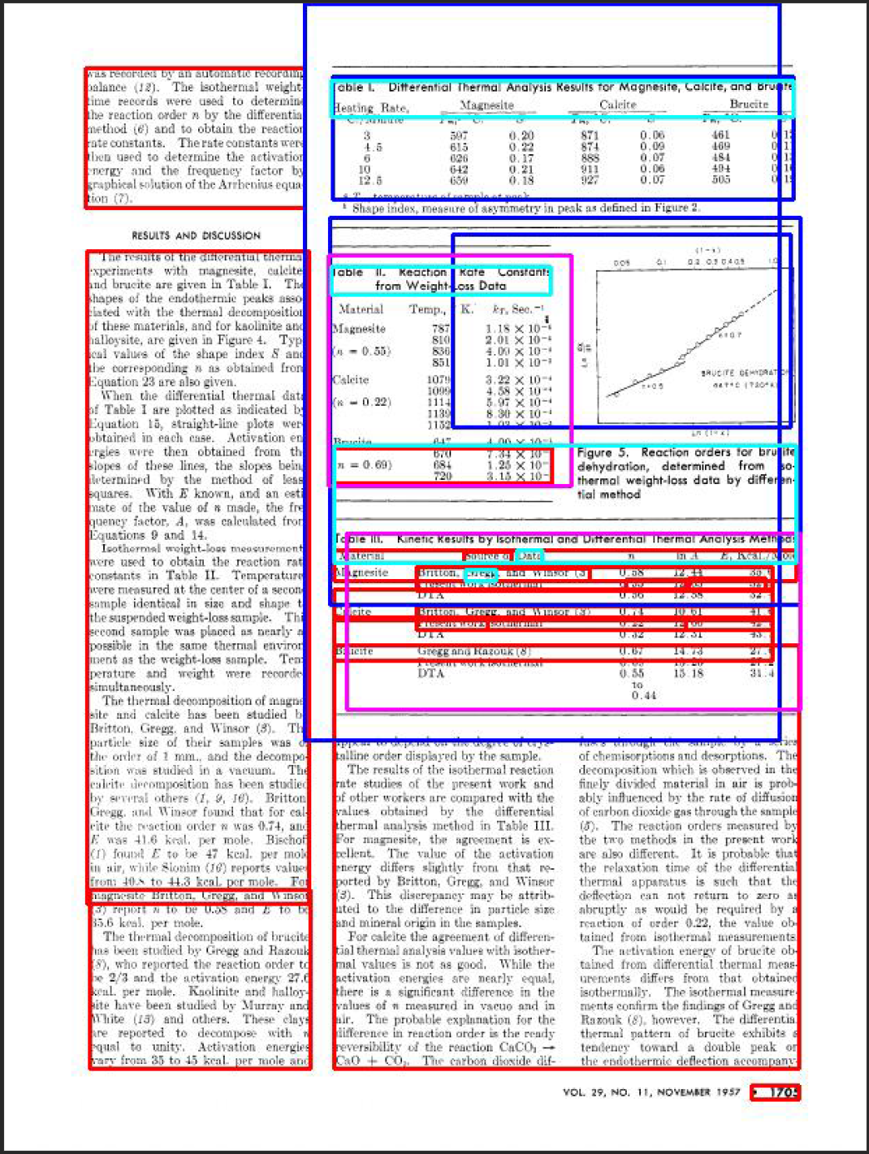
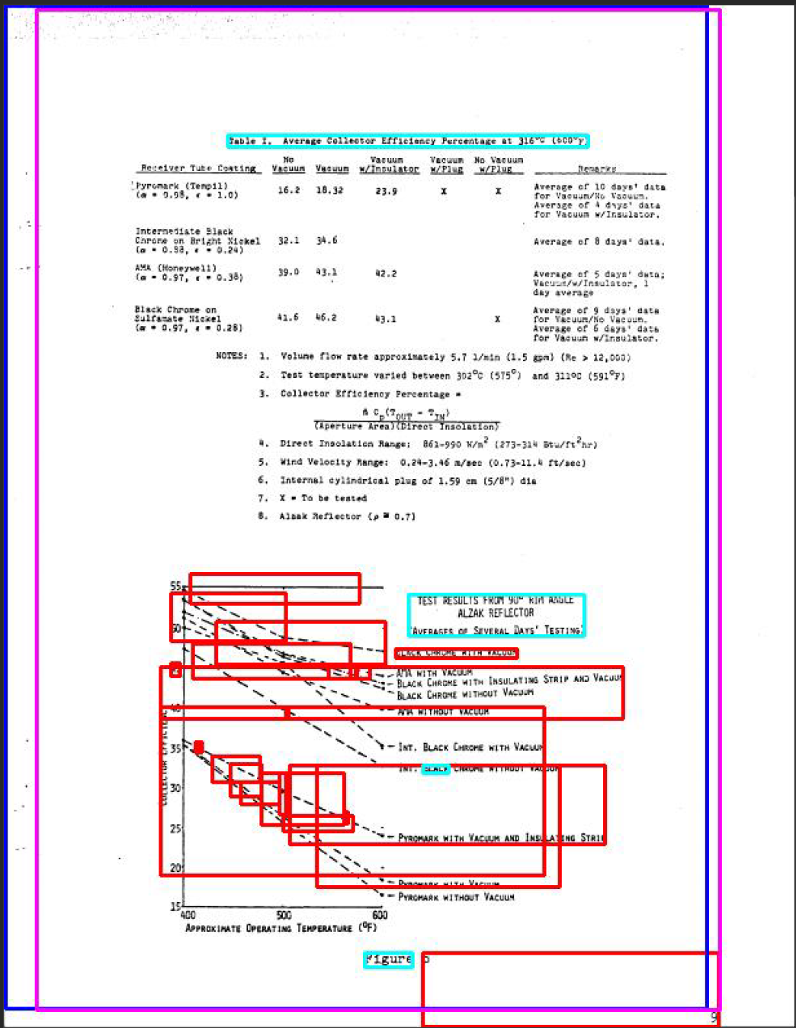
Scanned Documents: Formatting
Many tools rely on pdf metadata
Scanned documents do not have this data!
The right shows papermage failing to detect appropriate bounding boxes of elements
Notes:
In general, the format of scanned documents give the tools a lot of trouble.
Here are some examples where papermage just complete fails at determining appropriate bounding boxes

Slide 24
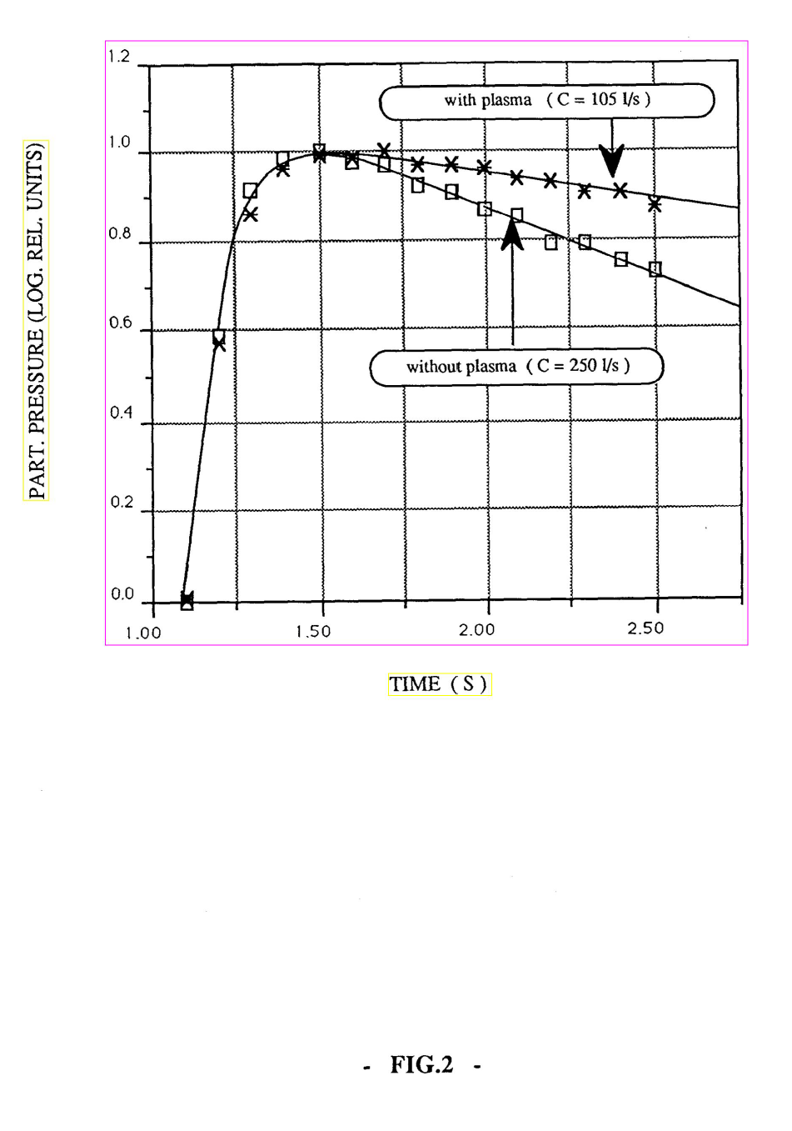
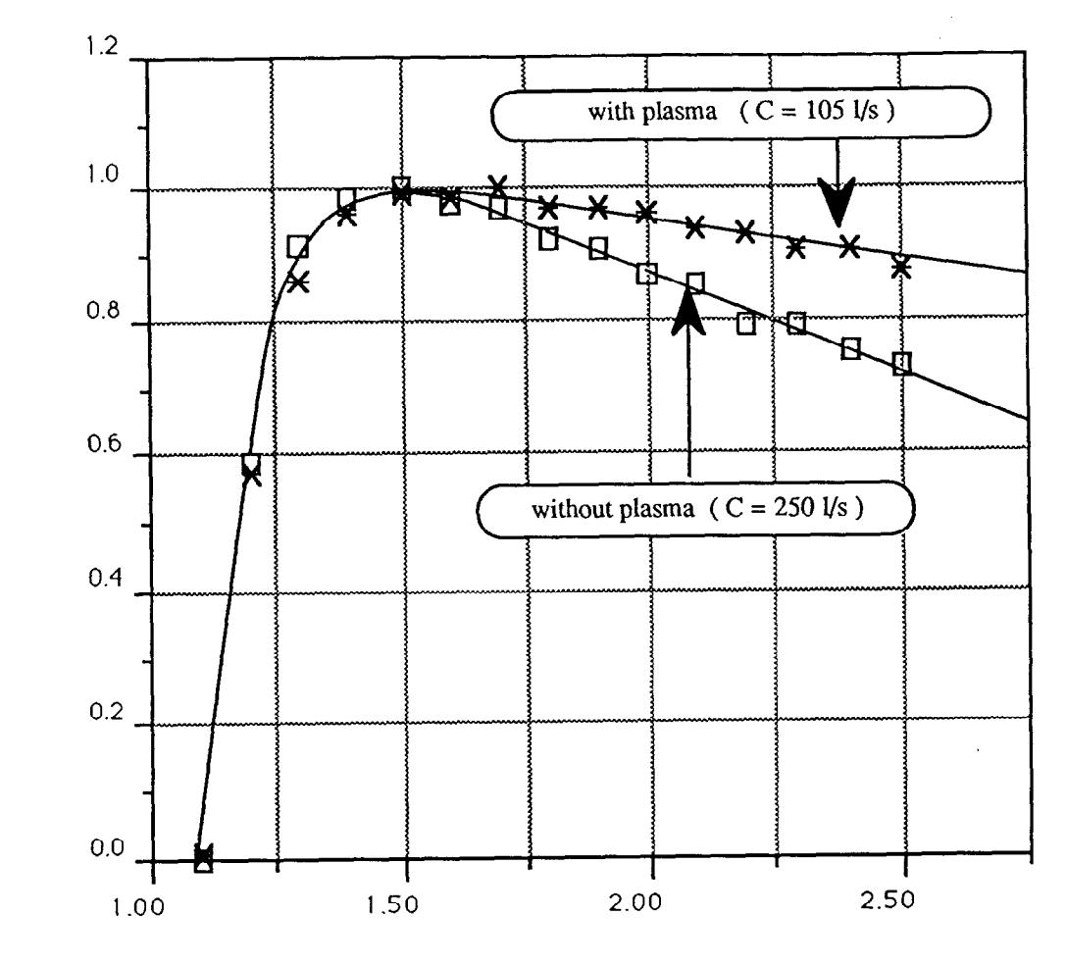
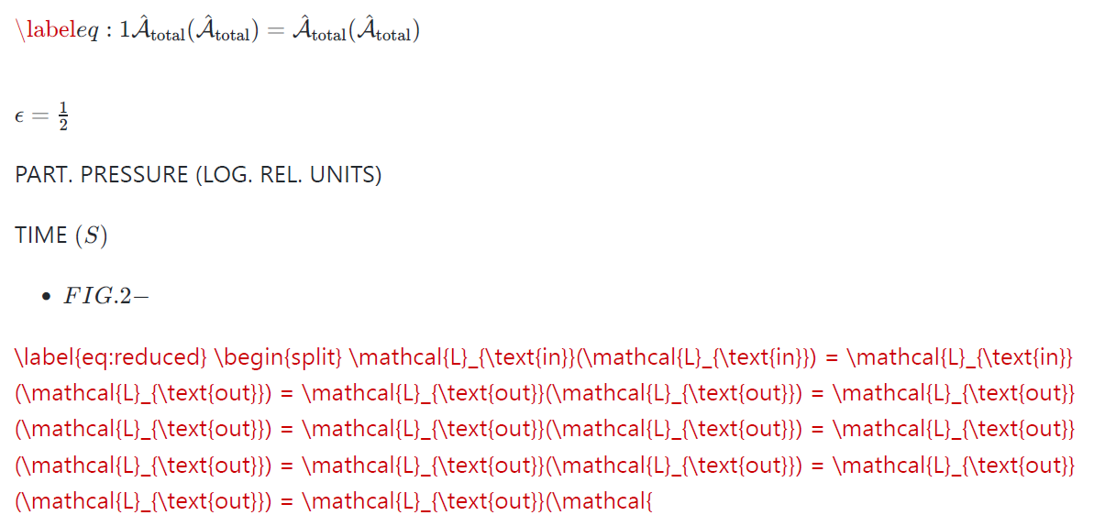
Scanned Documents Formatting
Marker is able to extract the figure, but has trouble extracting the axis labels
Original page contains only a single figure
Notes:
In addition to formmating, the actual text provides some challenges.
iN this example, marker is able to properly detec the figure, but struggles to capture the axis labels. (in fact it even generates syntax errors!)

Slide 25
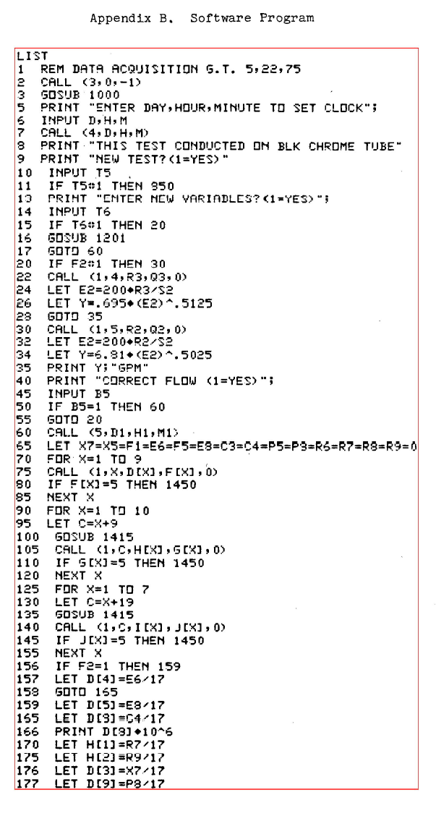
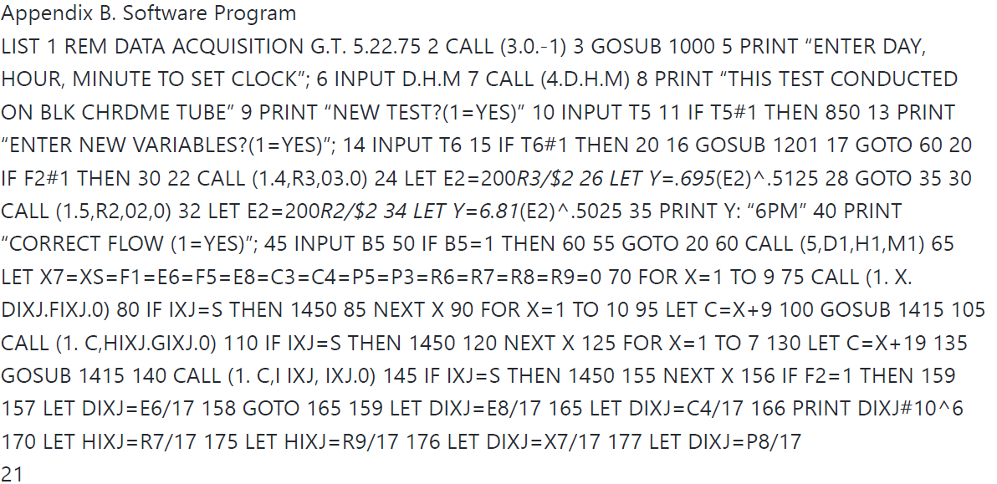
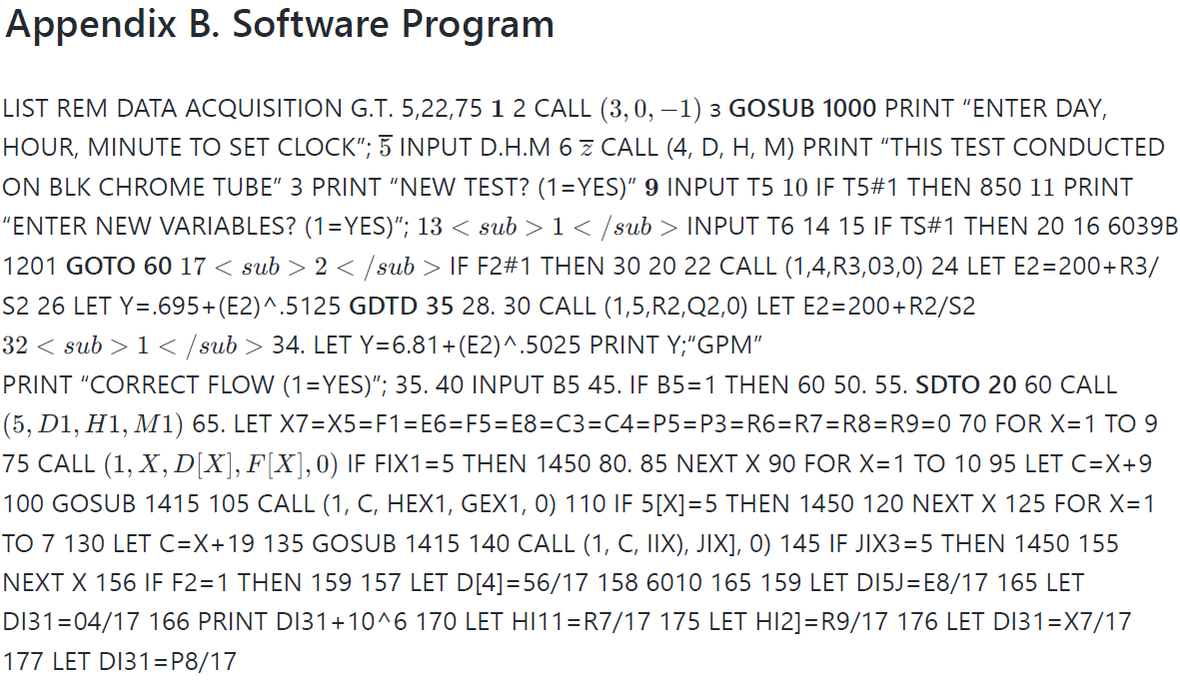
Assembly Like Code
Historical documents may contain older or more esoteric programming languages
While the specific languages may be “obsolete”, the overall content can still be highly relevant
Notes:
Assembly like code as well as esoteric programming languages also prove to be very challenging to properly extract.
Although many of these specific languages are considered “obsolete”, the documents they reside in still contain relevant information and there can still be a tn of high quality data contained within these code snippets

Slide 26
Takeaways
Notes:
Now I want to conclude with some key takeaways as well as highlight some future efforts

Slide 27
Conclusion
Document processing is hard!
We’ve only looked at PDFs!
Banyan-Ingest (the tool): curated set of tools we’ve evaluated
Looking at more rigorous ways of evaluating tool outputs
Developing methods to utilize multiple tools to ensure the highest quality outputs
Navigating licensing, API access, etc., since different tools have different requirements
Notes:
First and foremost: Document processing is hard!
In this presentation I’ve only talked about PDFs
There are several other kinds of document formats and each have their own set of challenges
Currently we are focused on PDFs but eventually we will like to also expand to over kinds of documents (like pptx)
Banyan-ingest (the tool) contains curated tools that we’ve evaluated and does quite well for our particular task
We are also looking at ways of evaluating and comparing tools in more objective and rigorous ways (some examples: we’ve begun looking at using an LLM to evaluate and compare the outputs but we are also looking at other ways,)
In addition, we are also looking at ways of combining tools to ensure the highest quality outputs

Slide 28
Conclusion
Tools are overall pretty robust but there are many areas of improvement!
Notes:
And I would like to end by coming back to this slide to remind everyone, that although I spent a large portion of this talk describing when these tools struggle and where they can improve, many tools overall do quite well at extracting content; but it is important to not blindly use the outputs.
Thank you all for your time!

