Slide 1
Noisy Weights: New Perspectives on Finding Noise-Robust Flat Minima
SAND2025-09198C
Philip Jacobson, Ben Feinberg, Patrick Xiao, Chris Bennett, Sapan Agarwal
2025 Sandia Machine Learning and Deep Learning Workshop

Slide 2
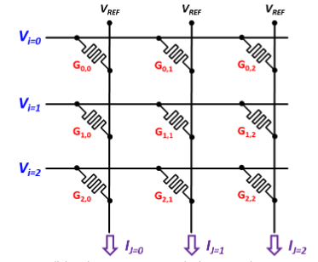

Motivation: Analog In-Memory Computing
Analog In-Memory Computing has emerged as an energy-efficient solution for neural network deployment at the edge.
However, analog matrix multiplication introduces device errors when model weights are programmed.
We want to induce noise-robustness through improved training
$${\left[\begin{matrix}x_{1} \\ x_{2} \\ x_{3}\end{matrix}\right]}^{T}\left[\begin{matrix}W_{1,1} & W_{1,2} & W_{1,3} \\ W_{2,1} & W_{2,2} & W_{2,3} \\ W_{3,1} & W_{3,2} & W_{3,3}\end{matrix}\right]$$

Slide 3
Flat Loss Landscape as a Measure of Noise Robustness
Sharp (Noise-Sensitive) Minimum
Flat (Noise-Robust) Minimum
Resiliene to weight-space perturbations means loss function is slowly increasing in neighborhood of the local minimum, i.e. the loss landscape appears “flat”

Slide 4














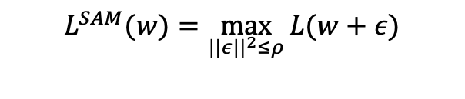
Optimizing for Flat Minima: Sharpness-Aware Minimization and Random Weight Perturbation
SGD
SAM
RWP
$$∇_{w}L\left(w_{p}\right)$$
$$w_{p}$$
$$w_{t+1}$$
$$w_{t}$$
$$w_{t+1}$$
$$w_{t+1}$$
$$η^{T}∇_{w}L\left(w\right)$$
$$ρ^{T}∇_{w}L\left(w\right)$$
$$w_{t}$$
$$w_{t}$$
$$w_{p}$$
$$ε\sim N(0,σ^{2})$$
$$∇_{w}L\left(w_{p}\right)$$
$$L^{SAM}(w)=\max_{||ε||^{2}≤ρ}{L(w+ε)}$$
$$L^{RWP}(w)=𝔼_{ε\sim 𝒩\left(0,σ^{2}I\right)}[L(w+ε)]$$
Sharpness-Aware Minimization (SAM) and Random Weight Perturbation (RWP) are two well-known optimization methods which modify SGD to implicitly optimize for flatter minima

Slide 5
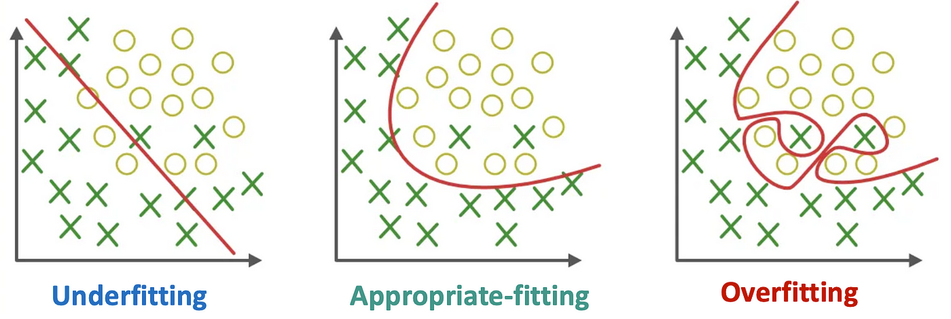



Unifying Our Understanding of Perturbed Training
Device Noise
Profile
$$w_{t}$$
$$w_{t+1}$$
Improved Generalization: SAM
Device-Noise Robustness: RWP
Two disjoint threads on finding flat minima: SAM-based and RWP-based
Can we unify these approaches to broadly understand how these methods ensure flat, noise-robust minima?

Slide 6
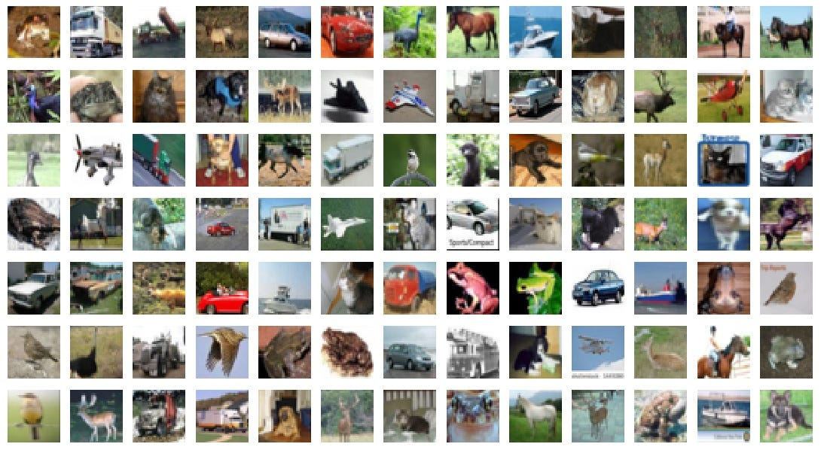
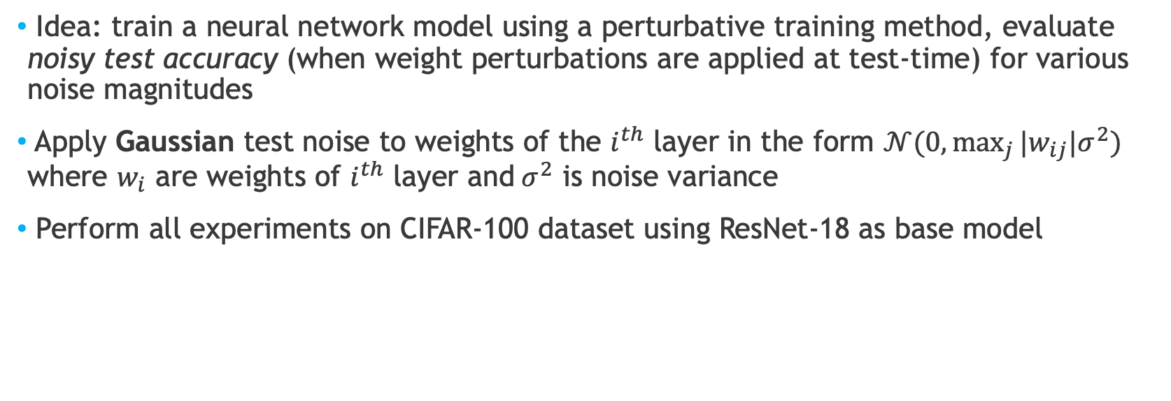
Setup for Noise Robustness Experiments
Idea: train a neural network model using a perturbative training method, evaluate noisy test accuracy (when weight perturbations are applied at test-time) for various noise magnitudes
Apply Gaussian test noise to weights of the $i^{th}$ layer in the form $𝒩(0,\max_{j}{|w_{ij}|σ^{2})}$ where $w_{i}$ are weights of $i^{th}$ layer and$σ^{2}$ is noise variance
Perform all experiments on CIFAR-100 dataset using ResNet-18 as base model

Slide 7
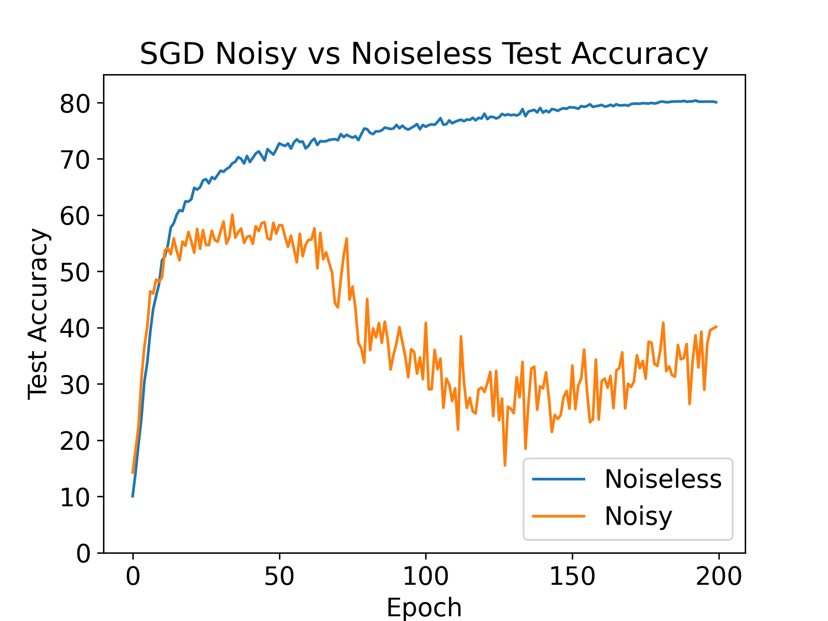
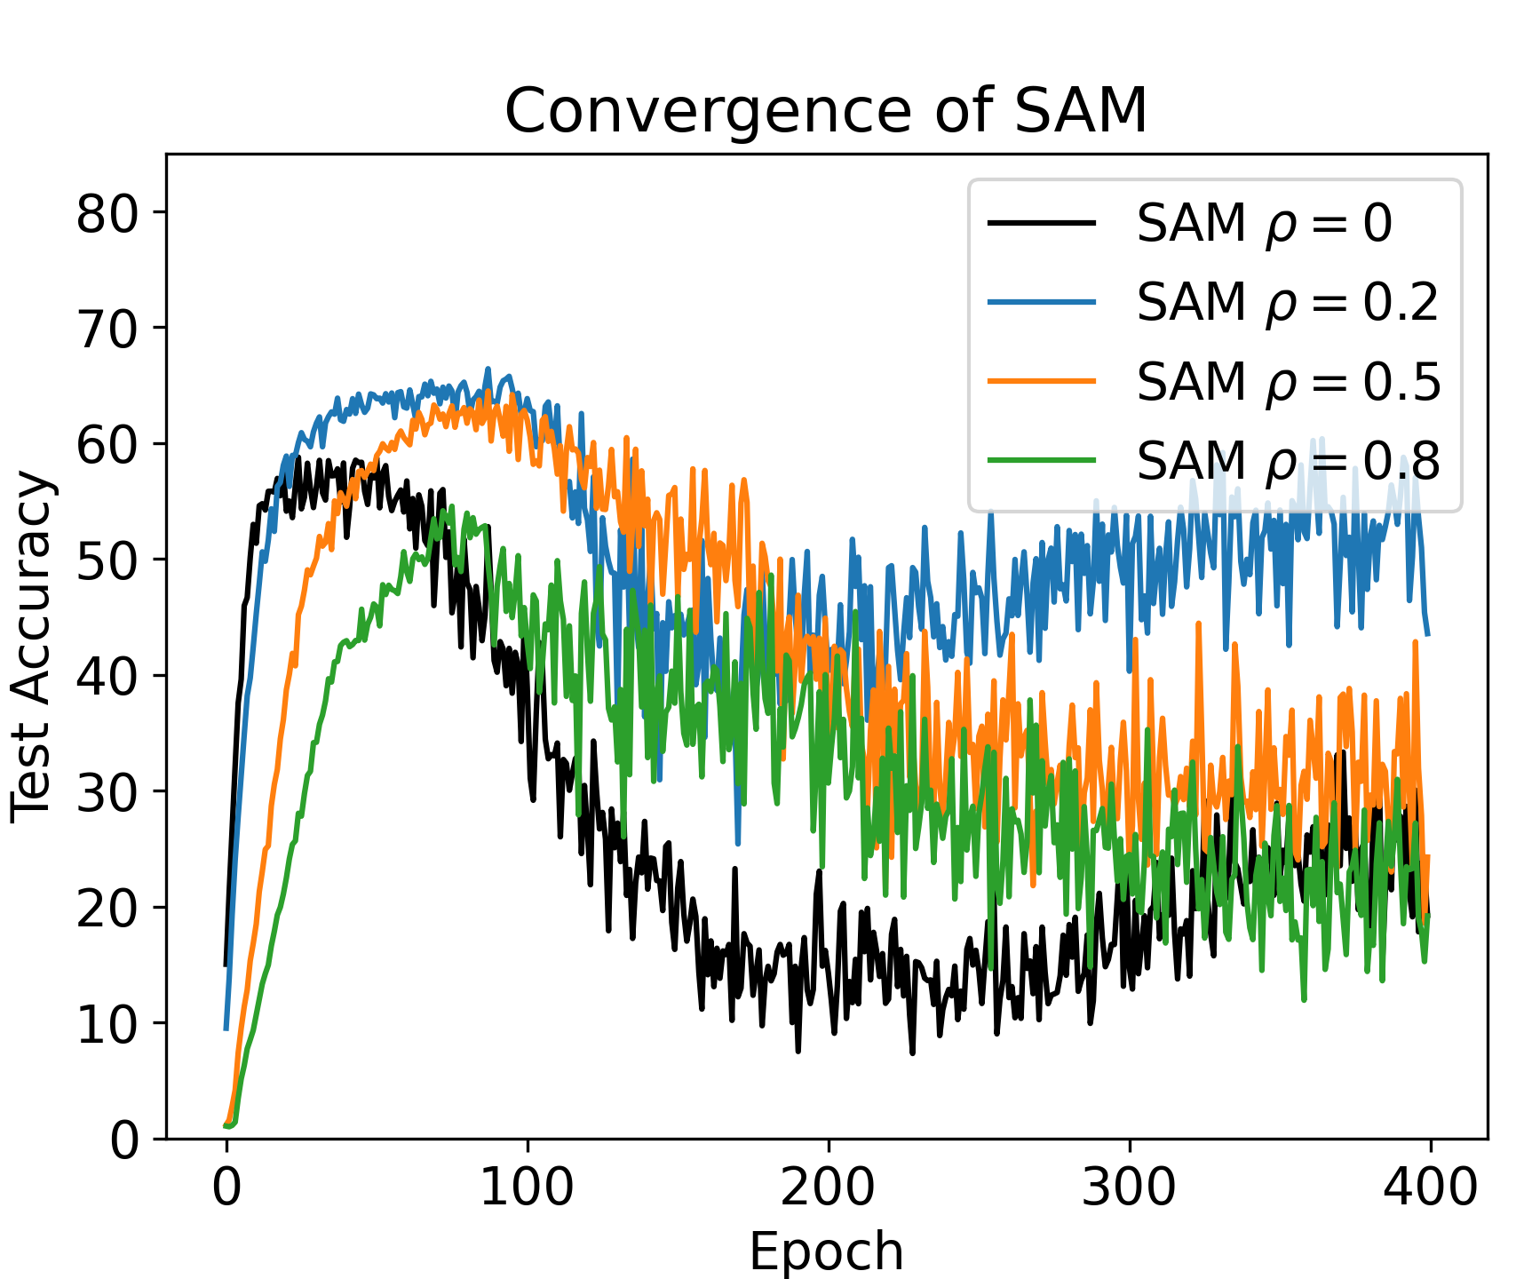
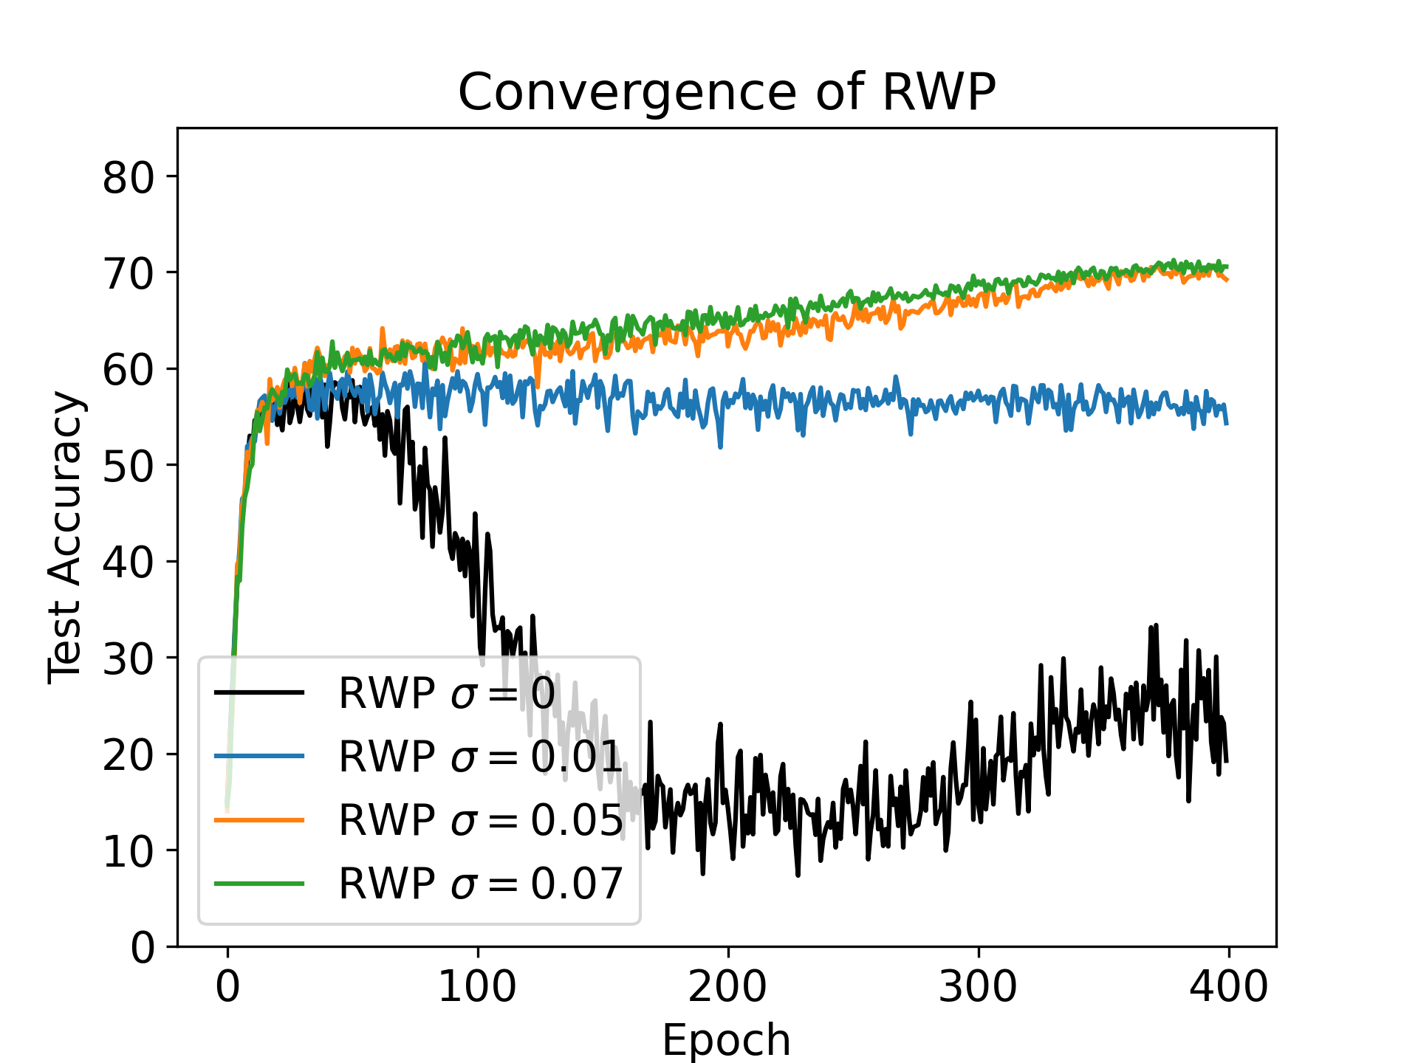
Observing Evolution of Noise Robustness During Training
Plot noisy test accuracy as a function of training epoch
SGD/SAM reach peak noise-robustness before convergence, whereas RWP achieves best noisy test accuracy at convergence

Slide 8
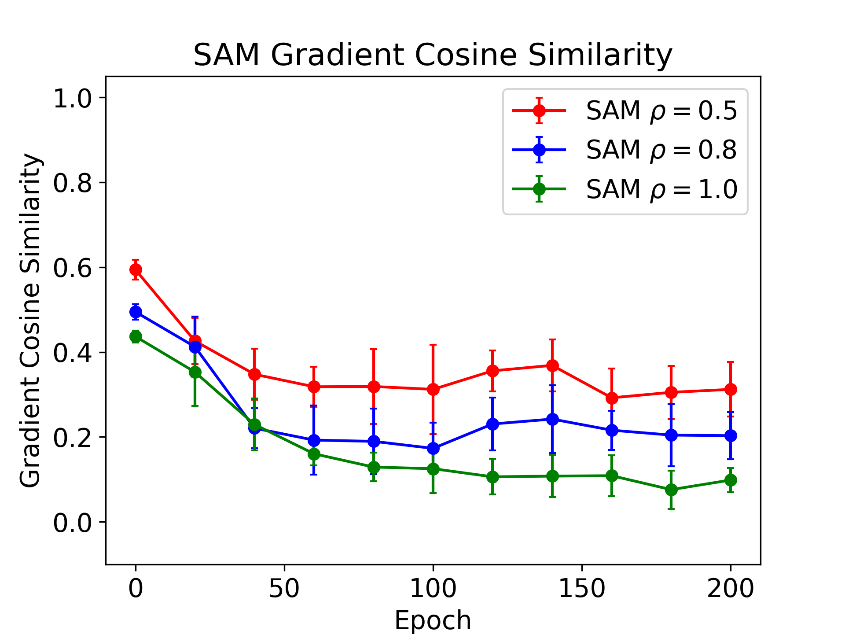
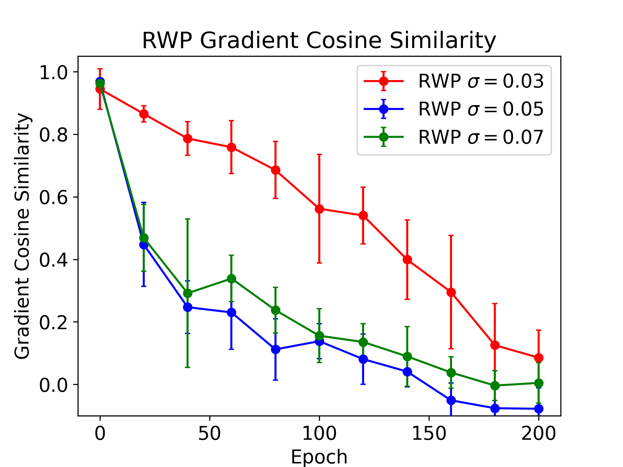
Why Does SAM Overfit? Comparing Gradient Similarities
Plot cosine similarity between perturbed and unperturbed gradient during training for SAM/RWP
Larger cosine similarity of SAM gradients indicates greater directional similarity to unperturbed gradients

Slide 9
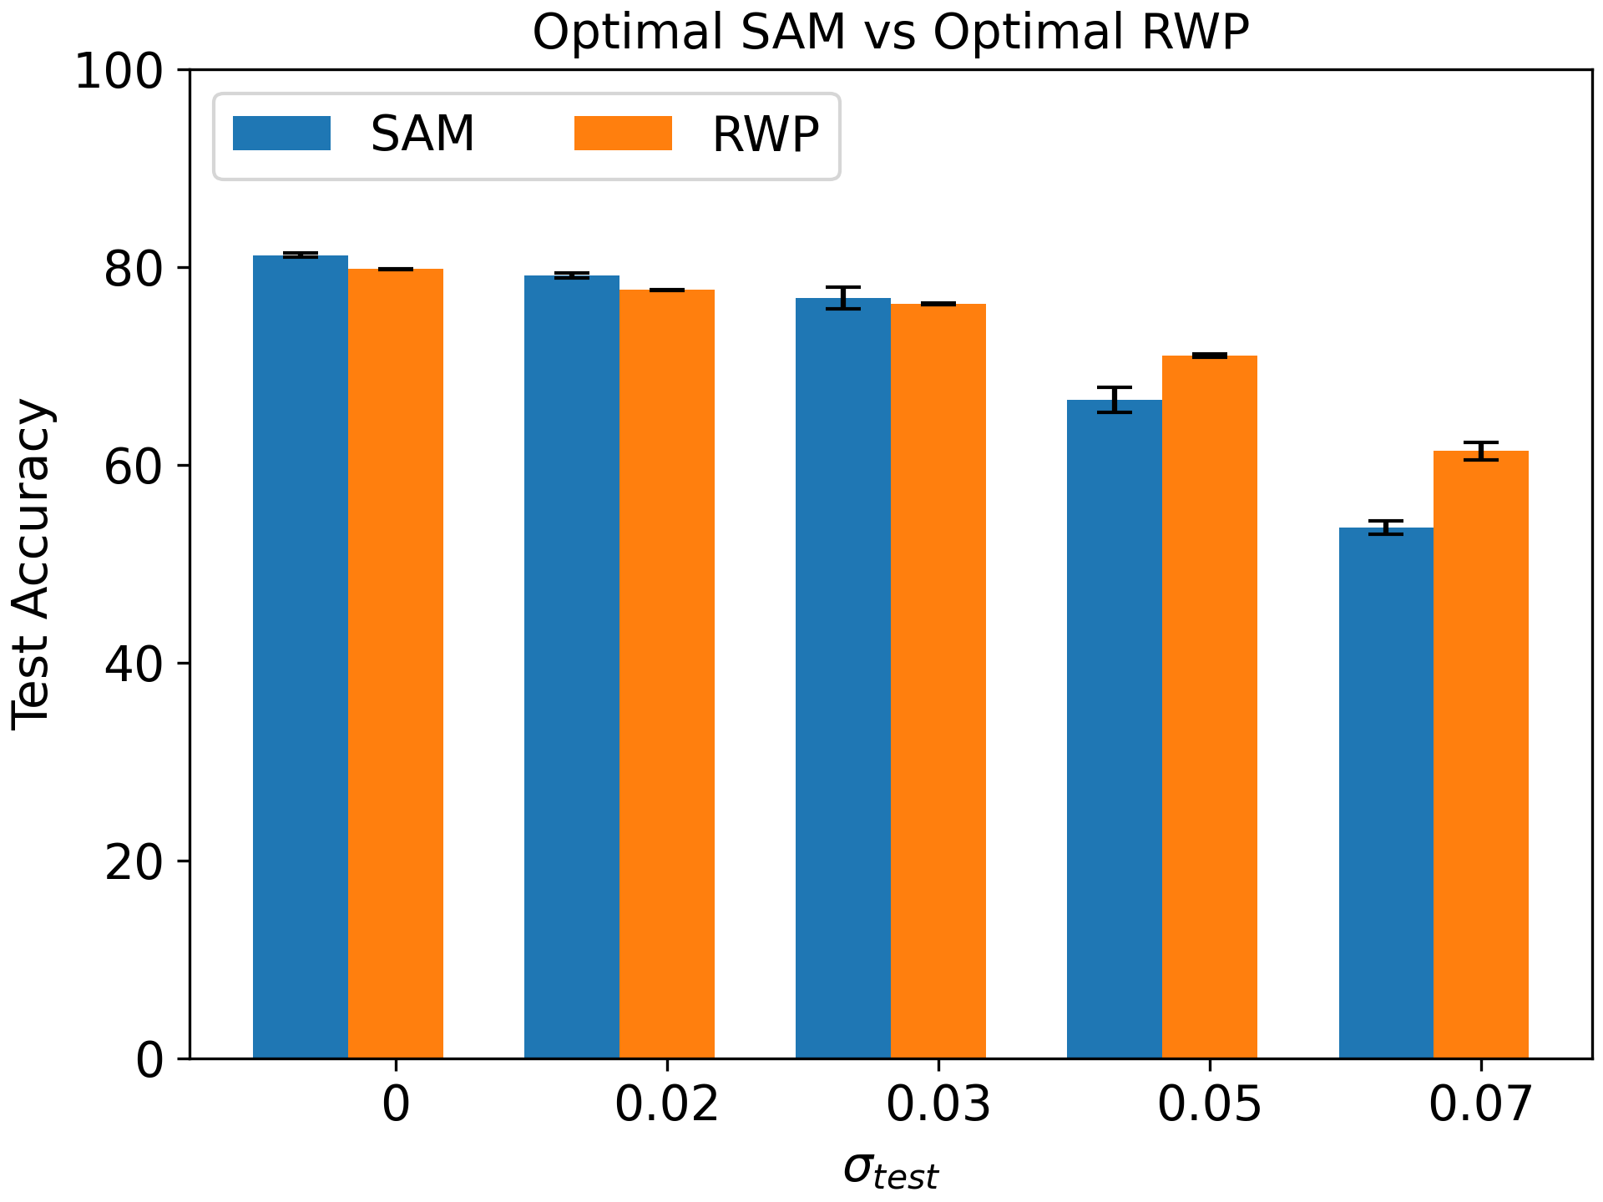
How Does Robustness Scale with Noise Strength?
Comparing noisy test accuracy for several different values of $σ_{test}$, we see that SAM works best for low-magnitude noise, whereas RWP works best for large-magnitude noise

Slide 10
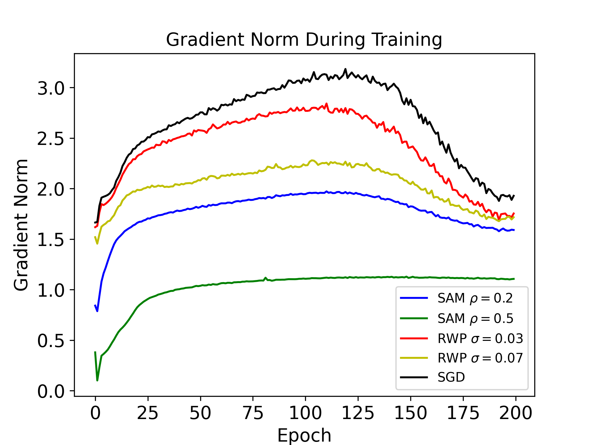
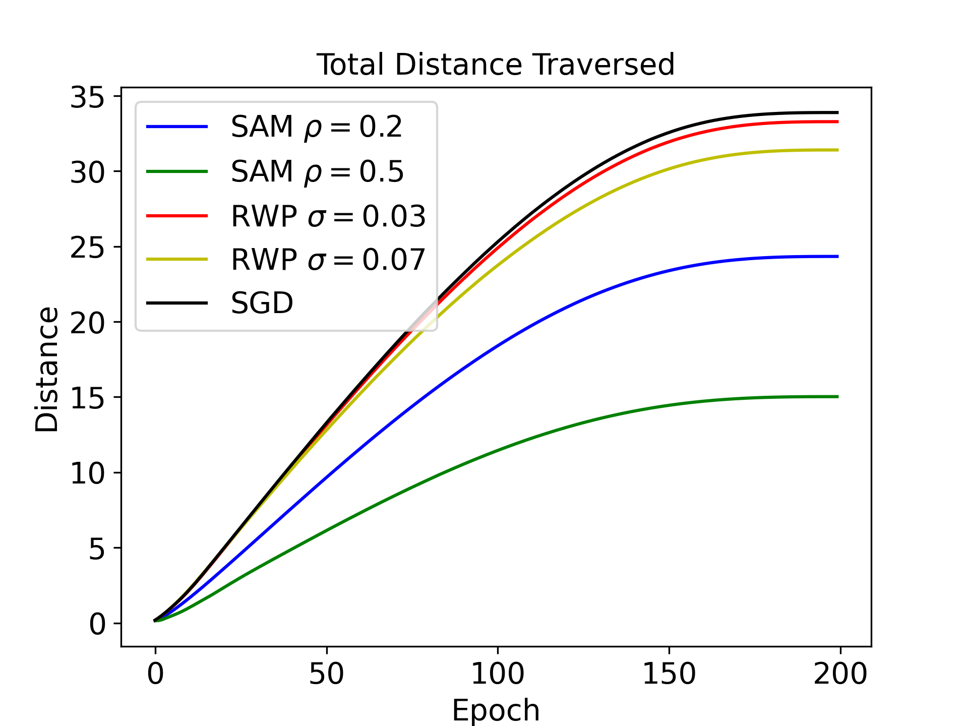
The Problem with Large Perturbations: Sharpness-Induced Vanishing Gradient
Large perturbations during training (especially large adversarial perturbation) reduce the magnitude of the gradient norm, greatly attenuating learning

Slide 11
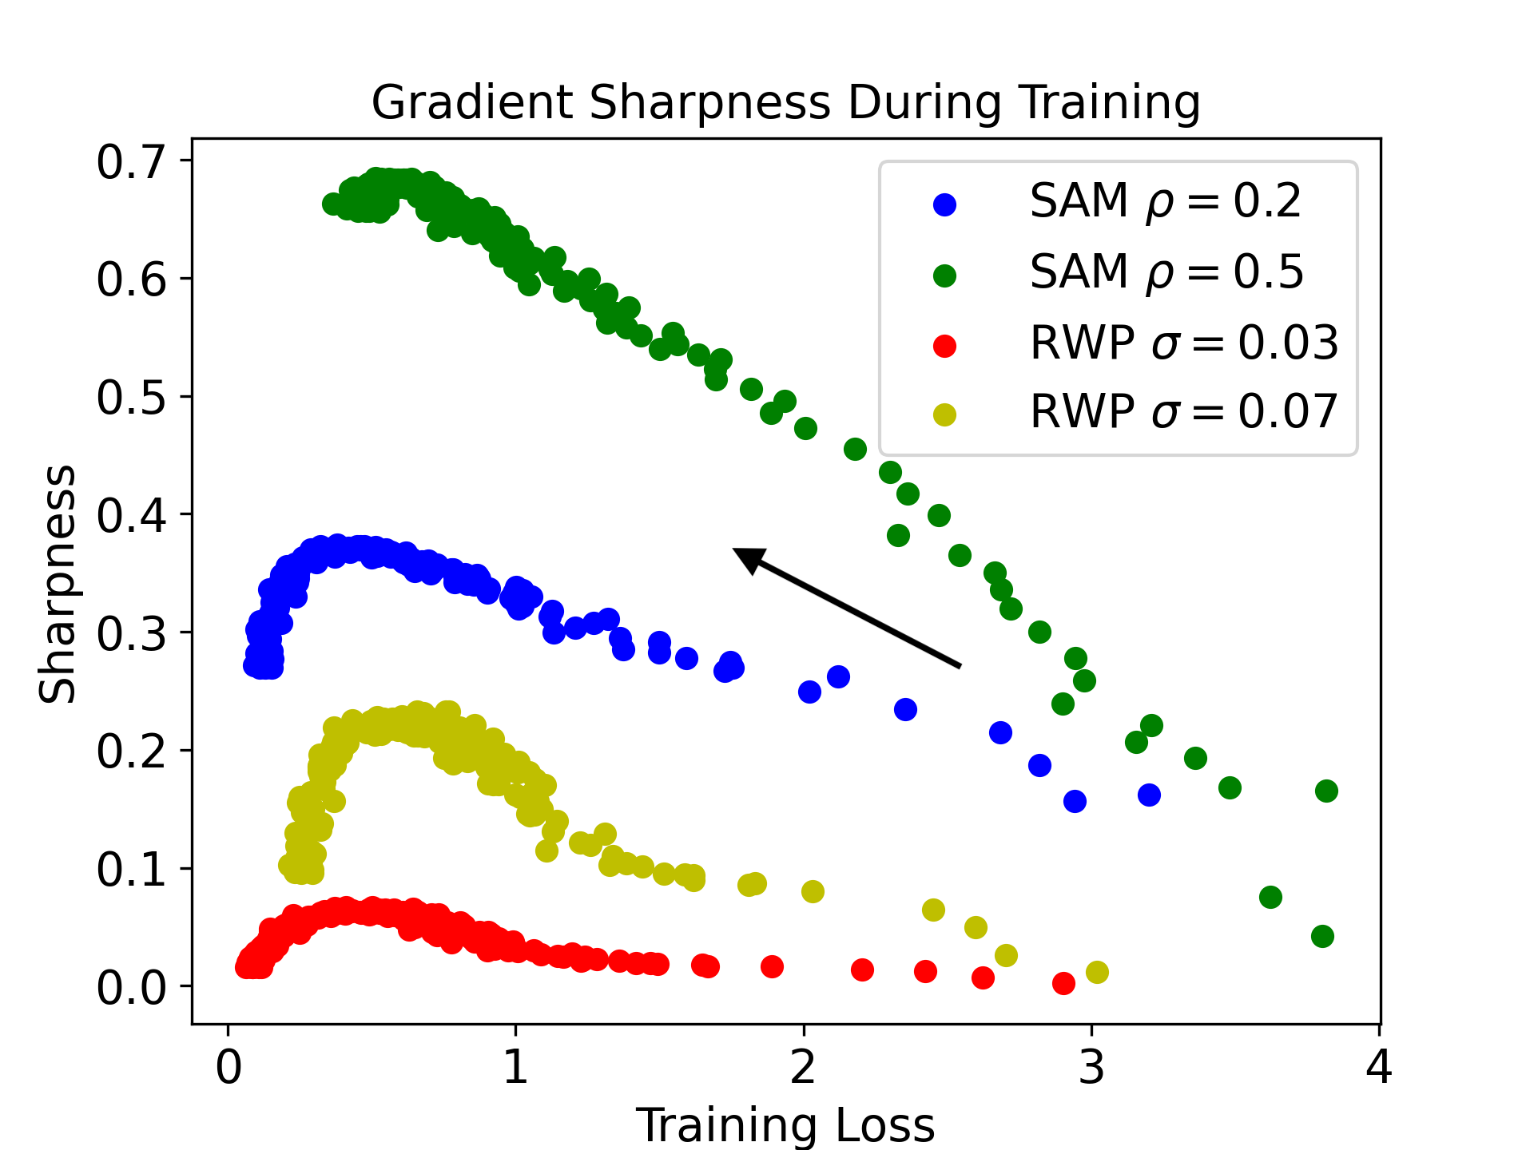
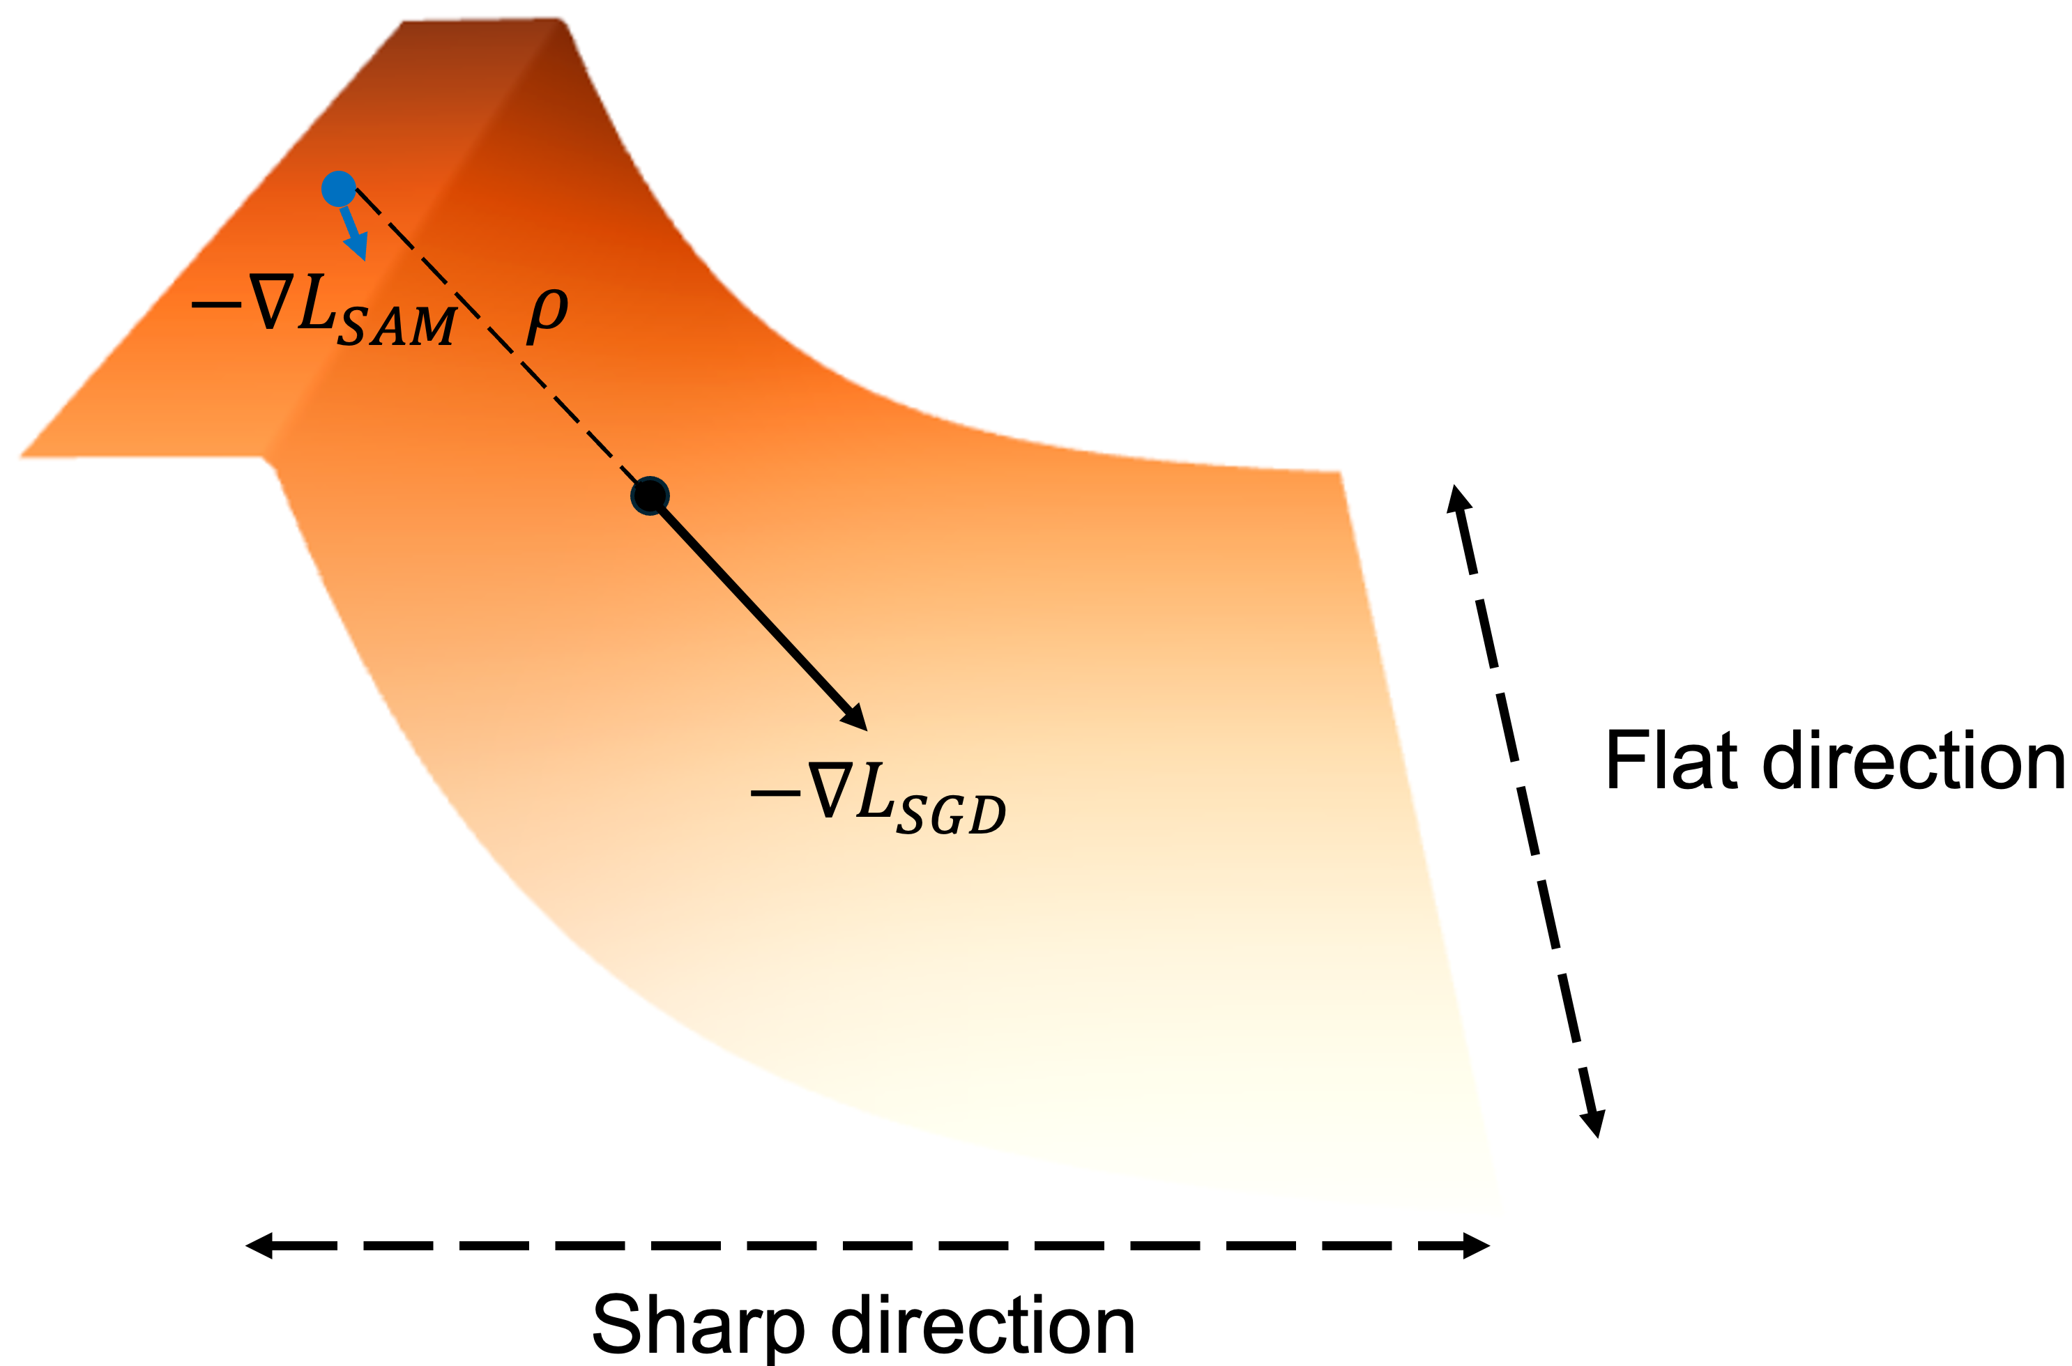

Visualizing Sharpness in The Loss Landscape
Sharpness: $L\left(w_{perturb}\right)−L(w)$
Plotting gradient-direction sharpness during training, we observe that the loss landscape is significantly sharper in the gradient direction than in a random direction

Slide 12
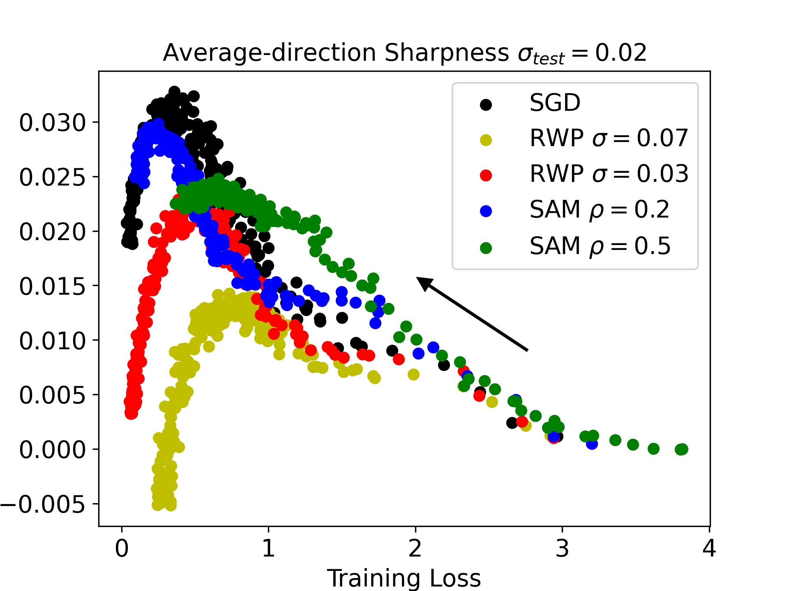
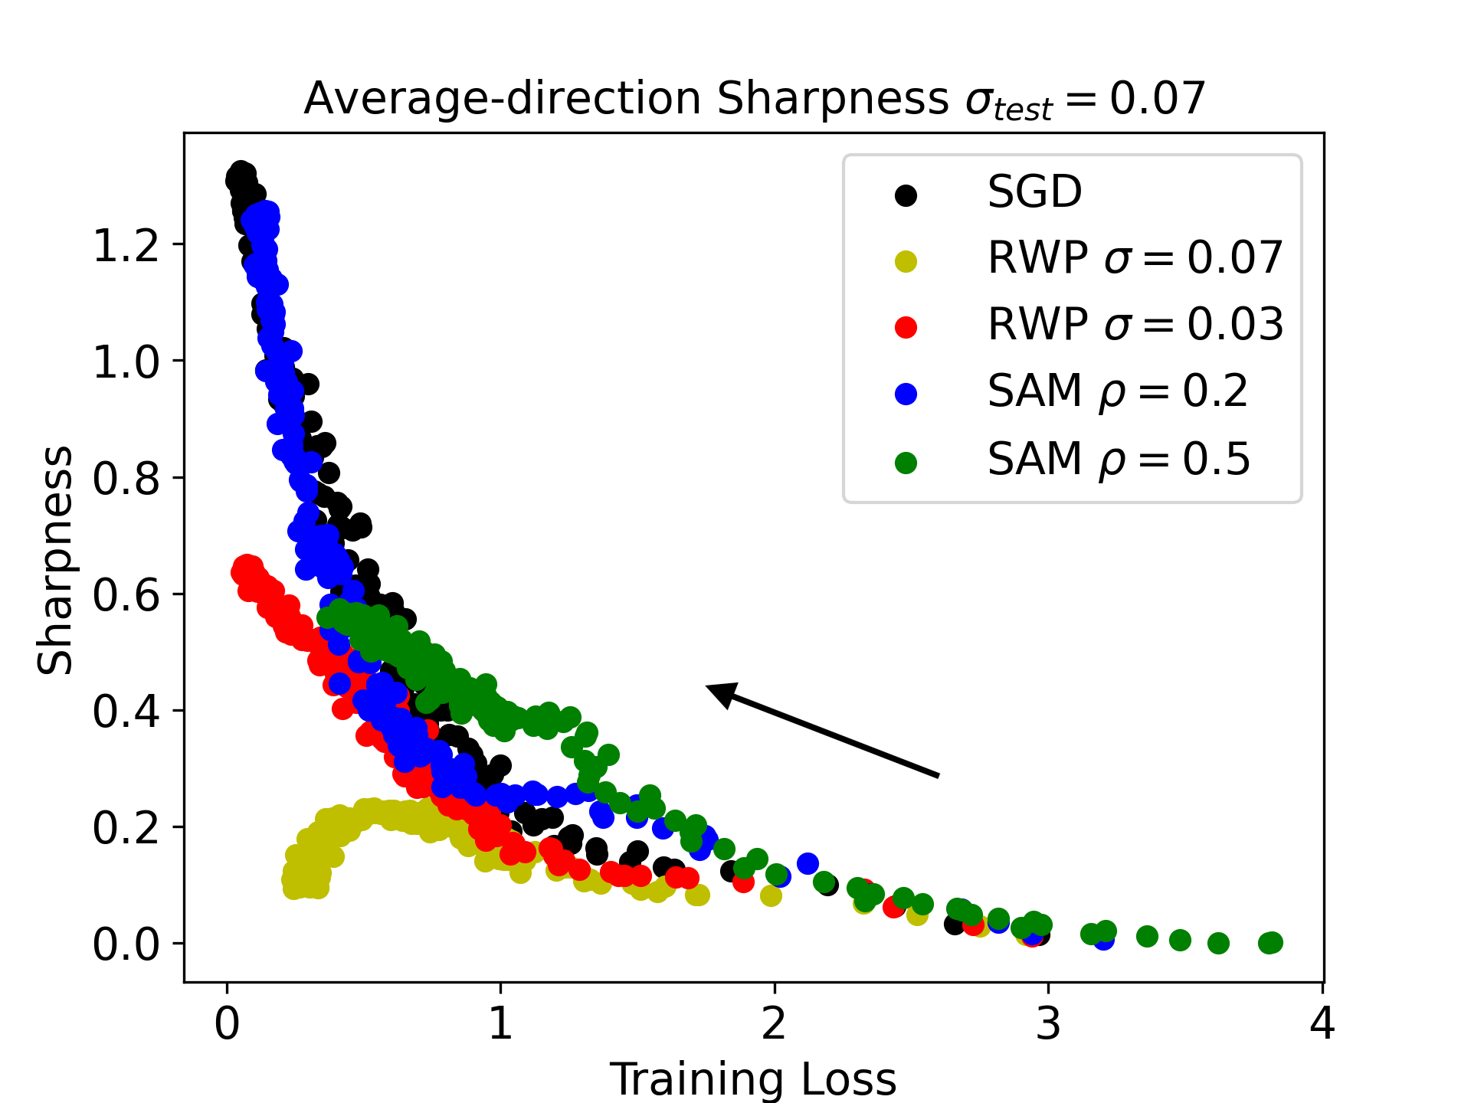
Visualizing Training Average-Direction Sharpness
Average-Direction Sharpness: $𝔼_{ε\sim N(0,σ^{2})}[L\left(w+ε\right)]−L(w)$
Plotting average-direction training sharpness reveals surprising result: optimal SAM training converges on a minimum which is both shallower and sharper than either SGD or RWP

Slide 13
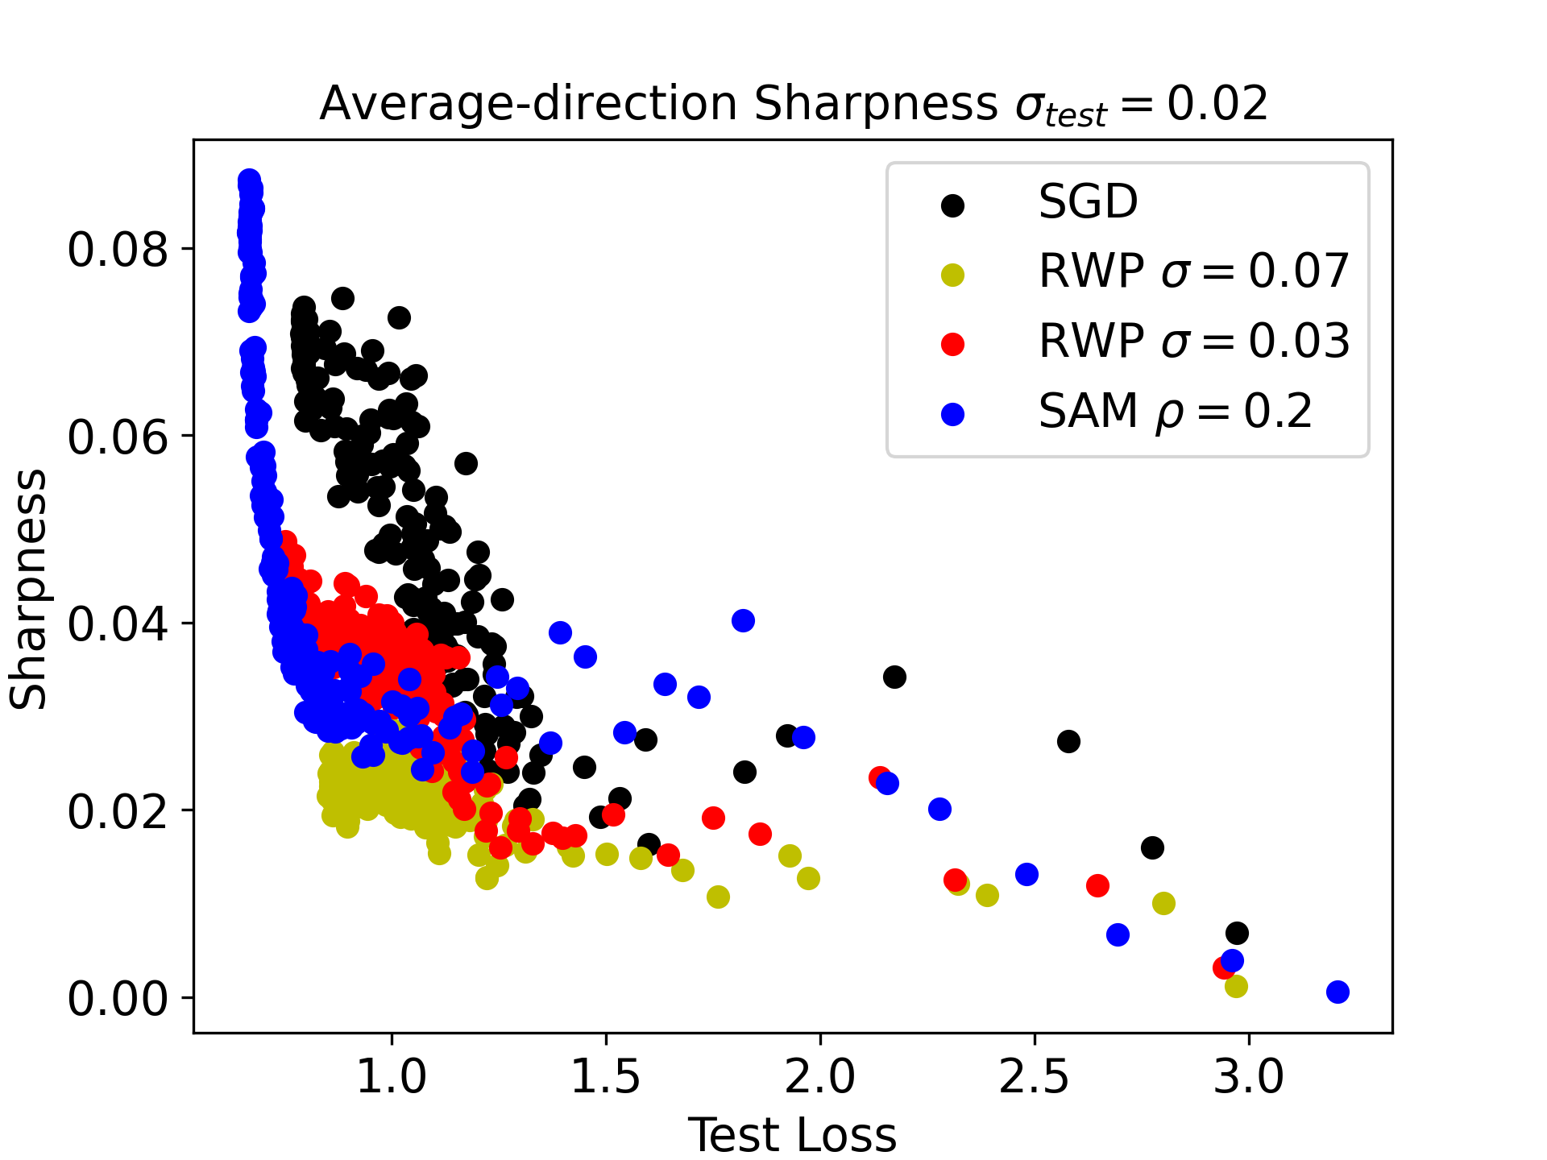
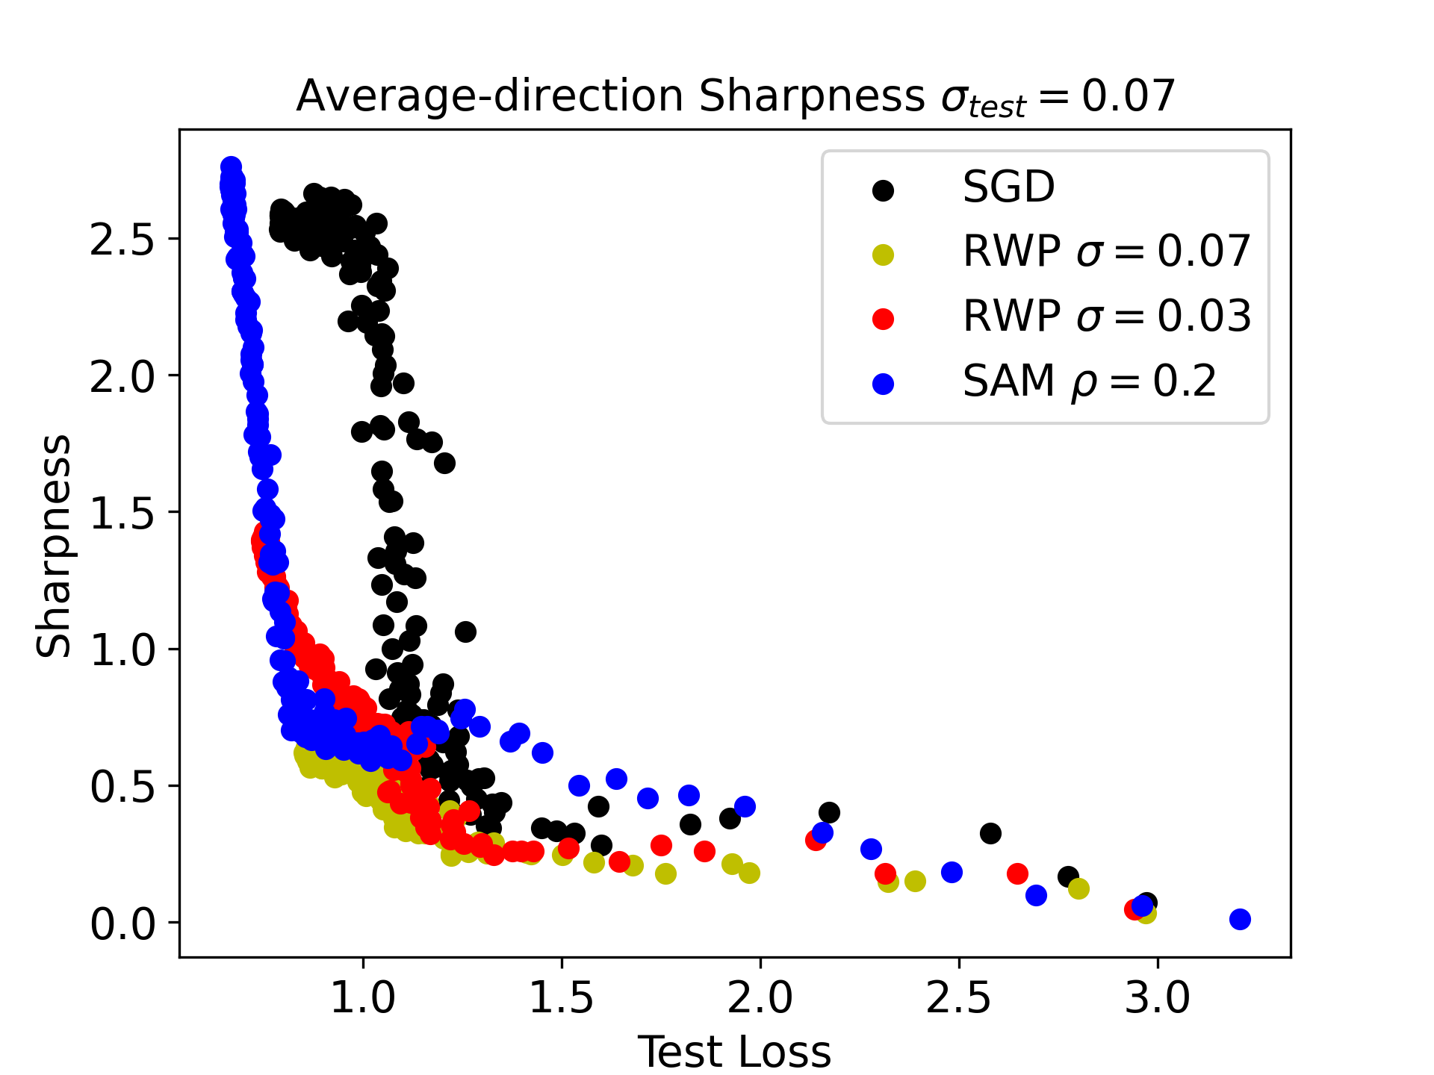
Visualizing Test Average-Direction Sharpness
Plotting average-direction test sharpness, we see that SAM follows a trajectory which is sharp in the training landscape, but flat in the test landscape- this tells us there is more to robustness than a flat training landscape!

Slide 14
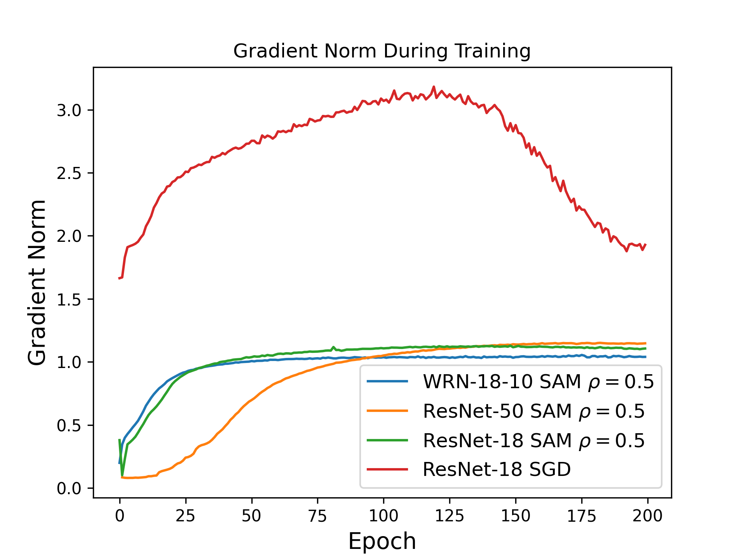
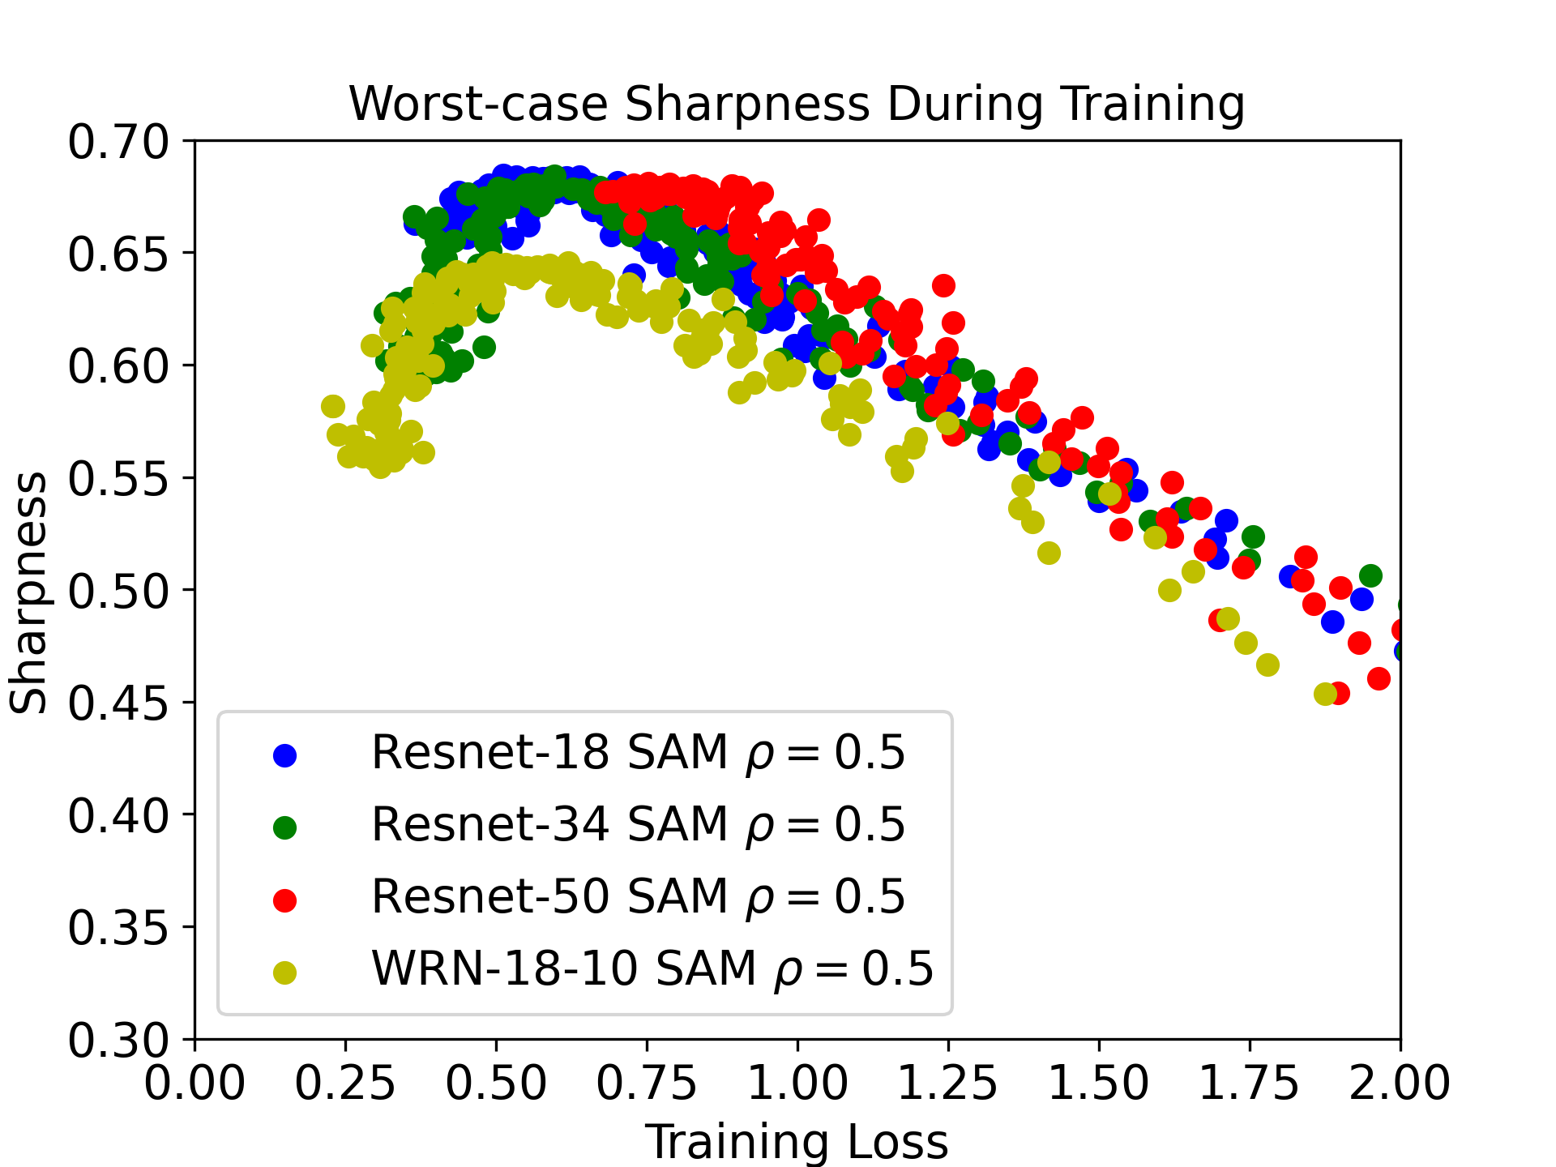

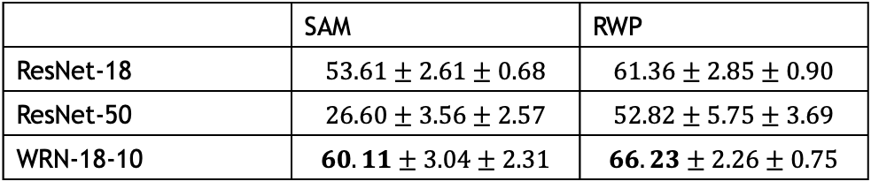
Scaling to Address Noise: Wide vs Deep Networks
$$σ_{test}=0.07$$
 | SAM | RWP
ResNet-18 | $$53.61±2.61±0.68$$ | $$61.36±2.85±0.90$$
ResNet-50 | $$26.60±3.56±2.57$$ | $$52.82±5.75±3.69$$
WRN-18-10 | $$60.11±3.04±2.31$$ | $$66.23±2.26±0.75$$
Comparing wider vs deeper ResNets, observe that wider ResNets exhibit smoother loss landscapes than deeper ones, and as such achieve greater noise robustness using SAM/RWP

Slide 15
Overcoming Sharpness in Loss Landscape
Low magnitude gradients in early epochs
Decreasing sharpness in late epochs
Two factors point to the fact that strong perturbations are particularly harmful in early training epochs

Slide 16
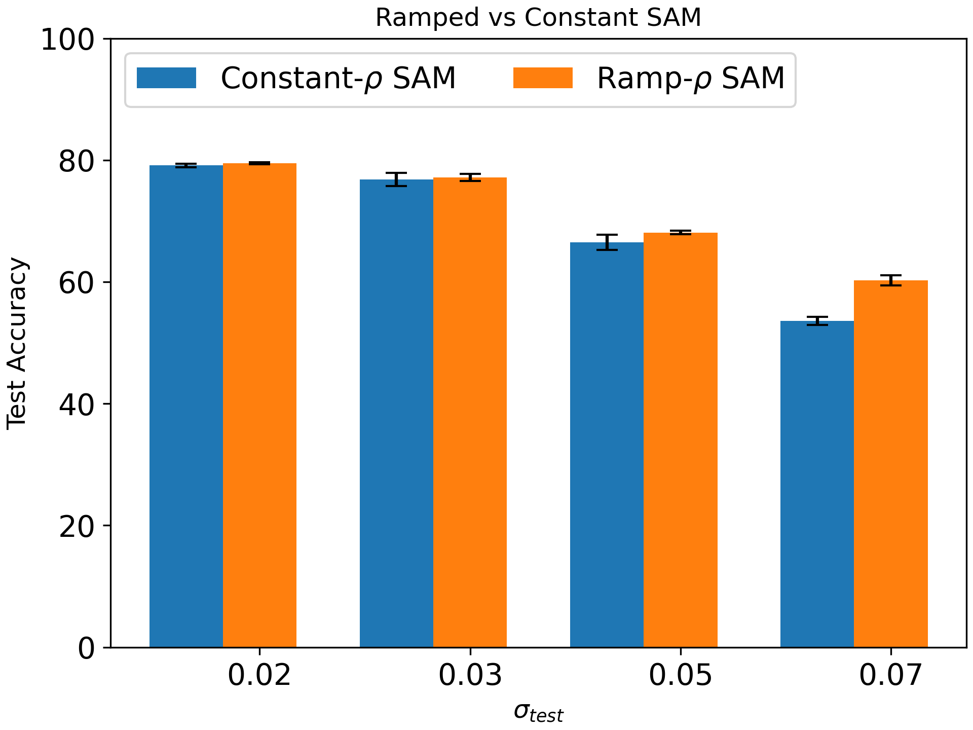
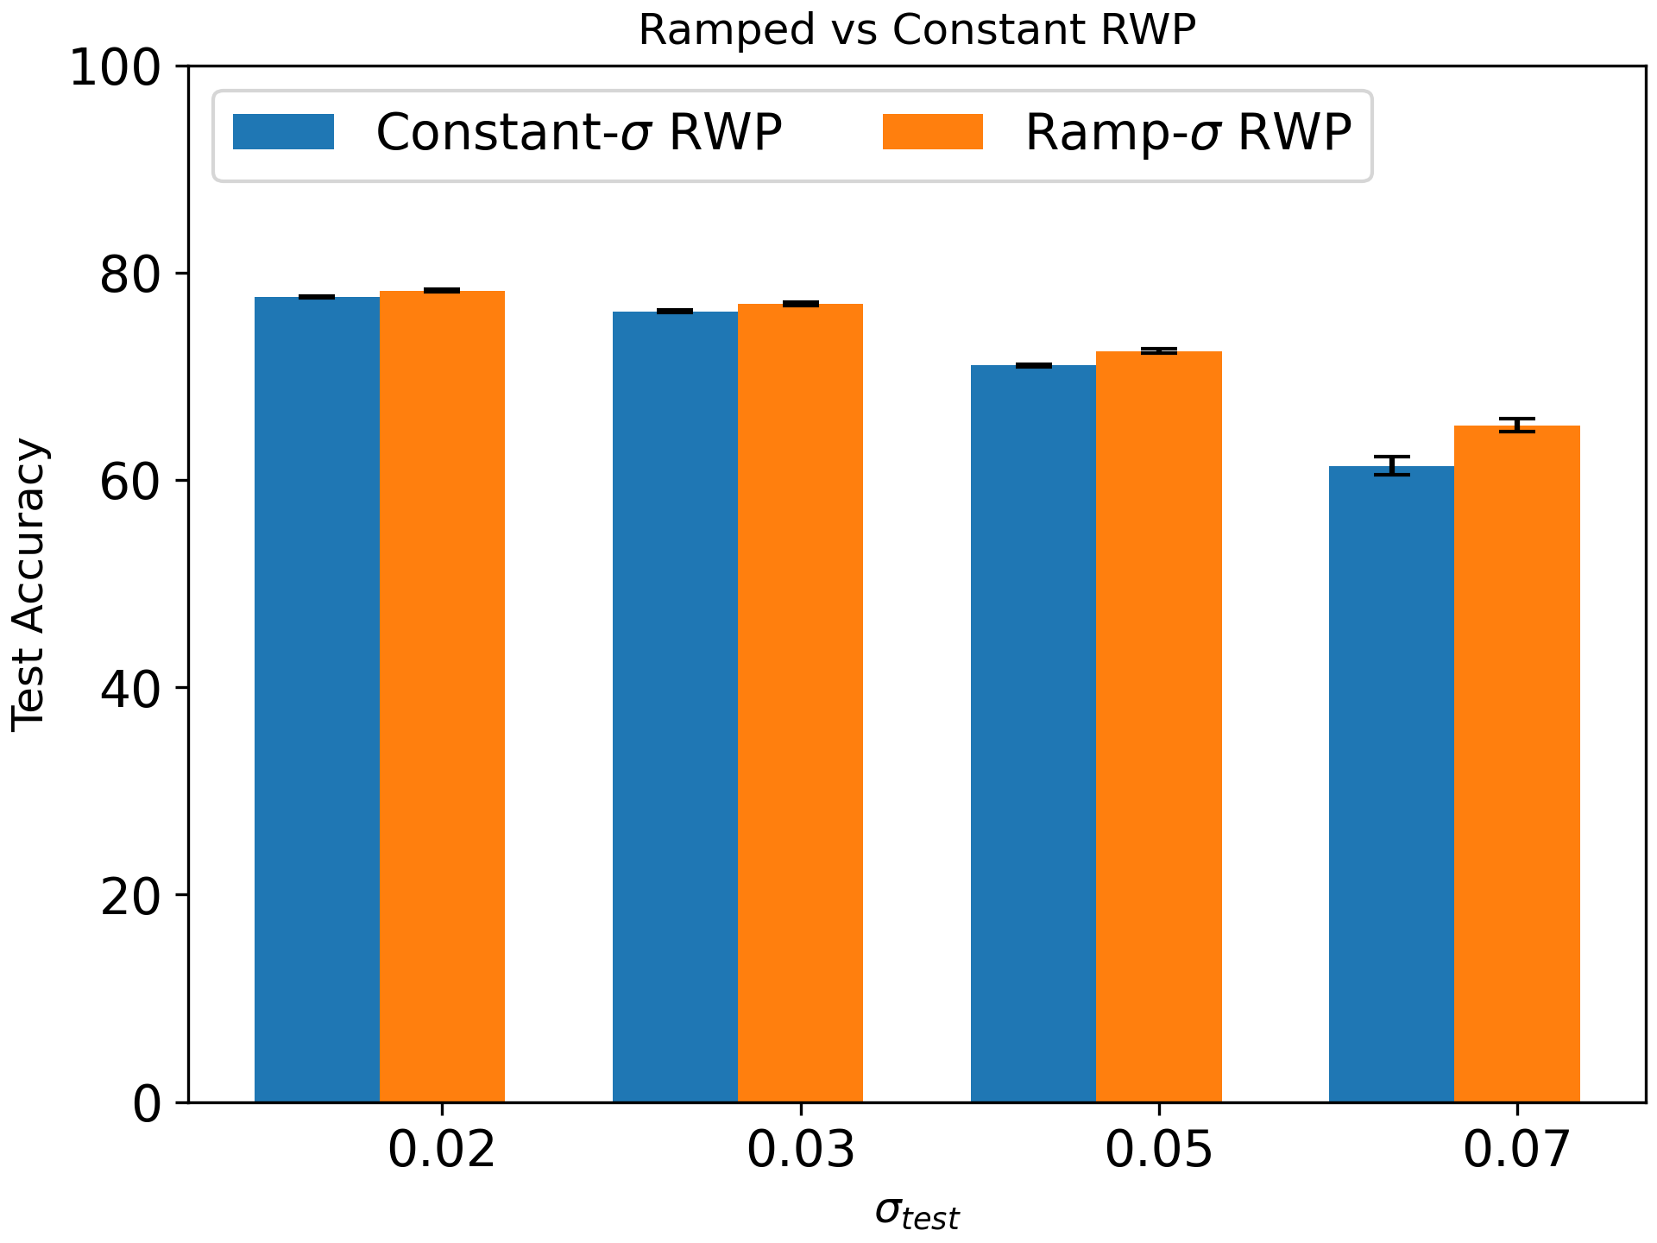
Ramped Perturbations: Stabilizing Training
Propose minimizing degradation from sharp loss landscape through using ramped perturbation schedule, increasing perturbations from 0 to fixed value over training

Slide 17
Summary
Perturbative training approaches (i.e. SAM/RWP) are successful at improving noise-robustness across a variety of settings
Although SAM is successful for small perturbation magnitudes, large adversarial perturbations induce a vanishing gradient effect (from sharpness in the loss landscape) which disrupts training. This effect is less pronounced for RWP
Wide networks exhibit smoother loss landscapes which are more amenable to perturbative training, in contrast to deep networks
Ramping the perturbation strengths greatly reduces the sharpness-induced vanishing gradient effect, improving performance

