Slide 1
A framework for mitigating malicious RLHF feedback in LLM training using consensus based reward
ZAFARYAB HAIDER
PhD Student
Department of Electrical and Computer Engineering
University of Maine
Haider, Z., Rahman, M.H., Devabhaktuni, V., Moeykens, S., Chakraborty, P. A framework for mitigating malicious RLHF feedback in LLM training using consensus based reward. Sci Rep 15, 9177 (2025).
https://doi.org/10.1038/s41598-025-92889-7

Slide 2
Large Language Models
Large Language Models (LLMs) are Advanced AI systems pre-trained on TBs of web data
Empowered by transformers and their attention mechanisms [Vaswani et al., 2017].
Flexible and customizable: LLMs can be fine-tuned to excel at specialized tasks, from writing code to composing poetry.
LMs blend language proficiency with audio, images, and videos and are revolutionizing the content creation.
Capable of human-like reasoning, but alignment and trust remain open challenges.

Slide 3
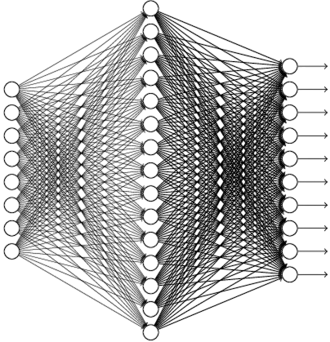





LLM Life Cycle
Raw
Internet Data
Self Supervised Learning
Pre-Trained Model
PreProcessing
Cleaned
Database
Initial/Fine-tuned Model
Supervised Learning
Demo Database
Improves task-specific performance
May generate biased or unsafe content without additional supervision.
Lacks full alignment with human preferences.

Slide 4



LLM Life Cycle
Output1
Preference Database
Output2
Prompts
Initial/Fine-tuned Model
Supervised Learning
RLHF
Suffers from Overoptimization [Gao et al., 2022]
Human-in-the-loop can be adversarial (M-HITL)
Reward Model

Slide 5
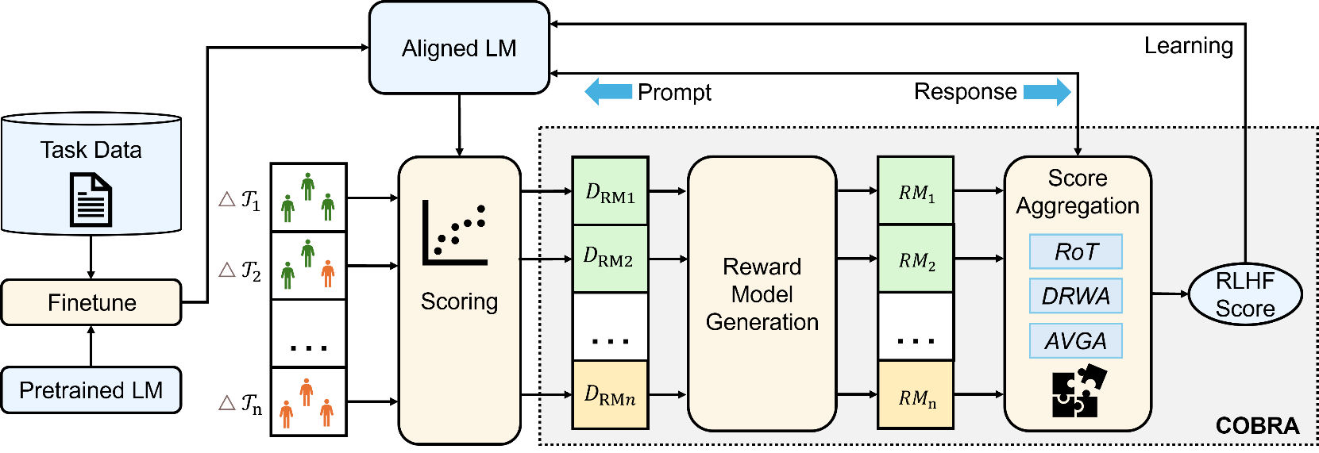
COBRA
COBRA (COnsensus-Based RewArd) mitigates adversarial RLHF threats via temporal cohorting
Feedback is segmented over time into distinct cohorts to detect trust patterns
One Reward Model (RM) trained per cohort
RMs are grouped into Trusted (Tc) and Untrusted (Uc) based on feedback quality
Aggregators fuse their reward signals to compute the final score used in training
Tested on sentiment analysis and conversational tasks with models like GPT-2 XL (1.5B parameters)

Slide 6
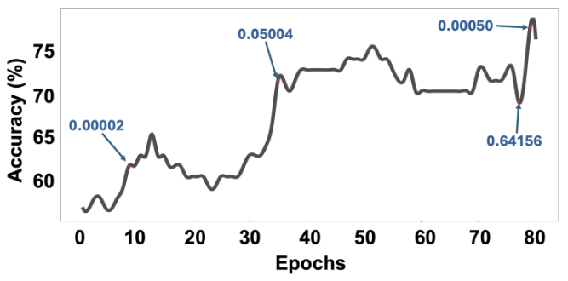
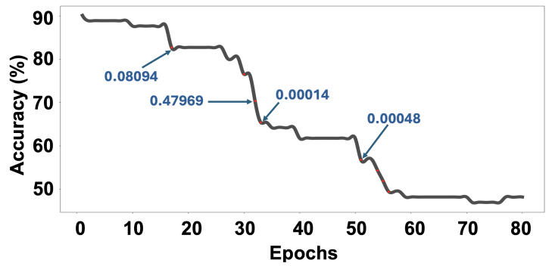
COBRA
KL-divergence penalizes both good and malicious updates equally
Limiting updates based on KL-div values can fully suppress RLHF improvements

Slide 7
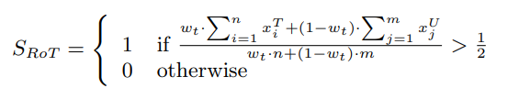
COBRA Aggregator
Root of Trust

Slide 8


COBRA Aggregator
Dynamic reliability weighted aggregation (DRWA)

Slide 9
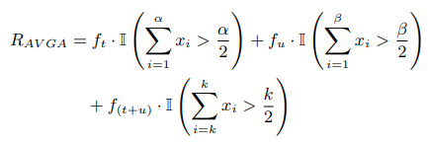
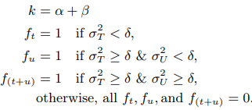
COBRA Aggregator
Adaptive variance-guided attention (AVGA)

Slide 10
COBRA: Experimental Setup
Sentiment Task
  Models: DistilBERT
  Dataset: SST-2 (Stanford Sentiment Treebank)
  Custom RM built using multi-head attention (see next slide)
  Trusted vs untrusted cohorts created by label flipping
  Focus: evaluating robustness of reward aggregation strategies
Conversational Task
  Model: GPT-2 XL
  Dataset: Anthropic HH-RLHF
  Used standard preference-based reward modeling
  Goal: Test generalizability of CoBRA aggregators
  No architecture development – focus on CoBRA’s scoring effectiveness
Data Fusion (DF): 1, 3, 9
  Controls granularity of cohort grouping

Slide 11
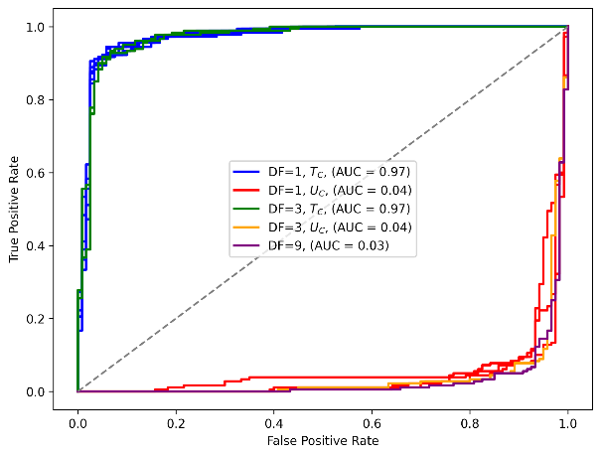
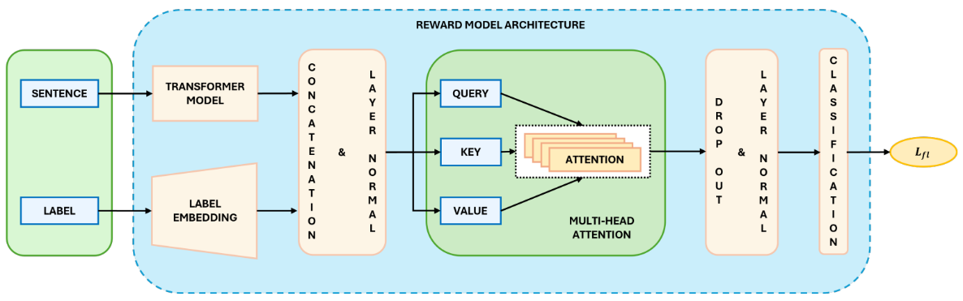
COBRA: Sentiment Analysis

Slide 12
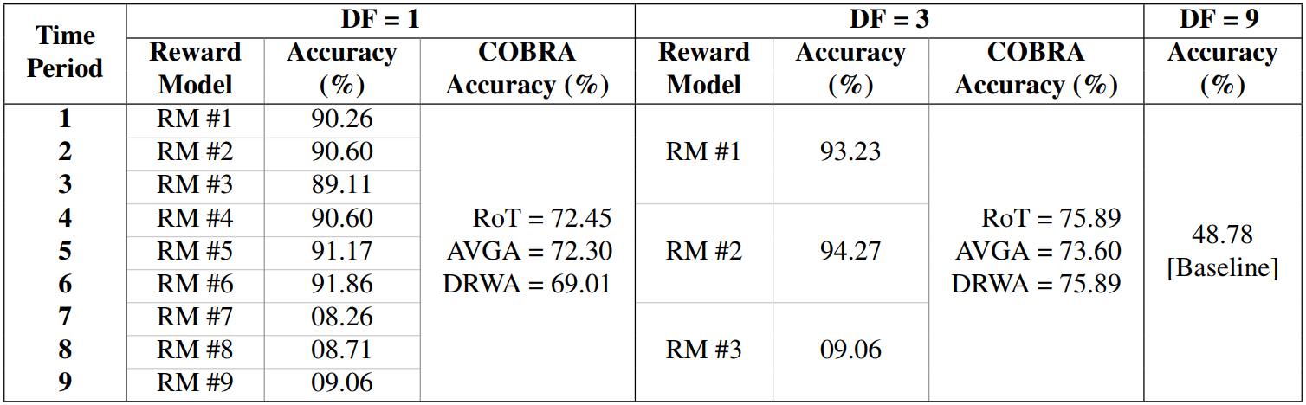
COBRA: Sentiment Analysis

Slide 13
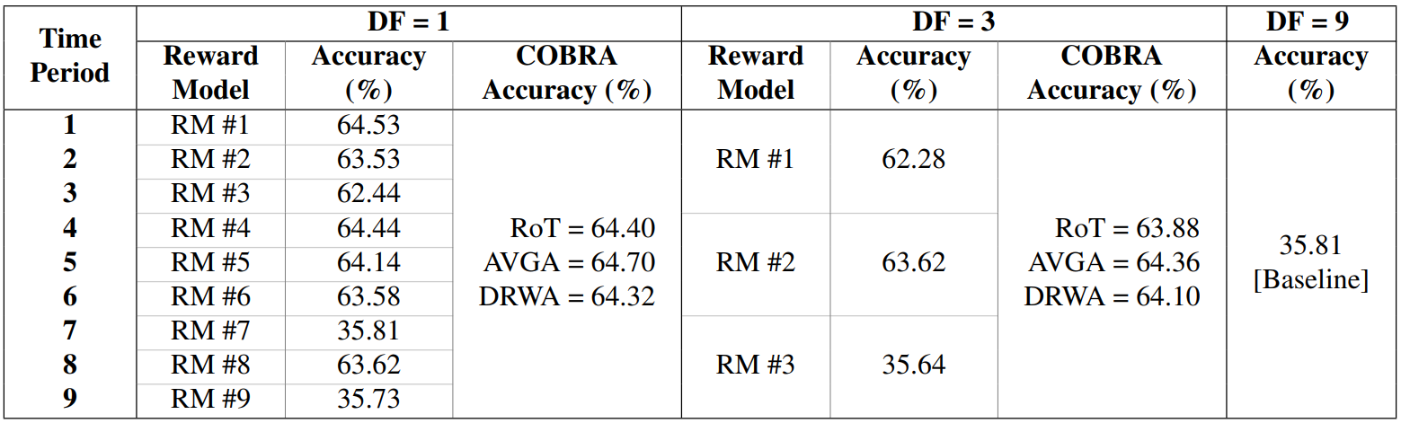

COBRA: Conversational Task

Slide 14
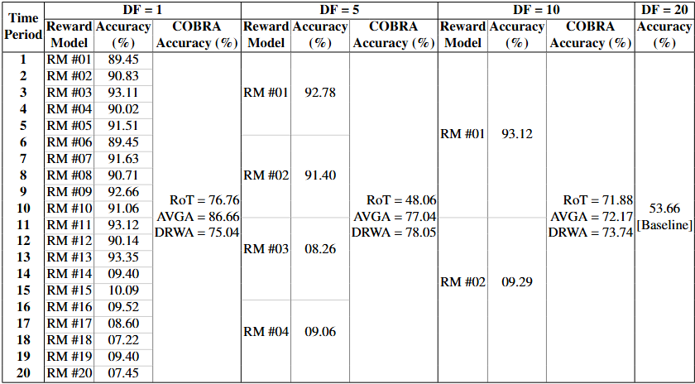
COBRA: Effectiveness of Defense Techniques

Slide 15
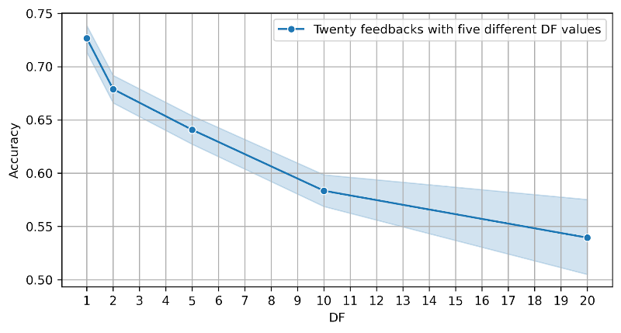
COBRA: Experimental Insights
Mitigation strategies work better than the baseline.
DF = 1: best accuracy but high compute cost (1 RM per feedback group)
DF = 3 or 5: acceptable accuracy, scalable cost
COBRA offers a scalable trade-off between trust, accuracy, and compute

Slide 16
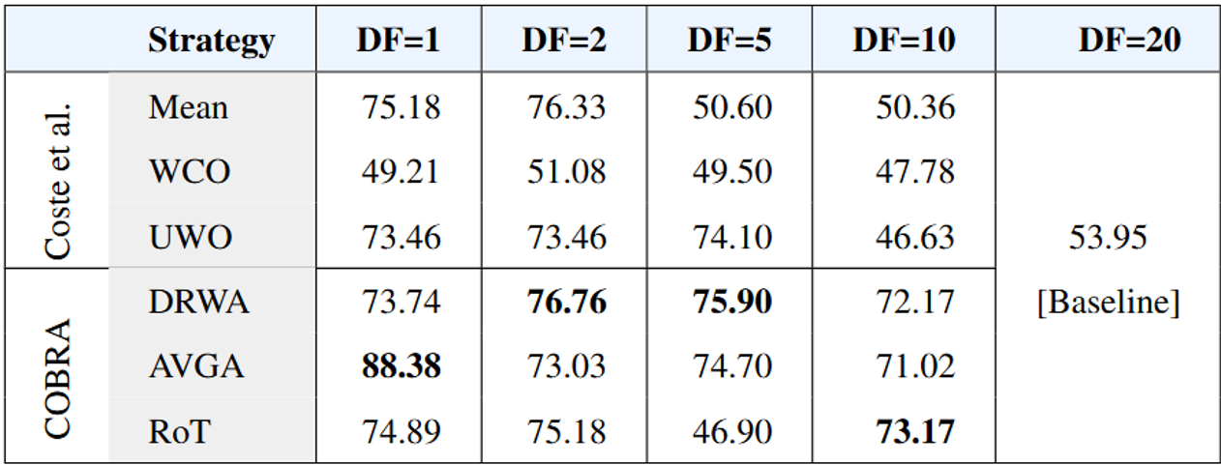
COBRA: SOTA Comparison

Slide 17
Thank you

