Slide 1



Trustworthiness of Digital-twin-based automation technology in nuclear power plant operation
1
1
2
2
Paridhi Athe, Nicholas Cittadino, Trang Tran, Jacob Yoder, Nam Dinh, Tran Cao Son
1
2
1
North Carolina State University, Raleigh, NC
New Mexico State University, Las Cruces, NM
2
July 2025

Slide 2

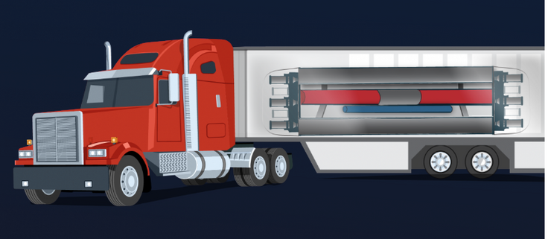
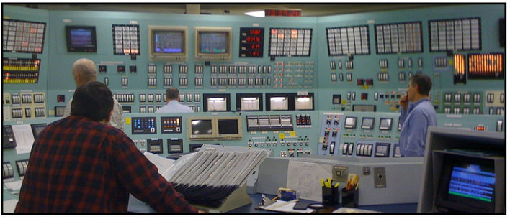
Background:
Autonomous Control System to
Meet New Challenges
What’s on the horizon?
New portable, operationally flexible and economical microreactors
How do we make that happen?
We need autonomous control in fulfilling operator tasks in diagnosis, prognosis and decision-making.
[1] Office of Nuclear Energy, “What is a Nuclear Microreactor?”, Office of Nuclear Energy, “https://www.energy.gov/ne/articles/what-nuclear-microreactor”, 2018
[2] R.L. Boring, “Human reliability considerations for the transition from analog to digital control technology in nuclear power plants”, NUC Workshop, Raleigh, NC, 2019
Notes:
New designs of portable, operationally flexible, and economically viable microreactors
- Small size and minimized structures, systems, and components (SSCs)
- Simplified design, operation, and maintenance
- Fast on-site installation
- Decrease reliance on human actions
Need for autonomous control that could fulfill operator’s tasks in
Diagnosis – Identifying faults and potential root causes
Prognosis – Forecasting short-term transients and consequence of control actions and procedures
Decision-Making – Ranking and recommending the optimal control actions

Slide 3
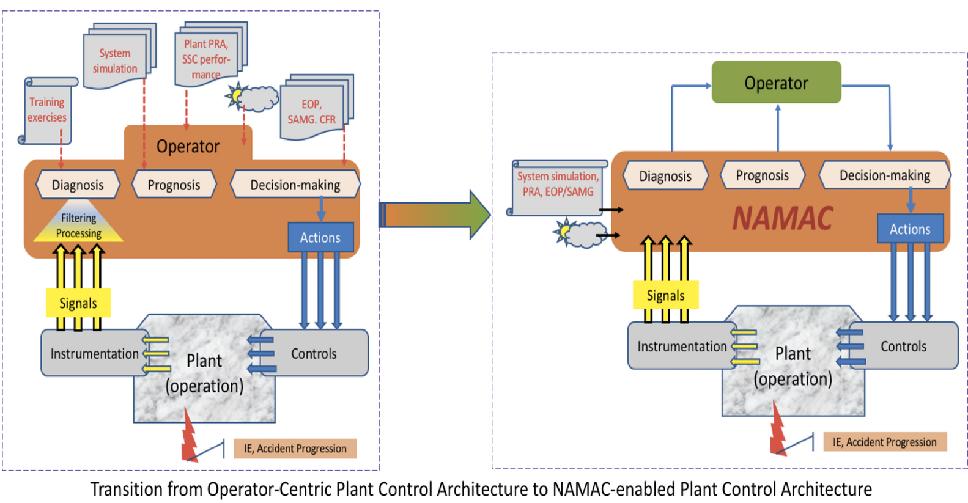
Background:
Nearly Autonomous Management and Control (NAMAC)
A computerized safety case that aims to achieve an alignment of Nuclear Power Plant (NPP) safety design, analysis, operator training and emergency management by furnishing recommendations to operators for effective actions.
Notes:
- Knowledge integration
Scenario-based model of plant (systems, success paths)
plant operating procedures, tech. specs., etc.
Real-time measurements
- Not to replace human operator
- Digital twin technology
- Expressive Power of AI/ML
NAMAC recommendations are derived from:
- Diagnosing the plant state
- Searching for all available mitigation strategies
- Projecting the effects of actions and uncertainties into the future behavior
- Determining the best strategy considering plant safety, performance, and cost.

Slide 4
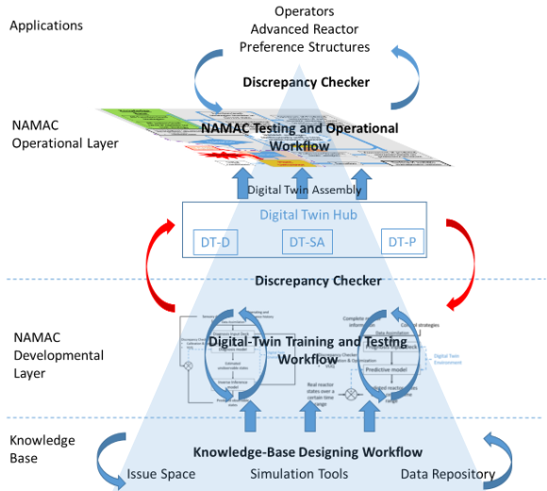
Background:
Nearly Autonomous Management and Control (NAMAC)
Three layer architecture in NAMAC:
Knowledge Base
Developmental Layer
Operational Layer
Notes:
The design of NAMAC include a Discrepancy Checker (DC) that detects anomalies and alerts the operator in situations that are outside the scope of NAMAC (beyond the training domain situations).

Slide 5
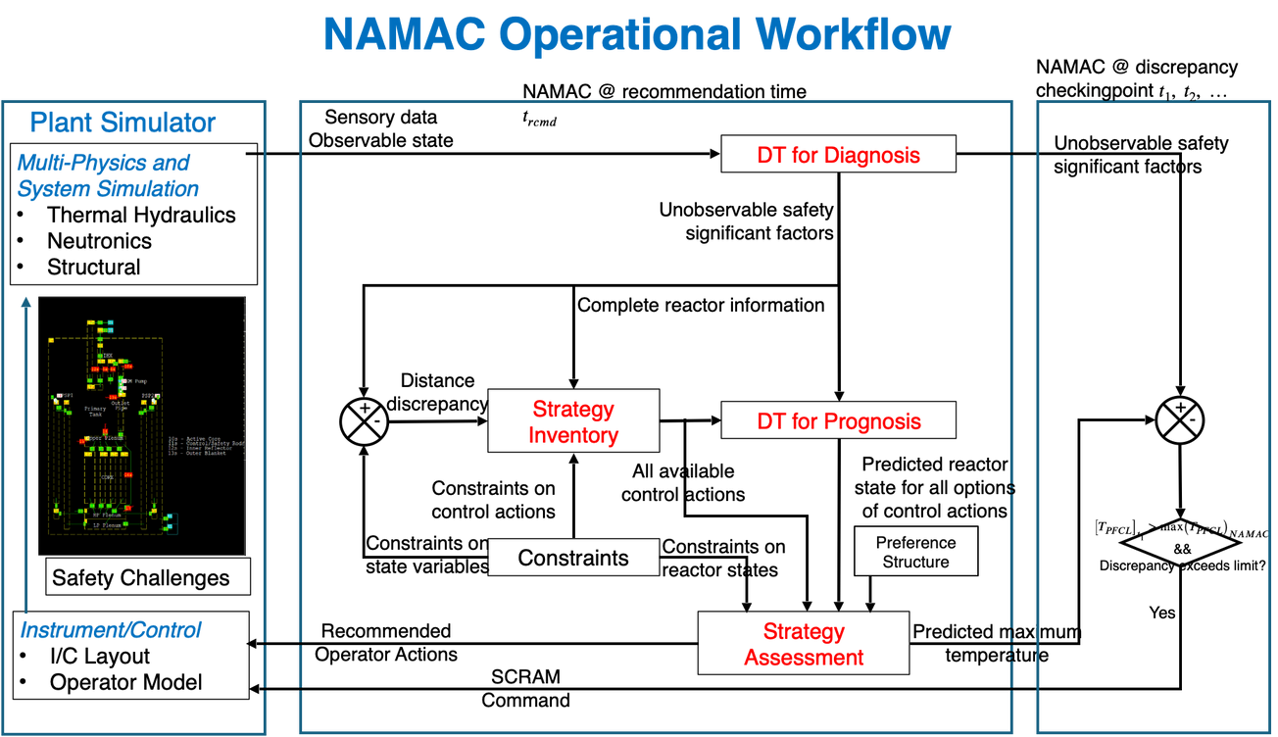
Background:
Nearly Autonomous Management and Control (NAMAC)
Digital Twins (DT) & Operational Workflow
Each is a knowledge acquisition system to support specific functions.
Individual DTs are assembled into a DT-Hub to support decisions in operational layer.
Notes:
Each Digital Twin (DT) is a knowledge acquisition system to support specific functions
- Digital Twin for Diagnosis (DT-D)
- Digital Twin for Strategy Inventory (DT-SI)
- Digital Twin for Prognosis (DT-P)
- Digital Twin for Strategy Assessment (DT-SA)

Slide 6
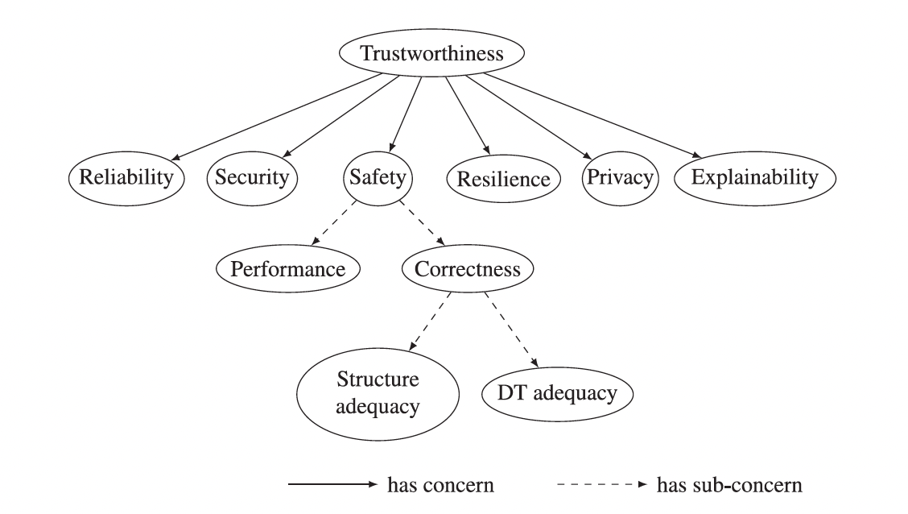
Background:
Trustworthiness Ontology
Based off of the NIST Framework for Cyber-Physical Systems.
Used to model the system trustworthiness and relationships between different trustworthiness concepts.
[1] Wang, L.; Lin, L.; and Dinh, N. 2024. Trustworthiness modeling and evaluation for a nearly autonomous management and control system. In Reliability Engineering System Safety
Notes:
Define ontology: Graphical representation of ideas/concepts. The highest "attribute", trustworthiness, is what we are trying to evaluate. This high-level attribute is broken down into sub-attributes which are known to influence the trustworthiness.
These sub-attributes are then broken down further until we get to fundamental sub-attributes which can be quantitatively evaluated.

Slide 7
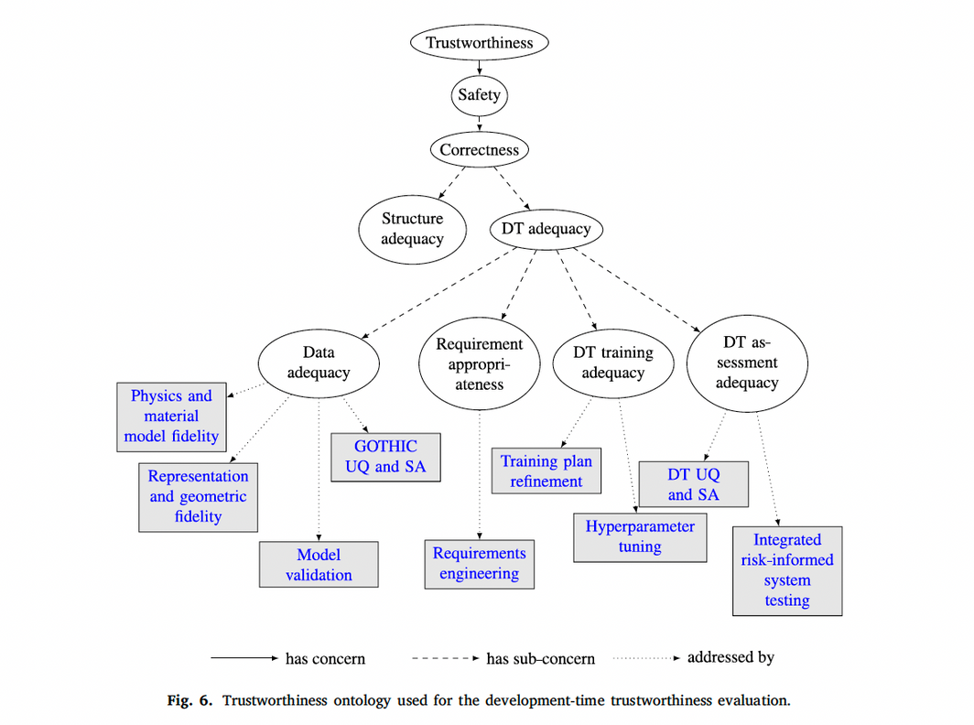
Background:
Trustworthiness Ontology
Each property (leaf node) must be addressed in order to properly address high level concerns.
[1] Wang, L.; Lin, L.; and Dinh, N. 2024. Trustworthiness modeling and evaluation for a nearly autonomous management and control system. In Reliability Engineering System Safety
Notes:
So from the ontology once we determine the attributes, we get the fundamental attributes in the picture they are labeled by the arrow 'addressed by'. These boxes are what is being evaluated.

Slide 8
LLM-assisted Trustworthiness Evaluation of NAMAC: Approaches & Implementation
Enhancement of DC in NAMAC (Athe et al. 2024)
Integrated LLM into DC using two differing methods - RAG and fine-tuning.
LLM based DC alerts operator to situations outside of NAMAC’s scope and acts as a chatbot to retrieve relevant information.
Proposed Pipeline for Knowledge Graph Integration
Knowledge graph (KG) generated from KB used in NAMAC development enabling structured representation.
Leverages KG and RAG to capture complex entity-relationships and provide explanations.
Multi-agent AI for digital twin development & Assessment
Customized AI agent for different tasks.
Semi-automated workflow with human-in-the-loop.
Preliminary analysis and demonstration using a case study on thermal energy storage system.
Risk Informed Approach for Trustworthiness Assessment
Explored LLM as scalable expert that helps detecting Out-of-Domain Distribution (ODD).
Bayesian Belief Network (BNN) are used to create risk informed decision framework.
Notes:
Enhancement of DC in NAMAC (Athe et al., 2024).
Integrated an LLM component to DC. Used Retrieval augmented generation (RAG) and finetuning to enhance the knowledge base of LLM.
LLM based DC alerts the operator in situations that are outside NAMAC’s scope. It also act as a chatbot that the operator can be used to retrieve relevant information (operating manuals, safety analysis reports, technical specifications, emergency operating procedures, maintenance manuals, records, etc.)
Proposed pipeline for knowledge graph integration
Knowledge graph integration
Knowledge graph generated from the knowledge base used in NAMAC development.
Enables structured representation of nuclear engineering concept.
Enhanced query answering module
Leverages Knowledge graph +RAG framework (Lewis et al., 2020).
Captures complex entity relationships and provide multi-granular explanation in NAMAC.
Explored multi-agent AI for implementation of digital twin development and assessment process (Athe et al., 2024)
Customized AI agent for different tasks such as: DT requirement formulation based on expert input and knowledge base, DT development and implementation (code assistant and executor agents) and DT assessment.
Semi-automated workflow with human-in-the loop.
Preliminary analysis and demonstration using a case study on thermal energy storage system.
DT-DAP is an involved process needing many different experts to answer questions.
RISK INFORMED APPROACH FOR TRUSTWORTHINESS: Explored LLM as a scalable expert that helps in detecting Out-of-Domain Distribution (ODD). Finetuning is used to enhance knowledge of LLM for ODD.
Bayesian Belief Network (BNN) are used to create a risk informed decision framework.

Slide 9
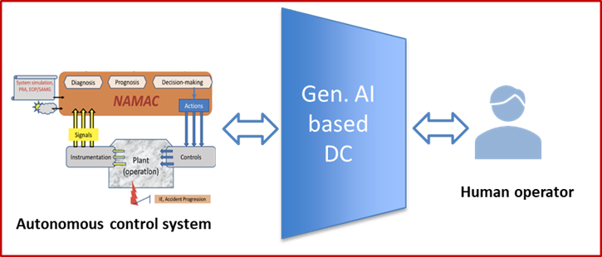
Enhancement of DC in NAMAC
DC acts as an uncertainty manager and anomaly detector for the NAMAC system and the reactor.
It detects anomalies and alerts the operator in situations that are outside the scope of NAMAC (beyond the training domain situations).
The implementation of DC is governed by a set of rules that are formulated during the phase of development and assessment of NAMAC. These rules are based on:
range of key parameters in the training domain, constraints related to
DTs, and
specific safety or operational criteria that require immediate
attention and intervention.
.
Generative AI based DC
Generative AI-based DC aims to support two functions:
Alert the operator in situations that are outside NAMAC’s scope
Act as a chatbot that the operator can use to retrieve relevant information
–retrieve relevant information from operating manuals, safety analysis reports, technical specifications, emergency operating
procedures, maintenance manuals, records, etc.
[1] Paridhi Athe, Linyu Lin, Nam Dinh, “Using Generative AI to implement the Discrepancy Checker for a Nearly Autonomous Management and Control System for Advanced Reactors,” 2024 International Congress on Advances in Nuclear Power Plants, Las Vegas, NV, June 9-12, 2024.
Notes:
- DC is an important element of NAMAC.

Slide 10
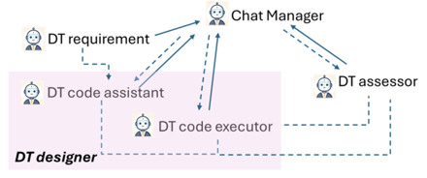
Multi-agent approach to DT-DAP
The development and assessment process of DTs requires expert inputs from multiple domains.
Can the use of LLMs with their coding and advanced reasoning capabilities help streamline (automate or semi-automate) the DT development and assessment process?
Multiple agents are created with GPT-4o which acts as the brain of the agents.
The DT requirement agents determines the requirements based on the initial prompt and its knowledge base.
The DT designer writes up and executes python code of a model from the requirements provided.
The DT assessor performs an assessment based on specified attributes to determine the performance of the designer.
An initial case study of the thermal energy storage system shows the potential of the multi-agent framework to support different elements of DT-DAP.
Workflow performance depends on :
Agent setup and abilities
Collaboration methods and knowledge sources
Context and specificity
Complex tasks benefit from human-guided iteration.
Paridhi Athe, Linyu Lin, Nam Dinh, Multi-agent AI collaboration for digital twin development and assessment, Nuclear Plant Instrumentation and Control & Human-Machine Interface Technology (NPIC&HMIT) conference, 2025.
Notes:
multi-agent approach for DT-DAP.
3 main agents. DT requirement agents determine the requirements based on its knowledge base (can be augmented with RAG), these requirements are sent to DT designer. Based on the requirements, DT designer creates and runs a python code and generates outputs. These outputs are then assess with the DT assessor. Attributes are chosen and evaluated qualitatively on a 1-5 scale.
Initial results show promise for the use of multi-agents for DT-DAP.

Slide 11
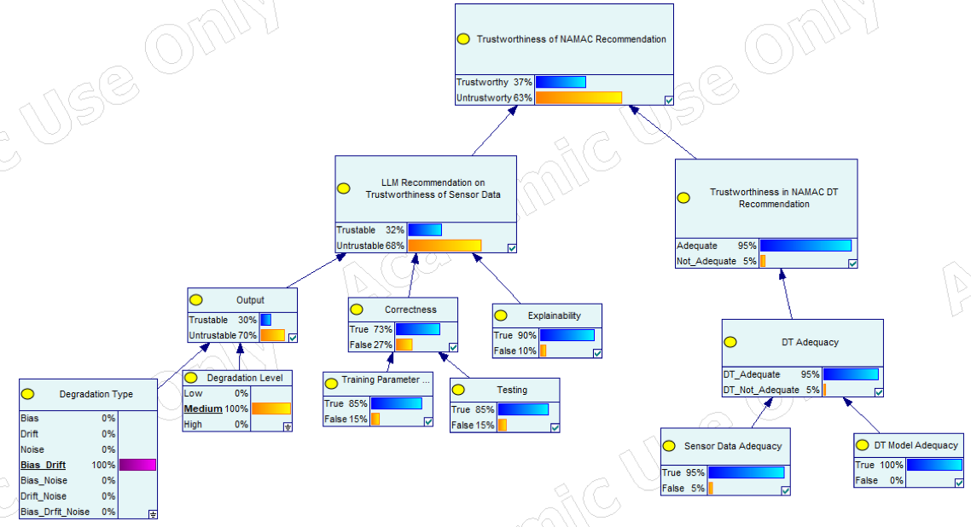
Risk Informed Approach for Trustworthiness Analysis
How do we deal with uncertainties when making decisions?
Performance of NAMAC DTs is governed by different factors: quality and coverage of the training data, model adequacy and sensor integrity. When out-of-distribution data is encountered, the trust in NAMAC recommendations plummets.
Preliminary analysis and demonstration using a case study on sensor degradation (Cittadino et al., 2025)
Manufactured sensor degradation data is used to enhance the understanding of LLM for different types of sensor degradation (bias, drift, noise) and levels of severity (low, medium, and high).
BBN are used to assimilate the knowledge about likelihood of scenario (from LLM), associated sources of uncertainty, consequence, and available set of evidence to quantify the level of trustworthiness of the NAMAC recommendation under different sensor degradation scenarios.
[1]Nicholas Cittadino, Paridhi Athe, Linyu Lin, Nam Dinh, A Risk-Informed Approach to Trustworthiness Assessment in Digital Twins-based Autonomous Control, Nuclear Plant Instrumentation and Control & Human-Machine Interface Technology (NPIC&HMIT) conference, 2025
Notes:
How can we assess trustworthiness during uncertain conditions? We generate sensor degradation data of varying severity (low, medium, high) which will introduce different amounts of risk into our system. To discern between the degradation in out data, we utilize the advanced reasoning capabilities.
On one hand we fine-tune a GPT-4o model to discern between the degradation types and severity levels.
On the other hand, using the trustworthiness ontology, we convert that to a BBN with user defined conditional probability tables.
As evidence is gather, the BBN is updated to inform us of the trustworthiness of the NAMAC recommendation under a given scenario.

Slide 12



Transforming Unstructured Data into a Knowledge Graph
Normally KG creation depends on large corpus of structured data with defined relationships between typed entities.
How can we create one out of a corpus of unstructured data?
Use proprietary tools : Neo4j Knowledge Graph Builder.
Create our own workflow.
Joint entity-relation extraction following specific schemas allows us to build triplets of information that are used to build the KG.
Text
LLM Joint entity-relation extractor agent
Text / Image Extractor
(LLM or OCR)
Knowledge Graph Builder
Image
VLM Image Summarization
[1]“Neo4j LLM Knowledge Graph Builder - Extract Nodes and Relationships from Unstructured Text - Neo4j Labs.” Neo4j Graph Data Platform, neo4j.com/labs/genai-ecosystem/llm-graph-builder/.
Notes:
Knowledge Graph Creation
Normally depends on large corpus of structured data with defined relationships between typed entities
How do we create one with unstructured data?
Neo4j’s Knowledge Graph Builder1 Tool
- Graph schema of entity and relationship types must be specified for relevant output
- Is unable to effectively extract information from images in unstructured documents
- On the back end, uses LLMs such as OpenAI’s GPT, Google’s Gemini, and Anthropic’s Claude to extract information
NAMAC Proposed Workflow
- Preprocess unstructured data by extracting images from text
- Text and Images are channeled through separate pipelines that uses an LLM to extract information before being piped into a knowledge graph builder

Slide 13
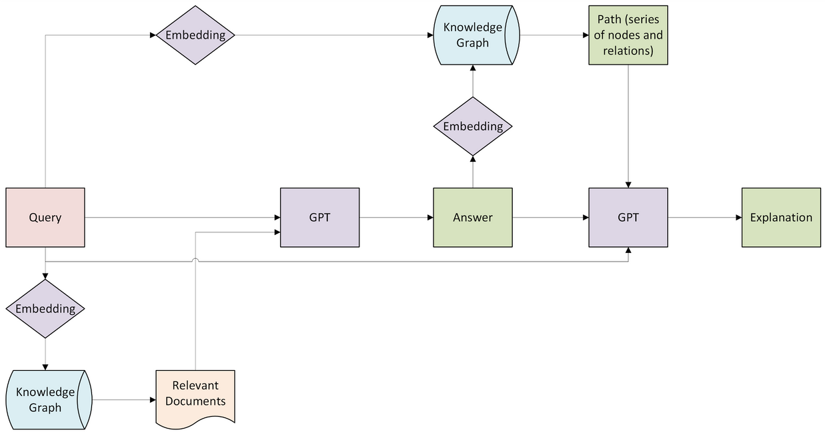
Enhance Explainability in Query Answering Module
How can we improve a models knowledge in a specific subject?
Leveraging Knowledge Graphs and RAG framework (Lewis et al., 2020).
We can improve a models subject matter expertise by grounding its knowledge in the searched documents.
How do we verify the LLM’s response?
Leveraging the same Knowledge Graph for grounding, we can search for “paths of logic” the LLM took.
Paths can be summarized and provided with output for users to be able to verify the models reponse and ‘logical steps of thought’.

Slide 14
Summary
This joint work presents a summary of different methods and approaches used to enhance trustworthiness in NAMAC recommendations. LLMs are used in conjunction with other approaches to enhance the explainability in NAMAC.
Enhanced DC function in NAMAC using LLMs.
Knowledge graphs used to improve query answering with RAG.
Bayesian networks are used to develop a risk assessment framework to assess trustworthiness by combining LLM insights, experts’ belief regarding situational severity, uncertainty sources and available evidence.
Multi-agent AI approach explored formalizing digital twin development and assessment.
Individual methods were tested using simplified case studies and synthetic data generation. Further analysis and testing are underway to evaluate the efficacy of proposed approaches for real-time demonstration with NAMAC under different conditions and scenarios.

Slide 15

THANK YOU
Please keep in touch
Paridhi Athe
Nicholas Cittadino
Trang Tran
Jacob Yoder
athe.paridhi@gmail.com
nrcittad@ncsu.edu
ttran@nmsu.edu
jayoder25@gmail.com
Nam Dinh
Son Tran
ntdinh@ncsu.edu
stran@nmsu.edu

Slide 16
References:
Lin, Linyu; Athe, Paridhi; Rouxelin, Pascal; Avramova, Maria; Gupta, Abhinav; Youngblood, Robert; Lane, Jeffrey; and Dinh, Nam. “Digital-Twin-Based Improvements to Diagnosis, Prognosis, Strategy Assessment, and Discrepancy Checking in a Nearly Autonomous Management and Control System,” Journal of Annals of Nuclear Energy, vol. 166, Feb 2022: 108715.
Botros, Hanna; Lin, Linyu; Athe, Paridhi; Son, Tran Cao; and Dinh, Nam. "Trusting Machine Learning in Nuclear Plant Control: A Reasoning-Based Discrepancy Checker." In 12th Nuclear Plant Instrumentation, Control and Human-Machine Interface Technologies. 2021.
Lewis, Patrick; Perez, Ethan; Piktus, Aleksandra; Petroni, Fabio; Karpukhin, Vladimir; Goyal, Naman; and Küttler, Heinrich; et al. "Retrieval-augmented generation for knowledge-intensive nlp tasks." Advances in Neural Information Processing Systems 33 (2020): 9459-9474.
Athe, Paridhi; Dinh, Nam and Lin, Linyu. Using Generative AI to implement the discrepancy checker for a Nearly Autonomous Management and Control System for Advanced Reactors. International Congress on Advanced Nuclear Power Plants ICAPP 2024 (also INL/CON-24-77000-Rev000. Idaho National Laboratory (INL), Idaho Falls, ID (United States), 2024).
Athe, Paridhi; Lin, Linyu; and Dinh, Nam. Multi-agent AI collaboration for digital twin development and assessment, Nuclear Plant Instrumentation and Control & Human-Machine Interface Technology (NPIC&HMIT) conference, June 2025.
Cittadino, Nicholas; Athe, Paridhi; Lin, Linyu and Dinh, Nam. A Risk-Informed Approach to Trustworthiness Assessment in Digital Twins-based Autonomous Control, Nuclear Plant Instrumentation and Control & Human-Machine Interface Technology (NPIC&HMIT) conference, June 2025.
Wang, Longcong; Lin, Linyu; and Dinh, Nam. 2024. Trustworthiness modeling and evaluation for a nearly autonomous management and control system. In Reliability Engineering System Safety.
Boschert, Stefan; and Rosen, Roland. 2016. Digital Twin—The Simulation Aspect. In Mechatronic Futures: Challenges and Solutions for Mechatronic Systems and their Designers, 59–74. Cham: Springer International Publishing.
“Neo4j LLM Knowledge Graph Builder - Extract Nodes and Relationships from Unstructured Text - Neo4j Labs.” Neo4j Graph Data Platform, neo4j.com/labs/genai-ecosystem/llm-graph-builder/.

