Slide 1
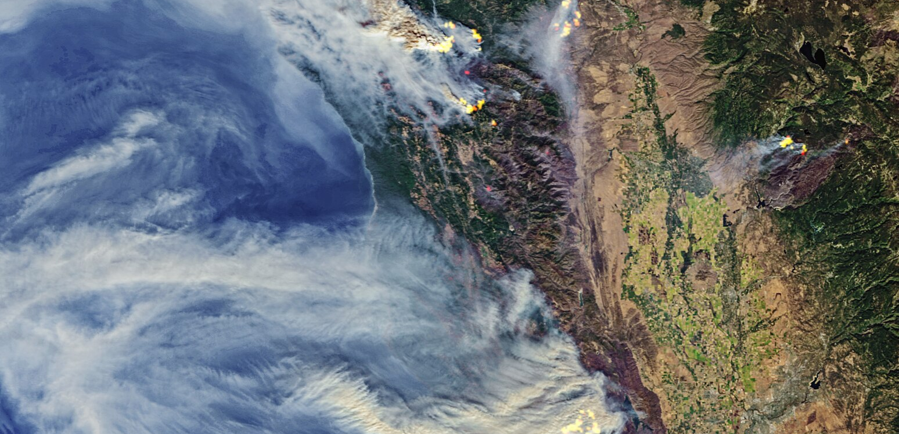
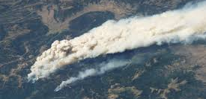
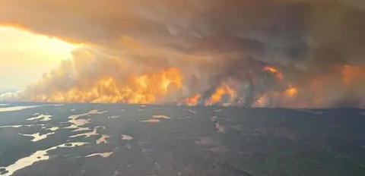
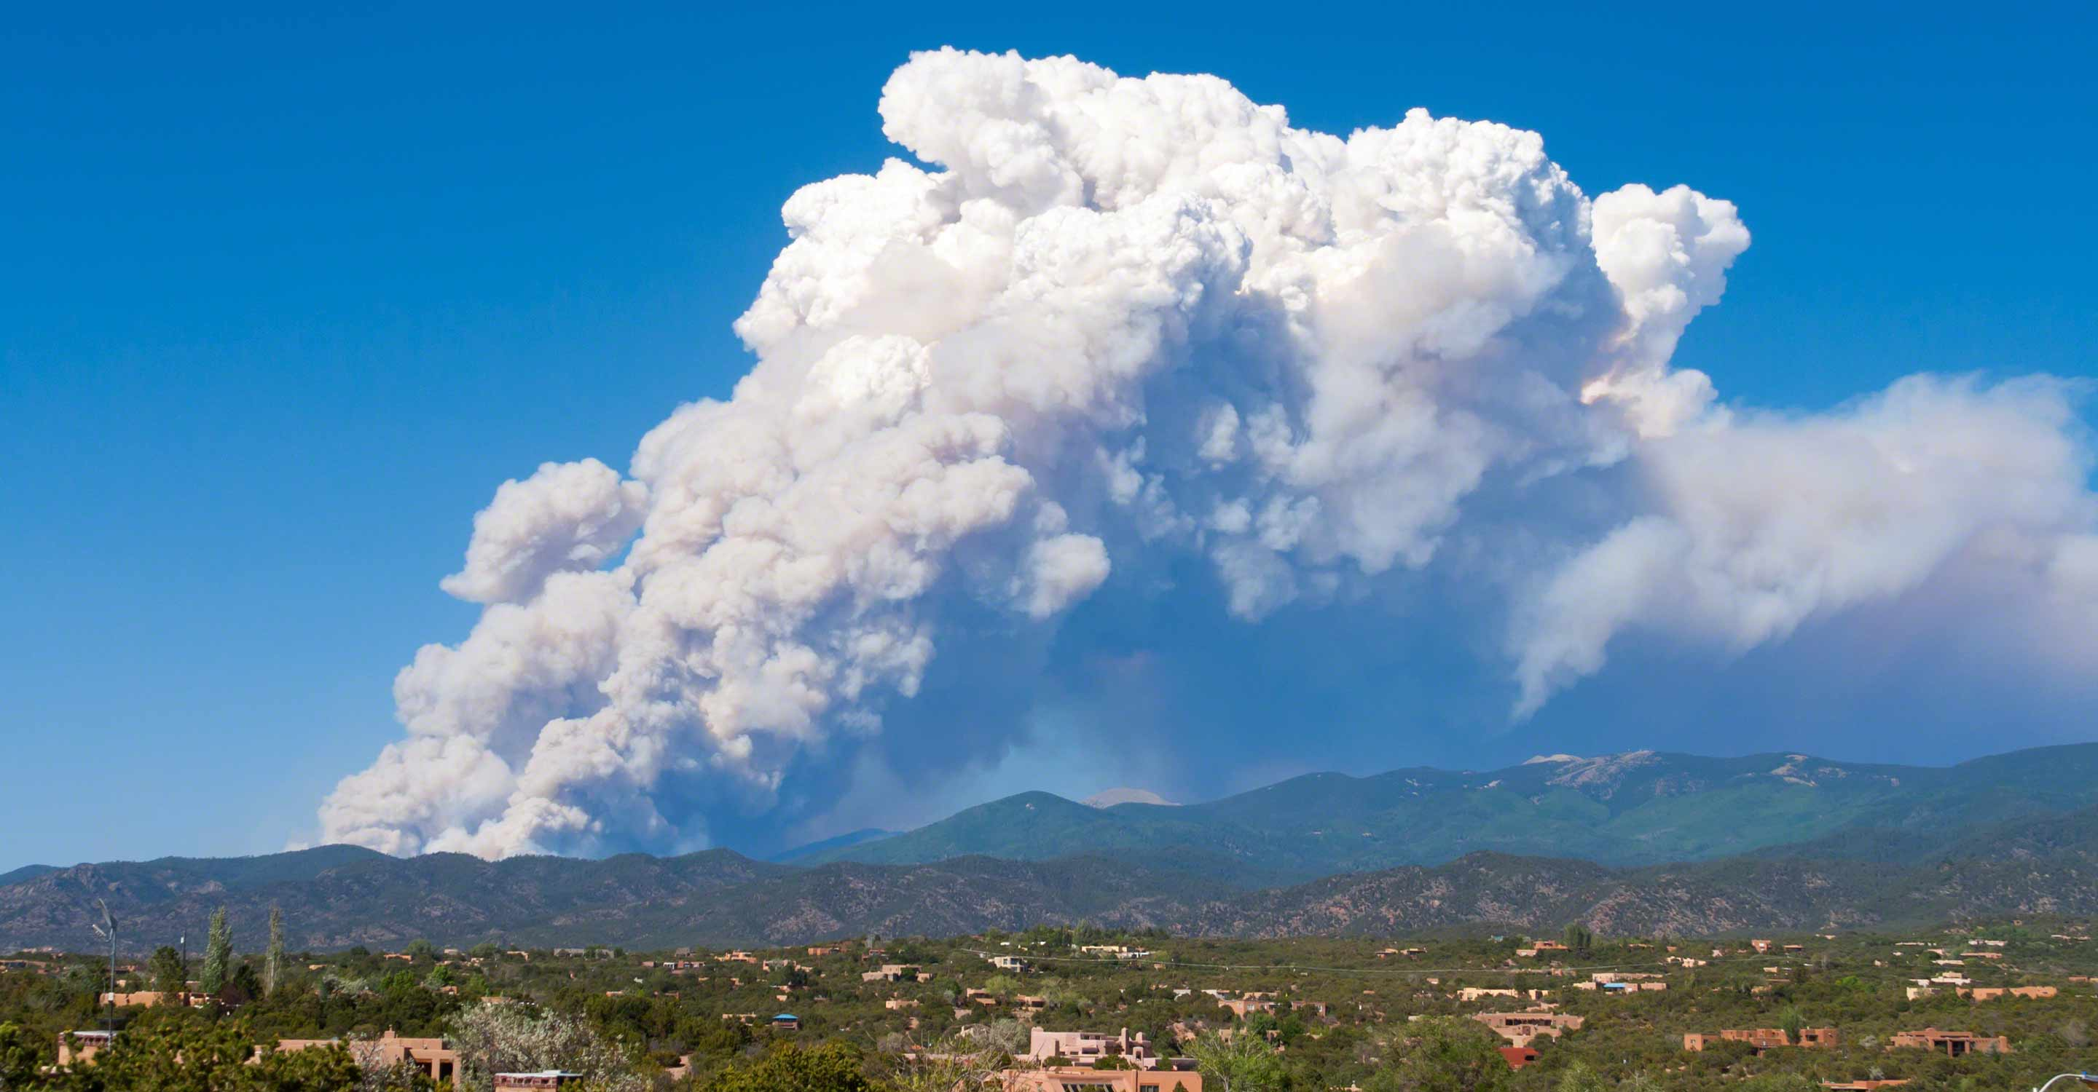

The Smokewise Simulation Framework
Integrating Multiple Models for Strategic Wildfire Smoke Modeling
Joseph Crockett*, Dan Krofcheck, Satyanadh Gundimada, Zachary Morrow, Jonathan Minoff, Esther John, Marco Campos
Contact: jlcrock@sandia.gov
9th Annual Sandia National Labs Machine & Deep Learning (ML/DL) Workshop
August 11 -14, 2025
SAND2025-09046C
Notes:
Hello everyone. I'm joseph crockett, a postdoc in earth systems analysis, and today i'll be presenting the smokewise simulation framework. This project has a lot of talented people working on it, and i'll be discussing the data generated and the challenges of long-term, or strategic, smoke modeling. Our companion prentation by jonahtan Minoff discusses the surrogate models that have been developed from this data, and I’ll have information about that presentation at the end.

Slide 2
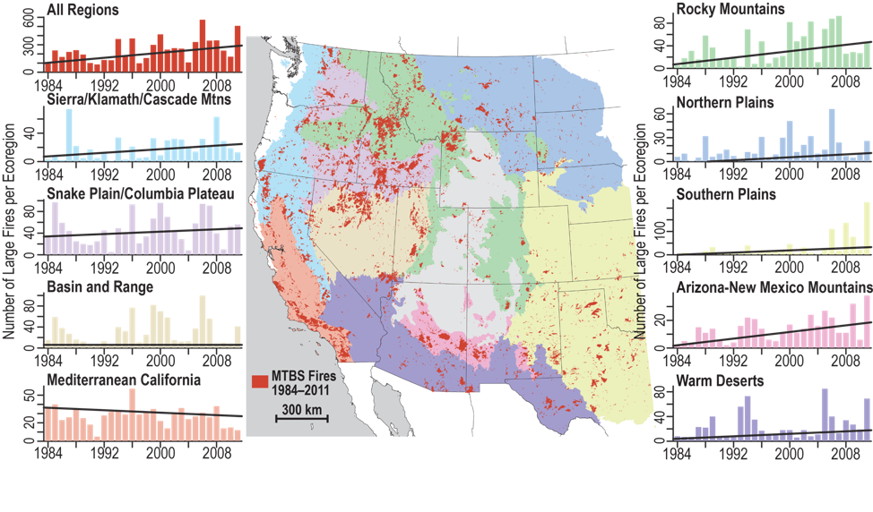
More extreme wildfire leads to more smoke
More fires > 400ha in US forests (Dennison et al. 2014)
Longer fire seasons due to earlier springs (Westerling 2016)
More severe fires (more vegetation consumed) (e.g. Singleton et al. 2019)
Drier, hotter conditions and hotter nights: More fires are more difficult to fight (Balch et al. 2022)
These fire trends lead to more area burned and impact much larger areas through wildfire smoke spread
Dennison et al. 2014
Notes:
While pre-fire management strategies aim to mitigate risks primarily to the wildland-urban interface and critical infrastructure,

Slide 3
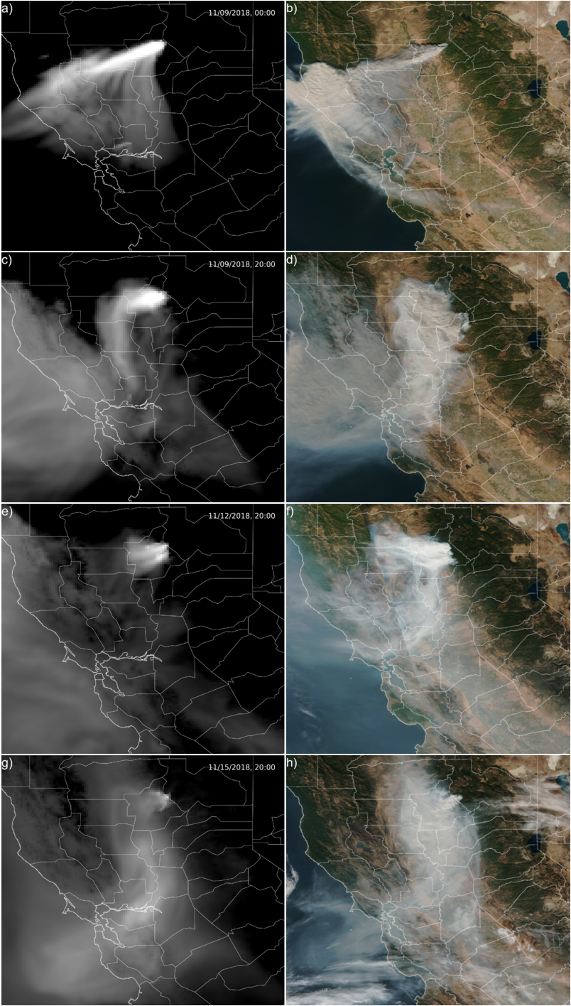
Impacts of Wildfire Smoke are felt far away from fires
Health:
Cardiovascular, asthma, cognitive function, decreased economic output (Reid et al. 2016, Cascio 2018)
Obscures optical systems
Decreased solar photovoltaic generation (Gilletly et al. 2023)
Decreased or increased vegetation growth rates (Behrer & Wang 2024)
Black carbon deposition on snow can accelerate snow melt (Ward et al. 2018)
Can alter weather, e.g. decreases precipitation (Huang et. Al. 2023)
Notes:
wildfire smoke extends the threat surface to include agriculture, economies, health, and solar photovoltaic (PV) outputs, even in areas with little to no risk of fire.

Slide 4
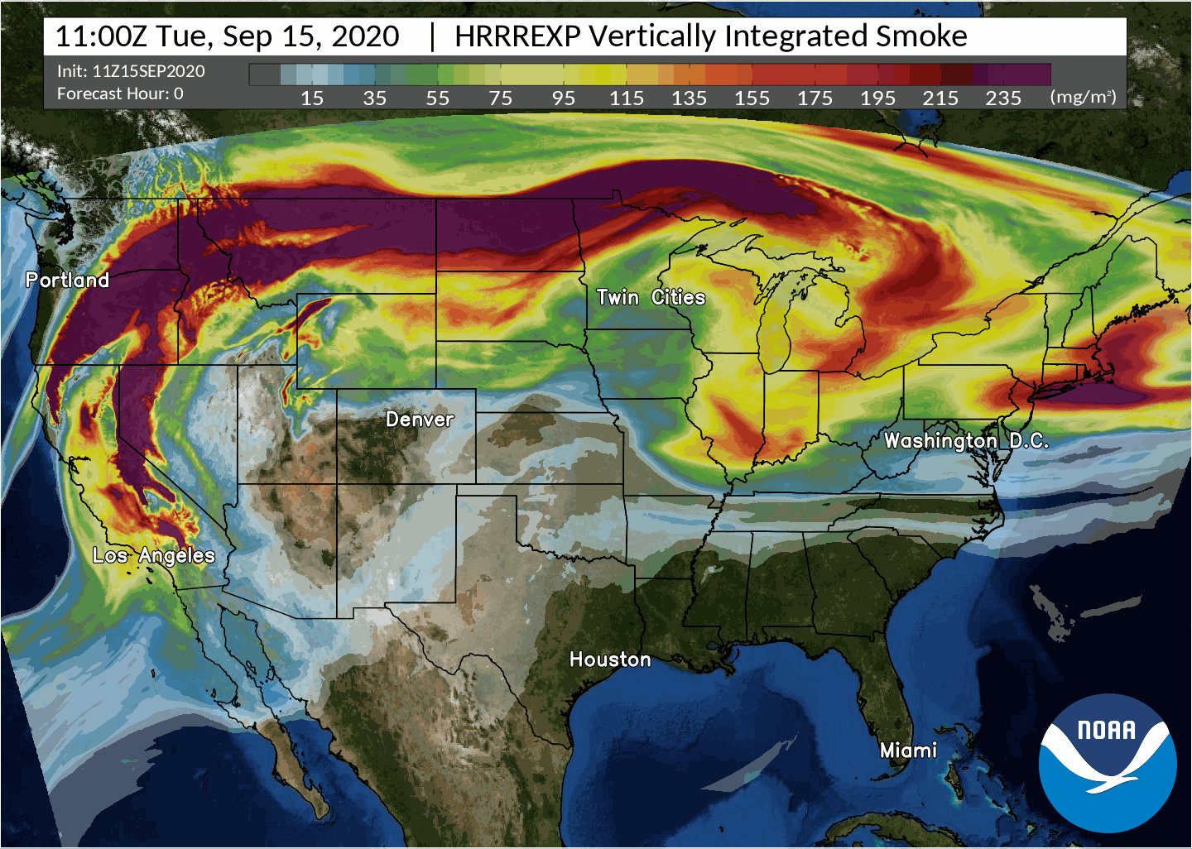

limitations to strategic smoke modeling
Fire spread models
Ongoing developments enhance accuracy, scale, fire behavior in various fuel types
Not all fire behavior represented
Smoke and fire can be limited by fuel categories
Weather inputs:
Uncertainty of future conditions requires many iterations
Wind speed, direction, surface + atmosphere heat, moisture, at large scale necessary
Fuel (vegetation)
Ecosystems transform (slowly)– communities of species change due to weather, disturbance, management, etc.
Future landscapes will look different than today – static fuel maps not sufficient
HRRR smoke model: https://www.weather.gov/news/200210-rapid-model
Notes:
https://www.weather.gov/news/200210-rapid-model

Slide 5
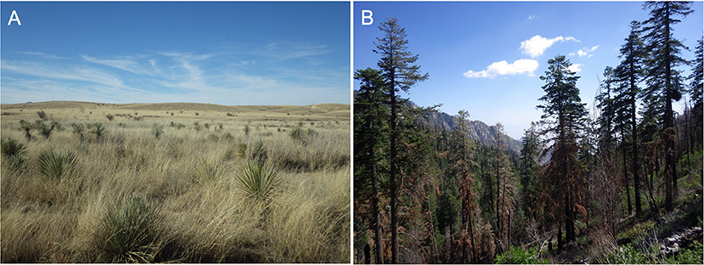
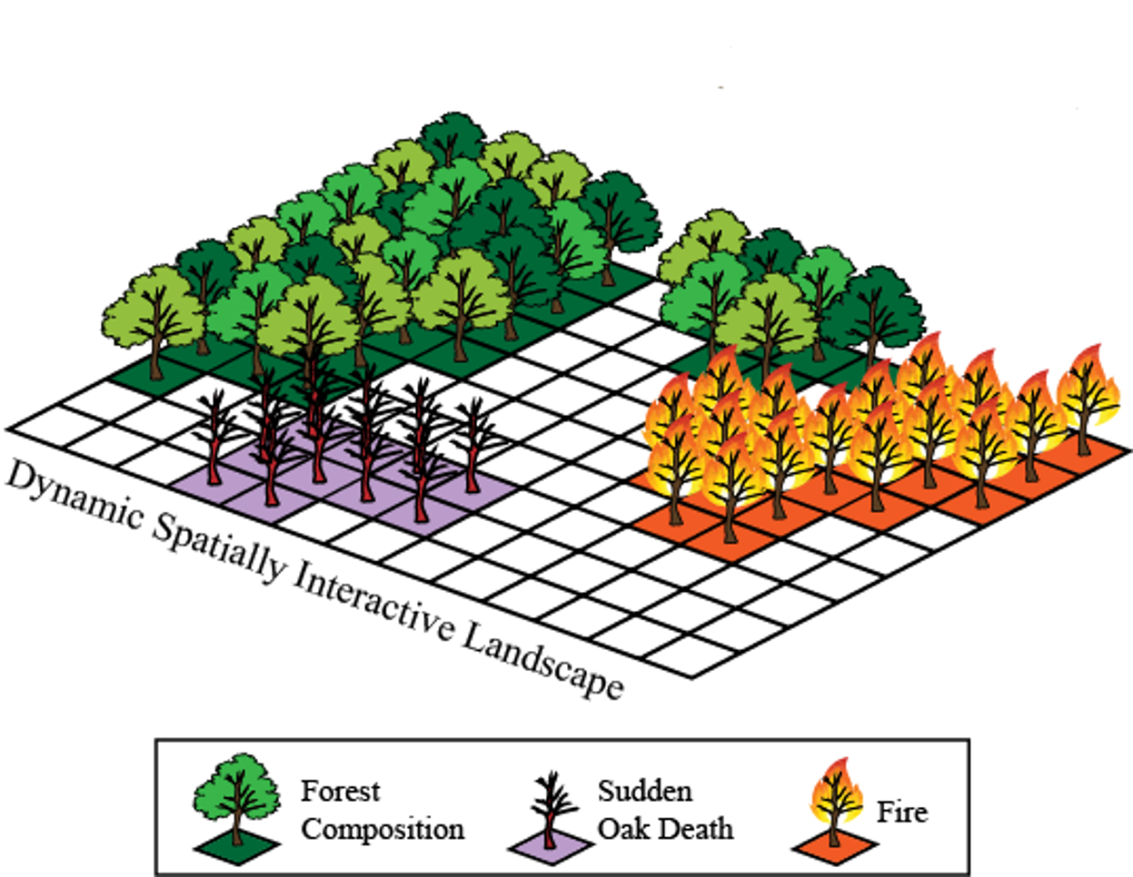
Incorporating smoke into long-term planning Requires dynamic inputs
Strategic smoke modeling incorporates vegetation change, weather uncertainty, and fire spread
Demonstrates effectiveness of various mitigation strategies on long time scales
However, no single model currently includes smoke spread with these other characteristics
Modeling future smokesheds will require robust uncertainty estimates of plume shape, spread, and composition
LANDIS-II forest landscape model

Slide 6
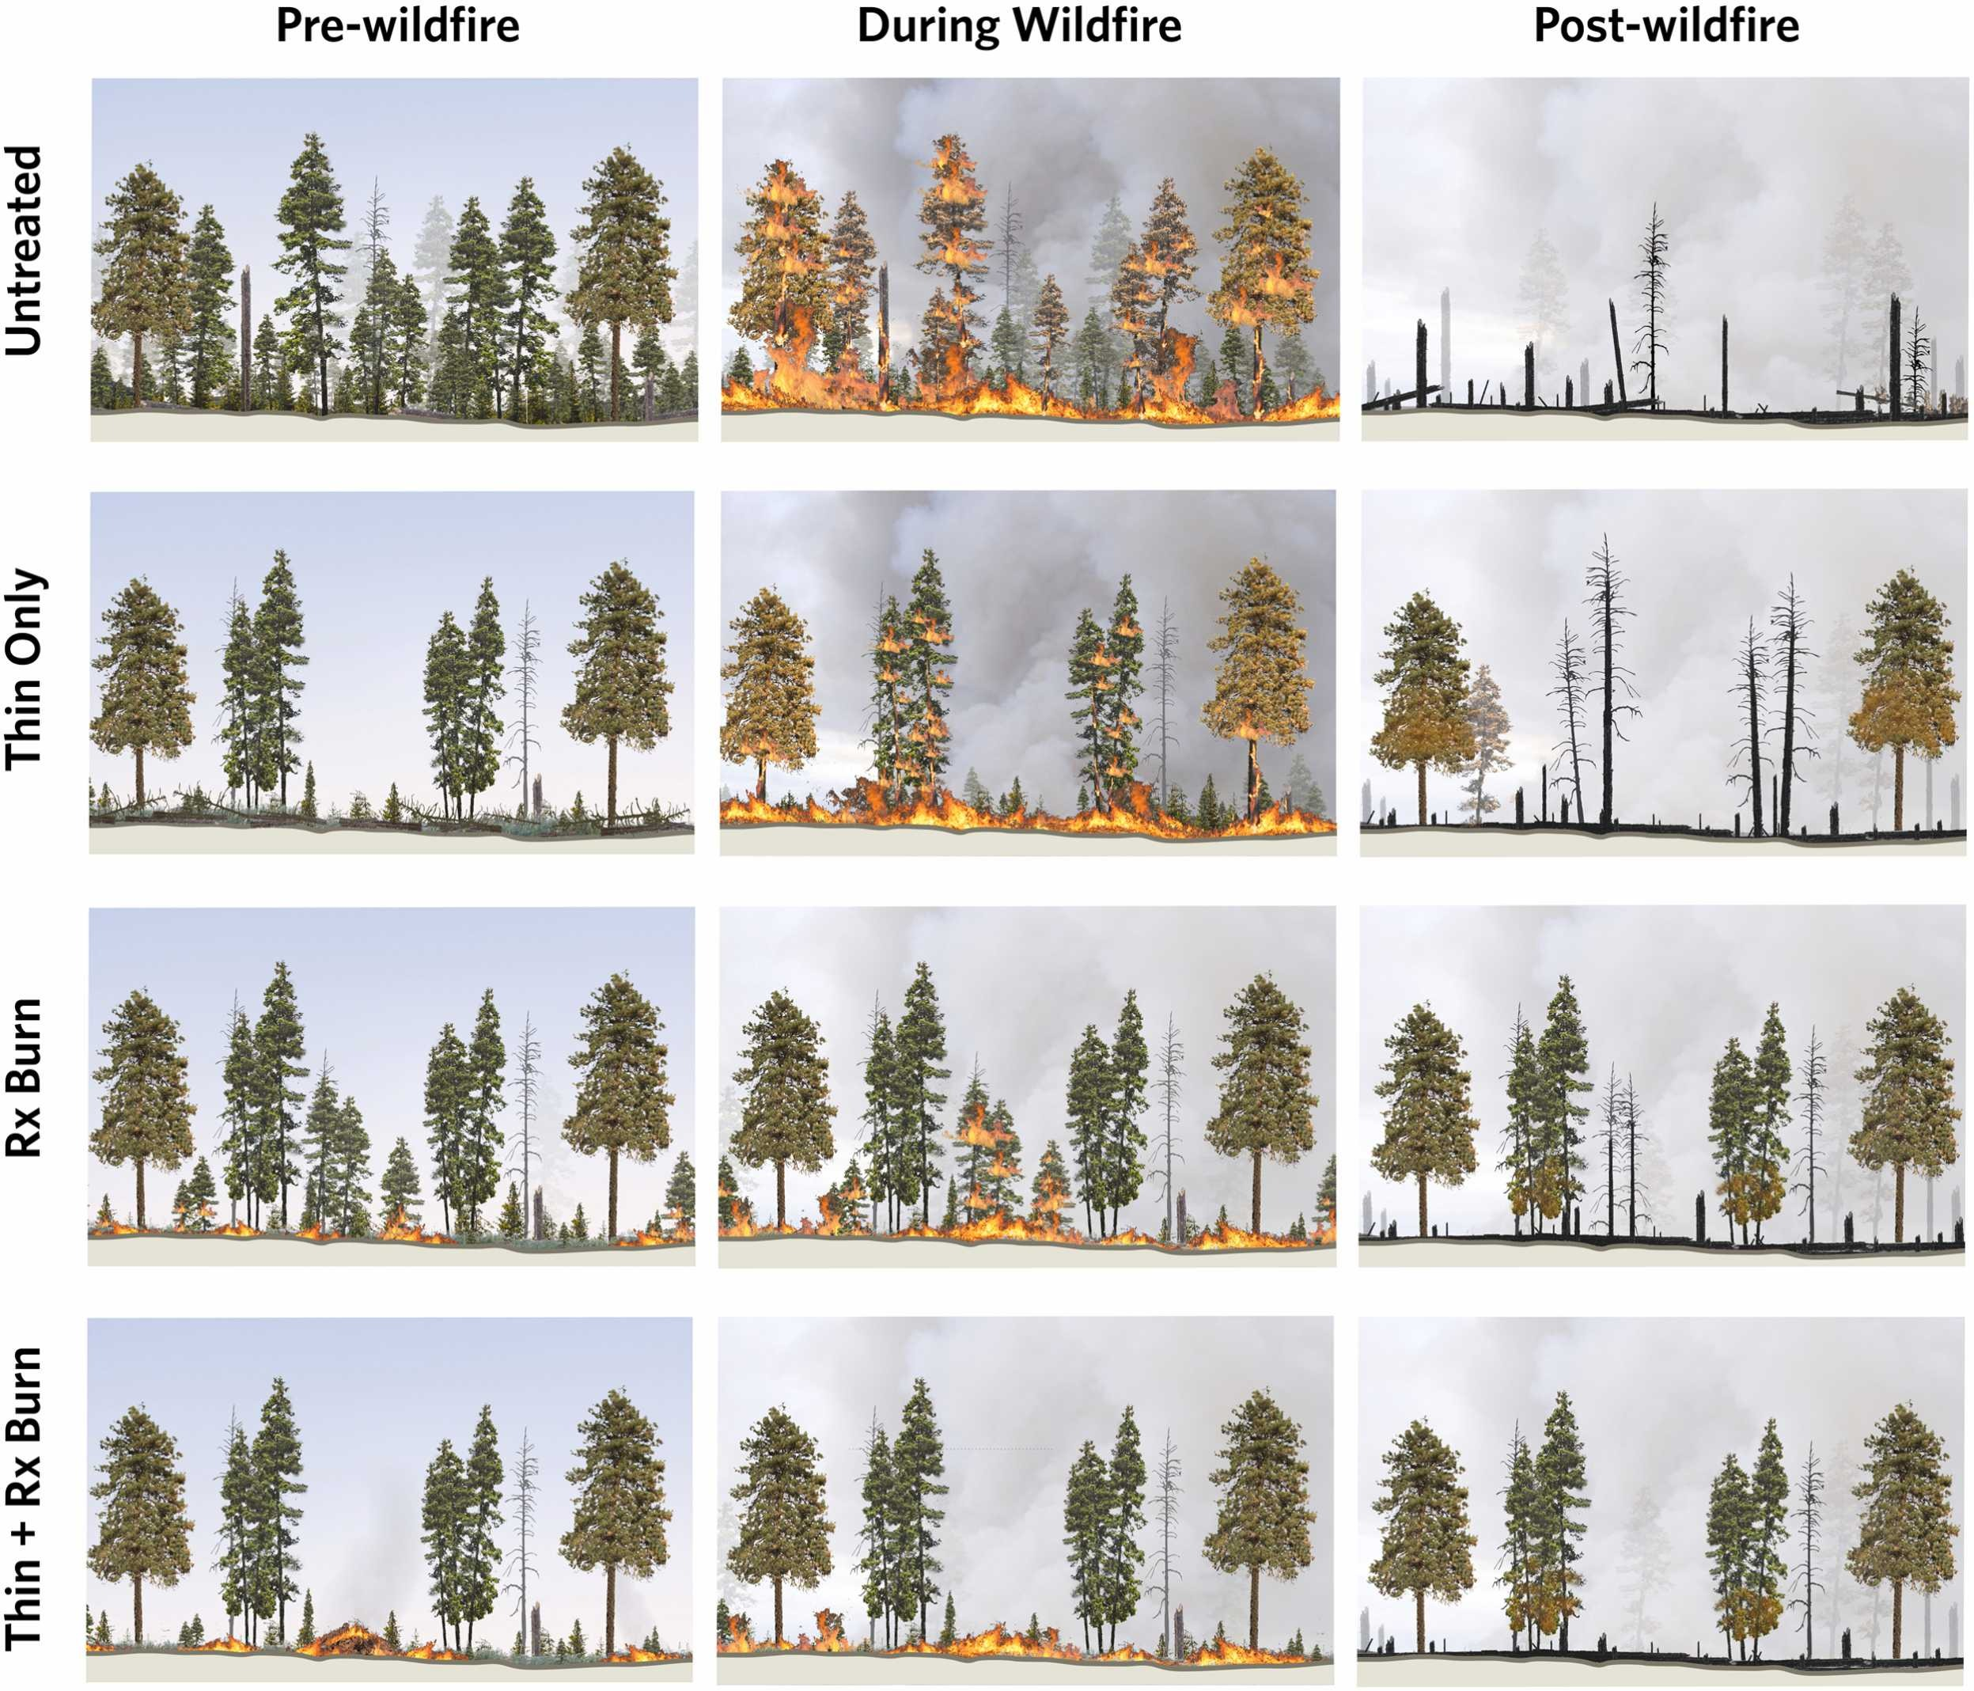
Fire Management Strategies influence fire and smoke spread
Thinning:
Reduce live fuels by removal (mastication, logging, etc)
Prescribed (Rx) Burning:
Intentionally burn undergrowth, thinned fuels, etc, to reduce fuel densities
No management:
Fire can spread from ground to canopy
More biomass burned
Davis et al. 2024

Slide 7
The Smokewise Framework
Fuel layers
Static geography
High resolution weather scenarios
Future weather draws
Fuel layers
High resolution weather scenarios
Future weather draws
Fuel layers
High resolution weather scenarios
Future weather draws
Fuel layers
Future weather draws
Fuel layers
Future weather draws
Fuel layers
Fire size distributions
Coupled fire/smoke simulator (WRF-Fire)
Fire size distributions
Fire size distributions
Fire size distributions
Fire size distributions
Fire size distributions
Forest landscape model (LANDIS-II )
Smoke plumes
Smoke plumes
Initial vegetation community
Smoke plumes
Smoke plumes
Smoke plumes
Fire boundaries
Fire boundaries
Smoke plumes
Wildfire smoke plumes
Management scenarios
Burned area comparisons
Notes:
Here’s the flow chart

Slide 8
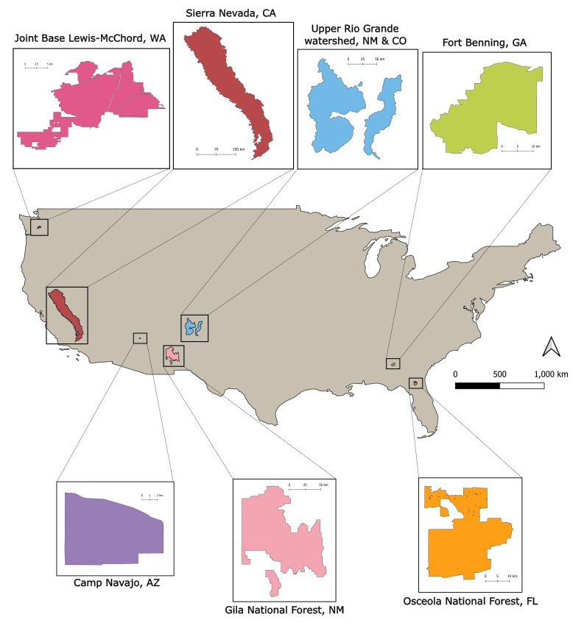
Widely available fuel inputs from LANDIS-II forest landscape model
Fuel input layers can originate from any future looking simulation (e.g. LANDIS II)
LANDIS-II simulates the dispersal, establishment, growth, and mortality of forest species using species-specific age cohorts
Can leverage existing published datasets for exemplar forests across CONUS
Available fuel layers represent vegetation communities of larger areas than just those simulated

Slide 9
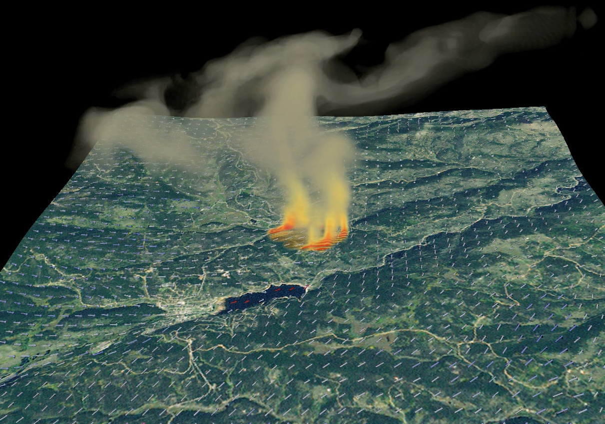
Smoke modeling from Ignition points with WRF-FIRE
WRF-Fire: A wildland fire spread simulator integrated into the Weather Research and Forecasting (WRF) weather prediction model
Considers environmental conditions:
Terrain slope
Fuel characteristics
Atmospheric conditions
Captures dynamic feedbacks with the atmosphere:
Fire behavior influences atmospheric environment, which influences fire behavior
Smoke Generation and Transport
Smoke (g smoke/kg dry air) generated as a passive tracer from burned fuels
Smoke data is aggregated to coarser resolution and passed from inner domain simulations to outer domains

Slide 10
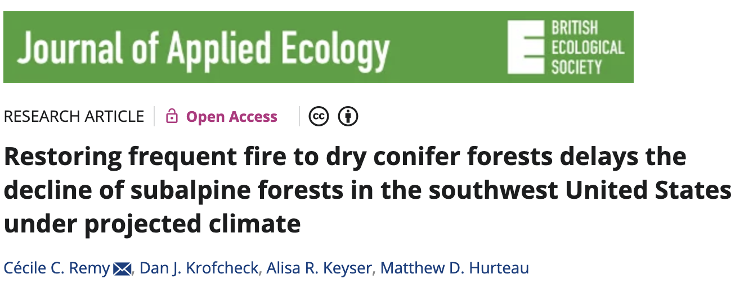
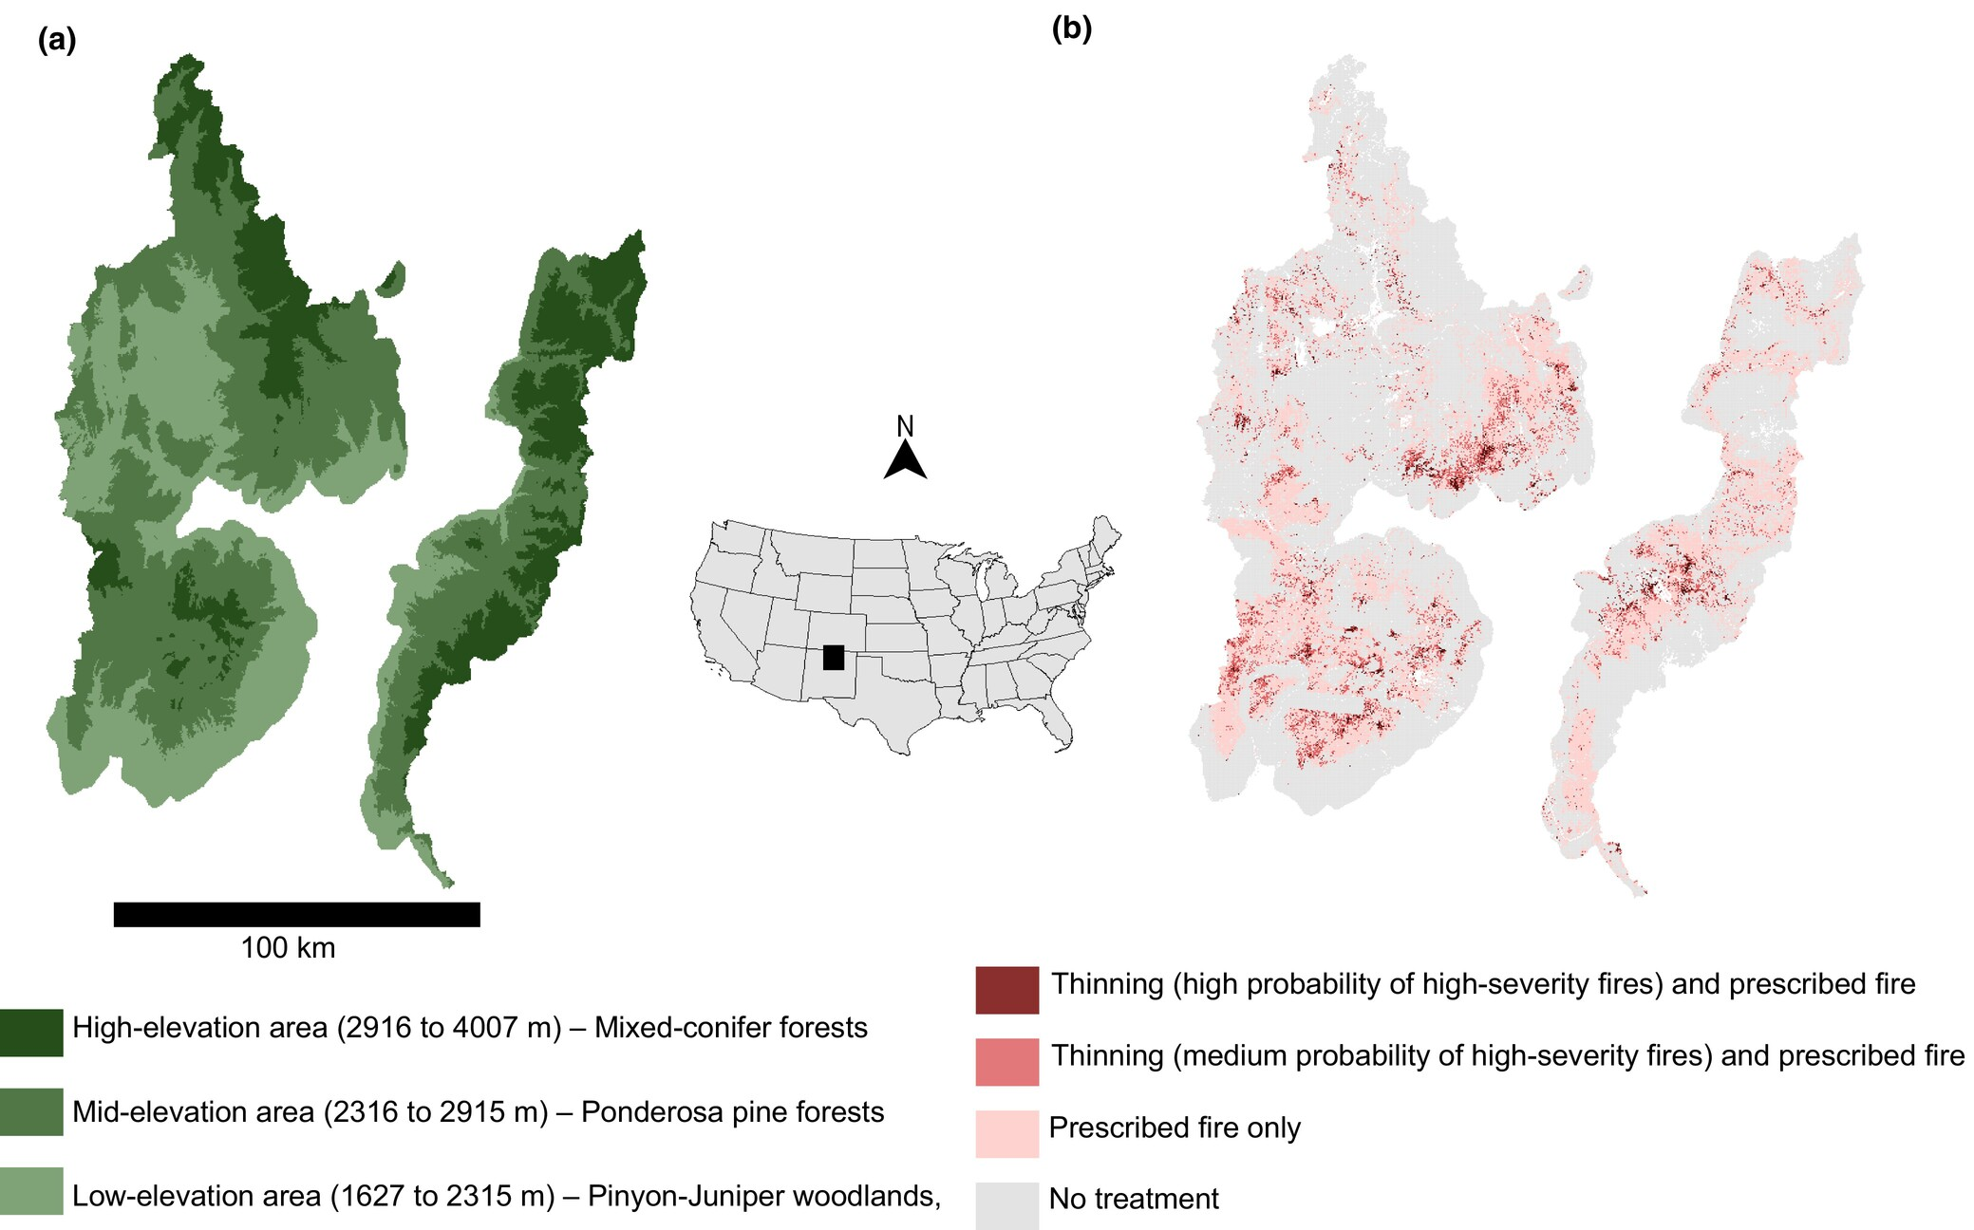
Example: Upper Rio Grande Watershed, New Mexico

Slide 11
Example: Multiple Management Scenarios
Four management scenarios:
No management
Burn only
Burn + thin minimal
Burn + thin expanded
> 5000 ignitions total, 2020-2050

Slide 12
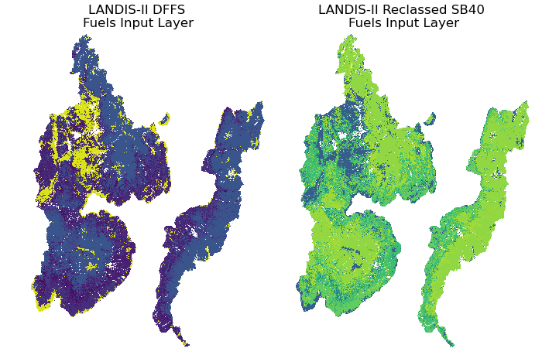
Example: Crosswalking Fuel categories
Reclassified fuel categories from LANDIS-II to Scott & Burgen 40 fuels
Necessary for WRF-Fire
Requires deep understanding of both categorizations
Assisted with collaborates at the University of New Mexico
Land area: 14,600 km
Domain area: 56,700 km
Notes:
Long term simulations of smoke and fire need inputs that incorporate uncertainty about future changes of fuels.
LANDIS-II is the Weather = climate narratives
Fuel model = rothermal, within WRF-FIRE
Smoke = parcel ….
FUEL

Slide 13
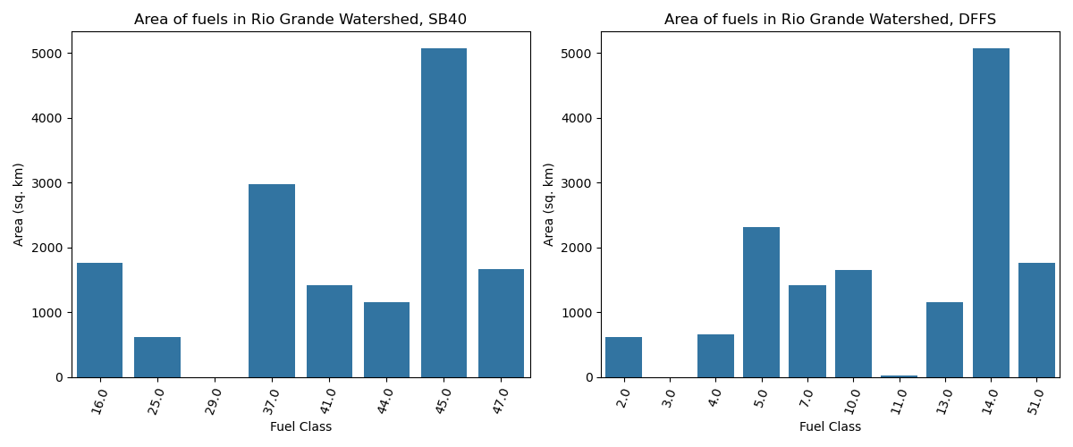
Example: Crosswalking fuel categories
Land area: 14,600 km
Domain area: 56,700 km

Slide 14
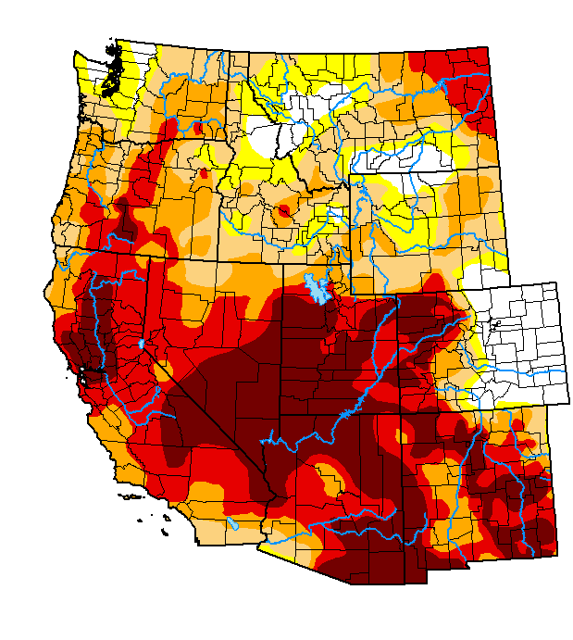
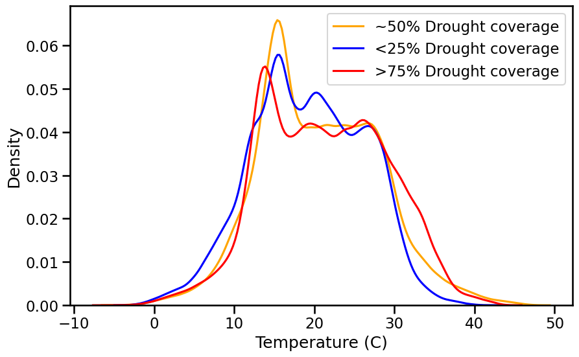
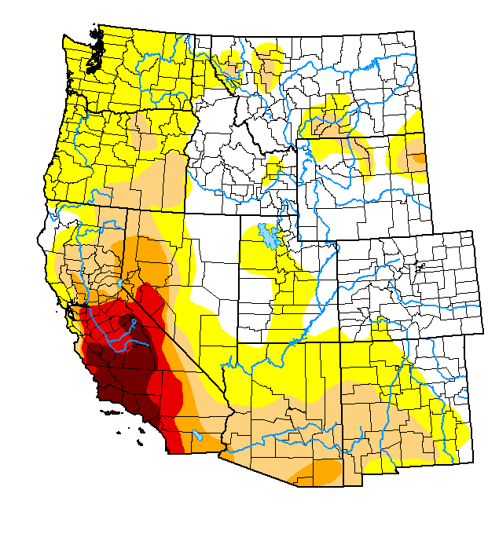
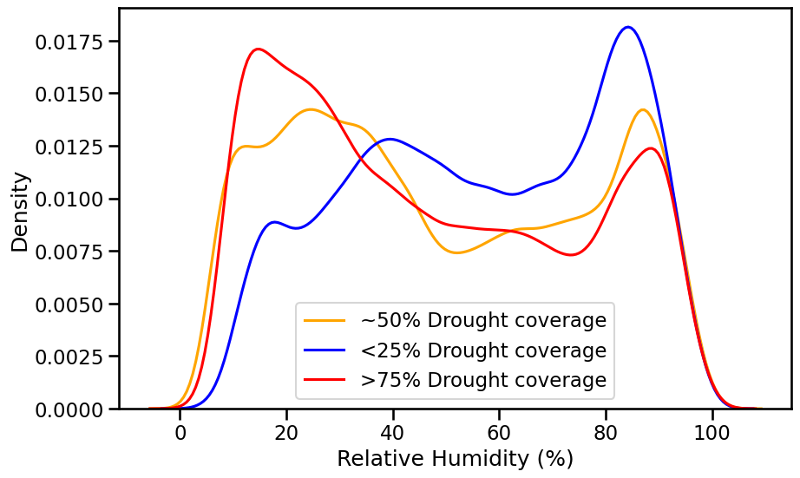
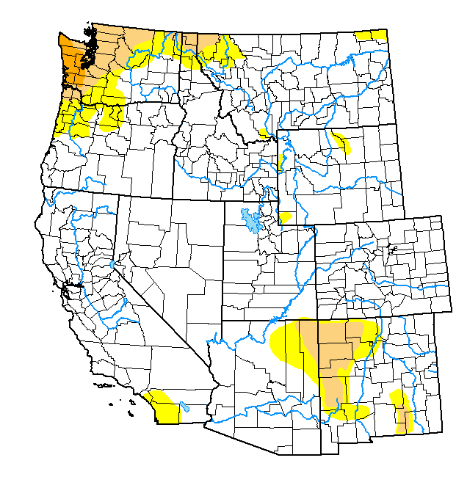
Example: Weather Simulation Scenarios based on drought coverage
US Drought Monitor based climate narratives:
Each LANDIS-II fire ignition point is simulated with the three scenarios (5000+ ignitions per scenario)
ERA5 reanalysis weather
30 km surface/atmospheric resolution
6 hourly data
Downscaled in WRF-fire to 3km atmosphere/ 300m surface in inner nested domain
7 day fire simulations

Slide 15
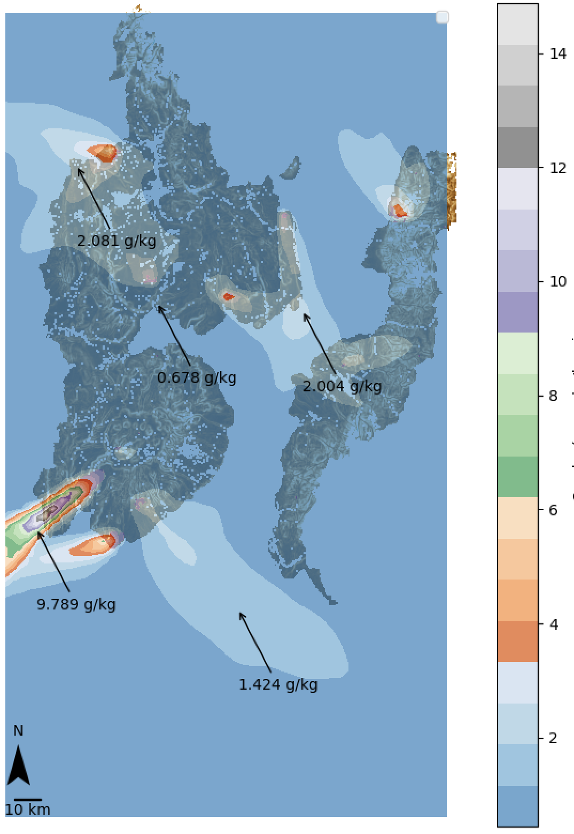
Example: Smoke simulations
We have custom WRF-Fire code running on Sandia HPC environments allowing in-parallel runs of large numbers of simulations.
Output at 3 hour intervals
Simulations at 120/40 second time steps
Burn time matching LANDIS-II fires
These 18 largest fires occurring over 10 years of LANDIS-II simulations cumulatively burned 50,000 acres (2000 – 2010), driven by contemporary weather, with dynamic fuels.

Slide 16
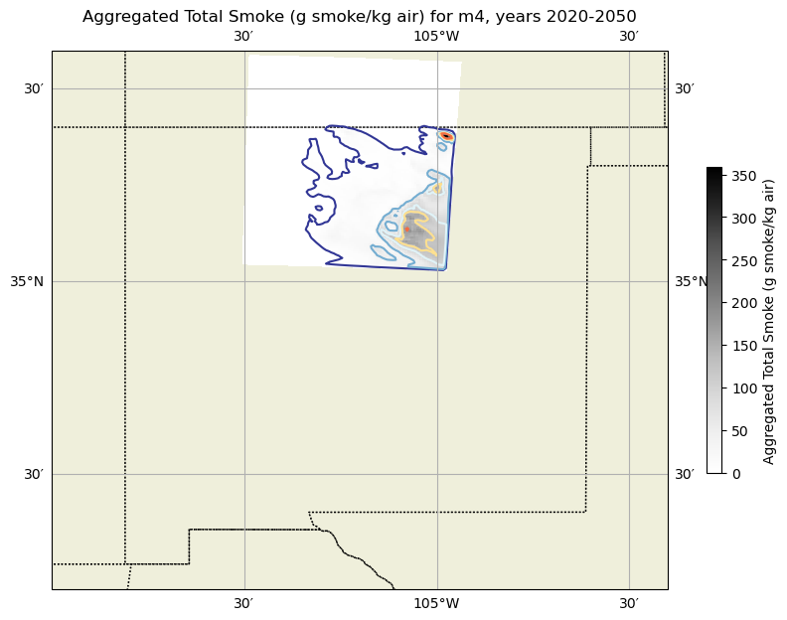
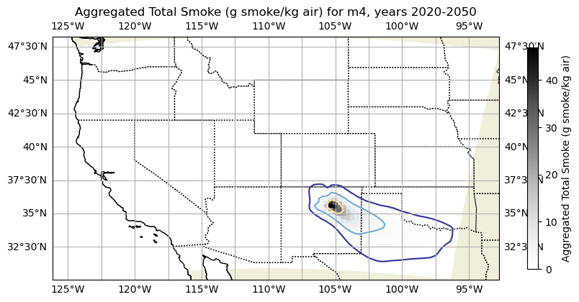
Smokewise Dataset status
Cumulative total smoke, inner domain for no management scenario, 2020-2050
Cumulative total smoke, outer domain for no management scenario, 2020-2050

Slide 17
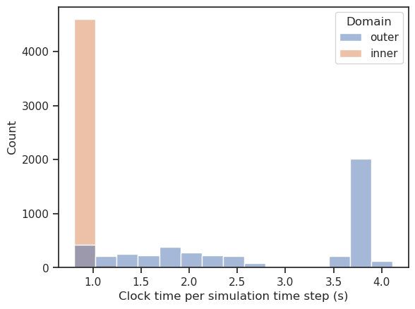
Smokewise Dataset: Simulations ongoing
Total fires simulated: 5686
Per management:
No management: 1399
Prescribed burn only: 1530
Limited burn + thin: 1385
Expanded burn + thin: 1372
Total size on disk:
2.9Tb (output files filtered to every six hours)
15Tb+ (all input/output files)

Slide 18
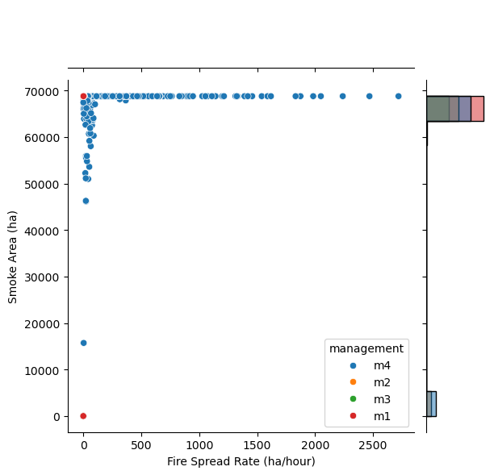
Smokewise Dataset status
Smoke spreads over full simulation area:
Positive correlation to fire spread rate
Indication of wide dispersal of smoke for all ignition points, fuel types, fire sizes

Slide 19
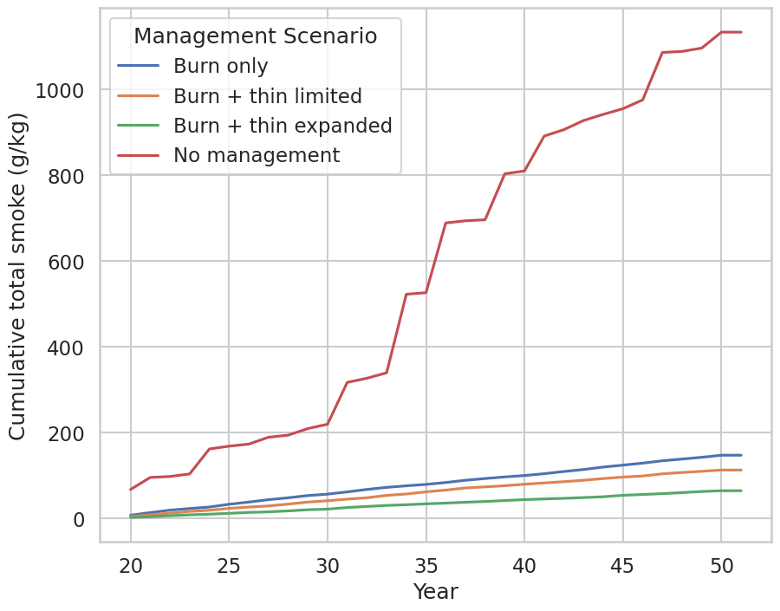
Management reduces biomass burned and produces less smoke
Management outcome:
total smoke generated with no management exceeds all management scenarios
Lower fuel density categories in managed scenarios resulted in less burned biomass conversion to smoke, despite similar fire sizes

Slide 20
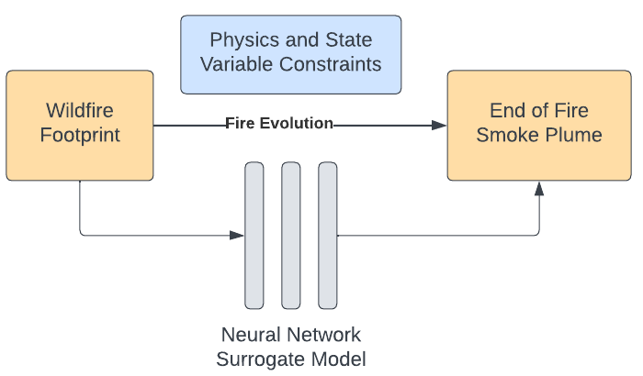
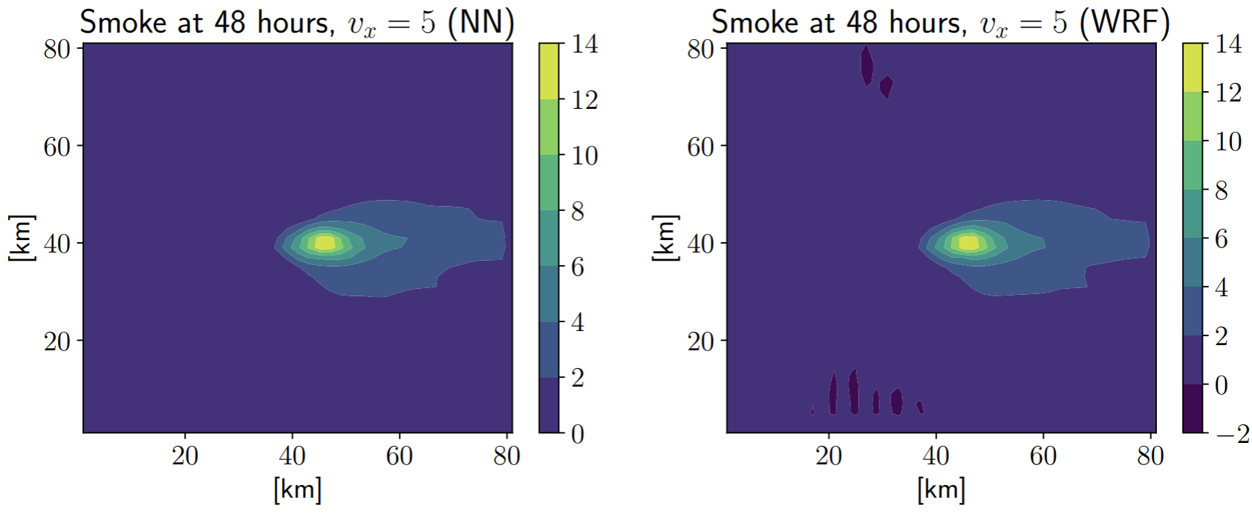
Next steps
Expand areas simulated
Incorporate perturbations to long-term weather means
Surrogate modeling
Quickly simulate smoke plumes from a fire footprint and state variables
Allows for sufficient simulations to robustly quantify uncertainty of smoke plume

Slide 21
Conclusions
More extreme fires are generating more smoke over large regions
Incorporating fuels from dynamic landscape models in a coupled fire model can simulate potential smokesheds
These high resolution, time resolved 3d smoke plumes are the first steps to generating surrogate models to quickly estimate plumes with uncertainty envelopes
- For more on the Smokewise surrogate modeling, see:
Surrogate Modeling for Wildfire Smoke Forecasts
Dan J. Krofcheck, Joseph Crockett, Satyanadh Gundimada, Zachary Morrow, Jonathan Minoff, Esther John, Marco Campos

Slide 22




Acknowledgements
Smokewise team: Dan J. Krofcheck, Satyanadh Gundimada, Zachary Morrow, Jonathan Minoff, Esther John, Marco Campos
University of New Mexico Collaborators: Matthew Hurteau, Marion Lacand
National Center for Atmospheric Research: Amy DeCastro
Contact:
jlcrock@sandia.gov
Joseph Crockett
Sandia National Laboratories is a multimission laboratory managed and operated by National Technology & Engineering Solutions of Sandia, LLC, a wholly owned subsidiary of Honeywell International Inc., for the U.S. Department of Energy’s National Nuclear Security Administration under contract DE-NA0003525. SAND2025-09046C

Slide 23
Citations
Balch, J. K., Abatzoglou, J. T., Joseph, M. B., Koontz, M. J., Mahood, A. L., McGlinchy, J., ... & Williams, A. P. (2022). Warming weakens the night-time barrier to global fire. Nature, 602(7897), 442-448.
Behrer, A. P., & Wang, S. (2024). Current benefits of wildfire smoke for yields in the US Midwest may dissipate by 2050. Environmental Research Letters, 19(8), 084010.
Cascio, W. E. (2018). Wildland fire smoke and human health. Science of the total environment, 624, 586-595.
Coen, J. L., Cameron, M., Michalakes, J., Patton, E. G., Riggan, P. J., & Yedinak, K. M. (2013). WRF-Fire: coupled weather–wildland fire modeling with the weather research and forecasting model. Journal of Applied Meteorology and Climatology, 52(1), 16-38.
Davis, K. T., Peeler, J., Fargione, J., Haugo, R. D., Metlen, K. L., Robles, M. D., & Woolley, T. (2024). Tamm review: A meta-analysis of thinning, prescribed fire, and wildfire effects on subsequent wildfire severity in conifer dominated forests of the Western US. Forest Ecology and Management, 561, 121885.
Dennison, P. E., Brewer, S. C., Arnold, J. D., & Moritz, M. A. (2014). Large wildfire trends in the western United States, 1984–2011. Geophysical Research Letters, 41(8), 2928-2933.
Gilletly, S. D., Jackson, N. D., & Staid, A. (2023). Evaluating the impact of wildfire smoke on solar photovoltaic production. Applied Energy, 348, 121303.
Huang, X., Ding, K., Liu, J., Wang, Z., Tang, R., Xue, L., ... & Ding, A. (2023). Smoke-weather interaction affects extreme wildfires in diverse coastal regions. Science, 379(6631), 457-461.
Reid, C. E., Brauer, M., Johnston, F. H., Jerrett, M., Balmes, J. R., & Elliott, C. T. (2016). Critical review of health impacts of wildfire smoke exposure. Environmental health perspectives, 124(9), 1334-1343.
Remy, C. C., Krofcheck, D. J., Keyser, A. R., & Hurteau, M. D. (2024). Restoring frequent fire to dry conifer forests delays the decline of subalpine forests in the southwest United States under projected climate. Journal of Applied Ecology, 61(7), 1508-1519.
Scheller, R. M., Domingo, J. B., Sturtevant, B. R., Williams, J. S., Rudy, A., Gustafson, E. J., & Mladenoff, D. J. (2007). Design, development, and application of LANDIS-II, a spatial landscape simulation model with flexible temporal and spatial resolution. ecological modelling, 201(3-4), 409-419.
Singleton, M. P., Thode, A. E., Meador, A. J. S., & Iniguez, J. M. (2019). Increasing trends in high-severity fire in the southwestern USA from 1984 to 2015. Forest ecology and management, 433, 709-719.
Ward, J. L., Flanner, M. G., Bergin, M., Dibb, J. E., Polashenski, C. M., Soja, A. J., & Thomas, J. L. (2018). Modeled response of Greenland snowmelt to the presence of biomass burning‐based absorbing aerosols in the atmosphere and snow. Journal of Geophysical Research: Atmospheres, 123(11), 6122-6141.
Westerling, A. L. (2016). Increasing western US forest wildfire activity: sensitivity to changes in the timing of spring. Philosophical Transactions of the Royal Society B: Biological Sciences, 371(1696), 20150178.

