Slide 1
Language embeddings and multi-head attention towards inter-experimental predictive power for biological phenotypes
Raga Krishnakumar
8625 Biosecurity and Bioassurance
ML/DL 2025
Aug 11-15, 2025
SAND2025-08741PE

Slide 2

Molecular biology in a nutshell
Can molecular information from a cell be predictive of its response?
How broadly applicable is this?
What about populations of cells? Organisms? Ecosystems?
Stimulus
Cell
Response
Receptors
Proteins
DNA
RNA

Slide 3




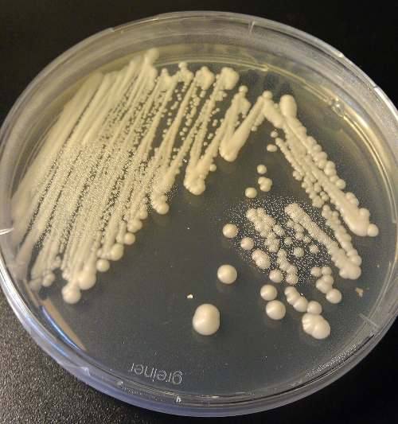
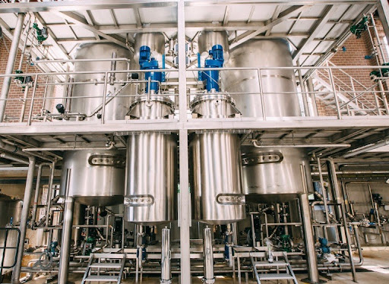
Scaling and transferability is a biology-wide problem

Slide 4
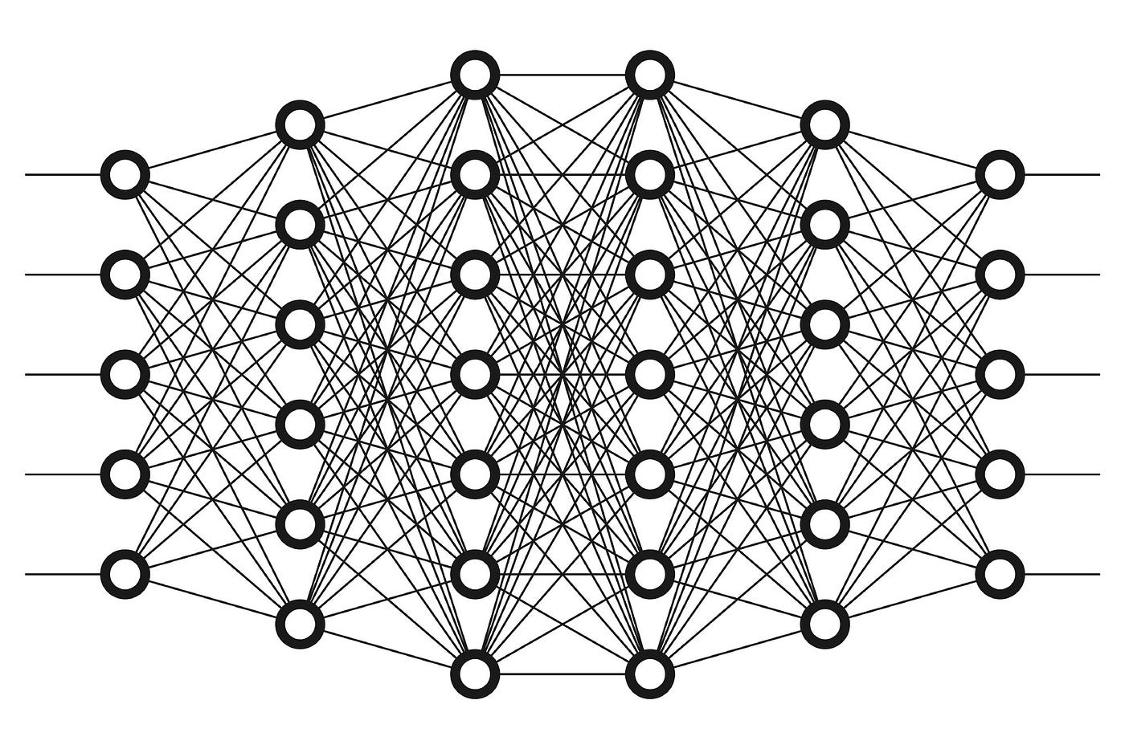
How do we predict outcomes across scales?

Slide 5
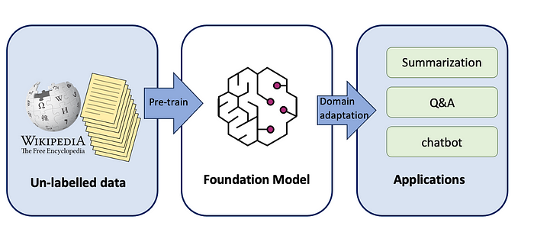
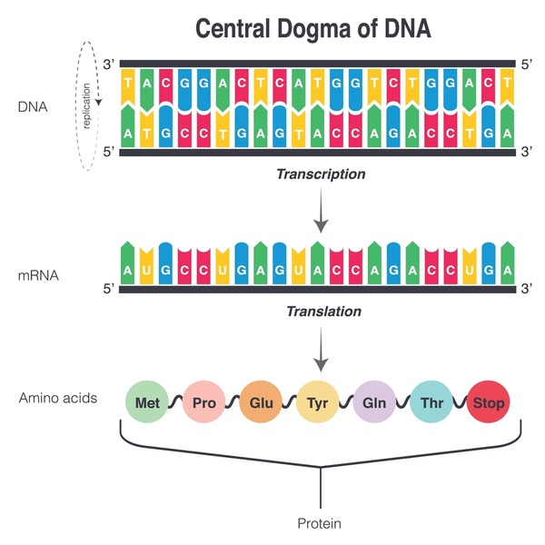
Biology is a language
Image from Mina Ghashami (2023)
Bio-Language foundation models
Extract embeddings
Functional queries
Predict sequences

Slide 6


UNDerstanding BIOLOGICAL language models – focus on DNA
Premise: DNA language model embeddings contain biologically relevant functional information about DNA sequences
Gene A
Gene A
Low similarity
High similarity
Low similarity
Gene B
Gene B

Slide 7
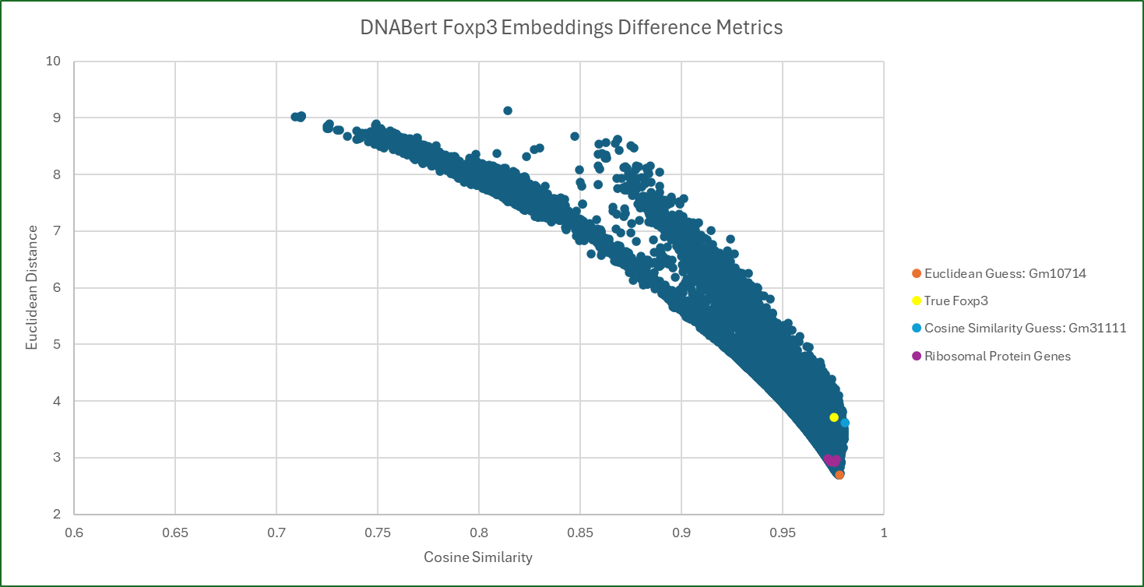
Exemplar – foxp3 (representative gene)
Human Foxp3 vs every gene in the mouse genome
Euclidian guess
True homolog
Cosine guess
Ribosomal protein genes

Slide 8
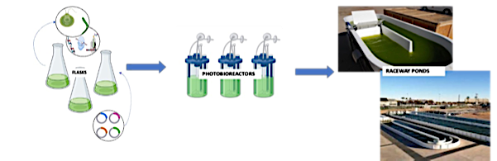
Microalgae - a case study
Photosynthetic organism
Biofuels
High-value products
Scale up challenges

Slide 9




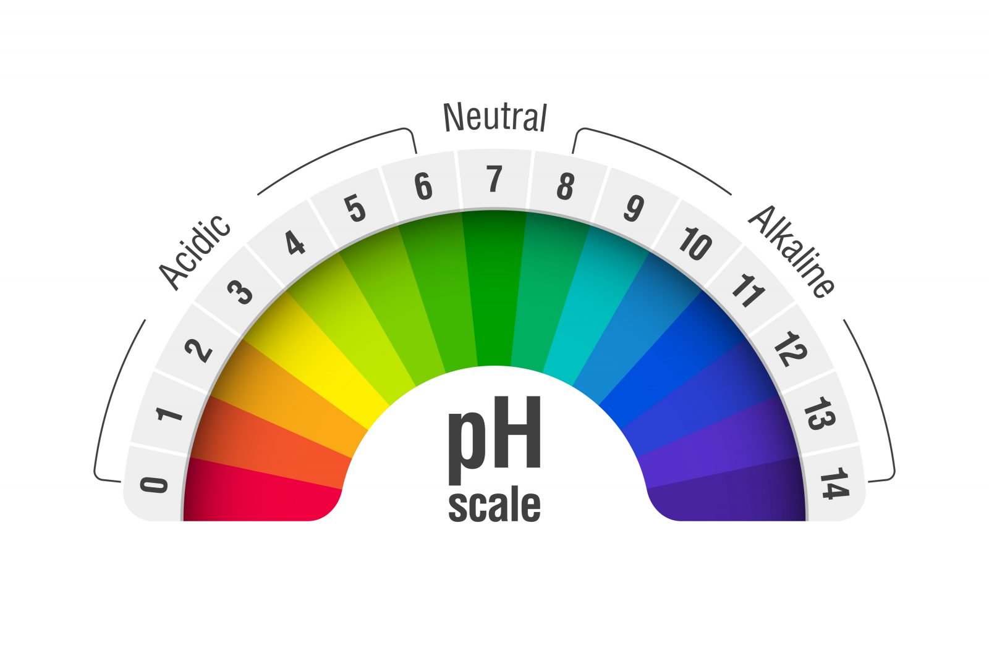

Using algae as sensors of their environment – molecular signatures
The effects of these changes need to be predictive AT SCALE to be effective
Molecular changes
Predictive power?

Slide 10
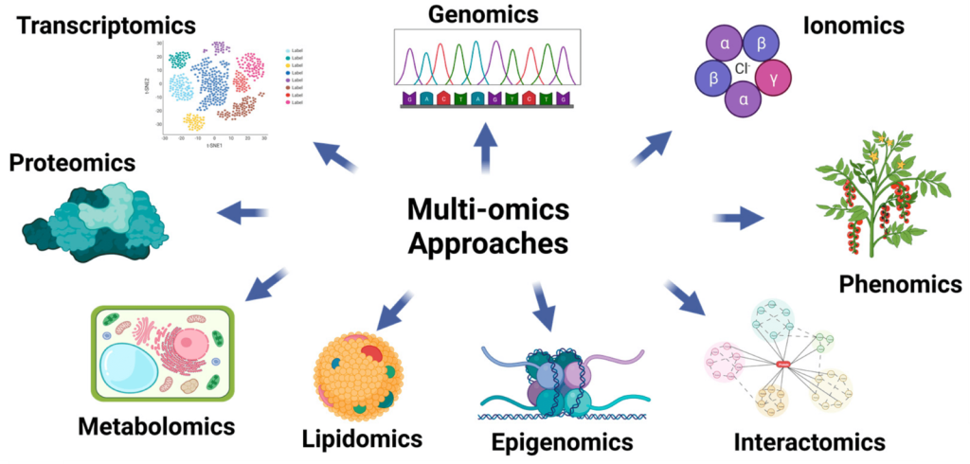
Multi-omics – the cutting-edge of big data in biology

Slide 11
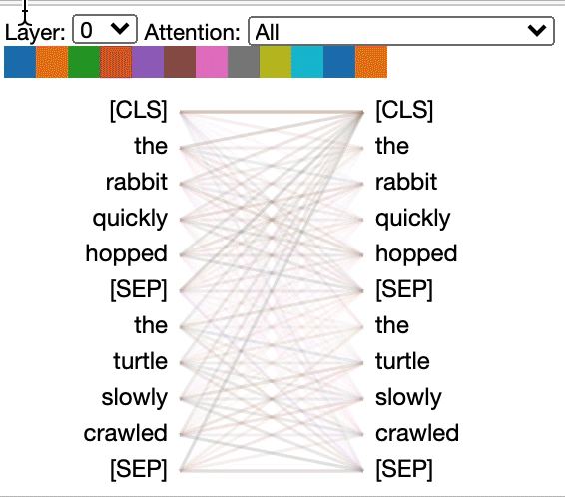


Attention mechanisms to focus ML algorithms
Large language models
Attention-based Models
Functional outcomes
https://github.com/jessevig/bertviz

Slide 12
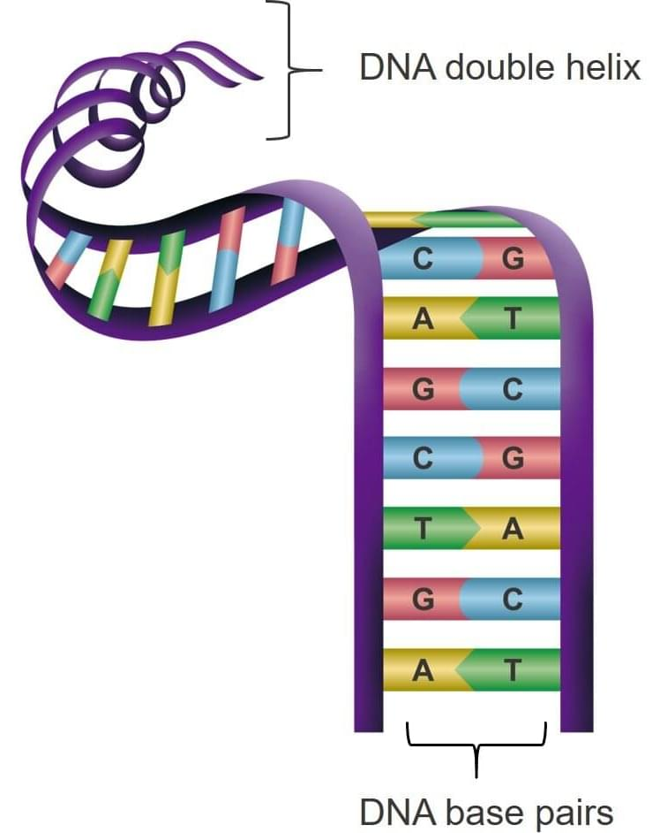
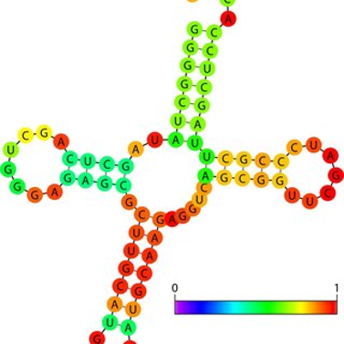
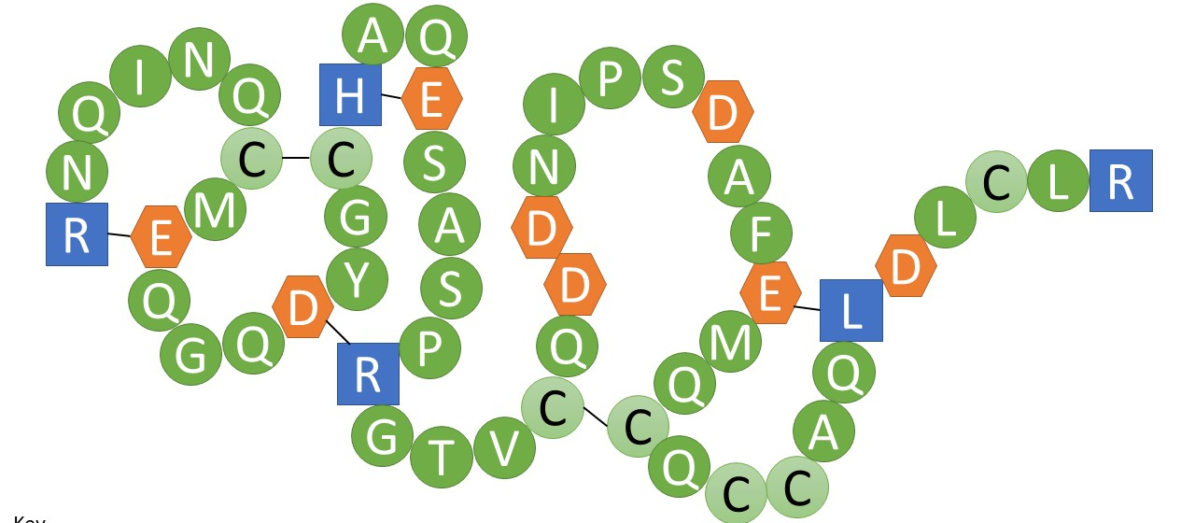
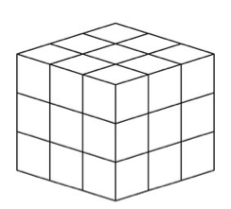
Attention mechanisms to focus ML algorithms
Language Models
+
Embeddings
(AKA gold!)
Functional outcomes Predict new sequences
Functional outcomes

Slide 13
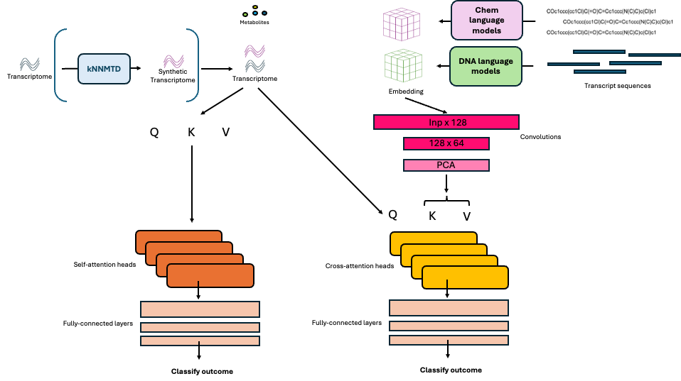
MAPPIE – multi-head attention for predicting phenotypes inter-experimentally

Slide 14



How can you use ML to help you gain predictive power?
Steady
Stressed
Steady
Stressed
Steady
Stressed

Slide 15
How can you use ML to help you gain predictive power?
Steady
Stressed
Steady
Stressed
How can we help the models focus on what is important?
Models often struggle to de-confound variables and focus on what is relevant when using data across studies

Slide 16
Results from running MAPPIE on multi-scale algal data
Model | Accuracy on test data
XGBoost (no language-based features) | 61% +/- 10%
MAPPIE-lite (no language-based features) | 68% +/- 9%
MAPPIE | 80% +/- 6%
Steady
Stressed
Steady
Stressed

Slide 17
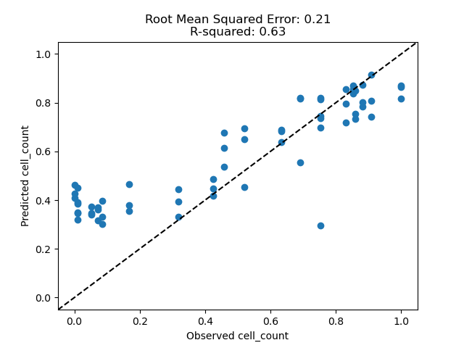
Future directions
Metabolites predict growth rates across scales
Predicted Cell Count
Observed Cell Count

Slide 18
Long-term perspectives
QUERY
LLM-based agent
Experimental design
Quantitative heterogeneous data
Physics-based models
Bio Language Models
OUTCOME PREDICTION

Slide 19
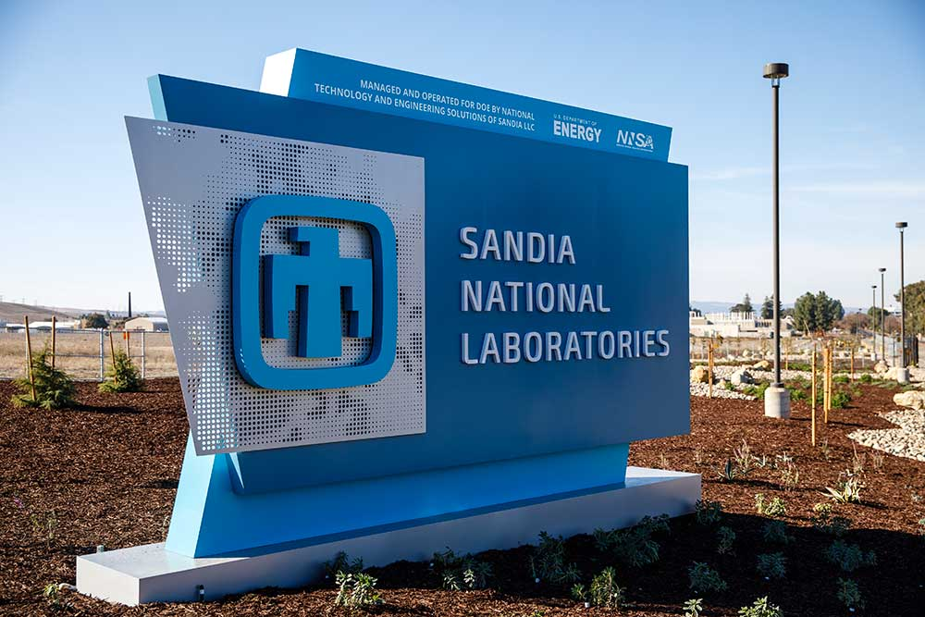
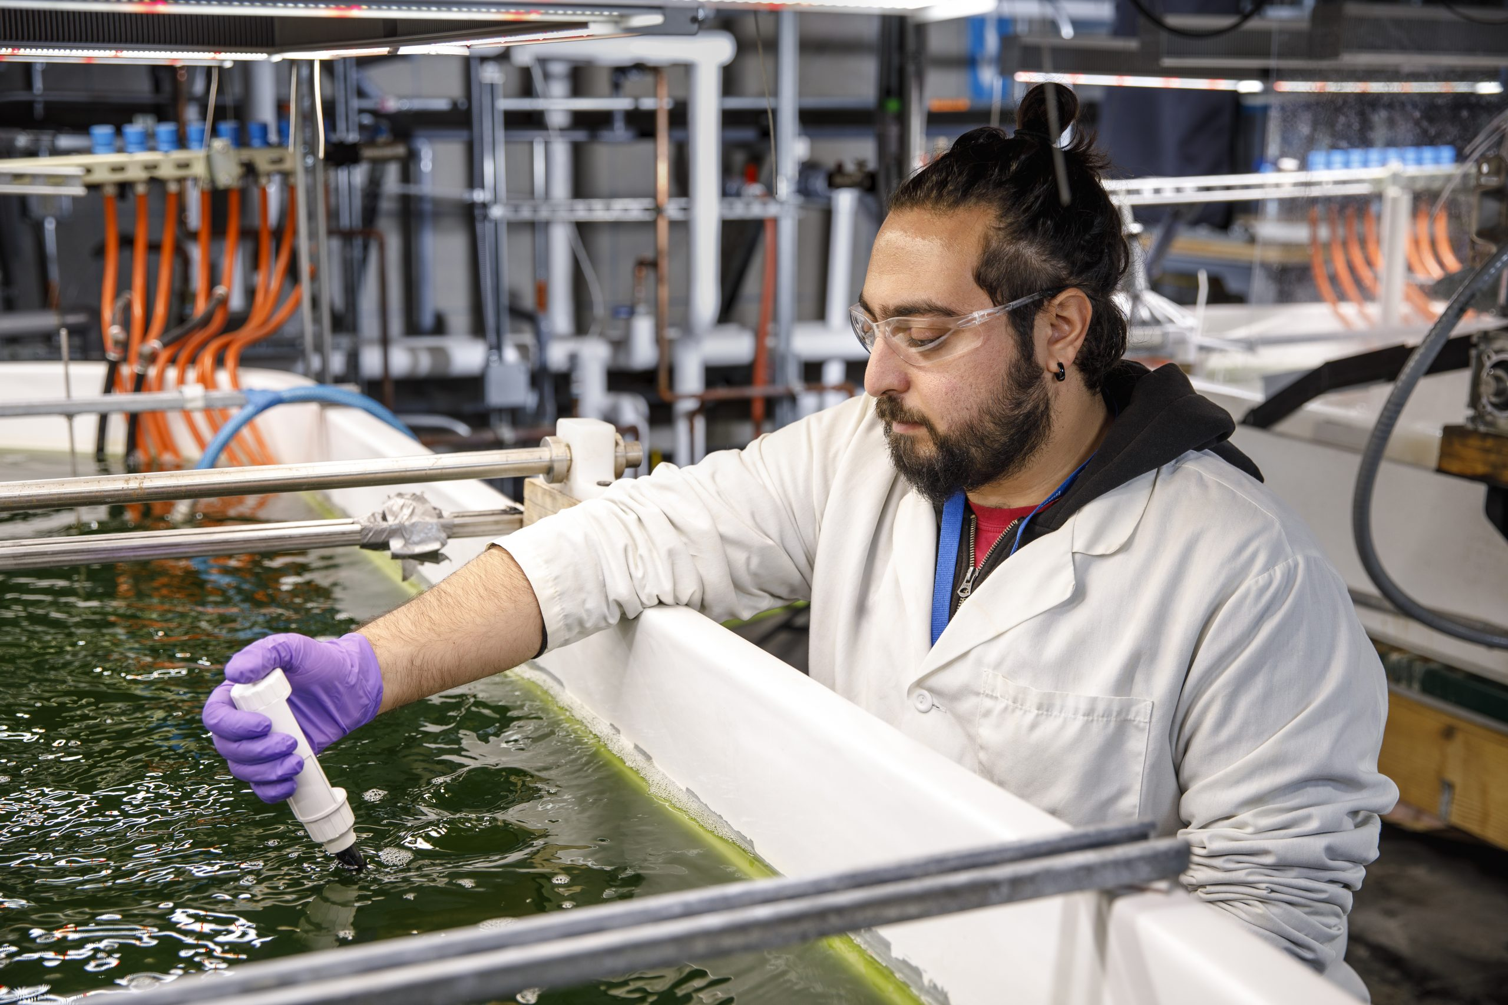
Acknowledgements
Tyler Bernard
Thomas Sheffield
Mark Forrer
Yorgos Kepesidis
Jenna Schambach
Todd Lane
Daniel Yang
Elise Wilbourn
Matthew Hirakawa
Carolyn Fisher
Victoria Dy
Maggie Nostrand
Anna Fisher
Matthew Hirakawa
Questions?
rkrishn@sandia.gov

Slide 20
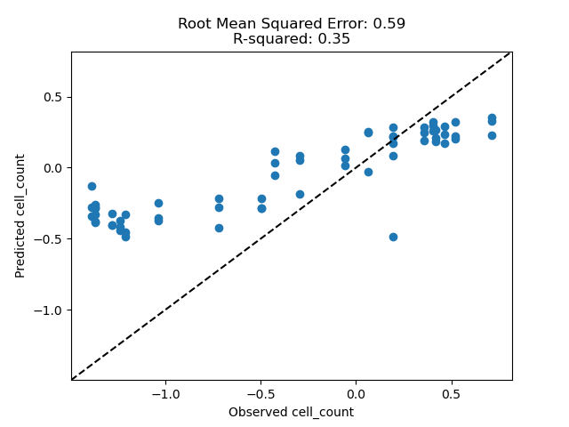
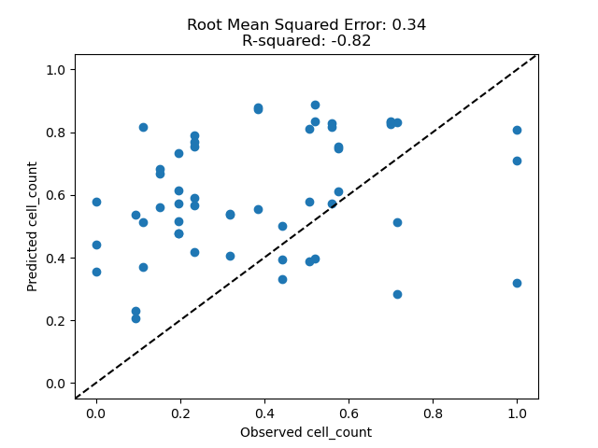
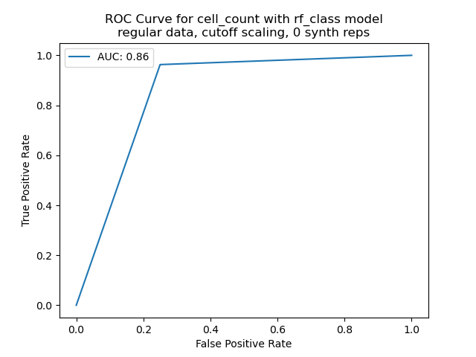
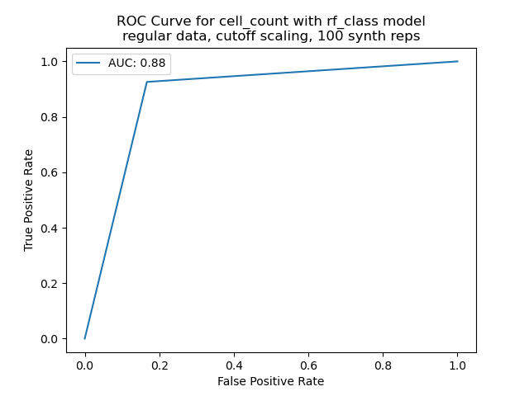
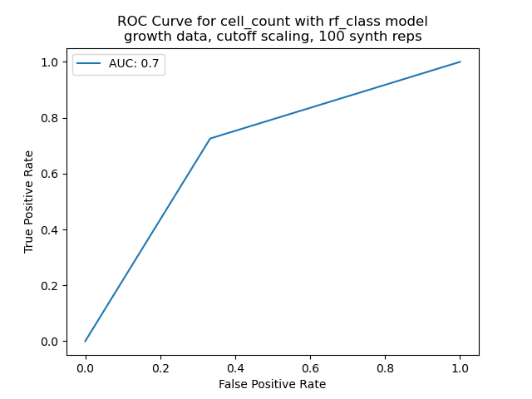
Selected Results
Random Forest Regression
RMSE: 0.59, R²: 0.35
Minmax Scaled Endpoints
RMSE: 0.21, R²: 0.63
Minmax Scaled Growth
RMSE: 0.34, R²: -0.82
Predicted Cell Count
Predicted Cell Count
Predicted Cell Growth
Observed Cell Count
Observed Cell Count
Observed Cell Growth
Cell Count Classification
Cell Count with Synthetic Data
Growth with Synthetic Data
True Positive Rate
AUC: 0.86
True Positive Rate
AUC: 0.88
True Positive Rate
AUC: 0.70
False Positive Rate
False Positive Rate
False Positive Rate

