Slide 1


PySIDT: Subgraph Isomorphic Decision Trees (SIDTs) for Molecular Property Prediction
Matthew S. Johnson and Judit Zádor
Department of Gas Phase Chemical Physics, Sandia National Laboratories

Slide 2
Molecular Property Prediction
Heuristic methods (Benson group additivity, UNIFAC, Joback)
  Can use data very efficiently
  Easily interpretable
  Can be very time intensive to construct, maintain, and extend
Deep Neural Networks (DNNs)
  Can train automatically off of data with minimal assumptions on form of model
  Can operate on very large datasets
  Relationship between structure and properties can be less clear
  Require very large datasets
  Challenging to interpret
  Large memory requirements even during inference
  Difficult to incorporate qualitative chemical knowledge
  Uncertainty estimation is challenging

Slide 3
Molecular Property Prediction
Neural Network Models + Molecules → Molecular DNNs
Heuristic Molecular Models + Machine Learning → ?

Slide 4
Subgraph Isomorphic Decision Tree (SIDT)
A SIDT makes predictions by starting with a molecular-graph input at the top of the tree
This input is checked against the subgraphs at the nodes connected below it
  If it matches one it moves to to that node
  If it doesn’t match any it stops at its current node
The output is then predicted based on what node the input stopped at
R1-H + R2•
C-H + R2•
O-H + R2•
O-CH2-H + R2•
C-CH2-H + R2•
O-H + C•
O-H + O•
Johnson, M. S., & Green, W. H. (2024). A machine learning based approach to reaction rate estimation. Reaction Chemistry & Engineering, 9(6), 1364–1380. https://doi.org/10.1039/D3RE00684K

Slide 5
Subgraph Isomorphic Decision Tree (SIDT)
Scale down well to smaller dataset sizes
As trees of molecular substructures are inherently readable and easy to visualize
Straightforward to extend and retrain
Inherent error cancellation on relative properties
Uncertainty estimation is usually straightforward
Enable easy integration of qualitative chemical knowledge
R1-H + R2•
C-H + R2•
O-H + R2•
O-CH2-H + R2•
C-CH2-H + R2•
O-H + C•
O-H + O•
Johnson, M. S., & Green, W. H. (2024). A machine learning based approach to reaction rate estimation. Reaction Chemistry & Engineering, 9(6), 1364–1380. https://doi.org/10.1039/D3RE00684K

Slide 6
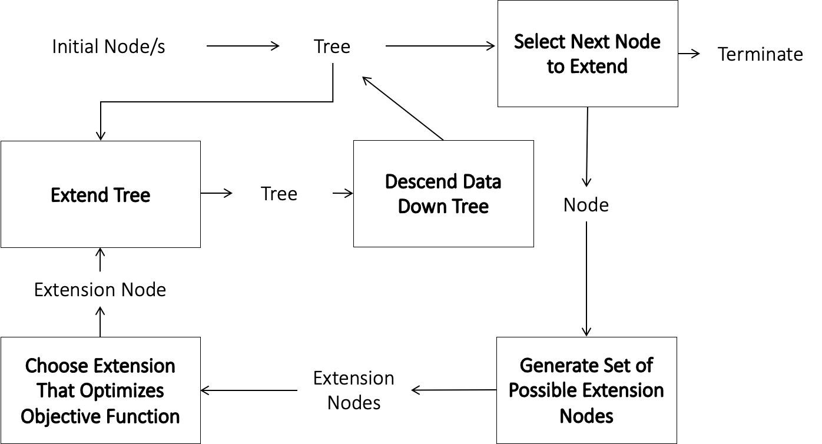
Decision Tree Training Algorithms
Johnson, M. S., & Green, W. H. (2024). A machine learning based approach to reaction rate estimation. Reaction Chemistry & Engineering, 9(6), 1364–1380. https://doi.org/10.1039/D3RE00684K

Slide 7
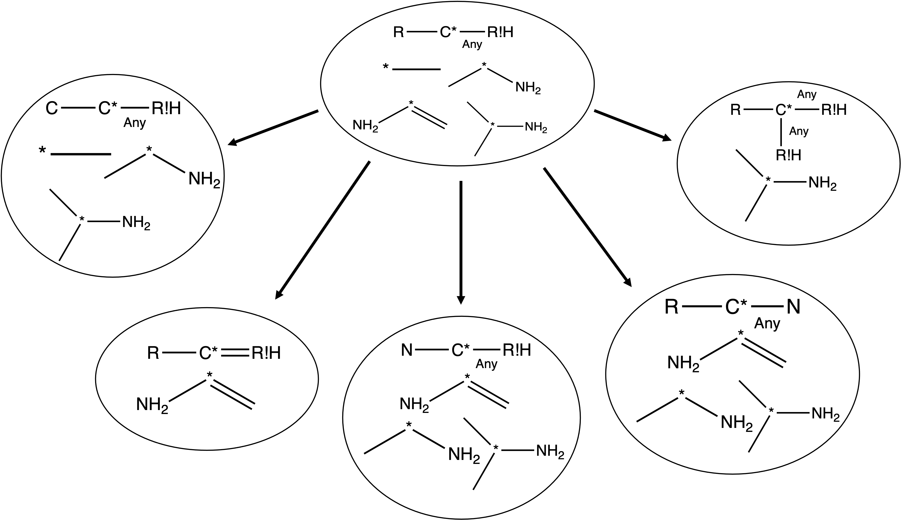
How do we find new extensions?
Individual Extension Types:
  Atom specification: Define the type of a currently undefined atom
  Internal Bond Creation: Form a bond of undefined order between two existing atoms
  External Bond Creation: Form a bond of undefined order between an atom in the molecule and a new R!H atom
  Bond specification: Define the order of a bond that has undefined order
  Unpaired Electron specification: Define the number of unpaired electrons on an atom
  Ring Attribute specification: Define whether an atom is in a ring or not
Explore bond creation extensions recursively until they divide the structures at the node
Collect all extensions that match some but not all of the structures at the node

Slide 8
SIDT Training Algorithm Variants
Single-Evaluation SIDT
  For predicting properties of tagged localities of molecule/s
  Training data is tagged structures with numerical or binary values
  Ex: reaction rate coefficients, pKa, surface diffusion coefficients, bond lengths, HBI corrections
Multi-Evaluation SIDT Regressor
  For predicting the properties of whole molecules or structures
  Training data is untagged structures with numerical values
  A decomposition is applied to each training structure to generate sets of tagged structures (such as tagging each atom or bond, or pairs of bonds etc.)
  Ex: energies of formation, heat capacity, energy corrections
Multi-Evaluation SIDT Binary Classifier
  For predicting binary properties of whole molecules or structures that are dependent on properties of individual localities
  Training data is untagged structures with binary values
  A decomposition is applied to each training structure to generate sets of tagged structures (such as tagging each atom or bond, or pairs of bonds etc.)
  Ex: stability, toxicity,

Slide 9
SIDT Analysis and Debugging
Since we extend SIDTs based on the data that match the nodes we retain a clear relationship between the rule at each node and the training data that determine it
Additionally, our subgraph/group representations of molecular substructures are very human readable
Put together this makes it very easy to analyze:
  Why SIDT is making a particular prediction
  What training data underlie that prediction
  How you might change a prediction:
    What new training data to add
    How to improve decompositions
    How to improve how you construct or evaluate the tree

Slide 10
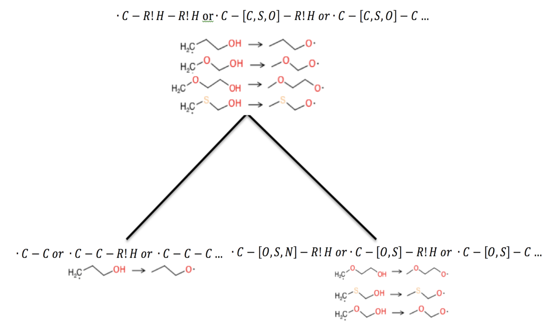
Embedding Qualitative Chemical Knowledge: Regularization in SIDTs
Regularization is fundamentally choosing between different models that have similar training accuracies
As you can see to the right there are many different groups that result in the same reactions splits and thus training accuracy
Applying a different regularization algorithm lets users embed their own assumptions about the chemical system

Slide 11
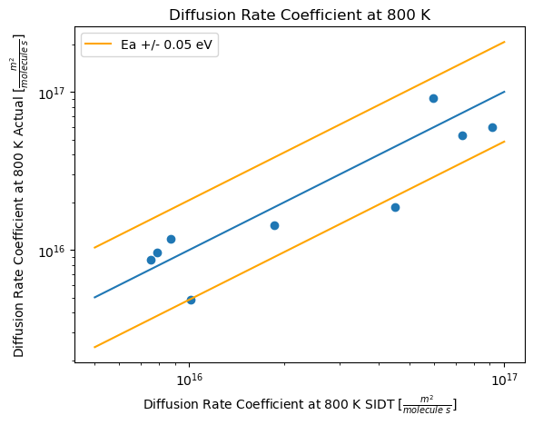
Aside on Small Datasets: Diffusion Coefficients on Cu111
Most well-studied problems are well-studied because they are hard and hard problems usually require very large datasets
DNN methods tend to require larger datasets
This can create the misconception that large datasets are always required
In reality, problems have a full ranges of difficulties with different data requirements
Here we look at fcc-hcp surface diffusion rate coefficients on Cu111 important for catalysis
Only 9 data points
Generated SIDT model accounts for about 80% of the variance in the data
Learning on this small of a dataset is possible because:
  The problem has low data requirements
  SIDT is able to learn from a dataset that small

Slide 12
Comparison with Heuristic Methods

Slide 13
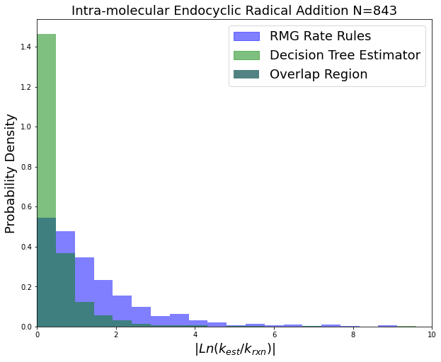
Gas-Phase Rate Coefficient Prediction
Rate coefficients are important for predicting the kinetics of important chemical systems
Gas phase rate coefficient SIDT predictors trained for five different reaction families using data from the RMG-database
Compared with the RMG-database’s native heuristic rate rule scheme
On the shown Intra-molecular Endocyclic Radical Addition reaction family:
  Rate Rules (Heuristics) MAE Factor Error: 98.3
  SIDT MAE Factor Error: 7.07
Johnson, M. S., & Green, W. H. (2024). A machine learning based approach to reaction rate estimation. Reaction Chemistry & Engineering, 9(6), 1364–1380. https://doi.org/10.1039/D3RE00684K

Slide 14
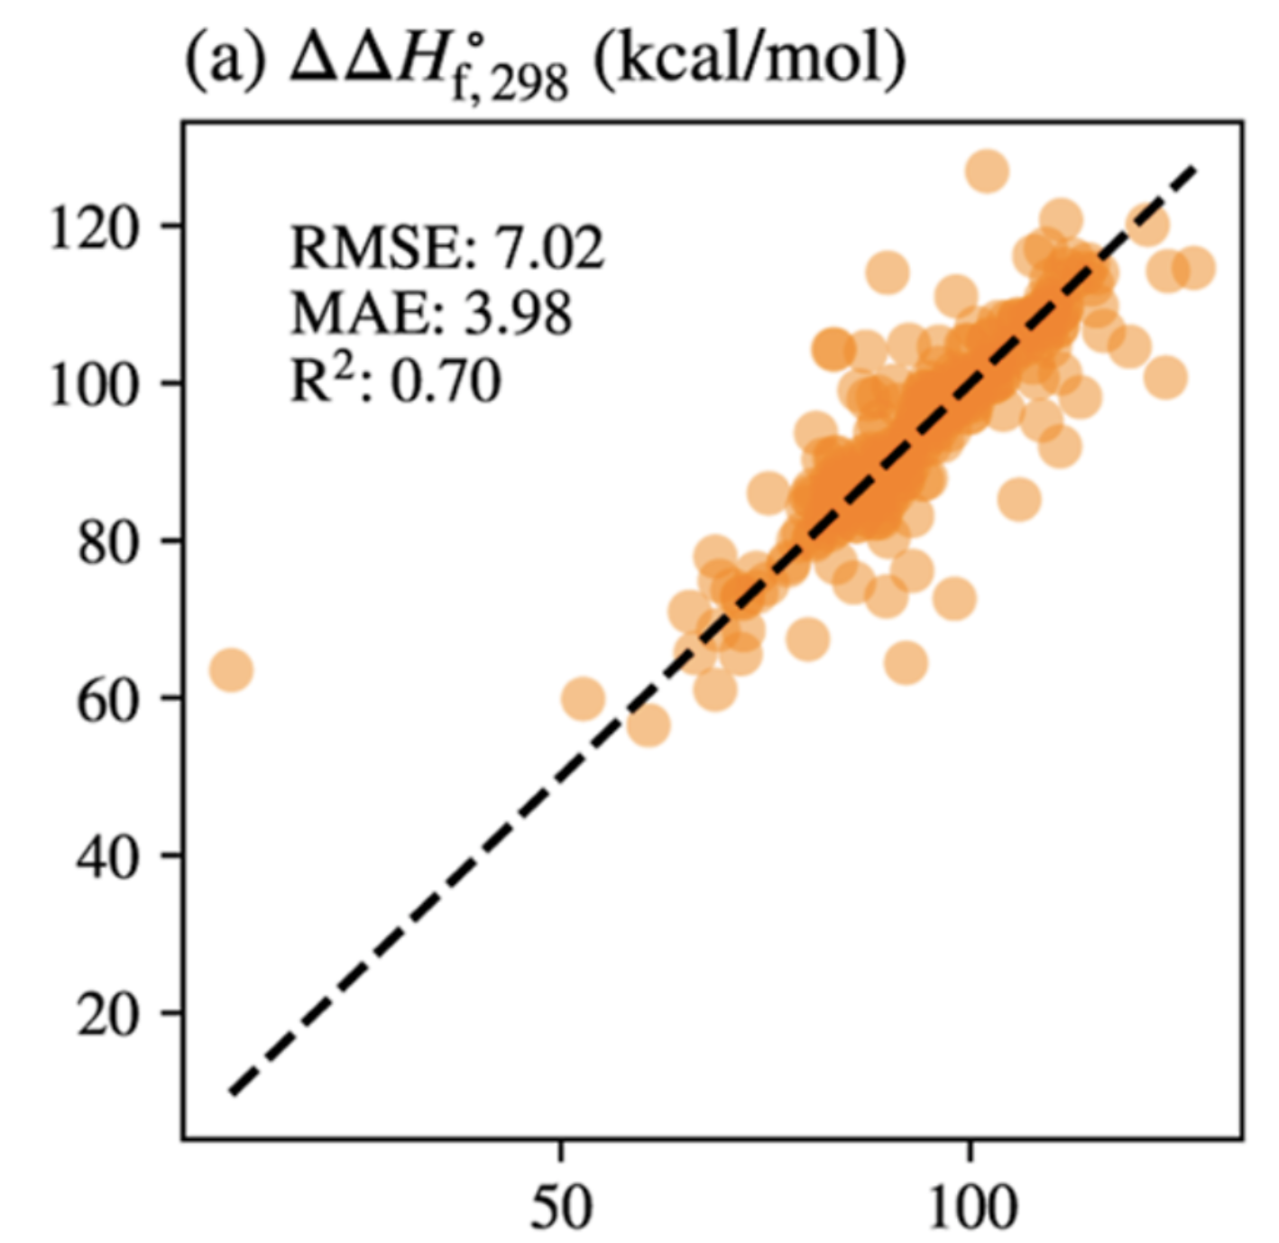
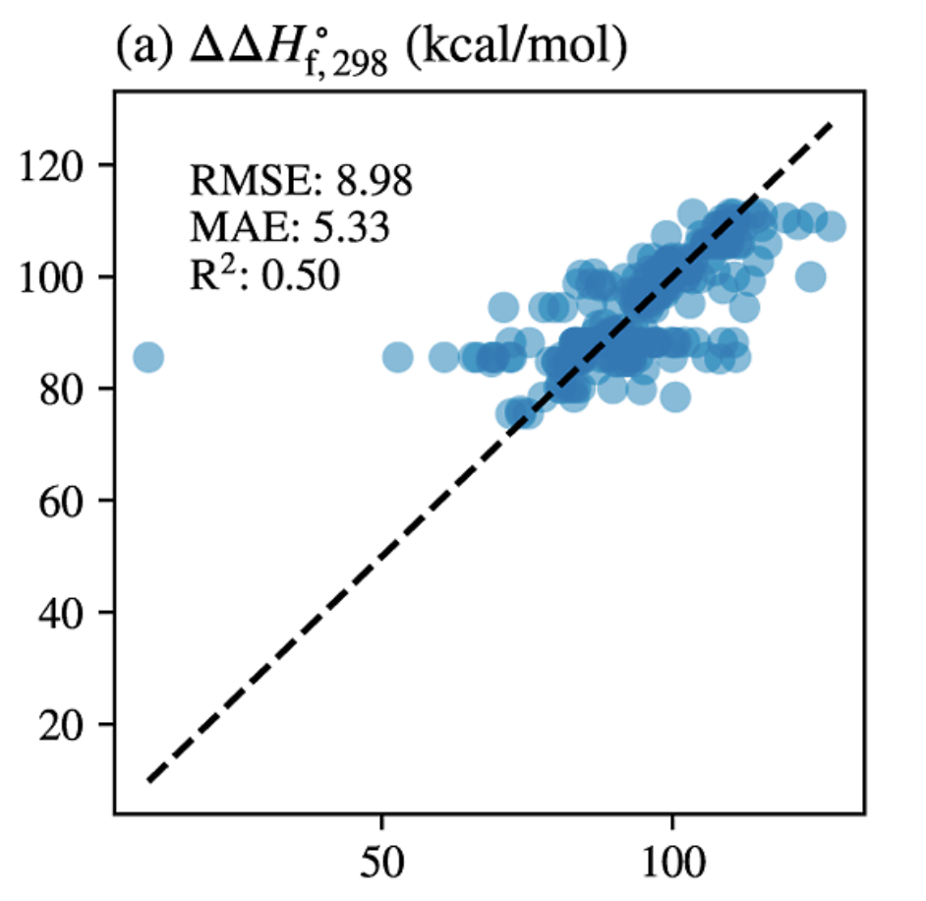
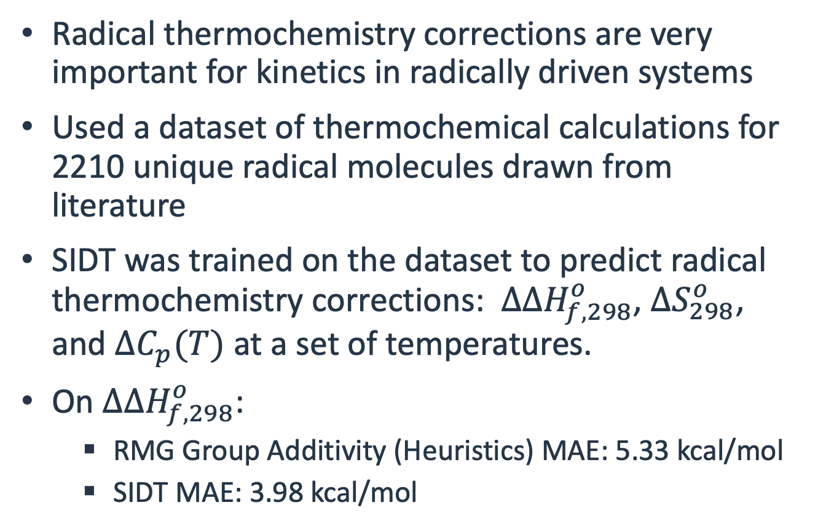
Radical Thermochemistry Corrections (HBI)
Radical thermochemistry corrections are very important for kinetics in radically driven systems
Used a dataset of thermochemical calculations for 2210 unique radical molecules drawn from literature
SIDT was trained on the dataset to predict radical thermochemistry corrections: $ΔΔH_{f,298}^{o}$, $ΔS_{298}^{o}$, and $ΔC_{p}(T)$ at a set of temperatures.
On $ΔΔH_{f,298}^{o}$:
  RMG Group Additivity (Heuristics) MAE: 5.33 kcal/mol
  SIDT MAE: 3.98 kcal/mol
SIDT
RMG Heuristics
Pang, H. W., Dong, X., Johnson, M. S., & Green, W. H. (2024). Subgraph Isomorphic Decision Tree to Predict Radical Thermochemistry with Bounded Uncertainty Estimation. Journal of Physical Chemistry A, 128(14), 2891–2907. https://doi.org/10.1021/ACS.JPCA.4C00569

Slide 15
Comparison with DNN Methods

Slide 16
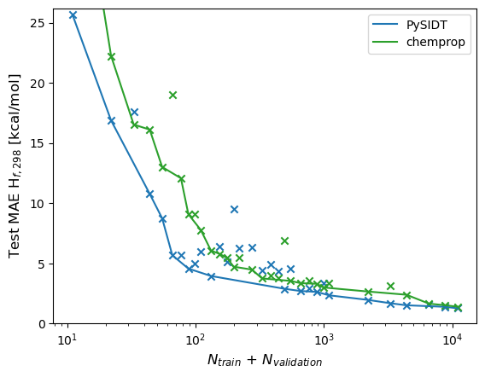
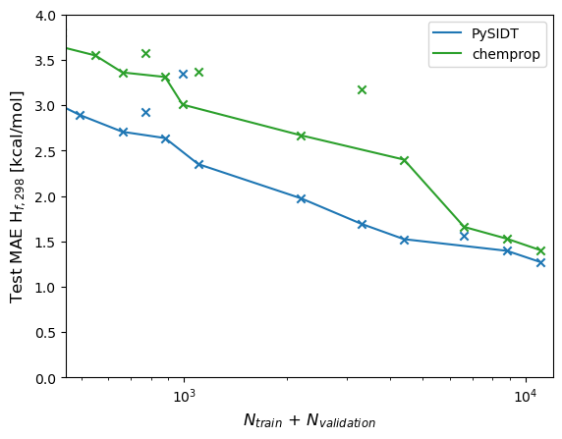
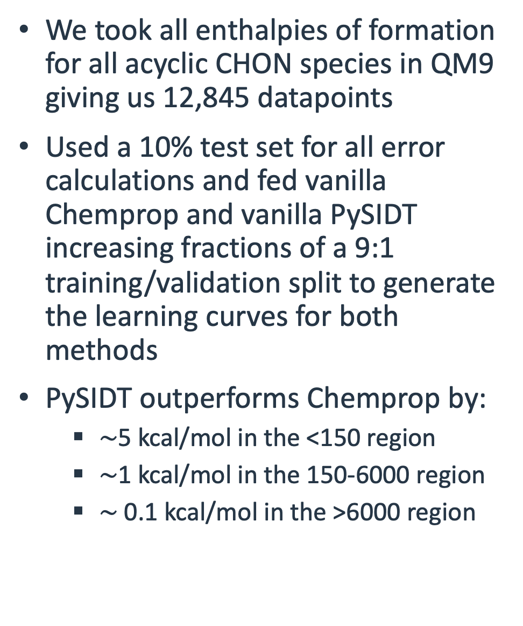
Enthalpies of Formation
We took all enthalpies of formation for all acyclic CHON species in QM9 giving us 12,845 datapoints
Used a 10% test set for all error calculations and fed vanilla Chemprop and vanilla PySIDT increasing fractions of a 9:1 training/validation split to generate the learning curves for both methods
PySIDT outperforms Chemprop by:
  $∼$5 kcal/mol in the <150 region
  $∼$1 kcal/mol in the 150-6000 region
  $∼$ 0.1 kcal/mol in the >6000 region

Slide 17
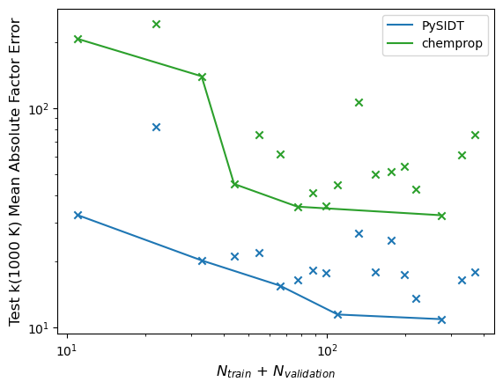
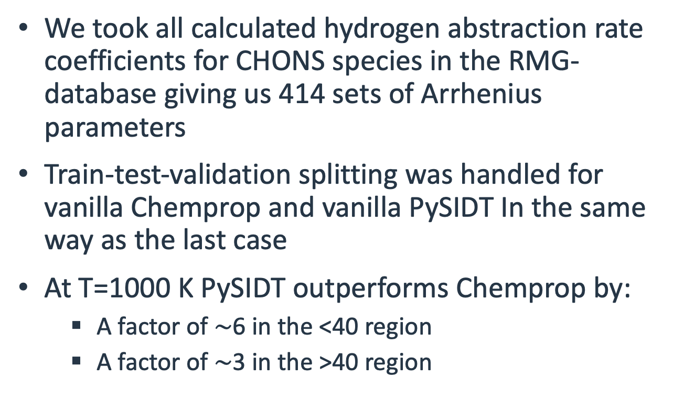
Hydrogen Abstraction Rate Coefficients
We took all calculated hydrogen abstraction rate coefficients for CHONS species in the RMG-database giving us 414 sets of Arrhenius parameters
Train-test-validation splitting was handled for vanilla Chemprop and vanilla PySIDT In the same way as the last case
At T=1000 K PySIDT outperforms Chemprop by:
  A factor of $∼$6 in the <40 region
  A factor of $∼$3 in the >40 region

Slide 18
SIDT Examples

Slide 19
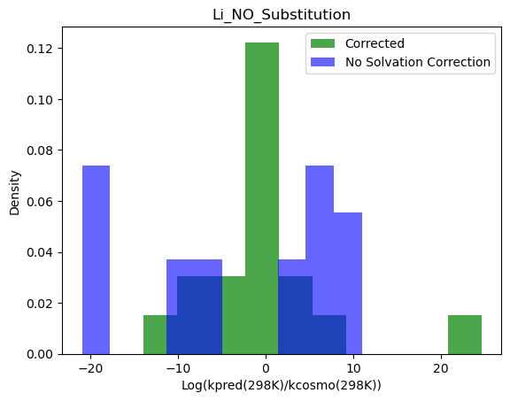
Transfer Learning: Kinetic Solvent Effect (KSE) Corrections
Chemical reactions occur at different speeds in different solvents and gas phase as a result of kinetic solvent effects
Since gas phase data is more plentiful we utilized transfer learning to predict kinetic solvent effects:
  We train a rate coefficient SIDT on gas phase data
  Then we copied that SIDT
  We descend the KSE data (that has the same molecular representation as the rate coefficient data) down the tree
  We fit rules to the KSE data
The resulting kinetic solvent effect predictions using leave-one-out:
  No Correction MAE Factor: 28000
  SIDT KSE MAE Factor: 153
Distribution of errors for Ln(k) in the RMG Li_NO_Substitution family in a 50:50 ethylene carbonate and dimethyl carbonate solution

Slide 20
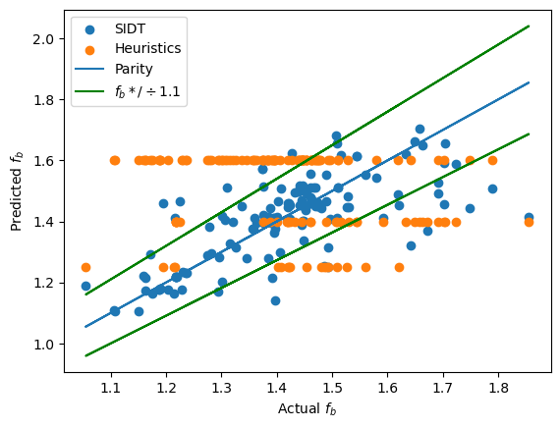
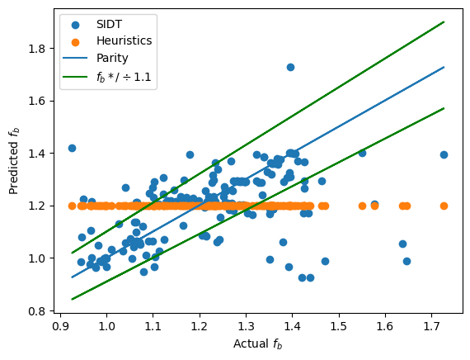
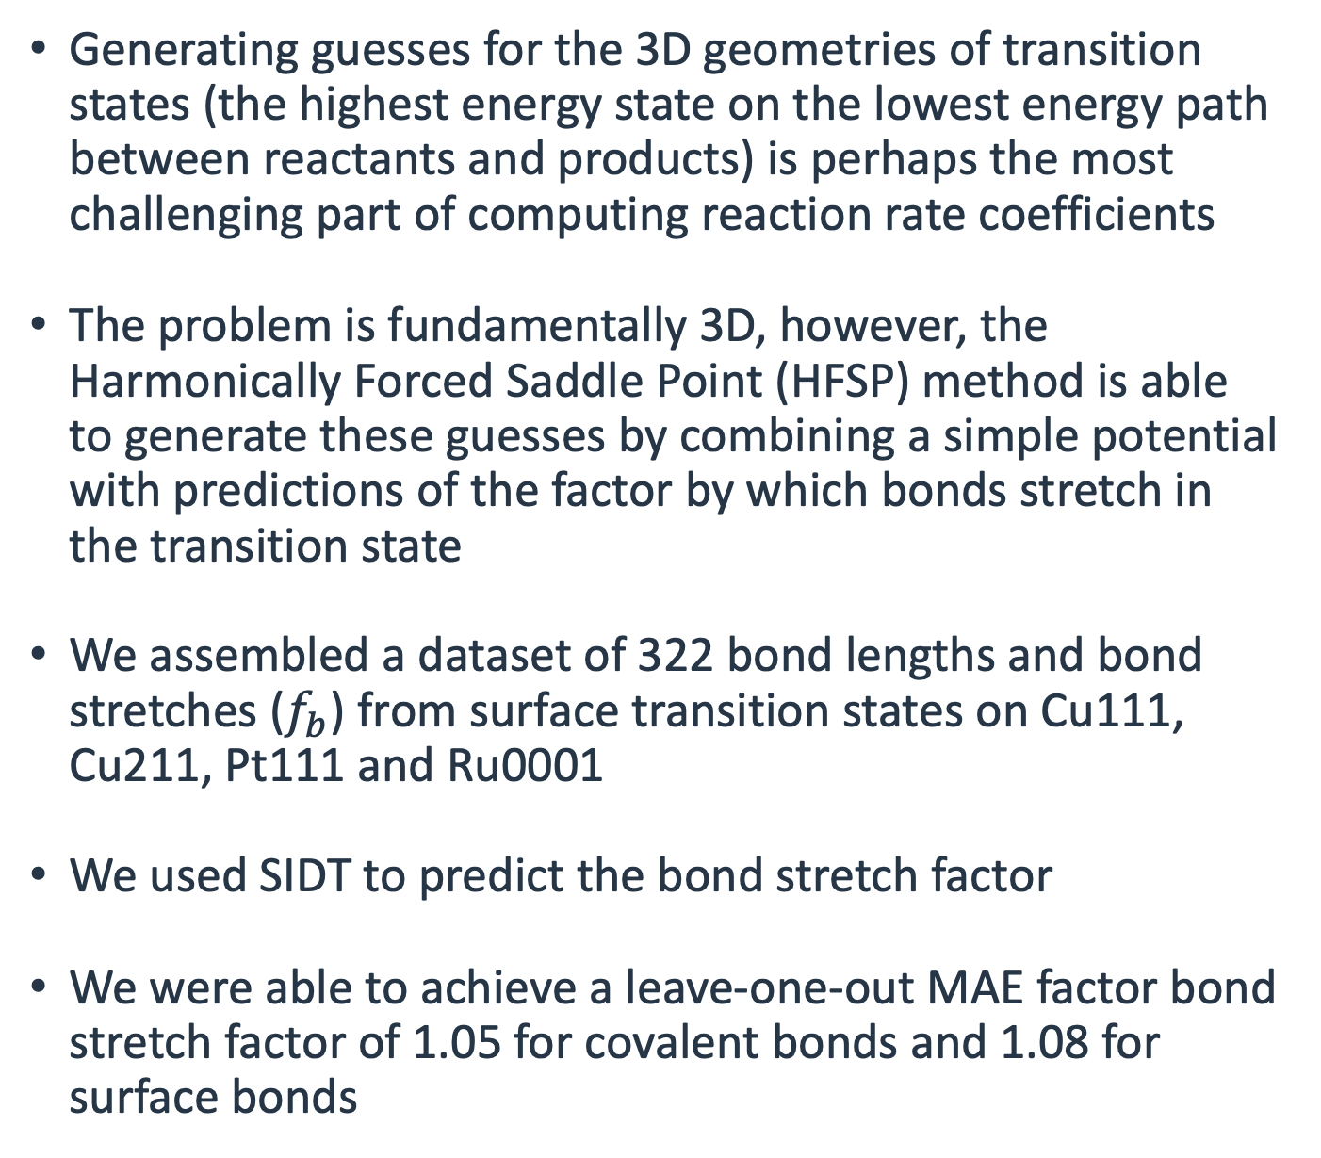
Converting 3D problems to 2D: TS Bond Stretch Factor Prediction
Generating guesses for the 3D geometries of transition states (the highest energy state on the lowest energy path between reactants and products) is perhaps the most challenging part of computing reaction rate coefficients
The problem is fundamentally 3D, however, the Harmonically Forced Saddle Point (HFSP) method is able to generate these guesses by combining a simple potential with predictions of the factor by which bonds stretch in the transition state
We assembled a dataset of 322 bond lengths and bond stretches ($f_{b}$) from surface transition states on Cu111, Cu211, Pt111 and Ru0001
We used SIDT to predict the bond stretch factor
We were able to achieve a leave-one-out MAE factor bond stretch factor of 1.05 for covalent bonds and 1.08 for surface bonds
Covalent Bonds
Surface Bonds

Slide 21
Combining Single-Evaluation Predictions: pKa Prediction
pKa is a critical property for drug discovery, design synthesis and formulation
While pKa is a general molecular property, the pKa of a molecule is equal to the deprotonation/protonation site with the lowest micro-pKa
We constructed a single-evaluation SIDT for predicting the micro-pKa of individual protonation sites using 1,964 micro-pKa values based on Baltruschat and Czodrowski
Using a 9:1 train-test split and taking the minimum of all micro-pKa’s we are able to predict the true pKa with MAE/RMSE of 0.85/1.38

Slide 22
Enthalpy of Formation Prediction
Enthalpy of formation is important for predicting important kinetic parameters such as heat of reaction and reverse rate coefficients
Used a dataset of high accuracy thermochemistry for 5000 closed shell molecules involving C, H, O, and N atoms.
Decomposed around every heavy atom:
  Ex: (CH3-OH => C*H3-OH + CH3-O*H)
Used a train/val/test = 4000/500/500
Test MAE: 1.96 kcal/mol

Slide 23
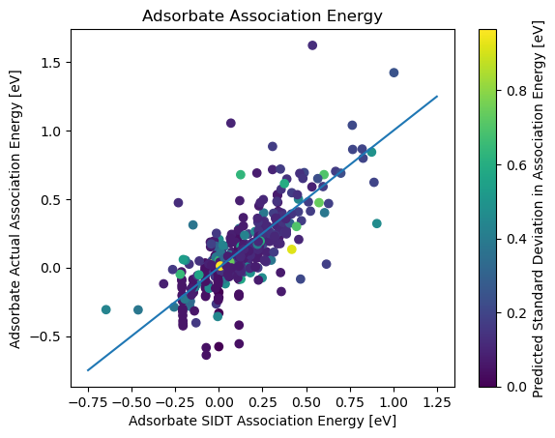
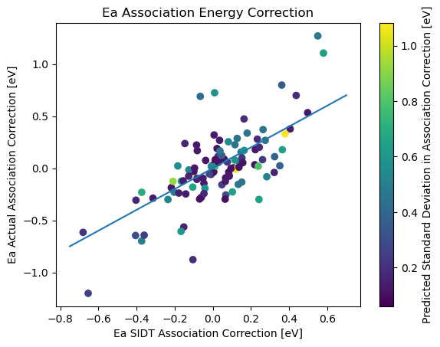
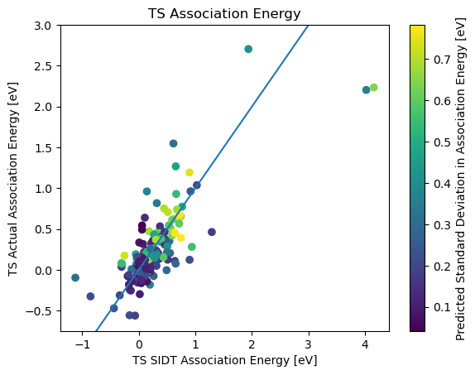
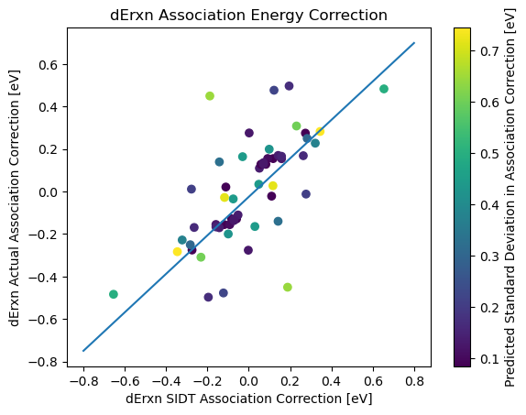
Surface Association Energy Prediction for Coverage Dependence
In chemical systems on surfaces kinetic parameters can be significantly altered by the presence/coverage of other nearby adsorbates
We trained a pair of SIDTs on single surface bond and pairs of surface bonds decompositions on 207 transition states and 477 adsorbates
We achieved leave-one-out errors of:
  Adsorbate Energy: MAE 0.107 eV
  Transition State Energy: MAE 0.172 eV
  Reaction Energy: MAE 0.130 eV
  Activation Barrier: MAE 0.176 eV
Due to natural error cancellation in SIDTs on relative properties our performance on composite properties (activation barrier and activation barrier) is significantly better than one would expect
Johnson, M. S., Bross, D. H., Zádor,J. Resolving Kinetic Coverage Dependence with Machine Learning and Automated Quantum Chemistry Workflows. In preparation.

Slide 24
Active Learning: Coverage Dependence
Coverage Dependence Active Learning Loop
In chemical systems on surfaces kinetic parameters can be significantly altered by the presence/coverage of other nearby adsorbates
There are many possible ways to place adsorbates/TSs on surfaces
Rather than calculating all possible configurations we can use active learning, iteratively selecting additional calculations to run enabling us to converge to accuracy
We take advantage of the structure and uncertainties of the SIDT to select configurations to calculate that are associated with SIDT nodes/substructures that have:
  High occurrence rates (in the configurations we are predicting on)
  High uncertainties
  Associated with low energy configurations (that matter more than others in this application)
Train SIDT Model
Evaluate Configurations
Develop Weights from SIDT Contributions and Uncertainties
Select Set of Uncalculated Configurations Based on Weights
Calculate New Configurations

Slide 25
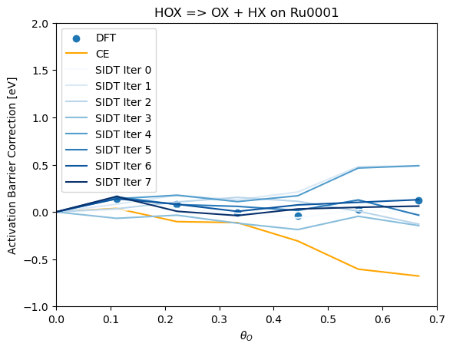
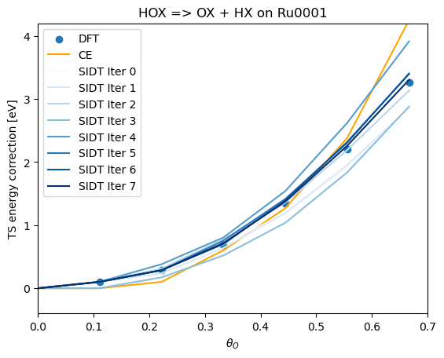
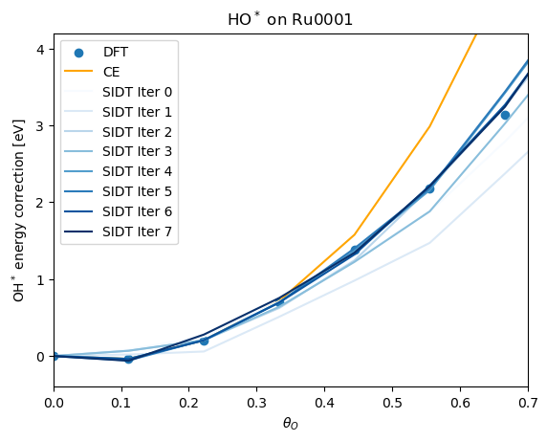
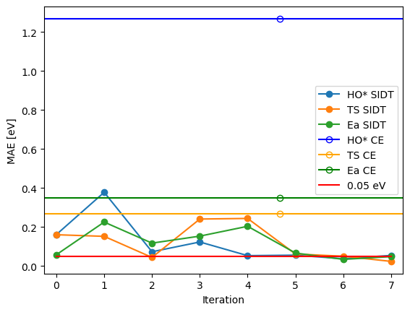
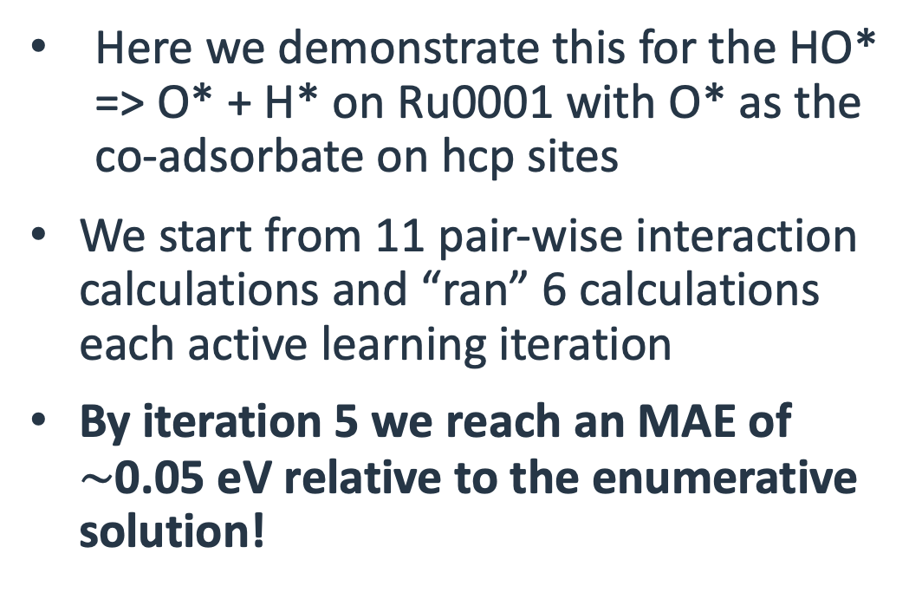
Active Learning: Coverage Dependence
Here we demonstrate this for the HO* => O* + H* on Ru0001 with O* as the co-adsorbate on hcp sites
We start from 11 pair-wise interaction calculations and “ran” 6 calculations each active learning iteration
By iteration 5 we reach an MAE of $∼$0.05 eV relative to the enumerative solution!

Slide 26
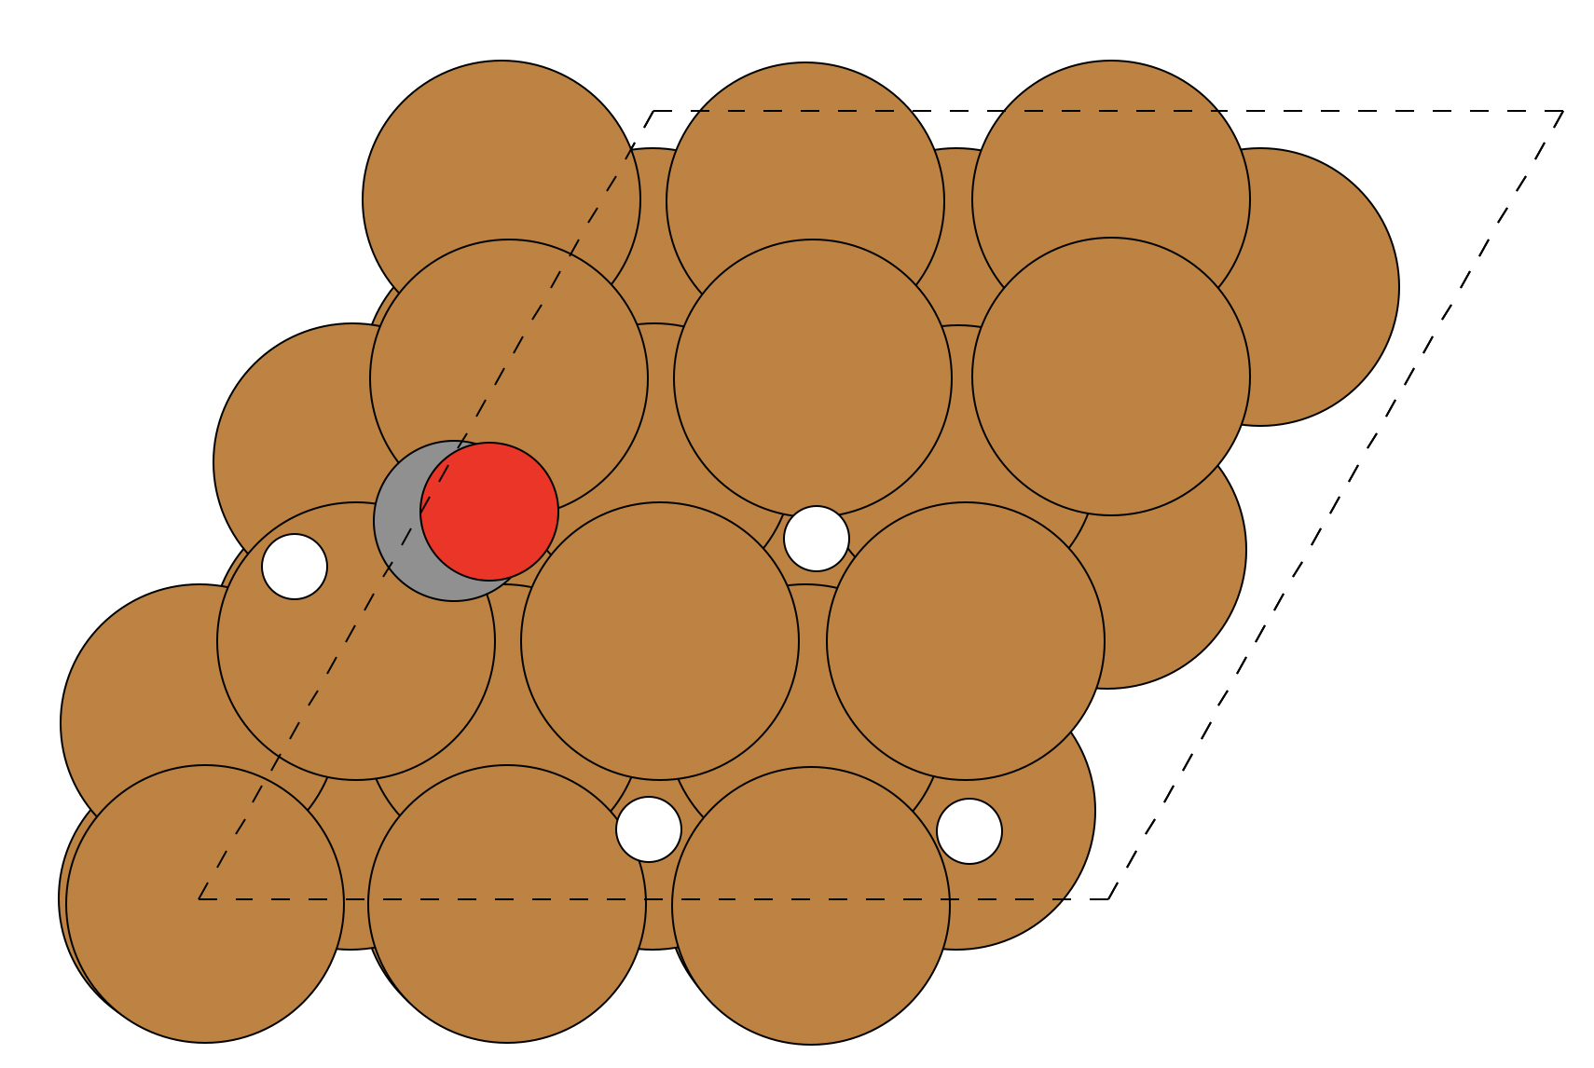
Stability Classification for Coverage Dependence
In chemical systems on surfaces kinetic parameters can be significantly altered by the presence/coverage of other nearby adsorbates
However not all configurations one might propose are stable
We trained an SIDT on 1720 attempted configuration calculations using the same decompositions as the regressor for coverage dependence to predict configuration stability
We achieved an accuracy of 86%
 | Predict True | Predict False
Value True | 91 | 9
Value False | 14 | 49

Slide 27
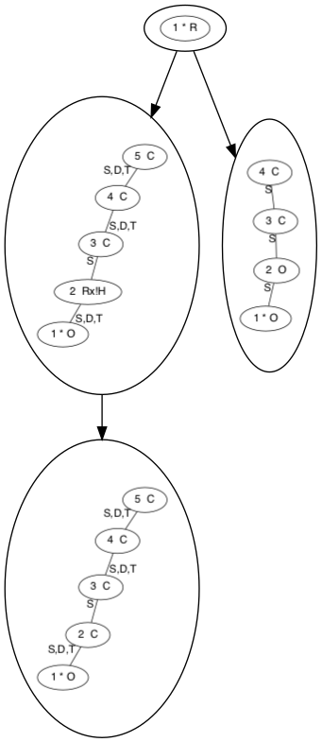
Stability of Molecules
Some chemical species one might propose are unstable such as nearly all molecules of the form –C·H-O-OH where C· denotes a radical
Based on this rule we supplied the SIDT algorithm with 39 stable and 4 unstable linear molecules and used an every heavy atom decomposition
  Ex: CH3-OH => C*H3-OH && CH3-O*H
The simplified tree and the associated adjacency list representations is shown
To most of you, unfamiliar with the RMG adjacency list format what you can read won’t be entirely clear
However, with some familiarity with the format and a careful reading one can in a relatively straightforward manner tell:
  How the SIDT thinks
  When the SIDT will fail
(True)
1 * R ux
(False)
1 * O u0 {2,[S,D,T]}
2 R!H ux {1,[S,D,T]} {3,S}
3 C u1 {2,S} {4,[S,D,T]}
4 C ux {3,[S,D,T]} {5,[S,D,T]}
5 C u0 {4,[S,D,T]}
(False)
1 * O ux {2,S}
2 O ux {1,S} {3,S}
3 C u1 {2,S} {4,[S,D,T]}
4 C u0 {3,[S,D,T]}
(True)
1 * O u0 {2,[S,D,T]}
2 C ux {1,[S,D,T]} {3,S}
3 C u1 {2,S} {4,[S,D,T]}
4 C ux {3,[S,D,T]} {5,[S,D,T]}
5 C u0 {4,[S,D,T]}

Slide 28
Conclusions
We have presented Subgraph Isomorphic Decision Tree (SIDT) machine learning technique for molecular property prediction
In our new software PySIDT we implement three SIDT algorithms:
  Single-Evaluation SIDT
  Multi-Evaluation SIDT Regressor
  Multi-Evaluation SIDT Binary Classifier
We have demonstrated that SIDTs can outperform deep-neural-network-based approaches in vanilla comparisons in the ≤10,000 datapoint regime
We have shown a highly diverse set of 10 different application examples
We believe these SIDT algorithms represent a significant improvement in the state-of-the-art for smaller scale molecular property prediction tasks SIDTs:
  Scale down to datasets sizes much smaller than is feasible for DNNs
  Are inherently readable and visualizable making them easy to analyze
  Are straightforward to extend and retrain
  Enable straightforward uncertainty estimation
  Can easily integrate expert knowledge
R1-H + R2•
C-H + R2•
O-H + R2•
O-CH2-H + R2•
C-CH2-H + R2•
O-H + C•
O-H + O•

Slide 29
Acknowledgements
Funding from the Exascale Catalytic Chemistry (ECC) Project
Sandia National Laboratories is a multimission laboratory managed and operated by National Technology & Engineering Solutions of Sandia, LLC, a wholly owned subsidiary of Honeywell International Inc., for the U.S. Department of Energy’s National Nuclear Security Administration under contract DE-NA0003525.

