Slide 1
Exploring Improvements to neural Galerkin Methods
For time-dependent PDEs
Brian Chen, Drew Kouri, James Stokes, Shravan Veerapaneni
1463
Aug 2025
SAND2025-08976C

Slide 2
Modeling time-dependent Pdes with neural networks
A lot of research over the past few years into using neural networks for modeling PDEs
Physics-informed neural networks¹
Neural operators^{2,3}
Traditional numerical methods work very well – why bother?
Hopefully can scale to high-dimensional problems⁴
Hopefully can provide faster solutions, within say PDE-constrained optimization⁵
1: Physics-informed neural networks: A deep learning framework for solving forward and inverse problems involving nonlinear partial differential equations, Raissi, Perdikaris, and Karniadakis (2019)
2: Physics-Informed Neural Operator for Learning Partial Differential Equations, Li, Zheng, Kovachki, Jin, Chen, Liu, Azizzadenesheli, and Anandkumar (2021)
3: DeepONet: Learning nonlinear operators for identifying differential equations based on the universal approximation theorem of operators, L. Lu, P. Jin, G. Karniadakis (2019)
4: Tackling the Curse of Dimensionality with Physics-Informed Neural Networks, Hu, Shukla, Karniadakis, and Kawaguchi (2024)
5: Efficient PDE-Constrained optimization under high-dimensional uncertainty using derivative-informed neural operators, Luo, O'Leary-Roseberry, Chen, and Ghattas (2024)

Slide 3


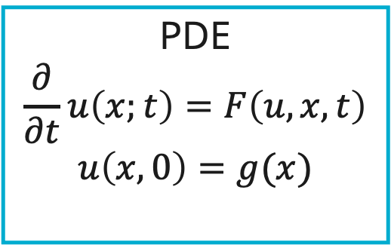

Another approach: evolutional deep Nn⁶ / neural Galerkin⁷
Suppose we knew a set of parameters $θ_{0}$ for a neural network that approximates the initial condition
$$v_{θ_{0}}(x)≈u(x,0)$$
How can we find parameters $θ_{0+δt}$ that approximate the solution at time $t=δt$?
PDE
$$\frac{∂}{∂t}u\left(x;t\right)=F\left(u,x,t\right)$$
$$u\left(x,0\right)=g(x)$$
6: Evolutional deep neural network, Du and Zaki (2021)
7: Neural Galerkin schemes with active learning for high-dimensional evolution equations, Bruna, Peherstorfer, and Vanden-EIjnden (2024)
?
$$u_{θ_{0}}\left(x\right)≈u(x,0)$$
$$u_{θ_{0+δt}}?$$

Slide 4
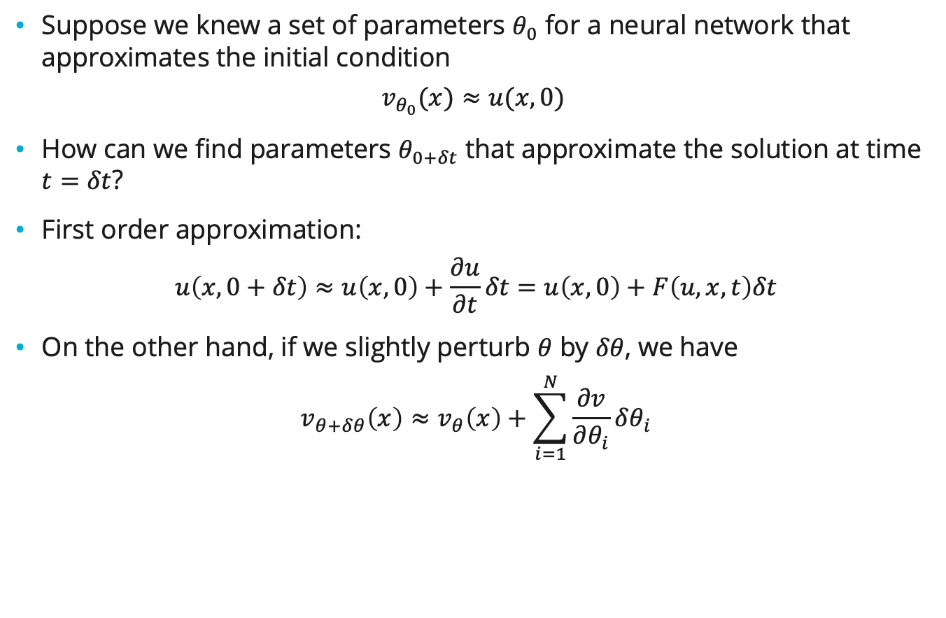
Another approach: evolutional deep Nn⁶ / neural Galerkin⁷
Suppose we knew a set of parameters $θ_{0}$ for a neural network that approximates the initial condition
$$v_{θ_{0}}(x)≈u(x,0)$$
How can we find parameters $θ_{0+δt}$ that approximate the solution at time $t=δt$?
First order approximation:
$$u\left(x,0+δt\right)≈u\left(x,0\right)+\frac{∂u}{∂t}δt=u\left(x,0\right)+F\left(u,x,t\right)δt$$
On the other hand, if we slightly perturb $θ$ by $δθ$, we have
$$v_{θ+δθ}\left(x\right)≈v_{θ}\left(x\right)+\sum_{i=1}^{N}{\frac{∂v}{∂θ_{i}}δθ_{i}}$$
PDE
$$\frac{∂}{∂t}u\left(x;t\right)=F\left(u,x,t\right)$$
$$u\left(x,0\right)=g(x)$$
Minimize some distance between these.
6: Evolutional deep neural network, Du and Zaki (2021)
7: Neural Galerkin schemes with active learning for high-dimensional evolution equations, Bruna, Peherstorfer, and Vanden-EIjnden (2024)
?
$$u_{θ_{0}}\left(x\right)≈u(x,0)$$
$$u_{θ_{0+δt}}?$$

Slide 5
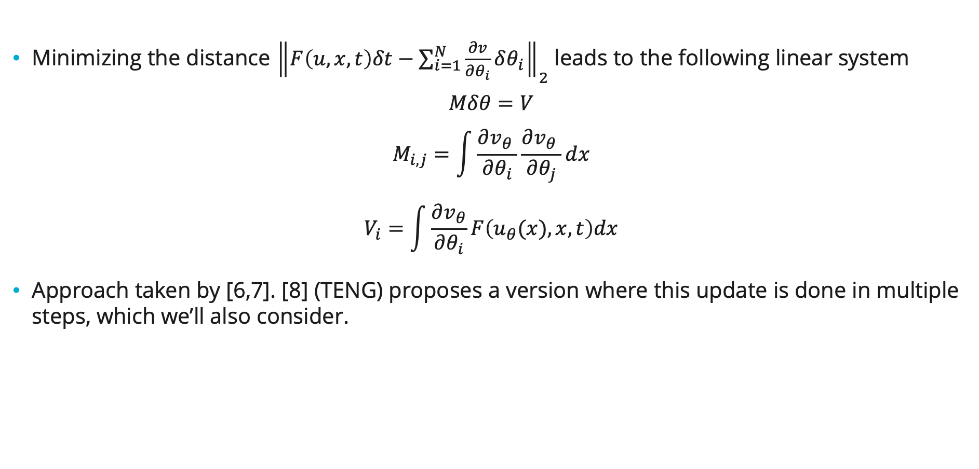
Evolutional Deep NN⁶ / Neural Galerkin⁷
Minimizing the distance ${\left\|F\left(u,x,t\right)δt−\sum_{i=1}^{N}{\frac{∂v}{∂θ_{i}}δθ_{i}}\right\|}_{2}$ leads to the following linear system
$$Mδθ=V$$
$$M_{i,j}=\int{\frac{∂v_{θ} }{∂θ_{i}}\frac{∂v_{θ} }{∂θ_{j}}dx}$$
$$V_{i}=\int{\frac{∂v_{θ}}{∂θ_{i}}F\left(u_{θ}(x), x, t\right)dx}$$
Approach taken by [6,7]. [8] (TENG) proposes a version where this update is done in multiple steps, which we’ll also consider.
6: Evolutional deep neural network, Du and Zaki (2021)
7: Neural Galerkin schemes with active learning for high-dimensional evolution equations, Bruna, Peherstorfer, and Vanden-EIjnden (2024)
8: TENG: Time-Evolving Natural Gradient for Solving PDEs With Deep Neural Nets Toward Machine Precision, Chen, McCarran, Vizcaino, Soljačić, and Luo (2024)

Slide 6
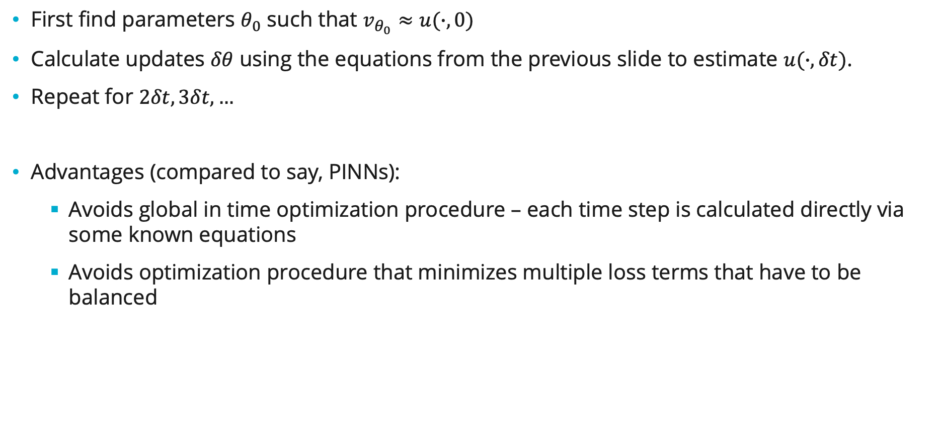
Evolutional Deep NN⁶ / Neural Galerkin⁷
First find parameters $θ_{0}$ such that $v_{θ_{0}}≈u(∙,0)$
Calculate updates $δθ$ using the equations from the previous slide to estimate $u(∙,δt)$.
Repeat for $2δt, 3δt, …$
Advantages (compared to say, PINNs):
Avoids global in time optimization procedure – each time step is calculated directly via some known equations
Avoids optimization procedure that minimizes multiple loss terms that have to be balanced
6: Evolutional deep neural network, Du and Zaki (2021)
7: Neural Galerkin schemes with active learning for high-dimensional evolution equations, Bruna, Peherstorfer, and Vanden-EIjnden (2024)

Slide 7
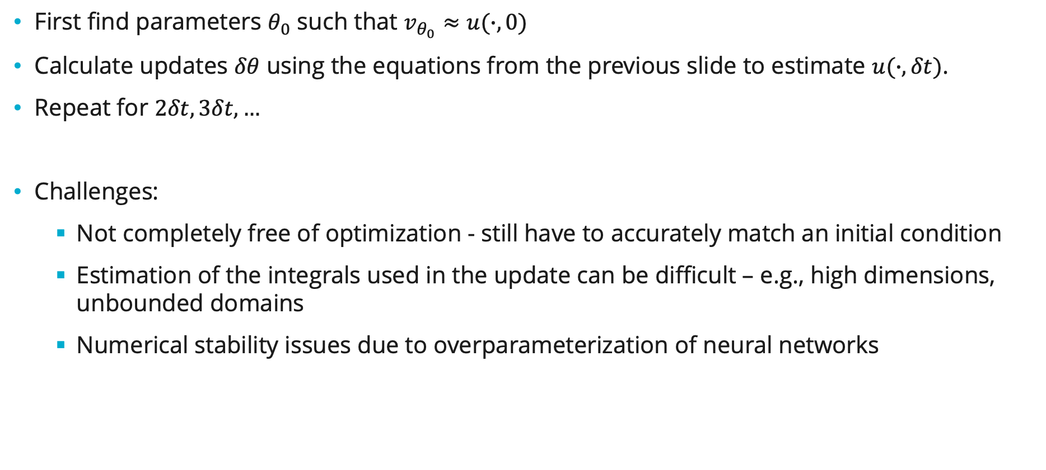
Evolutional Deep NN⁶ / Neural Galerkin⁷
First find parameters $θ_{0}$ such that $v_{θ_{0}}≈u(∙,0)$
Calculate updates $δθ$ using the equations from the previous slide to estimate $u(∙,δt)$.
Repeat for $2δt, 3δt, …$
Challenges:
Not completely free of optimization - still have to accurately match an initial condition
Estimation of the integrals used in the update can be difficult – e.g., high dimensions, unbounded domains
Numerical stability issues due to overparameterization of neural networks
6: Evolutional deep neural network, Du and Zaki (2021)
7: Neural Galerkin schemes with active learning for high-dimensional evolution equations, Bruna, Peherstorfer, and Vanden-EIjnden (2024)

Slide 8
Evolutional Deep NN⁶ / Neural Galerkin⁷
First find parameters $θ_{0}$ such that $v_{θ_{0}}≈u(∙,0)$
Calculate updates $δθ$ using the equations from the previous slide to estimate $u(∙,δt)$.
Repeat for $2δt, 3δt, …$
Challenges:
Not completely free of optimization - still have to accurately match an initial condition
Estimation of the integrals used in the update can be difficult – e.g., high dimensions, unbounded domains
Numerical stability issues due to overparameterization of neural networks
6: Evolutional deep neural network, Du and Zaki (2021)
7: Neural Galerkin schemes with active learning for high-dimensional evolution equations, Bruna, Peherstorfer, and Vanden-EIjnden (2024)

Slide 9
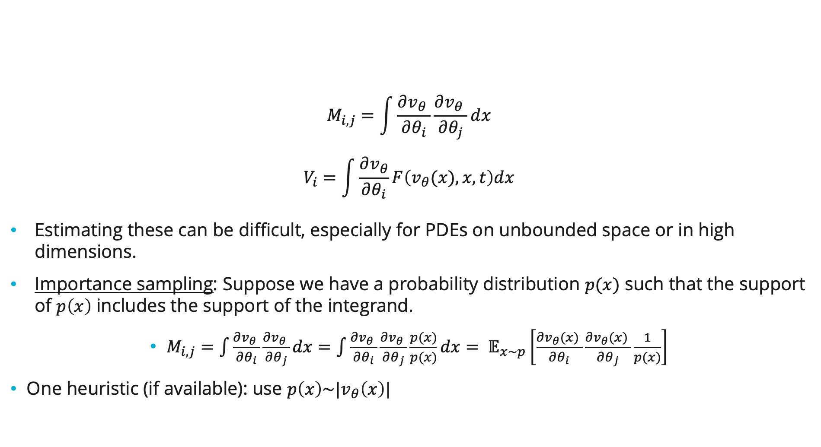
Estimation of integrals via importance sampling
$$M_{i,j}=\int{\frac{∂v_{θ} }{∂θ_{i}}\frac{∂v_{θ} }{∂θ_{j}}dx}$$
$$V_{i}=\int{\frac{∂v_{θ}}{∂θ_{i}}F\left(v_{θ}(x), x, t\right)dx}$$
Estimating these can be difficult, especially for PDEs on unbounded space or in high dimensions.
Importance sampling: Suppose we have a probability distribution $p(x)$ such that the support of $p\left(x\right)$ includes the support of the integrand.
$M_{i,j}=\int{\frac{∂v_{θ} }{∂θ_{i}}\frac{∂v_{θ} }{∂θ_{j}}dx}=\int{\frac{∂v_{θ} }{∂θ_{i}}\frac{∂v_{θ} }{∂θ_{j}}\frac{p(x)}{p(x)}dx}= 𝔼_{x∼p}\left[\frac{∂v_{θ}(x) }{∂θ_{i}}\frac{∂v_{θ}(x) }{∂θ_{j}}\frac{1}{p(x)}\right]$
One heuristic (if available): use $p\left(x\right)\sim |v_{θ}\left(x\right)|$

Slide 10
Using normalizing flows
Normalizing flows are a neural network architecture designed to model probability distributions.
Maps a “base” probability distribution to a probability distribution of interest, with parameterized bijective transformation
Bijectivity allows for both 1) sampling and 2) density estimation
Extend to non-probabilistic PDEs by also modeling a scalar term and a phase term (for complex-valued PDEs)
Similar approaches considered by previous work, but limited by either
Assumption that state variable of PDE is a probability density [8]
Applied to discretized grid instead of continuum [9]
8: Variational monte carlo approach to partial differential equations with neural networks, Reh and Gärttner (2022)
9:Quantum-inspired variational algorithms for partial differential equations: Application to financial derivative pricing, Zhao, Sun, Cohen, Stokes and Veerapaneni (2024)

Slide 11
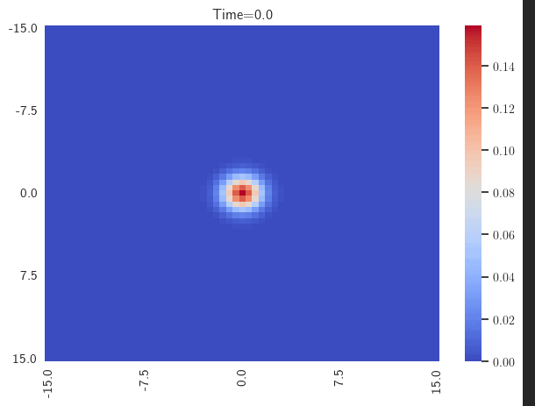
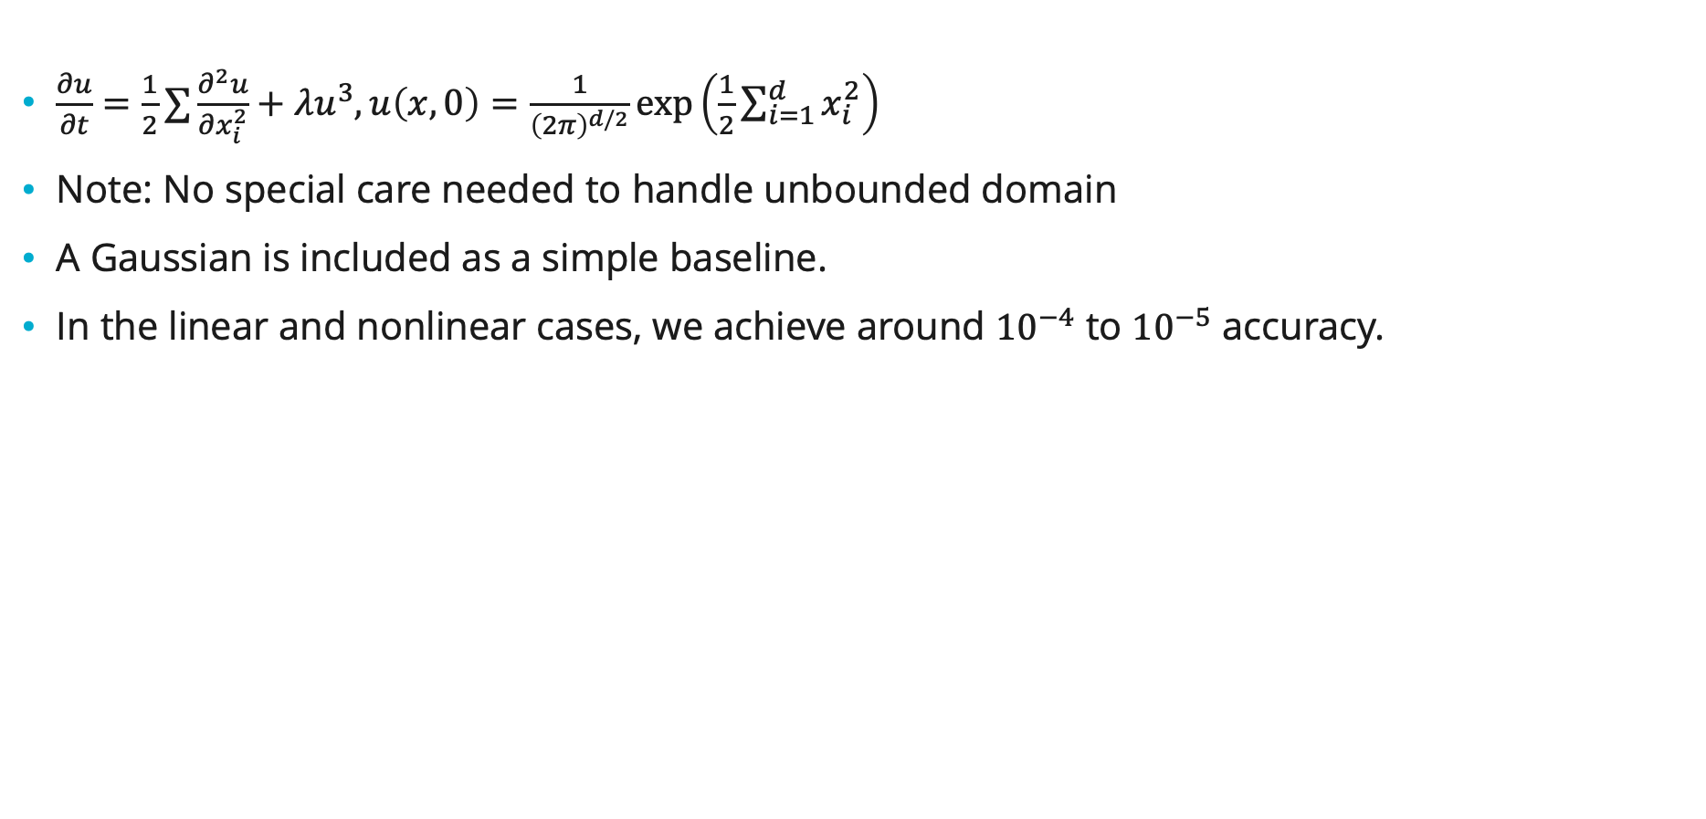
Heat Equation with cubic nonlinearity ($D=2$)
$\frac{∂u}{∂t}=\frac{1}{2}∑\frac{∂^{2}u}{∂x_{i}^{2}}+λu^{3}, u\left(x,0\right)=\frac{1}{{\left(2π\right)}^{d/2}}\exp\left(\frac{1}{2}\sum_{i=1}^{d}{x_{i}^{2}}\right)$
Note: No special care needed to handle unbounded domain
A Gaussian is included as a simple baseline.
In the linear and nonlinear cases, we achieve around ${10}^{−4}$ to ${10}^{−5}$ accuracy.

Slide 12
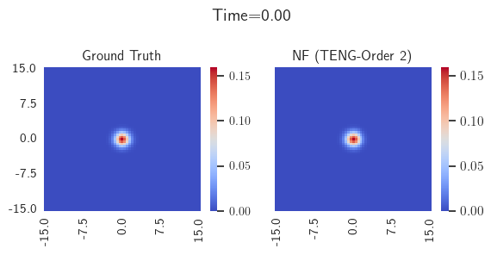
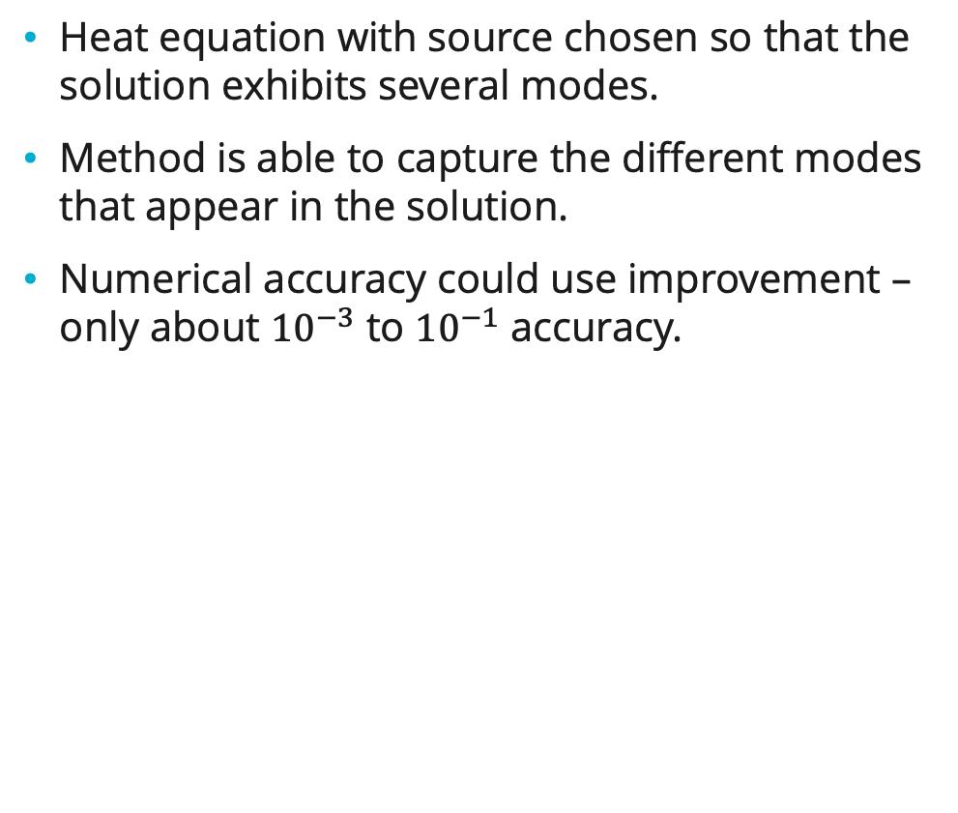
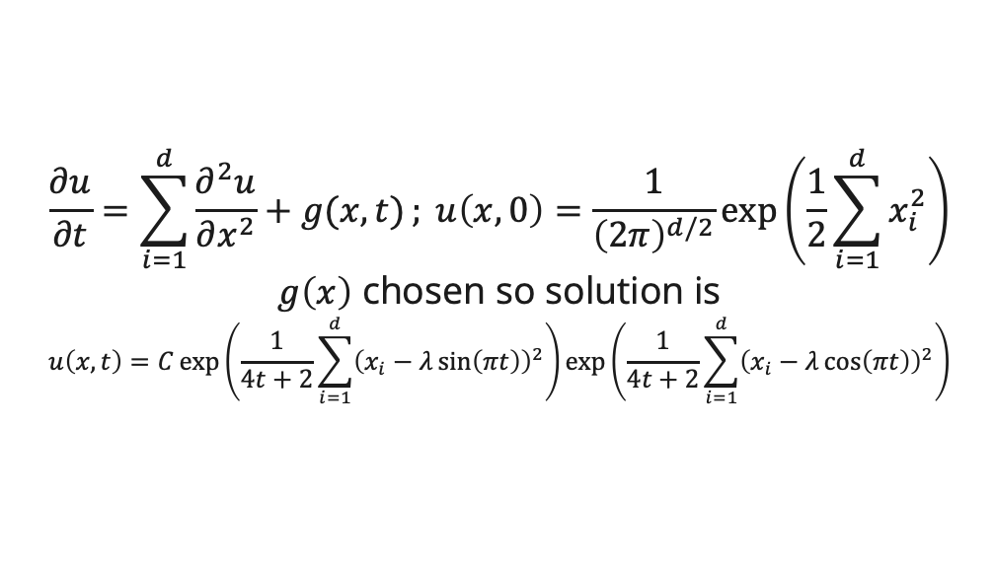
Heat equation with source ($D=2$)
Heat equation with source chosen so that the solution exhibits several modes.
Method is able to capture the different modes that appear in the solution.
Numerical accuracy could use improvement – only about ${10}^{−3}$ to ${10}^{−1}$ accuracy.
$$\frac{∂u}{∂t}=\sum_{i=1}^{d}{\frac{∂^{2}u}{∂x^{2}}+g(x,t)}; u\left(x,0\right)=\frac{1}{{\left(2π\right)}^{d/2}}\exp\left(\frac{1}{2}\sum_{i=1}^{d}{x_{i}^{2}}\right)$$
$g\left(x\right)$ chosen so solution is
$$u\left(x,t\right)=C\exp\left(\frac{1}{4t+2}\sum_{i=1}^{d}{{\left(x_{i}−λ\sin\left(πt\right)\right)}^{2}}\right)\exp\left(\frac{1}{4t+2}\sum_{i=1}^{d}{{\left(x_{i}−λ\cos\left(πt\right)\right)}^{2}}\right)$$

Slide 13
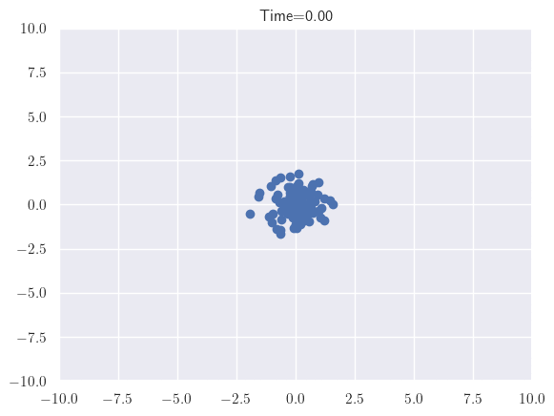
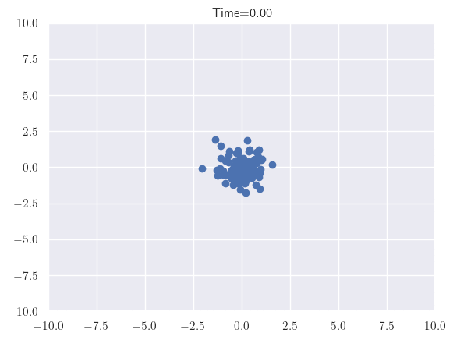
Sampling
Heat equation
Heat equation
w/ source

Slide 14
Higher dimensional pdes (D=5)
Repeat the examples from the previous two slides, but in five dimensions.
We get reasonable accuracies for the linear heat equation, but struggle more with the other example.

Slide 15
Ongoing work
Improve accuracy of these methods, especially in higher dimensions
We are also exploring how we can initialize the neural network to accurately / quickly match the initial condition.
May help error
Would also help in cases where we may have to run with many different initial conditions
Hope is to use these for PDE constrained optimization

Slide 16
Additional

Slide 17
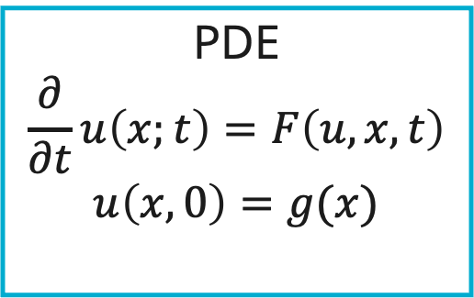
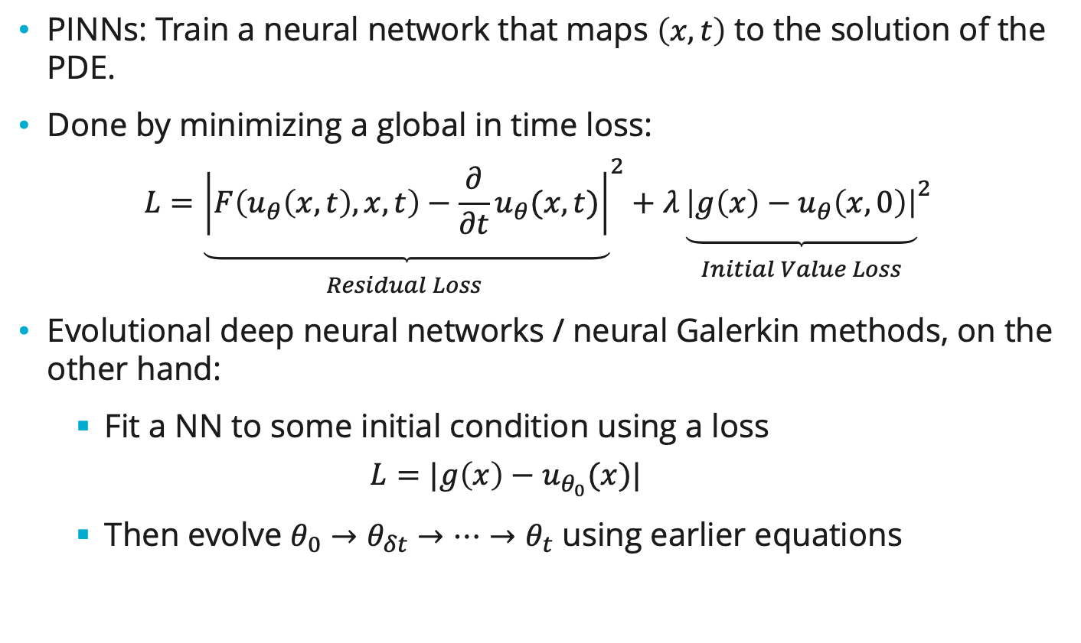
Comparison to PINNs
PINNs: Train a neural network that maps $\left(x,t\right)$ to the solution of the PDE.
Done by minimizing a global in time loss:
$$L={\underset{\begin{aligned} \\ Residual Loss \end{aligned}}{\underbrace{\left|F\left(u_{θ}\left(x, t\right), x, t\right)−\frac{∂}{∂t}u_{θ}(x, t)\right|}}}^{2}+λ{\underset{\begin{aligned} \\ Initial Value Loss\end{aligned}}{\underbrace{\left|{g\left(x\right)−u}_{θ}\left(x,0\right)\right|}}}^{2}$$
Evolutional deep neural networks / neural Galerkin methods, on the other hand:
Fit a NN to some initial condition using a loss
$$L=|g\left(x\right)−u_{θ_{0}}(x)|$$
Then evolve $θ_{0}→θ_{δt}→…→θ_{t}$ using earlier equations
PDE
$$\frac{∂}{∂t}u\left(x;t\right)=F\left(u,x,t\right)$$
$$u\left(x,0\right)=g(x)$$

Slide 18

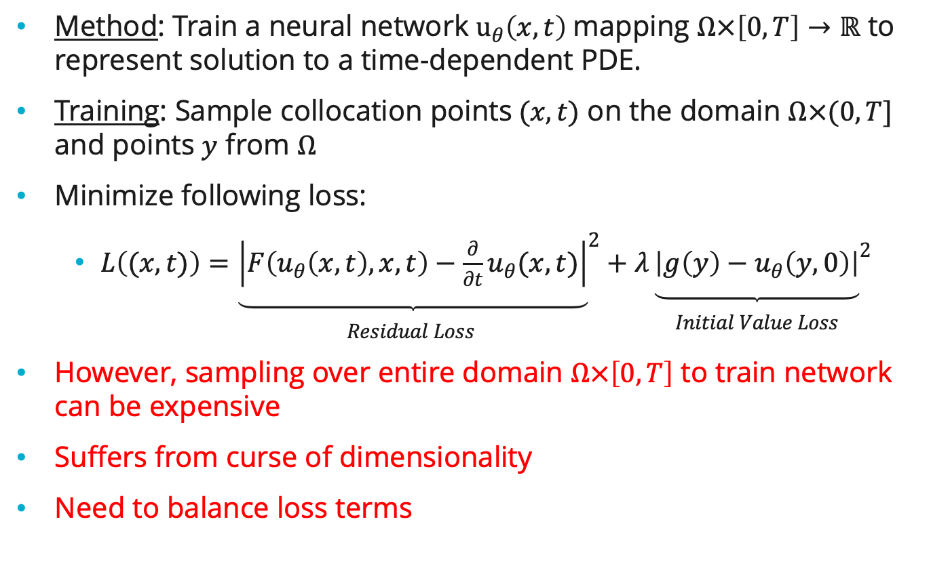
Background: Physics Informed Neural Networks
Method: Train a neural network $u_{θ}\left(x,t\right)$mapping $Ω×\left[0,T\right]→ℝ$ to represent solution to a time-dependent PDE.
Training: Sample collocation points$(x,t)$ on the domain $Ω×(0,T]$ and points $y$ from $Ω$
Minimize following loss:
$L\left((x,t)\right)={\underset{\begin{aligned} \\ Residual Loss \end{aligned}}{\underbrace{\left|F\left(u_{θ}\left(x, t\right), x, t\right)−\frac{∂}{∂t}u_{θ}(x, t)\right|}}}^{2}+λ{\underset{\begin{aligned} \\ Initial Value Loss\end{aligned}}{\underbrace{\left|{g\left(y\right)−u}_{θ}\left(y,0\right)\right|}}}^{2}$
However, sampling over entire domain $Ω×\left[0,T\right]$ to train network can be expensive
Suffers from curse of dimensionality
Need to balance loss terms
PDE
$$\frac{∂}{∂t}u\left(x;t\right)=F\left(u,x,t\right)$$
$$u\left(x,0\right)=g(x)$$

