Slide 1

Pattern Mining in Graphs via
Graph Neural Networks (GNNs)
Presented by: Bryan Arguello
SAND2025-09130C
7/21/2025

Slide 2
How can we use neural networks for subgraph pattern mining?

Slide 3
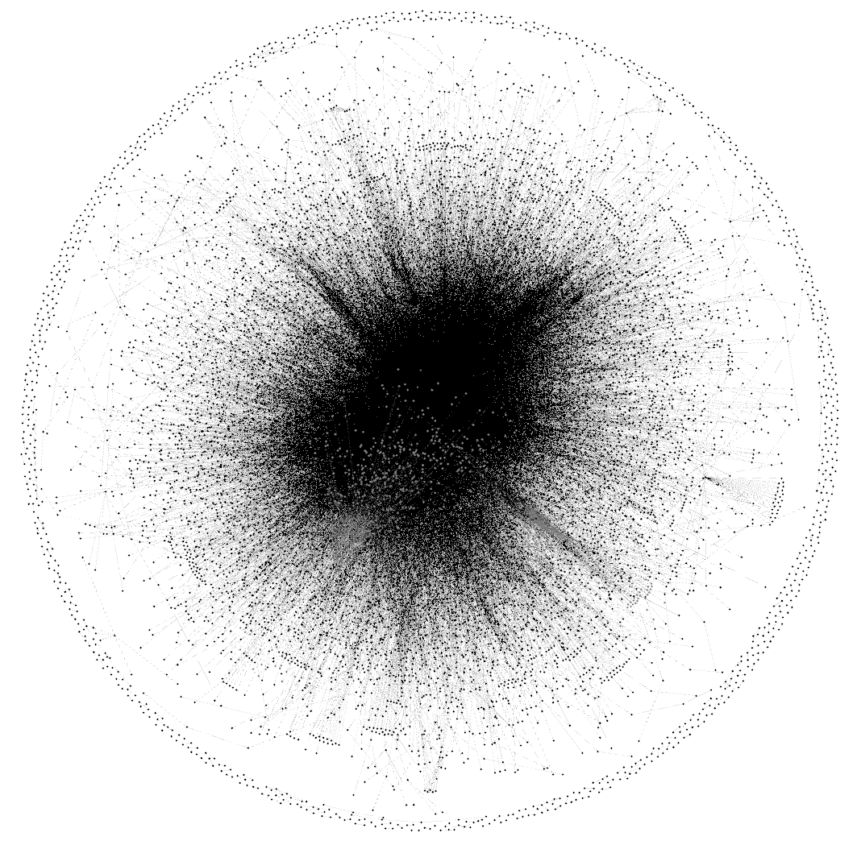
Frequent Subgraph Mining for National Security
Networks of mission relevance are often unwieldy, making detection of frequent or infrequent patterns extremely difficult
Subgraph Mining Problem Setup
Node and edge labels – Categories (not unique id’s)
Pattern – Subgraph with labels
Pattern frequency – Number of subgraphs that match pattern
Subgraph Matching
Node induced isomorphism – pattern contains all edge connections contained in subgraph match
Monomorphism – pattern only needs to contain a subset of nodes and edges from subgraph match
Requirements
Scalability
Generalizability
Applicable to labeled, directed networks
Notional example of a frequent labeled subgraph on 8 nodes

Slide 4
Discriminative Subgraph Mining
Discriminative subgraph mining:
Finding patterns that are frequent within a specific subgraph, yet not frequent in the context of the full graph
Notional example of a discriminative labeled subgraph on 8 nodes

Slide 5
Classic approaches

Slide 6
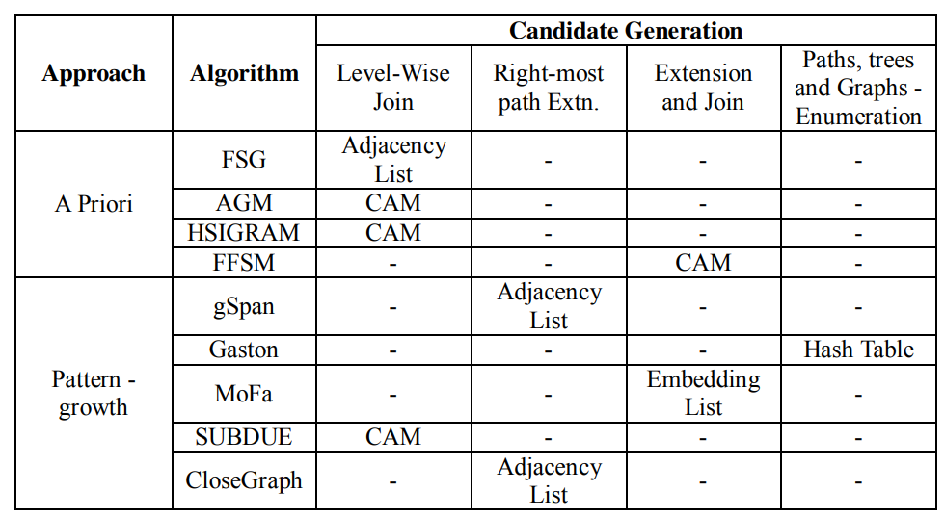
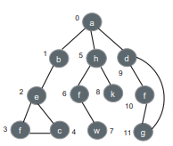
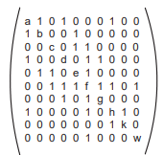
Well-established FSM Algorithms
Subgraph searching
Lattice of subgraphs forms a search space of potential frequent subgraphs
A priori: combine subgraphs to form new candidates
Pattern growth: candidates are grown by adding single edges
Pattern counting
Isomorphism detection needed to count number of pattern occurrences
Graphs can be represented in many ways
Canonical labeling used to ensure that isomorphic subgraphs will have identical representations
Pruning
Goal: extend in a way that prevents repetitive searching
Canonical Adjacency Matrix (CAM)
{(0,1,a,1,b), (1,2,b,1,e), (2,3,e,1,f), (3,4,f,1,c), (4,2,c,1,3)}
Adjacency list of DFS code for highlighted edges
Jiang C, Coenen F, Zito M. A survey of frequent subgraph mining algorithms. The Knowledge Engineering Review. 2013;28(1):75-105. doi:10.1017/S0269888912000331

Slide 7
A modern approach: Graph Neural Networks (GNN)

Slide 8
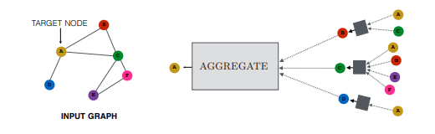
Graph Neural Networks
GNN’s encode graph structure through message passing.
Effectively, GNN’s are a neural version of traditional color refinement algorithms such as Weisfeiler-Leman.
Message passing
Node feature embeddings pass through a small layer to form a message (vector) passed from a node to its neighbor
Aggregate
Messages are collected and aggregated in a permutation invariant manner
Update
Aggregated messages are passed into a differentiable function to update the node embedding
Example architectures
GCN – conceptually similar to CNN’s
GIN – As expressive as 1-WL in determining graph isomorphism
GAT – conceptually similar to RNN transformers, they help determine level of effect of nodes on their neighbors
Basic Architecture
message
GNN architecture
Goals
B
A
A
Node-level
B
Edge-level
A
C
A
F
E
Graph-level
William L. Hamilton. (2020). Graph Representation Learning.
Synthesis Lectures on Artificial Intelligence and Machine Learning, Vol. 14,
No. 3 , Pages 1-159.

Slide 9
How do GNN’s help with pattern mining?

Slide 10
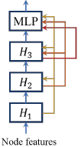
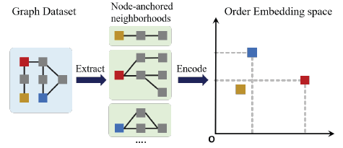

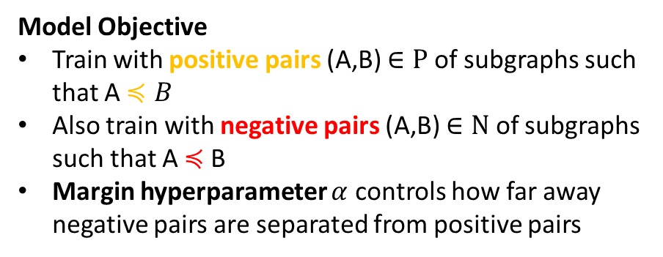


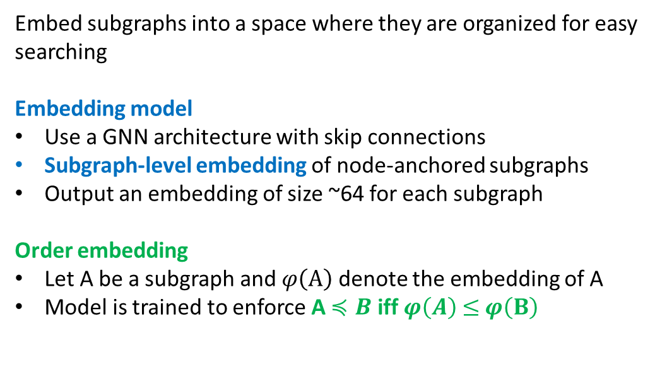
Order Embedder
Embed subgraphs into a space where they are organized for easy searching
Embedding model
Use a GNN architecture with skip connections
Subgraph-level embedding of node-anchored subgraphs
Output an embedding of size ~64 for each subgraph
Order embedding
Let A be a subgraph and $φ\left(A\right)$ denote the embedding of A
Model is trained to enforce A $≼B$ iff $φ\left(A\right)$ $≤$ $φ\left(B\right)$
Model Objective
Train with positive pairs (A,B) $∈P$ of subgraphs such that A $≼B$
Also train with negative pairs (A,B) $∈N$ of subgraphs such that A $≼$B
Margin hyperparameter $α$ controls how far away negative pairs are separated from positive pairs
$$≼$$
$$≼$$
Embedding model
Order Embedding
Ying, Rex, Tianyu Fu, Andrew Wang, Jiaxuan You, Yu Wang, and Jure Leskovec. "Representation Learning for Frequent Subgraph Mining." arXiv preprint arXiv:2402.14367 (2024)

Slide 11
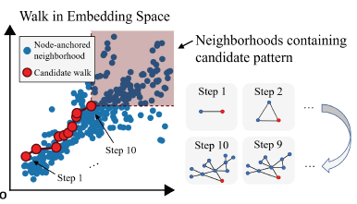
Pattern Mining with Order Embedding
Subgraph Mining
Similar to well-established algorithms, we still must generate candidate subgraphs
A subgraph is frequent if it is dominated by “many” subgraphs
Need a good sample of subgraphs to be embedded before this determination can be made
Approach
Sample many subgraphs of various sizes and embed them
Start with a single node and greedily add one node/edge at-a-time
Use the number of dominating points to guide subgraph extension
Ying, Rex, Tianyu Fu, Andrew Wang, Jiaxuan You, Yu Wang, and Jure Leskovec. "Representation Learning for Frequent Subgraph Mining." arXiv preprint arXiv:2402.14367 (2024)

Slide 12
Labeled Order Embedding Extension
Progress
Trained two models: one for node-induced matching and one for monomorphic matching
Extended original approach to include node labels
After training on completely synthetic graphs, we are able to obtain an accuracy of 92% - 99% embedding accuracy on application graphs
Future work
Extend models to include edge labels
Develop better search algorithms that can return more frequent subgraphs than current search approaches
Apply approach to discriminative subgraph mining

Slide 13
Is there a good neural approach to subgraph matching?

Slide 14
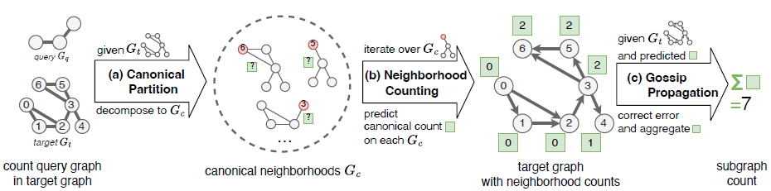
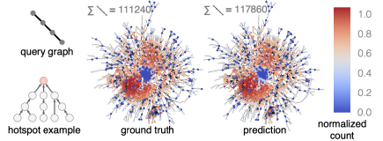
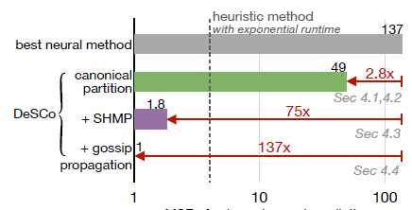
DESCO: Scalable DEep Subgraph COunting
Rex ying et. al. developed a promising GNN approach to subgraph counting
It not only counts pattern occurrences, but yields a position distribution
DESCO Pipeline
Canonical Partition – Creates neighborhoods around each node for efficient counting
Neighborhood Counting – Estimates number of matches in each neighborhood
Gossip Propagation – Error correction and aggregation
Fu, Tianyu, Chiyue Wei, Yu Wang, and Rex Ying. "Desco: Towards generalizable and scalable deep subgraph counting." In Proceedings of the 17th ACM International Conference on Web Search and Data Mining, pp. 218-227. 2024

Slide 15
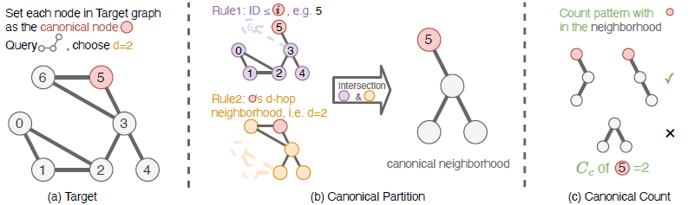
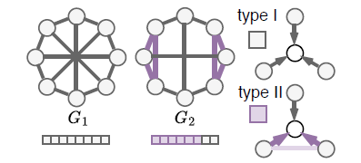

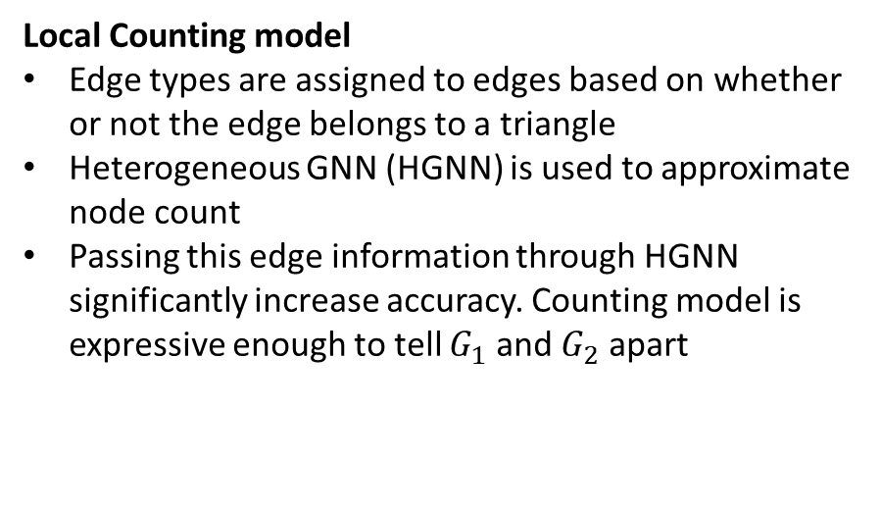
Canonical Partitioning and Neighborhood Counting
Local Counting model
Edge types are assigned to edges based on whether or not the edge belongs to a triangle
Heterogeneous GNN (HGNN) is used to approximate node count
Passing this edge information through HGNN significantly increase accuracy. Counting model is expressive enough to tell $G_{1}$ and $G_{2}$ apart
Canonical Partition
Only need a neighborhood with same diameter as query graph
Shifting counting responsibility to individual nodes, so each node needs an index
For each target node neighborhood, only include nodes with index below target
Fu, Tianyu, Chiyue Wei, Yu Wang, and Rex Ying. "Desco: Towards generalizable and scalable deep subgraph counting." In Proceedings of the 17th ACM International Conference on Web Search and Data Mining, pp. 218-227. 2024

Slide 16
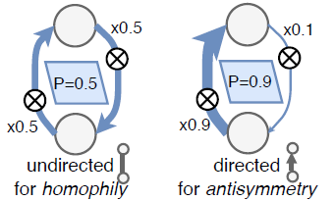

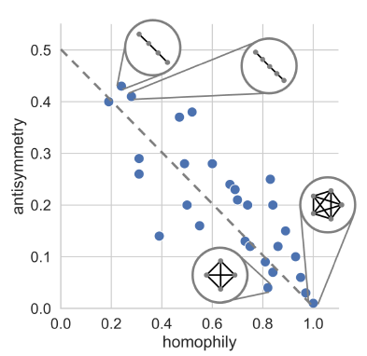
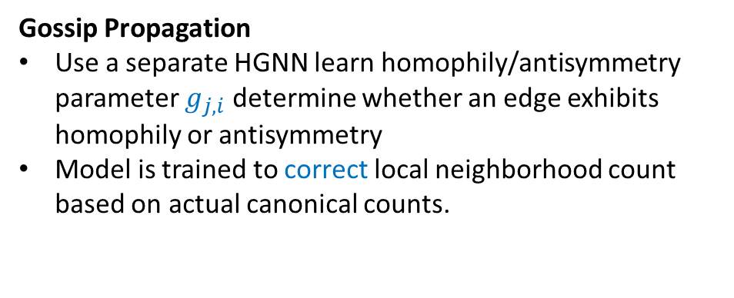
Gossip Propagation: homophily vs antisymmetry
Accuracy Improvement
Homophily – similar nodes are likely to be connected
Antisymmetry – Information only flows in one direction
Negative correlation between antisymmetry and homophily observed in different queries
Learning homophily/antisymmetry tendency helps improve counting
Gossip Propagation
Use a separate HGNN learn homophily/antisymmetry parameter $g_{j,i}$determine whether an edge exhibits homophily or antisymmetry
Model is trained to correct local neighborhood count based on actual canonical counts.
Fu, Tianyu, Chiyue Wei, Yu Wang, and Rex Ying. "Desco: Towards generalizable and scalable deep subgraph counting." In Proceedings of the 17th ACM International Conference on Web Search and Data Mining, pp. 218-227. 2024

Slide 17
Labeled Subgraph Counting Extension
Synopsis
This approach yields matching information that might be vital for pattern mining, especially for discriminant pattern mining
As with SP Miner, we need labels for our mission application
Extension
Repurpose message types in the HGNN models.
Rather than having message type encode whether or not an edge belongs to a triangle, have it encode source and destination node types

Slide 18
Can we use these two extended models together for improved pattern mining? What about discriminant pattern mining?

Slide 19
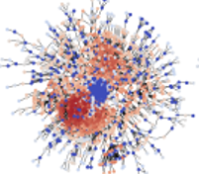
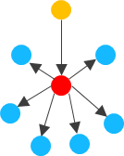
Pattern Mining with Labeled Embedder and Counting Models
labeled, directed subgraph with a relatively large number of nodes
labeled subgraph embedder
deep subgraph counting model
GNN Modeling for Pattern Mining
SOTA exact and approximate techniques for FSM can only detect labeled patterns of ~10 nodes. We would like to detect patterns with 20+ nodes.
We are developing a labeled subgraph encoder model to capture containment property. Number of dominating points indicates subgraph frequency.
Labeled subgraph counting model provides approximate local and global frequency approximations.
Our research will attempt to use these models for frequent and discriminant subgraph mining.

Slide 20
Thank you!
We welcome any methodology or application ideas!
Questions or Comments?

