Slide 1
Trust Calibration Maturity Model
for AI Applications and Systems
Scott Steinmetz (presenter), Asmeret Naugle, Matt Sweitzer, Michal Kucer (LANL), Alex Washburne, Paul Schutte
STEEL THREAD, NA-22
Funded by NNSA Office of Defense Nuclear Nonproliferation Research and Development, U.S. Department of Energy
SAND2024-09809C
Notes:
Hello! I’m Scott Steinmetz and today I’ll be presenting the Trust Calibration Maturity Model for AI Applications and Systems. This work is part of a multi-lab venture called Steel Thread funded by NA-22, and currently is a collaboration between several of us from Sandia as well as some folks from Los Alamos National Lab.

Slide 2
Bottom line up front
Trust framework for AI systems
Operationalized into a maturity model
 | Level 1 | Level 2 | Level 3 | Level 4
Performance | Unknown | Low confidence, tested on broad benchmark | Medium confidence, tested on specific task | High confidence, tested on end user, strong UQ
Bias & Robustness | Not considered | Some consideration | Significant consideration, communicated to user | Continuous testing
Transparency | Black box | Coarse mental model | Useful mental model | Accurate mental model
Safety & Security | Unknown | Awareness of vulnerability, basic guardrails | Quantified vulnerability, broad guardrails | Confidential with high confidence in integrity
Usability | None | Basic | Intuitive and well-targeted | Intuitive and adaptive to user/task
Notes:
I’m going to start with a very high level summary. Today I’m presenting the Trust Calibration Maturity Model (or TCMM) which is intended to operationalize applying Trust frameworks for AI by creating a more usable format. The intent here is to facilitate conversations about proposed and existing AI tools, similar to how the TRL system enables a quick shorthand for the stage of a project’s development and deployability.

Slide 3
Motivation
Notes:
First I’ll go over the motivation for this and our goal now that we’ve built out the maturity model

Slide 4
Trust literature
What is Trust?
Factor | Number of Surveyed Models that Include Factor
Reliability | 7
Transparency | 7
Context | 5
Accountability | 4
Accuracy | 4
Consistency | 4
Explainability | 4
Performance | 4
Predictability | 4
Privacy | 4
Risk | 4
Security | 4
Usability | 4
Auditability | 3
Competency | 3
Integrity | 3
Reputation | 3
Resilience | 3
Robustness | 3
Safety | 3
Situation | 3
Compliance | 2
Dependability | 2
Fairness | 2
Maturity | 2
Quality | 2
Responsibility | 2
Suitability | 2
Sustainability | 2
Vulnerability | 2
Acceptability | 1
Assurance | 1
Maintainability | 1
Variability | 1
Trust is the license to operate granted by a user.
i.e. a user will only use a tool so far as they trust that tool.
High performance means nothing if the use is unwilling to use the tool.
Notes:
Let’s start with “what is Trust in an AI system, and why does it matter?
Trust is the license to operate granted by a user. That is, a user will only use a tool so far as they trust that tool. High performance means nothing if the use is unwilling to use the tool.
And this is particularly the case in high consequence settings, which often have more stringent requirements for backing up any result or acting on any result.
I really want to emphasize here that trust is not a binary, it's not a single number.
It's not the full story to say that the more accurate a tool is, the more people trust it, nor the more people necessarily should trust it, depending on the use case and the ways in which it makes mistakes. Rather, trust should be aligned appropriately to the tool, the tool's capabilities, and the task being addressed.
[click]
So at the end of 2023 we surveyed the Trust literature, particularly various models of trust and trust frameworks to understand what AI system characteristics does the field think drives user trust. I’ve dropped in a table on the right showing a breakdown of, across 13 trust models and frameworks, how many models included each factor.
Now, many of these factors have significant overlap with each other, or put another way have highly technical definitions of their separations. To facilitate a more usable set of factors we needed to reduce both the amount of dimensions as well as clarify their separation.

Slide 5
Trust Framework - Motivation
Developed a “trust framework” in FY23
How can we start to make this actionable?
Notes:
This lead to us developing our own trust framework that focused on how a system’s trustworthiness characteristics impact the end user experience when using that tool… and that experience is what directly drives their trust in the system.
So based on that literature survey, we downselected, combined, and standardized the system characteristic names until we had those shown in this diagram driving trustworthiness: Performance, Transparency, Bias & Robustness, Safety & Security, with Usability affecting the user experience such that trust is ultimately impacted.

Slide 6
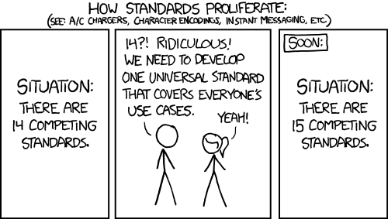
There’s an Xkcd for this
www.xkcd.com/927
Notes:
So, I’m well aware that I’ve just described a literature filled with trust frameworks to which we’ve added another one, but I promise this was a necessary step. Because while many such frameworks exist, they keep being created to fill a still unfulfilled need: how do you make AI tools more trustable in practice? Such that users trust them appropriately, not blindly trusting nor being overly skeptical.
And this is a complex question which somehow needs to be boiled down to a concrete and actionable system that doesn't require everyone involved to be an expert in AI trustworthiness metrics.

Slide 7
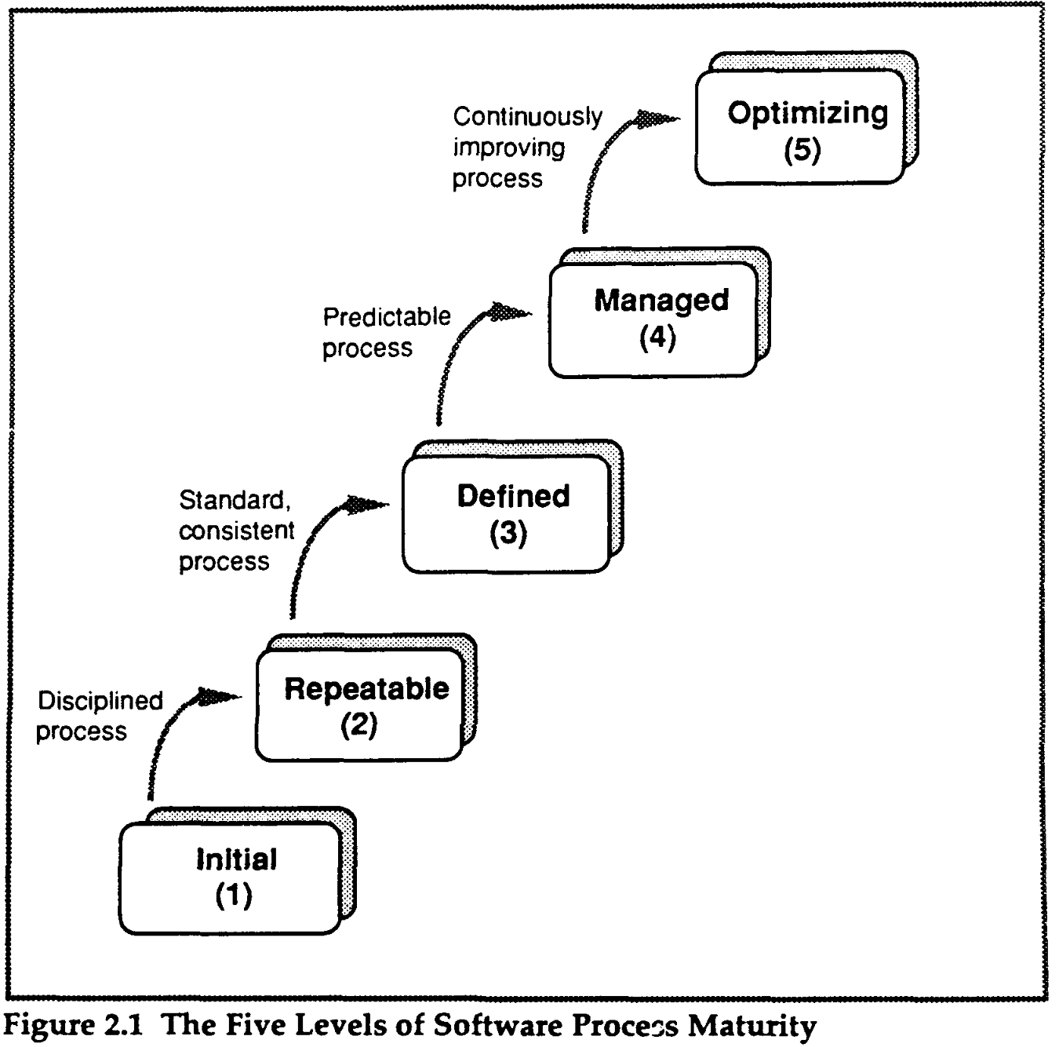
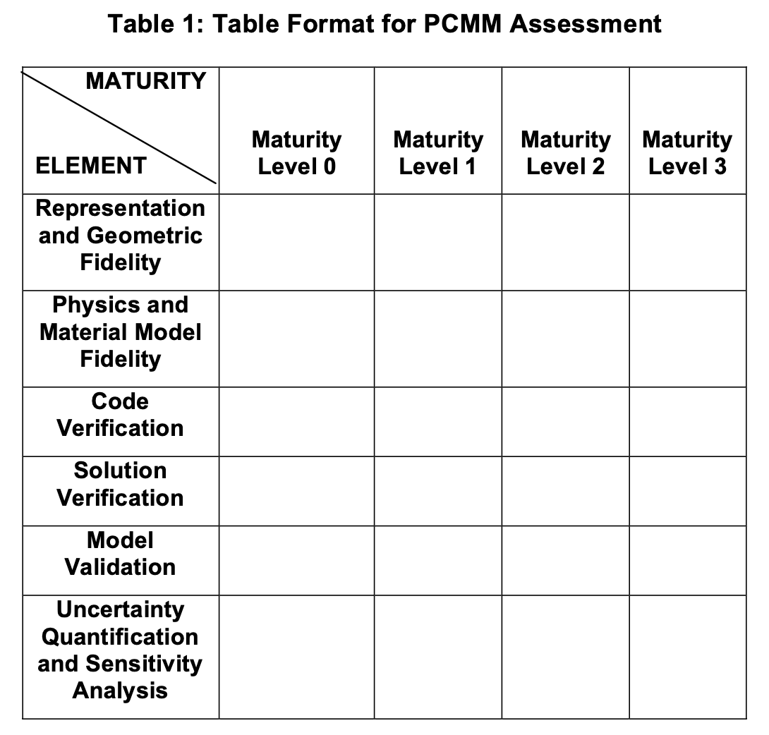
Maturity Models
Capability Maturity Models (CMM) Describe maturity of the software development process | Technology Readiness Levels (TRL) Describe maturity of technology development | Predictive Capability Maturity Model (PCMM) Describes maturity of predictive simulation
TRL 1
Basic principles observed and reported
TRL 2
Technology concept and/or application formulated
TRL 3
Analytical and experimental critical function and/or characteristic proof of concept
TRL 4
TRL 5
TRL 6
TRL 7
TRL 8
TRL 9
Actual system operated over the full range of expected mission conditions
Actual system completed and qualified through test and demonstration
Full-scale, similar (prototypical) system demonstrated in relevant environment
Engineering/pilot-scale, similar (prototypical) system validation in relevant environment
Laboratory scale, similar system validation in relevant environment
Component and/or system validation in laboratory environment
Paulk, M. C., Curtis, B., Chrissis, M. B., & Weber, C. V. (1991). Capability maturity model for software (p. 0073). Pittsburgh, PA, USA: Carnegie Mellon University, Software Engineering Institute.
Oberkampf, W. L., Trucano, T. G., & Pilch, M. M. (2007). Predictive Capability Maturity Model for computational modeling and simulation (No. SAND2007-5948). Sandia National Laboratories (SNL), Albuquerque, NM, and Livermore, CA (United States).
Department of Energy TRLs
Notes:
Maturity models are one way implementation gaps have been closed. Most people are probably most familiar with the TRL system out of these shown here. A common theme across these is that they take complex processes and stages and reduce them into simplistic levels for the purpose of a shared and structured understanding. Such a shared understanding facilitates conversations around project planning, capabilities, and funding.

Slide 8
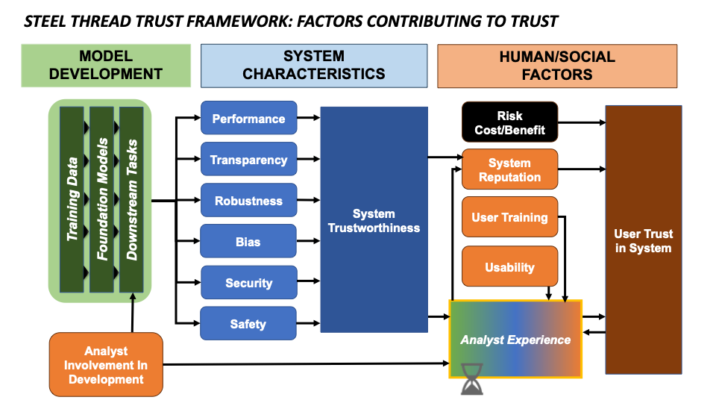
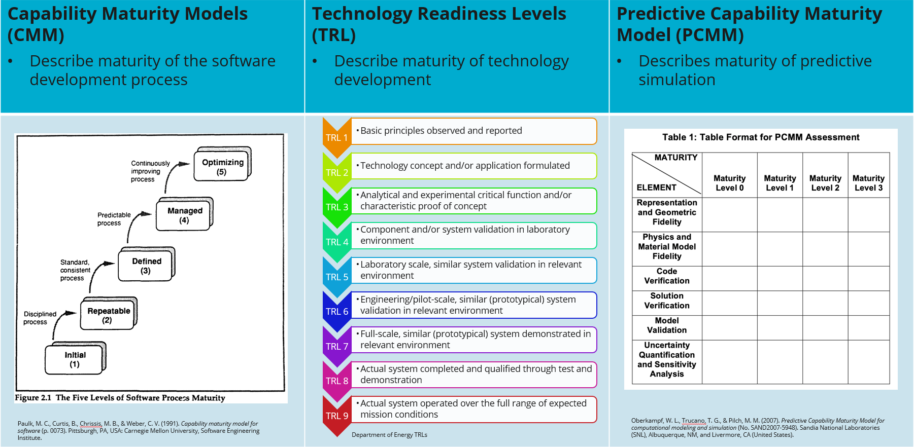
Project Goal – Operationalize AI Trust Framework
Notes:
Our goal was to operationalize the trust framework which captured shared dimensions across many in the literature by producing a Trust Calibration Maturity Model.

Slide 9
Trust Maturity Model Inspiration: PCMM Table & Descriptions
Key elements of evaluating predictive modeling & simulation
Maturity of key elements
Useful descriptions
Oberkampf, W. L., Trucano, T. G., & Pilch, M. M. (2007). Predictive Capability Maturity Model for computational modeling and simulation (No. SAND2007-5948). Sandia National Laboratories (SNL), Albuquerque, NM, and Livermore, CA (United States).
Notes:
We took particular inspiration from the Predictive Capability Maturity Model, which has 4 levels per dimension and bulleted sub-points of each level that an expert user can check off as they are present, while a less expert user can just think about the simplified level interpretations, so what does a level 123 rating mean in a simple takeaway.

Slide 10
Trust Calibration Maturity Model (TCMM)
Notes:
Let’s get into the TCMM in detail

Slide 11
Trust Calibration Maturity Model
Goal:
Characterize the maturity of trustworthiness metrics for an AI-powered tool on a specific task across key dimensions that drive user trust
Target audience:
end users
Researchers/developers
program managers and enterprise IT admin
Evaluation depends on task and considers the human-AI team
Emphasis is on calibrated trust – trust is not binary, but should align appropriately to the tool
Notes:
Our goal here was to develop a system capable of characterizing the maturity of trustworthiness metrics for an AI powered tool on a specific task across key dimensions that drive user trust.
And the reason I want to really highlight that this is a scoring per tool, per TASK in that the metrics and methods available depends on the specific model being used, the modality of the various inputs and outputs, and the costs and benefits for that specific task.
A student trying to ask chatGPT some questions for reference while writing an essay might have very different opinions about an answer that's generally correct but off in specific details when compared to a researcher trying to find citations for responding to a reviewers concerns.
Now, our target audience for the trust calibration maturity model is threefold.
The 1st and most straightforward is for end users who can look at a scoring (which is accompanied by the system components that justify the scoring) and get a sense of how much they will be able to calibrate their trust in this model.
The second audience is researchers and developers who are developing and building trustworthy systems. The TCMM provides a way to advertise on a research pitch or in your github readme or HF model card, “HEY! There are reasons to use this tool beyond accuracy numbers!”.
The third is the folks funding research and purchasing applications. Being able to see: once those projects are funded, what capabilities will be available in a more explicit, succinct, and standardized way, or when choosing between several tools that have already been developed to assess what would be best for their user base and their needs.
Again, evaluation depends on the task and considers the human AI team as a whole and as a unit, and the emphasis in this maturity model is on calibrated trust – trust aligned to the tool’s capabilities, what it communicates to the user, and the specific task being performed.

Slide 12
Trust Calibration Maturity Model - simplified
(Detailed dimension breakdown coming up)
For a target task, e.g. “Jungle bird image classification” or “nuclear science question answering”
 | Level 1 | Level 2 | Level 3 | Level 4
Performance | Unknown | Low confidence, tested on broad benchmark | Medium confidence, tested on specific task | High confidence, tested on end user, strong UQ
Bias & Robustness | Not considered | Some consideration | Significant consideration, communicated to user | Continuous testing
Transparency | Black box | Coarse mental model | Useful mental model | Accurate mental model
Safety & Security | Unknown | Awareness of vulnerability, basic guardrails | Quantified vulnerability, broad guardrails | Confidential with high confidence in integrity
Usability | None | Basic | Intuitive and well-targeted | Intuitive and adaptive to user/task
Notes:
Here’s the simplified version of the TCMM, which has 5 dimensions. These range from a level 1, which generally means nothing has been done for that dimension, to level 4, which represents the highest levels of maturity. For many tasks generative AI is being currently used for, level 4 on several dimensions is not currently attainable in our estimation.
Performance maturity reflects how well-quantified and understood the performance of the system is for the target task, ranging from performance being unknown, for example on novel or subjective tasks, to having detailed understanding of performance and strong UQ including end user testing to understand the fullness of the impact of the tool on user workflows.
Bias & Robustness maturity reflects the model’s consistency of performance across various dimensions of the input, including social bias, data bias, and input perturbation of various kinds and robustness to noise.
Transparency maturity, often called explainability or interpretability in the literature and sharing overlap with concepts like attribution, reflects the ability for the user to understand or interrogate how an output was produced.
Safety & Security maturity reflects the tool’s protections against user misuse as well as protect against external actor influence.
Finally, usability maturity reflects how easy it is for a user to get an output, and how much mental bandwidth is required to use the tool or make use of the various features.
another point to address here is that each of these dimensions will have overlap with the others and in and in some cases there may have to be a tradeoff.
It may be difficult to have a very intuitive and well targeted metric which gives you transparency into the inner causal mechanisms of a large local language model, right?
You might have a direct tradeoff between the transparency of the model and the security of a model in certain situations and under certain demands.
so there is definitely overlap between these dimensions, but this maturity model is intended as a tool for structured conversation between folks involved in developing projects and tools based on AI and folks using them, funding research, or purchasing a tool.

Slide 13
How to use the Trust calibration maturity model
Select the software system to score
Rather than thinking of this as grading just the model, think of it as grading the software or codebase handed to the user/customer
E.g. the UI, LLM, analyses, uncertainty metrics, etc
Selecting a specific target task to score the maturity for
e.g. Nuclear science question answering
Go through the detailed TCMM table one dimension at a time, starting at level 1
Check off each inline bullet as they are met
If all the bullets in a level are met, proceed to the next level and repeat the process
Notes:
Before I go into the detailed dimension breakdown, I want cover the TCMM scoring process:
<bullet 1 & 2>
An AI/ML expert familiar with the system or tool being scored goes through each dimension of the detailed TCMM scoring rubric (Figure 3) independently in relation to a target task. The AI/ML expert determines whether the developed system meets the criteria for each level along each dimension and records the system components which satisfy those criteria.
This maturity model is in relation to a specific, target task
E.g. “Nuclear science question answering for nonproliferation analysts”
Not for the general trustworthiness of an LLM itself in isolation, though the TCMM could be used for a set of tasks if an application supported those capabilities.

Slide 14
Dimension Criteria

Slide 15
Reminder
This maturity model is in relation to a specific, target task
E.g. “Nuclear science question answering for nonproliferation analysts”
Not for the general trustworthiness of an LLM itself in isolation, though the TCMM could be used for a set of tasks if an application supported those capabilities.

Slide 16
Trust Calibration Maturity Model: Performance
Dimension of Trustworthiness Assessment | Level 1 (not addressed) | Level 2 (basic) | Level 3 (systematic) | Level 4 (comprehensive)
Performance Model performance relevant to task, uncertainty quantification | Performance is unknown or unknowable. | Performance on at least one non-task specific benchmark(s) is known. | Performance on at least one benchmark specific to the task is systematically evaluated. Uncertainty has been estimated to some degree. | Performance for all dimensions relevant to the task is known. Uncertainty, and sources of uncertainty, are known with high confidence. End user performance on the task is measured.
Simple Example | Level 1 | Level 2 | Level 3 | Level 4
Performance | Unknown | Low confidence, tested on broad benchmark | Medium confidence, tested on specific task | High confidence, tested on end user, strong UQ
Notes:
Highlight the fact that for performance / bias, we are NOT trying to benchmark how good it is, but rather how well-characterized and well-measured it is.
These are pretty qualitative, will need to pin-down towards the specific task, modality, and tool. Will need to customize towards your needs. This is a tool for providing structure in conversations around designing ai systems.

Slide 17
Trust Calibration Maturity Model: Bias & Robustness
Dimension of Trustworthiness Assessment | Level 1 (not addressed) | Level 2 (basic) | Level 3 (systematic) | Level 4 (comprehensive)
Bias & Robustness Data bias, social biases, perturbation robustness, sensitivity to noise | Bias and robustness are not measured or considered. | Major sources of potential bias have been identified. Bias and robustness are each measured along at least one relevant dimension . | Multiple known relevant dimensions of bias and robustness are systematically measured. System communicates known sources and magnitudes of bias to user. Domain and conditions in which model should (and should not) be used are communicated to the user. | All known relevant dimensions of bias and robustness are comprehensively and systematically measured. Results minimize error across known sources of bias. System provides a mechanism for model-analyst team to proactively identify new conditions and sources of bias, and tests for robustness to new conditions. Retraining criteria are defined.
Simple Example | Level 1 | Level 2 | Level 3 | Level 4
Bias & Robustness | Not considered | Some consideration | Significant consideration, communicated to user | Continuous testing

Slide 18
Trust Maturity Model: Transparency
Dimension of Trustworthiness Assessment | Level 1 (not addressed) | Level 2 (basic) | Level 3 (systematic) | Level 4 (comprehensive)
Transparency Interpretability Explainability Attribution | Mapping between system inputs and outputs is unknown or unknowable. Causal mechanism of system function (e.g.: model weights) is inaccessible. Unexpected results may be common. | Users can infer a coarse mental model of how the system produced an output. Causal mechanism of system function is interrogated anecdotally. Unexpected results may occur in core capabilities. | Users maintain a faithful but approximate mental model of the system. Causal mechanism of system function is interrogated systematically and communicated to the user. Unexpected results may occur in some cases, usually in less-core capabilities. | Users have an accurate mental model of the system and how results were reached. Causal mechanism of system function is known and communicated to user. Users are rarely surprised by model outputs.
Simple Example | Level 1 | Level 2 | Level 3 | Level 4
Transparency | Black box | Coarse mental model | Useful mental model | Accurate mental model

Slide 19
Trust Calibration Maturity Model: Safety & Security
Dimension of Trustworthiness Assessment | Level 1 (not addressed) | Level 2 (basic) | Level 3 (systematic) | Level 4 (comprehensive)
Safety & Security Protection against system misuse & tampering by external actors | Model security is not considered. No user guardrails are in place. | Counter-adversarial measures are implemented by third parties but unverifiable by user. User inputs and system responses are accessible to third parties. User guardrails exist. | Some counter-adversarial measures are implemented by trusted parties. User inputs and system responses are accessible only to trusted parties. User guardrails prevent both direct and indirect efforts to misuse system, and have been tested through red teaming. Training data sources are known and reported to user. | Counter-adversarial measures account for all known threats, evolve with new threats, and are implemented by trusted parties. User inputs and system responses are accessible only to task-specific trusted parties. System prevents concerted misuse efforts, as confirmed through red teaming. Model is trained on known and controlled datasets only.
Simple Example | Level 1 | Level 2 | Level 3 | Level 4
Safety & Security | Unknown | Awareness of vulnerability, basic guardrails | Quantified vulnerability, broad guardrails | Confidential with high confidence in integrity

Slide 20
Trust Calibration Maturity Model: Usability
Dimension of Trustworthiness Assessment | Level 1 (not addressed) | Level 2 (basic) | Level 3 (systematic) | Level 4 (comprehensive)
Usability Ease of use, training and documentation, accessibility of system components, user feedback | Interface(s) either does not exist or is targeted toward developers. | User interface(s) exists. Basic usability features are incorporated, and some user/task needs are met. User training and documentation exist. | User interface(s) has undergone established usability testing and incorporated the results as appropriate. User training and documentation are comprehensive. User feedback is collected and considered. | Interface(s) is intuitive, adaptive, and tailored to individual analyst preferences. User training and documentation are well-targeted to task. User feedback is collected and utilized for continuous improvement.
Simple Example | Level 1 | Level 2 | Level 3 | Level 4
Usability | None | Basic | Intuitive and well-targeted | Intuitive and adaptive to user/task

Slide 21
Example Usecases
Notes:
Before I go into the detailed version of each of these dimensions, I want to first go over several usecases for the TCMM so you follow the intent here. For the scoring of any specific tool on a specific task, some dimensions or level bullets may not be relevant. This is to be expected, the TCMM is designed as a structured way to make the importance or irrelevance of these aspects of trustworthiness explicit to everyone involved.
---- go on ---
Depending on your project, some dimensions of the TCMM will be pretty obviously a level 1 (e.g. Usability is a 1 unless there’s some sort of GUI in place), and some may be irrelevant to your project (Safety & Security has many sub-bullets that likely are not important to a climate model). This is normal, the TCMM is trying to make explicit where a customer has expectations and where those various expectations are met. Some dimension/level scores are currently not reachable based on the state of the field (e.g. Transparency 4) for most models and tasks.

Slide 22
TCMM Example usecases
Communicate maturity of a tool’s trustworthiness to a user
 | Level 1 | Level 2 | Level 3 | Level 4
Performance |  |  | Assessed
Bias & Robustness |  | Assessed
Transparency |  | Assessed
Safety & Security | Assessed
Usability |  | Assessed
Adapted from Oberkampf, W. L., Trucano, T. G., & Pilch, M. M. (2007). Predictive Capability Maturity Model for computational modeling and simulation (No. SAND2007-5948). Sandia National Laboratories (SNL), Albuquerque, NM, and Livermore, CA (United States).
Notes:
The first, most straightforward use of the TCMM is for an end user

Slide 23
TCMM Example usecases
Identify trust needs for a tool, facilitate conversation around development
 | Level 1 | Level 2 | Level 3 | Level 4
Performance |  | Assessed | Required
Bias & Robustness |  | Assessed Required
Transparency | Assessed |  | Required
Safety & Security | Assessed |  |  | Required
Usability |  | Required | Assessed
Adapted from Oberkampf, W. L., Trucano, T. G., & Pilch, M. M. (2007). Predictive Capability Maturity Model for computational modeling and simulation (No. SAND2007-5948). Sandia National Laboratories (SNL), Albuquerque, NM, and Livermore, CA (United States).

Slide 24
TCMM Example usecases
Identify tools/metrics and research needs
 | Level 1 | Level 2 | Level 3 | Level 4
Performance |  |  | Metric Metric
Bias & Robustness |  | Metric Metric | Metric
Transparency |  | Metric
Safety & Security |  | Metric
Usability |  | Interface | Usability Framework | User Study

Slide 25
Example ratings

Slide 26
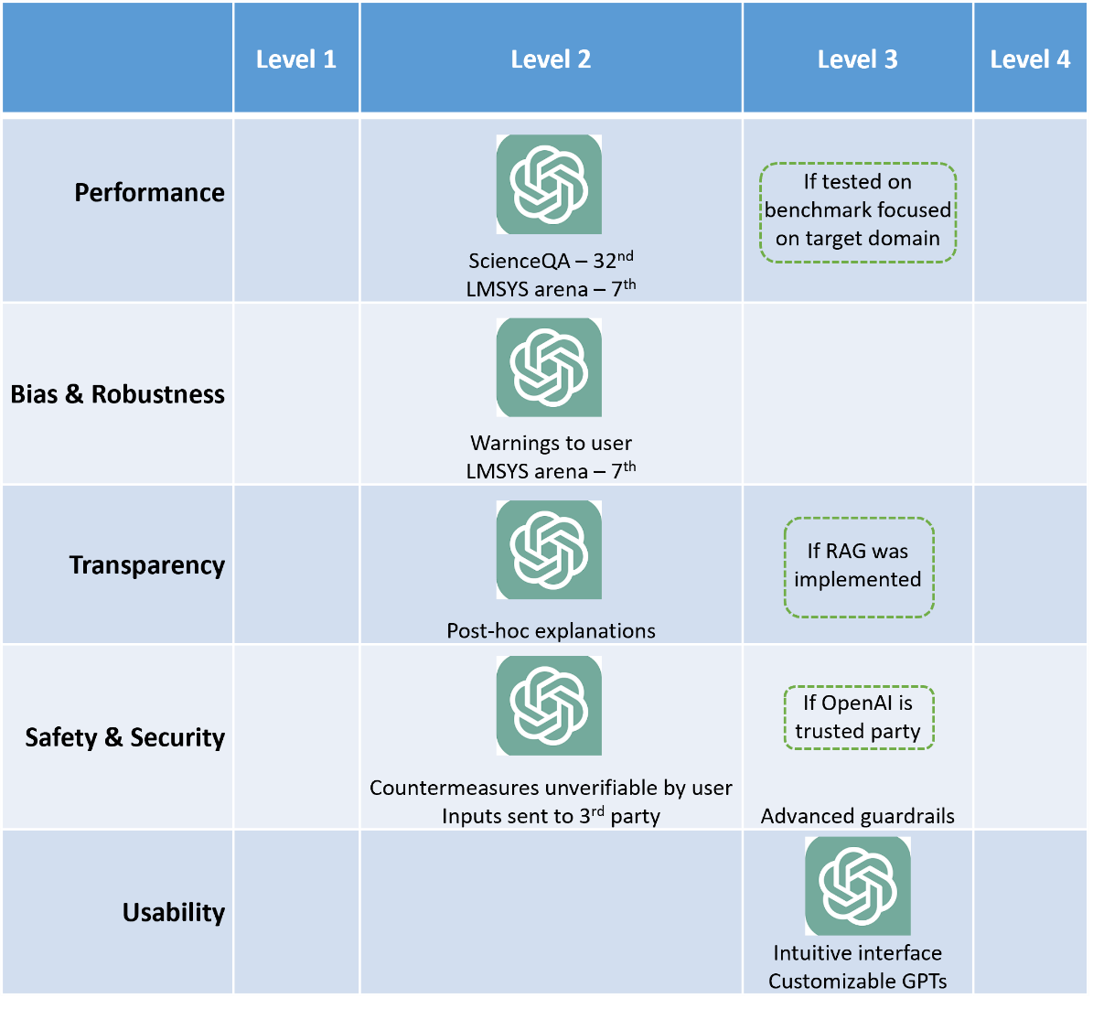
Example rating – chatgpt on nuclear science QA

Slide 27
Example - LLaMA 3.1 405B-Instruct for Code Generation
(local implementation)
 | Level 1 | Level 2 | Level 3 | Level 4
Performance |  | If basic UQ was not Implemented | HumanEval – 1st (assumes UQ)
Bias & Robustness | No bias benchmarks reported yet | If general bias benchmarks were run – could be done Robustness captured in code benchmarks
Transparency |  | Post-hoc explanations | If SAE dictionary was implemented
Safety & Security |  | Training data not explicitly known | Llama Guard 3 Prompt Guard Locally hosted
Usability | Just a model | If using LM Studio or bespoke interface program
Open research, not guaranteed

Slide 28
Questions?
Thank you!

