Slide 1
AI for Grid Resilience
Samuel T. Ojetola, Ph.D.
Machine Learning and Deep Learning Workshop
SAND2024-09924PE

Slide 2
Overview
Challenges in Grid resilience
How AI Can help
Sandia’s Application of AI/ML for protection
Laboratory and Field Testing
Risks
Criteria for accepting AI/ML for Grid Resilience
Opportunities looking forward
Summary

Slide 3
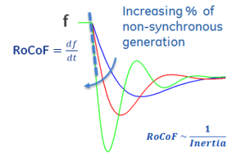
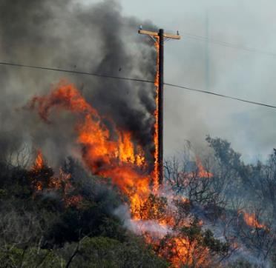

Challenges in grid resilience
Grid resilience is defined as the ability of the electric grid to withstand, recover and adapt to various type of disruptions (Natural disaster, cyberattacks, equipment failures, etc.)
The transition of the grid to more renewables & distributed energy sources is creating new challenges for the protection systems to maintain grid resilience.
  Power System reconfiguration
  High penetration of distributed energy resources
With the increasing number of sensors in the systems, traditional processes and analytical methods are struggling to keep-up with all the new data coming in:
  Wide Area Instabilities
  Human errors
  Relay/communication failures
Increasing frequency of Natural disasters
12/26/18 Transformer Fire in NYC from Failed Protection with Loss of Communication

Slide 4
how AI/ML can help
Power System is a perfect application for AI/ML due to its complex systems and large amount of data.
  Advances in computing power for real-time learning and decision making
  Additions of new sensing and measurement equipment.
Improve power system protection
  Use AI/ML to detect fault and correctly identify fault location
  Embedding ML algorithms in protective relays
  Back-up when communication is lost
Sandia National Laboratories played a major role in developing the first IEEE standard on AI/ML for Protection:
  PES-TR112: Practical applications of AI/ML in power system protection and control

Slide 5
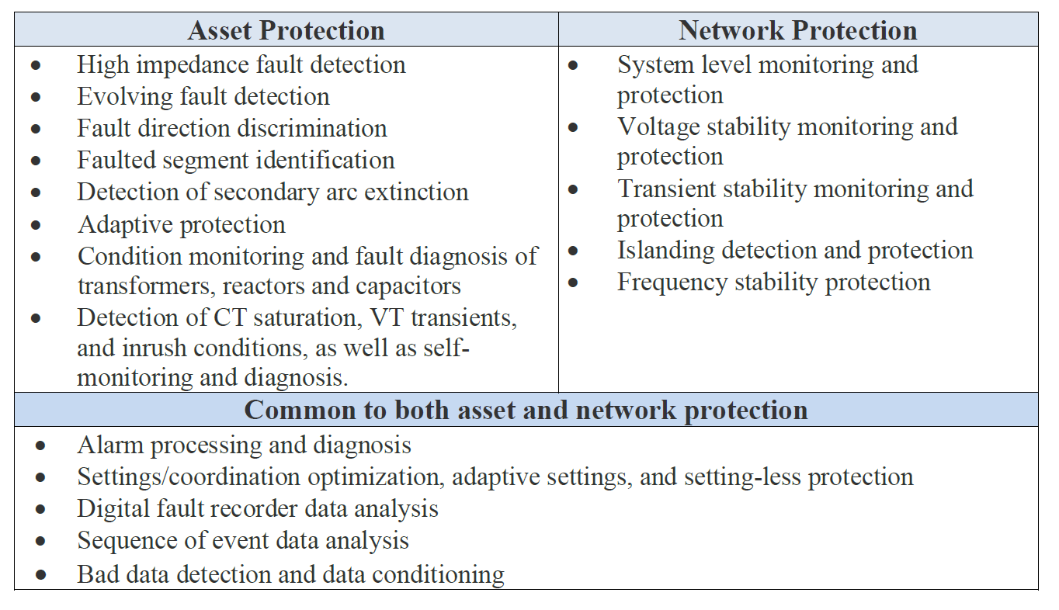
how AI/ML can help
  PES-TR112: Practical applications of AI/ML in power system protection and control

Slide 6
Sandia’s ai/ml algorithms for protection
Sandia have applied many cutting edge AI/ML algorithms to protection including;
  Convolutional Neural Network
  Support Vector Machines
  Prophet
  Random Forest
Integrated some algorithms into hardware and tested it with Opal-RT HIL side by side with SEL relays to validate the performance.

Slide 7
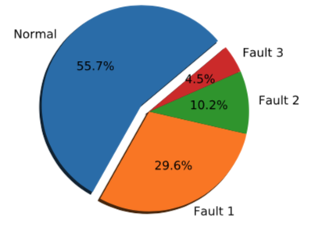
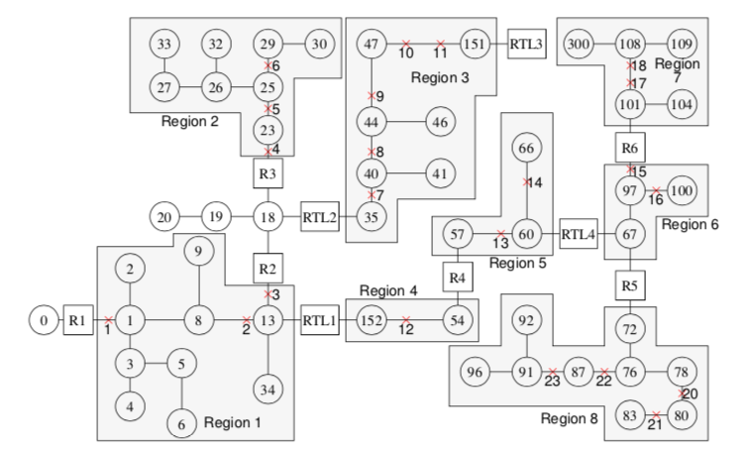
AI for fault detection and location in ac systems
IEEE 123 Bus Model (MATLAB Simulink)
Three Phase to Ground
Fault Simulated:
  3 phase to ground
  Single line to ground
  Line to Line
Fault applied to 19 different locations with varying fault resistance at different times of year.
Measured Data:
  Voltages and Currents
    Positive, negative and Zero sequence
Algorithm: Vector Machines (SVM)
Line to Line
Line to Ground

Slide 8
AI for fault detection and location in ac systems
SVM classification:
  Is there a fault?
  What type of fault is it?
  Where the fault location?
No false trips in yearlong testing with varying and dynamic loads
Correctly detect all faults events
100% accuracy for classifying the type of fault
Correct coordination (i.e. which relay trips first) for 99.6% of faults

Slide 9
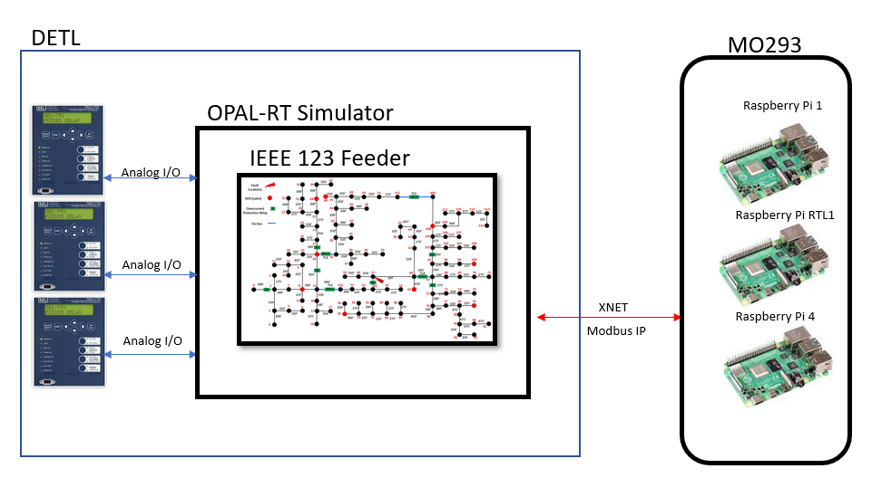
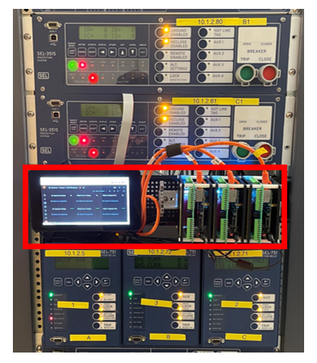
AI for fault detection and location in ac systems
Hardware In the Loop (HIL)Testing
The trained SVM classification is placed into a Raspberry Pi.
Using an Opal-RT real-time HIL simulator, the real-time voltage and current signals from the system are fed into the analog inputs of the Raspberry Pi
SEL-751 hardware relays are also included with a standard overcurrent curve for comparison
The SVM detects the fault in 0.17 seconds in comparison to the time overcurrent of 1.94 seconds
  This is more than 10 times faster

Slide 10

AI for fault detection and location in DC systems
EMERA TECHNOLOGIES- KIRTLAND AIRFORCE BASE DC MICROGRID (PSCAD)
PV System
Battery Storage
Power conversion
Protection
Control
Over 4 years of operation
Reconfigurable topology
Nanogrid black start capabilities
Controlled power transfer between nanogrid/microgrid
Autonomous Nanogrid load/generation balancing
Nanogrid islanding and reconnection
Microgrid islanding and reconnection

Slide 11
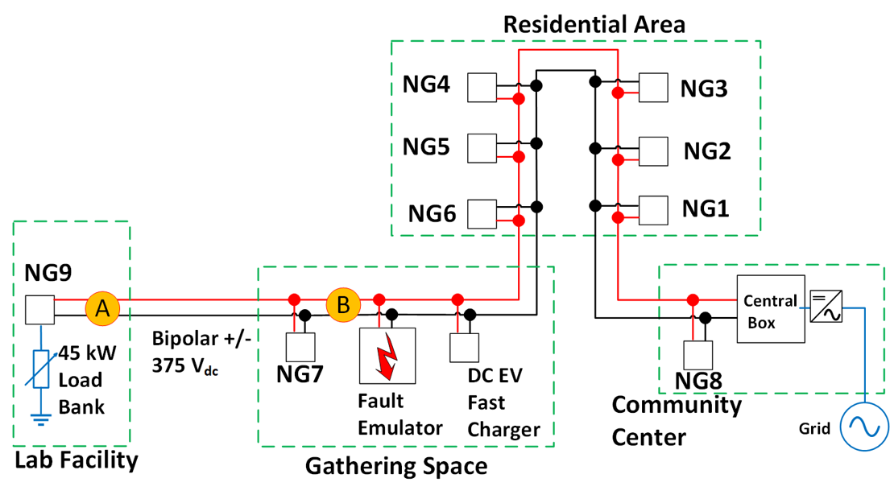
AI for fault detection and location in DC systems
EMERA TECHNOLOGIES- KIRTLAND AIRFORCE BASE DC MICROGRID (PSCAD)
Data is gathered from Node A & B
PSCAD data is used for training
Field data is used for testing
Fault Simulated:
  Pole to pole
  Positive pole to ground
  Negative pole to ground
Fault Classification:
  Fault/No Fault
  Fault Type
  Fault Resistance
  Fault Type
Measured Data:
  Voltages and Currents

Slide 12
AI for fault detection and location in DC systems
EMERA TECHNOLOGIES- KIRTLAND AIRFORCE BASE DC MICROGRID (PSCAD)
ML Classification Algorithms
Linear Classification
Time-Series Classification
Support Vector Classifier
Naïve Bayes
Decision Tree
Nearest Centroid
Multi-Layer Perception
Random Convolutional Kernel Transform
Continuous Wavelet Transform with CNN
Discrete Wavelet Transform with Random Forest
4.8 million total data points collected from PSCAD simulation is used for training the algorithms
8 million data points collected from the field for testing the trained algorithms.
Data distribution by fault type
Data Type | Fault Type
 | No fault | PPG | NPG
D1: Training data (Node A) | 50 % | 25 % | 25 %
D2: Training data (Node B) | 50 % | 25 % | 25 %
D3: Testing data (Node A) | 20 % | 35 % | 45%
D4: Testing data (Node B) | 50 % | 25 % | 25 %

Slide 13
AI for fault detection and location in DC systems
Classification Algorithm | Fault Detection | Fault Type | Fault Resistant | Fault Location
Support Vector Classifier | ✓ | ✓ | ✗ | ■
Bernoulli Naive Bayes | ✓ | ✗ | ✗ | ■
Decision Trees | ✓ | ✗ | ✗ | ■
Nearest Centroid | ✓ | ✓ | ✗ | ■
Multi-Layer Perception | ✓ | ✓ | ✓ | ■
Random Convolutional Kernel Transform | ✓ | ■ | ■ | ✗
Continuous Wavelet Transform with CNN | ✓ | ■ | ■ | ✓
Discrete Wavelet Transform with Random Forest | ✓ | ✓ | ■ | ✓
Physics-Based | ✓ | ■ | ■ | ✓
✓ - greater than 95% accuracy
✗ - less than 95% accuracy
■ - No result

Slide 14
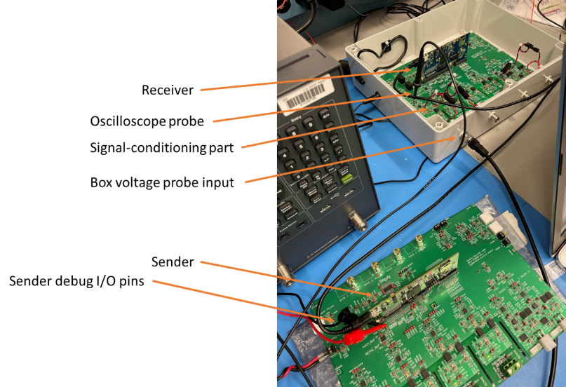
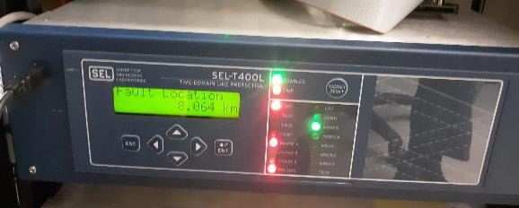
AI for fault detection and location in DC systems
Laboratory Testing
Decompose the high frequency fault signatures (i.e. the measured voltages and currents at the protection device location) using multiresolution wavelet analysis
Learn correlations of timeseries signature for fault classification
Component testing to verify how algorithms would work in hardware solutions
  Validate that our real-time setup is accurately capturing the full dynamics
  TI C2000 real-time DSP (TMS320F2837(D) is integrated into signal interface.

Slide 15
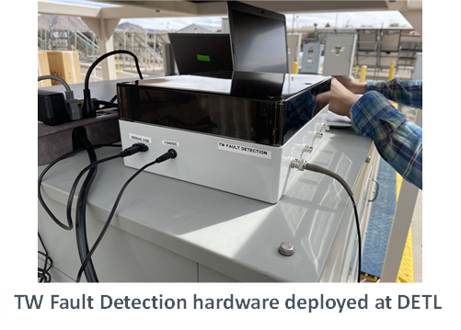
AI for fault detection and location in DC systems
Laboratory Testing
Sampling at 1Mhz with high-frequency transient instantly detected using a high-pass second order filter
  Detects the fault within 10µs
Data buffer logs 128 values before the fault trigger and 128 values after
Array of 256 values (0.256 ms) for voltage and current are sent to determine the fault type and location

Slide 16

Novel Microgrid protection algorithms
https://www.youtube.com/watch?v=pLtGcPc5hyo

Slide 17
risks
Applying AI/ML technology to solve problem that is not suitable for it
  AI technology should never be considered as some type of “magic “ technology that can be applied to solve all types of protection and resilience problems.
Failing to recognize the major challenges in applying the technology
AI/ML based protection algorithms needs to be vetted through many more test cases to make sure the algorithms perform well for all anticipated fault and non-fault conditions.
Traditional protective relay testing methods using physics-based models involve thousands of test cases
Taking shortcuts instead of going through rigorous training and testing, testing and validation process

Slide 18
Criteria for accepting AI/ML for grid resilience
It is necessary to do a study/proof of concept before accepting an AI/ML application in the actual power system. Generally this study should contain;
The impact of a failure of the device, system or any element that is been replaced or improved.
Cost of implementation, operation and benefit gain.
Schedule from proof of concept to implementation date.
Feedback/review plan for adjustment of deployed system (maintenance cost).
Personnel training plan to use the system.
List of departments impacted and how they need to adapt to the new system.
Change management, plan for regularly review/audit documentation and results of the AI/ML decision.

Slide 19
Opportunities looking forward
Many innovations in AI/ML are yet to be applied to the power system domain
Integration of physics-based constraint to AI
  Leveraging existing knowledge (physical laws, power flow, etc.) in AI-based algorithms
Explainable and verifiable AI
  Understanding why a particular prediction or decision was given
  Understanding the error bounds and uncertainty quantification on predictions/decisions
Distributed, AI-based control using Edge/Fog Computing
  Creating resilient systems in the event of communication loss

Slide 20
summary
AI methods can provide the decision advantage that can make the difference between riding through an event and catastrophic failure.
Algorithm can be trained offline using fault simulations. The trained algorithm can then be embedded in relays to provide decision making support.
AI/ML can provide a more resilient electric power grid to natural and manmade disasters. AI will help the electric grid to absorb shocks and keep operating, manage the disruption to contain it, and respond quickly to recover to get back to normal as quickly as possible.

Slide 21
References
[1] S. T. Ojetola, M. J. Reno, J. Flicker, D. Bauer, and D. Stoltzfuz, “Testing Machine Learned Fault Detection and Classification on a DC Microgrid”, IEEE Innovative Smart Grid Technologies (ISGT), 2022.
[2] A. R. Kurup, A. Summers, A. Bidram, M. J. Reno, and M. Martinez-Ramon, "Ensemble models for circuit topology estimation, fault detection, and classification in distribution systems", Sustainable energy, grids and networks, 2023.
[3] S. Paul, S. Grijalva, M. Jiménez-Aparicio, and M. J. Reno, “Knowledge-based Fault Diagnosis for a Distribution System with High PV Penetration”, IEEE Innovative Smart Grid Technologies (ISGT), 2022.
[4] S. Paruthiyil, A. Bidram, and M. J. Reno, “A Physics-informed Learning Technique for Fault Location of DC Microgrids Using Traveling Waves,” IET Generation, Transmission, and Distribution, 2022.
[5] M. Jimenez-Aparicio, J. Hernandez-Alvidrez, A. Y. Montoya, and M. J. Reno, "Embedded, Real-Time, and Distributed Traveling Wave Fault Location Method Using Graph Convolutional Neural Networks" Energies, 2022.
[6] B. P. Poudel, A. Bidram, M. J. Reno, and A. Summers, “Zonal Machine Learning-based Protection for Distribution Systems”, IEEE Access, 2022.
[7] R. Montoya, B. Poudel, A. Bidram, M. J. Reno, “DC Microgrid Fault Detection Using Multiresolution Analysis of Traveling Waves,” International Journal of Electric Power & Energy Systems, 2022.
[8] A. Summers, T. Patel, R. Matthews, and M. J. Reno, “Prediction of Relay Settings in an Adaptive Protection System”, IEEE Innovative Smart Grid Technologies (ISGT), 2022.
[9] F. Wilches-Bernal, M. Jiménez-Aparicio, and M. J. Reno, “Algorithm for Fast Fault Location and Classification Based on Mathematical Morphology and Machine Learning”, IEEE Innovative Smart Grid Technologies (ISGT), 2022.
[10] M. Jimenez-Aparicio, J. Hernandez-Alvidrez, A. Y. Montoya, and M. J. Reno, “Micro Random Forest: A Local, High-Speed Implementation of a Machine-Learning Fault Location Method for Distribution Power Systems”, IEEE PES General Meeting, 2023.
[11] S. Paruthiyil, A. Bidram, M. Jimenez Aparicio, J. Hernandez, and M. J. Reno, “Hardware Implementation of a Traveling Wave Protection Device for DC Microgrids” IEEE Kansas Power & Energy Conference (KPEC), 2023.

Slide 22






Acknowledgement

Slide 23
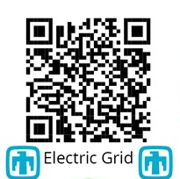
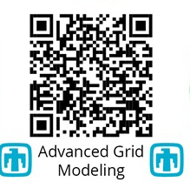
QUESTIONS?
Samuel T. Ojetola, Ph.D.
sojetol@sandia.gov

