Slide 1
HaMLET: Human and Machine Learning Effective Teaming
Kyra Wisniewski
Laura Matzen, Matt Hoffman, Karin Butler, Marie Tuft, Adam Hooker, Jacie Ritchie, Todd Farrell
SAND2024-09811C
Notes:
My name is Kyra Wisniewski and today I’ll be presenting on an on-going NSIST LDRD called HaMLET
HaMLET stands for human and machine learning effective teaming
And we are currently in our first of two years

Slide 2
Project Overview
SAND2024-09811C
The goal of HaMLET is to produce a novel understanding of multi-label classification (MLC) methods in the context of the human-machine team to support human comprehension and decision-making.
Notes:
In multi-label classification each item can be assigned one or more labels that are not mutually exclusive
Really MLC problems are prediction problems that have multiple properties of interest and this is the case in a lot of situations.
There are MLC problems related to:
Defect detection and characterization (which hardware parts are malfunctioning and in what ways)
There are also multi label text classification problems (author, topic, and sentiment is pos or neg)
Multi-object detection and classification falls under this category as well (vehicles, buildings, and people)
So, there are many mission relevant applications for MLC.
There are also many MLC methods ranging from those that transform MLC datasets in order to create a simpler classification problem to those that adapt classic ML methods (like SVMs and decision trees) specifically for MLC.
Yet, there has been little to no research on how to present the outputs of MLC models and information about their performance to human developers or end users of the models.
And this is a problem because when stakes are high and algorithms are used in Sandia mission applications, humans often make the final decisions based on these algorithms.
So, It’s insufficient to optimize algorithmic performance alone
We have to optimize the performance of the HMT.
On this project we are conducting foundational research on the comprehensibility of MLC to enable more effective development and deployment of MLC models across Sandia mission areas.

Slide 3
Relationship to Existing Literature
SAND2024-09811C
Multi-Label
Classification
Literature
Trust, Visualization,
and Cognitive Science Literature
Focus on how to present outputs of complex ML models to people.
Focus on developing algorithms to do MLC.
Little to no research on how to present the outputs/information about MLC models to developers or end users.
?
Notes:
Now I want to talk about how this project addresses a specific gap in the literature.
There are several relevant bodies of work to our problem.
The first is, of course, the multi-label classification literature.
This literature is focused on developing algorithms, not on presenting outputs of or information about models to users.
Which is an area that is not unique to MLC.
And has been explored in the trust, viz, and cog sci literature.
But these questions have not been specifically considered in the context of MLC.
And, given the size and complexity of both the input and output space of MLC models.
As well as, the unique property of MLC models to be partially correct for a single given output.
Humans will likely have specific challenges interpreting MLC in comparison to other types of classification.

Slide 4
Technical Approach
SAND2024-09811C
Research Thrust 1
Research Thrust 2
What are the most effective methods for presenting the outputs of MLC models to model developers and end users?
What are the most effective methods for presenting information about MLC model performance to model developers and end users?
vs.
vs.
Notes:
We are pursuing two parallel lines of research to try to understand these challenges.
In both lines of work we are conducting human subject experiments that use tightly controlled stimuli to test
user accuracy, response times, comprehension of model outputs/performance, model compliance (acting in agreement with the model outputs), and tolerance for risk in decisions.
Today, I’ll talk about our progress so far in both of these thrusts. I’m going to start with the first thrust where we are studying the following question:
Focus of this thrust is understanding the general cognitive properties of this problem and the emphasis is on the end users of models
Because of this focus AMT makes a great place to conduct experiments.
We can obtain large sample sizes at minimal cost and conduct multiple experiments in quick succession.
So, The first thing we are trying to understand is if people understand MLC differently than other types of classification problems? Specifically, MCC.
MCC is a more common problem where each item is assigned exactly one label and the labels are mutually exclusive
You can actually transform a MLC problem into a MCC problem (problem transformation approach called the label powerset method where each unique combination of labels is treated as its own class)
You can see on the screen the circle that contains light blue, light green, and dark green is transformed into a single orange label.
Our question is: is one output more comprehensible to humans?
And actually, creating an experimental paradigm to study this question was pretty difficult.
MLC involves complex ideas and we are trying to present them in a way that is comprehensible to the general public, AMTurkers
We are also filling a gap in the literature, so there is not really any work to draw on,
And this was a very interdisciplinary task as it required technical knowledge of MLC and MCC and cognitive science/design of experiments
3.25

Slide 5
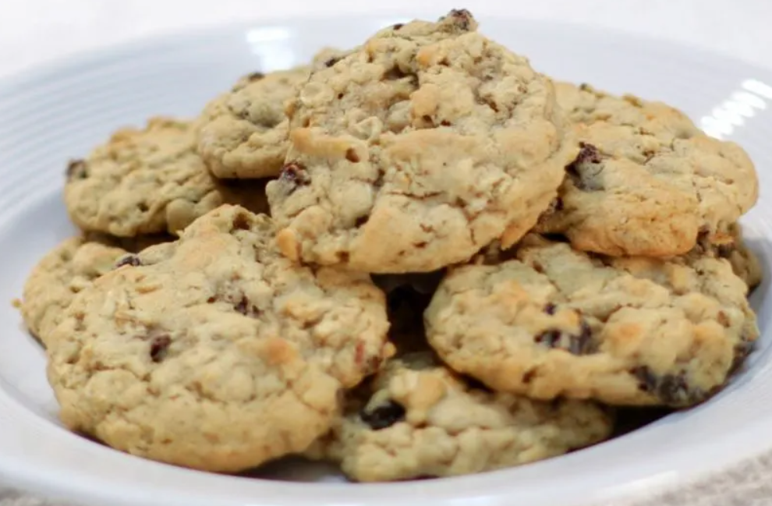
Understanding the differences between multi-label and multi-class outputs
SAND2024-09811C
Participants on Amazon Mechanical Turk look at the results of a “cookie analyzer” algorithm that tried to detect which ingredients are in a cookie based on a picture of the cookie.
The Cookie Analyzer has two modes and the outputs can be presented in two ways:
 | Cookie Mode (MCC) | Ingredient Mode (MLC)
Labels | Oatmeal Chocolate Chip - Yes Oatmeal Chocolate Chip with Walnuts - No Oatmeal Raisin - No Oatmeal Raisin with Walnuts - No | Oatmeal - Yes Chocolate Chip - Yes Raisin - No Walnut - No
Percentages | Oatmeal Chocolate Chip – 91% Oatmeal Chocolate Chip with Walnuts – 5% Oatmeal Raisin – 1% Oatmeal Raisin with Walnuts – 3% | Oatmeal – 90% Chocolate Chip – 90% Raisin – 5% Walnut – 3%
Notes:
That being said, now I’ll give some more details about the pilot experiment
Read bullet
The cookie analyzer has two modes
On cookie mode participants see outputs like oatmeal chocolate chip cookie oatmeal raisin cookie
These are multi class outputs
On ingredient mode participants see outputs like oatmeal, chocolate chip, and raisin
These are multi label outputs
So hopefully you can see the differences between these two classification problems given this example
The outputs are also presented in two ways: labels and percentages
1 min

Slide 6
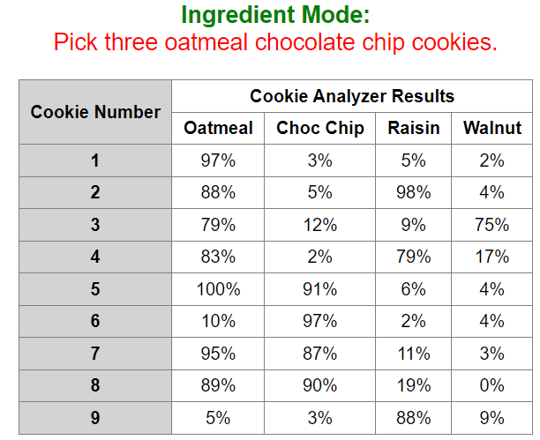
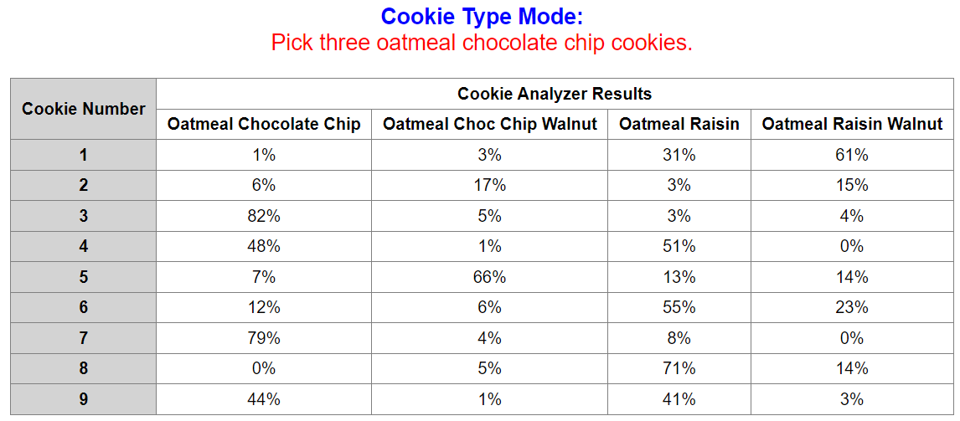
Example questions from the experiment
SAND2024-09811C
Question 2:
Question 7:
Most participants got this question correct
Most participants got this question incorrect
(chose cookie #4 instead of #9)
Notes:
Two example questions. Same question: pick three oatmeal chocolate chip cookies
Left is ingredient mode:
Most participants got this correct (87/100)
Right is cookie mode:
Most participants got this incorrect (27/100) made correct picks
What’s the difference?
In ingredient mode, participants must look at all the columns to find the oatmeal chocolate chip cookies
In cookies mode, participants don’t seem to be looking at contradictory evidence (high percentage of oatmeal chocolate chip cookie, but higher oatmeal raisin, just going down that first column)
1 minute

Slide 7
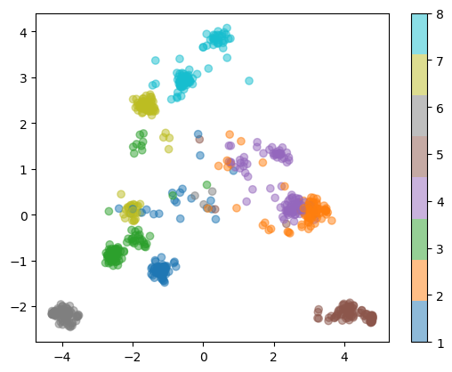
Pilot study results and outcomes
SAND2024-09811C
The general public can reason about this task.
Overall Accuracy: 88%
There are differences in human reasoning when outputs are displayed using multi-label vs. multi-class formats.
Participant preferences, accuracy, and confidence.
Baseline for kinds of errors people made
Experiment 2 will focus on replicating our findings that people tended to only look at one category in the multi-class case.
Additional studies can focus on different representation types, model biases, instance wise vs label wise errors, etc.
Refinement of participant pool
Participant Preferences
2 answer modes
 | Cookie Mode | Ingredient Mode
Labels | 39 | 11
Percentages | 18 | 32
Average Accuracy
 | Cookie Mode | Ingredient Mode
Labels | 97.5% | 90%
Percentages | 80.8% | 86.7%
1 answer mode
Exploratory Data Analysis
Notes:
The key result here is that we determined that we can frame MLC vs MCC in a way that members of the general public (MTURK) can reason about (high accuracy on pilot)
Additionally, these preliminary results, in terms of preferences, accuracy, and confidence, suggest differences in reasoning between MLC and MCC outputs, motivates more rigorously designed future experiments
We now also have a Baseline for the kinds of errors people make on this task
We are currently running an experiment designed to explore the error I discussed on the previous slide, we didn’t have the results before the slides were due, but the experiment has likely finished at this time, feel free to ask about this in the Q&A!
Easy to iterate on this initial experiment: model biases (struggles to differentiate between chocolate chips and raisins), instance wise vs label wise erros (which is worse… 1 mistake on 2 cookies (2 cookies mislabeled as chocolate chip when raisin) vs 2 mistakes on 1 cookie (1 cookies mislabeled as oatmeal raisin when peanut butter chocolate chip)
After conducting this pilot, we now have the experimental paradigm and the infrastructure to perform experiments in quick succession now
Refinement of the participant pool
Our participant pool moving forward is essentially tiple filtered: master Mturkers (statistical model analyzes worker performance), Laura filters bots out of those with a pretest (so she has her own pool of Mturkers she’s built up over the years) also gets individual difference data in this survey, then our pilot study weeds out people who don’t take the task seriously or don’t understand it

Slide 8
Technical Approach
SAND2024-09811C
Research Thrust 1
Research Thrust 2
What are the most effective methods for presenting the outputs of MLC models to model developers and end users?
What are the most effective methods for presenting information about MLC model performance to model developers and end users?
vs.
vs.
Notes:
So now revisiting the idea that we are pursuing two parallel lines of research on this project.
Our second thrust is exploring the following question:
On this thrust we’re interested in model selection and our emphasis is on model developers.
An end goal on this thrust would be enabling human comprehensibility as an input to model selection in addition to data complexity and computational complexity (model selection not just on properties of the model, model selection using properties of the human machine team)
Our initial work on this thrust focused on interviewing SMEs at the labs who use MLC for their work. If you work on or have worked on a MLC problem at Sandia please reach out to me, we’d love to learn about your work.
We’ve talked to folks classifying defects on solar panels, doing hyperspectral image target detection, and assigning classification guidance topics to text documents.
We also reviewed popular open source multi-label classification software, specifically the python library scikit-multilearn, a library compatible with the sklearn ecosystem which provides implementations of popular multi-label classification methods and techniques.
One of the key takeaways from all of this is that there is an abundance of MLC performance metrics, (11+) but they are difficult to interpret even for experienced ML practitioners.
I think a lot of this ultimately stems from a point I brought up earlier, that MLC predictions can be partially correct which makes them hard to assess.
There’s also a couple of different lenses to look at performance through: instance wise or label wise performance shown on the screen, macro vs micro, and others
After reviewing the literature further it became clear that relationships between MLC performance metrics (redundancies) and relationships between MLC performance metrics and dataset properties (how do metrics perform as labels increase, with dependencies between labels, with label imbalance, etc… which are all key components of mission datasets btw) are underexplored.
With this, we decided to conduct theoretical statistical simulation experiments to investigate performance metrics which we could then use to inform future human-subjects experiments.
________
Instance wise performance is on the left, how well does the model distinguish between positive and negative instances of a particular label.
Label wise is on the right, how well does the model distinguish relevant and irrelevant labels of an instance.
3 minutes

Slide 9
Simulation experiment
SAND2024-09811C
Population of Labels with Some Characteristics
Sample of Labels from Population (Data in hand to build model.)
Fake Classifier
(But really its just sampling labels in some known way.)
Metrics
Output Labels from the Fake Classifier
Notes:
This slide shows an overview of the simulation experiment framework.
To start- there is a population of labels we are interested in with some characteristics. Here we are assuming these are agnostic to the data type, ie this could be labels from images, waveforms, cyber data, anything that has multiple labels.
A classifier would be trained and tested on a sample of data from the population. The orange represents the data that would be in hand to build a model and hopefully is representative of the green population. Dataset characteristics can be measured using various metrics such as cardinality, mean imbalance ratio, density, ect. So we can use these as a guide to generate datasets with characteristics that we might be interested in, such as datasets with an imbalanced class.
From here we apply a “fake classifier”. This is really just sampling the labels from the generated dataset (orange) in specific ways to capture different possible behaviors of classifiers. For example, in the imbalanced class scenario, a classifier might be very good at classifying the common labels in the dataset but less able to capture the rare label. We can tweak this by applying different probabilities of getting the rare label correct in the way we sample.
Finally we apply a suite of performance metrics to asses the “fake classification”. We can then assess how the metrics perform relative to different dataset characteristics and “classifier” characteristics.
1.75
____
Not sure you want to bring this up but could also say:
While a classifier will be deterministic in behavior, there are many decisions a modeler makes when building an algorithm ie, model type (random forest, CNN, ect ect), different tuning parameters, feature engineering, what is included in the training data. We think its reasonable for now to capture this using a random sample, but future work includes assessing the degree to which this mimics behavior from real algorithms.

Slide 10
Imbalanced Class Scenario: Data Characteristics
SAND2024-09811C
Characteristic | Levels
Number of rare labels | 1
Probability of rare label occurring | 10%, 5%, and 1%
Number of non-rare labels | 2 and 10
Probability of non-rare label occurring | 70%
Number of instances | 50, 500, and 1000
Population of Labels with Some Characteristics
Sample of Labels from Population (Data in hand to build model.)
Notes:
We ran a simulation using the framework that I just described to assess how the metrics perform when there is an imbalanced class, which is a common property of MLC mission datasets.
These are the characteristics of the datasets generated. Note here that we had one rare label occurring out of either 3 or 11 total labels.
This rare label had three different levels of “rareness” with a 10%, 5%, and 1% possible rate of occurrence.

Slide 11
Imbalanced Class Scenario: Classifier Characteristics
SAND2024-09811C
Fake Classifier
(But really its just sampling labels in some known way.)
Characteristic | Levels
Accuracy of non-rare labels | 95%
Sensitivity of rare label P(correct classification | label present) | 0%, 5%, 50%, and 100%
Specificity of rare label P(correct classification | label absent) | 95%
Output Labels from the Fake Classifier
Notes:
These are the characteristics of the output predicted by the fake classifier. 1000 simulations were run per setting.

Slide 12
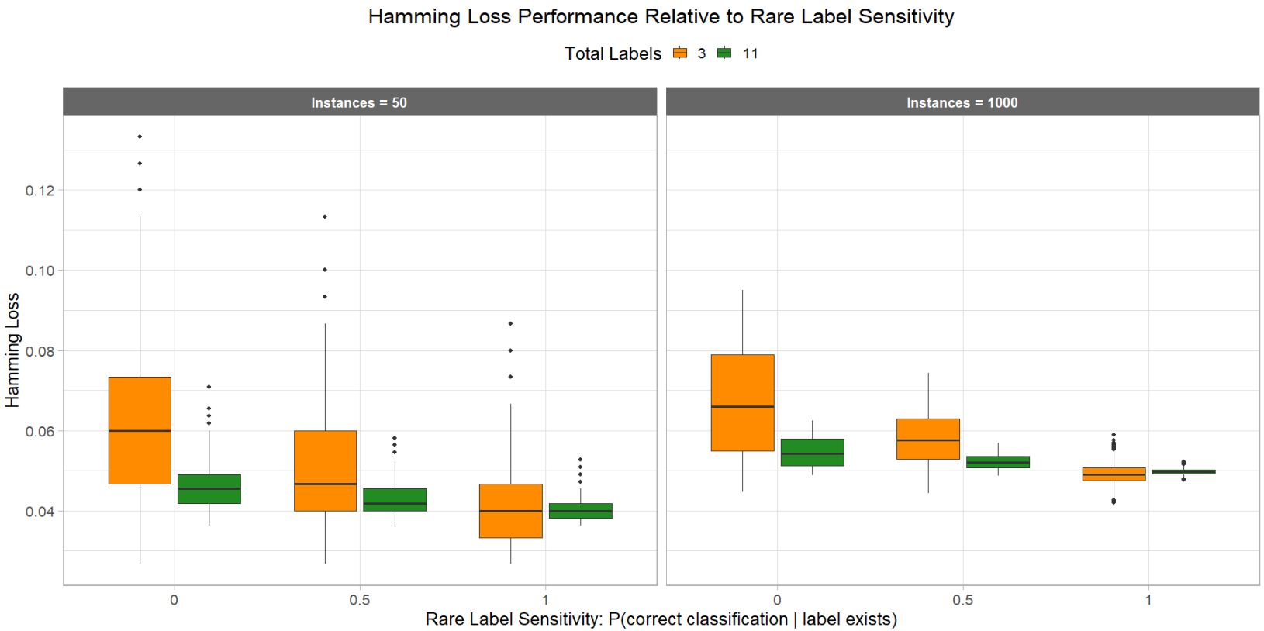
Selected Results: Hamming Loss
SAND2024-09811C
Hamming loss is the fraction of incorrectly predicted labels to the total number of labels.
Notes:
This is an example of a general evaluation of the relationship between a performance metric and classifier characteristic with respect to different dataset properties.
This plot visualizes the overall performance of hamming loss relative to changing the sensitivity of the classifier to the rare label.
Hamming is loss is often referred to as the most common MLC performance metric, it is the fraction of incorrectly predicted labels to the total number of labels. Lower is better.
On the x axis is sensitivity, where higher values indicate that the classifier was able to detect the rare label more often.
The y axis is hamming loss, where a lower value indicates better performance.
The plots are paneled by number of instances, on the left is 50 and on the right is 1000.
The boxes are colored by total number of labels in the dataset, orange = 3 and green = 11.
There are three trends to note here.
The first is that overall hamming loss goes down as label sensitivity goes up.
The second is that when comparing the two plots side by side, hamming loss is generally higher when there were more instances in the dataset.
And the third is that hamming loss is generally higher and has more spread when the total number of labels is fewer.
----
(Please note that some settings were dropped for clarify of visualization.)
Marie note: I removed some settings (instances = 500 and sensitivity = .05) were removed for ease of visualization. They didn’t add anything additional to the plot and I wanted to keep this as easy to digest as possible.

Slide 13
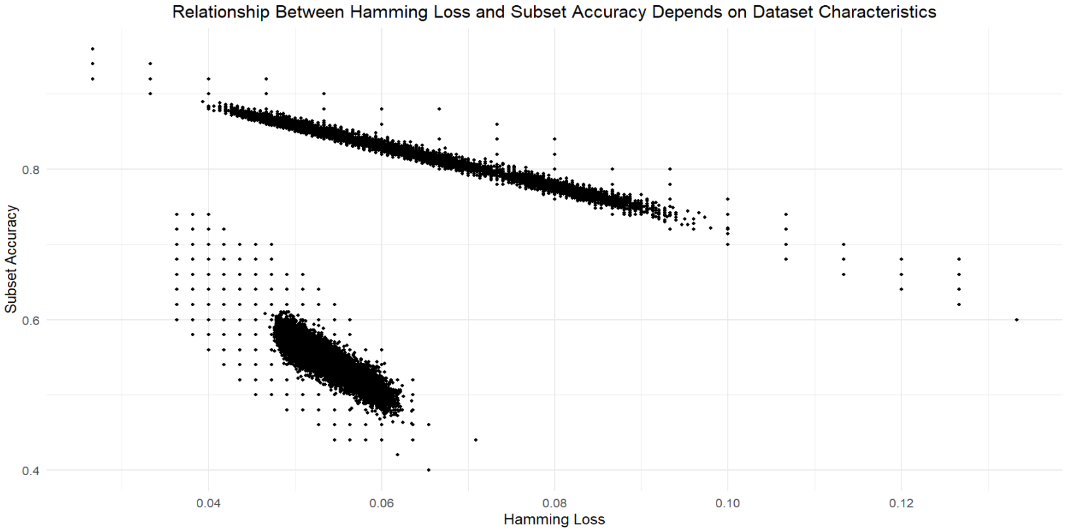
Selected Results: Hamming Loss
SAND2024-09811C
Existing literature claims Hamming Loss to be the metric least correlated with other performance metrics [1] .
Correlation = 0.10
[1] Pereira, R. B., Plastino, A., Zadrozny, B., & Merschmann, L. H. (2018). Correlation analysis of performance measures for multi-label classification. Information Processing & Management, 54(3), 359-369.
Notes:
One goal of this project is to find a minimal subset of metrics that should be used to evaluate performance.
As such, finding metrics that are uncorrelated with other metrics is important.
Existing literature we found claimed that Hamming Loss is a metric that is the least correlated with other metrics and should therefore always be calculated.
This paper reported the overall correlation of different metrics for 16 different datasets combined.
However, we’ve discovered in this simulation that the relationship between metrics depends on a given dataset’s characteristics.
For instance, we have plotted hamming loss on the x axis and subset accuracy (another metric where the predicted and real label sets are compared for full equality) on the y.
The overall correlation is 0.1, which is not very high. However, there are obviously two subgroups in this plot.
---
Marie note: it looks like the correlation should be -.1 instead of .1, but because the correlation is essentially fitting a line to both sets of data, it comes out positive overall.

Slide 14
Selected Results: Hamming Loss
SAND2024-09811C
Our preliminary findings contradict [1].
3 Labels
Correlation = -0.98
11 Labels
Correlation = -0.88
[1] Pereira, R. B., Plastino, A., Zadrozny, B., & Merschmann, L. H. (2018). Correlation analysis of performance measures for multi-label classification. Information Processing & Management, 54(3), 359-369.
Notes:
Once these are grouped by number of labels in the dataset, the correlation between the metrics is quite high.
This means that assessment of relationships between metrics should be kept within datasets of the same characteristics. This is true when looking at scatterplots of other metrics as well and this contradicts the existing literature.
In terms of next steps, once we have a good understanding of the correlations between performance metrics
We plan to use a human subjects experiment to determine which of those measures is most understandable by humans,
So we can then give a recommendation for a suite of metrics to use on a given problem that avoids redundancies and is understandable.
----
Many of the metrics seem correlated which is promising for reducing the number of metrics needed.

Slide 15
Questions?
SAND2024-09811C
Notes:
So today I covered a lot of the work that we’ve completed so far on HaMLET.
Like I said at the beginning of the presentation, we are in our first of two years so there is more work to come.
Does anyone have any questions?

