Slide 1
Cyber-Physical Data Fusion & Threat Detection with LSTM-Based Autoencoders in the Grid
SAND2024-05006C
Presenter: George Fragkos
Authors: George Fragkos, Logan Blakely, Shamina Hossain-McKenzie, Adam Summers, Christopher Goes
Published Paper’s Original Venue: IEEE Kansas Power & Energy Conference 2024
George Fragkos
Principal Member of Technical Staff @ Sandia National Laboratories
Machine Learning & Deep Learning Conference

Slide 2
Agenda
SAND2024-05006C
Introductory Notes
Electric Grid Testbed, Dataset & Threat Model
Cyber-Physical Data Fusion
LSTM-Based Autoencoders for Cyber-Physical Data Fusion & Threat Detection
Future work

Slide 3
Cybersecurity Challenges in the Grid
SAND2024-05006C
Cyber-Physical Power Grid
The power grid has undergone a significant transformation in recent years
High penetration of Distributed Energy Resources (DER)
Integration with cyber communication networks and modern digital components
Vast amounts of cyber and physical data are generated by the DER communication types and interfaces within the grid
Challenges
There is a need:
For a robust mechanism to ingest and process this data
To fortify the grid against potential threats that can compromise its integrity and disrupt its functionality
Examples of cyber-attacks: 2015 Ukraine grid cyber-attack, 2013 Metacalf snipper attack
How can we use high-fidelity cyber-physical data to protect the cyber-physical power grid?
Source: https://www.vifindia.org/article/2022/may/02/war-in-ukraine

Slide 4
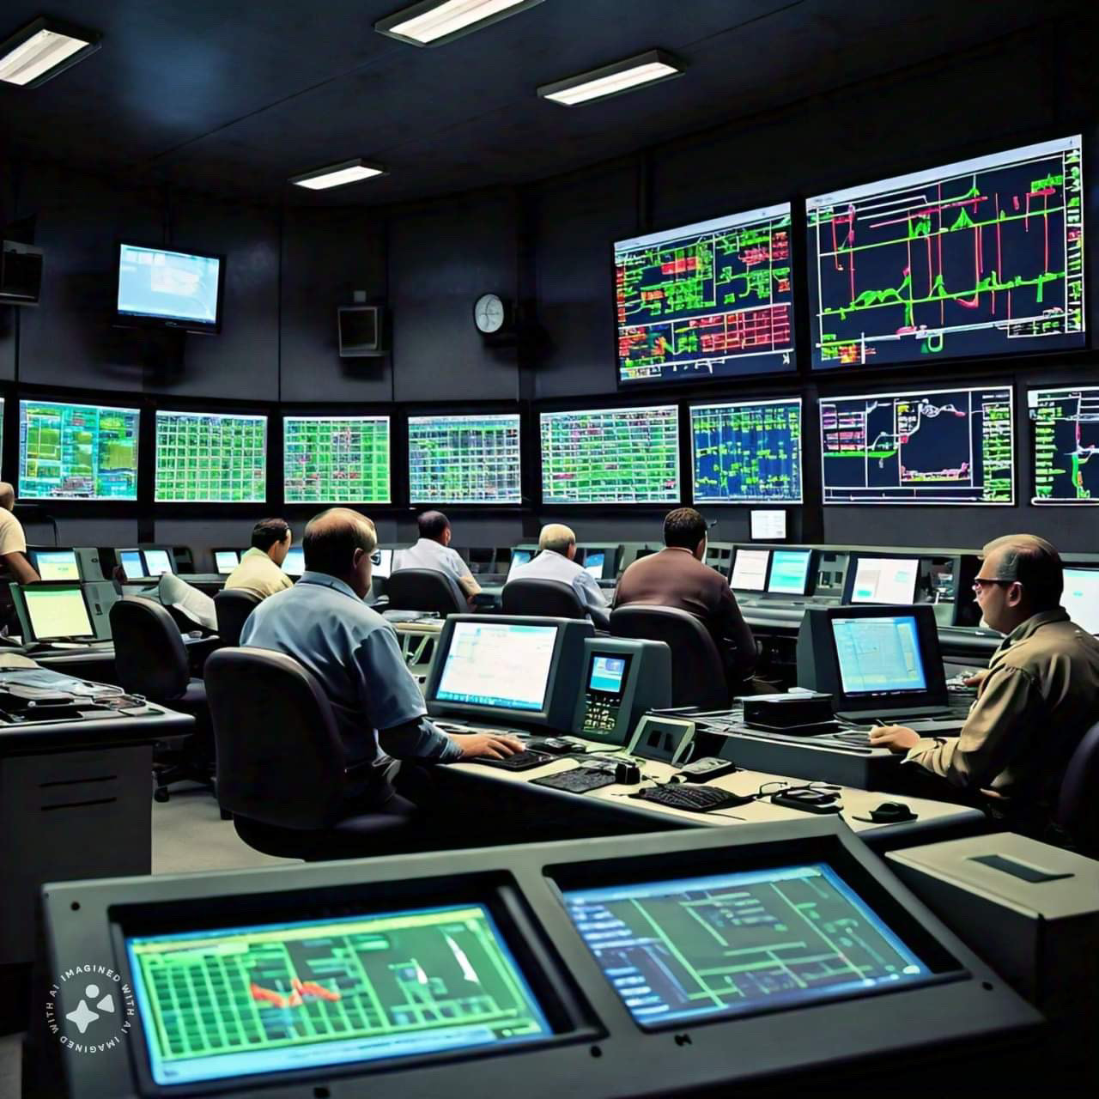
Artificial Intelligence (AI) for Cyber-Physical Security
SAND2024-05006C
Current Research Work Summary
A big part of the research work focuses on utilizing Deep Neural Networks (DNNs) for identifying physical disturbances in the grid’s measurements
Another big portion performs threat detection using only cyber data originating from the IT environment
There is a significant research gap for blending the physical with the cyber data
”How can we effectively fuse the cyber-physical data generated in the grid to ensure situational awareness and detect not only cyber threats but also physical disturbances?”
What do we propose?
A cyber-physical threat detection methodology through data fusion
Using a Long-Short Term Memory (LSTM)-based Autoencoder (AE)
To integrate the temporal and structural patterns of cyber-physical data
Generated by a Sandia’s testbed that simulates a part of the electric grid
Image created with the Llama 3 Generative model from Meta AI

Slide 5
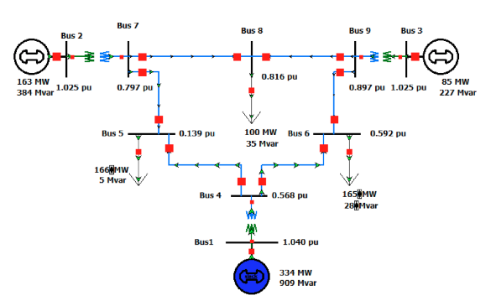
Electric Grid Testbed, Dataset & Threat Model
SAND2024-05006C
Electric Grid Testbed & Dataset
Emulation environment: real-time digital simulator (RTDS) that enables streaming C37.118 data from PMUs in the RTDS WSCC 9-bus models and SCEPTRE
SCEPTRE: Sandia Emulation Tool - It provides a comprehensive ICS/SCADA modeling and simulation capability that captures the cyber-physical impacts of targeted cyber events on critical infrastructure
Cyber Features: Collected from 3 different relays in each of the three substations – packet RTTs and packet retransmissions
Physical Features: Collected from 8 different PMUs – frequency, per-phase voltage, per-phase current
SCEPTRE Logo
Threat Model
Physical events: a generator and line outage event (mitigation: load shedding)
Cyber event: a Denial of Service (DoS) attack,
Cyber-Physical event: generator and line outage events + DoS that impedes the load-shedding signal issued by the control center
Result: Unstable system as defined by frequency instability
WSCC 9-Bus System

Slide 6
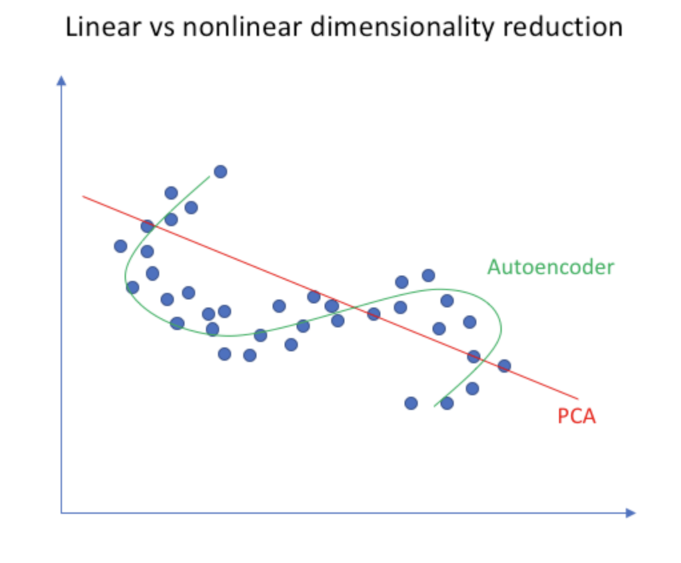
High Dimensionality & Multimodal Cyber-Physical Data
SAND2024-05006C
Problem
Analyzing and extracting meaningful insights from cyber-physical data require specialized techniques and handling
As the dimensionality of the input space increases, the complexity of the classification task also increases
There is a growing interest in reducing the dimensionality of the input space to enhance the predictive performance of classification models
Approaches for dimensionality reduction
PCA
[Principal Component Analysis]
Assumption: The data lies on a linear subspace
LDA
[Linear Discriminant Analysis]
Not always true in real-world scenarios!

Slide 7
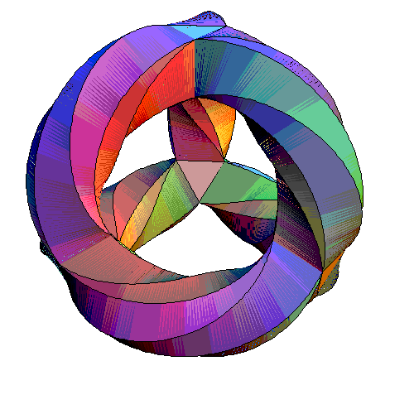
Cyber-Physical Data Fusion
SAND2024-05006C
It is a dimensionality reduction technique used to understand the underlying structure of complex high-dimensional cyber-physical data
It aims to uncover the intrinsic low-dimensional manifold on which the data points lie
By preserving the local and global relationships between the cyber-physical data points, manifold learning provides a more meaningful representation for further analysis, i.e., threat detection in the electric grid

Slide 8
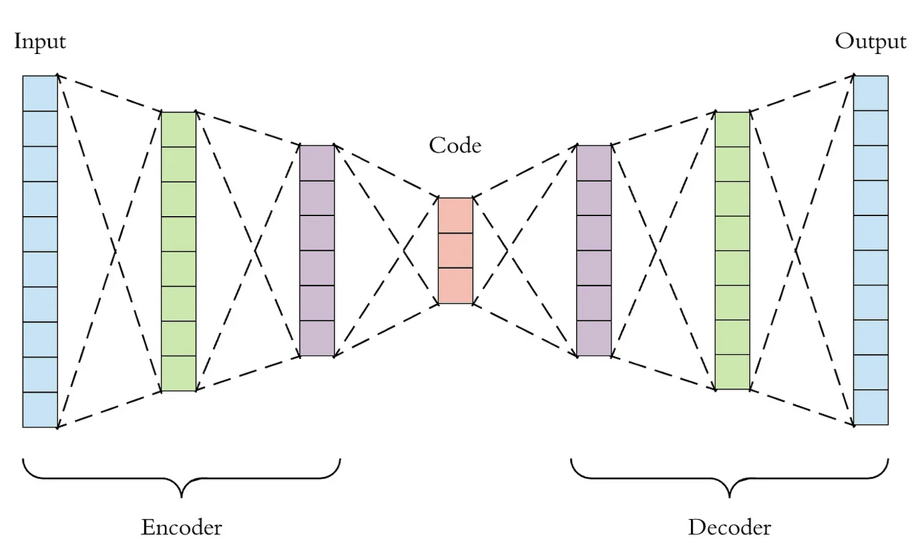
Autoencoders for Cyber-Physical Data Fusion
SAND2024-05006C
Description
How do they work? / Architecture
Autoencoders (AE) are a type of Artificial Neural Networks (ANN) used for:
Unsupervised Learning
Dimensionality reduction/Compression
Data Fusion
Encoder: Compresses the input cyber-physical data into a lower-dimensional space using an encoder network – bottleneck layer
Decoder: Then it reconstructs the input data back into the original space using a decoder network
It learns an internal representation/code to perform useful transformations on the input data (middle layer)
Finds a codification of the input cyber-physical data by learning non-linear combinations of their features
$$RE=|\left|x_{t}−\hat{x_{t}}\right||$$
Cyber-Physical readings
Reconstructed
Cyber-Physical readings
$$x_{t}$$
$${\hat{x}}_{t}$$

Slide 9
LSTM-Based Autoencoders for Cyber-Physical Data Fusion
SAND2024-05006C
Why LSTMs?
Plain AE might not capture the temporal ordering of the cyber-physical data
LSTM are a type of Recurrent Neural Networks (RNN) that can capture the temporal patterns in time-series data
LSTM-based AE: the only difference with the plain AEs is that the encoder and decoder are built using LSTM units instead of simple linear neural network layers
The LSTM architecture within the AE enables memorizing past units and utilizing this memory to make predictions about future cyber-physical inputs
L
L
L
L
S
S
S
S
T
T
T
T
M
M
M
M

Slide 10
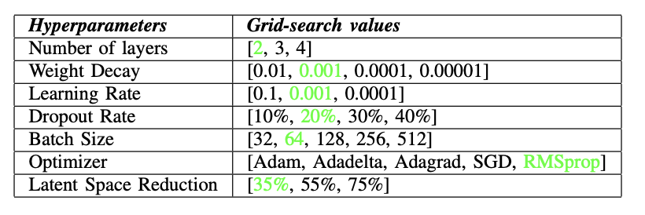
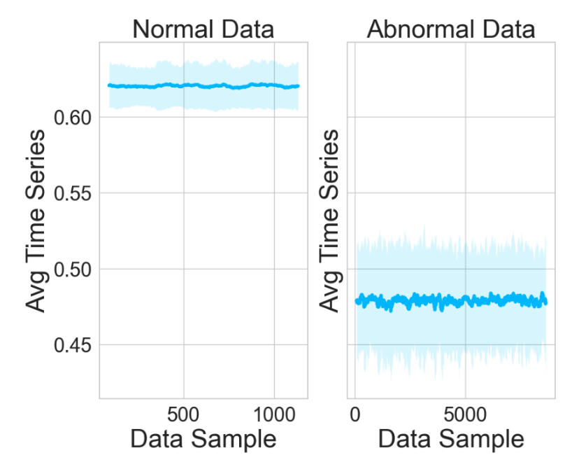
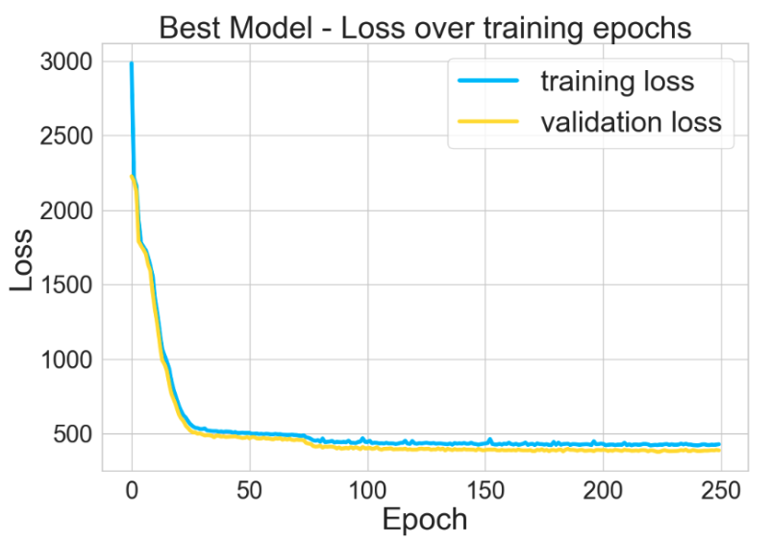
LSTM-Based Autoencoders for Cyber-Physical Threat Detection
SAND2024-05006C
Evaluation Analysis
Distinct pattern between normal and abnormal data
Grid-Search Hyperparameters Optimization
Optimized LSTM-based AE model is trained **ONLY** on normal data
Avg Normalized cyber-physical time series
Training & validation loss of the optimized LSTM-based AE model

Slide 11
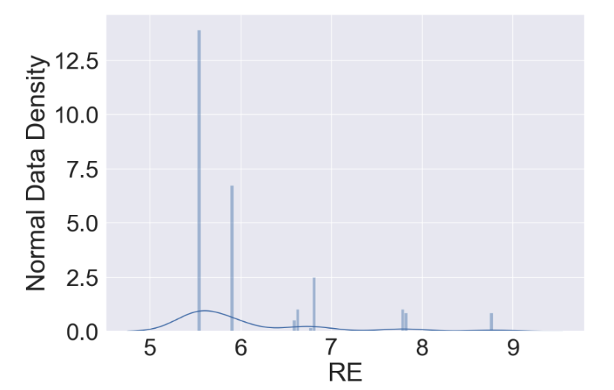
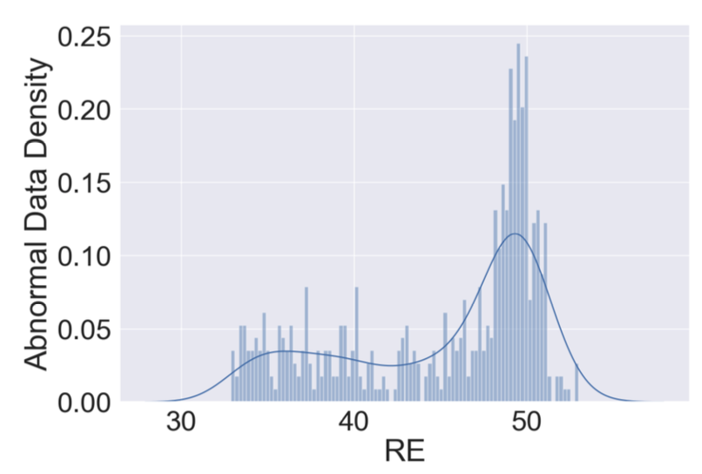
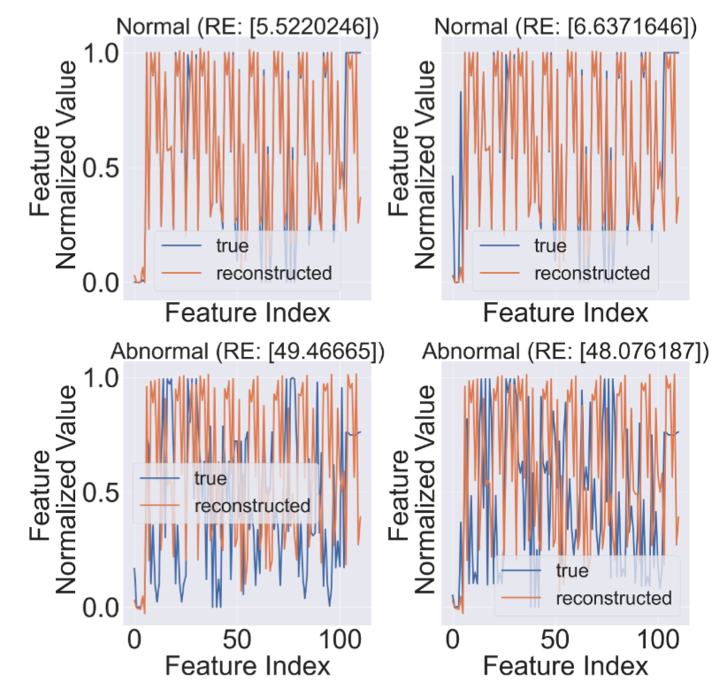
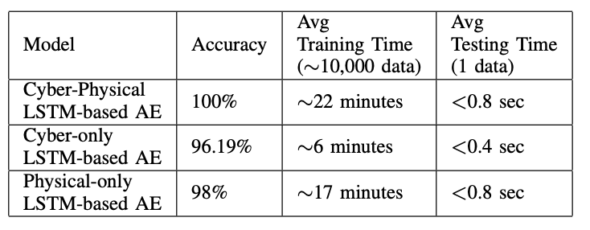
LSTM-Based Autoencoders for Cyber-Physical Threat Detection
SAND2024-05006C
Evaluation Analysis
Threat Detection
Threshold
$$th=9$$
RE Histogram on the normal data of the trained LSTM-based AE model
RE Histogram on the abnormal data of the trained LSTM-based AE model
Model’s feature input values, reconstructed feature values and errors

Slide 12
Future Work
SAND2024-05006C
Team will investigate how the cyber-physical attack can be located within the grid
Evaluate the combination of the LSTM-based AE model’s learned latent space with other ML models
Stealthier cyber-attacks will be examined

Slide 13
Contact: gfragko@sandia.gov
SAND2024-05006C

