Slide 1
Scoring Morphological Change in Computed Tomography Images of Pentaerythritol Tetranitrate (PETN)
Ariana Beste/ 7555, Daniel C. Bufford/ 7555,
Dan S. Bolintineanu/ 1516, Kevin M. Potter/ 5575
MLDL Workshop, September 9th -12th 2024
SAND2024-09459C

Slide 2
Problem Statement
Material transformation due to
thermal exposure
manufacturing defect
impurity
material incompatibility
Previously unseen changes
Energetic Material Surveillance
Component Shelf-life Programs
CT stack
~ 2000 2D images
Current SEM/CT image analysis workflow
Traditional morphology analysis
Convolutional neural networks
Data
Desired
Realization
Unlabeled data
Class imbalance
Unsupervised approach
Only nominal data is used
Feature Anomaly Detection System# (FADS)
# A. P. Garland, K. M. Potter, M. Smith, Feature anomaly detection system (FADS) for intelligent manufacturing, ArXiv 2022, abs/2204.10318.

Slide 3
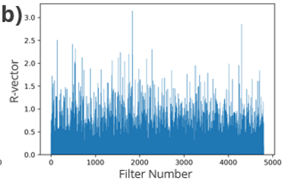
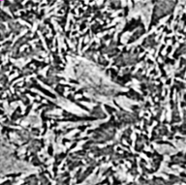
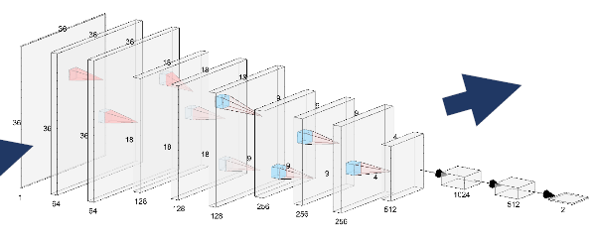
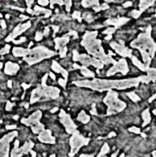
Approach
Morphology Scores: Feature Anomaly Detection System (FADS)
Nominal Images
Comparison of network activations
“Training”
Pretrained CNN
R-Vector
Difference between aggregated activations of nominal and test images per filter
Test Images
Testing
ResNet18
PETN powder 50% TMD
Aged for 1 to 3 weeks at 25°C, 70°C, 85°C, 100°C
MicroCT images, resolution 0.6 μm/pixel
~2000 image per scan, cropped to 1120x1120
Batches of 100 nominal and test images
Global histogram equalization
Morphology score: 90th percentile of R-vector

Slide 4
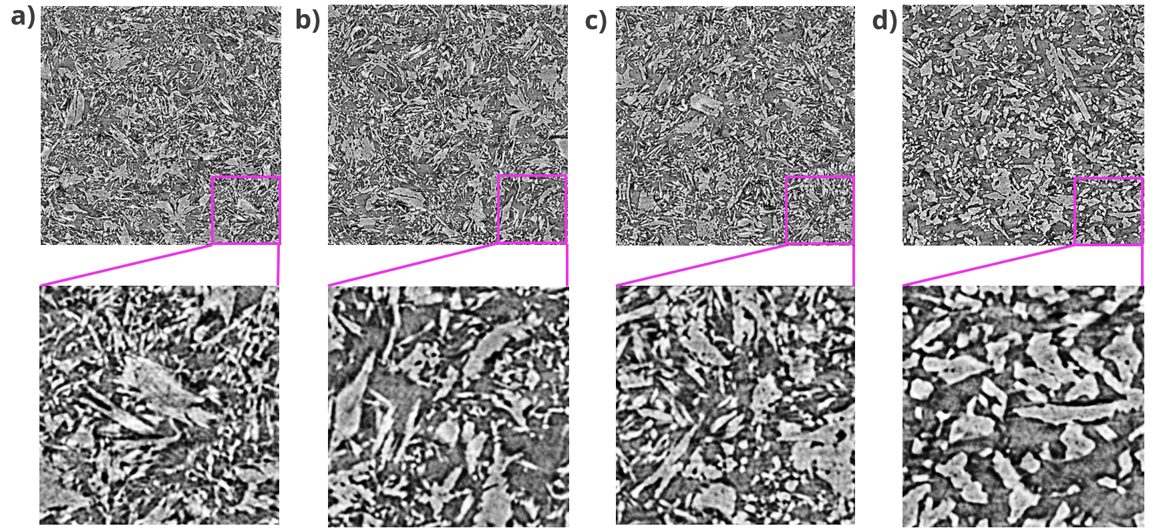
PETN CT Images
Pristine
Aged at 70°C
Aged at 85°C
Aged at 100°C

Slide 5
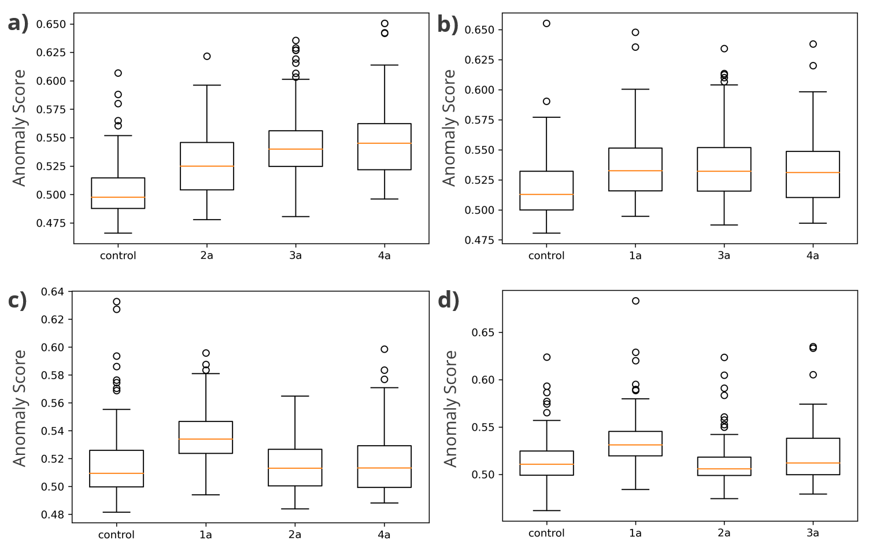
Anomaly Score Variations for Images of Pristine PETN
Exchange of nominal set
1a
2a
Anomaly score differences due to image-to-image variations
Mean: 0.53
Std: 0.027
Sample 1a stands out
3a
4a

Slide 6
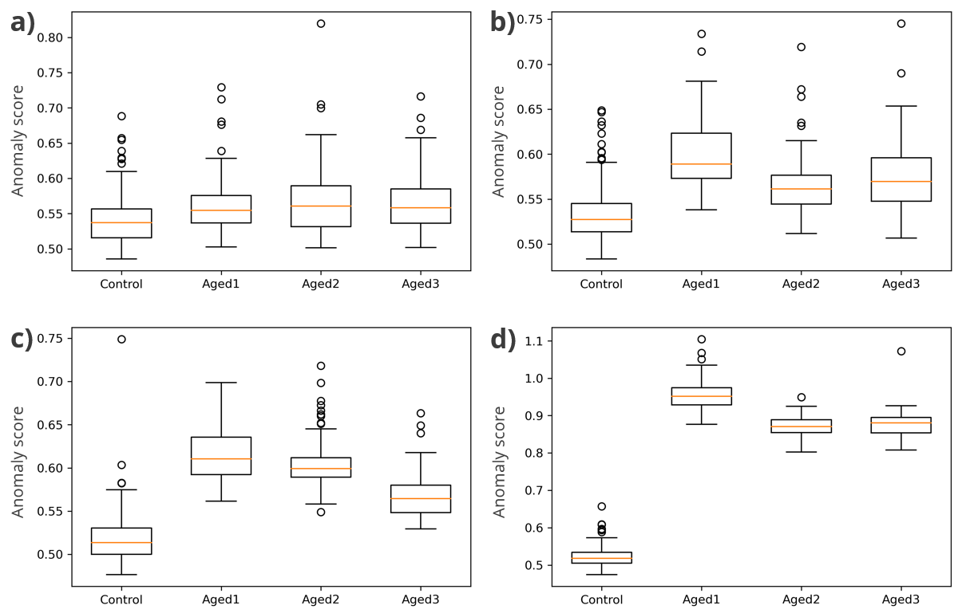
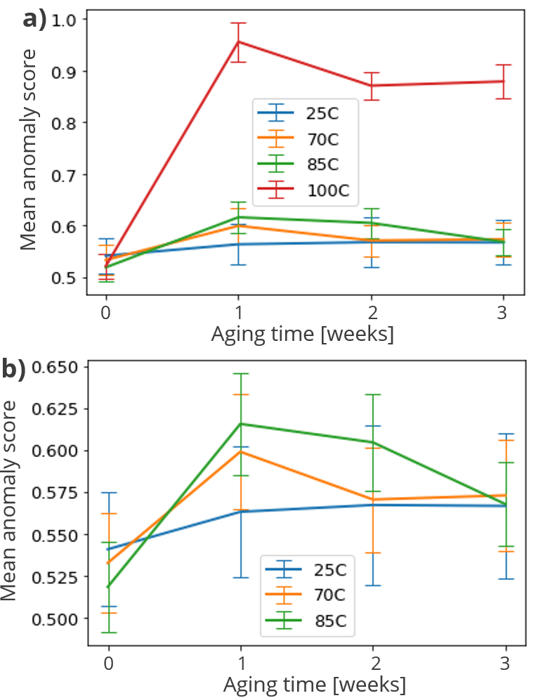
Anomaly Scores with Increasing Aging Temperature
25°C
70°C
85°C
100°C
Onset of morphological change at 85°C
Significant morphological change at 100°C
Morphological change within 1 week
Unexplained decrease in score after week 1

Slide 7
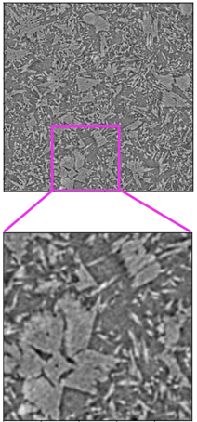
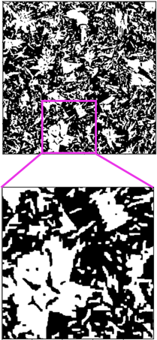
Morphological Metrics
Understanding and interpretation of neural network scores
Random walker segmentation, no filter
volume fraction (density)
specific boundary length (specific surface area)
two-point correlation function (measure of the probability that two points separated by a given distance fall within the same phase)
local thickness of the pore and particle phase (pore and particle size distribution)

Slide 8
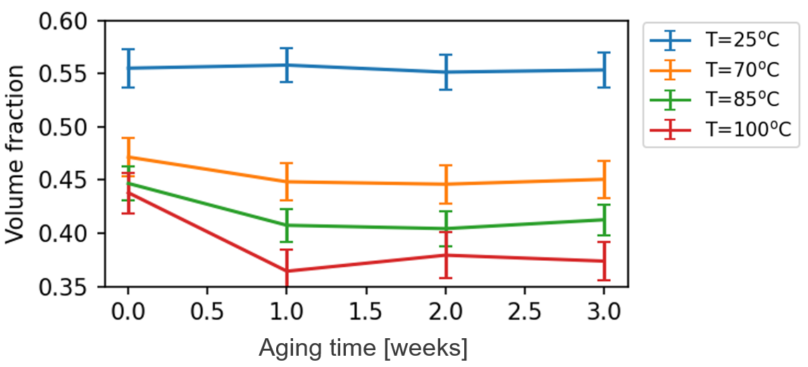
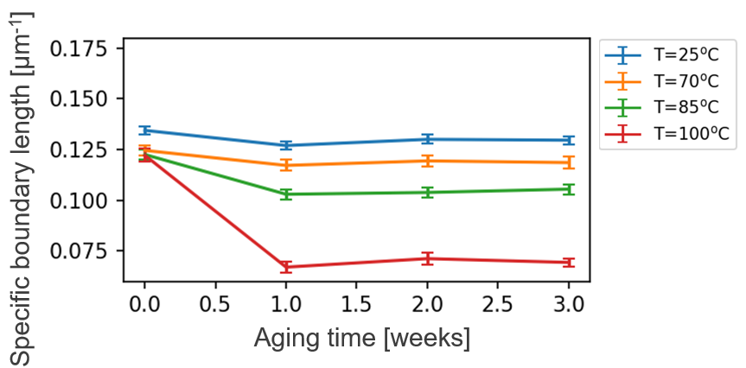
Volume Fraction, Specific Boundary Length
Sample 1a pressed to higher density → higher anomaly scores
Unphysical volume fraction decrease likely due to effective resolution change as PETN coarsens
1a
Onset of decrease at 85°C
Significant decrease at 100°C
Decrease due to volume fraction decrease and coarsening
Same trends as for anomaly scores
Kink in volume fraction and specific boundary length as in anomaly scores

Slide 9
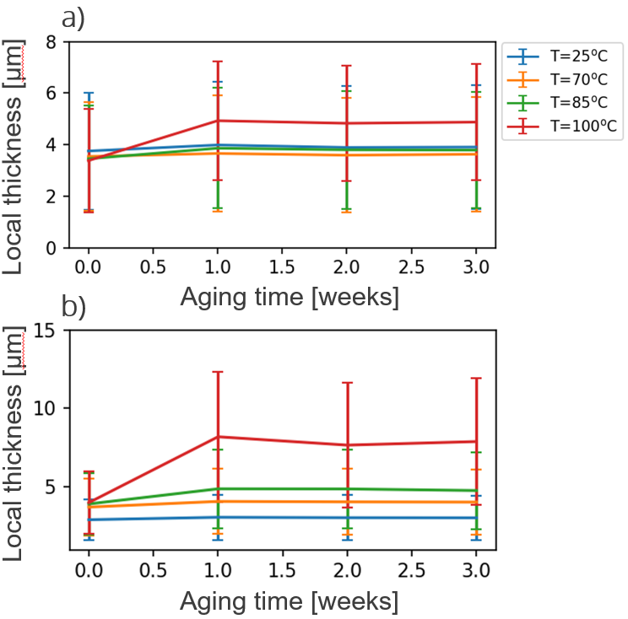
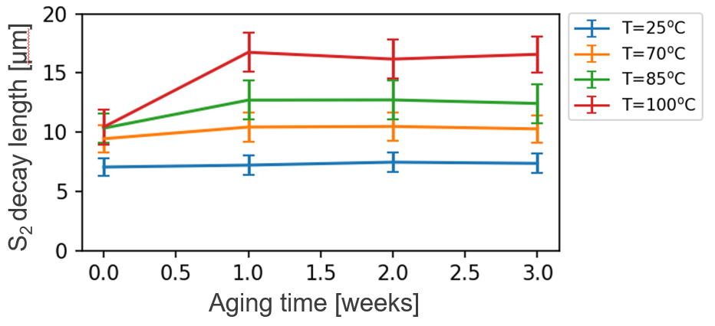
S₂ Decay Length and Local Thickness
Solid phase
Measures of characteristic particle/pore size
Same trends as for specific boundary length and anomaly scores but less separation
Pore phase
Kink in S₂ decay length and local thickness as in anomaly scores

Slide 10
Conclusion
FADS to score morphological change in CT images of PETN aged at different temperatures
Clear separation between pristine PETN and PETN aged at 100°C, onset of morphological change at 85°C
Higher scores for sample 1a
Initial score increase due to aging followed by a score decrease as PETN was aged beyond one week
Verification of trends and ‘outlier’ sample by visual inspection and calculation of morphological metrics
Morphological metrics varying success in quantification of material change

Slide 11
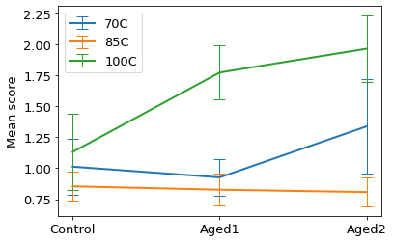
FADS Scores for SEM Images of PETN Pellets
Large score variations
Lots of noisy image data within energetic material surveillance
High resolution but inconsistent imaging artefacts

