Slide 1
Hybrid Deep Reinforcement Learning For Online Distribution Power System Optimization and Control
Nicholas Corrado 8722
Michael Livesay 8722
Jay Johnson 8812
Tyson Bailey 5683
Drew Levin 8721
Funding Source: LDRD
SAND2022-9851 C

Slide 2
Motivation
Decentralization in the power industry makes power systems more vulnerable to attacks.
Prior work on grid resilience primarily uses optimization techniques
May not scale to large systems
Not designed to defend against an active adversary
Can a reinforcement learning (RL) agent defend a distribution power system by controlling a collection of utility-owned distributed energy resources?

Slide 3
Contributions
Prior work on RL-based grid resilience focus on discrete-action settings or continuous-action settings. We are the first to consider a parameterized-action setting, a more natural setting for grid resilience tasks.
Agent can learn optimal DER setpoints as well as the optimal path to the optimal setpoints.
We introduce a deterministic greedy algorithm, and find that it performs quite well.
We empirically demonstrate that RL agents can successfully regulate distribution systems and outperform the greedy algorithm.
We evaluate several RL algorithms and observe that algorithms specially designed for parameterized action tasks are significantly more data efficient.
This work takes an additional step towards a more realistic multi-player distribution system control game

Slide 4
Reinforcement Learning Interaction Protocol
Policy $π$
Action | Left | Down | Up | Right
Probability | 0.4 | 0.1 | 0.2 | 0.3
agent
(wants to maximize reward)
environment
action
observation (state), reward

Slide 5
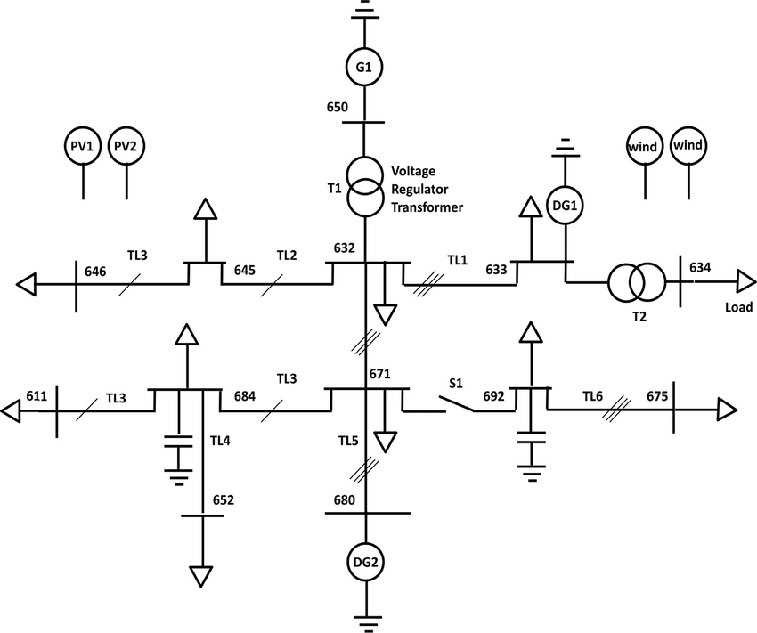
Power System 1: IEEE 13-bus Model
14 controllable DERs
Agent controls the active and reactive power of each DER
On-load tap changing transformers (LTCs) adjust the number of windings on the transformer to correct low/high voltages. We assume the agent makes decisions very quickly, allowing us to ignore the LTC dynamics.
IEEE-balanced: LTCs are tapped to default values.
IEEE-unbalanced: LTCs are tapped to the 0.95 pu state to produce a severe voltage condition in which all bus voltages are less than 0.95 pu.

Slide 6
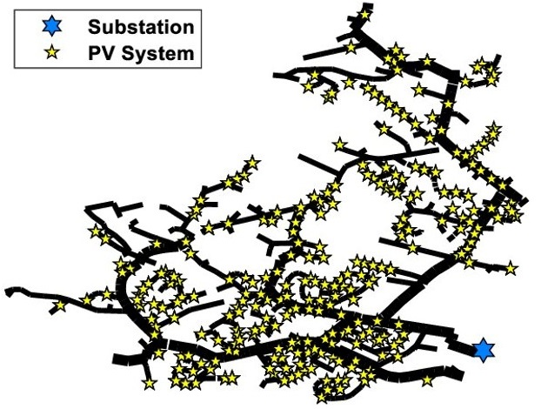
Power System 2: EPRI Ckt5 Model
701 total controllable DERs
Agent controls the power factor of each DER
Power factor = ratio of active and reactive power
EPRI-14: Agent only controls DERs with the 14-largest power ratings.
EPRI-32: Agent only controls DERs with the 32-largest power ratings.

Slide 7
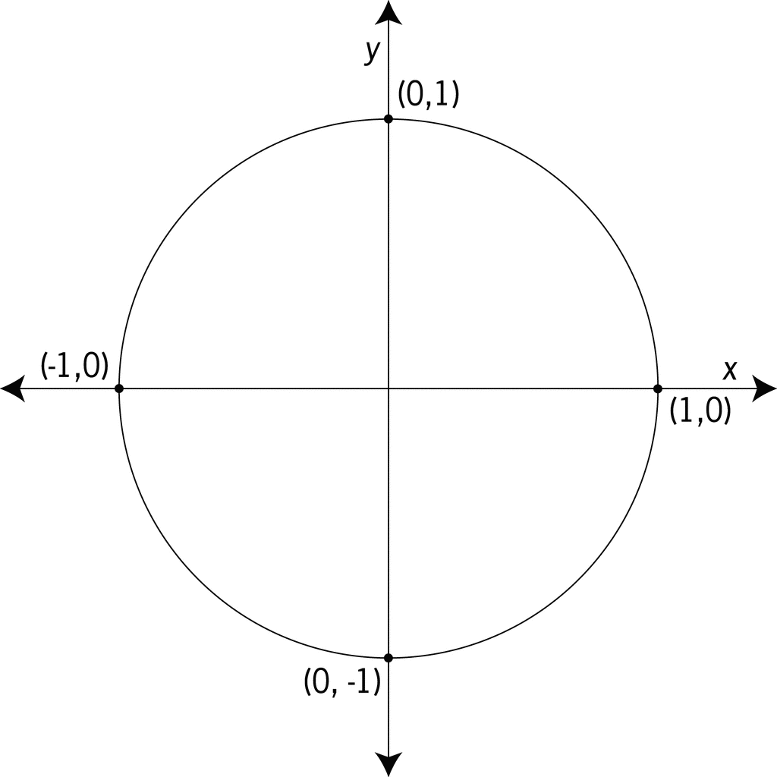
Environment Description
Let $n=$ number of controllable DERs (i.e. number of discrete actions)
Parameter space $𝒳$: The set of possible setpoints for a single DER
IEEE: $𝒳=$ unit disk
EPRI: $𝒳=[−1,+1]$
Action space: $\{0,…,n−1\}×𝒳$
For the EPRI model, action $(7, 0.4)$ changes the setpoint of DER 7 to 0.4
For the IEEE model, action $(7, (0.4, −0.2))$changes the setpoint of DER 7 to $(0.4, −0.2)$
State space: The current setpoints of all DERs (i.e. a list of $n$ points in $𝒳$)
Initial state distribution: All bus states are initialized to a point in or on the unit circle uniformly at random.
Reactive Power
Real Power
Parameter space for the IEEE model
-1
+1
Parameter space for the EPRI model

Slide 8
Environment Description
Reward: negative sum of squared errors of bus voltages compared to nominal voltage values.
$$r=−\sum_{i=0}^{n−1}{{\left(V_{i}−V_{i}^{∗}\right)}^{2}}$$
where $V_{i}$ and $V_{i}^{∗}$ are the current voltage and nominal voltage of DER $i$, respectively.
Objective: Maximize the expected discounted reward
$$J=E_{π}\left[\sum_{t=1}^{T}{γ^{t}r_{t}}\right]$$
where $γ∈(0,1)$ is a discounting factor and $T=100$ is the horizon
Objective Interpretation: Stabilize the system by bringing voltages as close to nominal as possible.

Slide 9
Parameterized Action Spaces
At each step, the agent chooses which DER to modify (a discrete action) and a new setpoint for the chosen DER (continuous parameters).
We generalize continuous-action RL algorithms to handle parameterized actions using the technique introduced in [https://arxiv.org/pdf/1511.04143.pdf]:
Choosing a discrete action: Use $n$ output weights followed by a softmax activation, and then a sample from the resulting distribution.
Choosing the continuous parameters: output continuous parameters for all discrete actions, and then select the parameters corresponding to the choses discrete action.
This is an ad-hoc technique: the agent must learn that only the continuous parameters corresponding to the chosen discrete action affect the environment.
The Multi-Pass Deep Q-Network (MPDQN) algorithm is specially designed to handle parametrized actions
Special architecture lets the agent know that only the continuous parameters corresponding to the chosen discrete action affect the environment.
Notes:
produce noisy gradients during updates.
i.e. the agent needs to learn that only the parameters corresponding to the chosen action actually matter.

Slide 10
Greedy Algorithm
Coordinate descent-based approach
At each step, the algorithm identifies a set of promising actions—one for each DER—and then chooses the action from this set that maximally increase its immediate reward.
Define:
$s=$ current state
$s_{i}=$current state of DER$i$
$r_{i}\left(s,x\right)=$immediate reward for changing the setpoint of DER $i$ to $x$ in state $s$.
For each DER, we approximate the gradient $∇_{x}r_{i}\left(s,x\right).$
Let $x_{i}^{′}=s_{i}+η∇_{x}r_{i}\left(s,x\right)$, where $η$ is a small step size parameter
The agent then chooses the action $(i, x_{i}^{′})$ with the maximum immediate reward
Notes:
produce noisy gradients during updates.
i.e. the agent needs to learn that only the parameters corresponding to the chosen action actually matter.

Slide 11
Experiments: Setup
RL algorithms:
Proximal Policy Optimization (PPO)
Deep Deterministic Policy Gradient (DDPG)
Soft Actor-Critic (SAC)
Multi-Pass Deep Q-Network (MPDQN)
IEEE Model: Train 5 agents over 10k episodes, evaluate performance every 100 episodes
EPRI Model: Train 5 agents over 50k episodes, evaluate performance every 1k episodes.

Slide 12
Experiments: Evaluation Metrics
Data efficiency: How many environment interactions are required to train each agent to convergence?
Final state reward: How good is the final state achieve by each agent?
Path to final state: In a episode, how many steps does it take the agent to reach it’s final solution?

Slide 13
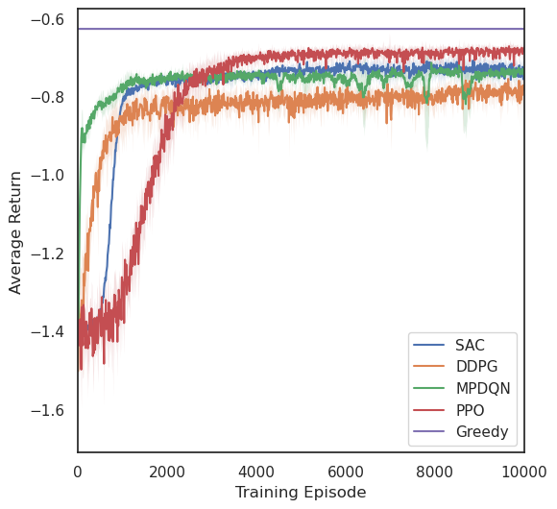
IEEE 13-bus: Balanced

Slide 14
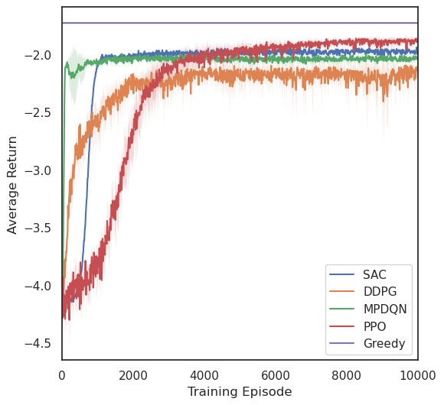
IEEE 13-bus: Unbalanced

Slide 15
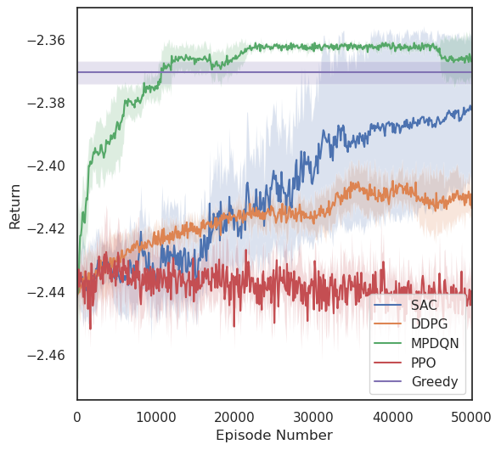
PV-14 Model

Slide 16
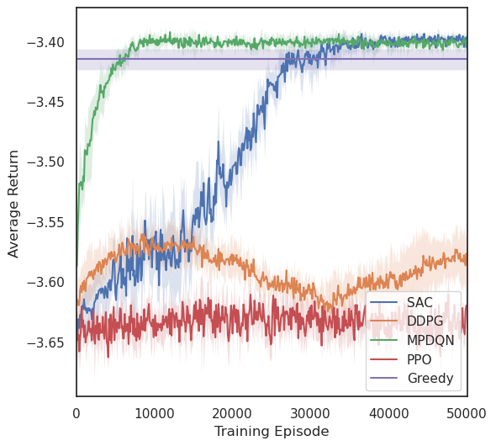
PV-14 Model

Slide 17
Results Summary
MPDQN is significantly more data efficient than the other RL algorithms and finds a good final state in all tasks.
SAC can find a slightly better solution, but requires 4x as much data
DDPG and PPO can only stabilize the simpler IEEE model
MPDQN and SAC can outperform the greedy algorithm on the more complex EPRI Ckt5 model

Slide 18
2-Player Environment Experimentation
Attack and defender take turns modifying DERs
We experimented with splitting the range of busses that a given agent can control.
With training they often found equilibriums where each agent would settle on a small set of actions 1-2 it would repeat alternating between turns.
1 | 2 | 3 | 4 | 5 | 6 | 7
Attacker
Defender

Slide 19
Conclusions
RL agents can learn to stabilize distribution power systems in a parameterized-action environment.
This works marks an additional step towards more realistic multi-player distribution system control game which could train an agent to defend the power grid under a potential cyberattack.
Future considerations:
Transmission systems
Different attack models

