Slide 1
Applying Random Forest Models to Quantify Wildfire Smoke Impacts on Solar Photovoltaic Production
Using Historical and Synthetic data
Samuel D. Gilletly, Nicole D. Jackson, Andrea Staid
Work funded by the Advanced Grid Modeling (AGM)
SAND2022-9091 C

Slide 2
Acknowledgements
Sandia National Labs
Thushara Gunda
Joshua Stein
DOE
Ali Ghassemian (AGM)
Industry partners
Cypress Creek Renewables
Strata Solar
Trimark Associates
sPower
Nexamp
This material is based upon work supported by the U.S. Department of Energy’s Office of Electricity’s Advanced Grid Modeling (AGM) Research Program

Slide 3
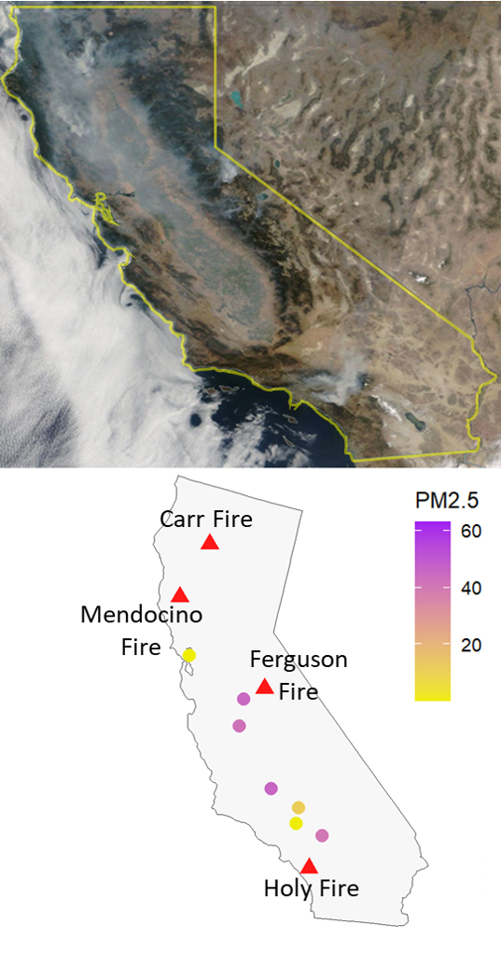
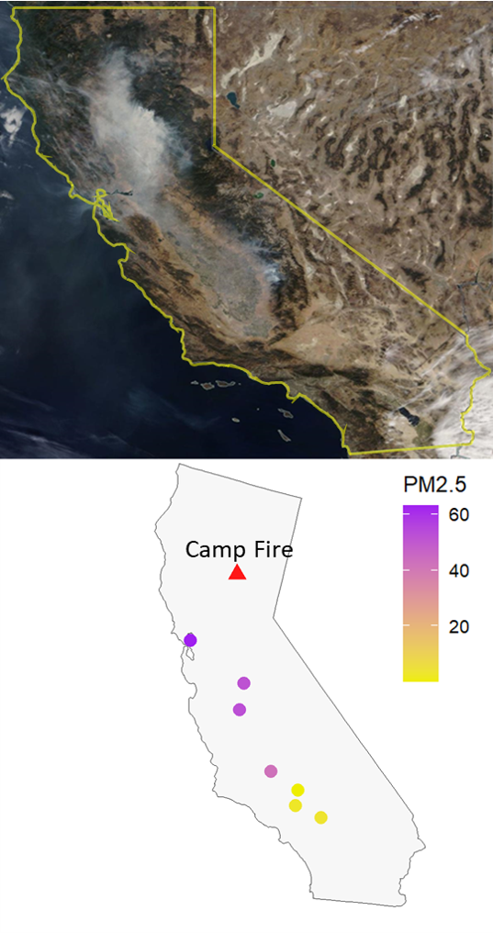
Background
We seek to quantify the impacts of wildfire smoke on solar PV production using historical data from 2018-19
Wildfire events are becoming both larger and more frequent in the Western United States
During this Wildfire season there were several major fires including the Camp Fire and the Mendocino Complex Fire
The primary pollutant of wildfire smoke is PM2.5, which is monitored at many stations across the US
We seek to quantify the impacts of wildfire smoke on solar PV production using historical data from 2018-19
Satellite image and PM2.5 measurements from August 8th, 2018.
Satellite image and PM2.5 measurements from November 14th, 2018.

Slide 4
Analytical Framework
Historical data from several different sources are cleaned, aggregated and merged
A final Random Forest model is constructed, supported by some supplementary analysis
Synthetic PM2.5 is generated and used in the RF model to quantify the impacts of wildfire smoke on solar PV production

Slide 5
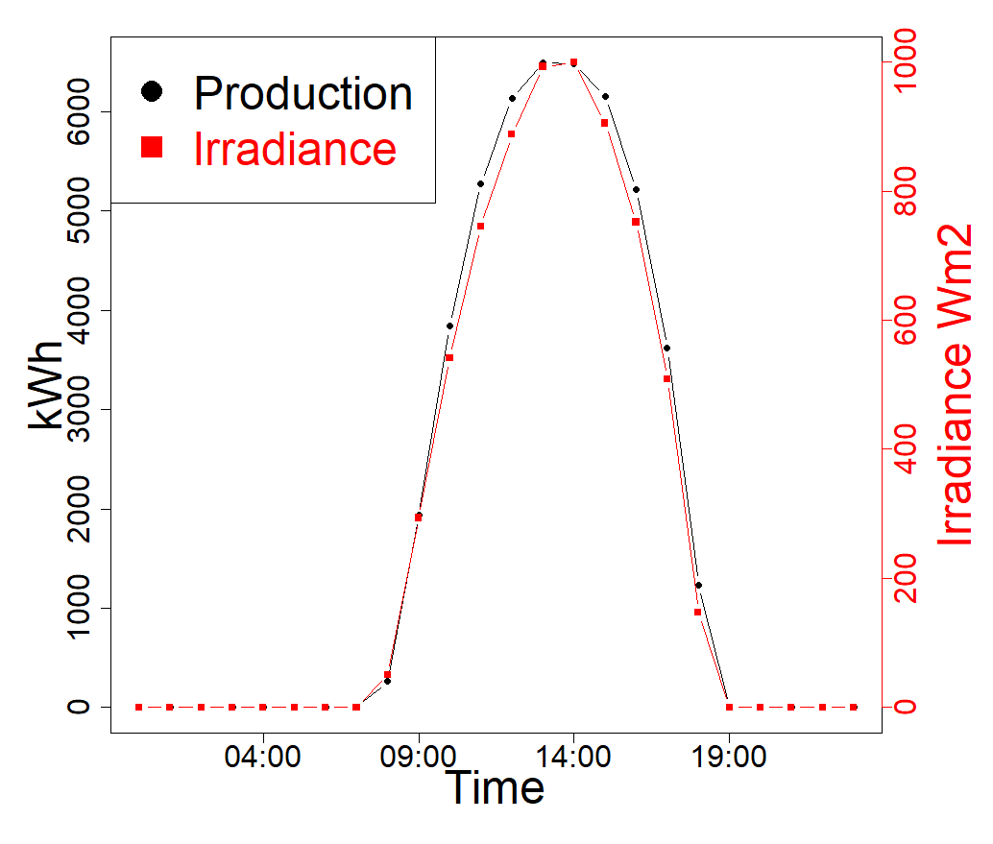
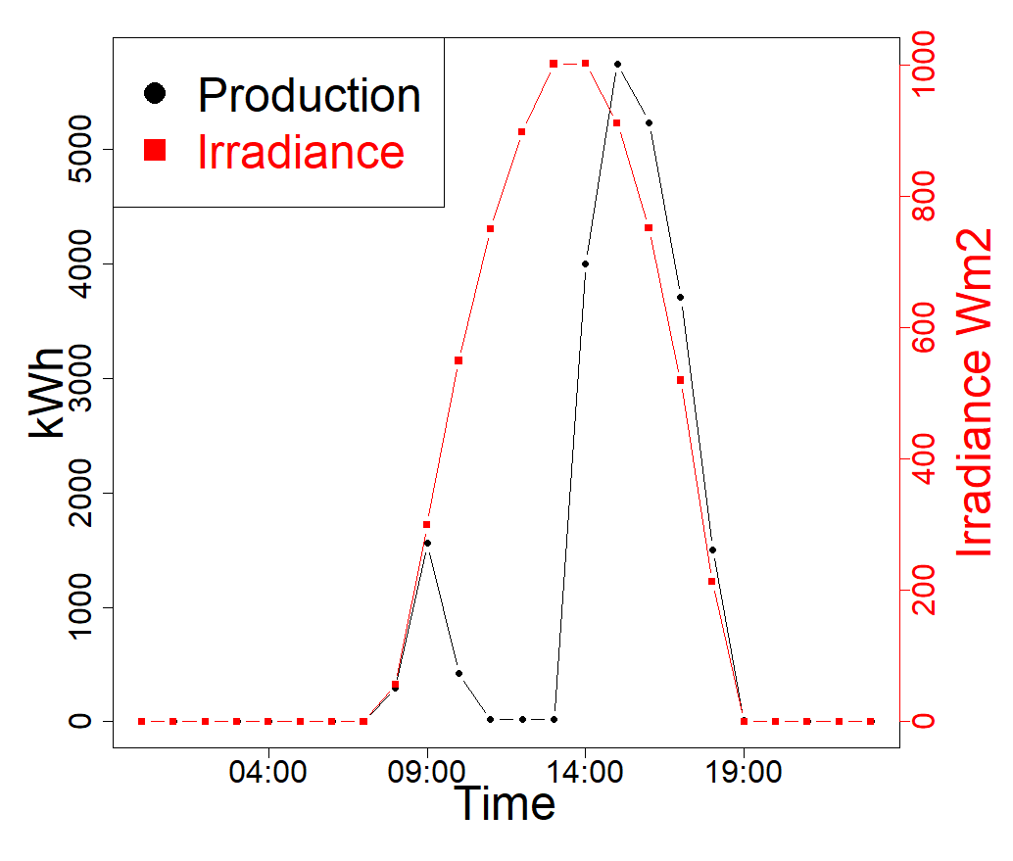
Production Data from Sandia’s PV Reliability, Operations, and Maintenance Database (PVROM)
Locations: 53 utility-scale sites in the Western US (primarily California)
Daily site-level production data for 04/01/2018 – 04/01/2019
Data quality and cleaning observations:
Data contained unexplained and problematic variability
Limited data to days with relatively normal production
Expected normal daily production
Problematic daily production

Slide 6
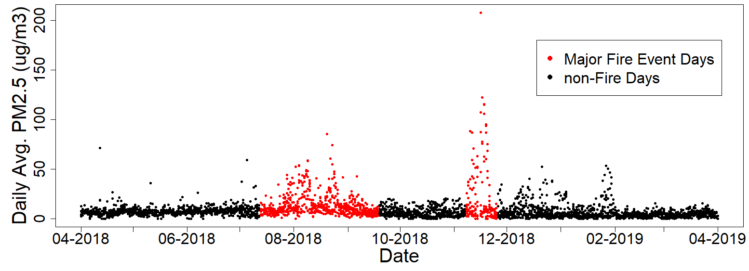
PM2.5 and Ambient Condition Data
PM2.5 counts were used to quantify daily smoke
Monitoring station-level data provided by Airnow.gov website
Hourly PM2.5 data translated to daily PM2.5 data using an irradiance weighted average to ensure that this measure reflect conditions during daylight hours
NASA POWER repository provided satellite-measured weather data to improve model predictive performance and capture any interactions between ambient conditions and wildfire smoke
Camp Fire Event
Ferguson Fire & Mendocino Complex Fire

Slide 7
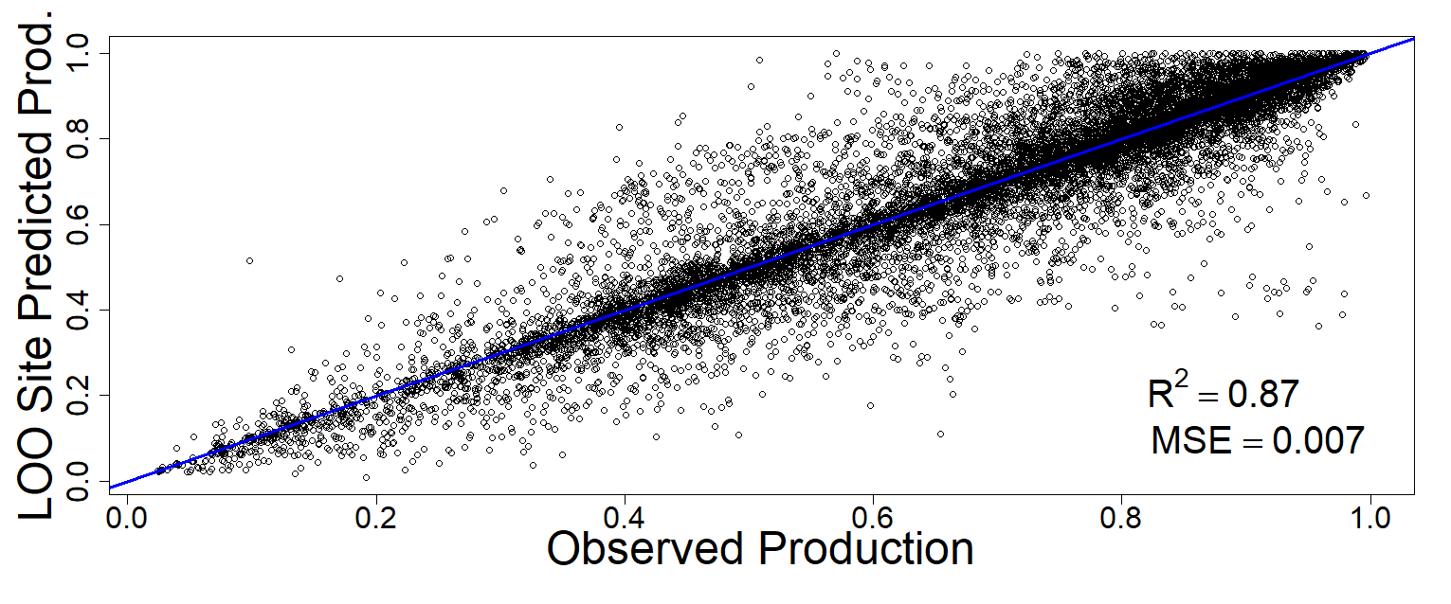
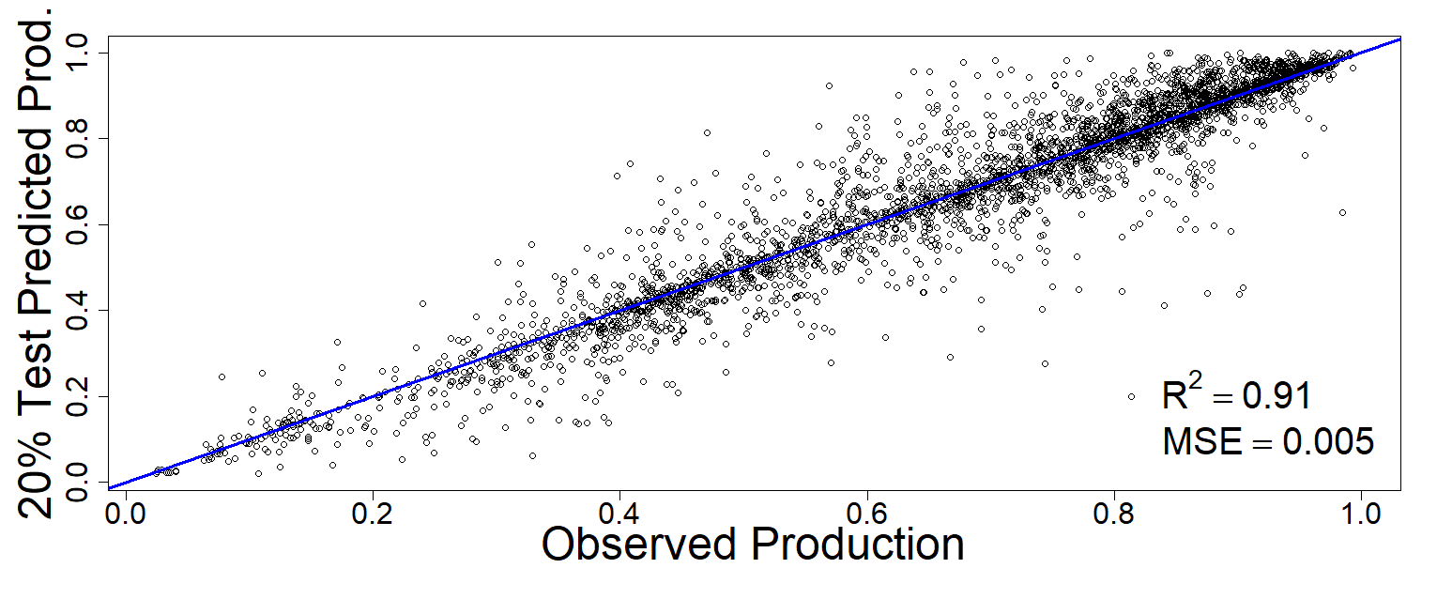
Random Forest Model Regression
Constructed using PM2.5 and ambient weather conditions as features to predict changes in daily production
Modeling optimization using the training data, the number of trees, and number of features
A Leave-one-out (LOO) site specific approach
Based on training data
Used to verify that the model was capable of effectively predicting on sites not seen during model training
Final results were reported for a model trained on the entirety of the training data and tested on the remaining testing data
LOO Approach Results
Tested Model Results

Slide 8
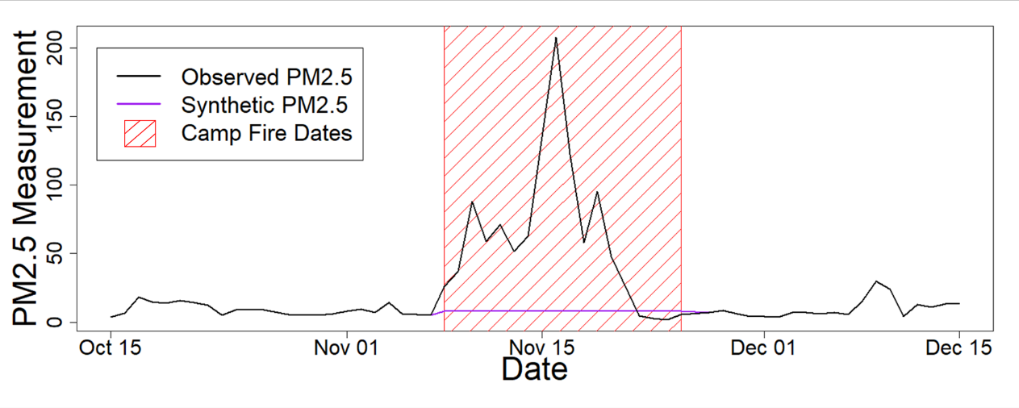
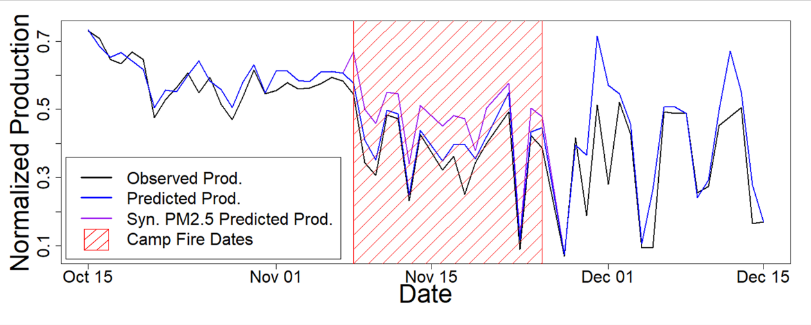
Additional Model Testing with Artificial PM2.5 Data
Motivation: isolate the PM2.5 variable in order to quantify the impact of wildfire smoke directly
Approach:
Incorporate a synthetic PM2.5 feature which artificially removed the increases associated with wildfires
Calculate an average non-fire PM2.5 value for each site
Replace observed PM2.5 for all known wildfire days
Compare model performance between real PM2.5, synthetic PM2.5 to quantify the impact of wildfire produced PM2.5 (on wildfire days w/ >35 PM2.5 measurements)

Slide 9
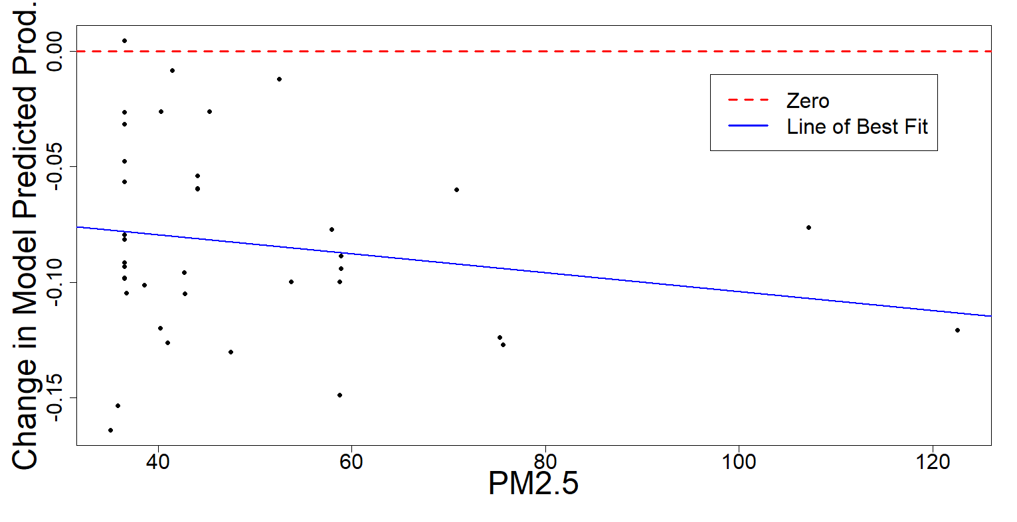
Final Model Results
Single site and fire event: the average change in model predicted production is 7.7%
All sites and fire events: the change in model predicted production is 8.3%
Overall modeled PV production performance impact due to wildfires
Based on days when smoke is present
8% decrease on average in production
Maximum modeled production impact is 15% reduction

Slide 10
In conclusion, we have developed a machine learning-based predictive model to quantify the impact from wildfires on PV energy generation
Model based on real PV production data fused with weather data and captures multiple wildfire events
Leave-One-Out analysis suggests overall model is representative of sites and events not seen during the analysis
8% production reduction on average is comparable to the literature
Our model estimates 8% reduction on average
This study’s dataset is larger and more representative of PV in the western US
Model can be used for both immediate response planning as well as long term grid planning

