Slide 1

Using Reinforcement Learning to Control Grid Operation from Near-blackout to High Stability while Continuing to Serve Load
Stephen J. Verzi, Ross Guttromson, Ace Sorensen, Birk Jones
Sandia National Laboratories
2022 Machine Learning / Deep Learning Workshop
July 25-28, 2022
This work is currently funded through the DOE/OE Advanced Grid Modernization (AGM) Program under the guidance of Dr. Ali Ghassemian.
SAND2022-9013 PE

Slide 2
Problem Statement and Solutions Researched
  Grid operating security studies are typically employed to establish operating boundaries, ensuring secure and stable operation for a range of operations under NERC guidelines. However, if these boundaries are violated, the existing system security margins will be largely unknown. As an alternative to the use of complex optimizations over dynamic conditions, this work employs the use of reinforcement-based machine learning to identify a sequence of secure state transitions which place the grid in a higher degree of operating security with greater static and dynamic stability margins. The approach requires the training of a machine learning agent to accomplish this task using modeled data and employs it as a decision support tool under severe, near- blackout conditions.

Slide 3
Outline
  Project Purpose
  Technical Approach
  Results
  Conclusions/Summary
  Future Work
  Acknowledgments and Contacts

Slide 4
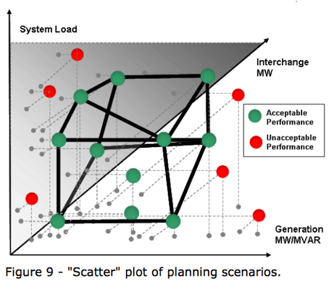
Project Objective and Purpose
In the infrequent occurrence when grid operations depart from planned criteria, how do we move to a ‘good’ operating point?
Where are we? Where do we want to go? What path do we take?
During near blackout conditions, grid operators may have an opportunity to restore the system to a safe condition if a real-time decision support tool is available.
This project investigates the development of a real-time decision support tool for that purpose.
Image from North American Electric Reliability Corporation (NERC), Reliability Concepts document, pg 40.

Slide 5

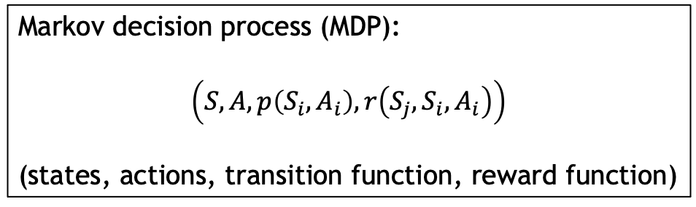
General Method
The solution method uses Deep Neural Networks (DNNs) to represent the sequence of control actions and dispatches needed for the grid to increase its stability margins.
Our approach offers the potential of a speedy solution to this problem, with a low risk of non-convergence. The solution will not be proven optimal, although it will be demonstrated to be feasible and ‘good’ during off-line testing.
Based on recent work conducted at Sandia
Markov decision process (MDP):
$$\left(S,A,p\left(S_{i}, A_{i}\right),r\left(S_{j},S_{i},A_{i}\right)\right)$$
(states, actions, transition function, reward function)

Slide 6
General Method
The solution method uses Deep Neural Networks to represent the sequence of control actions and dispatches needed for the grid to increase its stability margins.
Our approach offers the potential of a speedy solution to this problem, with a low risk of non-convergence. The solution will not be proven optimal, although it will be demonstrated to be feasible and ‘good’ during off-line testing.
Based on recent work conducted at Sandia
Discrete 3D grid sample navigation environment
DQN

Slide 7
Defining the State Space and Security Metrics
  We started with data sampled from a 3 generator system model (ℛ^3 control dimensions) and associated multi-dimension security scores
Proof-of-concept: power grid model (ℛ^3)
Security Metrics
Bus Voltage
Line Flow
Transient Stability
Small Signal Stability
Normalize each such that
1 is feasible,
0 is failure, and
between 0 and 1 is penalty

Slide 8
Actions and State Transitions
  Actions (7)
    Increase/decrease single generator output or keep all the same
    For 3 control dimensions (G1, G2, G3) the action set is
      {stay, decrease G1, increase G1, decrease G2, increase G2, decrease G3, increase G3}
    In the 3D visualizations this set is
      {stay, backward, forward, left, right, down, up}
  State Transitions
    Effect on grid state managed by power flow model
    Exhaustively sampled using 25 discrete values (i.e., cardinality of state space is 25^3)

Slide 9
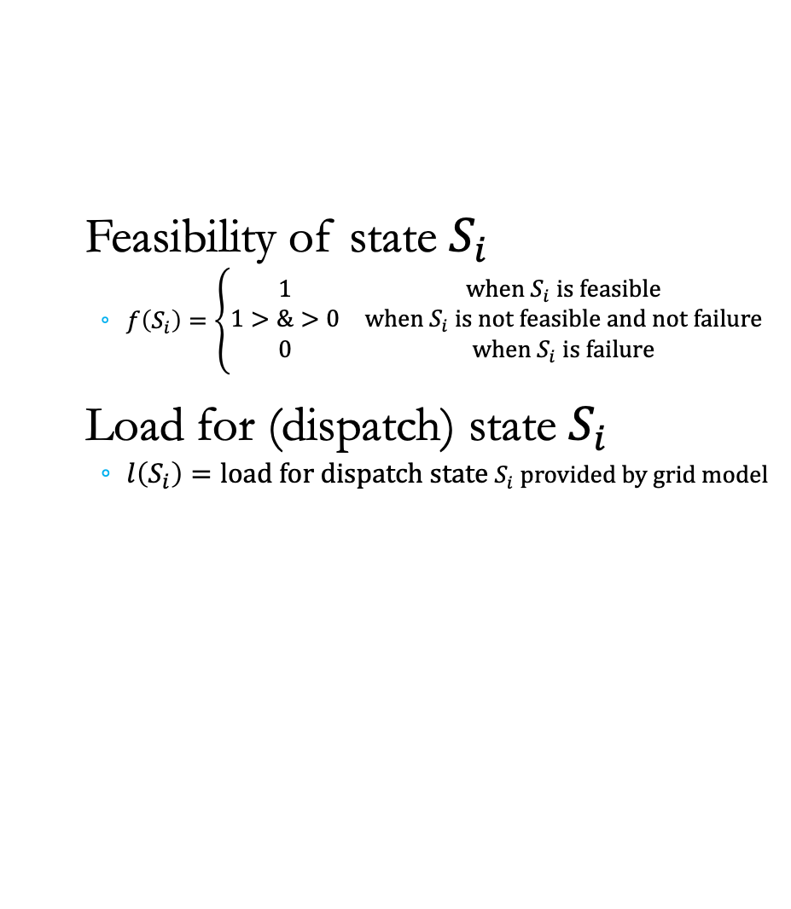
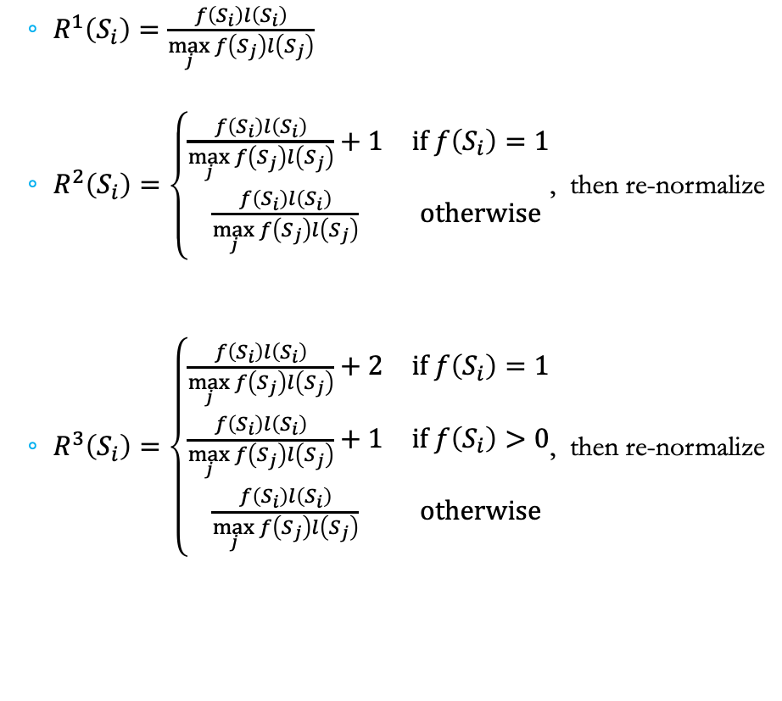
Reward Objective Function
  $R^{1}\left(S_{i}\right)=\frac{f\left(S_{i}\right)l\left(S_{i}\right)}{\max_{j}{f\left(S_{j}\right)l\left(S_{j}\right)}}$
  $R^{2}\left(S_{i}\right)=\left\{\begin{matrix}\frac{f\left(S_{i}\right)l\left(S_{i}\right)}{\max_{j}{f\left(S_{j}\right)l\left(S_{j}\right)}}+1 & \text{if} f\left(S_{i}\right)=1 \\ \frac{f\left(S_{i}\right)l\left(S_{i}\right)}{\max_{j}{f\left(S_{j}\right)l\left(S_{j}\right)}} & \text{otherwise}\end{matrix}\right.$, then re-normalize
  $R^{3}\left(S_{i}\right)=\left\{\begin{matrix}\frac{f\left(S_{i}\right)l\left(S_{i}\right)}{\max_{j}{f\left(S_{j}\right)l\left(S_{j}\right)}}+2 & \text{if} f\left(S_{i}\right)=1 \\ \frac{f\left(S_{i}\right)l\left(S_{i}\right)}{\max_{j}{f\left(S_{j}\right)l\left(S_{j}\right)}}+1 & \text{if} f\left(S_{i}\right)>0 \\ \frac{f\left(S_{i}\right)l\left(S_{i}\right)}{\max_{j}{f\left(S_{j}\right)l\left(S_{j}\right)}} & \text{otherwise}\end{matrix}\right.$, then re-normalize
Feasibility of state $S_{i}$
  $f\left(S_{i}\right)=\left\{\begin{matrix}1 & \text{when}{ S}_{i} \text{is} \text{feasible} \\ 1>\&>0 & \text{when}{ S}_{i} \text{is} \text{not} \text{feasible} \text{and} \text{not} \text{failure} \\ 0 & \text{when}{ S}_{i} \text{is} \text{failure}\end{matrix}\right.$
Load for (dispatch) state $S_{i}$
  $l\left(S_{i}\right)=\text{load} \text{for} \text{dispatch} \text{state} S_{i} \text{provided} \text{by} \text{grid} \text{model}$

Slide 10
Security / Stability Metrics
Overlapping Power Grid Stability Level Curves
Individual Power Grid Stability
Level Curves

Slide 11
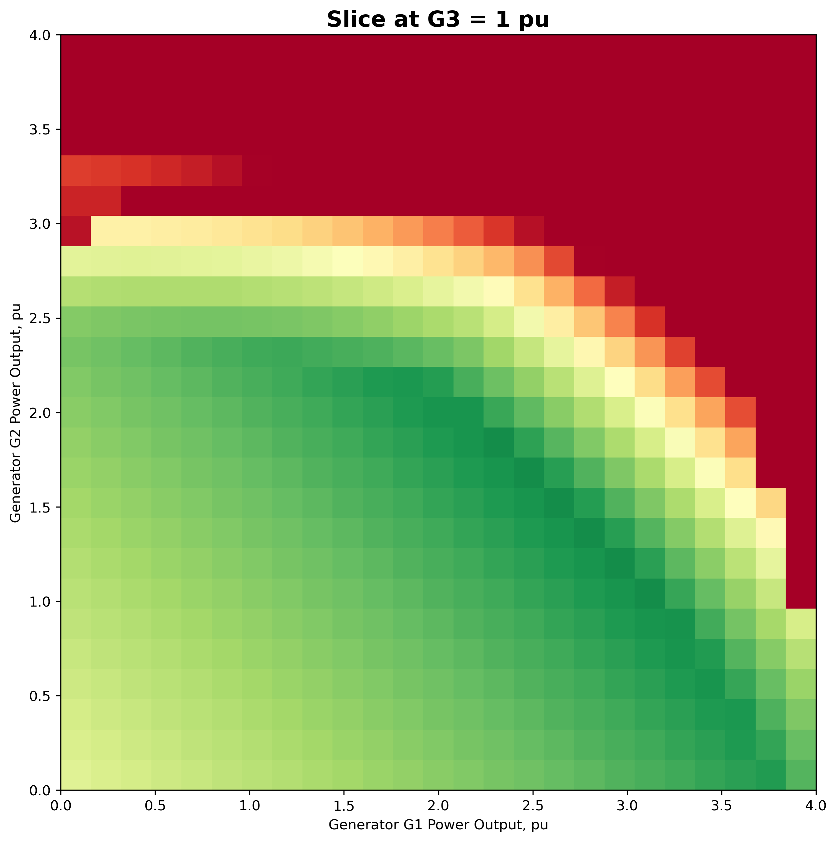
Security / Stability -> Reward Objective $R^{1}$
Overlapping Power Grid Stability Level Curves
2D Slice of Reward (Learning Objective)

Slide 12
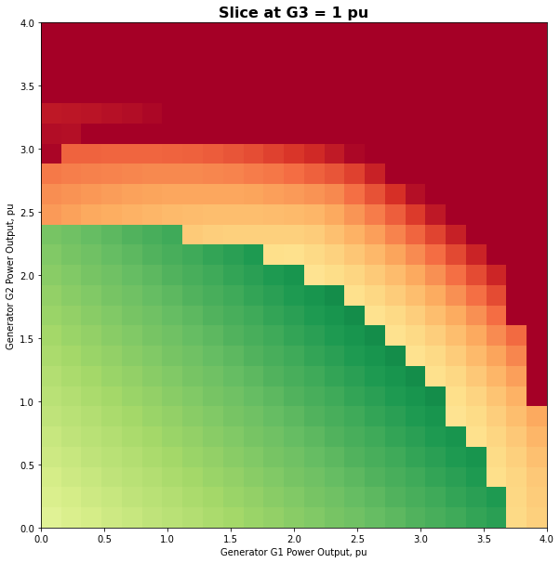
Security / Stability -> Reward Objective $R^{2}$
Overlapping Power Grid Stability Level Curves
2D Slice of Reward (Learning Objective)

Slide 13
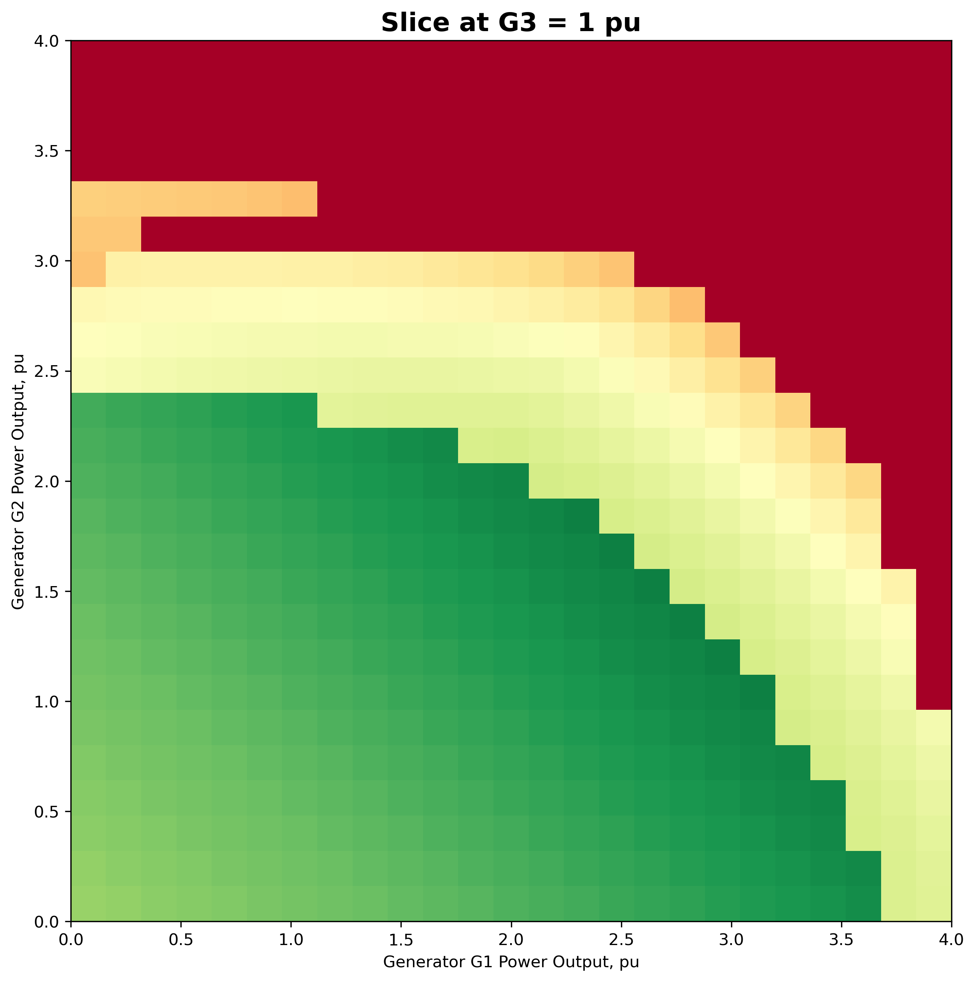
Security / Stability -> Reward Objective $R^{3}$
Overlapping Power Grid Stability Level Curves
2D Slice of Reward (Learning Objective)

Slide 14
Feasibility (3D) & Reward (2D slice) Objective $R^{1}$
Optimum (3D) discretized feasible load is at (2.24,0.80,2.88)
3D Reward Space
2D Slice of Reward (Learning Objective)

Slide 15
Feasibility (3D) & Reward (2D slice) Objective $R^{2}$
Optimum (3D) discretized feasible load is at (2.24,0.80,2.88)
3D Reward Space
2D Slice of Reward (Learning Objective)

Slide 16
Feasibility (3D) & Reward (2D slice) Objective $R^{3}$
Optimum (3D) discretized feasible load is at (2.24,0.80,2.88)
3D Reward Space
2D Slice of Reward (Learning Objective)

Slide 17
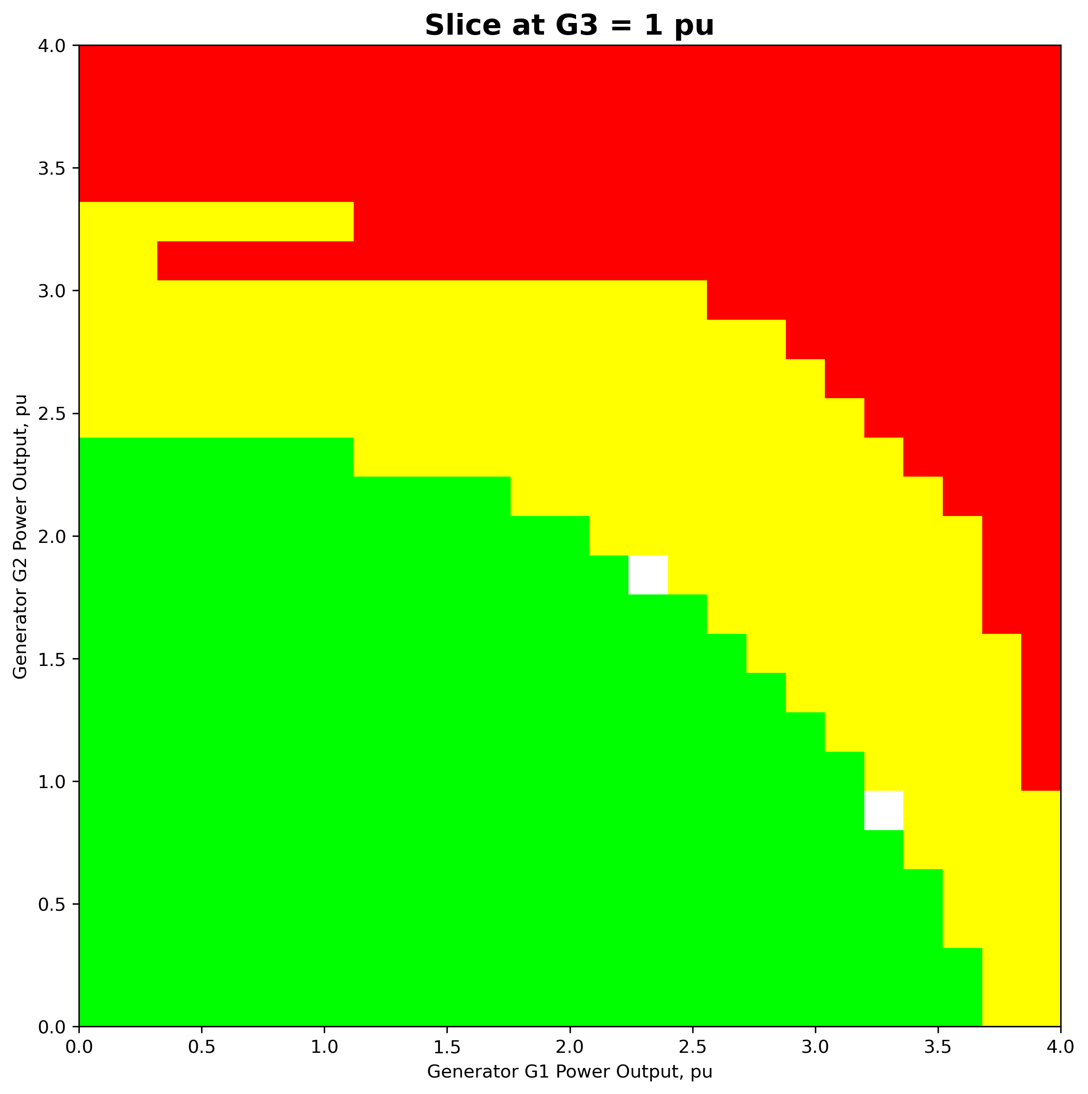
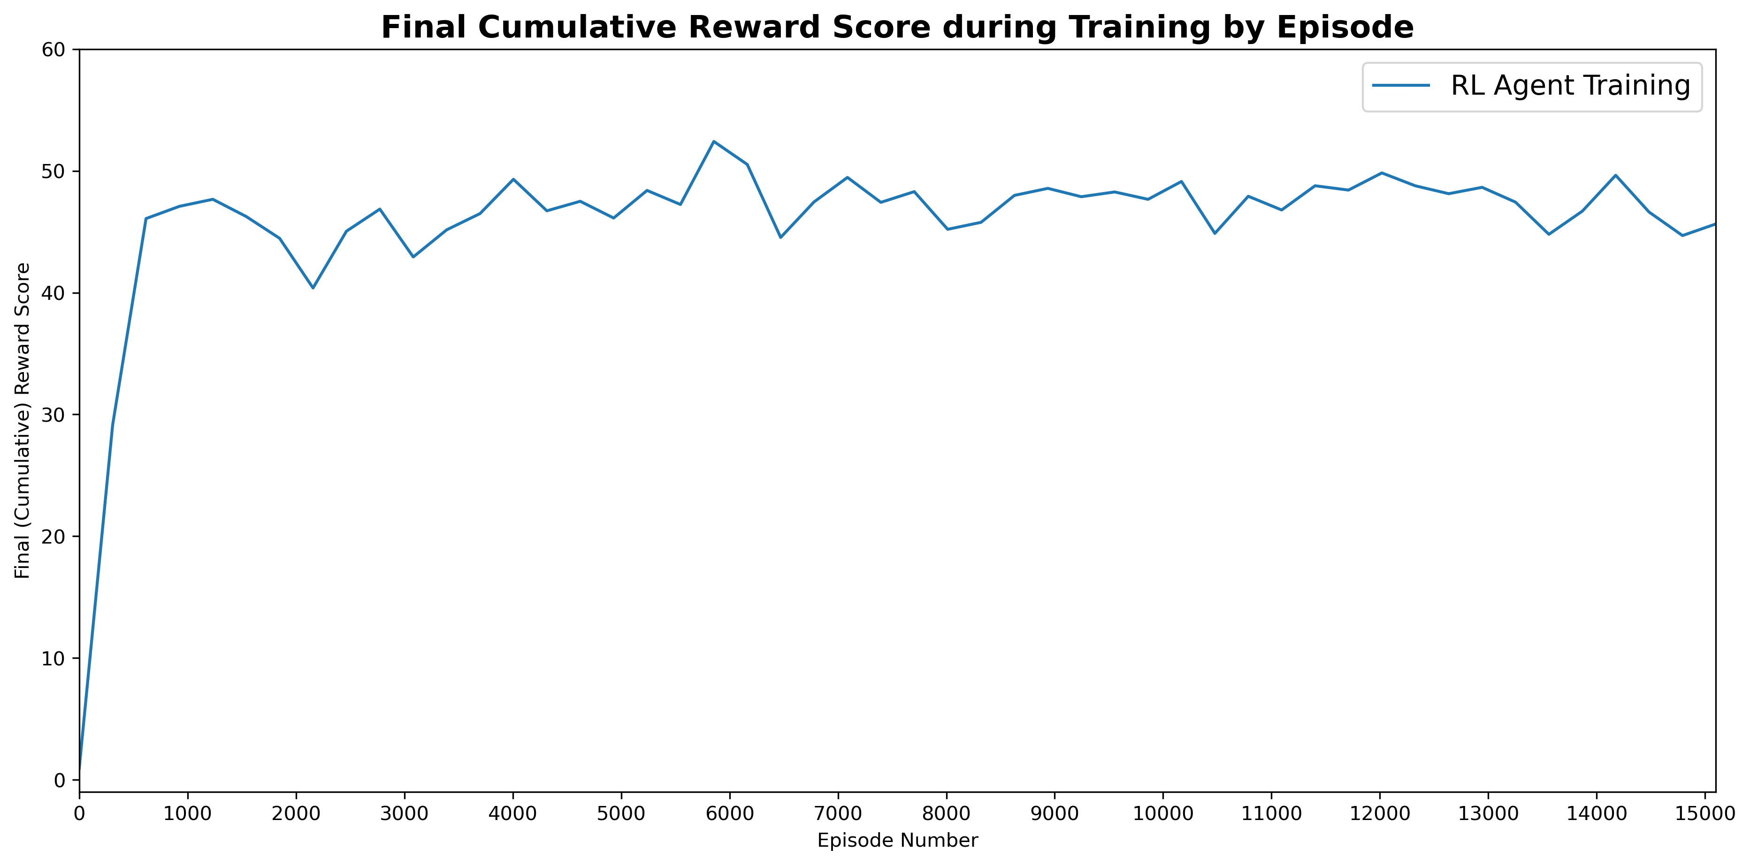
Learning Results (Objective $R^{1}$)
Results in discretized 25x25x25 navigation space (15,000 episodes)
Training Progress
final reward
episode
episode = 50 actions
Final state | Trained RL agent | Random player | Greedy player
Penalty | 39.4% | 38.5% | 35.4%
Failure | 2.0% | 43.4% | 0.0%
Feasible | 58.6% | 18.2% | 64.6%
Optimum / Feasible | 451 / 3038 | 1 / 941 | 384 / 3348
15625
4968
5477
5180
Total % | Category
31.8 | Feasible (green)
35.1 | Failure (red)
33.2 | Penalty (yellow)
Feasible: all stabilities are >= 1.00
Failure: any stability is <= 0.00
Penalty: all other states
Optimum (3D) discretized feasible load is at (2.24,0.64,3.04) & (2.24,0.80,2.88)

Slide 18
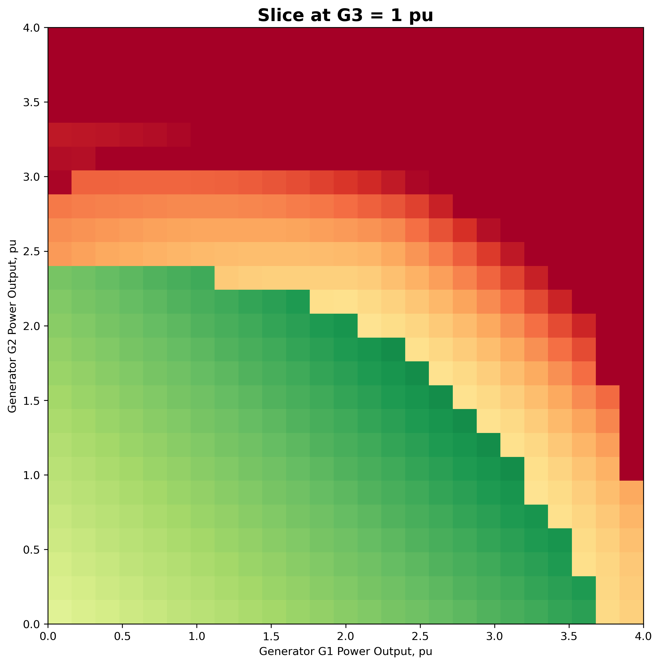
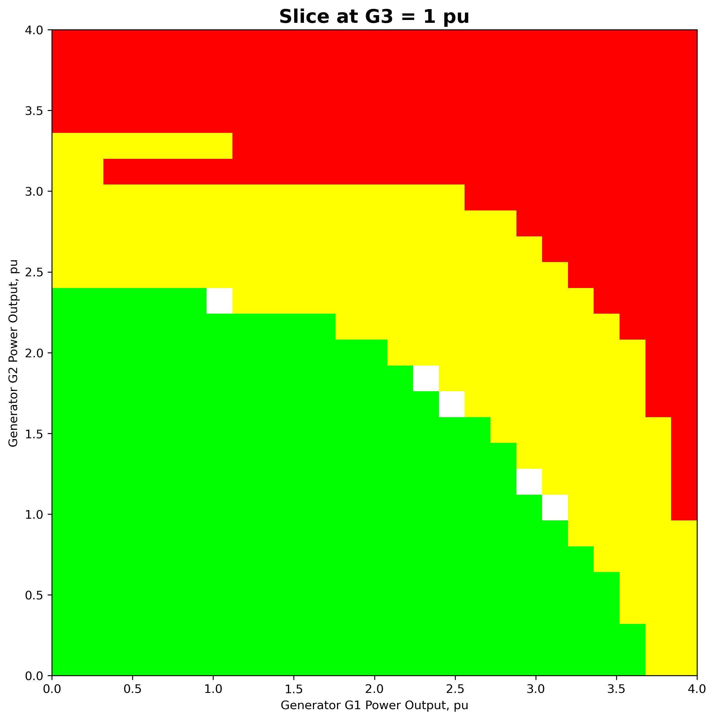
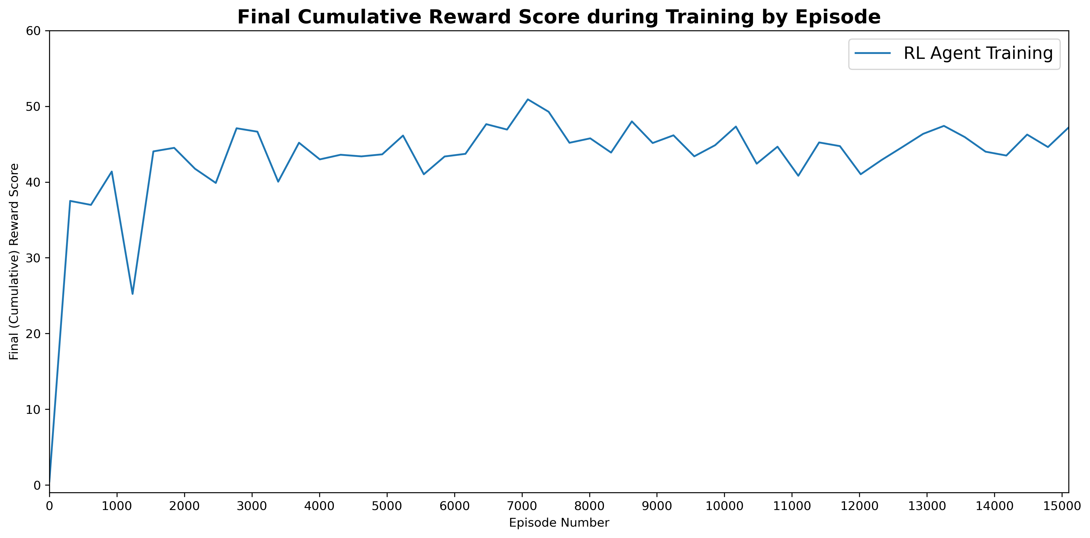
Learning Results (Objective $R^{2}$)
Results in discretized 25x25x25 navigation space (15,000 episodes)
Training Progress
final reward
episode
episode = 50 actions
Final state | Trained RL agent | Random player | Greedy player
Penalty | 0.1% | 37.7% | 1.7%
Failure | 2.2% | 44.1% | 0.0%
Feasible | 97.7% | 18.2% | 98.3%
Optimum / Feasible | 445 / 5061 | 0 / 943 | 443 / 5092
15625
4968
5477
5180
Total % | Category
31.8 | Feasible (green)
35.1 | Failure (red)
33.2 | Penalty (yellow)
Feasible: all stabilities are >= 1.00
Failure: any stability is <= 0.00
Penalty: all other states
Optimum (3D) discretized feasible load is at (2.24,0.64,3.04) & (2.24,0.80,2.88)

Slide 19
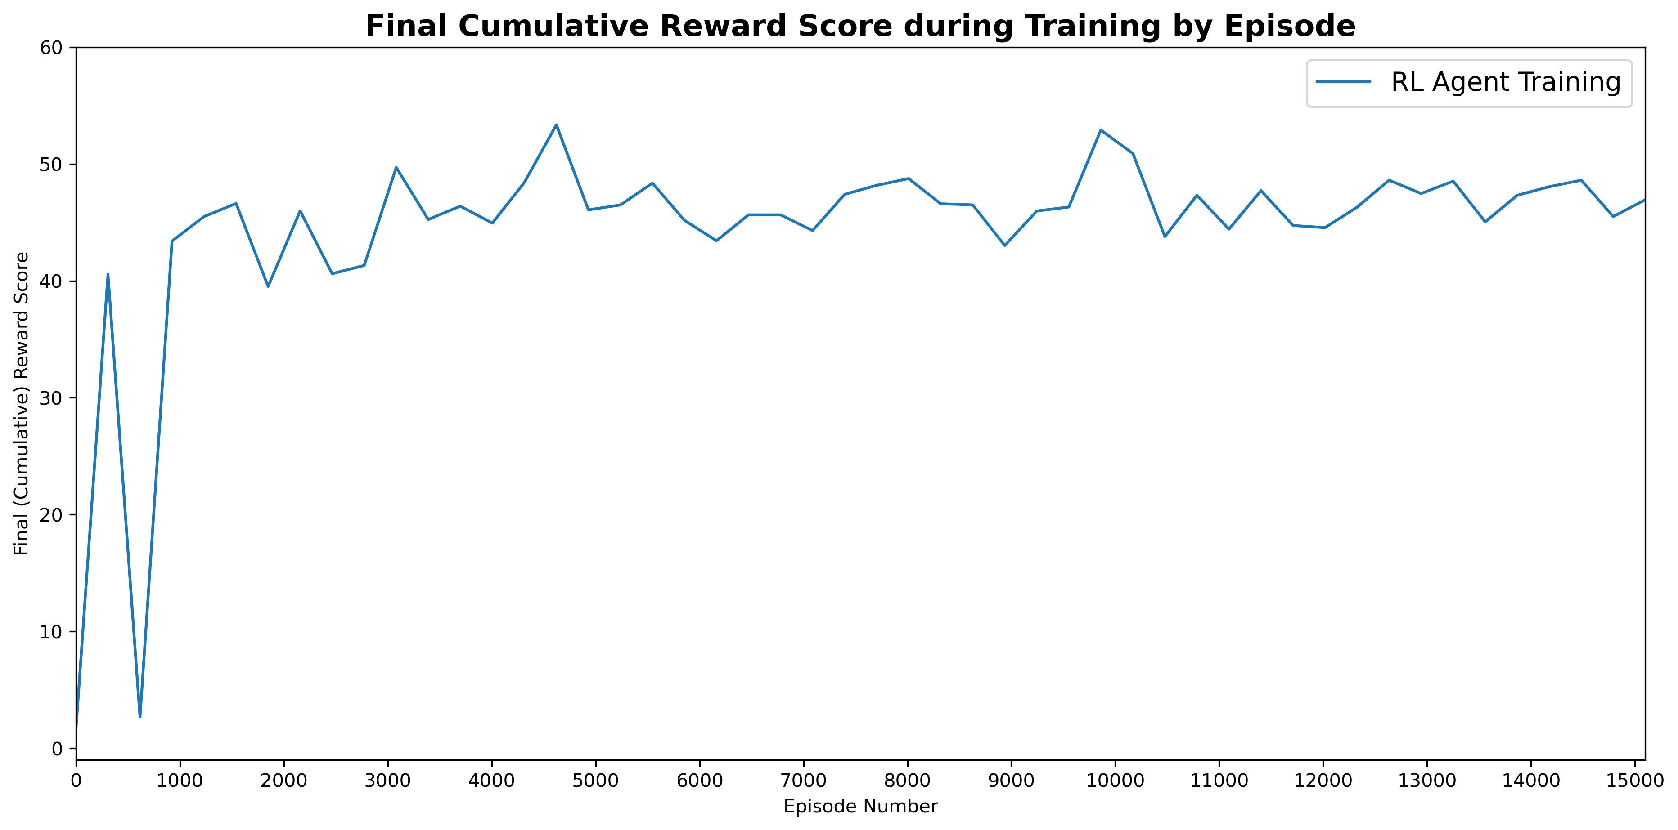
Learning Results (Objective $R^{3}$)
Results in discretized 25x25x25 navigation space (15,000 episodes)
Training Progress
final reward
episode
episode = 50 actions
Final state | Trained RL agent | Random player | Greedy player
Penalty | 0.1% | 39.0% | 1.7%
Failure | 1.5% | 43.8% | 0.0%
Feasible | 98.4% | 17.2% | 98.3%
Optimum / Feasible | 398 / 5096 | 1 / 890 | 443 / 5092
15625
4968
5477
5180
Total % | Category
31.8 | Feasible (green)
35.1 | Failure (red)
33.2 | Penalty (yellow)
Feasible: all stabilities are >= 1.00
Failure: any stability is <= 0.00
Penalty: all other states
Optimum (3D) discretized feasible load is at (2.24,0.64,3.04) & (2.24,0.80,2.88)

Slide 20
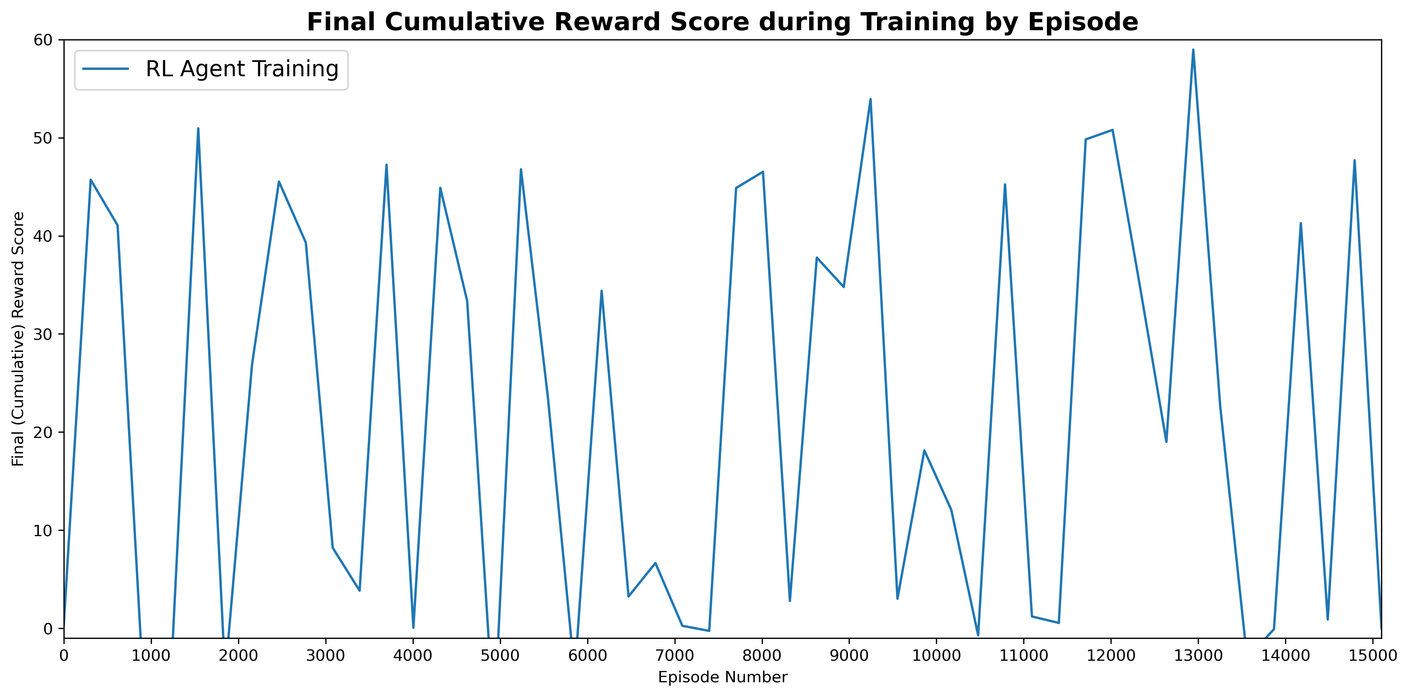
Learning Results (Objective $R^{3}$w/ Prioritized Replay)
Results in discretized 25x25x25 navigation space (15,000 episodes)
Training Progress
final reward
episode
episode = 50 actions
Final state | Trained RL agent | Random player | Greedy player
Penalty | 0.0% | 39.0% | 1.7%
Failure | 1.3% | 44.1% | 0.0%
Feasible | 98.7% | 16.9% | 98.3%
Optimum / Feasible | 593 / 5115 | 1 / 876 | 443 / 5092
15625
4968
5477
5180
Total % | Category
31.8 | Feasible (green)
35.1 | Failure (red)
33.2 | Penalty (yellow)
Feasible: all stabilities are >= 1.00
Failure: any stability is <= 0.00
Penalty: all other states
Optimum (3D) discretized feasible load is at (2.24,0.64,3.04) & (2.24,0.80,2.88)

Slide 21
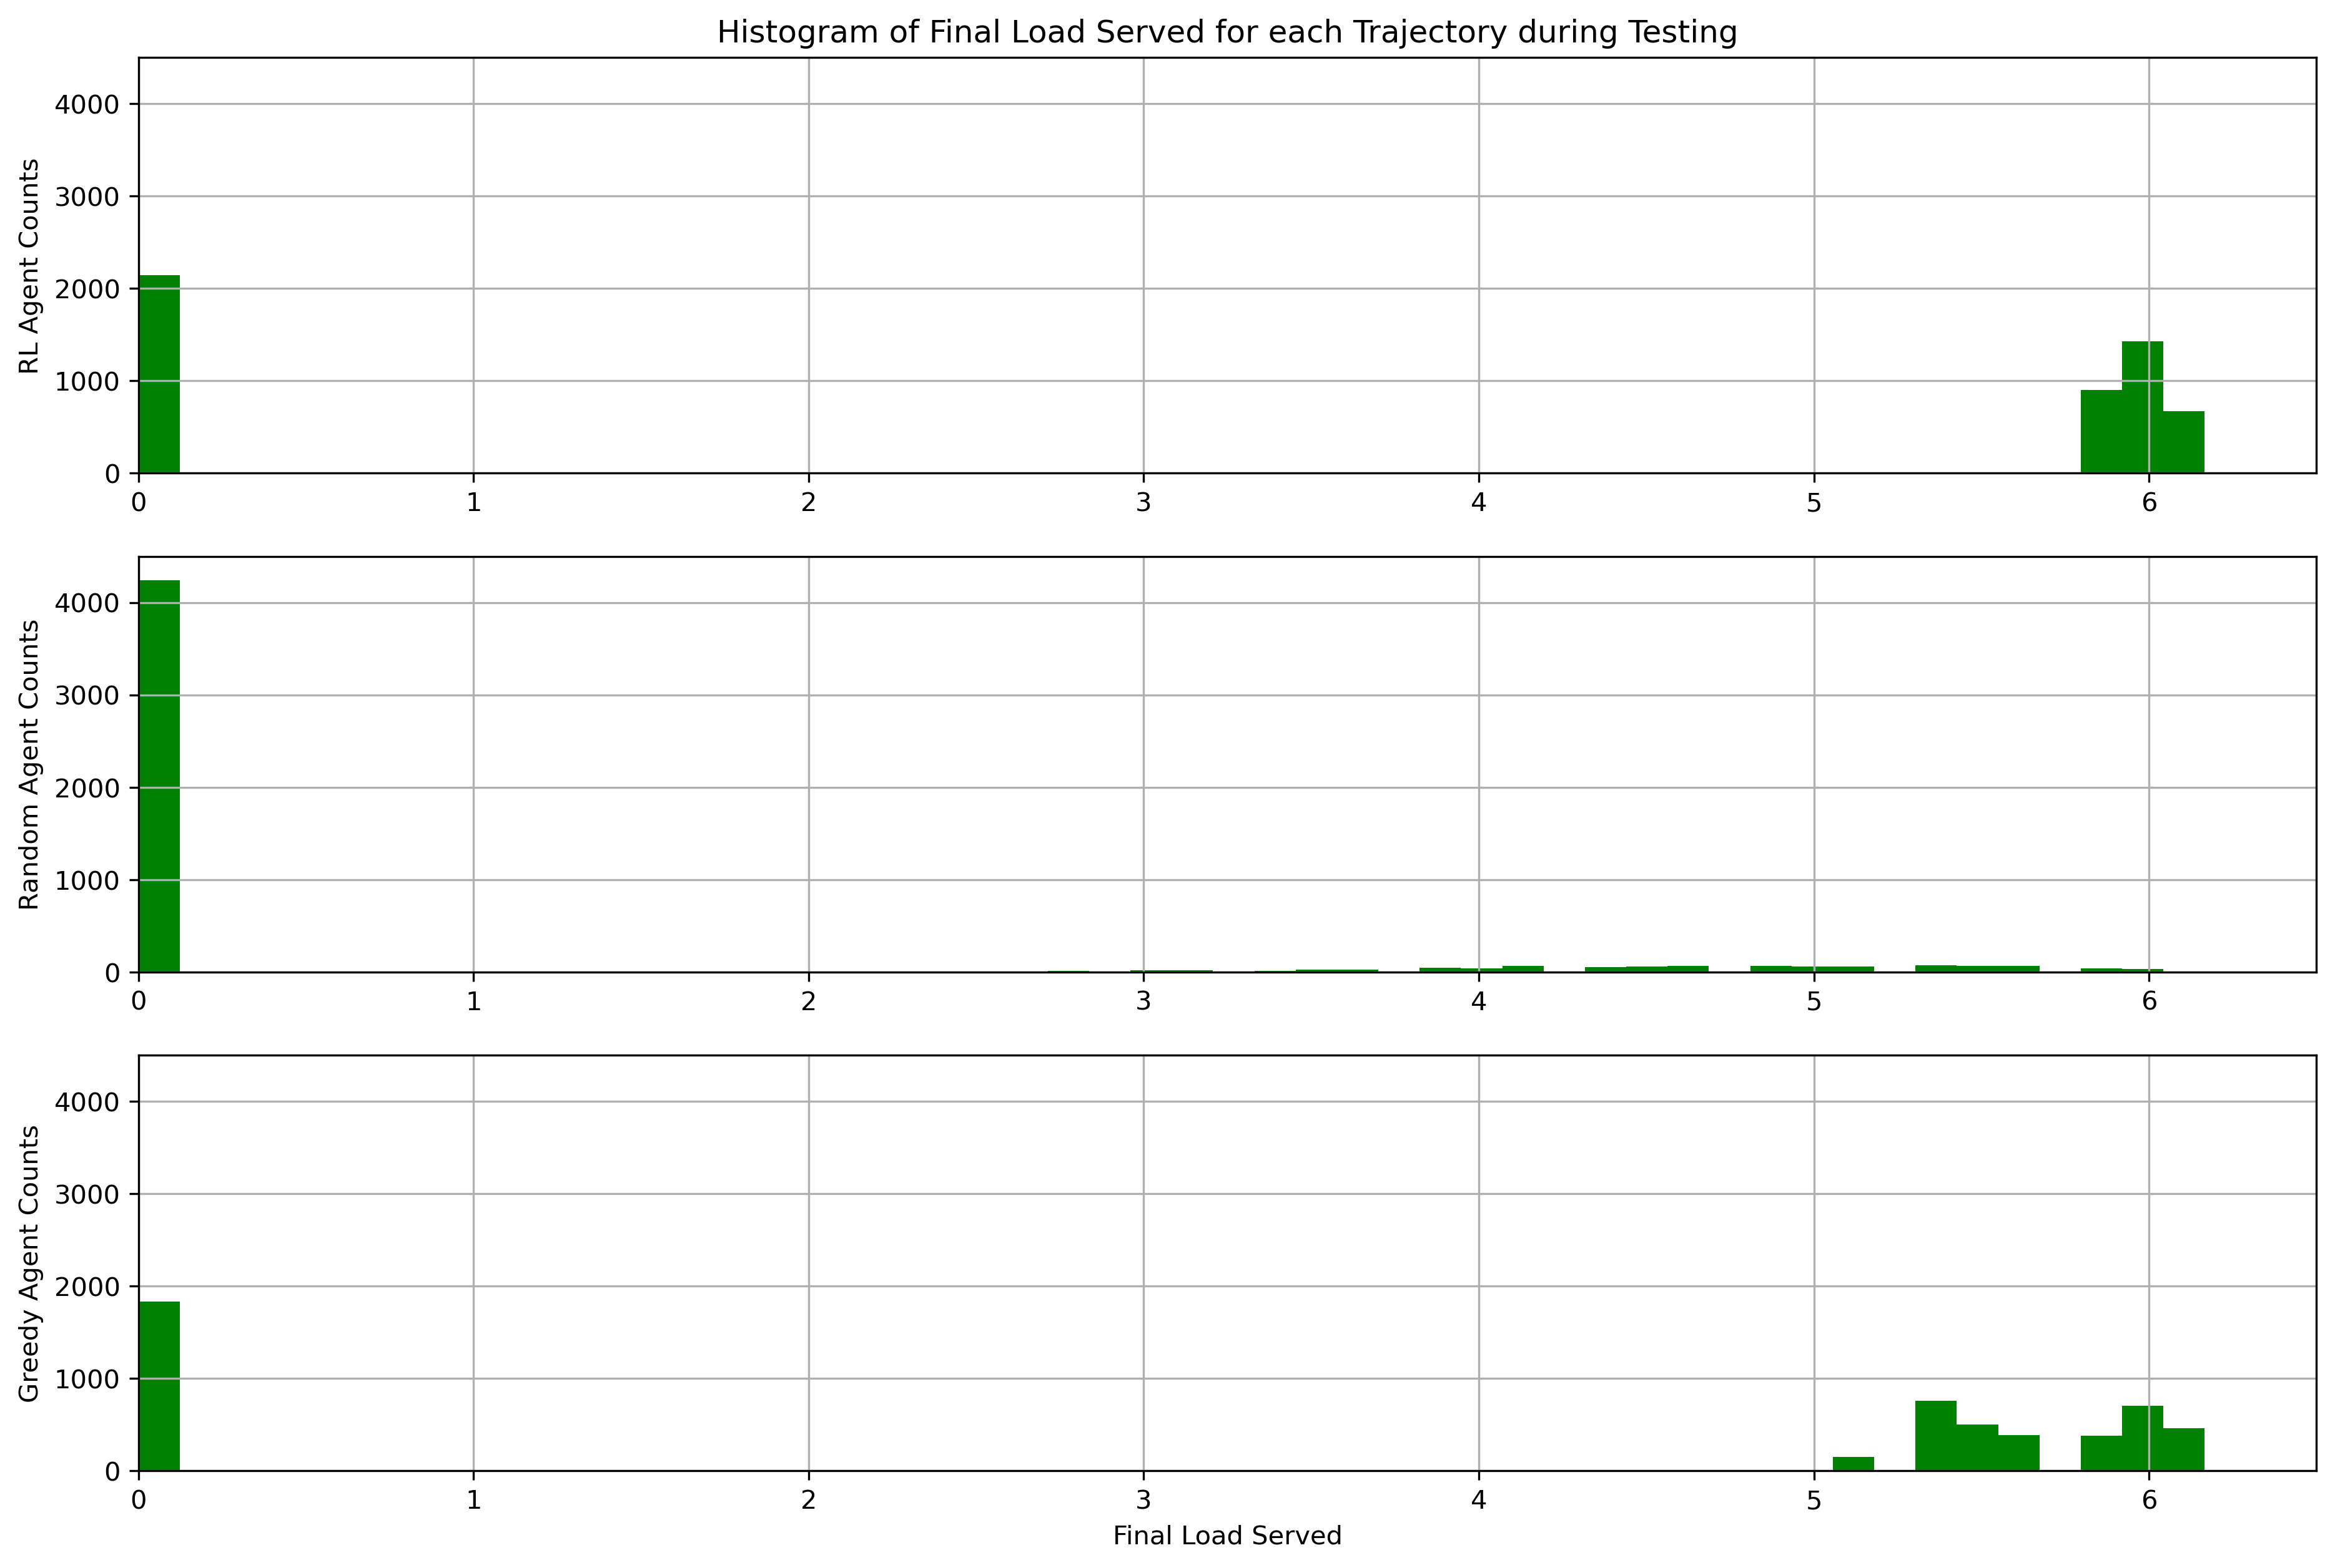
Learning Results – Reward and Load Served ($R^{1}$)
Percent of optimal and penalized final load served (15,000 episodes)
Final state | Trained RL agent | Random player | Greedy player
Average percent of optimal load served | 56.7% | 13.7% | 59.8%
Optimal (3D) discretized feasible load is 6.167
Penalized final load served

Slide 22
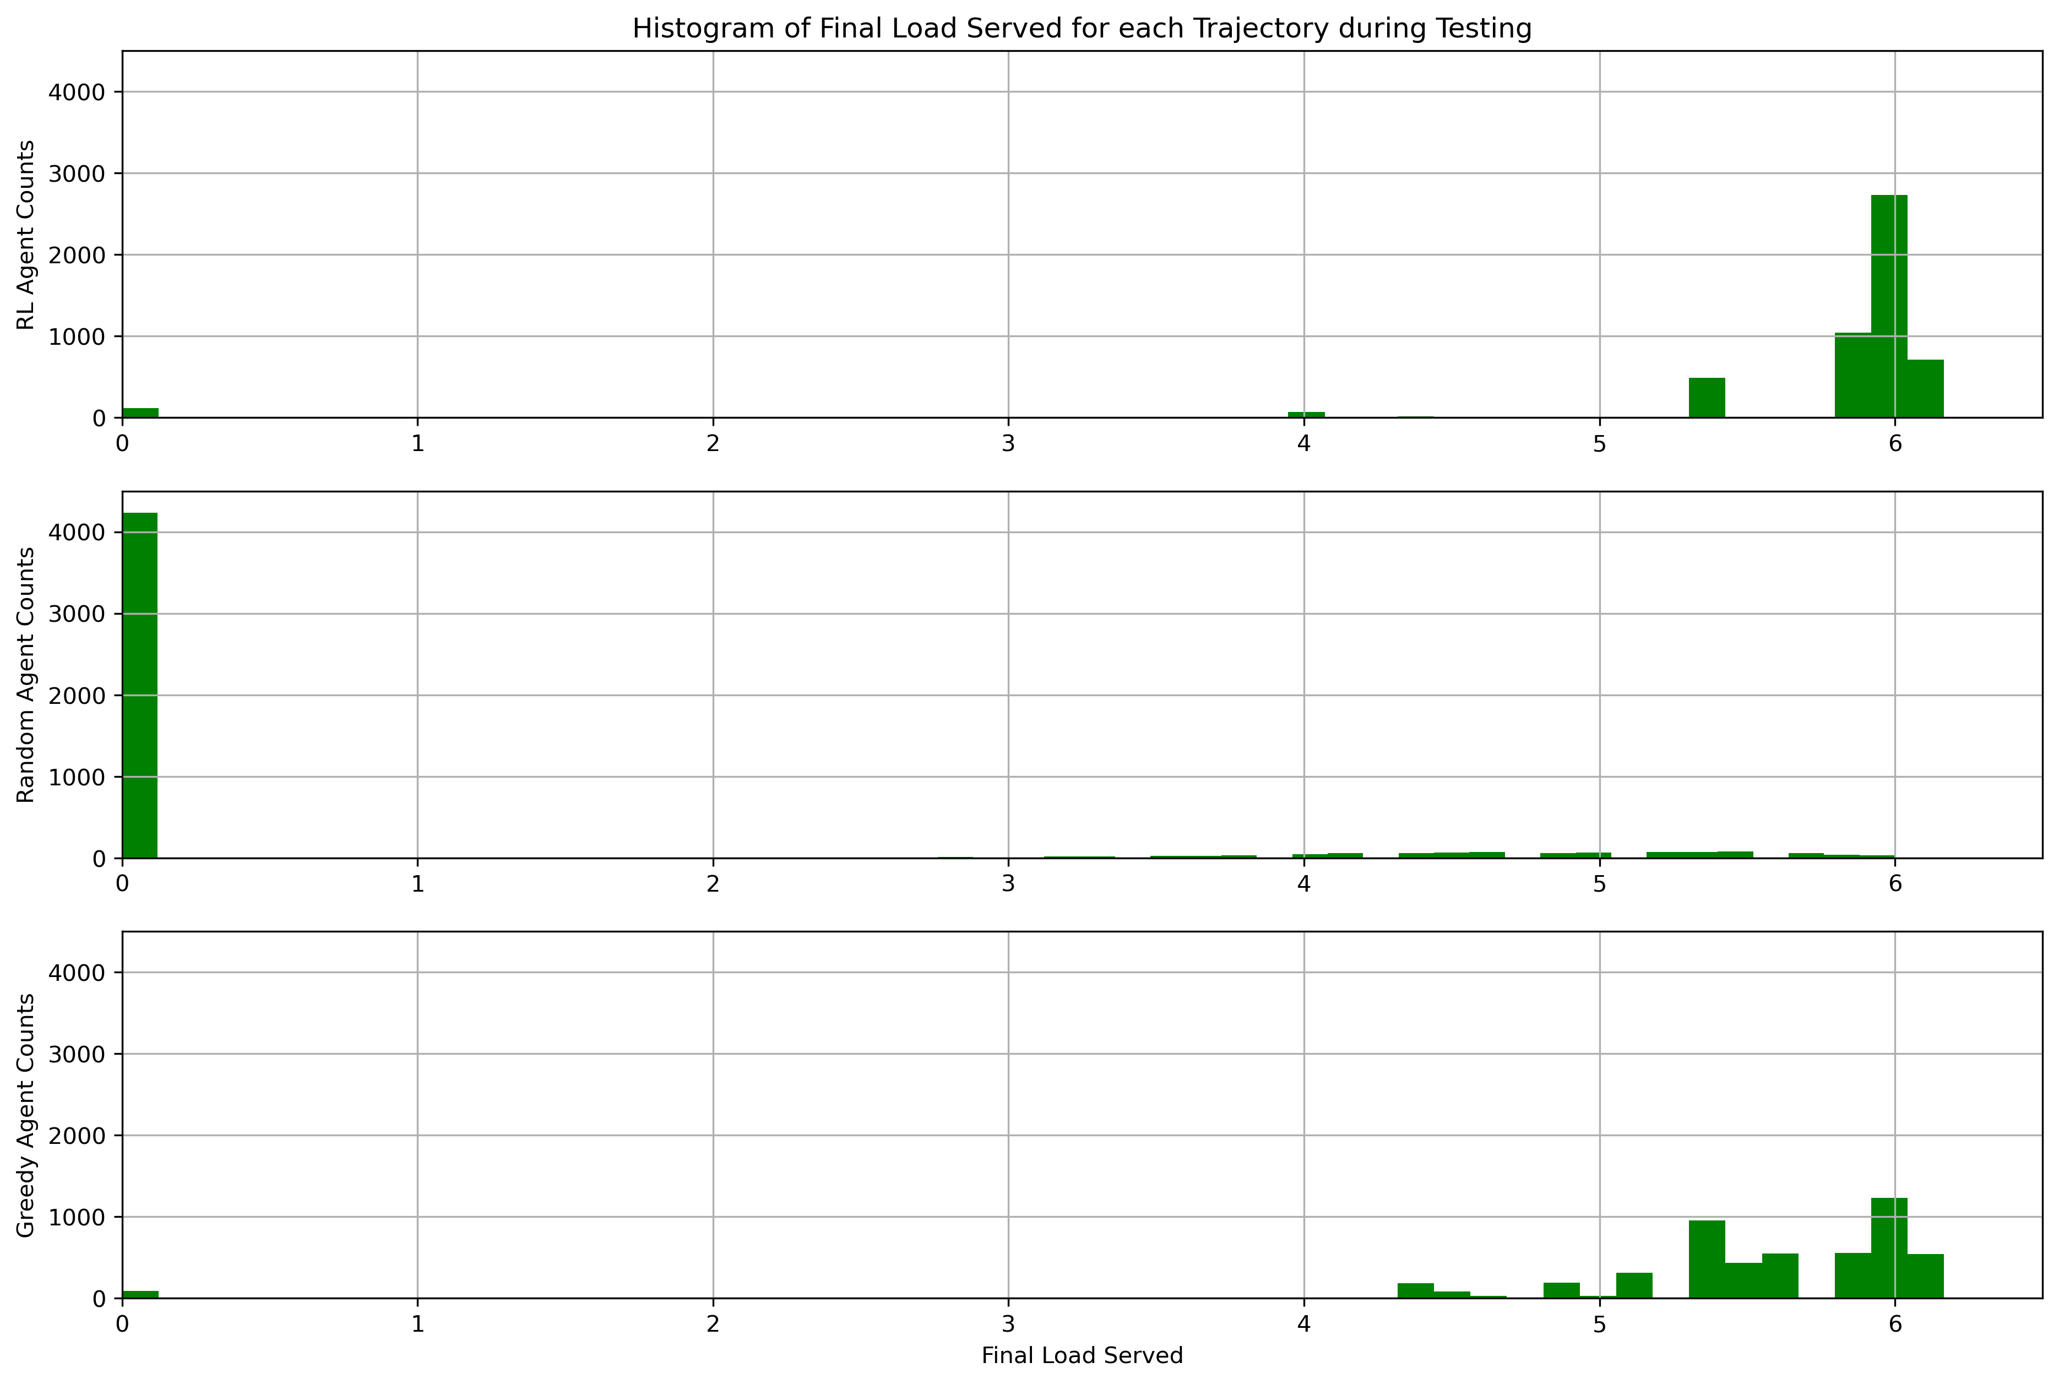
Learning Results – Reward and Load Served ($R^{2}$)
Percent of optimal and penalized final load served (15,000 episodes)
Final state | Trained RL agent | Random player | Greedy player
Average percent of optimal load served | 93.3% | 13.8% | 89.4%
Optimal (3D) discretized feasible load is 6.167
Penalized final load served

Slide 23

Learning Results – Reward and Load Served ($R^{3}$)
Percent of optimal and penalized final load served (15,000 episodes)
Final state | Trained RL agent | Random player | Greedy player
Average percent of optimal load served | 94.6% | 12.9% | 89.4%
Optimal (3D) discretized feasible load is 6.167
Penalized final load served

Slide 24
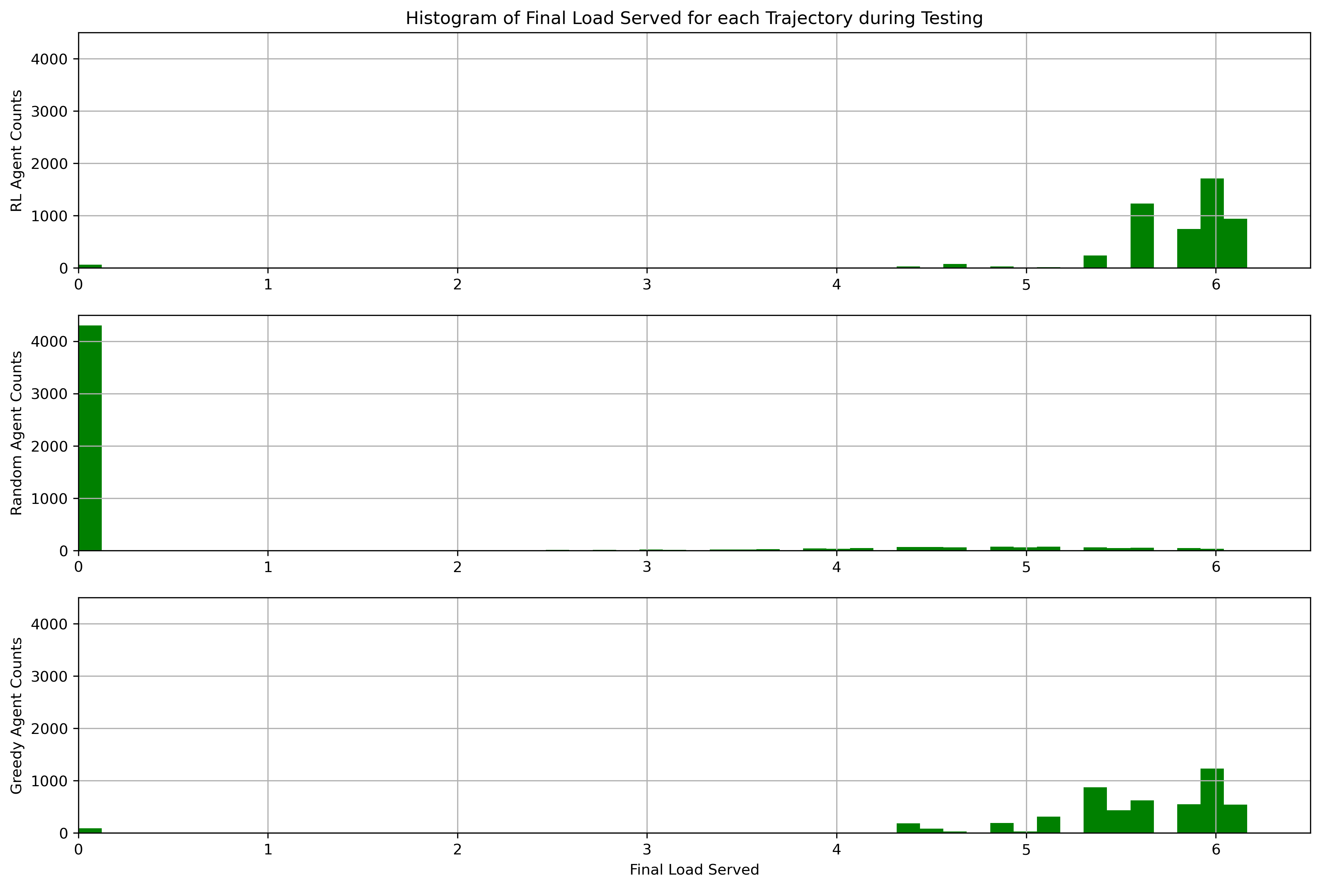
Learning Results – Reward and Load Served ($R^{3}$)
Percent of optimal and penalized final load served (15,000 episodes, w/ prioritized replay)
Final state | Trained RL agent | Random player | Greedy player
Average percent of optimal load served | 92.9% | 12.8% | 89.4%
Optimal (3D) discretized feasible load is 6.167
Penalized final load served

Slide 25
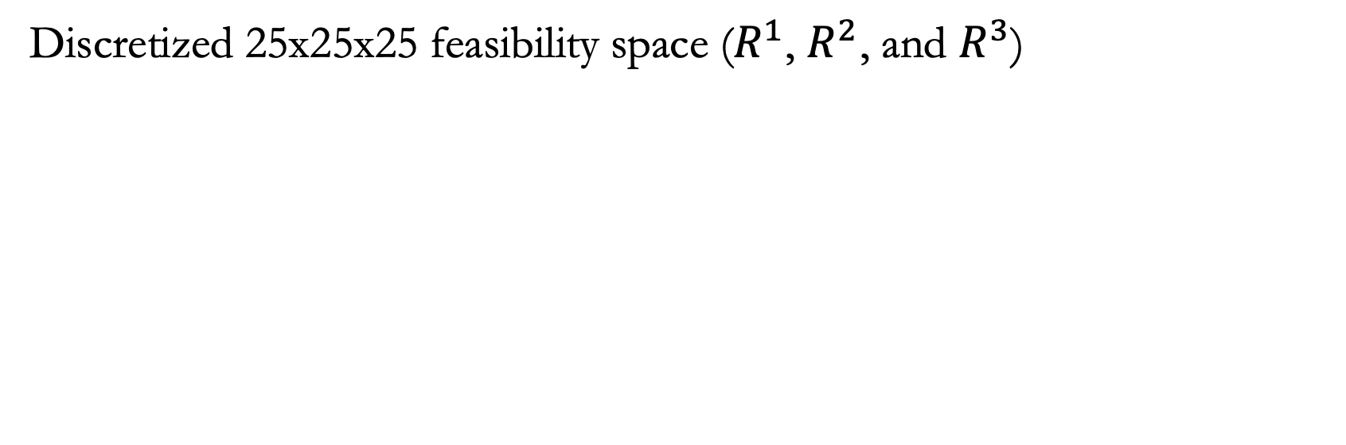
Feasibility Space – 3D Navigation
Discretized 25x25x25 feasibility space ($R^{1}$, $R^{2}$, and $R^{3}$)
Optimum (3D) discretized feasible load is at (2.24,0.80,2.88)

Slide 26
Example 3D Navigation ($R^{1}$)
Example navigation for 3 different starting states (15,000 episodes)

Slide 27
Example 3D Navigation ($R^{2}$)
Example navigation for 3 different starting states (15,000 episodes)

Slide 28
Example 3D Navigation ($R^{3}$)
Example navigation for 3 different starting states (15,000 episodes)

Slide 29
Example 3D Navigation ($R^{3}$)
Example navigation for 3 different starting states (15,000 episodes, w/ prioritized replay)

Slide 30
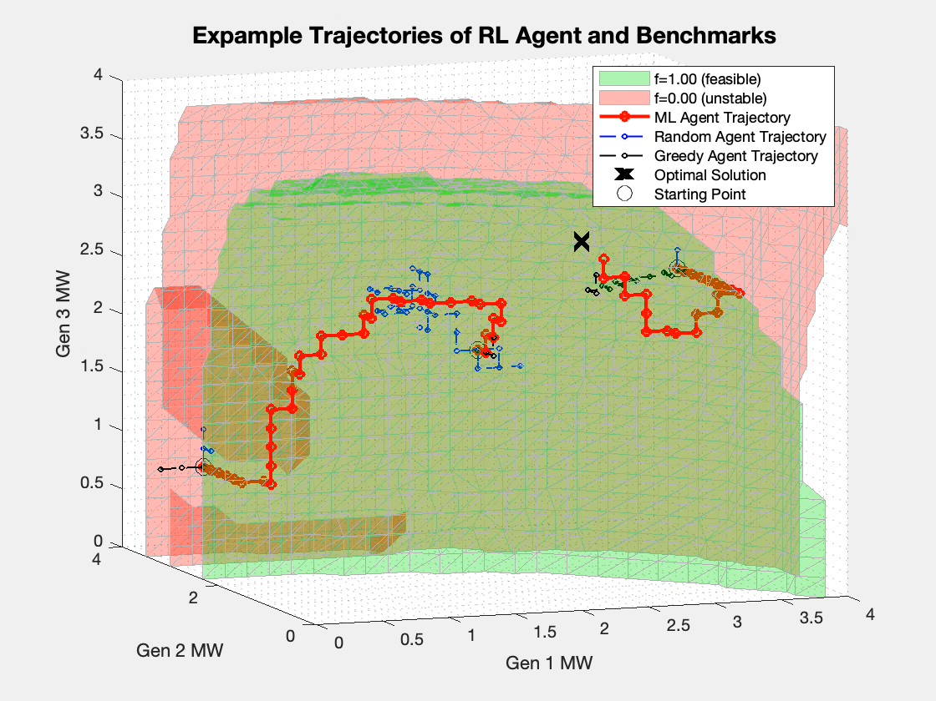
Example 3D Navigation Movie ($R^{1}$)
Example navigation for 3 different starting states (15,000 episodes)

Slide 31
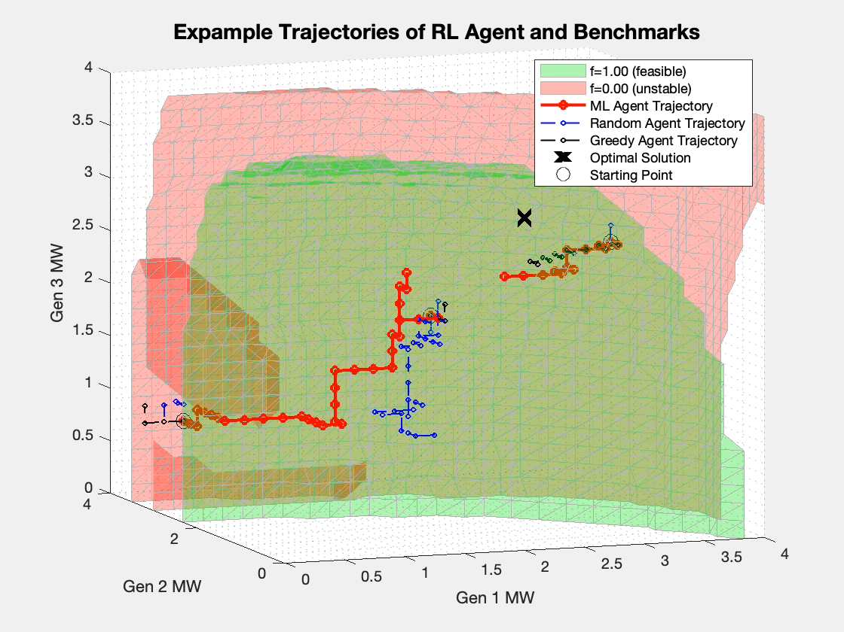
Example 3D Navigation Movie ($R^{2}$)
Example navigation for 3 different starting states (15,000 episodes)

Slide 32
Example 3D Navigation Movie ($R^{3}$)
Example navigation for 3 different starting states (15,000 episodes)

Slide 33
Example 3D Navigation Movie ($R^{3}$)
Example navigation for 3 different starting states (15,000 episodes, w/ prioritized replay)

Slide 34
Conclusions
We demonstrated the feasibility of this approach
We verified that reinforcement learning can better achieve objectives than
  Random state walk
  Greedy state transition
Higher-fidelity navigation requires more training
Recent paper accepted and presented at IEEE KPEC 2022
  Presenting at IEEE PES GM (July 19th)
  Other manuscripts in progress

Slide 35
Future Work
Scalability of State Space Dimensions- Map reduction without losing fidelity
Modify solution from discrete space to continuous space
Evaluation of tool across multiple scenarios – Checking solution accuracy against many constraints
Use of Transfer Learning – Allows a DNN to be trained for a specific system without starting from a blank DNN
DNN partitioning – Provides metadata, allowing insights into each solution (geography, type of security constraint, etc.)

Slide 36
Our Team – Sandia
  Stephen J. Verzi (co-PI)
  Ross Guttromson (co-PI)
  Asael “Ace” Sorensen (deep reinforcement machine learning)
  Christian “Birk” Jones (grid modeling)
  The authors would like to acknowledge project support and sponsorship by Dr. Ali Ghassemian of the Department of Energy’s (DOE) Office of Electricity (OE) Advanced Grid Modeling (AGM) program.
Sandia National Laboratories is a multimission laboratory managed and operated by National Technology and Engineering Solutions of Sandia LLC, a wholly owned subsidiary of Honeywell International Inc. for the U.S. Department of Energy’s National Nuclear Security Administration under contract DE-NA0003525.

Slide 37
Thank You
  Questions?
References
Y. Zhou, B. Zhang, C. Xu, T. Lan, R. Diao, D. Shi, Z. Wang, and W. Lee "A data-driven method for fast AC optimal power flow solutions via deep reinforcement learning," Journal of Modern Power Systems and Clean Energy, vol. 8, no. 6, pp. 1128-1139, 2020. https://doi.org/10.35833/MPCE.2020.000522
Y. Zhang, J. Wu, Z. Chen, Y. Huang, and Z. Zheng, "Sequential node/link recovery strategy of power grids based on Q-learning approach," in 2019 IEEE International Symposium on Circuits and Systems (ISCAS), pp. 1-5, 2019. doi: 10.1109/ISCAS.2019.8702107
M. Mandich, "Power System Stability Assessment with Supervised Machine Learning," Masters thesis, University of Tennessee, 2021.
Power System Toolbox. (2008). Cherry Tree Scientific Software.
J. D. Glover, M. S. Sarma, and T. Overbye, Power System Analysis & Design, SI Version. Stamford, CT: Cengage Learning, 2012. ISBN: 978-1-111-42579-1
P. Kundur, Power System Stability and Control. New York, NY: McGraw-hill, 1994. ISBN: 978-0-070-35948-1
C. J. Watkins and P. Dayan, "Q-learning," Machine learning, vol. 8, no. 3-4, pp. 279-292, 1992. https://doi.org/10.1007/BF00992698
V. Mnih, K. Kavukcuoglu, D. Silver, A. Graves, I. Antonoglou, D. Wierstra, and M. Riedmiller, "Playing atari with deep reinforcement learning," arXiv preprint arXiv:1312.5602, 2013.
T. Bailey, J. Johnson, and D. Levin, "Deep reinforcement learning for online distribution power system cybersecurity protection," in 2021 IEEE International Conference on Communications, Control, and Computing Technologies for Smart Grids (SmartGridComm), pp. 227-232, 2021. https://doi.org/10.1109/SmartGridComm51999.2021.9631991
A. Paszke et al., "Pytorch: An imperative style, high-performance deep learning library," Advances in neural information processing systems, vol. 32, pp. 8026-8037, 2019.
R. S. Sutton, and A. G. Barto, Reinforcement Learning: An Introduction, Cambridge, MA: A Bradford Book, 2018. ISBN: 978-0-262-03924-6
Verzi, S., Guttromson, R., & Sorensen, A. (2022). “Using Reinforcement Learning to Increase Grid Security Under Contingency Condition,” To appear in the proceedings of the Kansas Power & Energy Conference (KPEC) 2022. https://www.kpec-ksu.org/program.

