Slide 1
Shortest Path Navigation using Reinforcement Learning
By Srideep Musuvathy, Tyson Bailey, Abel Osvaldo Gomez Rivera, Meghan Sahakian
RELACSS
7/14/2022
SAND2022-9852 C

Slide 2
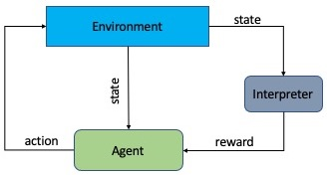
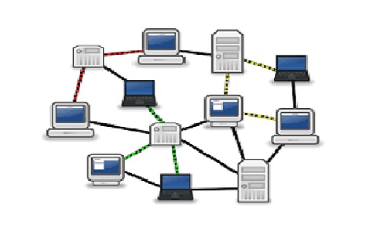
Cyber RL in 60 seconds
Defensive Agent
Offensive Agent
Network
How can we test and protect our systems?

Slide 3
Problem
The goal is for an attacker to navigate a graph with edges that can disappear based on some probability function
The probability of disappearing is simply a stand in for a defensive agent killing edges on the network to constrain the attacker
Can our agent learn to take a longer path if it’s more reliable?

Slide 4
Network
Probability of successful transition from s2 to s3

Slide 5
State Representations
First attempt was to use the following state representation:
Current | S1 | S2 | S3 | S4 | S5 | S6 | S7
Which node we are on
values 1 through 7
Whether we have visited a particular node
Values 0 and 1

Slide 6
Action Space
Similar to the state space we have the option of selecting *any* node
S1 | S2 | S3 | S4 | S5 | S6 | S7

Slide 7
Rewards
-1 for each step
100 for finding the terminating node.
Given the probabilities proposed in the graph, statically the agent should *prefer* to take S2->S3->S7

Slide 8
Results
Able to train (easily) using PPO and solve the problem.

Slide 9
Issues Arise
However, when training, we teach the agent to follow the longer path, but what happens if the shorter path exists how can we make the agent take it?
Since RL tends to find a optimal path, or policy, training on a system that behaves a certain way will result in a policy that is static, meaning that if we train it to prefer s2->s3->s7 then we will always attempt that path, independent of whether s2->s7 is possible.
The current state structure and action space, require complete knowledge of the graph, meaning that you have all nodes in your state, as well as all nodes in your actions

Slide 10
Solution (State Space)
So we changed the problem slightly, rather than keeping all nodes in memory as to which ones we’ve visited, we propose simply keeping track of what node we are on, and a subset of nodes we can see.
This means that if we have a very large network, we don’t need such a large input space.
We default it to 3 slots currently
The available nodes are filtered by the probability, then all remaining nodes are shuffled and the first 3 selected.
If less than 3 are available the slots will contain a 0 starting in the rightmost column

Slide 11
Solution (State Space)
Current | S1 | S2 | S3 | S4 | S5 | S6 | S7
Action 0 selected
Current | Slot 1 | Slot 2 | Slot 3
Selects slot that contains 7
1
2
0
0
2
7
3
1
Randomized Order
2
3
7
1

Slide 12
Solution (Action Space)
Similar to the state space, we chose to reduce our action space from enumerating all possible nodes we can visit, we constrain it to only being able to select a slot from the visible/available nodes.
If the agent selects an empty slot that is a “do nothing” action.
S1 | S2 | S3 | S4 | S5 | S6 | S7
1,2,3…n

Slide 13
Results
After taking 10000 timesteps training (not that long) the below is an example run
For the following run, our agent started on s1, and could see s2. It chose to move to s2.
Then it was in s2 and was able to see s3 or s1, so it chose to go to s3.
Finally while it was in s3, the chances of seeing s7 are quite high and it took it.

Slide 14
Results
Another example from the same training run
For the following run, our agent started on s1, but couldn’t see anything so it wasn’t able to move.
The next round it could see s2. It chose to move to s2.
Then it was in s2 and was able to see s7, so it chose to go to s7.

Slide 15
Results
Another example from the same training run
For the following run, our agent started on s1, and it could see all 3 edges.
Here it can decide, does it go to s7 or s3, it chooses s7

Slide 16
Results
Another example from the same training run
This does the same thing as last run, but if you note, all the prior runs, picked the 0th slot every time, it just happened to be that the best action was in slot 0 each time.
However, this example shows the agent learned that 7 was the important number and not slot 0.

Slide 17
Results
Finally just to show, we do have the possible nodes in a shuffled order, this is the code that defines the path, you can see 3,7,1 in the code, but the state below shows 1,3,7
self.lookup = {
1 : [2],
2 : [3,7,1],
3 : [4,6,7,2],
4 : [5,3],
5 : [4],
6 : [3],
7 : [2,3]
}

Slide 18
Making it more interesting
Next we asked the question, can we learn on a more general graph and then perform the same experiment on the same smaller graph and achieve our desired goal?

Slide 19
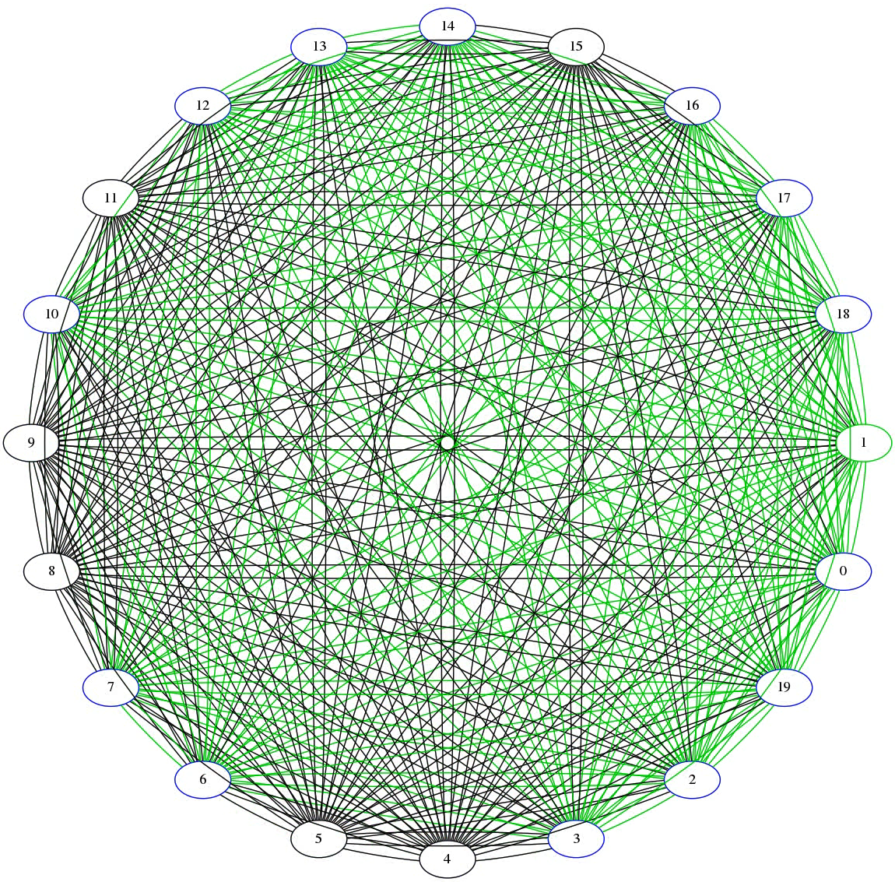
Large Graph
20 node fully connected graph.
Green lines indicate active edges for a given timestep

Slide 20
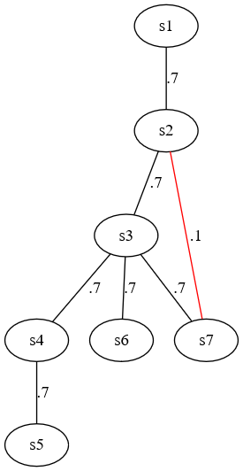
Results
The agent was successful on the smaller graph starting from s1 similar to the earlier experiments.
However, repeated running based on probabilities it occasionally jumped into a segment of the network it got stuck in (namely s4/s5), more training might be required
Would this work in a higher fidelity environment?

Slide 21
Higher Fidelity Environment
Built the above network in Septre, using virtual machines.
Built a translation layer to enable moving around between machines.
Built a tool to search for a target file on the machine
Check for any missing edges, and force the agent to return to the last node it has full access to.
Built a python script that turns the network edge between s2 and s7 on and off for a minute at a time.
It worked!

Slide 22
Summary
Pros:
This approach seems to work well with some appearance of generalization
It avoids hardcoding the underlying graph structure.
It prevents you from requiring total knowledge of all nodes present ahead of time
It avoids having a static policy that fails when an edge is removed, because it prefers the policy and the edge isn’t in the state.
Cons:
Got stuck in the smaller graph, more training may fix this
Larger graphs (200 nodes) may require a LOT more time to train

Slide 23
Core Challenges
How do we define what a target machine is? In this case we consider S7 to be our goal node, we could replace the “hard coded” S7 with a node that has a flag of interest.
How would this affect the problem? This becomes a shortest path from all nodes to all other nodes (Dijkstras algorithm)
Requires a translation layer to work in the target environment

Slide 24
Future work
Defensive Agent experimentation
Improve fidelity of target environment
Continue Attacking Agent training
Possibly compare other RL algorithms
Add more useful capabilities, such as scanning for and copying files
Better definition of scoring

