Slide 1
Utilization of the critic subnetwork of a generative adversarial network as detector of morphological material change in image data
Ariana Beste/7555
Dan Bolintineanu/1516, Dan Bufford/7555
FY22 Exploratory Express LDRD, Project 226346
SAND2022-9134 C

Slide 2
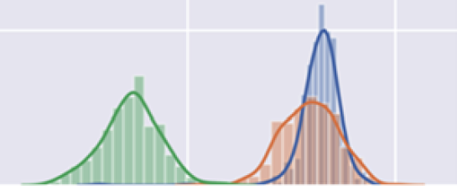
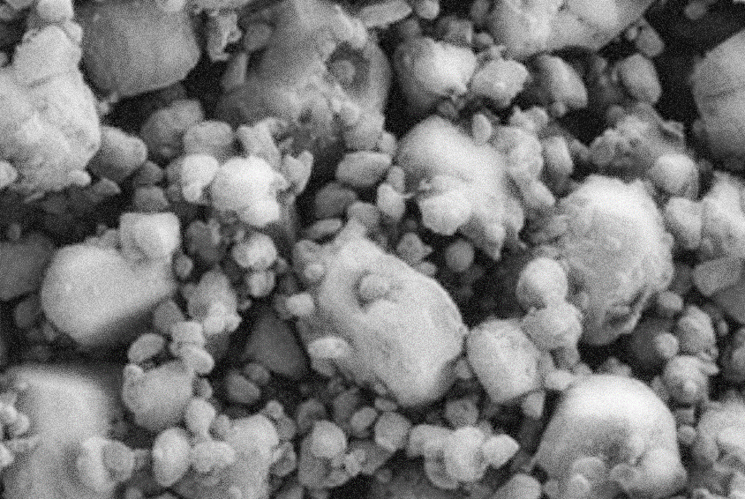
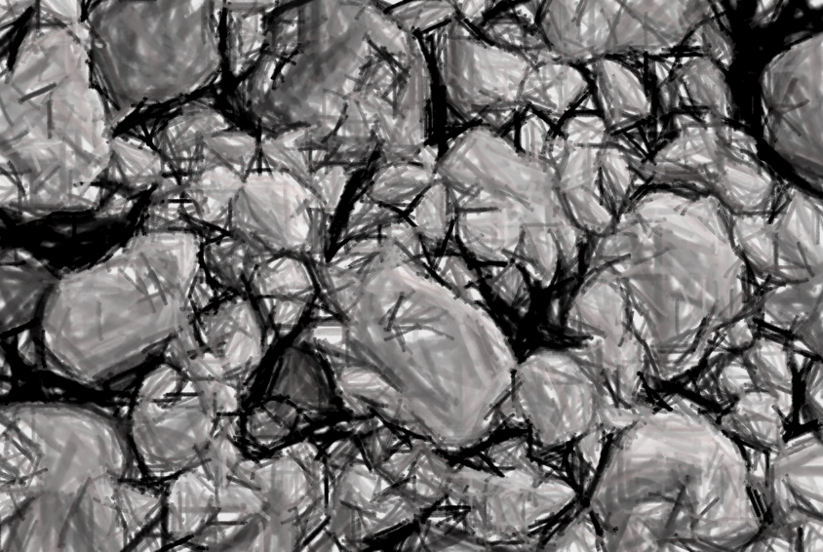
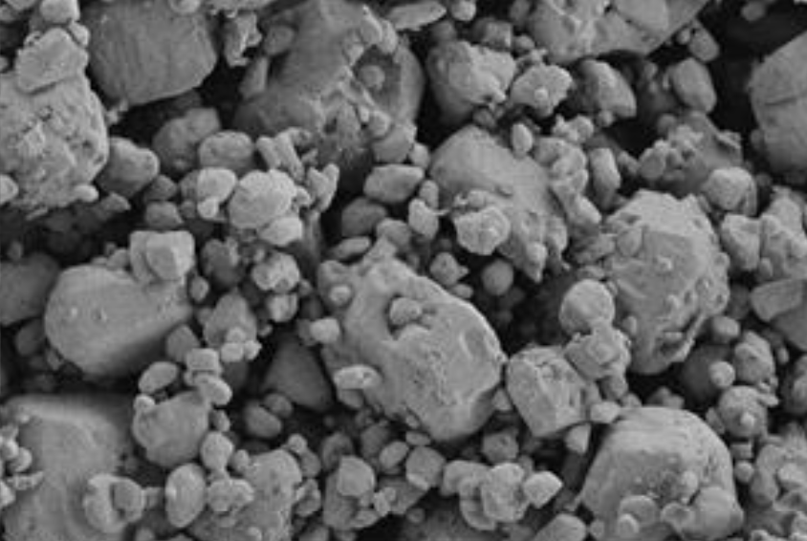
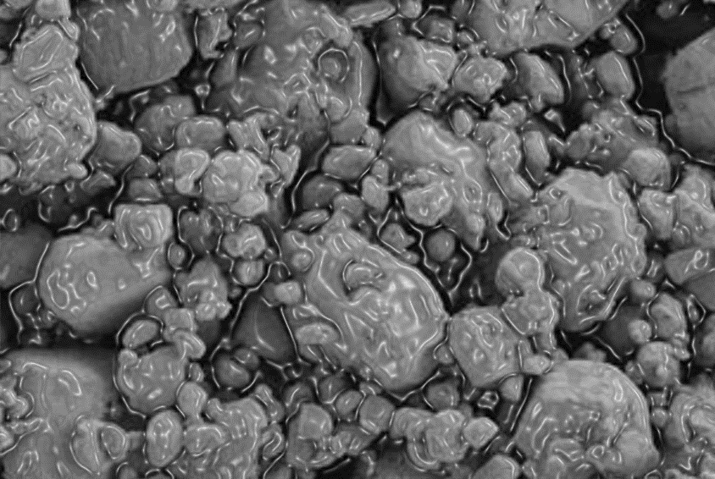
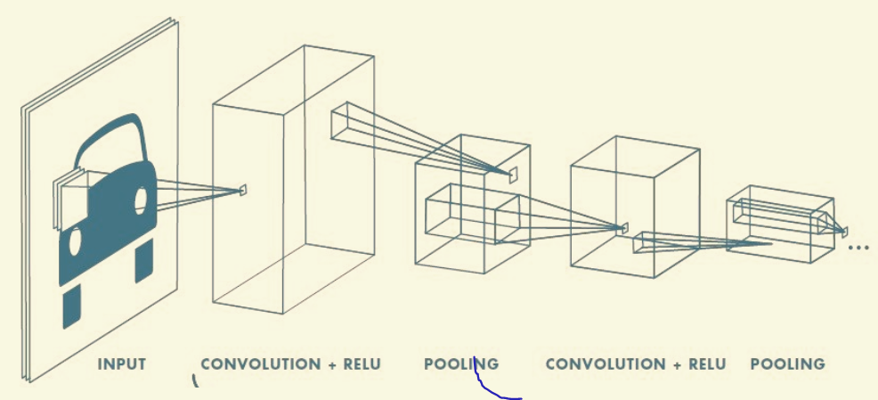
Problem
Traditional morphology analysis
Surveillance
A priori choice
Information loss
Dependence on experimental setup
Segmentation
Single-point metrics
Spatial correlations
Regional statistics
Dimensionality Reduction
Lack of test data
Computer Vision
Original images
No prior choice
Little information loss
Representation of complex function
Reduced dependence on experimental setup
Convolutional neural network

Slide 3
Algorithmic Approach
Utilization of previous implementation¹ to generate realistic microstructures from SEM images
Wasserstein Generative Adversarial Network (WGAN)
Critic
Critic
Scores generated images according to how well they resemble the training images
Generator
Generator
Generates synthetic images that resemble training images as closely as possible
Critic and generator trained together with images of pristine material
Generator
3 up-sampling/convolutional (ReLu)/batch normalization layers, 1 convolutional (Tanh) layer
Filters 256-128-64-32
Critic
7 convolutional layers (LeakyReLu)
Filters 32-32-64-64-128-128-256
Critic tested with images of potentially altered material morphology -> Image scores
¹ Hsu, T., et al., Microstructure Generation via Generative Adversarial Network for Heterogeneous, Topologically Complex 3D Materials. Jom, 2020

Slide 4
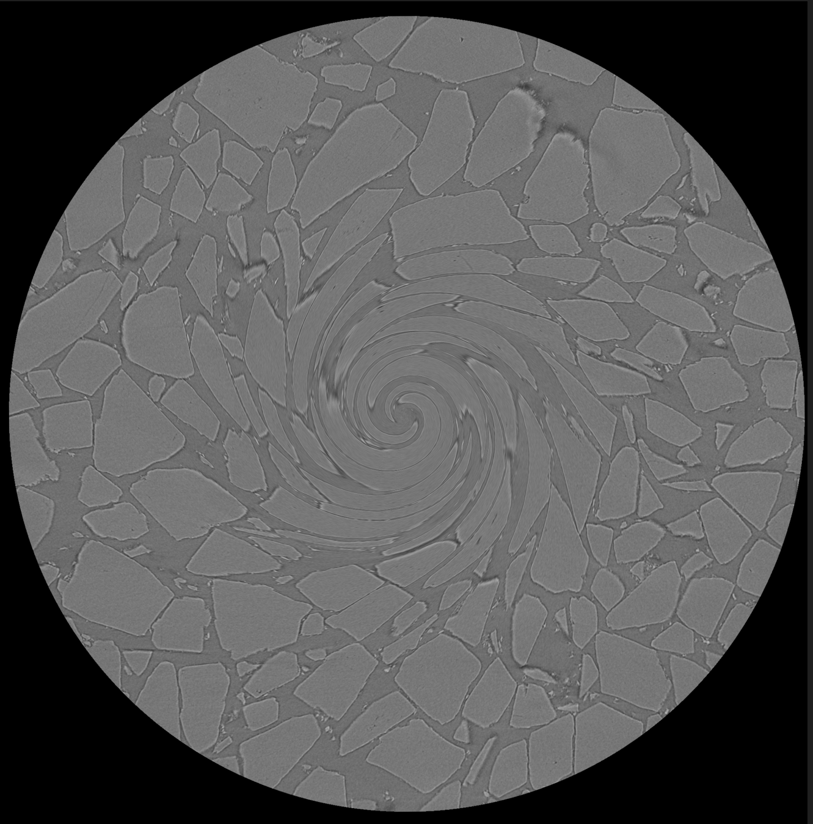
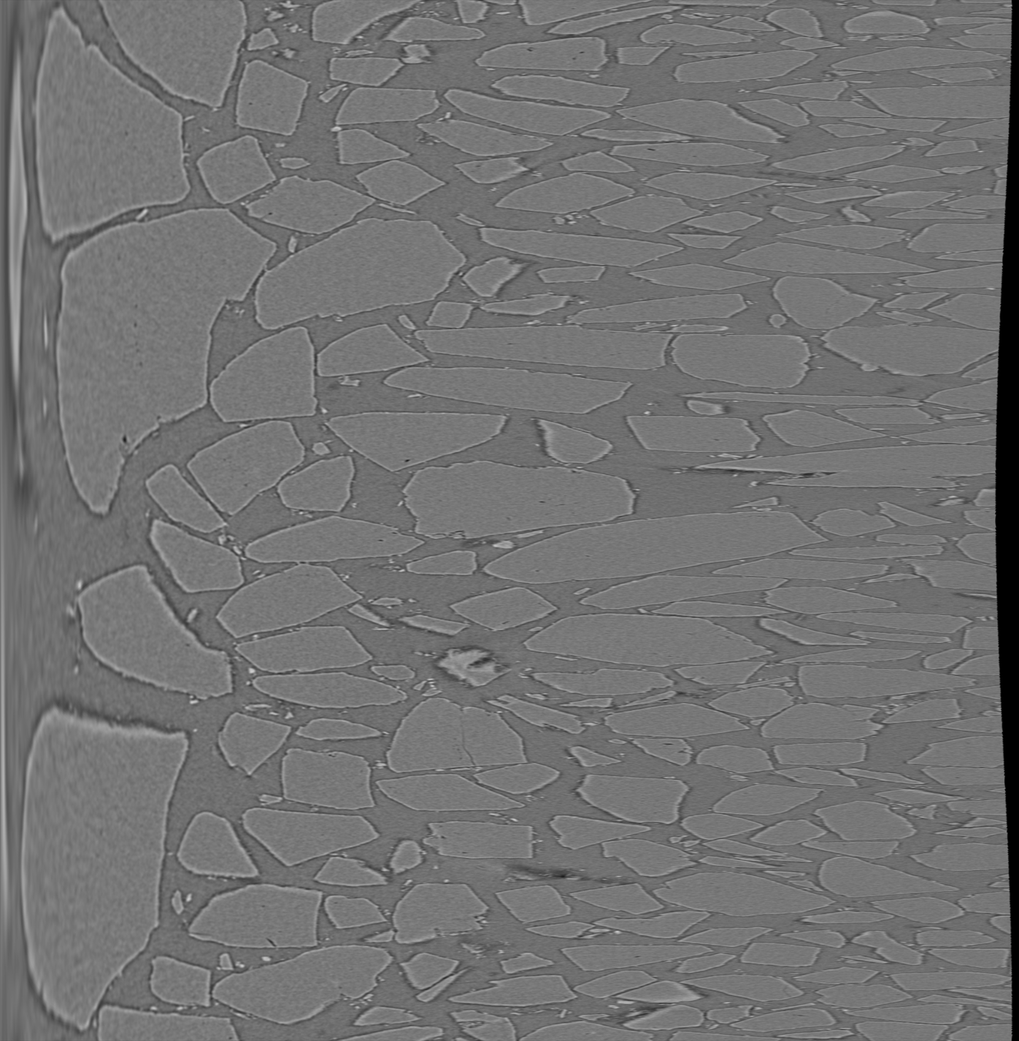
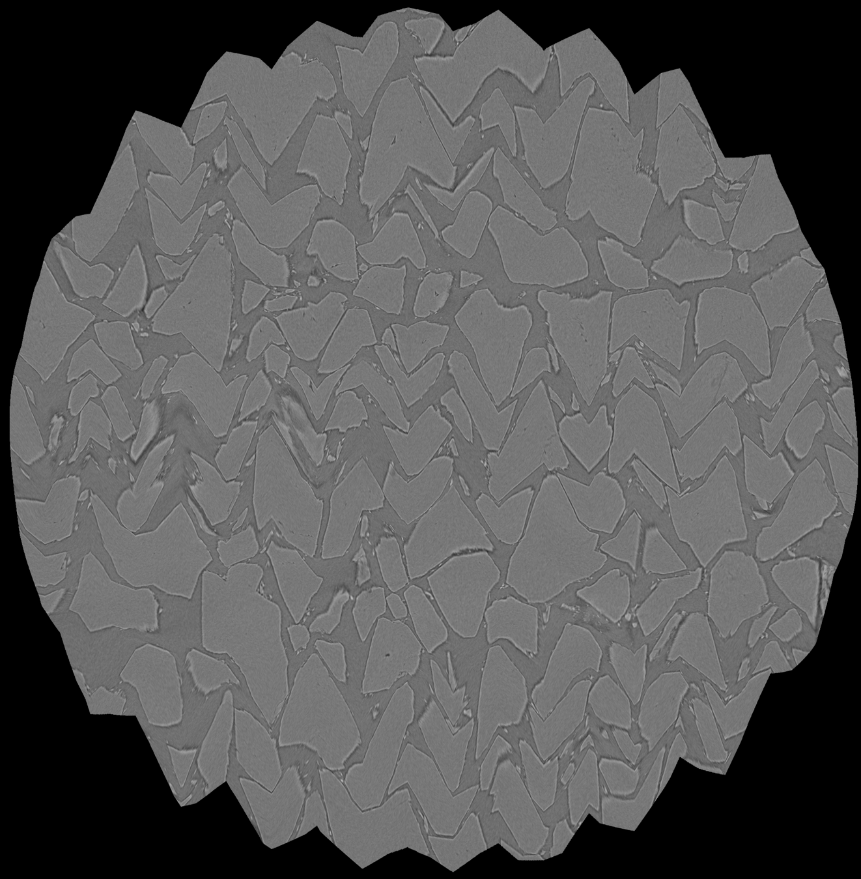
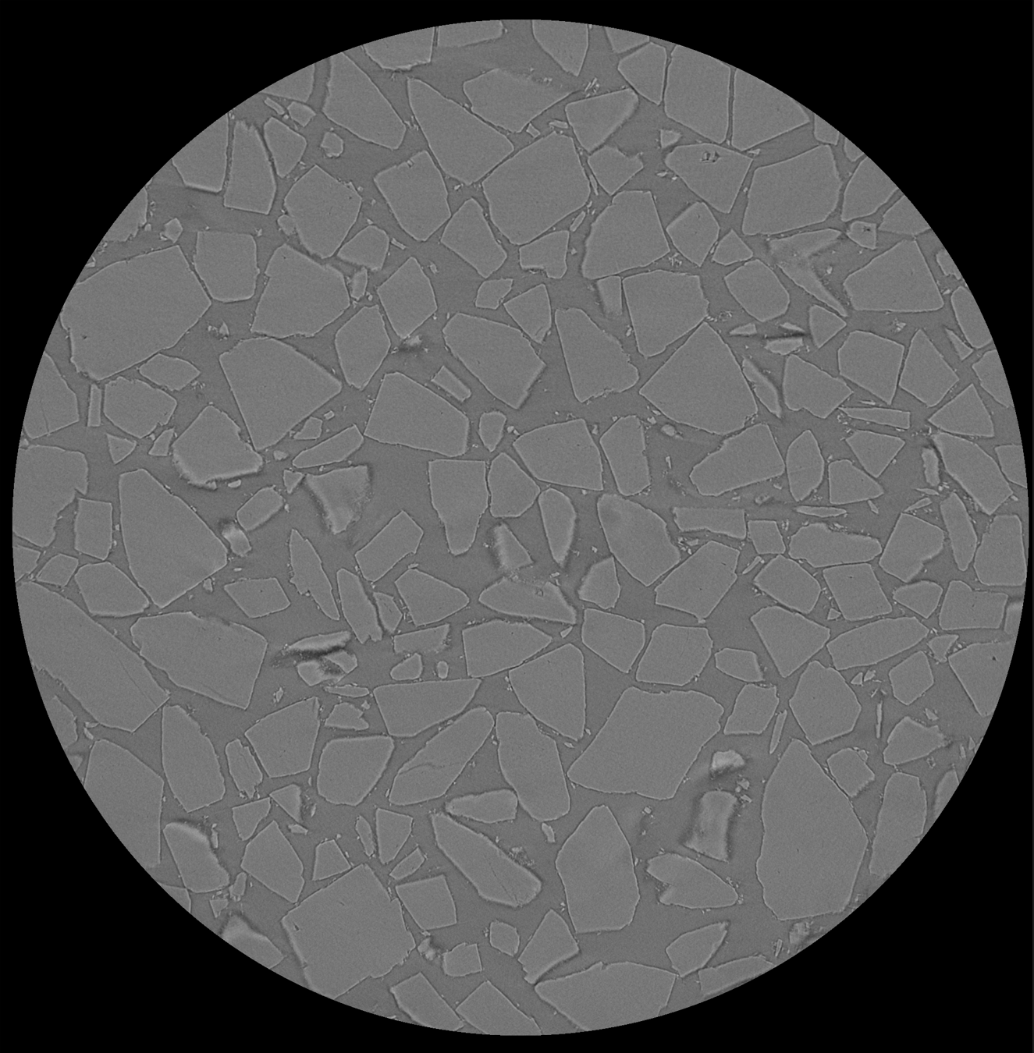
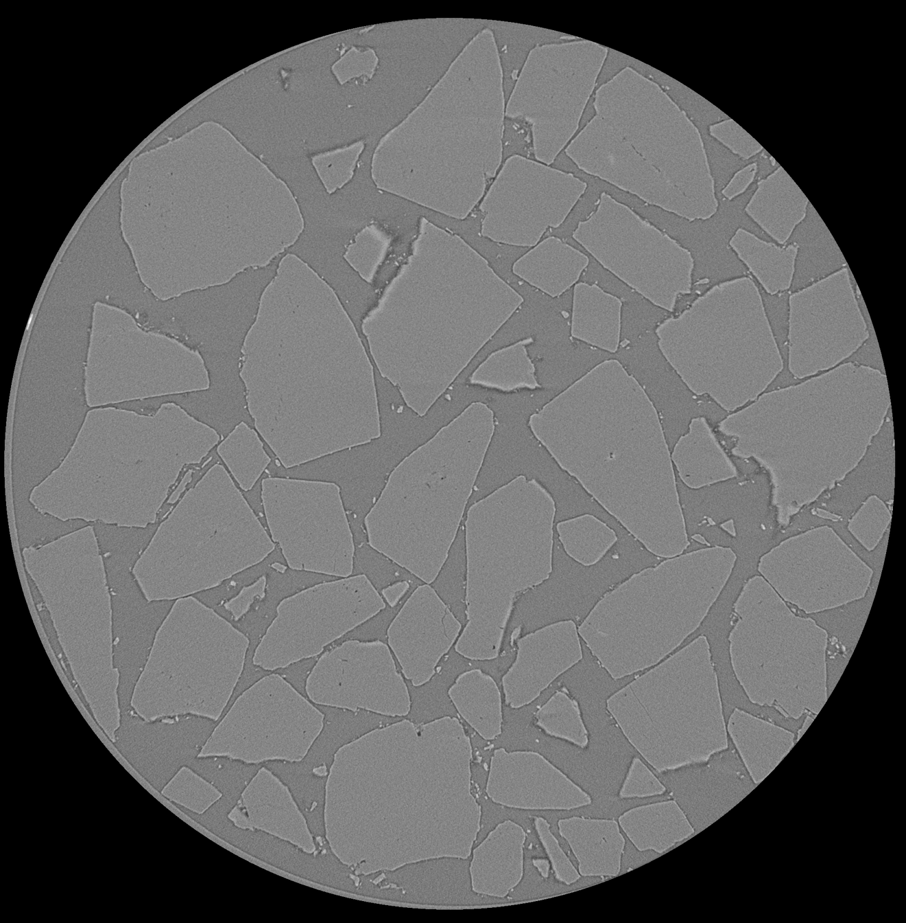
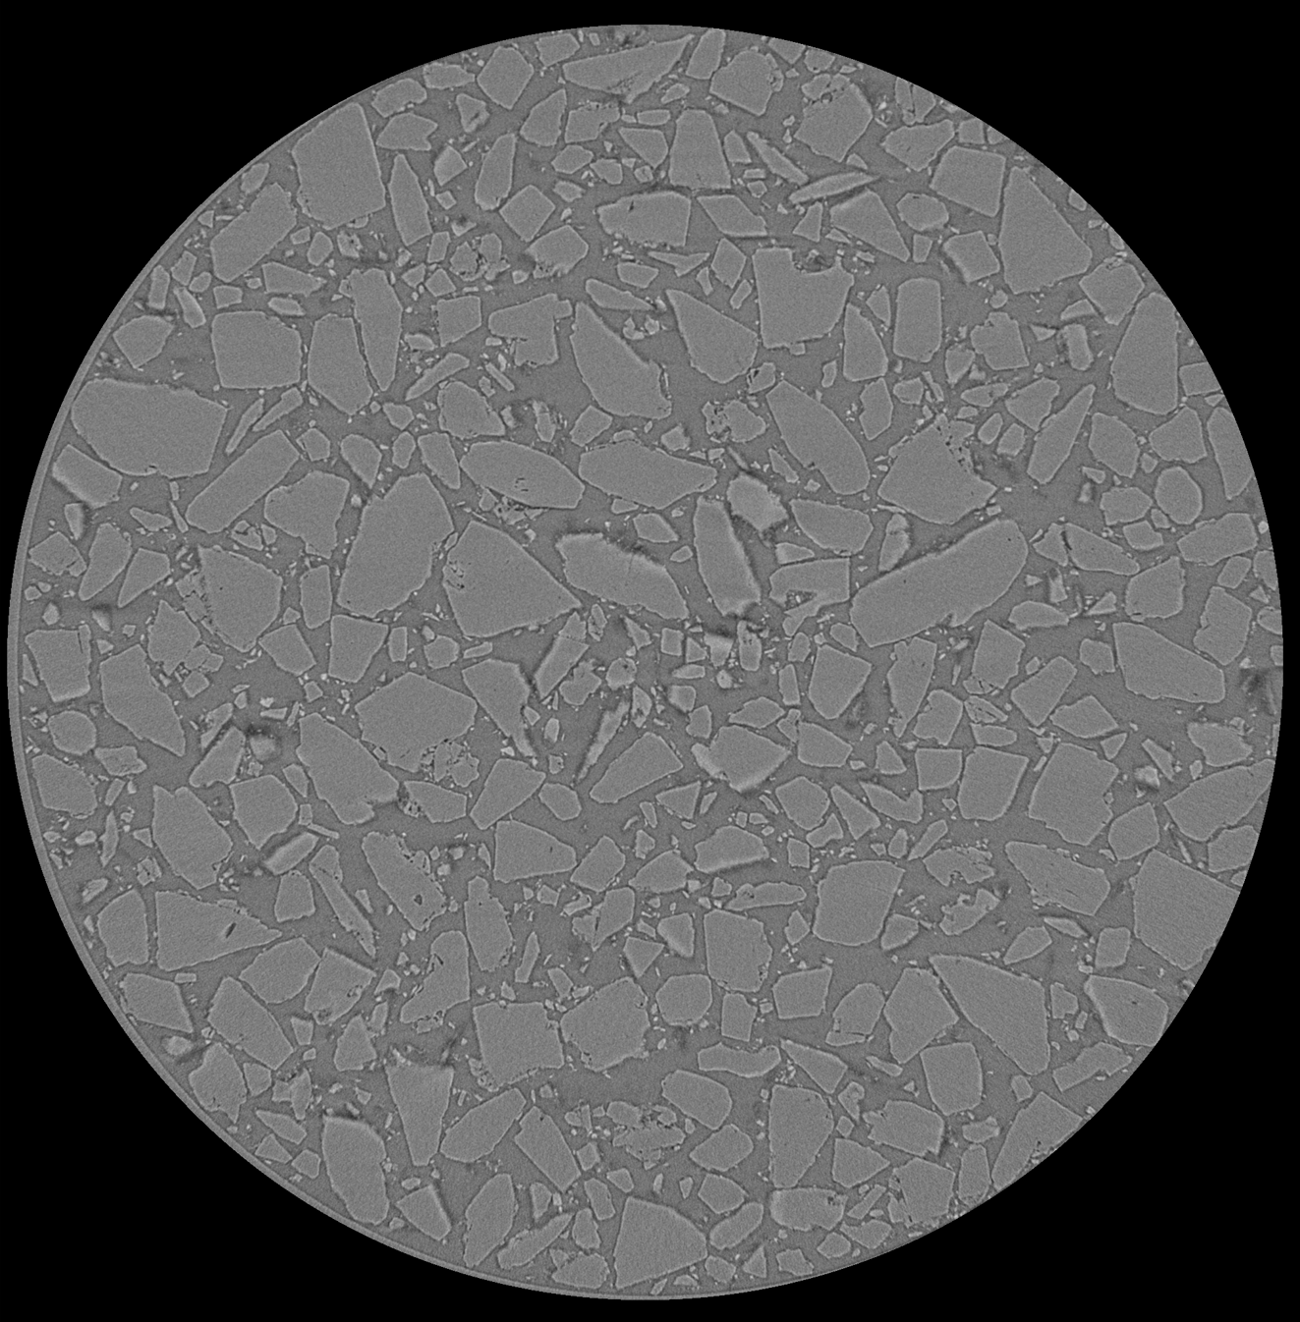
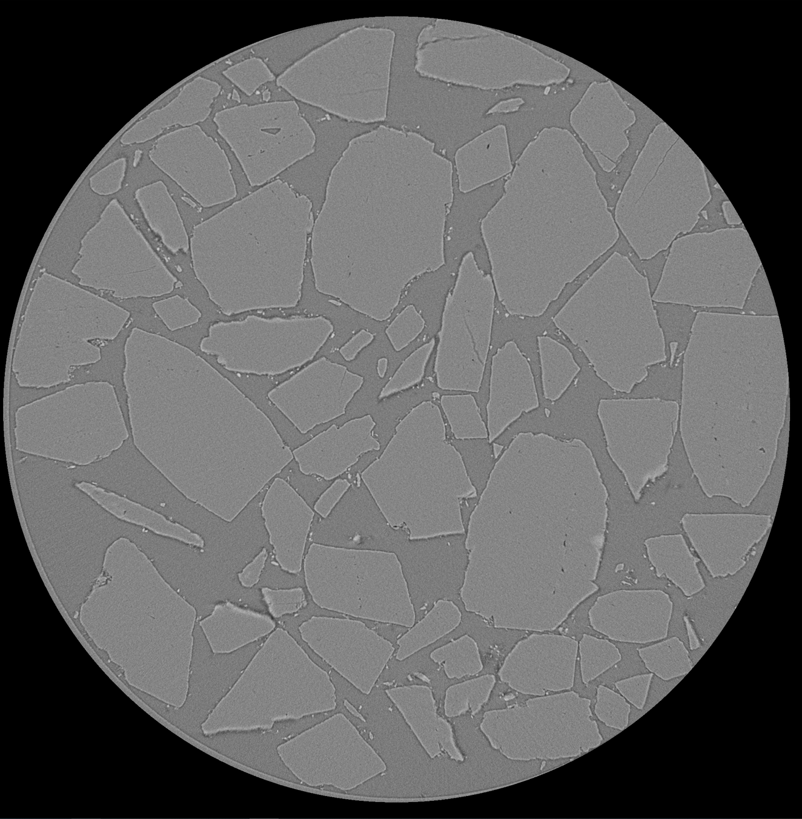
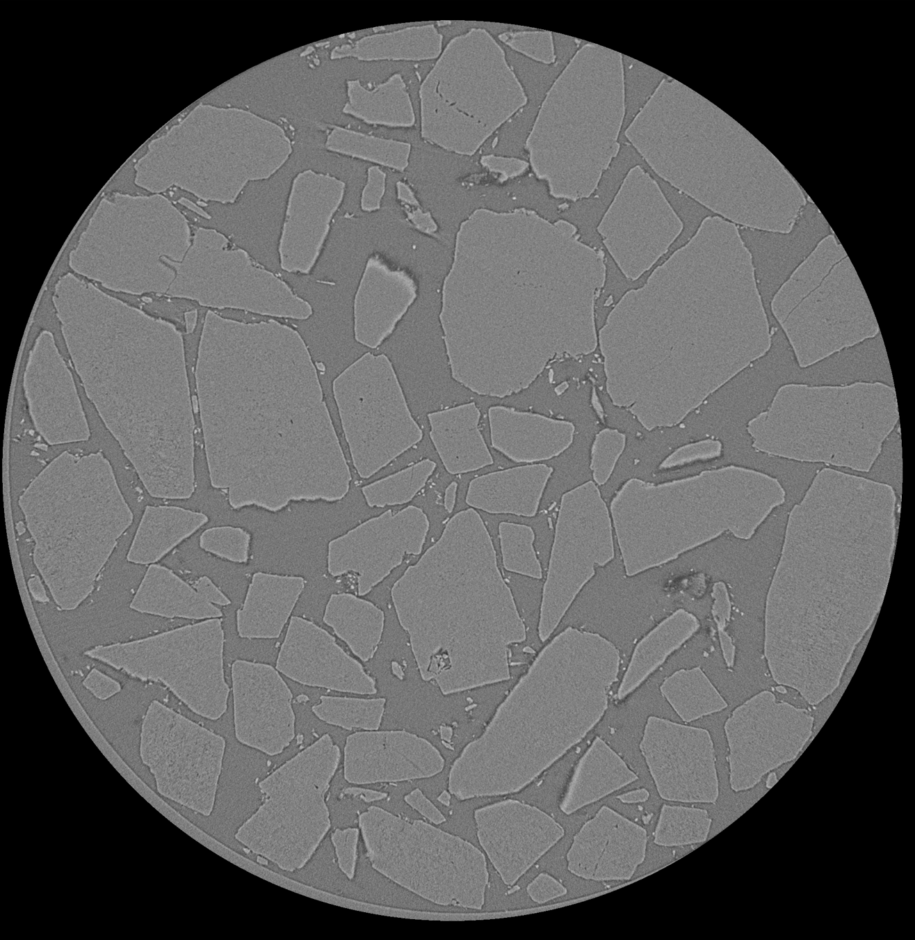
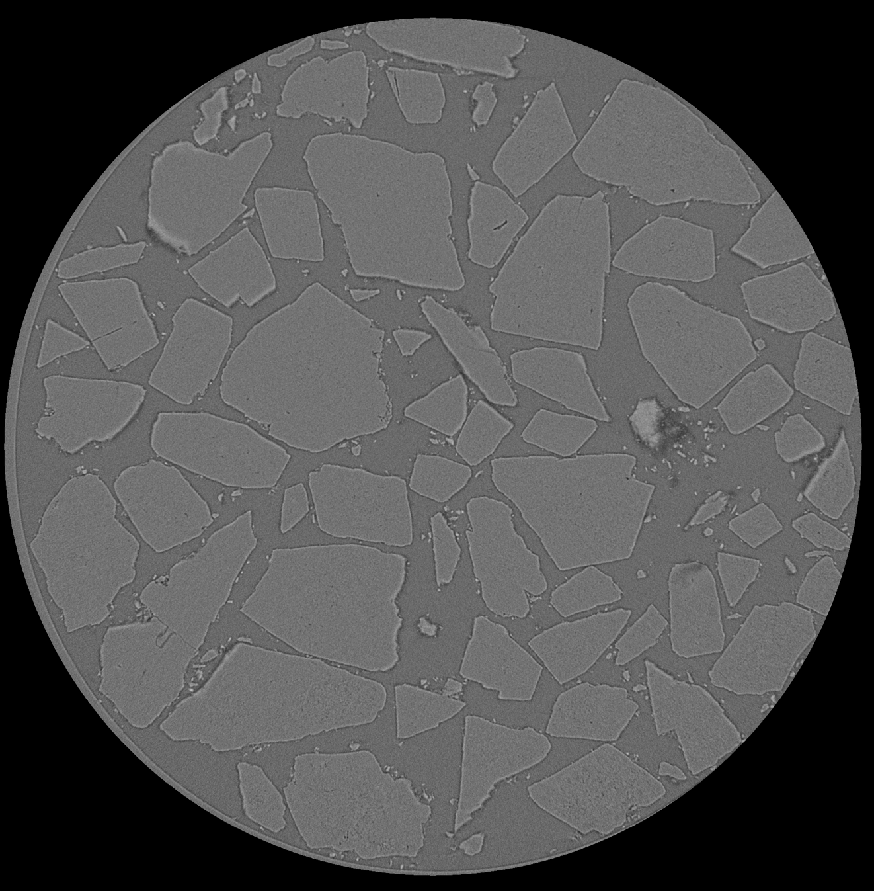
Data
Training
Testing
CT scan of pristine Pharmatose
1800 2d images
Each 2d image 2,000x2,000 pixels
Batch: 64 down-sampled (1/4) 512x512 cropped segments
Image Transformations
Swirl
Polar
Wave
Varying Particle Sizes
Large
Medium
Small
Aged Material (120°C)
HMX microstructure generation with single 3,000x3,000 pixel SEM image ¹
¹ Chun, S., et al., Deep learning for synthetic microstructure generation in a materials-by-design framework for heterogeneous energetic materials. Scientific Reports, 2020. 10(1).
Pristine
1 Week
2 Weeks

Slide 5
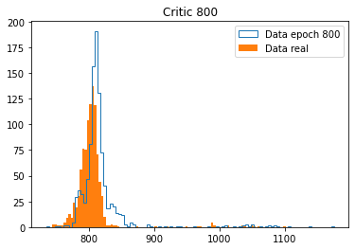
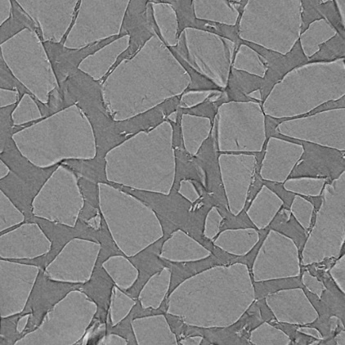
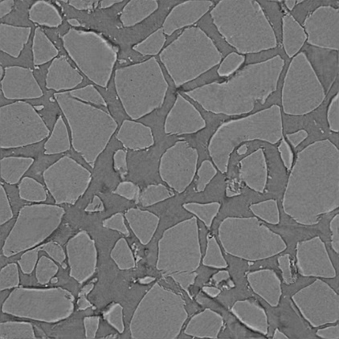
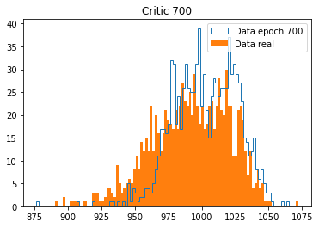
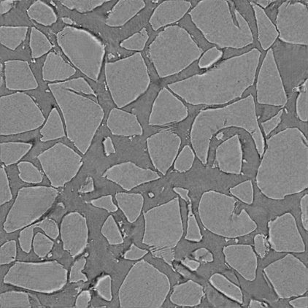
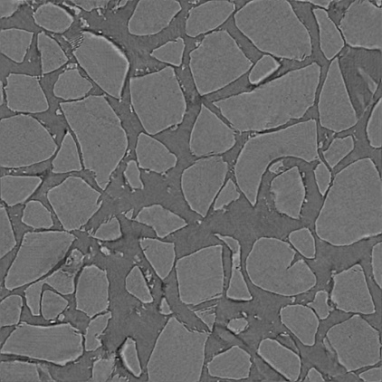
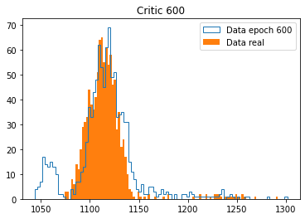
Results – Image Generation
Real
Epoch 800
Image 440
Epoch 700
Epoch 600
Critic scores (1000 images)
For a given epoch, the critic scores real and fake images similarly
Scores vary significantly between epochs
“Blobs” in fake images don’t seem to improve
Training restriction 512x512 pixels image size

Slide 6
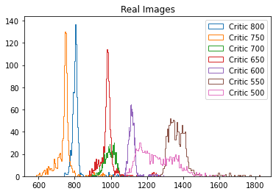
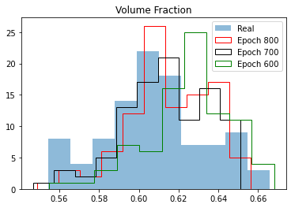
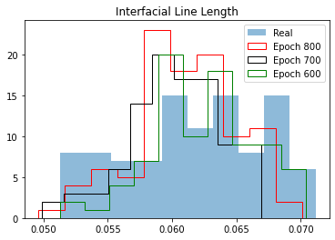
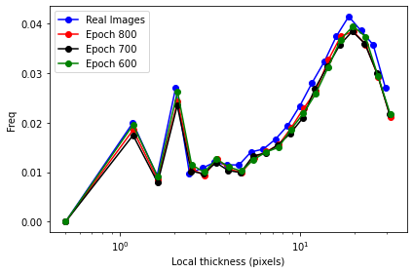
Results – Image Generation
100 images
Count
Count
Critic scores (1000 images)
Converging?
Count
Despite “blobs” image properties appear to be well reproduced
Voxel ⁻¹
Volume fraction: epoch 800 closest to real images
Interfacial line length: different epochs similar distribution
100 images

Slide 7
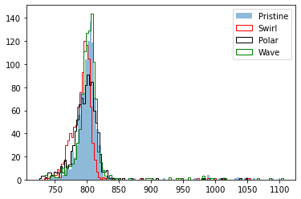
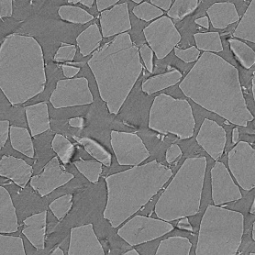
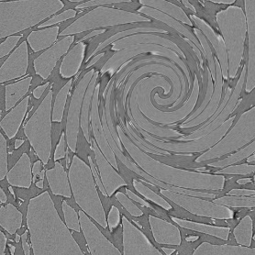
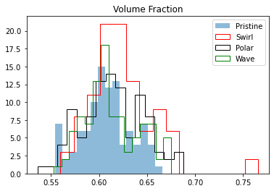
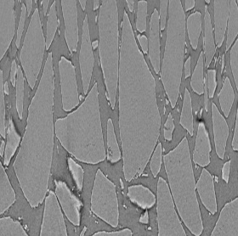
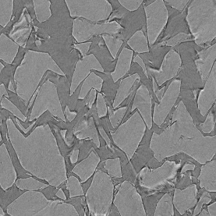
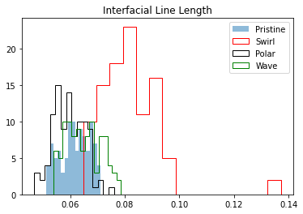
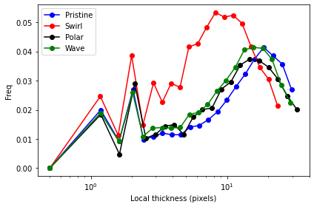
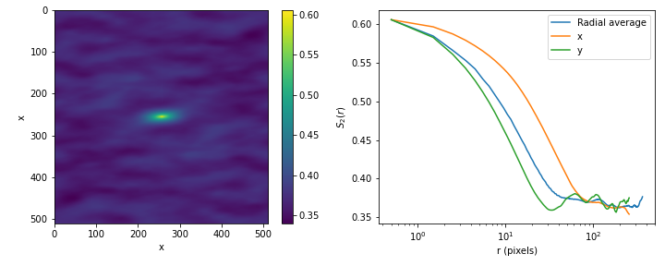
Results – Scores for transformed images
100 images
Count
Pristine
Swirl
Count
Critic scores (1000 images, critic epoch 800)
Polar
Wave
Although there is some response, critic is not sensitive enough to pick up differences in particle shape
Count
Voxel ⁻¹
Two-point correlation function Example image, polar transformation
100 images

Slide 8
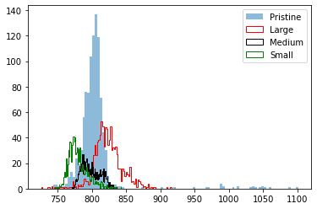
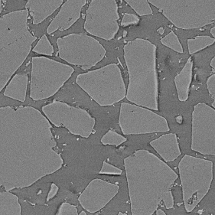
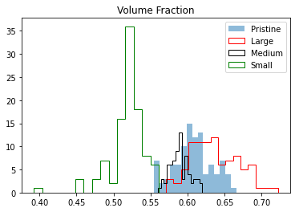
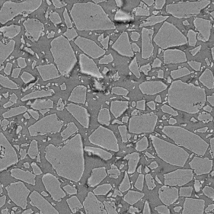
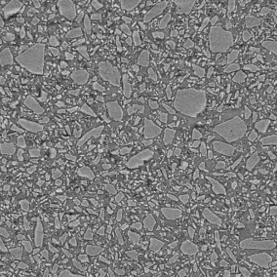
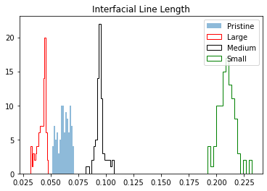
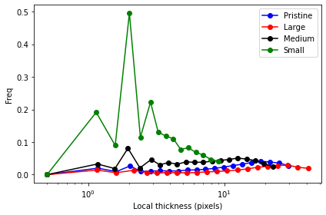
Results – Scores for varying particle sizes
100 images
Count
Pristine
Large
Count
Critic scores (1000 images, critic epoch 800)
Medium
Small
Critic scores images of different particle sizes differently and in consistent order
Count
Voxel ⁻¹
100 images

Slide 9
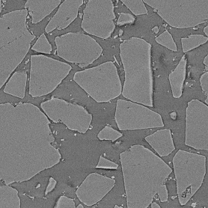
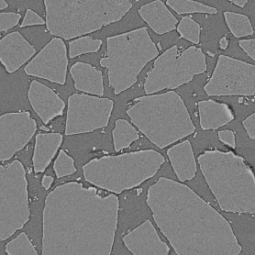
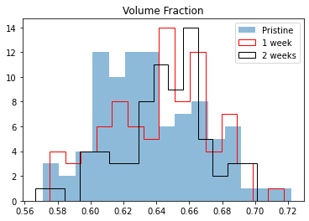
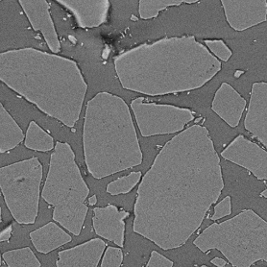
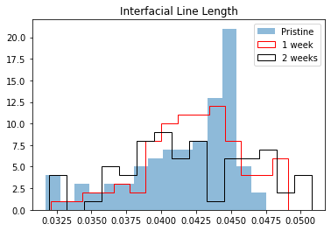
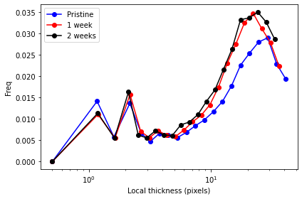
Results – Scores for aged data
100 images
Network training in progress
Scores will be available soon
Pristine
1 week
Count
Unlikely, that critic scores can differentiate between materials …
2 weeks
Count
Voxel ⁻¹
Only subtle differences between pristine and aged material using traditional metrics.
100 images

Slide 10
Conclusions
Concept works, the critic of a GAN can be used as a detector of morphological change but significant improvements needed before the critic can be used in practice:
Image generation without “blobs”
Increase critic sensitivity
Increase of training image size
Help (ideas, collaborations) from ML/DL community very much appreciated
Potentially interested customers: NA-193, Aging & Lifetimes

