Slide 1
Transfer Learning with Auto-Generated Labels for Cloud Segmentation With application in forecasting
Ben Pierce, Sandia National Labs

Slide 2
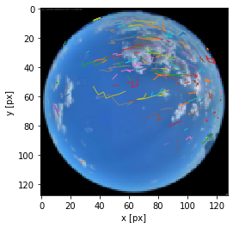
Introduction & Objective
Forecasting in the near future useful for PV to balance inputs to the grid
Short term power prediction impacted by cloud behavior.
Clouds in front of Sun = change in irradiance received
Task I: Identify clouds from image
Easy for humans
Hard to do automatically due to various sky conditions
Task II: Track & predict cloud movement through time
Will there be clouds in front of the Sun in the next 10 minutes?

Slide 3
Part I: Cloud Segmentation

Slide 4
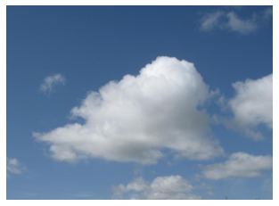
Classical Segmentation Methods
Need some method to isolate clouds within an image
“Segmentation”
Multiple classical (i.e. non-ML methods)
Differ in various ways
Sensitive to changes in image type
Camera distortion
Luminosity
Obstructions
Filtering approach
Find some image transform to isolate clouds
How do we find a general, robust model that can adapt to the data?

Slide 5
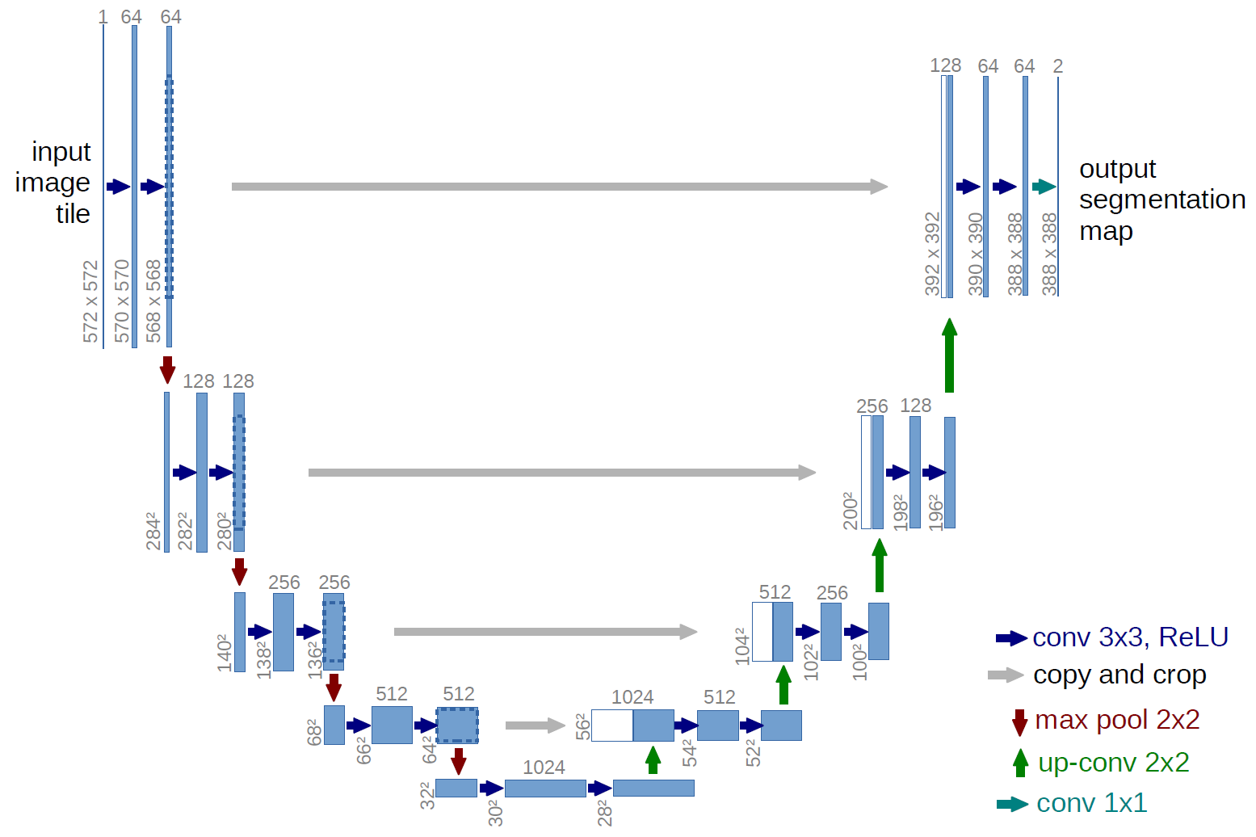
Can a ML model be trained with auto-generated labels?
Problem: training data is expensive
Manual (human) labeling
Idea: use (all) classical methods as training data
Learn from strengths/weakness from all methods
Challenge: Can UNet model learn from imperfect, auto-generated training data?
Also: does this process generalize well to different sources of data?
Supervised learning requires large ground-truth training set
Input
Output
(128,128,1) probability map
RBG (128,128,3)
(128,128,1) Binary {0,1}

Slide 6
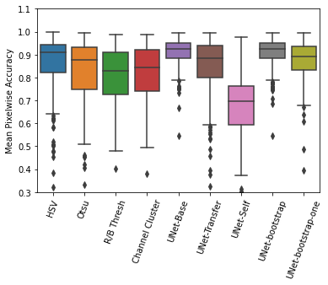
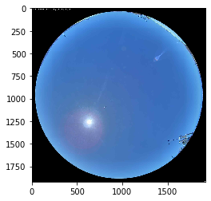
Performant, Sample Efficient ML
Three subsets
In sample ground truth
In sample masks
Out of sample masks
Masks generated via classical algorithms
Differences & challenges for generalization
Cameras (hemispheric vs rectangular)
Cloud types
Geographic location
Dataset 1
Dataset 2
Classical
In-sample truth
When trained on G.T. model performs better then previous state of the art
Model can generalize out of sample
Location & camera independent
Masks created by classical algo. can be used to boost initial performance w/o ground truth training data
Out of sample masks
In-sample masks
Out of sample masks + in sample truth

Slide 7
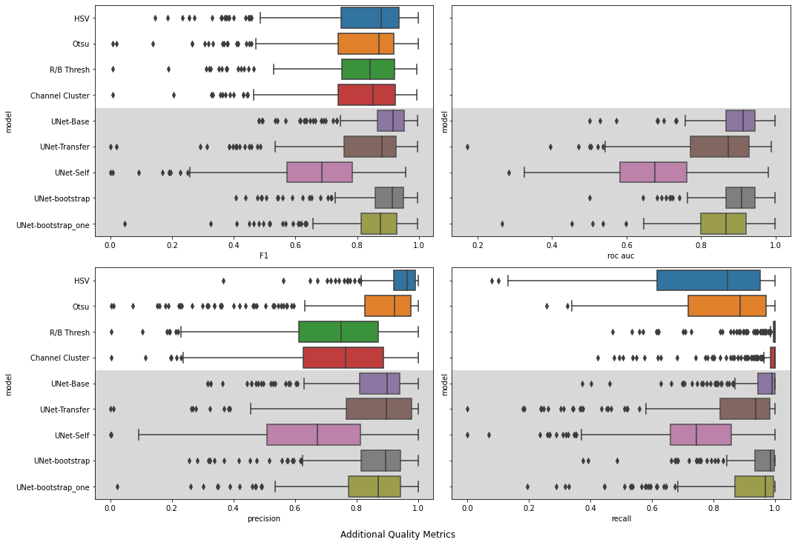
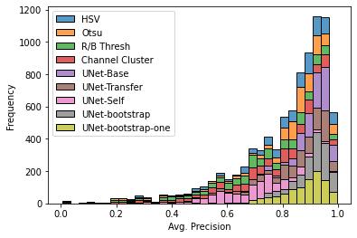
Performance Metrics
Additional metrics include
F1 Score
Precision
Recall
Area under ROC curve
Performance of UNet models appears to be quite good
Reasonable precision/recall trade-off

Slide 8
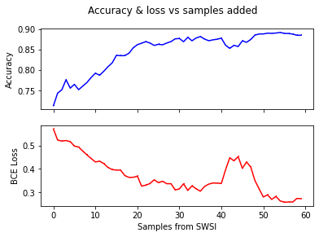
Quick convergence with additional samples
Training process
Train model on autogenerated labels
Add hand-labeled samples on different dataset
Within ~50 samples, we start to see comparable performance to full 1000 imgs
Note that without the transfer learning, accuracy does not exceed 65% in these 60 samples

Slide 9
Part II: Motion tracking & prediction

Slide 10
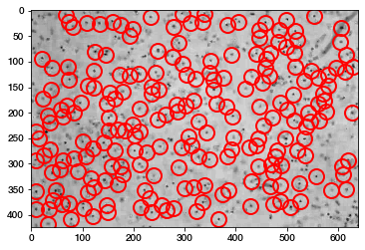
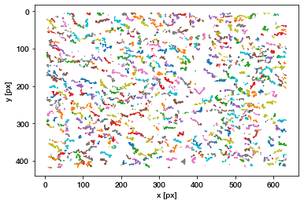
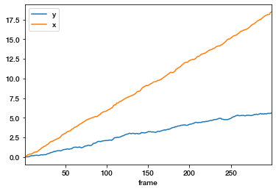
Motion tracking & prediction by applying colloidal tracking
Crocker and Weeks, 1996 present a method for tracking colloidal particles
Isolate particles from binary mask
Find brightness maxima
Use maxima to locate centroids
Link though time
Implemented in open-source Python trackpy package
Easy to apply to new data
Provides exactly the statistics we need
Locate objects
Object level drift
Overall drift

Slide 11
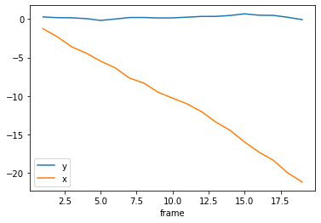
Using motion linkages to predict future cloud motion
N
Trackpy links particles through time
This provides us with their xy position over n minutes
How do we predict the future?
Numerical gradients via Taylor expansion/central differences
Once gradient is calculated, take mean with respect to x and y directions.
This is projected cloud drift
W
E
S

Slide 12
ML + colloidal tracking viable for cloud segmentation and prediction
Deep Learning achieves great accuracy on cloud segmentation, but can be hindered by lack of a training dataset
This can be addressed with imperfect, autogenerated labels
Simple colloidal tracking algorithms can be repurposed for motion tracking and prediction of clouds
These methods are useful to calculate projected input to grid as short-term forecasts
Additional use in single-axis tracking optimization
If we encounter an extended period of cloudiness, move tracker to horizonal to absorb diffuse
Questions?
Contact
Ben Pierce, Sandia National Labs
bgpierc@sandia.gov

