Slide 1
Multifidelity Deep Operator Networks
Amanda Howard
Mauro Perego, George Karniadakis, Panos Stinis

Slide 2
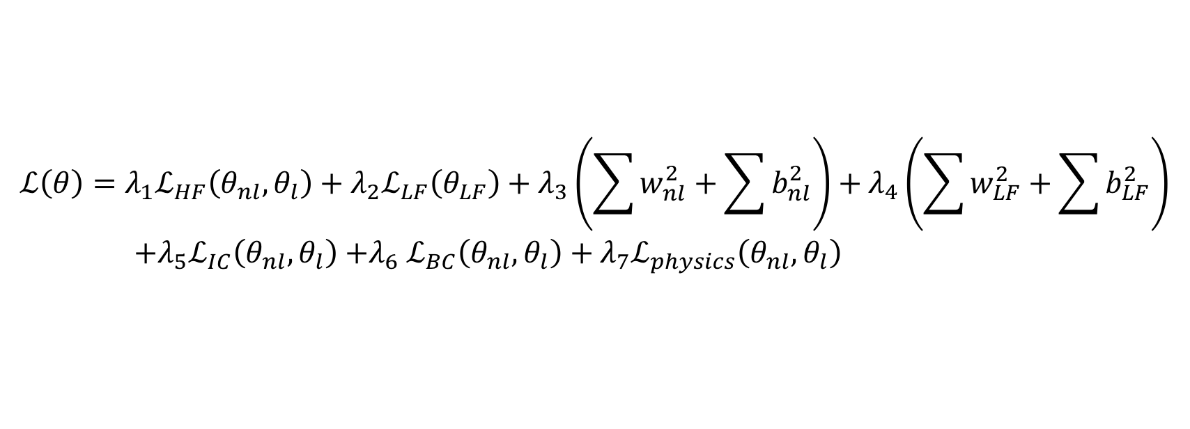
General framework
$$ℒ\left(θ\right)=λ_{1}ℒ_{HF}\left(θ_{nl}, θ_{l}\right)+λ_{2}ℒ_{LF}\left(θ_{LF}\right)+λ_{3}\left(\sum{w_{nl}^{2}}+\sum{b_{nl}^{2}}\right)+λ_{4}\left(\sum{w_{LF}^{2}}+\sum{b_{LF}^{2}}\right)$$
${+λ}_{5}ℒ_{IC}\left(θ_{nl}, θ_{l}\right){+λ}_{6}ℒ_{BC}\left(θ_{nl}, θ_{l}\right)+λ_{7}ℒ_{physics}\left(θ_{nl}, θ_{l}\right)$
Modified DeepONet: https://arxiv.org/abs/2110.01654

Slide 3
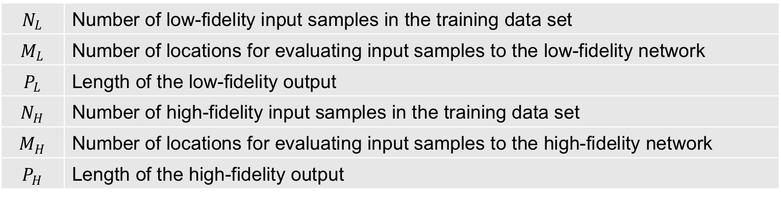
Advantages of composite training
No need to know the low fidelity values for the same input samples and at the same locations of the high fidelity values
Reduces inaccuracies due to interpolation
Adaptive to available information
$$N_{L}$$ | Number of low-fidelity input samples in the training data set
$$M_{L}$$ | Number of locations for evaluating input samples to the low-fidelity network
$$P_{L}$$ | Length of the low-fidelity output
$$N_{H}$$ | Number of high-fidelity input samples in the training data set
$$M_{H}$$ | Number of locations for evaluating input samples to the high-fidelity network
$$P_{H}$$ | Length of the high-fidelity output

Slide 4
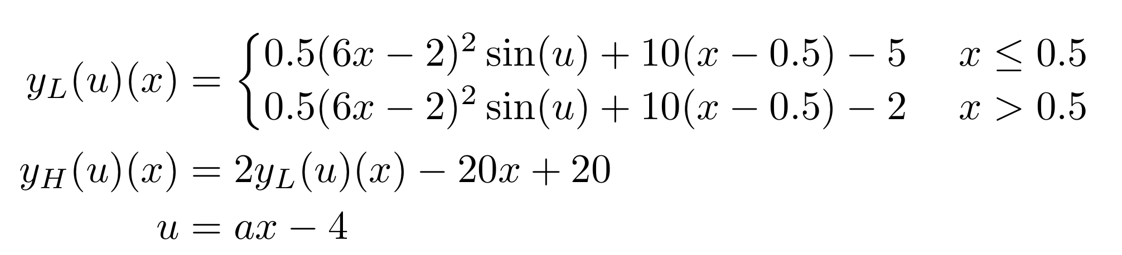
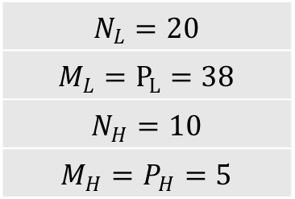
One-dimensional jump function
$$N_{L}=20$$
$$M_{L}=P_{L}=38$$
$$N_{H}=10$$
$$M_{H}=P_{H}=5$$

Slide 5
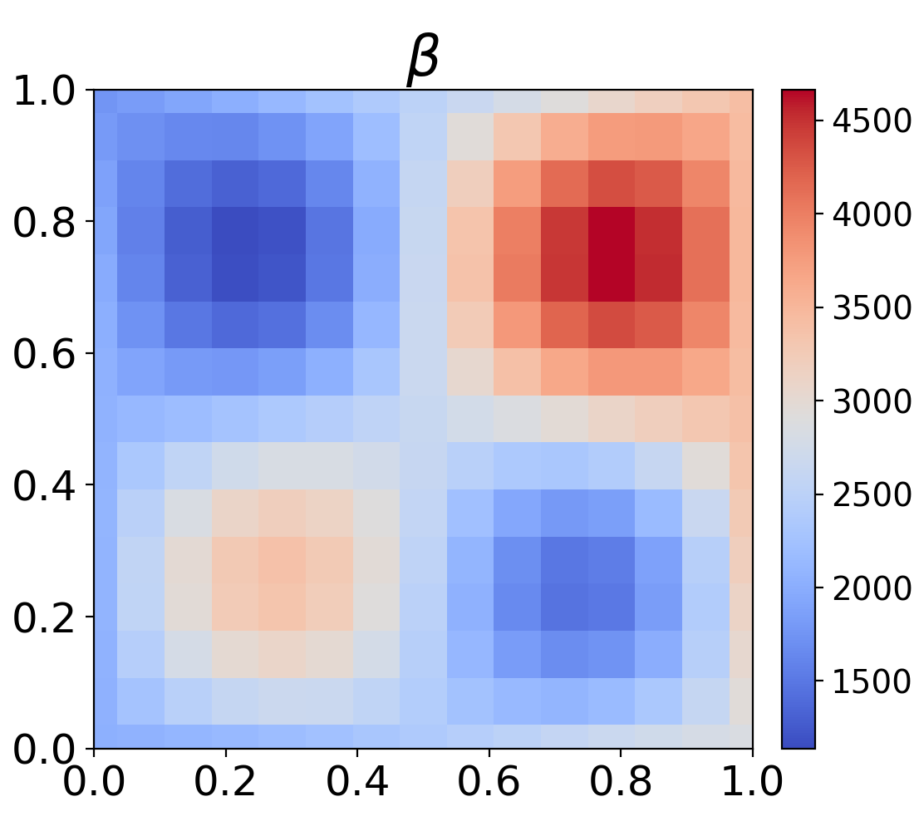
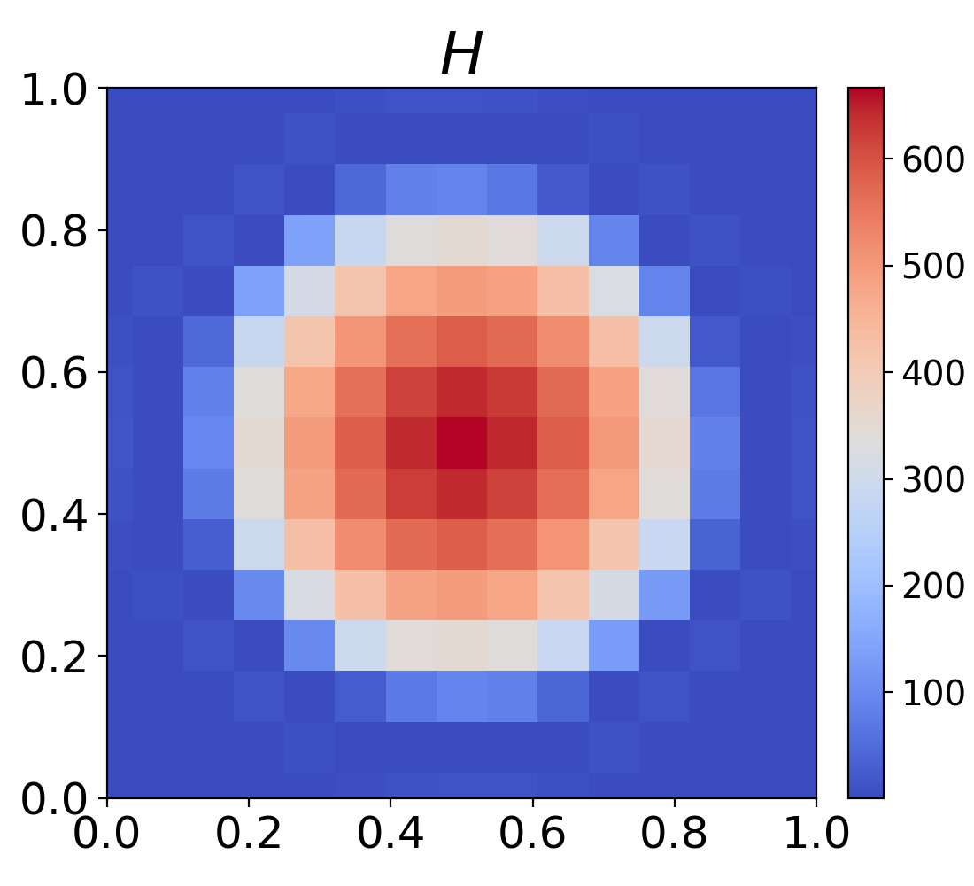
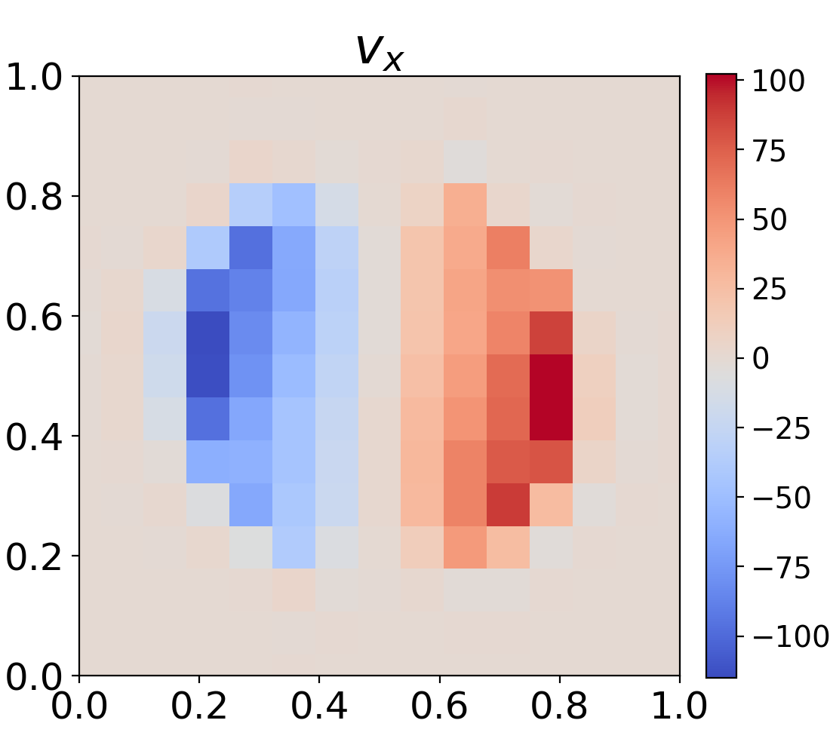
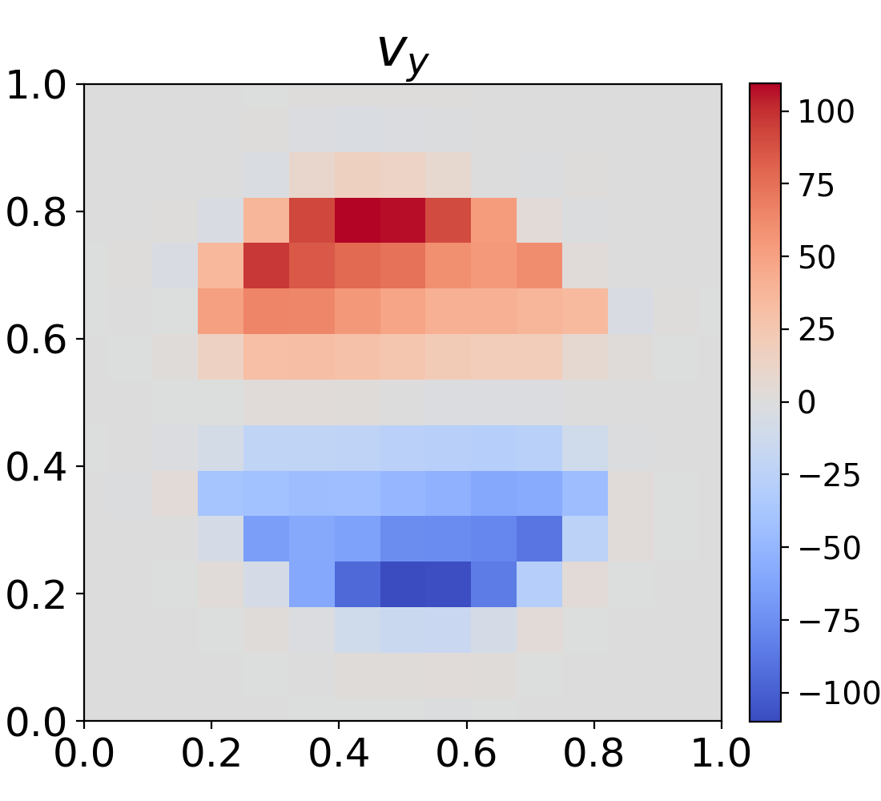
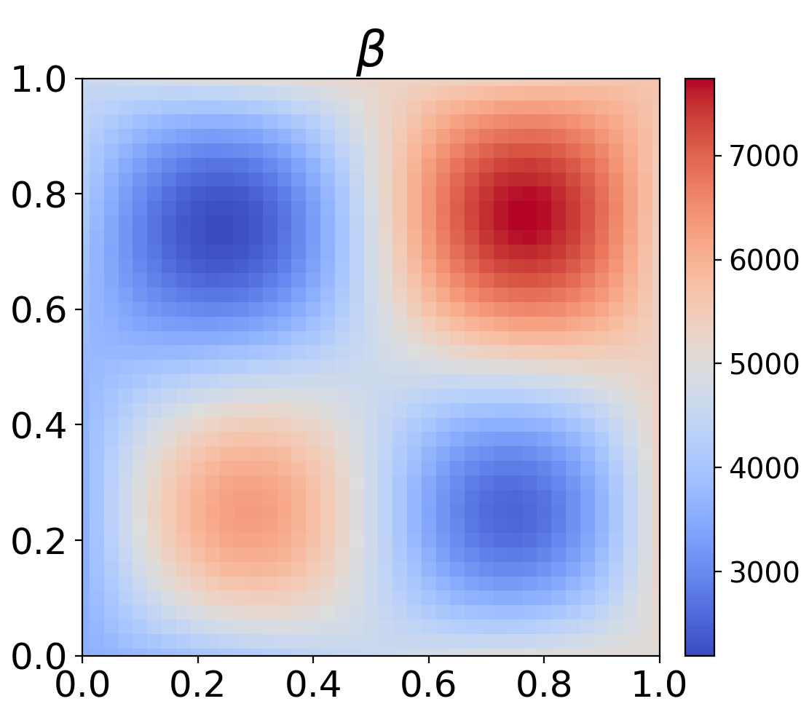
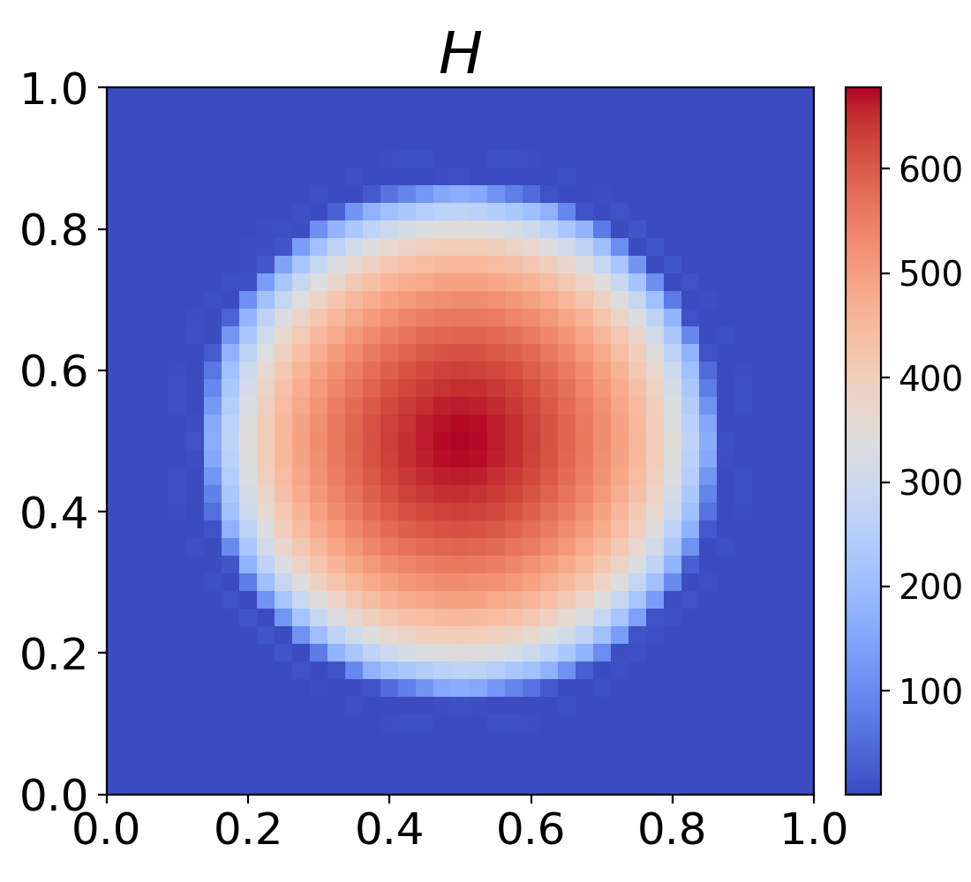
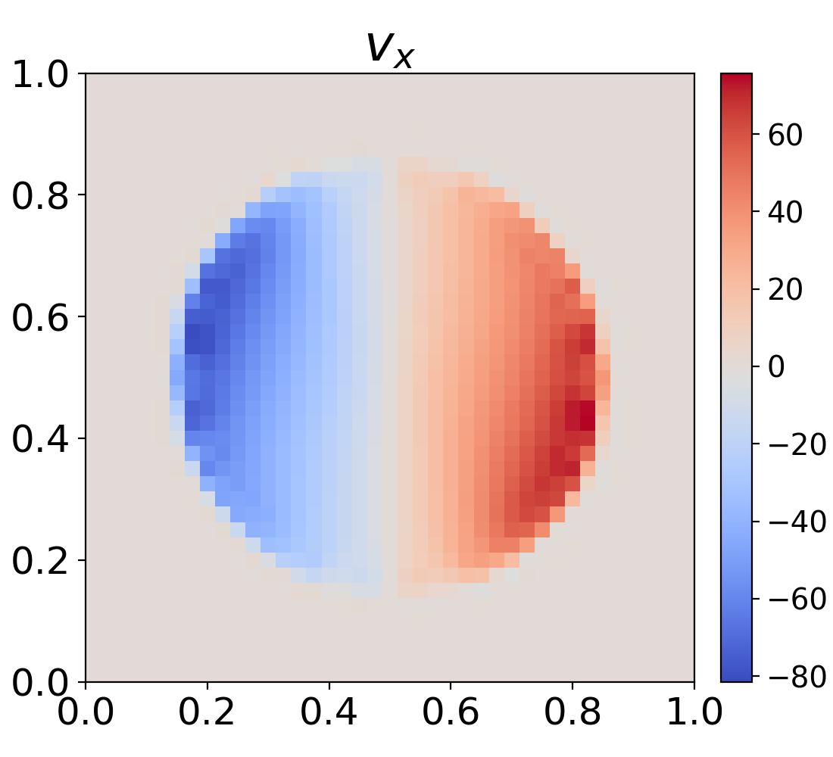
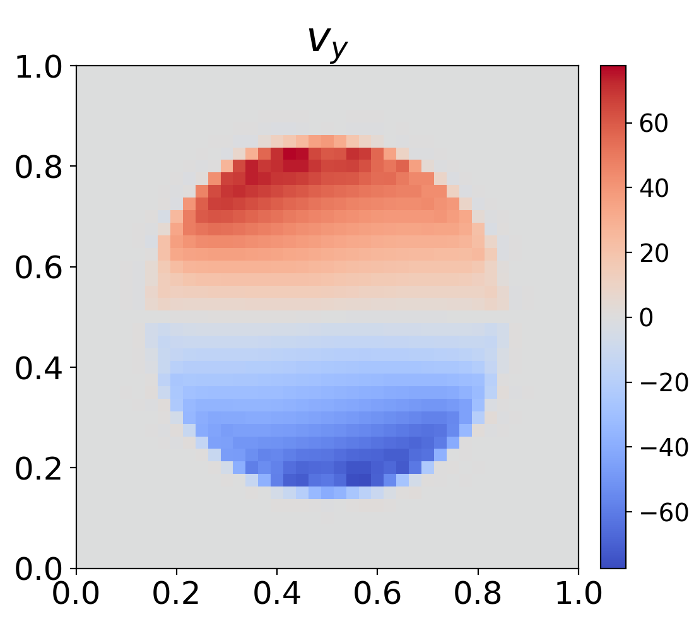
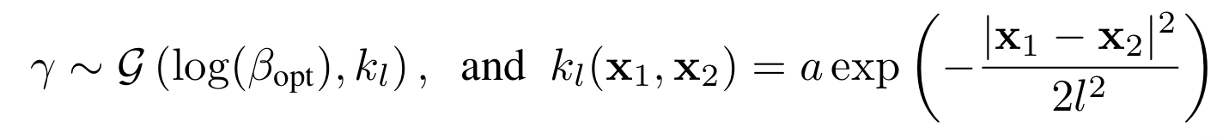

Ice sheets: multiresolution
P_{L} = 15x15
P_{H} = 41x41
$$β=exp⁡(γ)$$

Slide 6
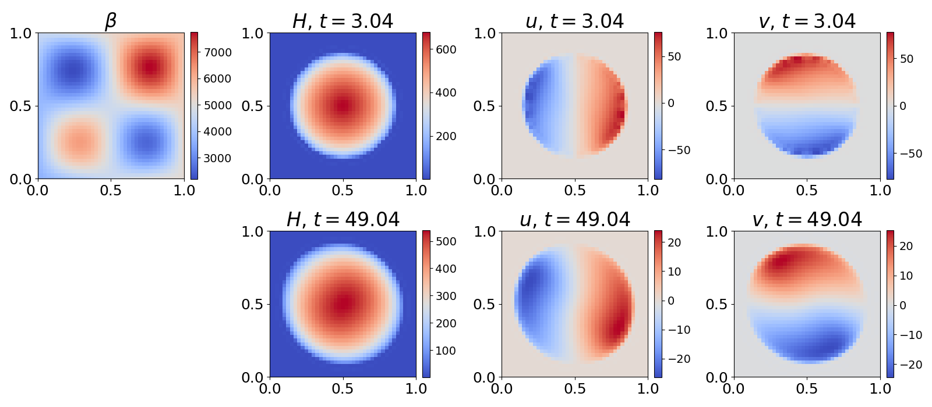

Slide 7
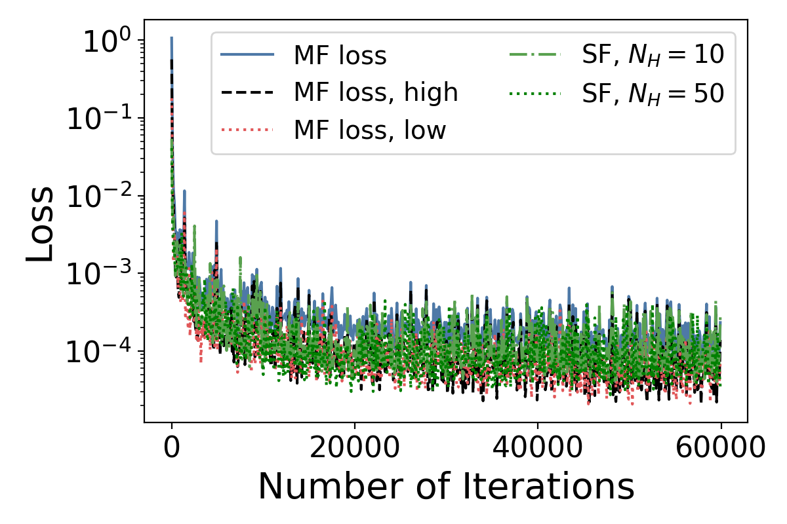
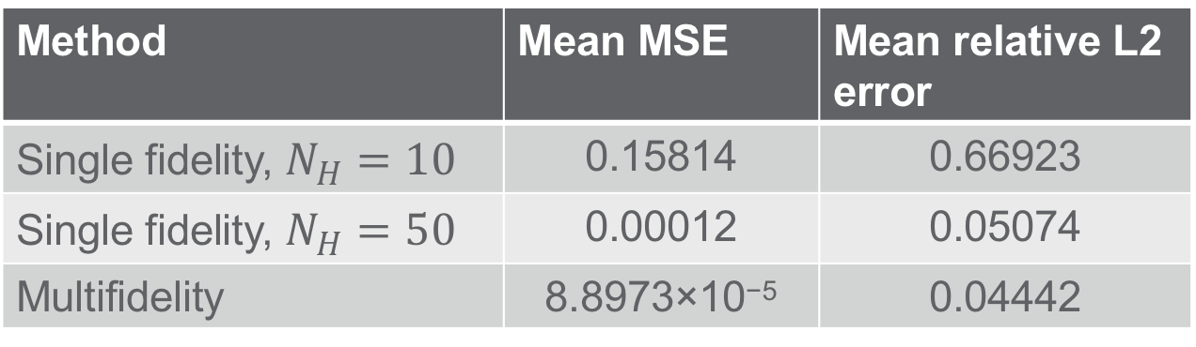
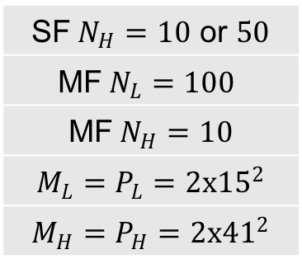
Ice sheets: multiresolution
SF$N_{H}=10$ or $50$
$$\text{MF} N_{L}=100$$
MF$N_{H}=10$
$$M_{L}=P_{L}=2x{15}^{2}$$
$$M_{H}=P_{H}=2x{41}^{2}$$
Method | Mean MSE | Mean relative L2 error
Single fidelity, $N_{H}=10$ | 0.15814 | 0.66923
Single fidelity, $N_{H}=50$ | 0.00012 | 0.05074
Multifidelity | 8.8973×10⁻⁵ | 0.04442

Slide 8
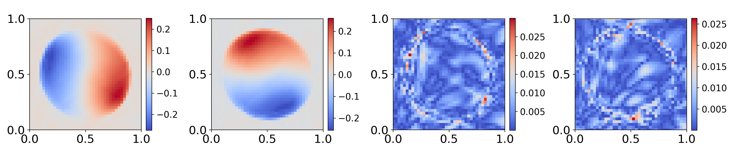
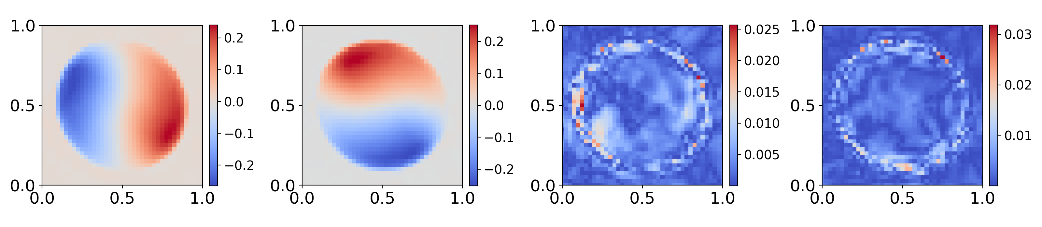

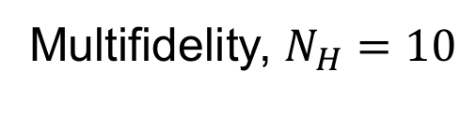
Ice sheets: multiresolution
$$N_{H}=50$$
Multifidelity, $N_{H}=10$

Slide 9
General framework
$$ℒ\left(θ\right)=λ_{1}ℒ_{HF}\left(θ_{nl}, θ_{l}\right)+λ_{2}ℒ_{LF}\left(θ_{LF}\right)+λ_{3}\left(\sum{w_{nl}^{2}}+\sum{b_{nl}^{2}}\right)+λ_{4}\left(\sum{w_{LF}^{2}}+\sum{b_{LF}^{2}}\right)$$
${+λ}_{5}ℒ_{IC}\left(θ_{nl}, θ_{l}\right){+λ}_{6}ℒ_{BC}\left(θ_{nl}, θ_{l}\right)+λ_{7}ℒ_{physics}\left(θ_{nl}, θ_{l}\right)$
Modified DeepONet: https://arxiv.org/abs/2110.01654

Slide 10
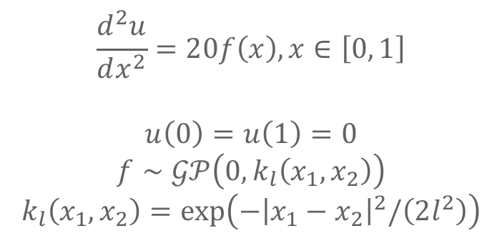
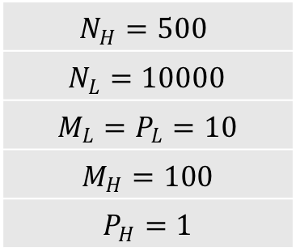
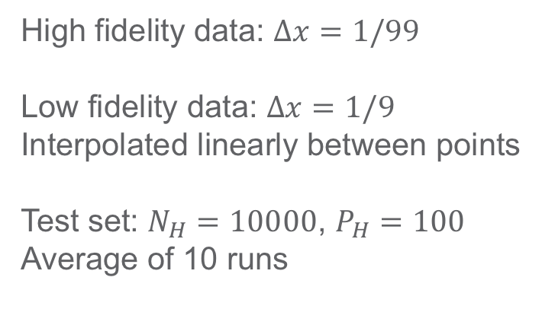
Poisson problem
High fidelity data: $Δx=1/99$
Low fidelity data: $Δx=1/9$
Interpolated linearly between points
Test set: $N_{H}=10000$, $P_{H}=100$
Average of 10 runs
$$\frac{d^{2}u}{dx^{2}}=20f\left(x\right), x∈\left[0, 1\right]$$
$$u\left(0\right)=u\left(1\right)=0$$
$$f∼𝒢𝒫\left(0, k_{l}\left(x_{1},x_{2}\right)\right)$$
$$k_{l}\left(x_{1},x_{2}\right)=exp\left(−{\left|x_{1}−x_{2}\right|}^{2}/\left(2l^{2}\right)\right)$$
$$N_{H}=500$$
$$N_{L}=10000$$
$$M_{L}=P_{L}=10$$
$$M_{H}=100$$
$$P_{H}=1$$

Slide 11
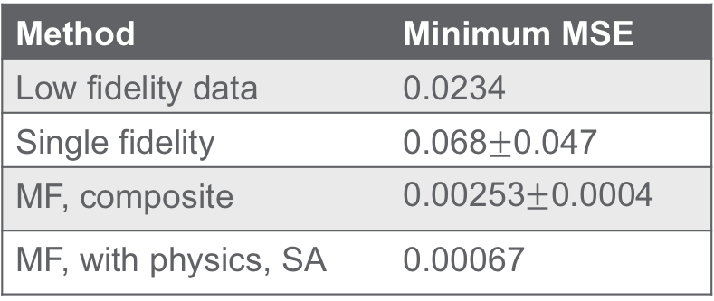
Poisson problem
Method | Minimum MSE
Low fidelity data | 0.0234
Single fidelity | 0.068$±$0.047
MF, composite | ﻿0.00253$±$﻿0.0004
MF, with physics, SA | 0.00067

Slide 12
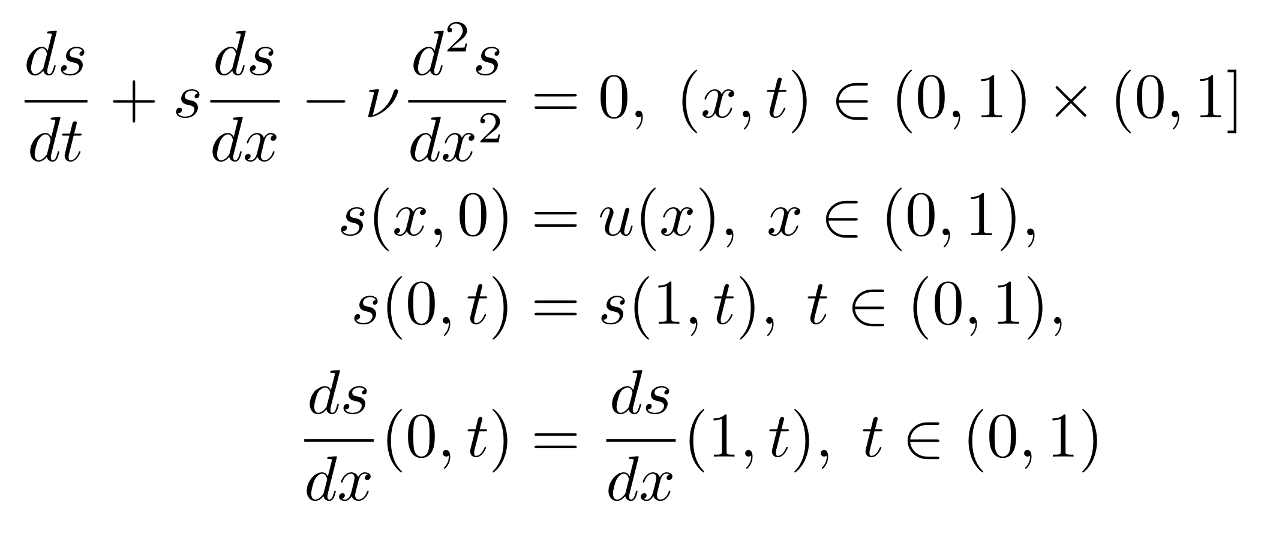
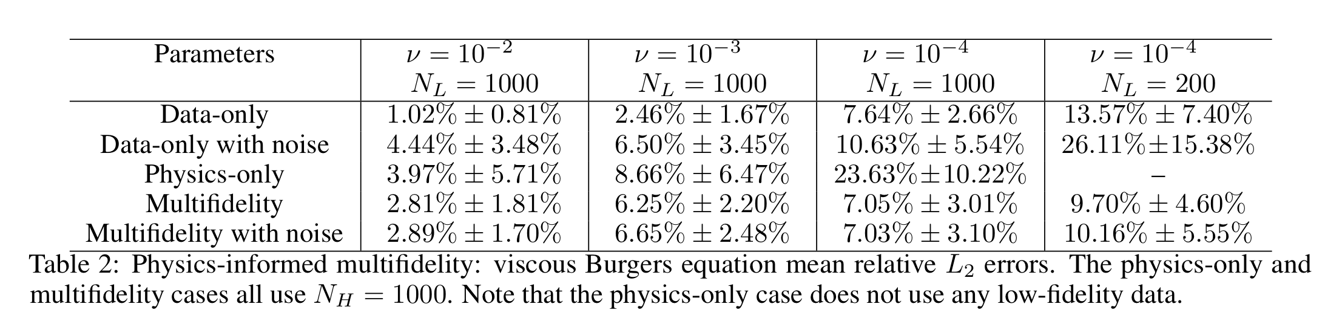
Burgers equation
Low fidelity simulations
Physics enforced as high fidelity model

Slide 13
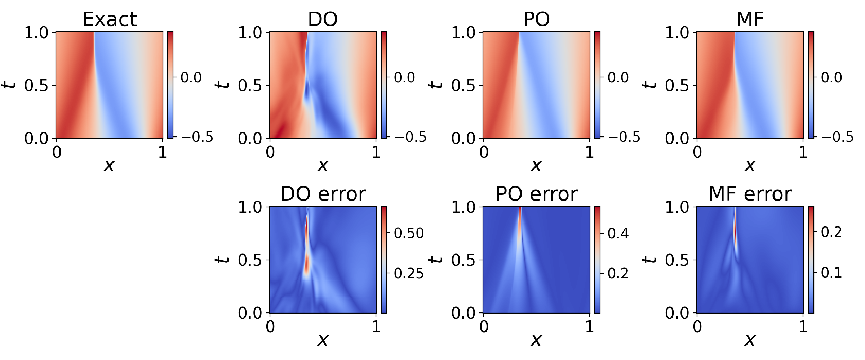

$ν={10}^{−4}, N_{L}=200$with noise

Slide 14
Thank You
https://arxiv.org/pdf/2204.09157.pdf

