Slide 1

Enhanced Physics-Constrained Deep Neural Network for Redox Flow Battery Modeling
Prepared for ML/DL 2022 Workshop
Yucheng Fu¹, Qizhi (KaiChi) He²,
Panos Stinis¹, Alexandre Tartakovsky³
¹Pacific Northwest National Laboratory (PNNL)
²University of Minnesota
³University of Illinois Urbana-Champaign
BUSINESS SENSITIVE

Slide 2
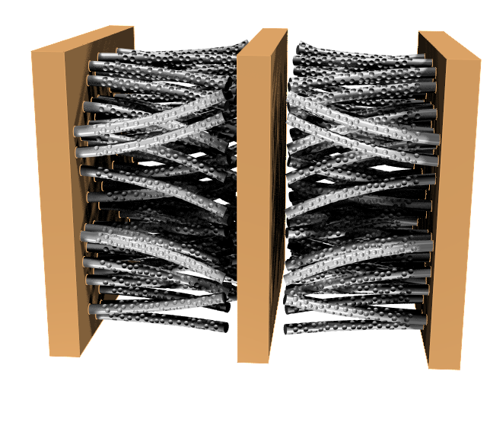
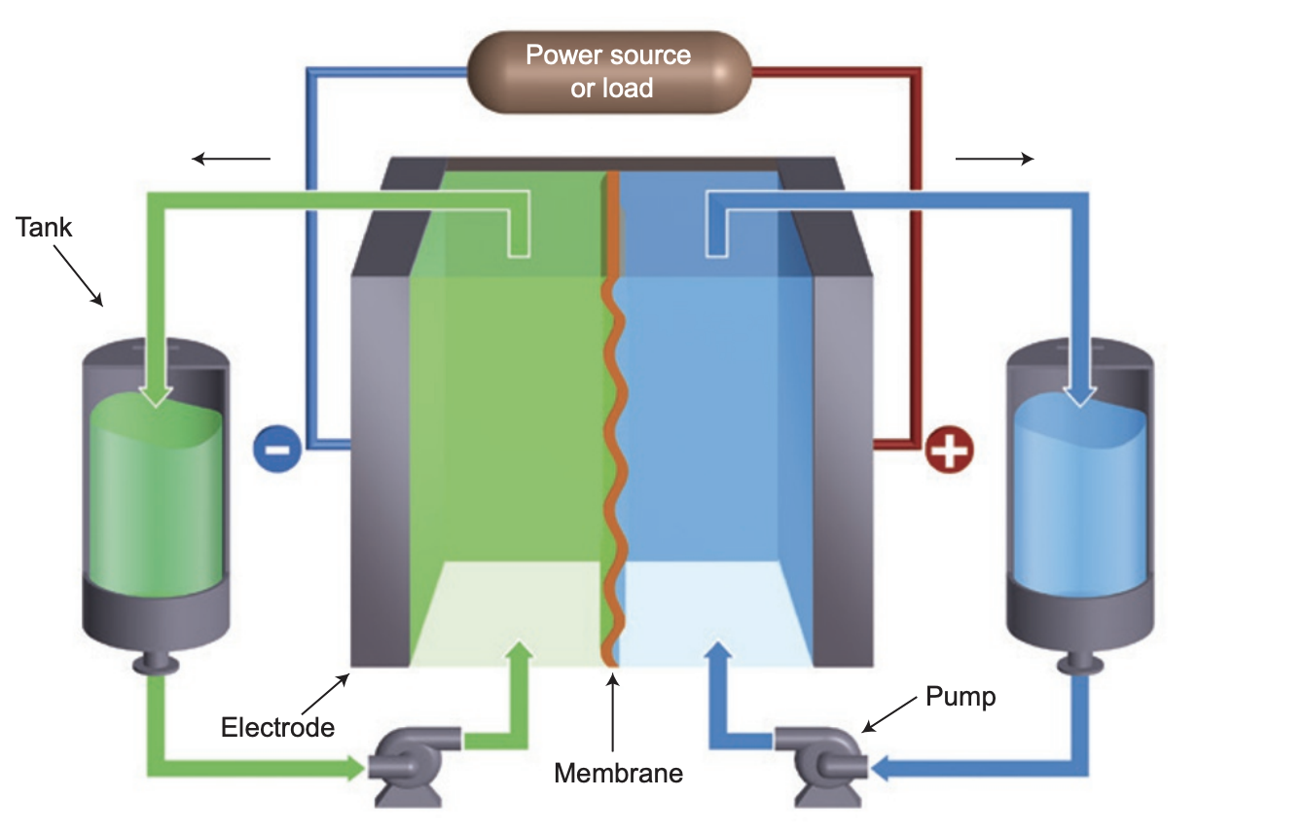
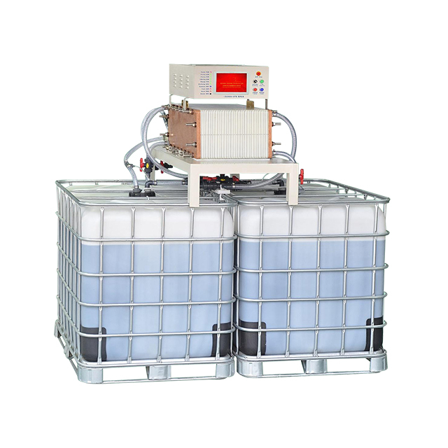
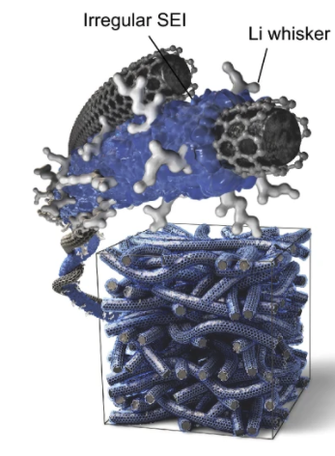

Energy Storage Material Initiative:
Digital Twin of Battery
Build a battery digital twin by integrating existing and new data from experiments and simulations
Surrogate models relating structure of redox molecules to the solubility and other electrochemical properties of the electrolyte
A physics-informed machine learning framework to link performance to battery properties/design
Physics-informed ML model
Predict battery performance
Material synthesis,
High throughout test
Processing conditions
Up scaling
Geometry
Up scaling
Component
Optimizing
Data curation
REV level
Cell level
Test, control,
Feedback
Guide better design and material discoveries
Pore level
Stack level

Slide 3
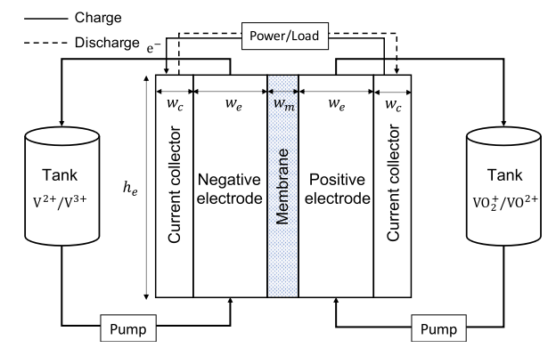


Vanadium redox flow battery (VRFB)
$$− ve electrode:V\left(III\right)+e^{−}⇌V(II)$$
Physical considerations:
$$+ ve electrode:VO^{2+}+H_{2}O⇌VO_{2}^{+}{+2H^{+}+e}^{−}$$
Fluid dynamics in porous electrodes (Mass conservation and transport equations)
Reaction kinetic in electrolytes (Butler-Volmer equations)
Ion diffusion and advection through membrane
Cell potential:
$$E^{Cell}\left(t,p;μ\right)=E^{OCV}+η^{act}+η^{ohm}$$
Challenges:
Physics-based methods: high-fidelity but computationally intensive
Data-driven ML methods: data intensive & poor generalizability
VRFB (since 1980s):
Closer to commercialization
Power and energy are separate enabling greater flexibility and safety; less cross-contamination.
All vanadium-based instead of two different electroactive elements
Idea:
Develop a deep neural network (DNN) model that leverages both experimental data and electrochemical models
Achieve automated calibration of model parameters w.r.t. different operating conditions & efficient prediction

Slide 4





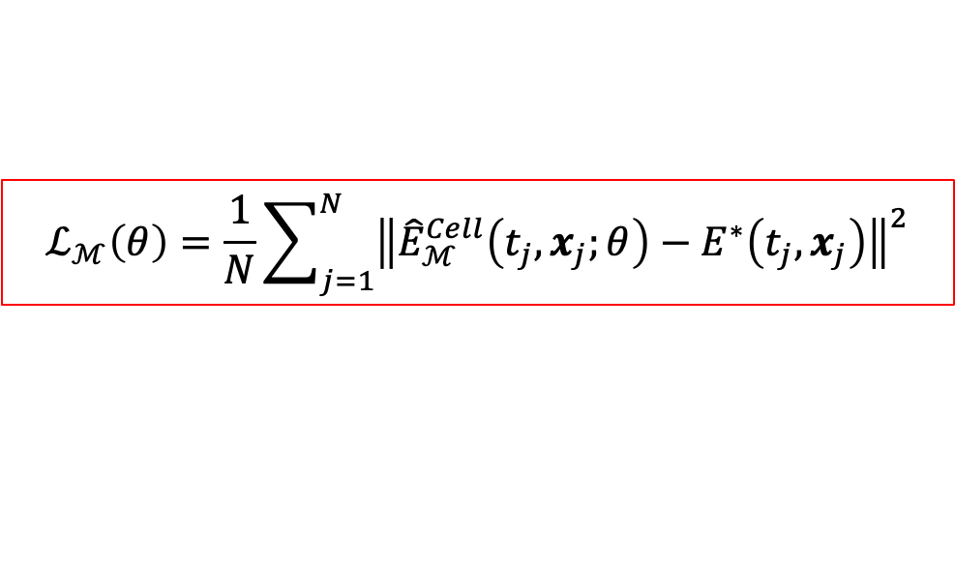


Physics-constrained deep neural networks (PCDNN)
Physics-based model constrain: 0D Model
Proposed PCDNN approach
Inputs: $x=\left\{c_{i,0},I,u\right\}$, $SOC\left(t\right)$
Model parameters: $μ=\left\{S,k_{n},k_{p},σ_{e}\right\}$
DNN approximation:
$$\hat{μ}(x,θ)=𝒩𝒩(x;θ)$$
$$ℒ_{ℳ}\left(θ\right)=\frac{1}{N}\sum_{j=1}^{N}{{\left\|{\hat{E}}_{ℳ}^{Cell}\left(t_{j},x_{j};θ\right)−E^{∗}\left(t_{j},x_{j}\right)\right\|}^{2}}$$
$E^{∗}:$ Measurement data
$N:$ total number of data points in an SOC-V curve
$x$: inputs of operating conditions (current $I$, flow rate $u$, $c_{i,0}$)
Positivity-preserving output neurons:
$ℳ$: the given numerical modes to compute concentrations
$c_{i}=c_{i}({t,c}_{i,0},I, u;μ)$, $i=V\left(II\right), V\left(III\right),V\left(IV\right),V\left(V\right),H^{+},H_{2}O$
He, Q., Stinis, P., & Tartakovsky, A. M. (2022). Physics-constrained deep neural network method for estimating parameters in a redox flow battery. Journal of Power Sources, 528, 231147.

Slide 5
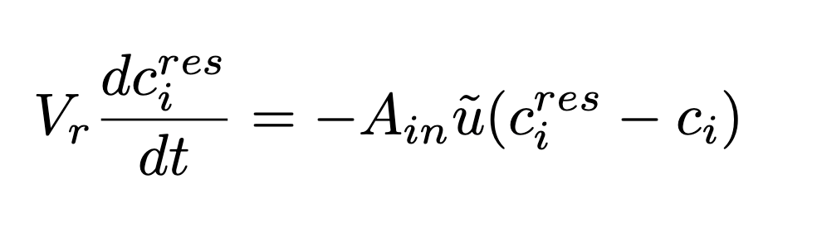
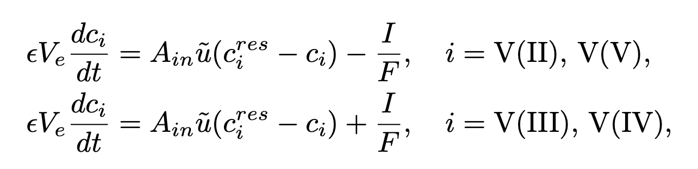


Physics-constrained deep neural networks (PCDNN)
Physics-based 0D Model
Assumption: Space-independent ([Shah 2011])
Mass conservation of species in reservoirs (control volume)
Mass conservation of species in electrodes (involves chemical reactions):
$x$: inputs of operating conditions (current $I$, flow rate $u$, $c_{i,0}$)
$ℳ$: the given numerical modes to compute concentrations
State of Charge:
$c_{i}=c_{i}({t,c}_{i,0},I, u;μ)$, $i=V\left(II\right), V\left(III\right),V\left(IV\right),V\left(V\right),H^{+},H_{2}O$
He, Q., Stinis, P., & Tartakovsky, A. M. (2022). Physics-constrained deep neural network method for estimating parameters in a redox flow battery. Journal of Power Sources, 528, 231147.

Slide 6
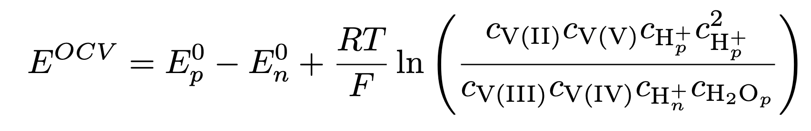
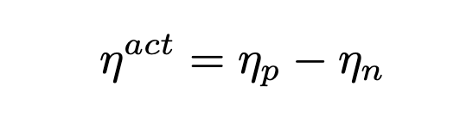
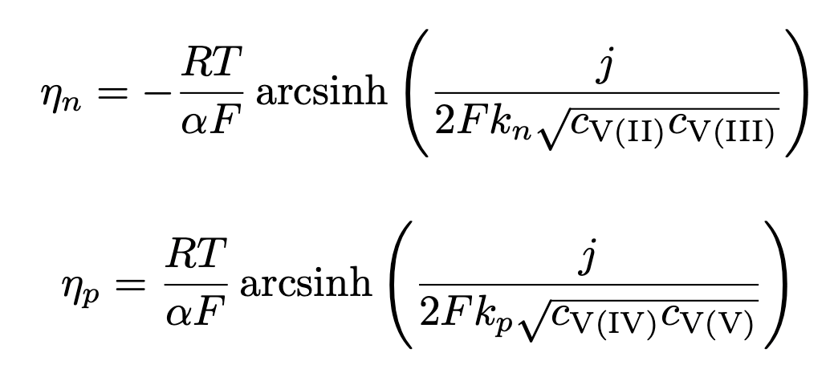
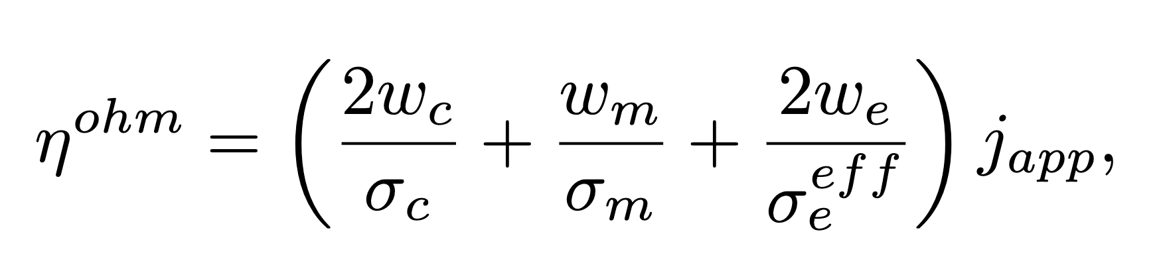



Physics-constrained deep neural networks (PCDNN)
Reaction kinetics
Cell voltage:
$$E^{Cell}\left(t,p;μ\right)=E^{OCV}+η^{act}+η^{ohm}$$
Reversible open circuit voltage (Nernst’s equation):
Activation overpotential (Butler-Volmer equations):
$x$: inputs of operating conditions (current $I$, flow rate $u$, $c_{i,0}$)
$$j=I/A_{s}$$
$ℳ$: the given numerical modes to compute concentrations
Ohmic losses:
$c_{i}=c_{i}({t,c}_{i,0},I, u;μ)$, $i=V\left(II\right), V\left(III\right),V\left(IV\right),V\left(V\right),H^{+},H_{2}O$
Model parameters: $μ=\left\{S,k_{n},k_{p},σ_{e}\right\}$
He, Q., Stinis, P., & Tartakovsky, A. M. (2022). Physics-constrained deep neural network method for estimating parameters in a redox flow battery. Journal of Power Sources, 528, 231147.

Slide 7
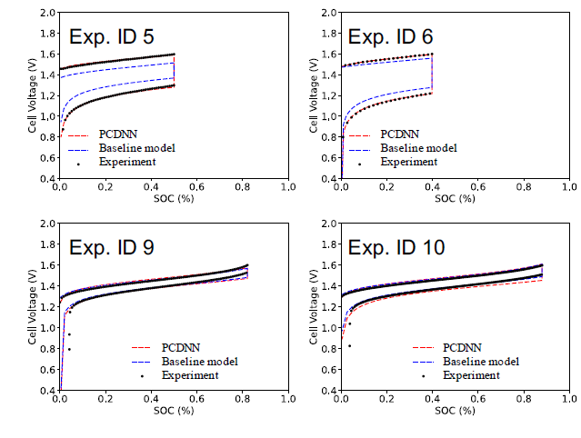
PCDNN for flow battery voltage prediction
Baseline model is the physics-based 0D model prediction without parameter calibration
PCDNN has overall good accuracy for voltage prediction across the whole SOC range
PCDNN struggles at extreme SOC conditions (limited due to the physics-model simplifications)

Slide 8
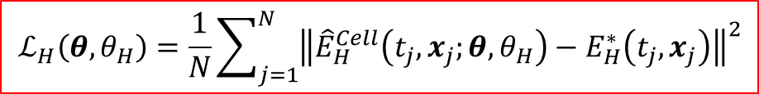

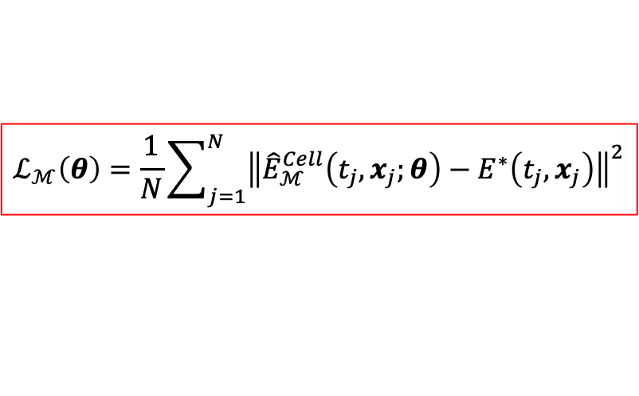

ePCDNN: Enhanced Physics-Constrained Deep Neural Network Method
ePCDNN enables:
Fusing data and physical models
Mitigate physical model bias
Discovering hidden physics
Adapting to multi-fidelity data
Predicting unseen experiments (Better generalization)
$$ℒ_{ℳ}\left(θ\right)=\frac{1}{N}\sum_{j=1}^{N}{{\left\|{\hat{E}}_{ℳ}^{Cell}\left(t_{j},x_{j};θ\right)−E^{∗}\left(t_{j},x_{j}\right)\right\|}^{2}}$$
$$ℒ_{H}\left({θ,θ}_{H}\right)=\frac{1}{N}\sum_{j=1}^{N}{{\left\|{\hat{E}}_{H}^{Cell}\left(t_{j},x_{j};{θ,θ}_{H}\right)−E_{H}^{∗}\left(t_{j},x_{j}\right)\right\|}^{2}}$$
Minimize $ℒ_{ℳ}$to identify optimal parameters
Minimize $ℒ_{H}$ to achieve best voltage prediction
Notes:
ePCDNN consists of two components: The first component is the PCDNN part whose voltage outputs satisfy the given reduced order 0D model. By minimizing the mismatch against measurements, we learn the optimal lumped parameters for the designed model.
The second component is the correction part, which is used to capture the key features that are not well well represented in 0D model. The correction is also represented by a DNN that can be trained using measurements.
The enhanced voltage prediction is the sum of the PCDDN output and the enhancement y_H.
The combined loss functions are simultaneously minimized to achieve best voltage prediction and optimal parameters.
If given different measurement data, it can be natural extended to multifield consideration.
While PCDNN improves the performance of the 0d model, there is still room for improvement to overcome the limitations of the 0d model.
We have enhanced the physics constrained DNN by introducing another level of DNN approximation.
ePCDNN consists of two components: The first component is the PCDNN part whose voltage outputs satisfy the given 0D model. By minimizing the mismatch against measurements, we learn the optimal lumped parameters for the designed 0D model. The second component is the correction part, which is used to capture the key features that are not well well represented in 0D model. The correction is also represented by a DNN that can be trained using measurements.
The enhanced voltage prediction is the sum of the PCDDN output and the enhancement y_H.
The combined loss functions are simultaneously minimized to achieve best voltage prediction and optimal parameters.
Moreover, we use positivity-preserving output neurons to ensure the learned parameters are positive. Our numerical tests also show that this helps to obtain better multiple parameter identification
Physics constrained DNN (PCDNN) was introduced in our work last year in order to improve the estimation of the parameters of a physical model, in our case the 0d redox flow battery model
The idea behind PCDNN is to train a neural network which takes as input various parameters related to settings and operating conditions and outputs parameters that appear in the 0d model. Thus, the parameters of the 0d model are represented as functions of the operating conditions.
The output parameters of the model are used in the model to predict the voltage. As we have shown in previous work, this leads to an improvement of the predicted potential by the 0d model compared to the voltage prediction using parameters estimated in the traditional way where they are treated as constants and have to be found anew for every new set of operating conditions through optimization.
While PCDNN improves the performance of the 0d model, there is still room for improvement to overcome the limitations of the 0d model.
We have enhanced the physics constrained DNN by introducing another level of DNN approximation.
ePCDNN consists of two components: The first component is the PCDNN part whose voltage outputs satisfy the given 0D model. By minimizing the mismatch against measurements, we learn the optimal lumped parameters for the designed 0D model. The second component is the correction part, which is used to capture the key features that are not well well represented in 0D model. The correction is also represented by a DNN that can be trained using measurements.
The enhanced voltage prediction is the sum of the PCDDN output and the enhancement y_H.
The combined loss functions are simultaneously minimized to achieve best voltage prediction and optimal parameters.
Moreover, we use positivity-preserving output neurons to ensure the learned parameters are positive. Our numerical tests also show that this helps to obtain better multiple parameter identification.

Slide 9


Modeling of experimental tests
Comparison of PCDNN & ePCDNN for 12 experiments
Parity plots to compare the ground-truth voltage with predicted models
$$RSME =5.139×{10}^{−2}$$
$$RSME =2.196×{10}^{−2}$$
Baseline model
ePCDNN
He, Q., Fu, Y., Stinis, P., & Tartakovsky, A. (2022). Enhanced physics-constrained deep neural networks for modeling vanadium redox flow battery. arXiv preprint arXiv:2203.01985.
Notes:
Left figures shows that the proposed ePCDNN model reduces the test errors by about 30% compared to the PCDNN approach regardless of the size of the training dataset used.
We fist show the comparison of voltage prediction between the proposed approach with the previous one PCDNN. Here we show the enhanced version outperforms the previous one by reducing about 30% Root mean square errors(RMSE).
We test the ePCDNN on the 12 experimental dataset with different setting and operating conditions. I also want to point out that six of these experiments use Naion 115 and the others use Nation 212, which made the learning and prediction challenging.

Slide 10
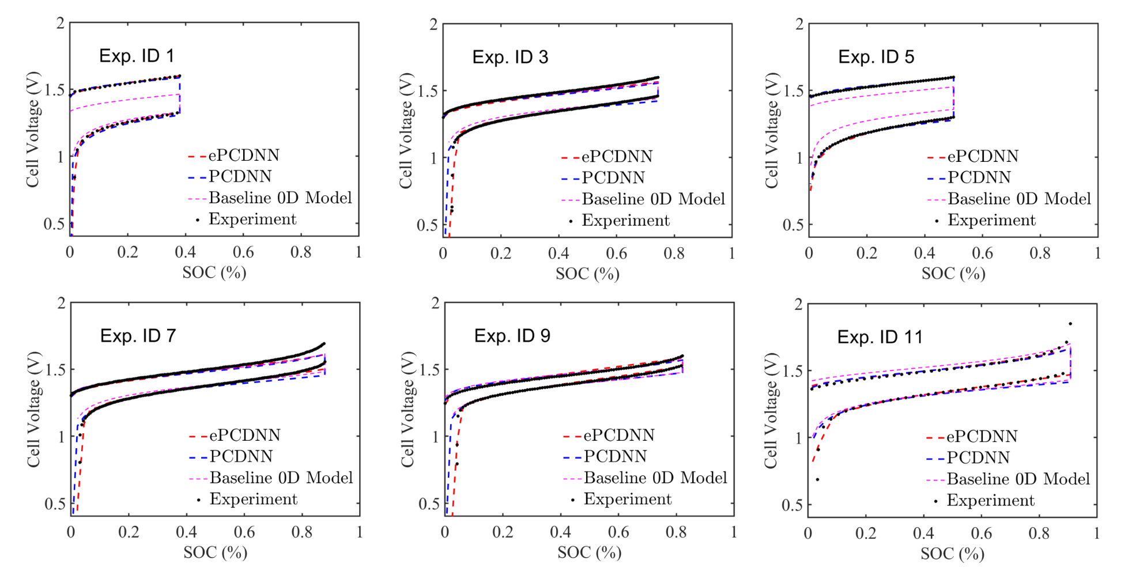
ePCDNN for Experiment data
Notes:
For example, the training results on Exp 1 show that ePCDNN especially well predict the “tail” features that are difficulty to capture in 0D model. But both PCDNN and the enhanced one improve the voltage prediction by their parameter calibration capacity compared to the baseline model using parameters from literature.

Slide 11
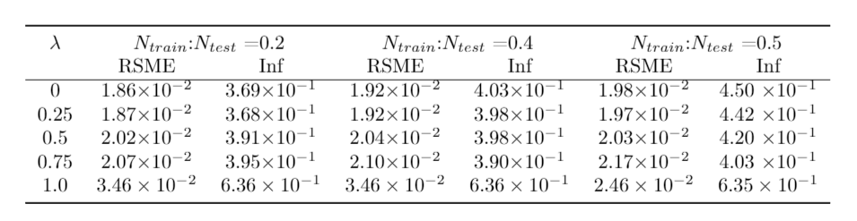
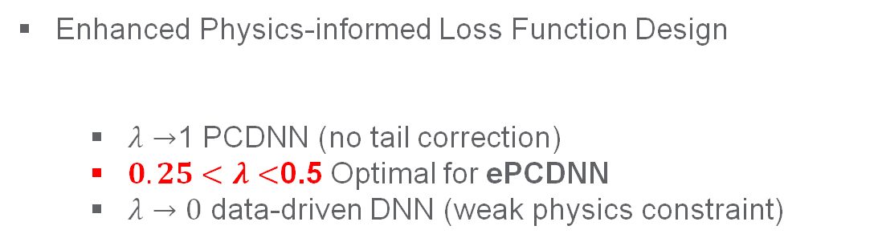
Improving the Predictive Performance for Experimental data through ePCDNN
Enhanced Physics-informed Loss Function Design
  $λ→$1 PCDNN (no tail correction)
  $0.25<λ<$0.5 Optimal for ePCDNN
  $λ→0$ data-driven DNN (weak physics constraint)
$$ℒ\left(θ,θ_{H}\right)={λℒ}_{ℳ}\left(θ\right)+(1−λ)ℒ_{H}\left({θ,θ}_{H}\right)$$
Experimental Data Sampling and Cutoff Time Prediction
  Uniform SOC Sampling vs. Uniform Voltage Sampling
Prediction of unseen experiments
(ePCDNN vs. PCDNN, Baseline)
s
Exp No.3 (Nafion 115)
Exp No.12 (Nafion 212)
Discharge cutoff at 0.8V
Notes:
The loss function should be designed to combine the Lm and Lh function with a weight coefficient of lambda. To determine the weight coefficient lambda, a parameter study was carried out with varying lamda and train/testing data ratio. With lambda -> 1, the loss function become the same with the PCDNN with no addition corrections on the tail voltage discrepancy. From the top right table, it can be seen that the RSME and L_inf error are both the largest compared to other lambda value. With lambda ->0, the function will reduce to the data-driven DNN with no physics enforced in the neural network. This make it less reliable for predicting unseen conditions. With large test data set (N test = 0,4/0.5), the L_inf error will become larger than lambda ~0.5 cases. Therefore, it would be reasonable to select lambda at 0.25 to 0.5 range with balance of enforce physic to predict unseen cases and the overall accuracy.
The experimental data set has uniform sampling interval along the SOC variable. The potential can skew the cut-off time prediction with less data points on the tail region. To compare, another sampling method is used to sample the experimental data with uniform interval in the voltage response. The accuracy of predicting the cut-off time is compared in the bottom second left figure. The accuracy of cutoff time prediction can be improved by around 2 times with uniform voltage sampling method.
Bottom right figures compare the ePCDNN and PCDNN method and also using ePCDNN approach for predicting unseen experiments, which means that we don’t use any experimental measurements from these test cases in training the model. We can see ePCDNN gives satisfactory prediction for both conditions cases. First the ePCDNN has improve capability to capture the sharp tail drop at the near end of discharge. Compared to the pure data-driven scheme, such as direct DNN regression, ePCDNN provides more robust prediction regardless the test conditions. This is attributed to the introduction of the physical model.
Finally, we test the ePCDNN approach by predicting unseen experiments, which means that we don’t use any experimental measurements from this test cases in training the model. We can see ePCDNN give satisfactory prediction for these two cases. Importantly, compared to the pure data-driven scheme, such as directly DNN regression, ePCDNN provides more robust prediction regardless the test conditions. This is attributed to the introduction of physical model.

Slide 12
Conclusions
The enhanced physics-constrained deep neural network (ePCDNN) has been developed for Redox Flow Battery performance predictions.
The loss function form is more flexible by assigning possibly different weights on its two terms, one for the physics-constrained DNN and one for the enhanced DNN.
  For applications with high-fidelity physics models, the weight can be increased to emphasize the physics-constrained DNN contribution.
  On the other hand, if the physics model is simple, the weight of the loss function term for the enhanced DNN can be increased to address the missing physics in the model and to improve the performance.
In addition to the studied VRFB system, the developed ePCDNN framework can be applied to different battery systems by replacing the enforced physics model.
This makes the ePCDNN framework suitable for aiding the acceleration of battery system design and optimization.
He, Q., Fu, Y., Stinis, P., & Tartakovsky, A. (2022). Enhanced physics-constrained deep neural networks for modeling vanadium redox flow battery. Journal of Power Sources. 542, 231807

Slide 13
Yucheng Fu, Ph.D. (yucheng.fu@pnnl.gov)
Mathematician @ Pacific Northwest National Laboratory (PNNL)

Slide 14
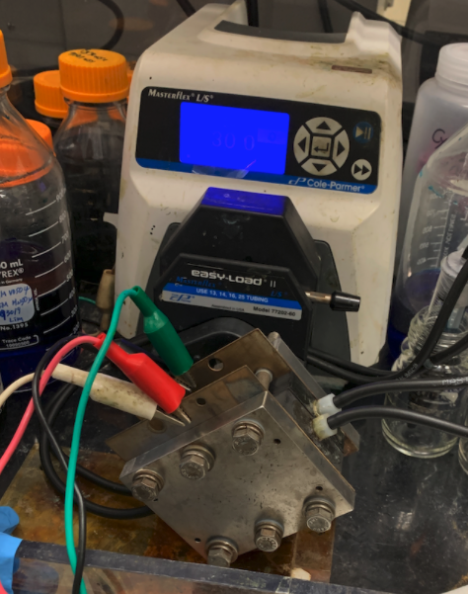
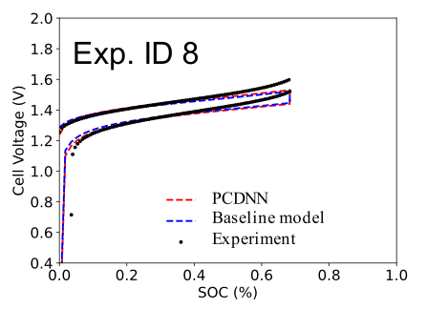
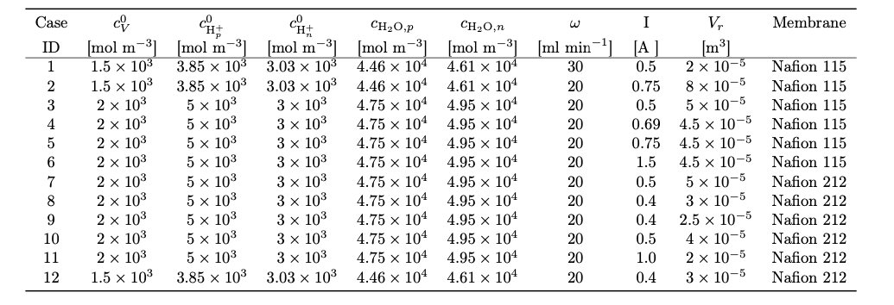
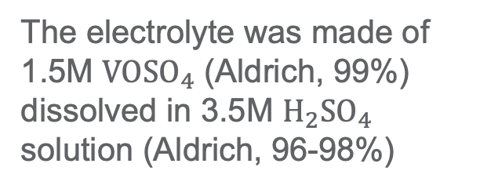
VRFB experiments @ PNNL
SOV-Voltage charge–discharge curves for the 12 PNNL experiments (record data in the third cycle)
Single VRFB cell
The electrolyte was made of 1.5M $VOSO_{4}$ (Aldrich, 99%) dissolved in 3.5M $H_{2}SO_{4}$ solution (Aldrich, 96-98%)
Variability in operating conditions: Initial concentrations, flow rate, applied current, volume size, Membrane, etc.

