Slide 1

Predicting circuit success rates with artificial neural networks
Daniel Hothem, Tommie Catanach, Timothy Proctor, Kevin Young
Quantum Performance Laboratory
Sandia National Laboratories
2022 MLDL Workshop
07/27/2022
SAND2022-2363 C

Slide 2
Background – Quantum Computing
Potential exponential speedups
  Optimization
  Quantum chemistry
NISQ era
  Noisy and error prone
Need scalable and efficient performance predictors
Notes:
Bit about its potential, noise, what a quantum circuit looks like

Slide 3
Motivation
Question:
Can we use machine learning to better understand the capabilities of a quantum device?
Our goal:
Train neural networks on classically simulable circuits to predict the performance of generic quantum circuits
Notes:
Make sure you say later on that we are training and testing on classically simulable circuits

Slide 4
Motivation
Question:
Can we use machine learning to better understand the capabilities of a quantum device?
This work:
Train neural networks on classically simulable circuits to predict the success rate of (new) classically simulable circuits
Notes:
Another slid:
Motivation – How do dataset size and measurement precision affect a NNs ability to learn?

Slide 5
Motivation
Question:
Can we use machine learning to better understand the capabilities of a quantum device?
This work:
How do dataset size and data quality affect a neural network’s ability to learn?
Notes:
Another slid:
Motivation – How do dataset size and measurement precision affect a NNs ability to learn?

Slide 6
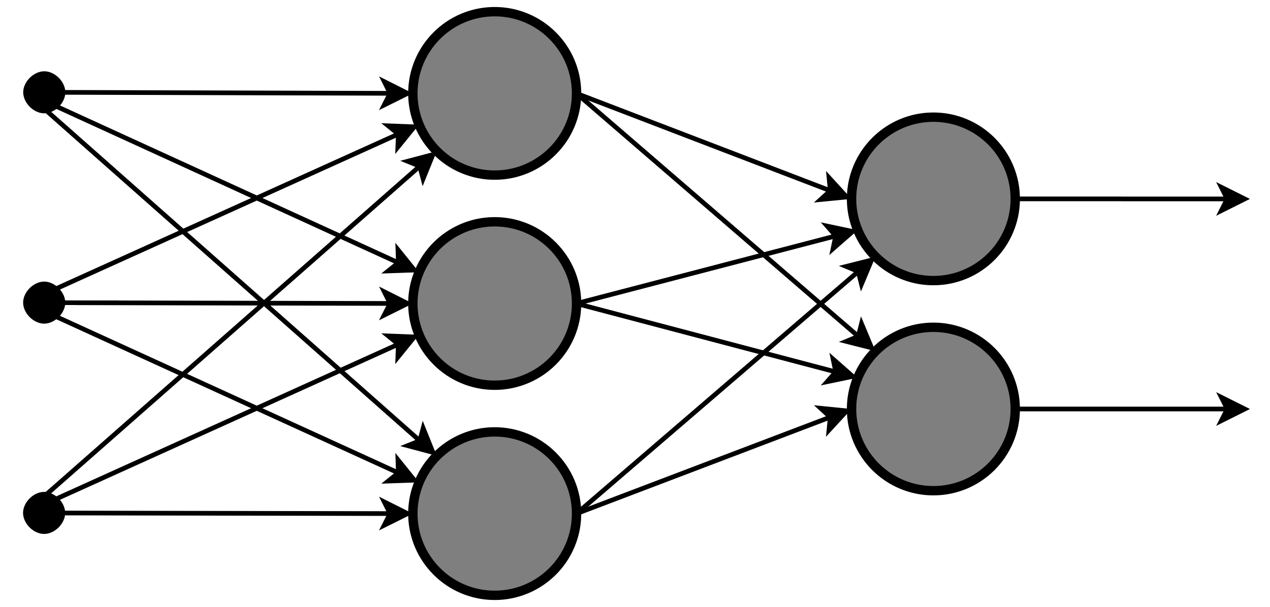
Background – Other Approaches
Current quantum computers are noisy and error prone
Phenomenological models¹
  Built on benchmarking tools
  Rely on human extracted features
  Poor performance
Quantum process models²
  Informed by “tomography”
  Depend on circuit structure
  Specious assumptions
  Hard to scale
Neural network models
  Extract their own features
  Few assumptions
  Potentially scalable
Map to 1-2
features
Look up performance
on table
(w,d)
p_{success}
Multiple elements from a set
of (very large) matrices
p_{success}
p_{success}
¹Characterizing Quantum Gates via Randomized Benchmarking, Magesan et al, Phys. Rev. A 85, 042311, 11 April 2012
²Gate Set Tomography, Nielsen et al, Quantum 5, 2021
Notes:
Cite: First bullet (standard randomized benchmarking by Magesan et al PRL2011)
Second bullet: Some tomography method (omnibus GST paper)

Slide 7
Our Approach
Encode circuits as images
Feed images into convolutional layers
Extracted features are input into a deep multilayer perceptron
Predict success probability with a softmax function
Notes:
Make sure you point out that you are training and testing on classically simulable circuits

Slide 8
Some more details
Multiple datasets with 100, 300, 500, 1000, 16600 circuits
  11 different 100 circuit datasets
  5 different datasets per circuit count for the rest
Each dataset was simulated at four levels of precision (shot count)
  Same error model
Hyperparameter tuning
  Once per level of precision and dataset size (except for 16600 circuits)
  Remaining models use the same architecture
  16600 circuit models use the best architecture from the corresponding 1000 circuit model
Notes:
Add an image of your Excel spreadsheet??

Slide 9
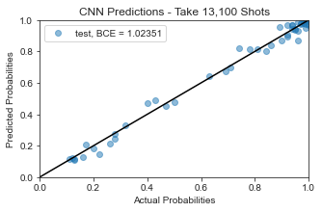
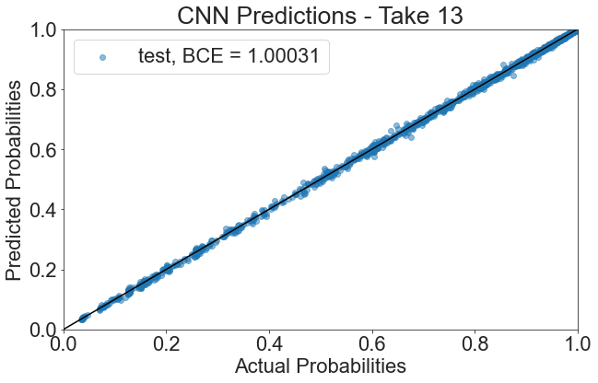
Results – Simulated Data
Biased local stochastic error model
Mirror Clifford circuits
  Width: 1 to 5 qubits
  Depth: 3 to 1033 layers
Neural networks provided with additional information
Improved performance as dataset size and quality improves
Data: 500 circuits, Infinite Precision and 16600 circuits, Infinite Precision
Notes:
Explain what an error rates model and what an MLE error rates model is

Slide 10
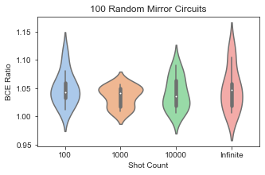
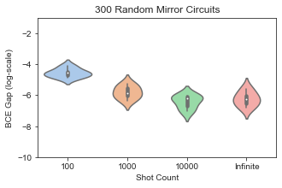
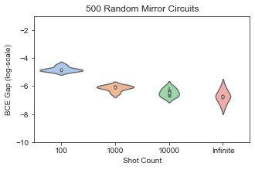
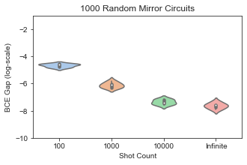
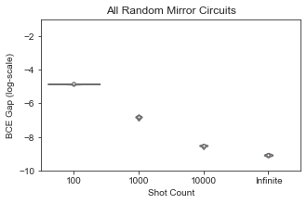
Results – Simulated Data cont.

Slide 11
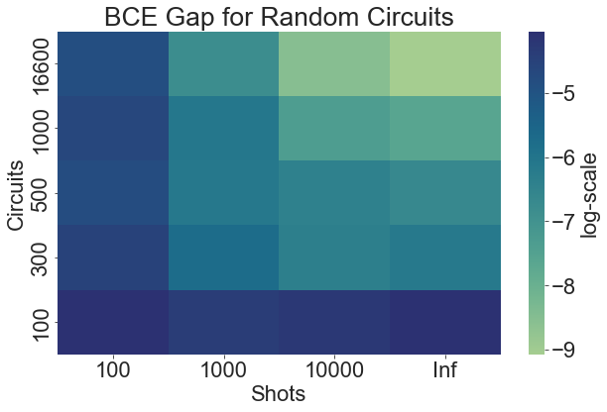
Results – Performance and Data
More circuits = Better performance
Increased precision = Better Performance
Notes:
Change colors. Use a log scale on the BCE difference

Slide 12
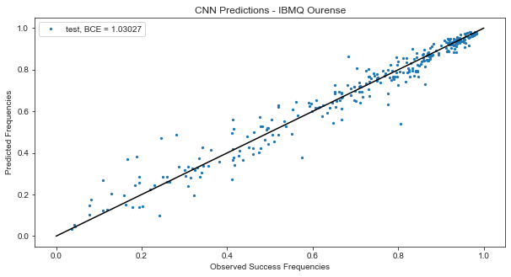
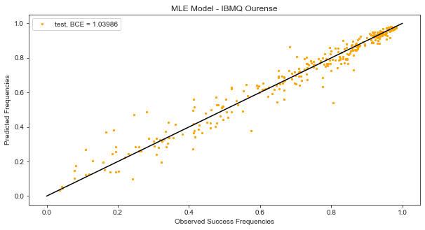
Preliminary Results – Experimental Data
Run on IBMQ Ourense
  Unknown error model
Mirror Clifford circuits
  Width: 1 to 5 qubits
  Depth: 3 to 319 layers
Neural networks were provided with additional information
Worse performance than on simulated data
  Still beats MLE model
Notes:
Include SPEC data?

Slide 13
Conclusions and Future Work
CNNs can learn to predict the success rates of some quantum circuits
Performance scaling
  Circuit count
  Measurement precision
Future work
  Scaling to wider circuits
  Different types of networks
  More complicated error models

Slide 14
Acknowledgements
This work was funded in part by Sandia’s Laboratory Directed Research and Development program. This material was funded in part by the U.S. Department of Energy, Office of Science, Office of Advanced Scientific Computing Research Quantum Testbed Program. All statements of fact, opinion or conclusions contained herein are those of the authors and should not be construed as representing the official views or policies of the U.S. Government. Sandia National Laboratories is a multimission laboratory managed and operated by National Technology and Engineering Solutions of Sandia, LLC, a wholly owned subsidiary of Honeywell International, Inc., for the U.S. Department of Energy's National Nuclear Security Administration under contract DE-NA0003525.

