Slide 1
Gaussian Process for Autonomous Control and Calibration of the GlueX Central Drift Chamber
Diana McSpadden,
Naomi Jarvis, David Lawrence, Thomas Britton, Torri Jeske, Nikhil Kalra
Notes:
I’m Diana McSpadden from Jefferson Lab, and working with a team from JLab’s EPSCI group, and Naomi Jarvis from CMU.
I’m will Introduce Jefferson Lab’s GlueX central drift chamber known as the CDC
And the motivation for and the system implemented to control CDC gain for changing environmental and experimental conditions using an ML model and the associated uncertainty quantification.
I will show results from the system working in an autonomous mode.

Slide 2
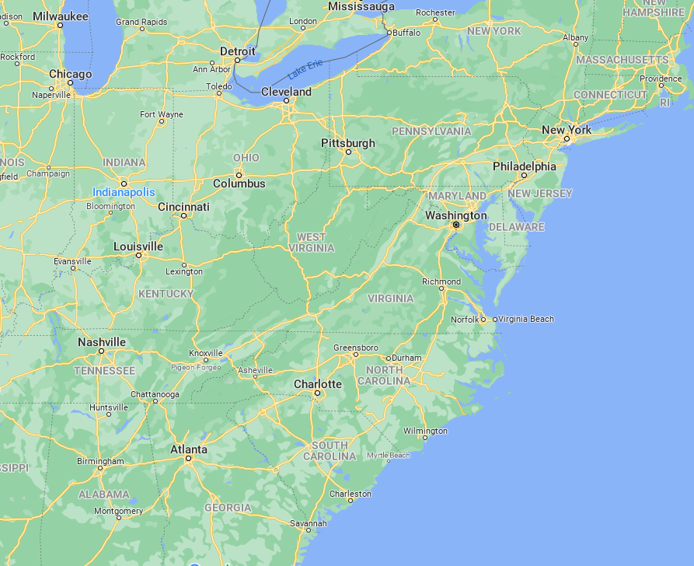
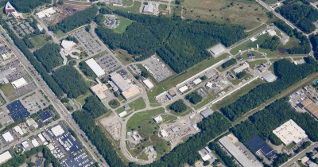
Thomas Jefferson National Accelerator Facility
CEBAF Center
4 experimental halls
Up to 12 GeV electron beam
We (initially) focused on on Hall D
July,2022
‹#›
Notes:
Thomas Jefferson National Accelerator Facility is located in Newport News, Virginia and is home to the Continuous Electron Beam Accelerator Facility, or CEBAF, show from above. The accelerator serves 4 experimental halls.
We initially focused on Hall D, outlined in red.

Slide 3
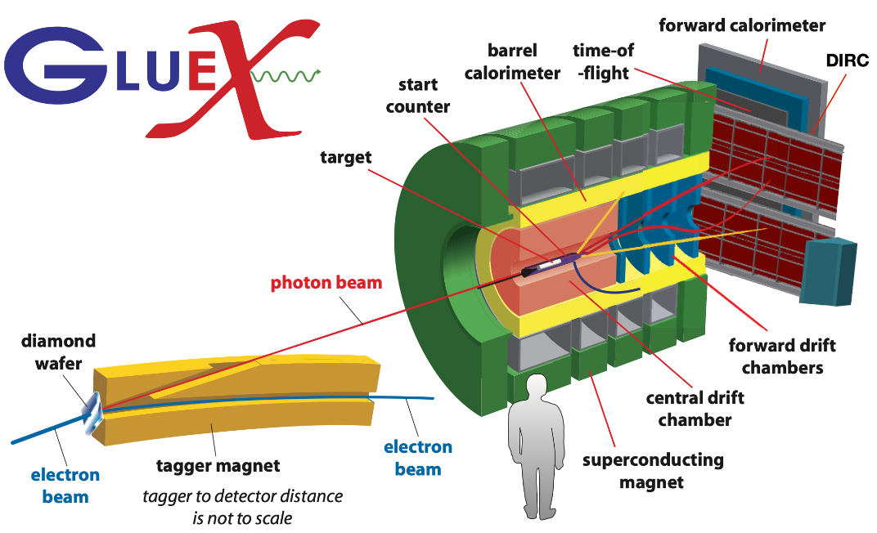
GlueX: Central Drift Chamber (CDC)
GlueX detector located in Hall D at Jefferson Lab, VA
(CDC)
July,2022
‹#›
Notes:
Hall D is the home of the GlueX experiment. The GlueX detector is composed of multiple particle detectors.
[CLICK]
I have outlined a couple people in red to provide a scale for the detectors.
[CLICK]
One of the detectors is the central drift chamber known as the CDC, shown on the left.
On the right, the CDC is inside the red solenoid tube.

Slide 4
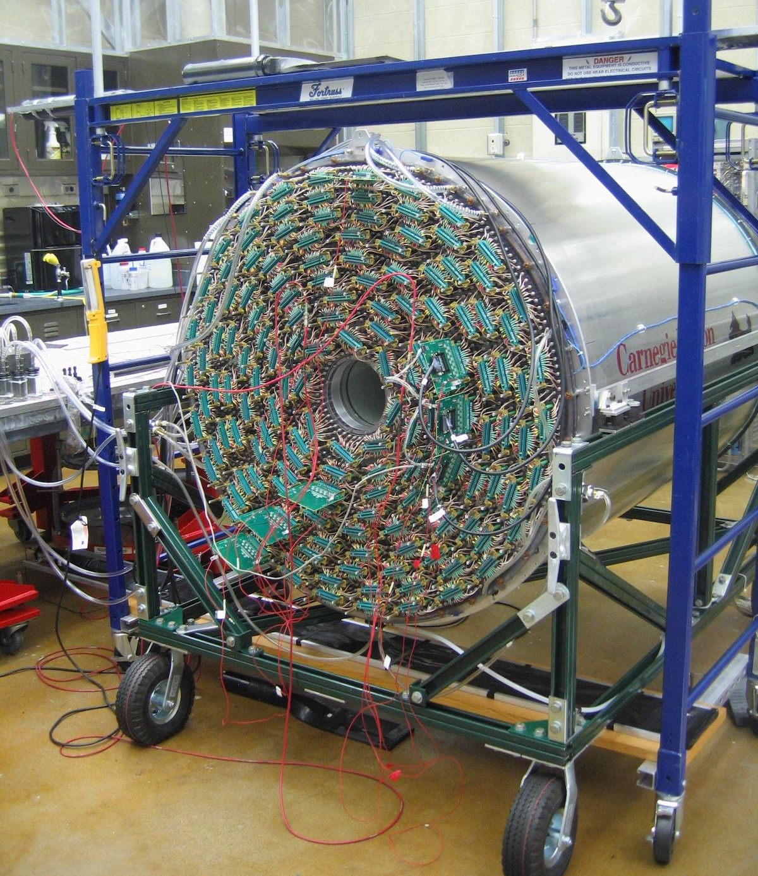
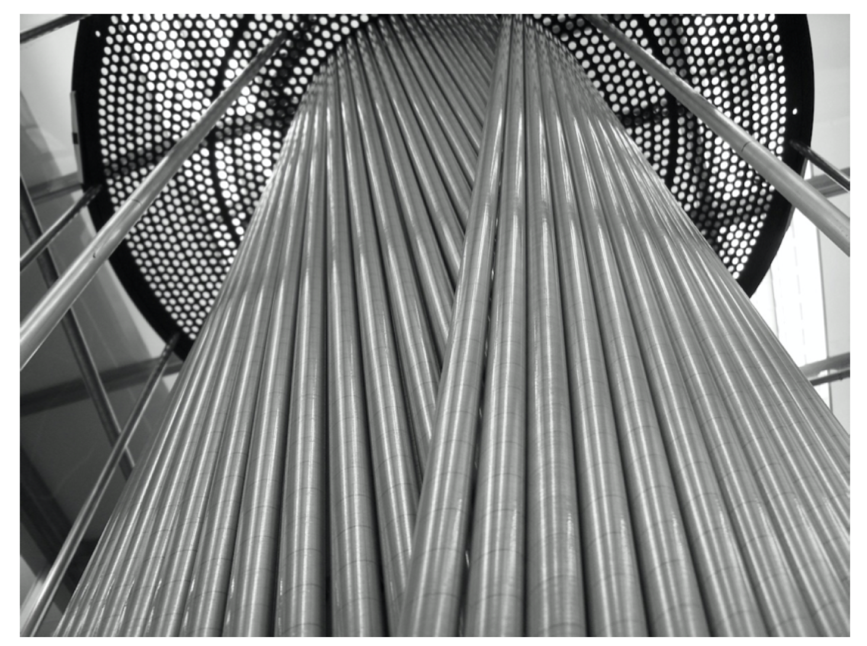
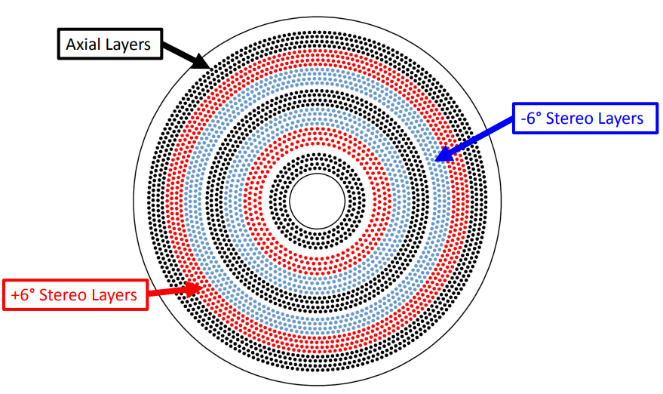
The CDC
Measures drift time and deposited charge, used for particle identification
3522 anode wires at 2125V inside 1.6cm diameter straw
50:50 Ar/CO₂ gas mix
Requires two calibrations: chamber gain and drift time-to-distance
Gain Correction Factor: gain calibrations have the most variation +/- 33%
Has one control: operating voltage
July,2022
‹#›
Notes:
The CDC is used to detect, identify, and track charged particles.
Within the CDC are over 35 hundred anode wires in Aluminized Mylar tubes filled with a gas mix- [prop]: I am holding one of the unused tubes.
CLICK
The CDC requires 2 calibrations: chamber gain, the focus of this talk, and a time to distance calibration.
The gain calibration is the most straightforward and varies the most, +/- 33%
There is one CDC control available: the operating voltage.
#### Gain calibration is primarily due to the condition of the gas in the tubes.
## They are at these angle to increase resolution.

Slide 5
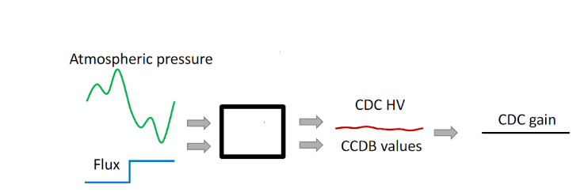
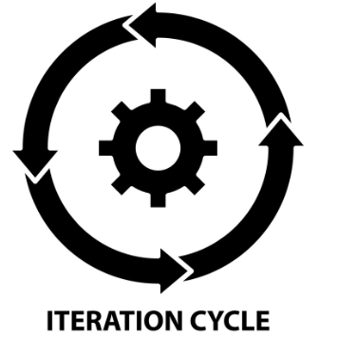
Conventional Calibration and Motivation for ML
Calibration Paradigms
Conventional
Control: CDC operating voltage fixed at 2125 V
Calibrate: calibration values iteratively, produced after the experiment
~2 hour runs
ML
Control: Stabilize detector response to changing environmental/experimental conditions by adjusting CDC HV
Calibrate: online calibration values produced during the experiment
ML
July,2022
‹#›
Notes:
Calibration of the CDC is required to provide reliable particle identification for physics analysis.
Calibrations are Iterative and time consuming and calibration of all Hall D detectors can take up to months depending on complexity.
[CLICK]
This is an impediment to analysis/publication.
Conventionally, data is take in ~2 hour chunks, each known as a run. 2 hours because that is the time for which conditions are stable enough for calibration
However, the CDC expert must keep an eye on weather, and has had to call shift workers if a storm is rolling through and ask them to stop and re-start a new run in order to have run data that is able to be calibrated.
Even without storms, each time we stop and start a run we lose data during the minutes of downtime.
[CLICK]
You can stabilize the HV and change the GCF through offline calibration, this is the conventional method --OR-- stabilize the GCF and change the HV - this is what we want to do so that we are calibrating via control, while online.
We have multiple motivations for ML control and calibration
####We would like a system to adjust CDC HV to control for changing environmental and experimental conditions.
#####We would also like to produce calibration constants while online.
#####This is a first step towards autonomously controlled detectors.

Slide 6
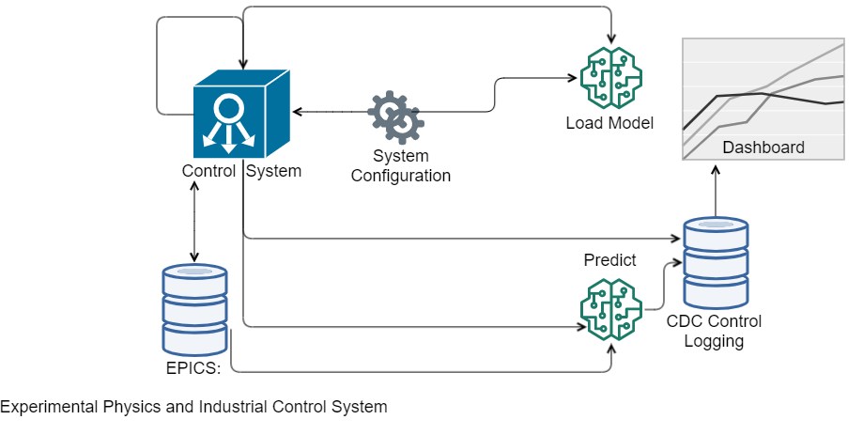
Modular System: RoboCDC
July,2022
‹#›
Notes:
I’ve described the motivation for a machine learning system to control CDC gain. Here’s a chart of the system, which, for this talk I will cheekily call RoboCDC.
We designed the system to be modular, and have implemented RoboCDC.
I’ll describe the elements, including the Gaussian Process model.

Slide 7
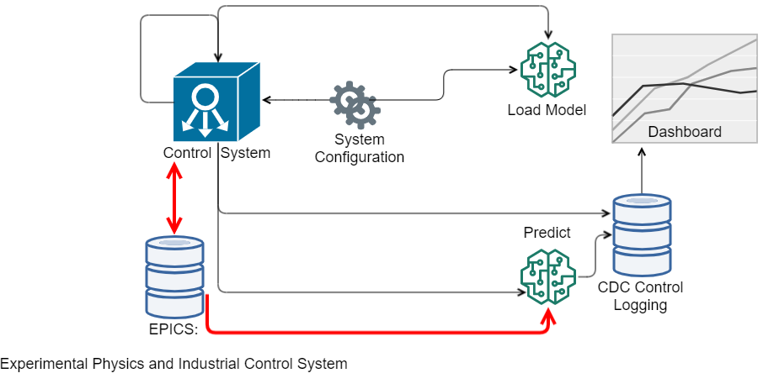
RoboCDC: EPICS
July,2022
‹#›
Notes:
EPICS is the Experimental Physics and Industrial Control System and stores measurements of environmental and experimental conditions at JLab.
RoboCDC created new EPICS variables: one is a toggle for whether RoboCDC is controlling CDC HV. This toggle enables the Control System
[CLICK]
to run RoboCDC in a predict-only mode without controlling the CDC high voltage, but still to predict and store the gain correct factor calibration constants.
[CLICK]
Additionally, EPICS is the source of our near real time input features for Predict.

Slide 8
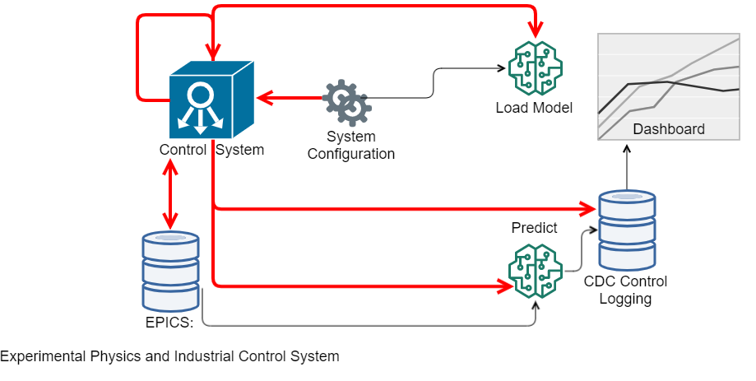
RoboCDC: Control System
July,2022
‹#›
Notes:
The Control System retrieves configuration from EPICS and System Configuration, and
[CLICK]
controls when we reload the model,
[CLICK]
at what frequency we predict,
whether we recommend the high voltage to the CDC by updating an EPICS parameter for CDC high voltage set point,
[CLICK]
and logs all predictions.
[CLICK]
The control system is also configured to work in either an autonomous or human-in-the-loop mode based on System Configuration.
#If the CDC high voltage set point is updated the rate of change is ~10V/s and we expect to only see changes between 0 and 5 V.

Slide 9
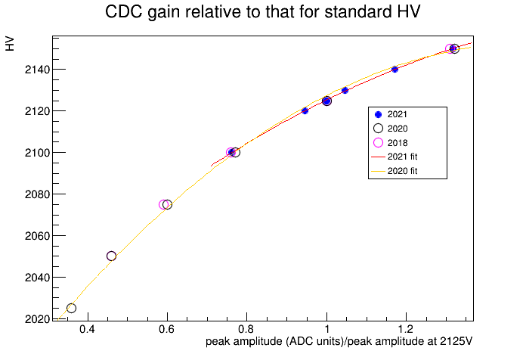
RoboCDC: Setting CDC HV
Control System In Production:
Ideal GCF: GCF at standard pressure (101.3 kPa) and 2125 V
Predicted GCF: Predicted GCF at prevailing conditions
Recommended HV: Obtained from known behaviour of HV
Recommended HV (V)
Relative Gain Correction Factor
(Predicted GCF / Ideal GCF)
CDC HV
CDC gain
ML
July,2022
‹#›
Notes:
Our model predicts the gain correction factor, so how do we determine how to set the CDC high voltage?
Well, we know there is a relationship between voltage and gain
We train the model to predict a gain correction factor
Then, the Control System uses the gain correction factor prediction to identify a stabilizing high voltage using the known relationship shown in the plot, and we also have the corresponding gain correction factor calibration.
#### You can stabilize the HV and change the GCF --OR-- stabilize the GCF and change the HV - this is what we want to do so that we are calibrating while online.
##Two normalization calcs: the quadratic HV relationship and the ratio comparing the GCF at 2125V.
##The Control System initialization uses the known behavior of relative gain vs. HV to find the desired HV based on the predicted gain correction factor.
##During RoboCDC initialization the CDC is operated at 2125V and the Control System asks for the predicted gain correction facts at ideal pressure.
##This becomes our ideal GCF. Then in production the Control System asks for the predicted gain correction factor at prevailing conditions and calculates the relative change in gain needed using known behavior of relative gain vs HV to find our new CDC HV set point.
####The relationship comes from historical data. We know how this detector behaves in terms of gain when changing high voltage from high voltage scans done for every past run period.

Slide 10
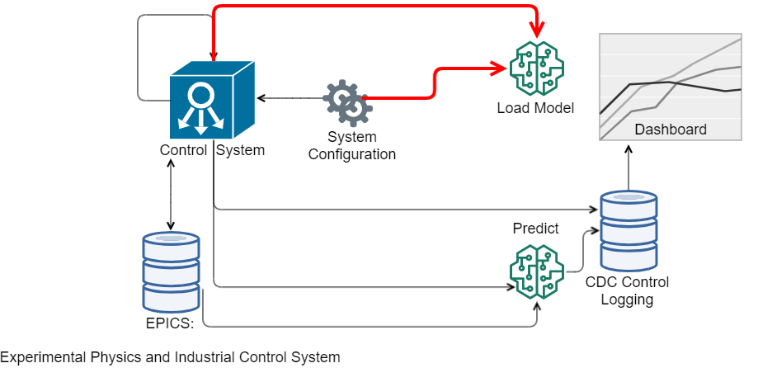
Robo CDC: Load Model
July,2022
‹#›
Notes:
The load model module is called by the Control System
And is a python script that loads the model and supporting model files so it does not need to be reloaded for every call to predict.
[CLICK]
The requested model is identified in the System Configuration.
This also supports hot swapping of models which could support an online training scenario.
Currently, Load Model uses our trained Gaussian Process model.

Slide 11
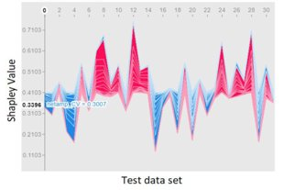
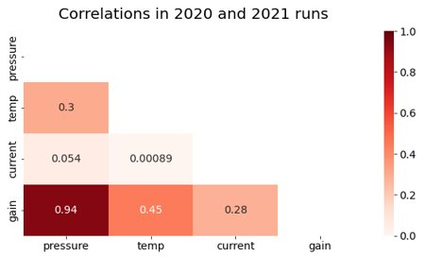
The Model: Environmental and Experimental Data
Began with 122 available features, reduced our features to 3 after evaluation.
Selected features are readily available from EPICS in near real time.
Atmospheric pressure, gas temperature
Current drawn by the innermost ring of CDC HV boards
Training and Test Data:
536 runs from 2020 run period
65 runs from 2021 run period
“Pressure balanced” train and test sets:
Equal proportions of low, medium, and high atmospheric pressure
Training: 480 runs
Test: 121 runs
Example Shapely value analysis for feature important evaluation.
July,2022
‹#›
Notes:
We began with over 122 available features
After feature importance testing we landed on a few number of reasonable environmental variables - atmospheric pressure and temperature
And a Single experimental variable related to the beam current, our variable is the current drawn from a CDC HV board.
it is reasonable to ask about the rich particle tracking data; however, analyzing the data read from the detector itself takes too long. We want to predict calibration constants before ever taking the data, as opposed to deriving them from the data after it is taken.
For our near-real time system, we have three readily available input features, and our target value is the conventionally calculated gain correction factor.
You can see this is not a big data problem. - we have 480 training runs, 121 test runs. And few features.
#####Because pressure is known to be the primary driver of gain, we pressure balanced our training and test sets to include equal proportions of low, medium, and high pressures. Low and high pressures are less common, and we wanted both training and test to proportionally include runs with relatively extreme atmospheric pressures.
##### We could use additional experimental variables, and it is reasonable to ask about post-reconstruction particle tracking data; however, this data is not available in a time scale that is reasonable - particle tracking construction takes significant processing time, and we are looking for a system that could be run on a much faster time scale than track reconstruction.

Slide 12
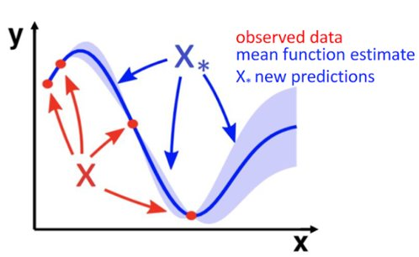
The Model: Data Science Technique
Gaussian Process
3 features
1 target
GP calculates PDF over all admissible functions that fit the data
GP provides the standard deviation - which we can exploit for uncertainty quantification
We initially used a basic GP kernel: Radial Basis Function + White Noise
Do not set the CDC HV to a value for which we are uncertain
July,2022
‹#›
Notes:
A Gaussian Process suited our needs.
We have smaller data and GP’s work well for smaller data sets
A Gaussian Process provides an uncertainty quantification - our detector expert, who also works on the months long calibration efforts, does NOT want us to set the HV to an uncertain value.
We use the GPFlow python library for our Gaussian Process
#####Even as we acquire additional training data, the data will not grow outside a Guassian Process’s ability to create the covariance matrix

Slide 13
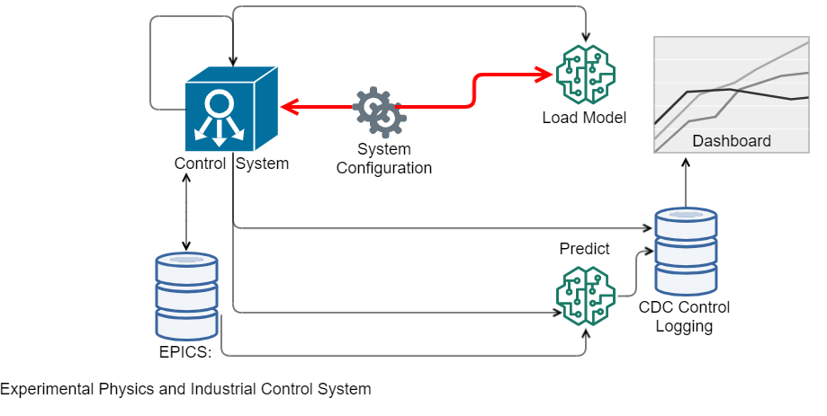
RoboCDC: System Configuration
{"model_name": "[PKL FILE LOCATION]",
"poll_time": 1, "rec_scale": -1, "control_window": [HV_MIN, HV_MAX], "epics_trailing_window": 15, "ideal_gcf": 0.141, "default_hvbi": 9.0, "require_human": 0, "control_mask": "ALL", "debug": 0, "default_temp": 298.84999999999997, "default_pressure": 100, "baseline_V": 2125, "fail_safe_timeout": 90, "confidence_threshold": 0.03, "UQcorrection": 1}
July,2022
‹#›
Notes:
The System Configuration module is a json file that can be edited while the system is running, which results in the Control System re-initializing.
Configurations settings include:
[CLICK]
model file,
the ideal gain correction factor for the current experiment,
default input variables,
whether the system should correct the gain correction factor when uncertainty is high,
and the threshold for high uncertainty.

Slide 14
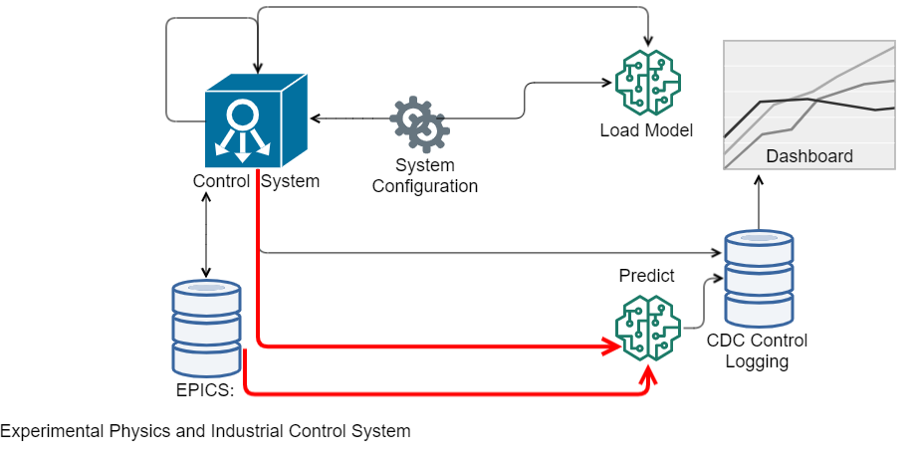
Modular System: Predict
July,2022
‹#›
Notes:
The UQ correction configuration is used by the Predict module, which is a python file called by the Control System that predicts using the loaded model, and performs any uncertainty correction to the gain correction factor.

Slide 15
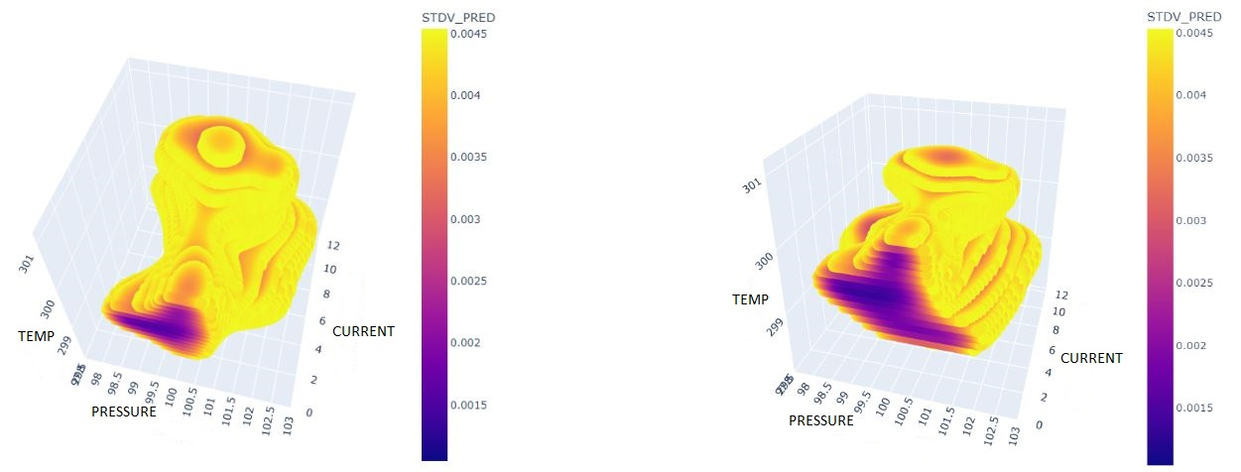
RoboCDC: Validation and Use of UQ
Model Performance on Test Data
Percent Error used as criteria:
Mean % Error: 0.7%
Max % Error: 3.4% (only 3/106 test set runs over 2% error)
Validate the Model’s Stdv/Errors/Uncertainty Quantification:
Within 1 stdv: 74%
Within 2 stdv: 92%
Within 3 stdv: 99%
Few low current training runs
More low current training runs
July,2022
‹#›
Notes:
We used absolute % error as our criteria. On test set data our mean % error was 0.7% with only 3 of 106 test set runs with over 2% error.
We also validated the errors to validate that the Gaussian Process was modeling errors as expected. The results are acceptable.
Additionally, we created an uncertainty threshold surface.
[CLICK]
For a given threshold of % of gain, we can compare a prediction standard deviation and determine if the prediction lives inside or outside our threshold surface. Here we visually plot the threshold surface. I show two certainty surfaces at a 3% threshold. The plot on the left is with a set of training data that did not include many runs with low current. The plot on the right is with training data that did include low current runs. You can see that the certainty surface at low currents (the part of the plot facing us) is larger with the additional low current training data.
Using System Configuration we can choose to only set the CDC high voltage to value where we are certain. If we receive a prediction with a standard deviation outside a selected threshold, we project to the closest point in Euclidean distance to the certainty surface and use the associated gain correction factor prediction, and corresponding high voltage setting.

Slide 16
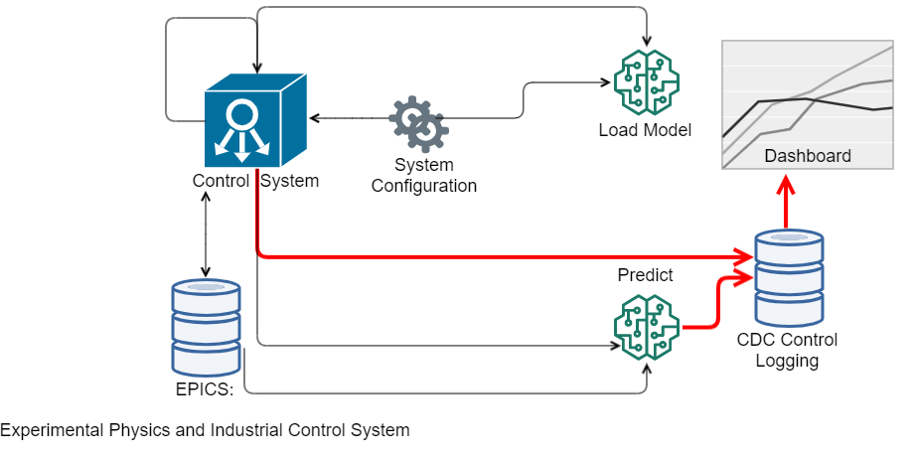
Modular System: Logging and Dashboard
July,2022
‹#›
Notes:
Now that we are running our system, how do we log and monitor.
Every prediction made by the system is logged to a MySQL database.
The date/time,
model used,
input and output,
standard deviation,
UQ corrected gain correction factor,
and the recommended high voltage are all saved.
We connected a grafana dashboard to the database and have a RoboCDC dashboard

Slide 17
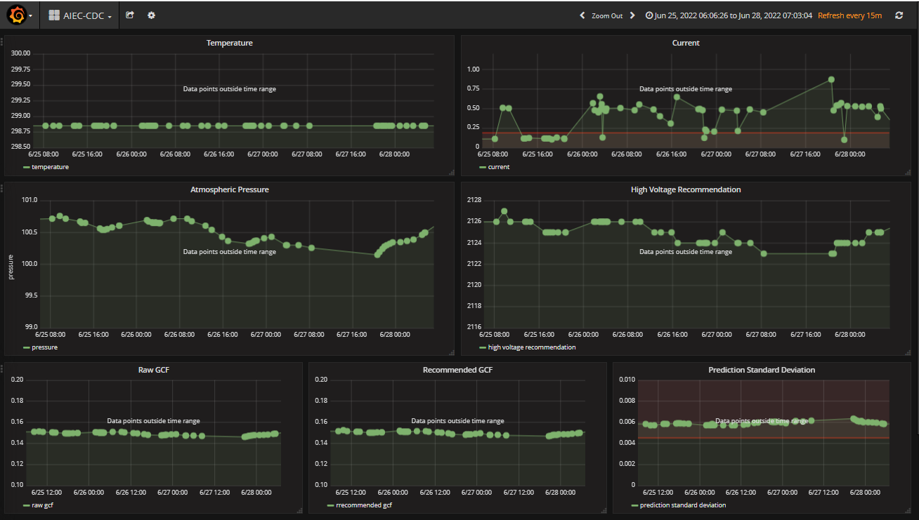
Modular System: Dashboard
July,2022
‹#›
Notes:
Here’s the dashboard from our latest experiment.

Slide 18
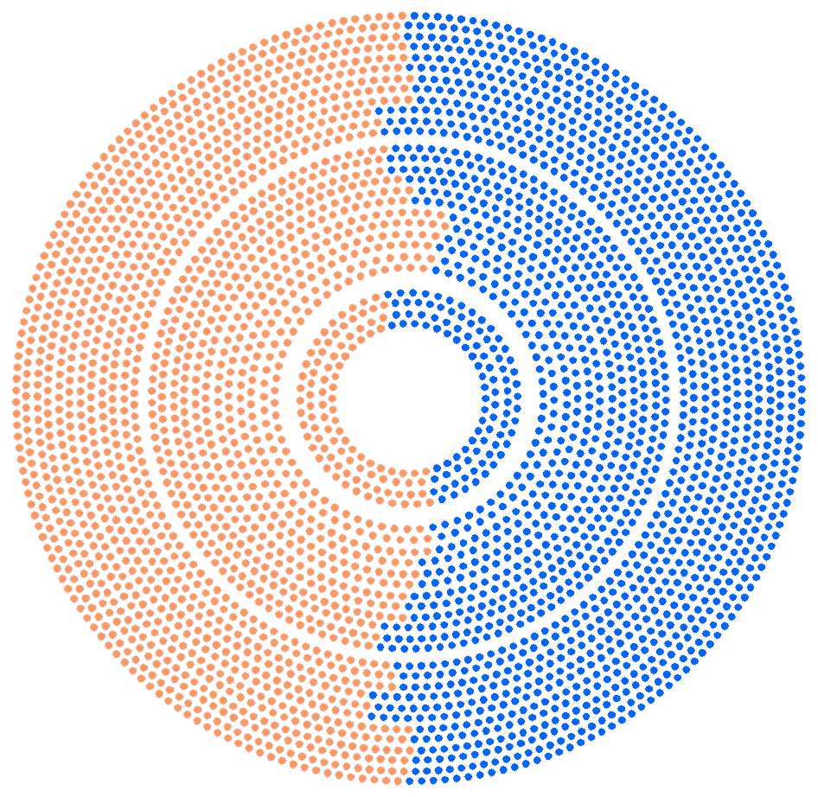
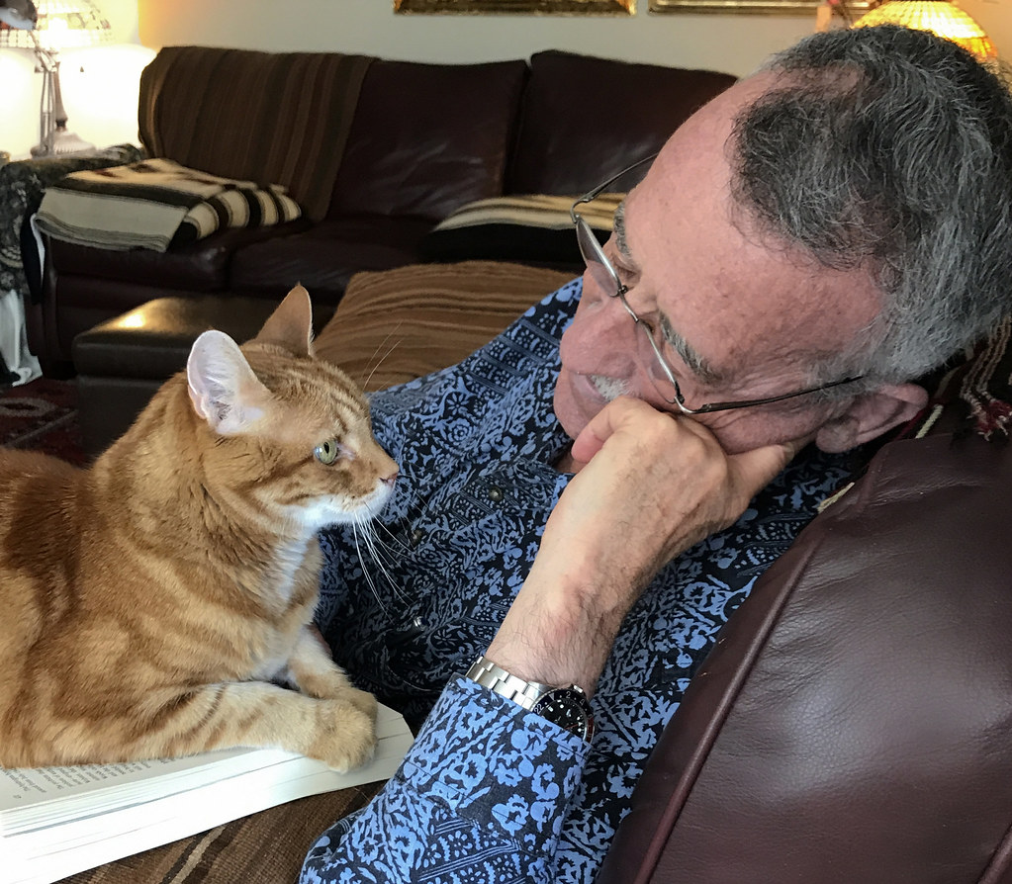
But Does It Work: Cosmics Test
Split the CDC into 2 halves
Leave one side at a fixed HV (conventional)
Let the ML control the other
Autonomously adjust HV every 5 min
Should see the ML system side’s gains stabilized
06/07/22
‹#›
Notes:
But Does The Model and System Work?
We tested the system by splitting the straws of the CDC into 2 halves in software to verify both the model and system worked.
The orange half was kept at 2130V.
The blue half we controlled the high voltage using the ML system every 5 minutes.
We did not use UQ correction for the cosmic test because the risk was low.
[CLICK]
Half the physicists went on vacation during the experiment (that’s our detector expert in a skate ski race), and the other half monitored from their living room. This was truly autonomous.
[CLICK]
We should see stabilized gains on the ML-controlled side and we must verify all modules of the system work as expected.
So, what did we see …
##### For a cosmic ray test there is no electron beam. We set the current input parameter to 9 uA (micro amps, in case anyone asks), which was the current for which we had the most training data.

Slide 19
Cosmics Test Results
Conventional in orange
ML in blue
06/07/22
‹#›
Notes:
The plot shows most probable value for gain for the controlled (blue side) vs. for the orange side that was not controlled. We extract the gain correction value from the orange and blue sides and hoped the blue would be flat and it is.
#####The MPV is extracted from a Landau fit to the pulse height from hits on track. We were able to separate the tracks in the different sides of the CDC (via software) and then fit them.
[I need Torri’s description of how we got the MPV for the cosmic run in case I am asked]
Here we are plotting the Most Probable Value, extracted from a Landau fit to the pulse height from hits on tracks. We were able to separate the tracks in the different sides of the CDC (via software) and then fit them. You might not need to go in to that much detail, but the point is we would like to see this distribution be much more flat throughout the experiment even in the presence of changing atmospheric pressure, current, temperature, and whatever else. The GCFs are initially extracted using this method, but are later fine tuned with dE/dx (except for cosmics we do not have dE/dx information at all because there is no magnetic field, so this is our next best option). You could emphasize the orange is what we typically see during an experiment, because the HV is normally kept constant. The blue gives us a lot of confidence that adjusting the HV can stabilize the chamber gain.

Slide 20
Cosmics Test Results
SUCCESS!
06/07/22
‹#›
Notes:
The blue line is much more stable than the orange line. SUCCESS!

Slide 21
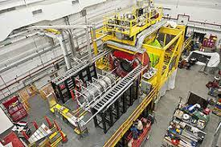
Next Steps
Production Experiment
Beam and UQ on - DONE
Other Detectors and Interoperability
In and out of GlueX
Forward Drift Chamber
Barrel Calorimeter
Time of Flight Detector
Smart bridge between detectors
Afterall, we want to optimize the physics results….
06/07/22
‹#›
Notes:
Our next steps are implementing the system during a beam-on experiment with UQ correction. Which is actually happening right now.
[CLICK]
We are very interested in calibration and control of multiple detector systems to optimize physics results.

Slide 22
Acknowledgements
Jefferson Science Associates, LLC operated Thomas Jefferson National Accelerator Facility for the United States Department of Energy under U.S. DOE Contract No. DE-AC05-06OR23177
This work was supported by the US DOE as LAB 20-2261.
The Carnegie Mellon Group is supported by the U.S. Department of Energy, Office of Science, Office of Nuclear Physics, DOE Grant No. DE-FG02-87ER40315.
GlueX acknowledges the support of several funding agencies and computing facilities: www.gluex.org/thanks.
July,2022
‹#›
Notes:
Thank you to all the groups that contribute to this work.

Slide 23
References
GlueX Detector NIM A987, 164807 (2021)
GlueX Central Drift Chamber NIM A962, 163727 (2020)
Experimental Physics and Industrial Control System https://epics.anl.gov/
T. Jeske , D. McSpadden, N. Kalra, T. Britton, N. Jarvis, D. Lawrence. Using AI to Predict Calibrations for the Central Drift Chamber in GlueX at Jefferson Laboratory, ACAT, 2021.
T. Jeske , D. McSpadden, N. Jarvis, K. Rajput, T. Britton, D. Lawrence. AI for Experimental Controls at Jefferson Lab, https://doi.org/10.1088/1748-0221/17/03/C03043, 2021.
July,2022
‹#›
Notes:
And I included some references.

Slide 24
Small Step Towards Self-Driving Labs
July,2022
‹#›
Notes:
This is a small step towards self-driving labs.

