Slide 1
July 25-28, 2022
Cody Walker
Research Scientist
Use of Machine Learning for Signature Development in a Multi-Sensor Environment for Safeguard Applications of Solvent Extraction Processes

Slide 2
Goals and impacts
Goal 1
Integrate a variety of atypical sensors into a system of centrifugal contactors for signal discovery.
SIGNIFICANCE
Goal 2
Use data science and signal analysis techniques to extract features that identify process stages and equipment usage in various stages of operation.
SIGNIFICANCE
Local Impact
Equip system operators with process awareness so they can be informed of:
Process conditions
Normal/abnormal operations
Ways to improve process operations
Equipment failures and predictions of failure.
SIGNIFICANCE
Broad Impact
If features provide evidence of diversion, this research could potentially enhance the safeguarding of special nuclear materials.
SIGNIFICANCE

Slide 3
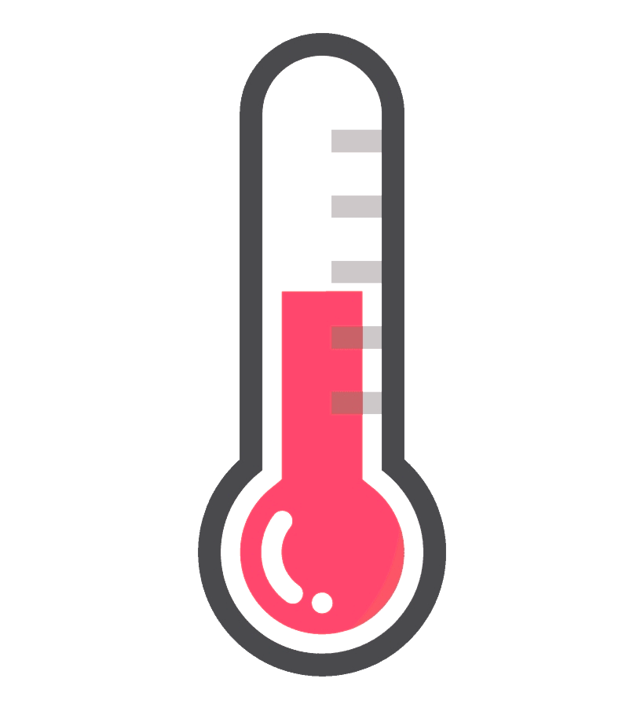
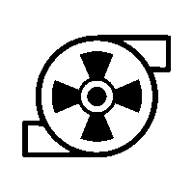
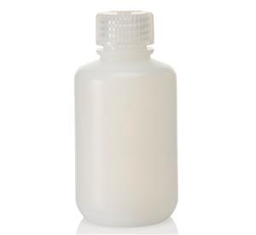
Many types of sensors for monitoring a chemical separation process
Centrifuge Motor
Aqueous Sensors
Organic Sensors
RPM
Multimodal sensor
RGB Color
Temperature Probe
Temperature Probe
Conductivity Probe
Conductivity Probe
pH Probe
Motor Current
pH Probe
Aqueous Out
Organic Out
Aqueous
Pump
#9
Organic
Pump
Aqueous
Heater
Organic
Heater
Aqueous
Flow
Organic
Flow
Aqueous
Feed Tank
Organic
Feed Tank
Aqueous
Beaker
Organic
Beaker
Organic
Effluent
Aqueous
Effluent
Infrasound
Thermal Camera
Seismic

Slide 4
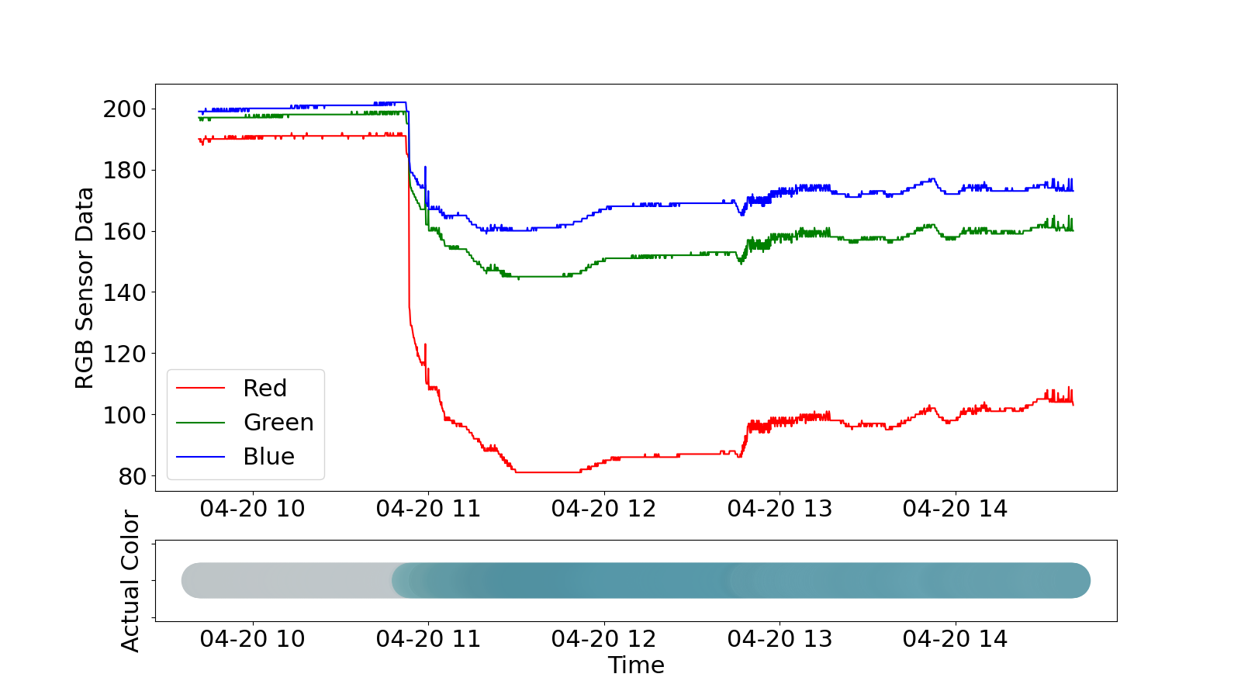
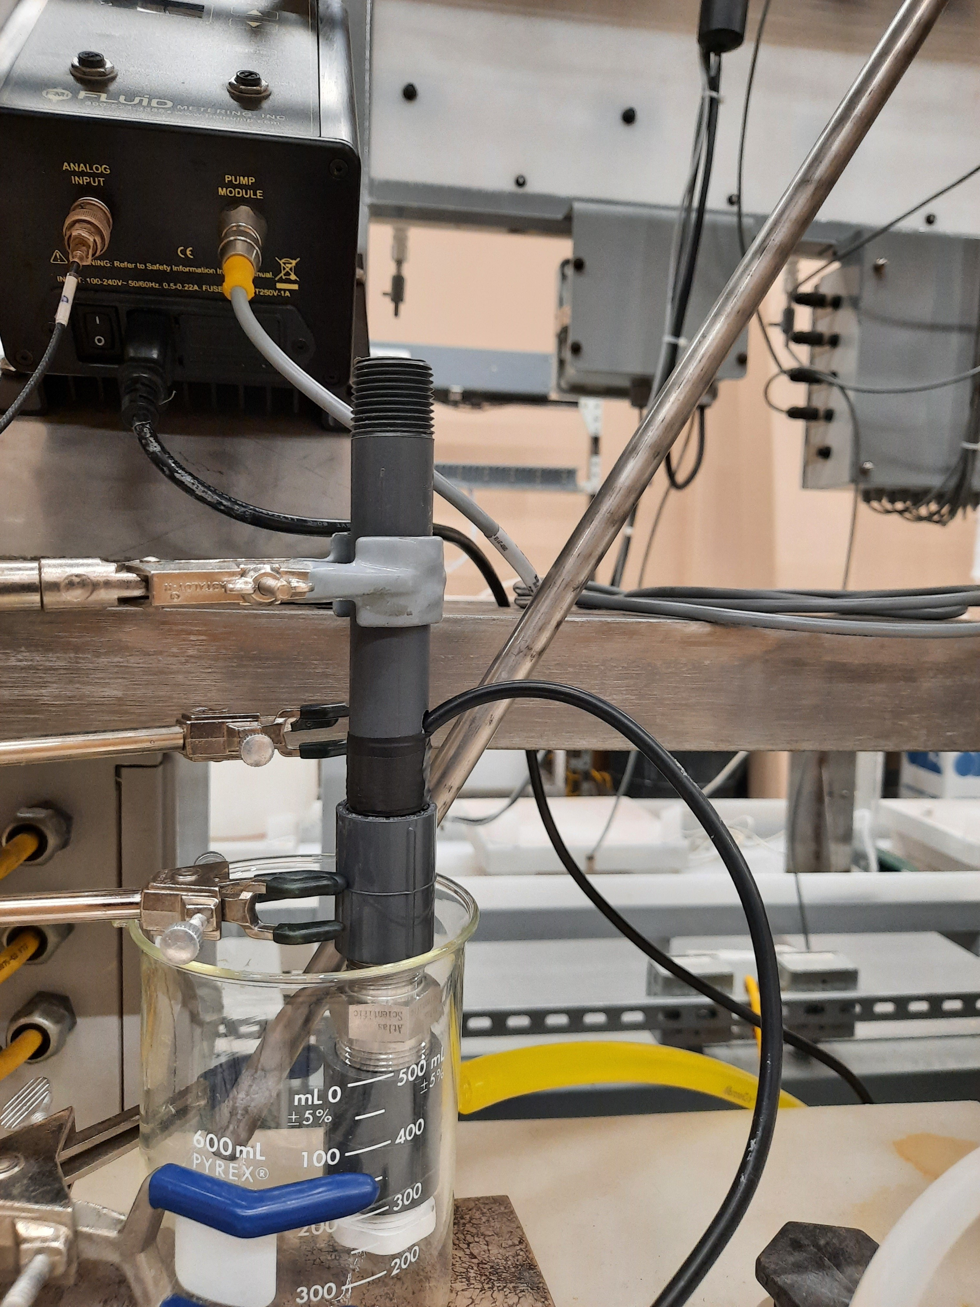
Atypical sensors can generate new insights
Colorimetric sensors monitor the organic concentration throughout the process.
No organic present (color of container)
Organic slowly introduced in the solution
Concentration of organic increasing
1.
2.
3.

Slide 5
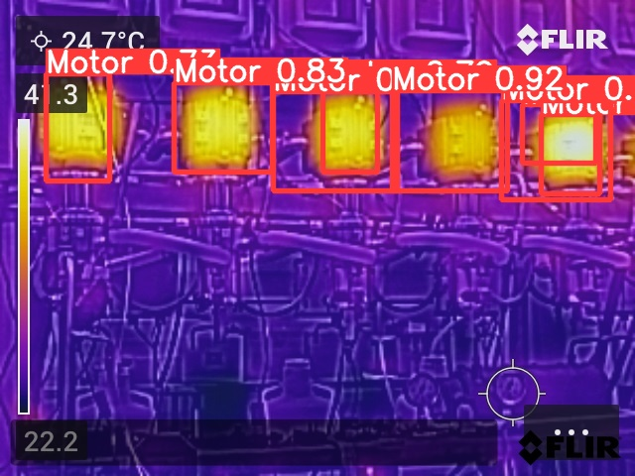
Yolov5 is being used with an infrared camera to gauge the temperature of motors and contactors
Images from an infrared camera are processed to locate thermally active equipment (e.g., motors).
The approximate temperature is measured based on the color of the object.
This temperature is then used as a process variable to determine whether the component is “healthy” or “faulted.”
Instead of using one thermocouple per component, the infrared camera covers multiple units.
He, K., Zhang, X., Ren, S., & Sun, J. (2016). Deep Residual Learning for Image Recognition. Proceedings of the IEEE Conference on Computer Vision and Pattern Recognition, 8.

Slide 6
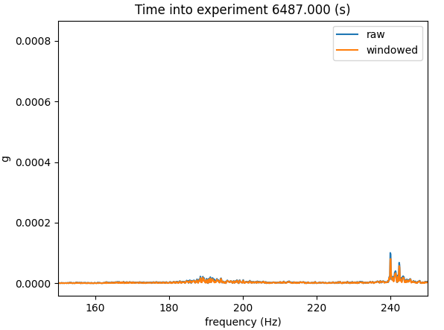
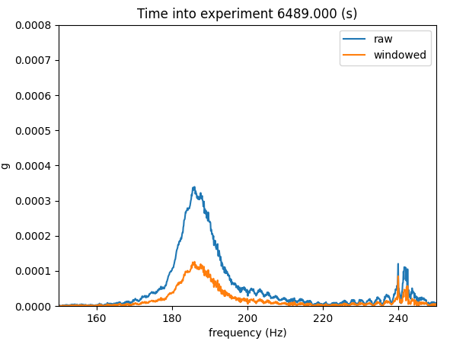
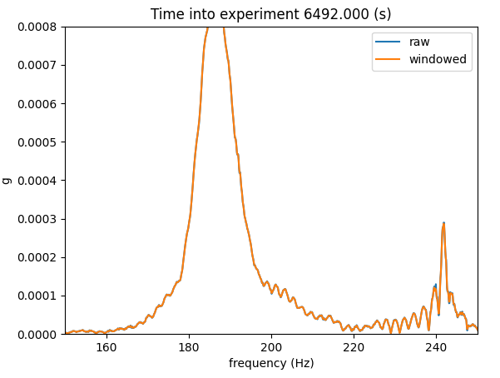
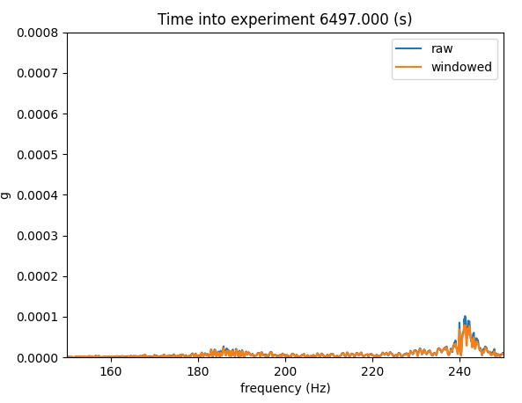
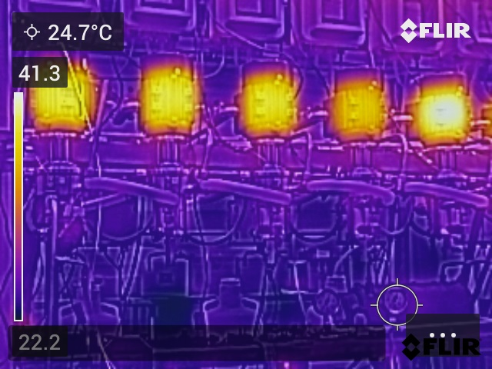
Contactor fault identified in the data
An event caused a contactor to flood.
The entire event occurred within 10 seconds (initiation to shutoff).
It was captured by the vibrations and infrared cameras.

Slide 7
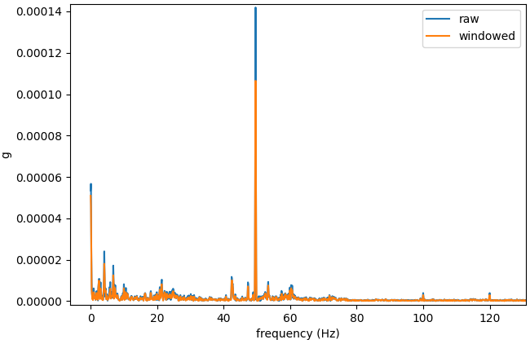
Data wrangling and feature extraction enable easy analysis of large, complex datasets
Colorimetric sensor
Motor rpm
Measurement sources include vibration, acoustic, current, conductive, flow, colorimetric, pH, viscosity, density, humidity, and thermal data.
These measurements vary in magnitude, frequency, and location.
Feature importance is determined by using SHAP values.
Information is being used to detect operational changes that are either intentional (e.g., changing operational set points) or malicious (e.g., flow diversion) in nature.
$$\frac{1 sample}{10 seconds}$$
Determine organic %
Determine operating condition (rpm)
$$\frac{12,800 samples}{ second}$$
Operating State
Vibration, pH, thermal, density, etc.
Extracted Features
Classification of System Health Using Support Vector Machine and Random Forest
“Healthy”
“Faulted”

Slide 8
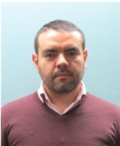
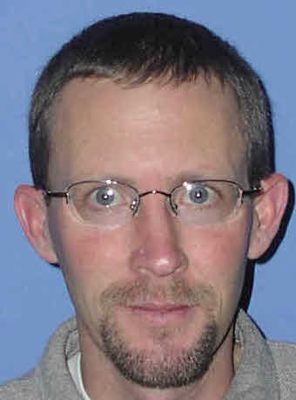
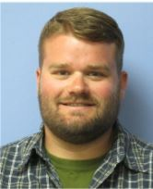
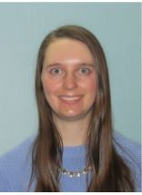
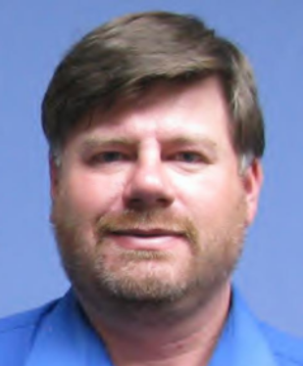
MUSSDBear Team
Luis Ocampo Giraldo
Safeguards, data collections, data communications, signal analysis
Cody Walker
Machine learning, statistics, signal analysis, feature extraction
Mitchell Greenhalgh
Extraction process expert, sensor installation, process operations
Jay Hix
Sensor installation, sensor communications & networking, data collections, LabView expert
Katherine Wilsdon
Deep Lynx integration and programming, GUI programming
James Johnson
Sensor installation, sensor communications & networking, data collections, LabView expert
Edna Cárdenas
Data collections, signal analysis, feature extraction, experiment planning & organization

