Slide 1
Automated knowledge sharing with NLP ensemble recommendations to enhance laboratory operations
6th Annual Sandia MLDL Workshop
erhtjhtyhy
Matthew T. Dearing
Faming Li
AIOps Technical Lead
BIS ESS
mdearing@anl.gov
Machine Learning Engineer
BIS ESS
fli@anl.gov
July 27, 2022

Slide 2
Just an outline
Brief intro to AI for Operations at Argonne.
The operational business challenge: Discovering and applying related lessons learned is crucial for laboratory safety.
Phase 1: Generate related keywords to initiate the manual search process.
Phase 2: Automated direct recommendations of related Lessons Learned.
What’s next? and DOE best practice designation.
Notes:
Template text: https://anl.app.box.com/file/942120023891

Slide 3
Why AI in operations?
little ideas to Big Ideas … all include similar ideas
Recommendations to support business process decisions.
Predictions for operational next steps, assignments, and proactive issue resolutions.
Automating routine processes that require excessive person-hours.
Mining of related valuable information not otherwise discoverable.
Detection of anomalies and errors in operations and processes not otherwise observable.
Assisted decision-making through advanced data and text-based analytics.
Monitoring of performance risks and system issues before occurrence.

Slide 4
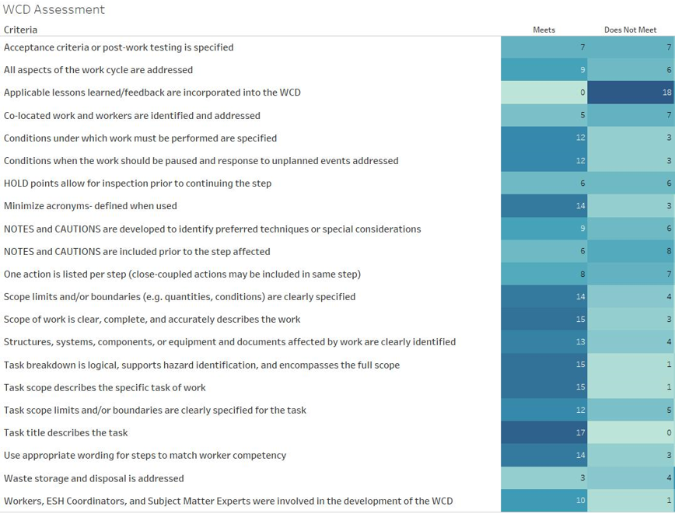
Lessons learned are hard to find
Or, is it just hard to get started?
A 2019 assessment of Argonne Work Control Documents (WCD) found overall positive quality… … except for incorporating related Lessons Learned.
Not making the same mistakes twice is key to laboratory-wide safety, so a very high value is placed on identifying Lessons Learned.

Slide 5
Lessons learned on opexshare
DOE-hosted searchable repository for the laboratory complex
Supporting operational excellence across the U.S. Department of Energy.
~ 3,400 Lessons Learned documents published today.
DOEOPEXSHARE.doe.gov is a one-stop resource for the most current and historical operating experience information. A comprehensive library containing various types of content that cover all elements and disciplines for the whole user community.

Slide 6
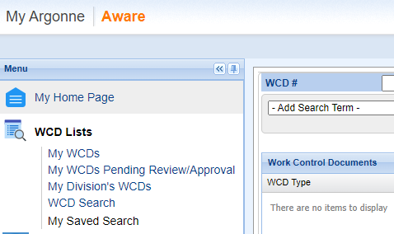
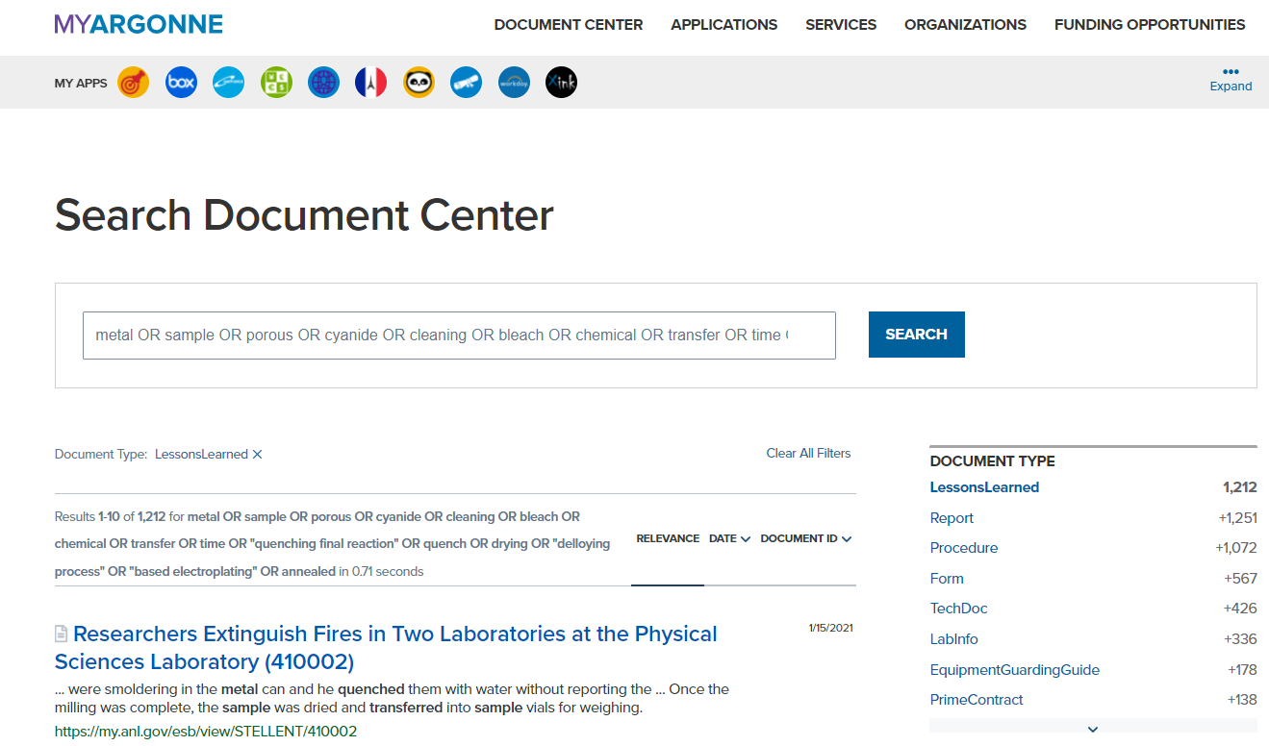
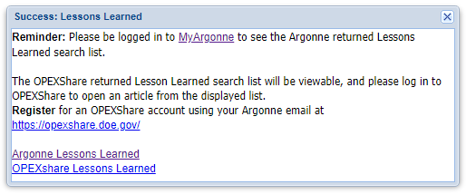
Phase 1: WCD-AI keyword discovery
Knowledge mining to augment search for related Lessons Learned
Apply state-of-the-art NLP algorithms and knowledge mining techniques to support Work Control Document authors to identify meaningful lessons learned for improving work planning and safety outcomes.

Slide 7
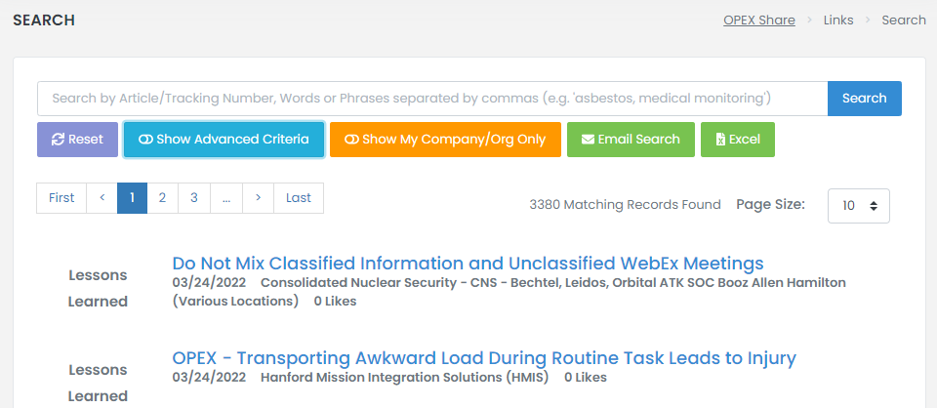
Phase 2: Wcd-ai recommender
Recommend recent Lessons Learned for ongoing work projects
Ensemble of state-of-the-art NLP algorithms to automate the discovery of new Lessons Learned related to active Work Control Document-authorized work.
Support maximizing continuous safety by periodically informing key personnel of the latest safety knowledge not previously available during planning stages.

Slide 8
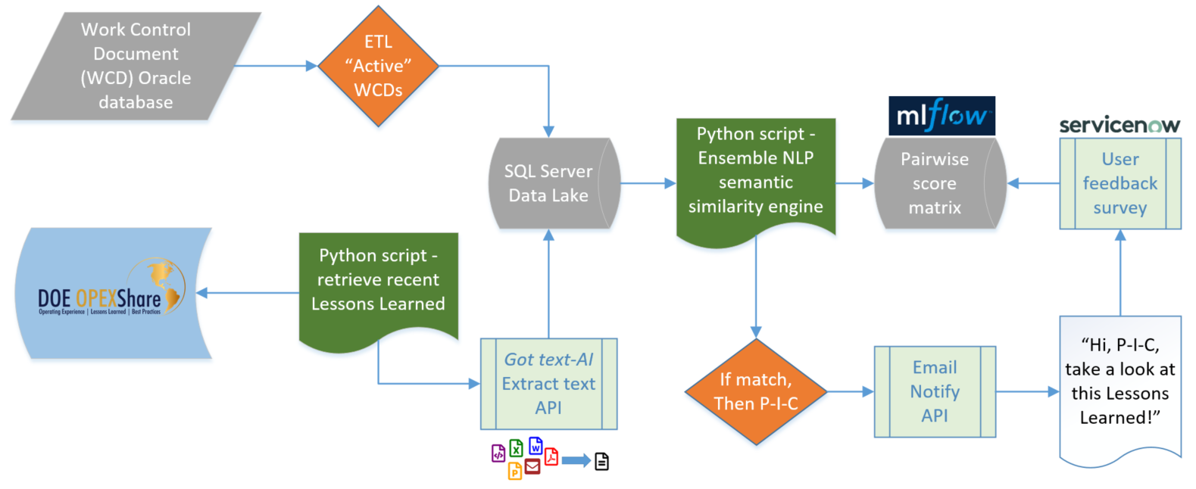
Wcd-ai data & Process pipeline
Discovering new related Lessons Learned workflow

Slide 9
Wcd-ai data & Process pipeline
Discovering new related Lessons Learned workflow

Slide 10
Wcd-ai recommendation engine
High-level summary of our ensemble technique
Inputs
Single Lessons Learned document text and metadata.
Selected text from all active WCD records (~700 in production).
Text data components used in similarity comparisons
Lessons learned: title, topics, summary, content text
WCDs: title, scope and tasks details, attachment text

Slide 11
Wcd-ai recommendation engine
High-level summary of our ensemble technique
Core algorithms integrated to generate vectors for cosine similarity scoring
TF-IDF vectorizer
doc2vec with pre-trained English Wikipedia DBOW model (669,549 vocab size)
BERT sentence transformer with bert-base-nli-mean-tokens model (arXiv:1908.10084 [cs.CL])
Universal Sentence Encoder (arXiv:1803.11175 [cs.CL])
Output
Pairwise similarity score matrix, normalized across each NLP algorithm.
Average pairwise score.

Slide 12
Wcd-ai recommendation engine
High-level summary of our ensemble technique
Recommendation threshold
Aggregate scores: WCD-Lessons Learned pairwise score occurring in top 1% for >= 2 similarity algorithms
Early results – with a limited initial truth set curated by our SME team
TP: 66% | FP: 34%
Matched WCD not always identified for every Lessons Learned (a good thing).
SME-evaluated ‘not relevant’ recommendations are often subtle.
Challenge: some Lessons Learned are very general.

Slide 13
Wcd-ai recommendation engine
Example results
Recommended for WCD titles: (1) On-road test vehicle operation Relevant (2) AVTC Vehicle Inspection Not relevant

Slide 14
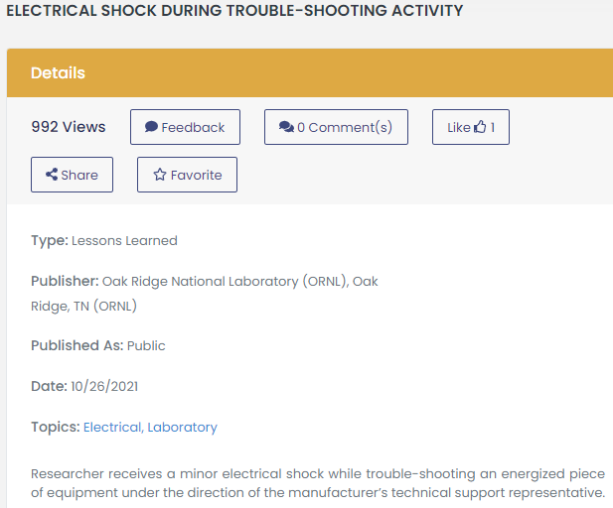
Wcd-ai recommendation engine
Example results
Recommended for WCD titles: (1) Facility Hazard Analysis-Dry Lab Activities Relevant (2) Electrical/Electronic Work Relevant

Slide 15
Next steps

Slide 16
Wcd-ai What’s next
An expectation of continuous improvement and algorithm fine-tuning
Anticipated designation as a complex-wide best practice following a recent Argonne program review by the DOE Office of Enterprise Assessments (EA-32).
Expanded pilot to launch in August 2022.
User feedback will guide fine-tuning (and increase our SME-curated truth set baseline).
Continued experimentation to enhance the ensemble semantic similarity algorithms:
Explore alternate BERT sentence transformer pre-trained models.
Long-form semantic comparisons to target most related information in attachments.
K-means to filter recommendation output into learned “relevant” clusters.
Knowledge graph of Lessons Learned to leverage graph algorithms for predicting related content.

Slide 17
This ending is just the beginning.

