Slide 1



Python Data-Driven Model Integration for the
Xyce Circuit Simulator
July 27th, 2022
Paul Kuberry (SNL, 1442)
Biliana Paskaleva (SNL, 1356)
Ting Mei (SNL, 1355)
Eric Keiter (SNL, 1355)
Pavel Bochev (SNL, 1400)
Thomas Buchheit (SNL, 1356)
Matthew Glickman (SNL, 1462)

Slide 2
The need for Python-defined models
National Laboratories Software Ecosystem
(mostly C++)
Machine Learning
Software Ecosystem
“75% of ML developers and data scientists use Python”
- State of the Developer Nation
(Slashdata.co 2020)
https://s3-eu-west-1.amazonaws.com/vm-blog/uploads/2020/04/DE18-SoN-Digital-.pdf
Our goal is to enable ML advancements to impact design phases of
nuclear deterrence electrical systems via data-driven compact device models
Notes:
Most of the advancements being made in ML are coded in Python and are inaccessible to C++ codes used at the laboratory

Slide 3

What is Xyce-PyMi?
Xyce Python Model Interpreter
National Laboratories Software Ecosystem
(mostly C++)
Machine Learning
Software Ecosystem
Leverages General External interface (C++) from Xyce, by Tom Russo
Easily installable and callable capability for executing Python ML models in a production circuit simulation software (Xyce ←→ PyBind11)
Provide data-driven compact device modeling approaches (GMLS, splines, deep neural networks) from ongoing LDRDs at Sandia such as Data-Driven, Radiation-Aware, Agile Modeling Approach for Rapid Nuclear Deterrence Design Assessment
as well as a multitude of other external/internal developments
Notes:
A conscious decision has been made to be performant at the cost of flexibility
The goal is to allow quick prototyping of ideas

Slide 4
Provide a tool that...
rapidly assesses impact of device behavior on circuit level performance
  Device changes may not be representable by underlying model parameters
performs this type of evaluation efficiently
  Calibration using proprietary software is not required
  Process is automated
can use experimental or high-fidelity simulation data as an input
  Example: Device behavior extracted from a TCAD simulation
Notes:
Not to 'predict' the aging behavior, but understand the effect of changes in device behavior and how that affects circuit level performance.
Device level behavior can be captured with TCAD models.
What impacts to small changes in devices (information that we have) have on the circuit response.
Not intended as a tool to or a tool that necessarily uses perfectly calibrated device data
Combine 7 and 8, just describve what we are trying to accomplish. Not a question and answer slide, it is an answer slide.
Not trying to model all of the physics in the device. Capture changes in device behavior and assess the circuit level performance.

Slide 5
How to call and specify device/subcircuit behavior
* example.cir (Example of easy inclusion in a netlist)
YGENEXT devicename terminal1 terminal2
+ SPARAMS={NAME=MODULENAME VALUE=PythonDevice.py}
>>
Xyce-PyMi
example.cir
Xyce-PyMi
(Xyce Python Model Interpreter)
Full Xyce functionality + devices / subcircuits / circuits defined in Python
Python class defines how F, Q, B, dF/dX, and dQ/dX vectors/matrices are populated for Xyce DAE equation:
  residual = f(x,t) + dq(x,t)/dt - b(t)
Supports all popular machine learning frameworks such as TensorFlow, Keras, PyTorch, Jax, Numba, Scipy, etc…
# PythonDevice.py
import numpy as np
from BaseDevice import BaseDevice
class Device(BaseDevice):
def computeXyceVectors(…):
# definition of device in Python goes here

Slide 6
Dependencies of Xyce-PyMi
Xyce-PyMi
Xyce
Python
pip
Trilinos
pybind11
tensorflow
Suite-Sparse
flex
bison
numpy
BLAS
LAPACK

Slide 7
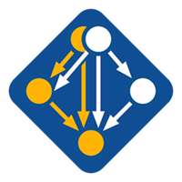
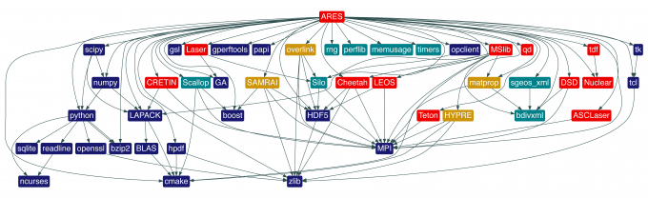
Spack
HPC Package Manager (like pip is to Python)
handles the complexity of connecting each software package with a consistent set of dependencies
Resources:
https://computing.llnl.gov/projects/spack-hpc-package-manager
https://spack-tutorial.readthedocs.io/en/latest/

Slide 8
>> spack spec xyce+pymi
xyce@github.master%apple-clang@12.0.0~ipo+mpi~plugin+pymi~shared build_type=Release cxxstd=11 arch=darwin-catalina-skylake
^bison@3.8.2%apple-clang@12.0.0 arch=darwin-catalina-skylake
^diffutils@3.8%apple-clang@12.0.0 arch=darwin-catalina-skylake
^libiconv@1.16%apple-clang@12.0.0 libs=shared,static arch=darwin-catalina-skylake
^m4@1.4.19%apple-clang@12.0.0+sigsegv patches=9dc5fbd,bfdffa7 arch=darwin-catalina-skylake
^libsigsegv@2.13%apple-clang@12.0.0 arch=darwin-catalina-skylake
^perl@5.34.0%apple-clang@12.0.0+cpanm+shared+threads arch=darwin-catalina-skylake
^berkeley-db@18.1.40%apple-clang@12.0.0+cxx~docs+stl patches=b231fcc arch=darwin-catalina-skylake
^bzip2@1.0.8%apple-clang@12.0.0~debug~pic+shared arch=darwin-catalina-skylake
^gdbm@1.19%apple-clang@12.0.0 arch=darwin-catalina-skylake
^readline@8.1%apple-clang@12.0.0 arch=darwin-catalina-skylake
^ncurses@6.2%apple-clang@12.0.0~symlinks+termlib abi=none arch=darwin-catalina-skylake
^pkgconf@1.8.0%apple-clang@12.0.0 arch=darwin-catalina-skylake
^zlib@1.2.11%apple-clang@12.0.0+optimize+pic+shared arch=darwin-catalina-skylake
^cmake@3.22.3%apple-clang@12.0.0~doc+ncurses+openssl+ownlibs~qt build_type=Release arch=darwin-catalina-skylake
^openssl@1.1.1n%apple-clang@12.0.0~docs~shared certs=system arch=darwin-catalina-skylake
^flex@2.6.3%apple-clang@12.0.0+lex~nls arch=darwin-catalina-skylake
^findutils@4.8.0%apple-clang@12.0.0 patches=440b954 arch=darwin-catalina-skylake
^openmpi@4.1.2%apple-clang@12.0.0~atomics~cuda~cxx~cxx_exceptions~gpfs~internal-hwloc~java~legacylaunchers~lustre~memchecker~pmi~pmix+romio~singularity~sqlite3+static~thread_multiple+vt+wrapper-rpath fabrics=none schedulers=none arch=darwin-catalina-skylake
^hwloc@2.7.0%apple-clang@12.0.0~cairo~cuda~gl~libudev+libxml2~netloc~nvml~opencl~pci~rocm+shared arch=darwin-catalina-skylake
^libxml2@2.9.12%apple-clang@12.0.0~python arch=darwin-catalina-skylake
^xz@5.2.5%apple-clang@12.0.0~pic libs=shared,static arch=darwin-catalina-skylake
^libevent@2.1.12%apple-clang@12.0.0+openssl arch=darwin-catalina-skylake
^openssh@8.9p1%apple-clang@12.0.0 arch=darwin-catalina-skylake
^libedit@3.1-20210216%apple-clang@12.0.0 arch=darwin-catalina-skylake
^py-pybind11@2.9.1%apple-clang@12.0.0~ipo build_type=RelWithDebInfo arch=darwin-catalina-skylake
^py-pycompadre@master%apple-clang@12.0.0+trilinos debug=0 arch=darwin-catalina-skylake
^trilinos@13.2.0%apple-clang@12.0.0~adios2+amesos+amesos2+anasazi+aztec+basker+belos~boost~chaco+complex~cuda~cuda_rdc~debug~dtk+epetra+epetraext+epetraextbtf+epetraextexperimental +epetraextgraphreorderings~exodus+explicit_template_instantiation~float+fortran~gtest+hdf5~hypre+ifpack~ifpack2~intrepid~intrepid2~ipo+isorropia+kokkos~mesquite~minitensor~ml+mpi~muelu~mumps+nox~openmp~panzer~phalanx~piro~python~rocm~rocm_rdc~rol~rythmos+sacado~scorec~shards+shared~shylu~stk+stokhos~stratimikos~strumpack+suite-sparse~superlu~superlu-dist~teko~tempus~thyra+tpetra+trilinoscouplings~wrapper~x11+zoltan~zoltan2 build_type=RelWithDebInfo cxxstd=14 gotype=long_long patches=b9614a5 arch=darwin-catalina-skylake
^hdf5@1.12.1%apple-clang@12.0.0~cxx~fortran+hl~ipo~java+mpi+shared~szip~threadsafe+tools api=default build_type=RelWithDebInfo patches=ee351eb arch=darwin-catalina-skylake
^metis@5.1.0%apple-clang@12.0.0~gdb~int64~real64+shared build_type=Release patches=4991da9 arch=darwin-catalina-skylake
^parmetis@4.0.3%apple-clang@12.0.0~gdb~int64~ipo+shared build_type=RelWithDebInfo patches=4f89253,50ed208,704b84f arch=darwin-catalina-skylake
^suite-sparse@5.10.1%apple-clang@12.0.0~cuda~graphblas~openmp+pic~tbb arch=darwin-catalina-skylake
^gmp@6.2.1%apple-clang@12.0.0 arch=darwin-catalina-skylake
^autoconf@2.69%apple-clang@12.0.0 patches=35c4492,7793209,a49dd5b arch=darwin-catalina-skylake
^automake@1.16.5%apple-clang@12.0.0 arch=darwin-catalina-skylake
^libtool@2.4.6%apple-clang@12.0.0 arch=darwin-catalina-skylake
^mpfr@4.1.0%apple-clang@12.0.0 arch=darwin-catalina-skylake
^autoconf-archive@2019.01.06%apple-clang@12.0.0 arch=darwin-catalina-skylake
^texinfo@6.5%apple-clang@12.0.0 patches=12f6edb,1732115 arch=darwin-catalina-skylake

Slide 9
Installation / Execution using Spack
Installation:
1) git clone https://github.com/spack/spack.git
2) source spack/share/spack/setup-env.sh
3) spack install xyce+pymi
4) pip install tensorflow { other packages }
Possibly Needed Post-Install:
(after noting library conflict when running)
5) pip show numpy ← note version
6) pip uninstall numpy
7) spack install py-numpy@{noted version}
All Spack installed libraries are consistent.
However, they may conflict with python packages
later installed with pip.
Current Solution: Install as many packages as possible with pip, note conflicts, and reinstall conflicting packages with Spack (minimum packages installed from source).
Future Solution: (Developers) will change Xyce-PyMi behavior to build from static libraries, ensuring no conflict with pip installed packages.
Loading / Execution:
1) source spack/share/spack/setup-env.sh
2) spack load xyce
3) Xyce-PyMi netlist.cir
Loads Xyce-PyMi, python, and pip
(all managed by Spack) into $PATH,
$LD_LIBRARY_PATH, and $PYTHONPATH

Slide 10
Dependencies of Xyce-PyMi
Xyce-PyMi
Xyce
Python
pip
Trilinos
pybind11
tensorflow
Suite-Sparse
flex
bison
numpy
BLAS
LAPACK
. /projects/gmls_xyce/load_xyce_pymi.rc && eval "LD_LIBRARY_PATH=$PYMI_LD_LIBRARY_PATH PYTHONPATH=$PYMI_PYTHONPATH PATH=$PYMI_PATH $PYMI_PREPEND $PYMI_EXECUTABLE" $*
Using Spack to load Xyce-PyMi provides the values for the above referred variables and enables
users to use Xyce-PyMi without ever being aware of Spack

Slide 11
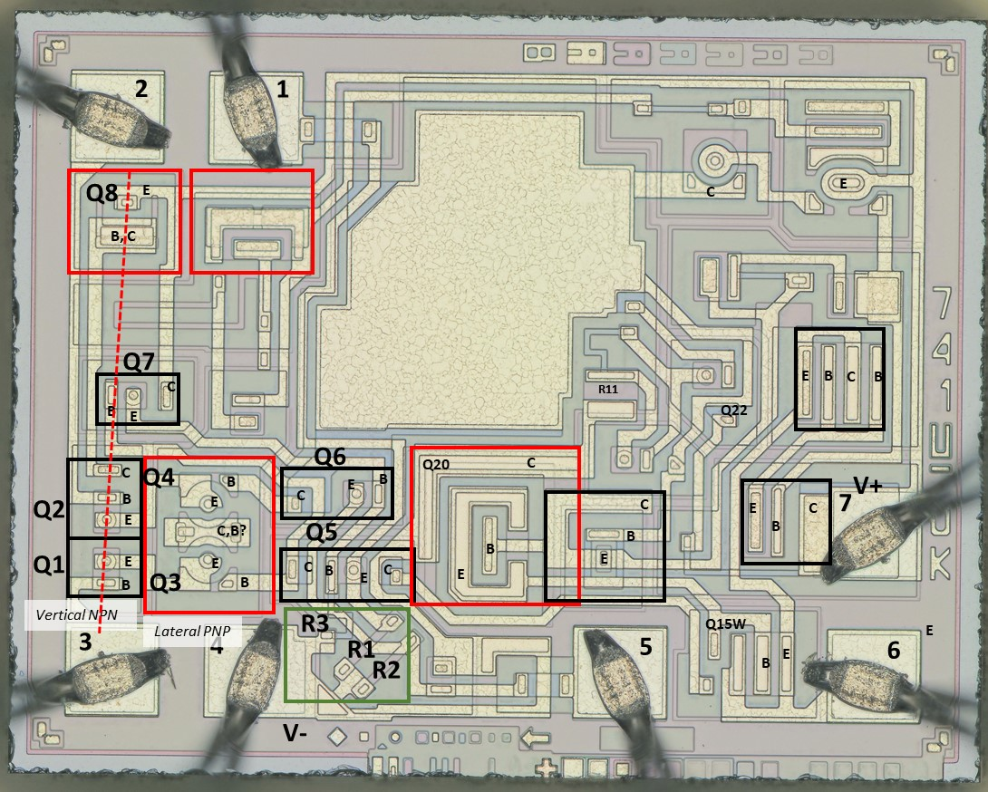

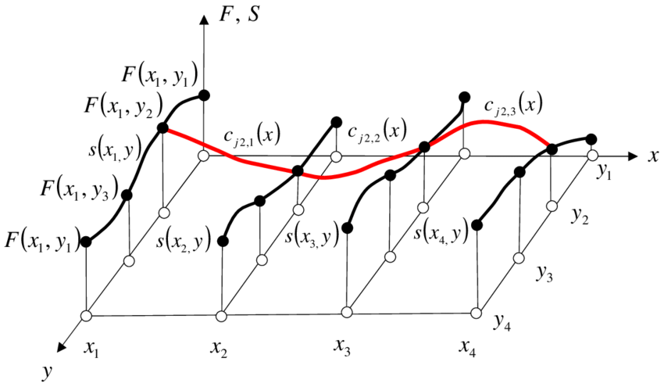
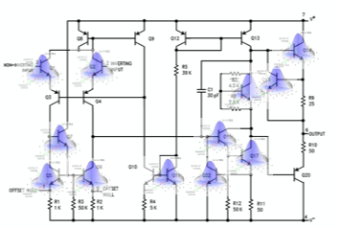
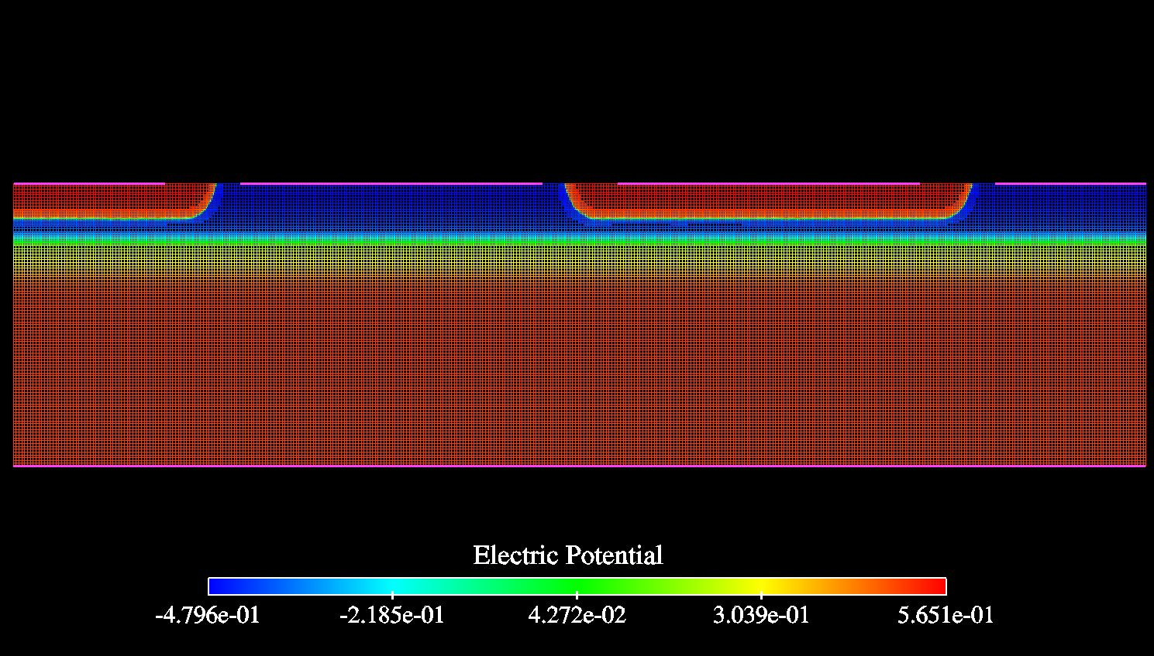
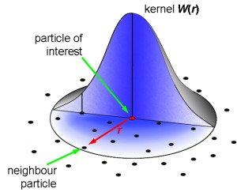
Our “data-to-simulation” pipeline in Xyce-PyMi
Xyce-PyMi
Measured or simulated (TCAD)
Data–driven models
Xyce-PyMi LM148 circuit model
Data-driven LM148 simulations

Slide 12
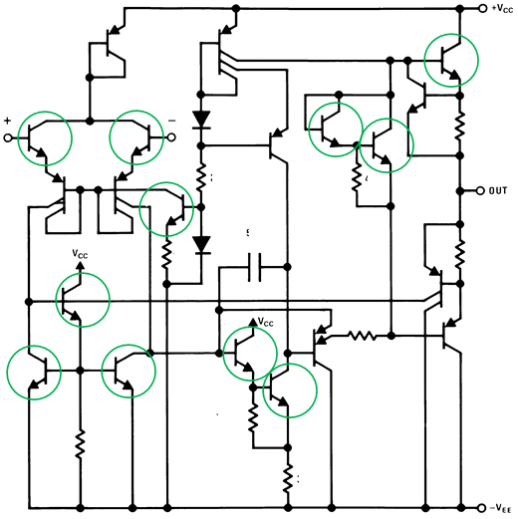
Demonstration Case: LM148 Op-Amp
Vendor Supplied Model- Validated with Xyce
LM148 Op-Amp Schematic
V_{cc}
Parameters thought to affect the forward characteristics of a transistor due to aging:
Gain, Emitter Resistance, and Transport Saturation Current
Generate 30 transistor datasets by perturbing the aging related parameters
Extract 30 data driven (DD) models
Execute 30 circuit simulations based on the 30 DD models, substituting all NPN transistors in the circuit with the
same DD model instance
+
-
NPN transistors identified
Generate a statistical sampling of datasets for data-driven models derived from a gaussian distribution of three parameters used in the compact models for the NPN Transistors in the LM148.​
Notes:
Move circuit die to previous slide.

Slide 13
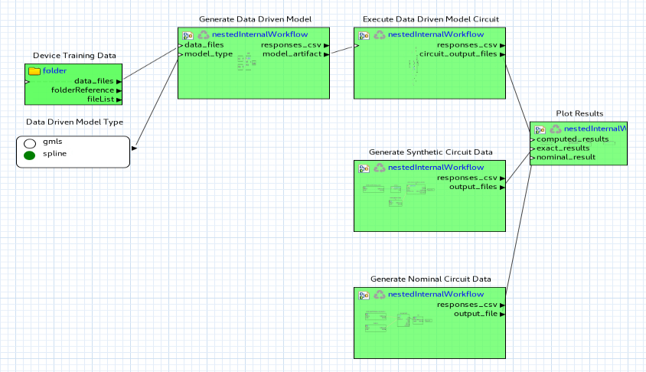
Sandia Analysis Workbench (SAW) workflow

Slide 14
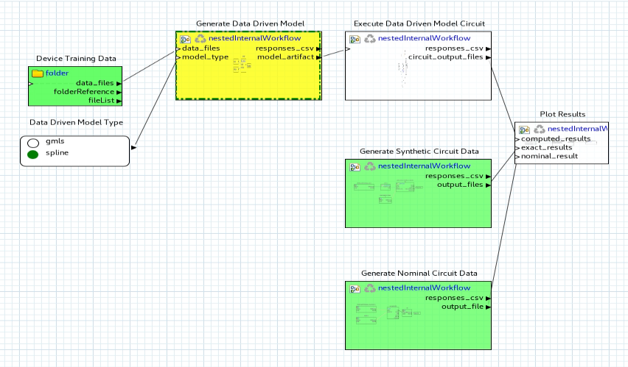
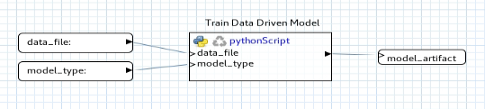

Slide 15
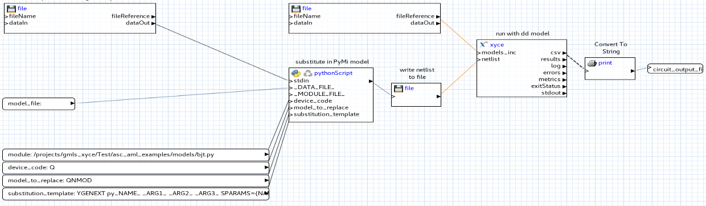

Slide 16
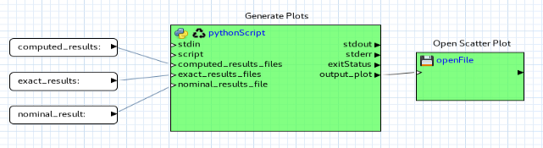

Slide 17
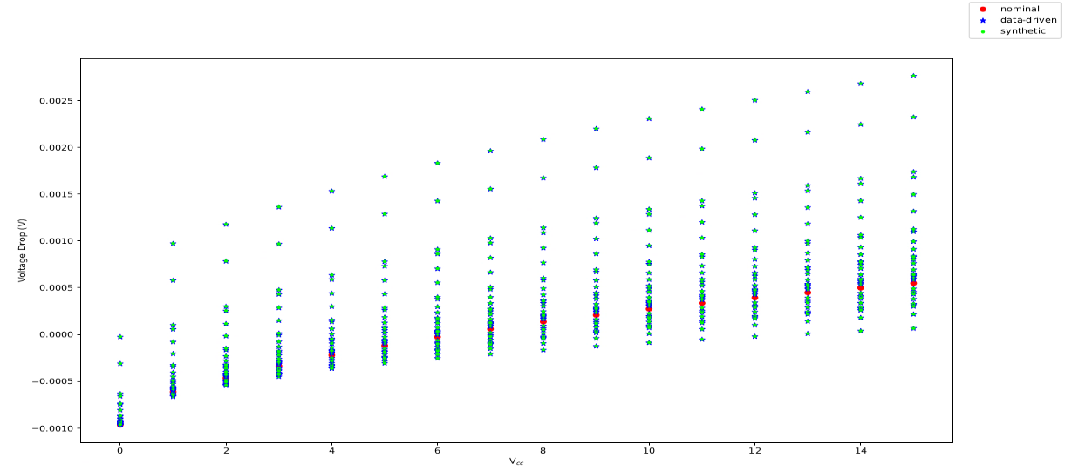
Comparison of 30 data-driven circuit results and exit criteria

Slide 18
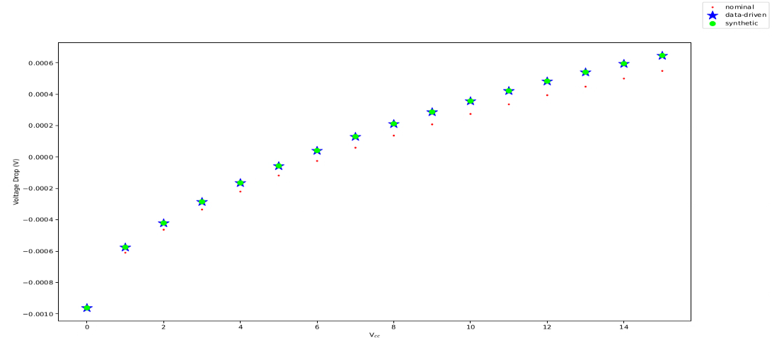
Single comparison of data-driven vs. synthetic circuit

Slide 19
Examples
Operational Amplifier with BJTs
**************
* Netlist for Operational Amplifier
**************
VDD 1 0 DC 2.5
R1 1 4 1e4
R2 1 5 1e4
R3 6 0 5e3
C1 4 0 5e-12
C2 5 0 5e-12
YGENEXT pyQ1 4 7 6
+ SPARAMS={NAME=MODULENAME,DATAFILE
VALUE=../models/gmls_bjt_2N2222.py,../data/2N2222_alan.01.dat}
RQ1 7 2 50
YGENEXT pyQ2 5 8 6
+ SPARAMS={NAME=MODULENAME,DATAFILE
VALUE=../models/gmls_bjt_2N2222.py,../data/2N2222_alan.01.dat}
RQ2 8 3 50
Em_plus 2 0 VALUE={1+50e-3*sin(2*pi*10*time)}
Em_minus 3 0 VALUE={1-50e-3*sin(2*pi*10*time)}
* Runs GMLS on data generated from synthetic MMBT2222, NPN, Fairchild
Fast switching 1N4148 diode in bridge rectifier
**************
* Netlist for Bridge Rectifier
**************
V3 1 2 SIN (0 2 10)
R3 3 0 10M
R4 3 4 100K
YGENEXT pyd3 1 4
+ SPARAMS={NAME=MODULENAME,DATAFILE VALUE=../models/gmls_diode_1N4148.py,../data/1N4148_synthetic.dat}
YGENEXT pyd1 3 1
+ SPARAMS={NAME=MODULENAME,DATAFILE VALUE=../models/gmls_diode_1N4148.py,../data/1N4148_synthetic.dat}
YGENEXT pyd4 3 2
+ SPARAMS={NAME=MODULENAME,DATAFILE VALUE=../models/gmls_diode_1N4148.py,../data/1N4148_synthetic.dat}
YGENEXT pyd2 2 4
+ SPARAMS={NAME=MODULENAME,DATAFILE VALUE=../models/gmls_diode_1N4148.py,../data/1N4148_synthetic.dat}
.TRAN 0 0.3s
.options timeint reltol=1.0e-4
.PRINT TRAN V(1) V(2) V(3) V(4) V(2,1) V(4,3)
.END
* Runs GMLS on data generated from synthetic 1N4148

Slide 20
Example results using experiments
Fast switching diode 1N4148 spline model
1N4148
1N4148
1N4148
1N4148
Zener diode MMSZ5239 (9.1 V, 500 mW)

Slide 21
Questions?
Installation / usage details:
P. Kuberry, E. Keiter, An embedded Python model interpreter for Xyce (Xyce-PyMi),
Sandia Report SAND2021-9504, 2021. doi:10.2172/1813650.
https://spack.readthedocs.io
https://pybind11.readthedocs.io
https://cee-gitlab.sandia.gov/Xyce/code/uur-proprietary/
Xyce/-/wikis/Developer-Guide/Building-and-Testing/Xyce-PyMi

