Slide 1
Error-in-variables modelling for operator learning
MLDL 2022 Workshop
Ravi G. Patel(1441), Indu Manickam(5555), MK Lee(University of Alabama), Mamikon Gulian(8734),

Slide 2
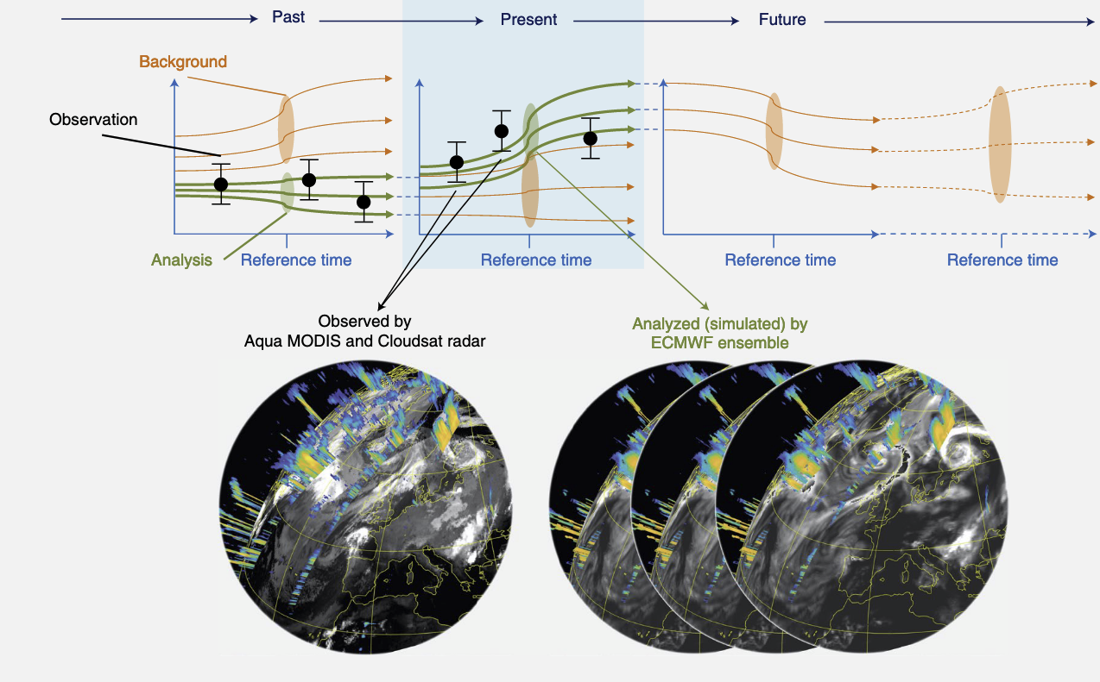
Operator learning – an ingredient for surrogate models
An Earth digital twin - combining MODIS and Cloudsat observations with ECMWF simulations¹
¹Bauer et al., Nature Computational Science, 2021

Slide 3
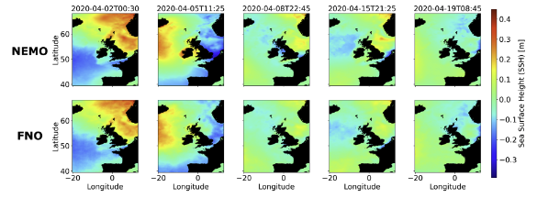
Operator learning – an ingredient for surrogate models
Operator learning as a component of digital twins. FNO used to emulate NEMO simulations of coastal and ocean dynamics²
An Earth digital twin - combining MODIS and Cloudsat observations with ECMWF simulations¹
¹Bauer et al., Nature Computational Science, 2021
²Jiang et al., arXiv:2110.07100, 2022

Slide 4
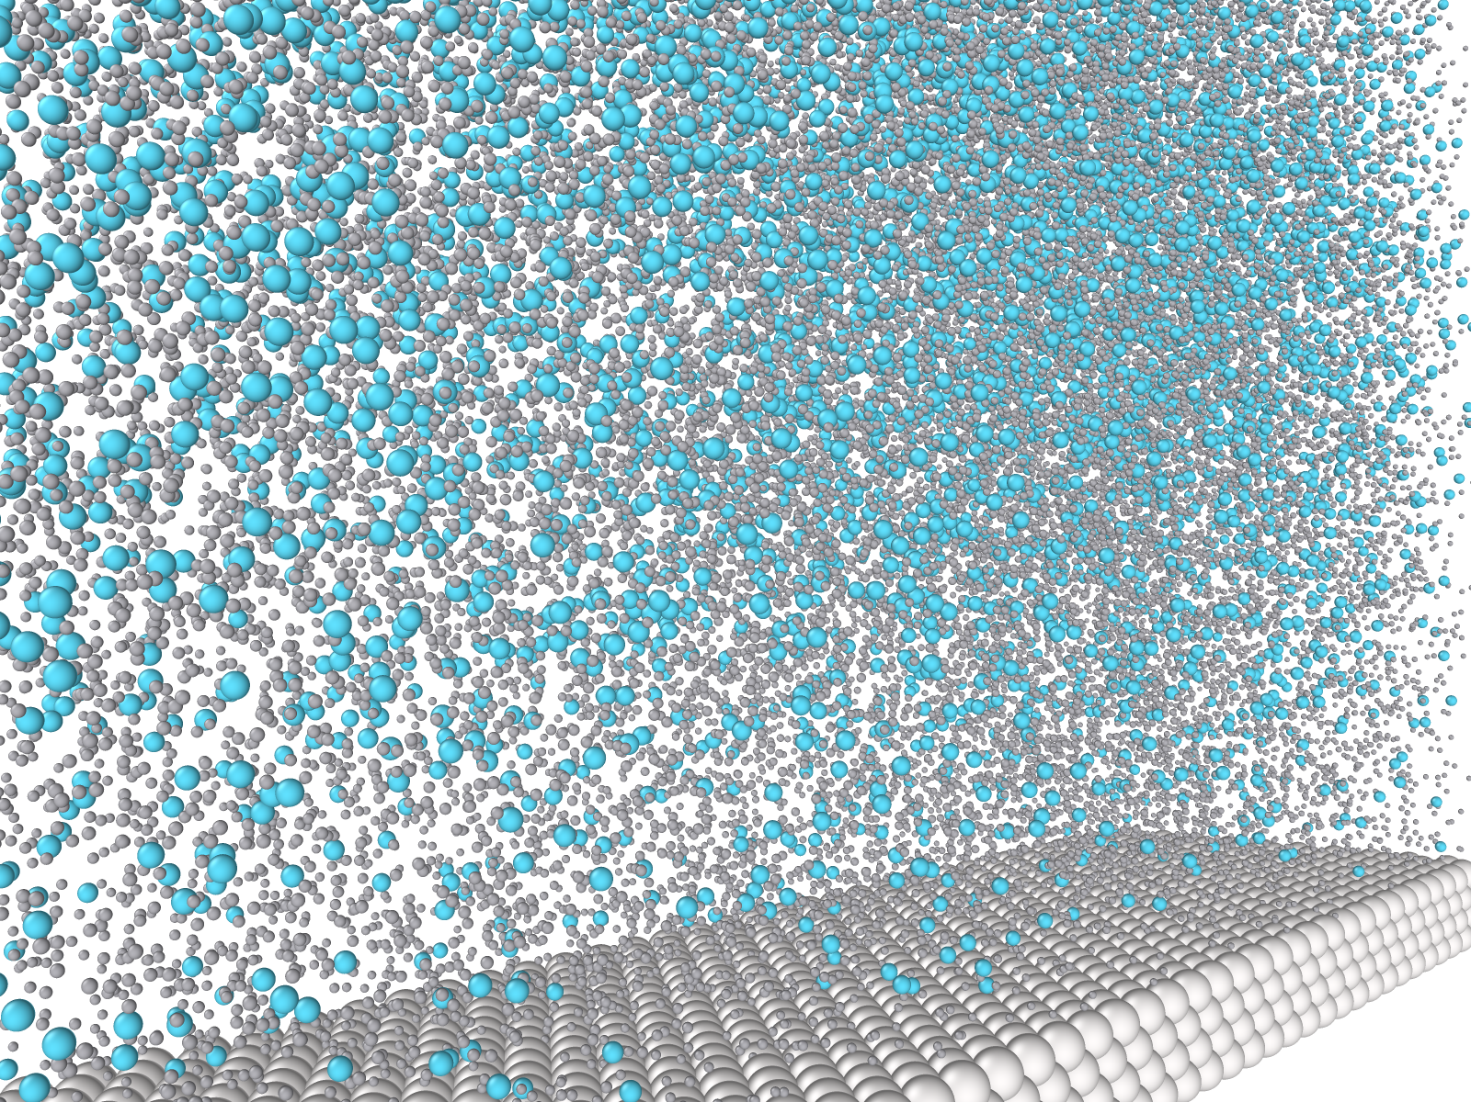
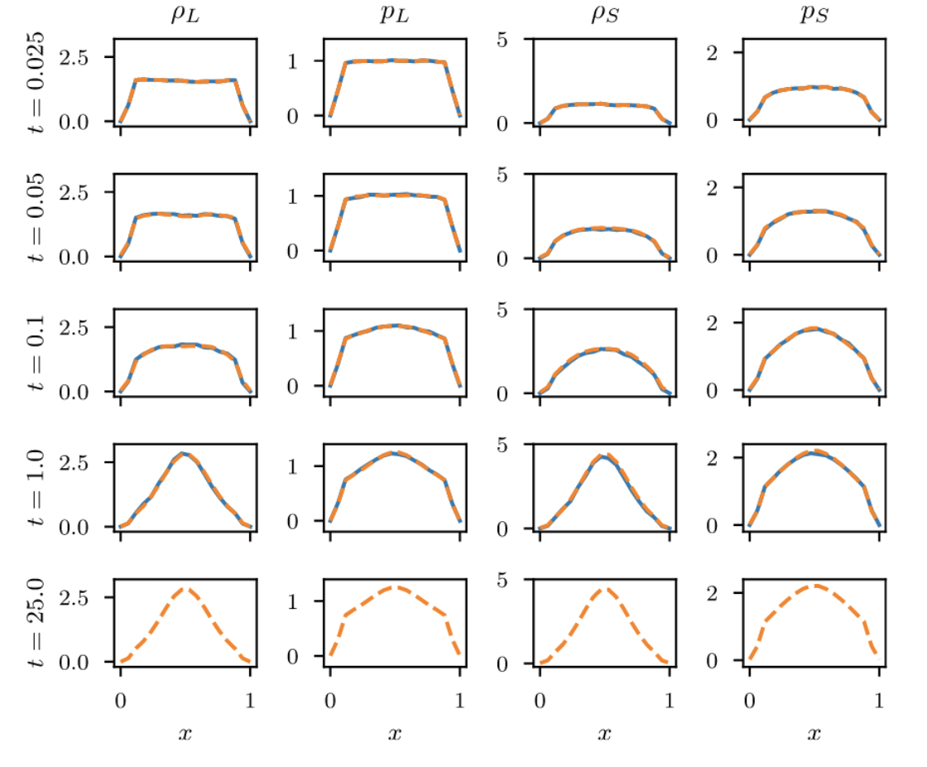
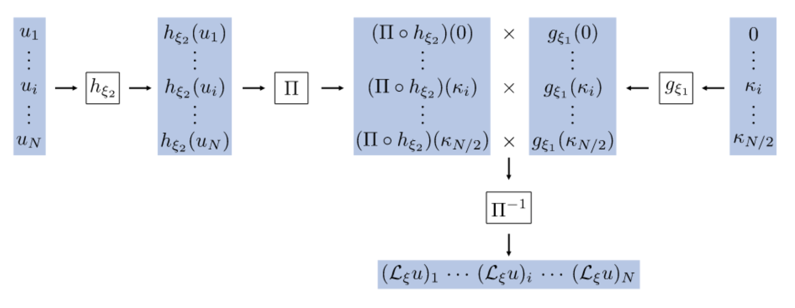
Operator learning methods
MOR-Physics^{1,2}
MOR-Physics parameterization
MOR-physics learns dynamics of colloidal system from molecular dynamics simulations. Generalizes to unseen concentration and colloid diameter
¹Patel and Desjardins, arXiv:1810.08552, 2018
²Patel et al., CMAME, 2021

Slide 5
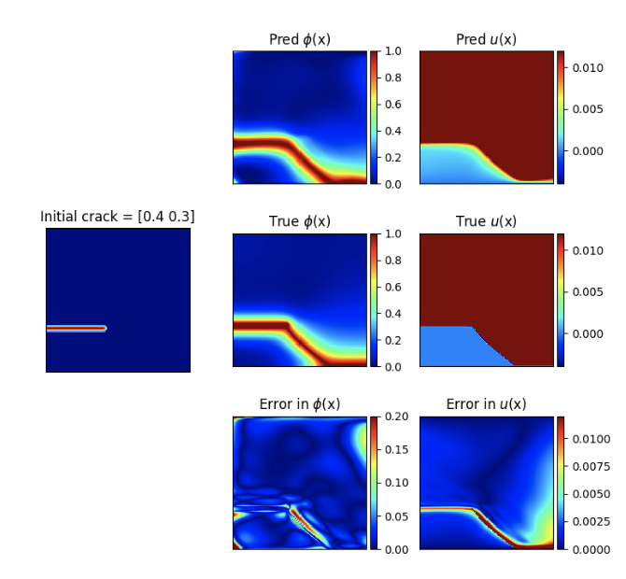
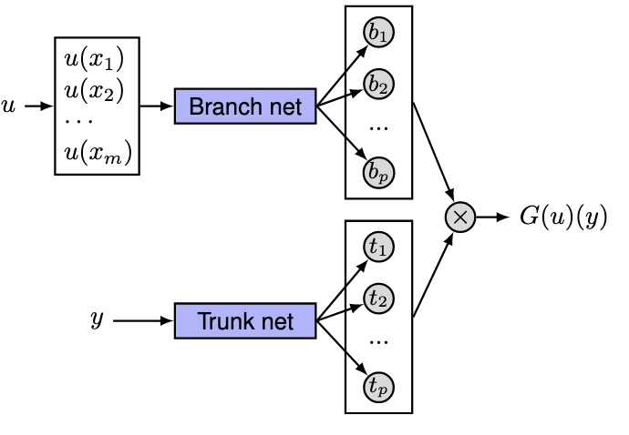
Operator learning methods
DeepONet¹
Unstacked DeepONet parameterization
Variational DeepONet learns crack path under shear loading. Generalizes to unseen crack tip locations.²
¹Lu, Jin and Karniadakis, Nature, 2021
¹Goswami et al., CMAME, 2022

Slide 6
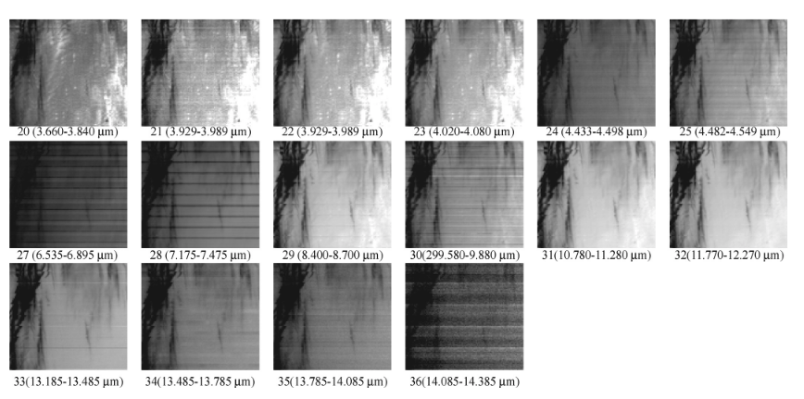
Functional data is always noisy
Terrestrial MODIS data exhibits striped noise pattern¹
¹Liu et al., IEEE GEOSCIENCE AND REMOTE SENSING LETTERS, 2006

Slide 7
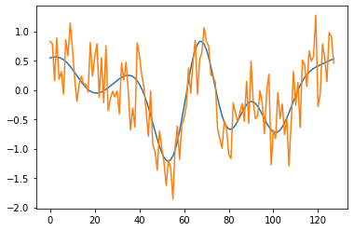
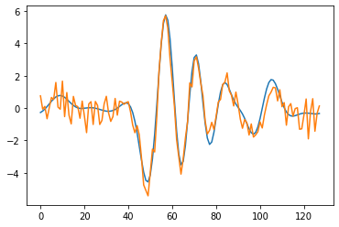
Noisy independent variables lead to biased estimates in ordinary least-squares (OLS) operator regression
Find

Slide 8
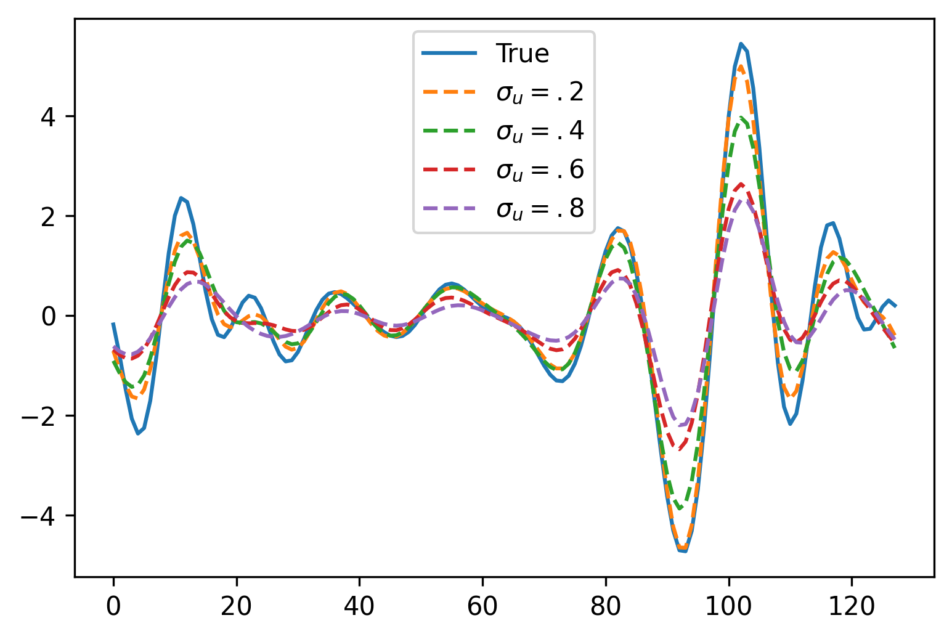
Noisy independent variables lead to biased estimates in ordinary least-squares (OLS) operator regression
OLS:
Find
Action of learned operators on noiseless test u:

Slide 9
Noisy independent variables lead to biased estimates in ordinary least-squares (OLS) operator regression
OLS:
Find
Action of learned operators on noiseless test u:
Project goal:
Develop and demonstrate an error model that corrects for bias
Assuming smooth functions and white noise

Slide 10
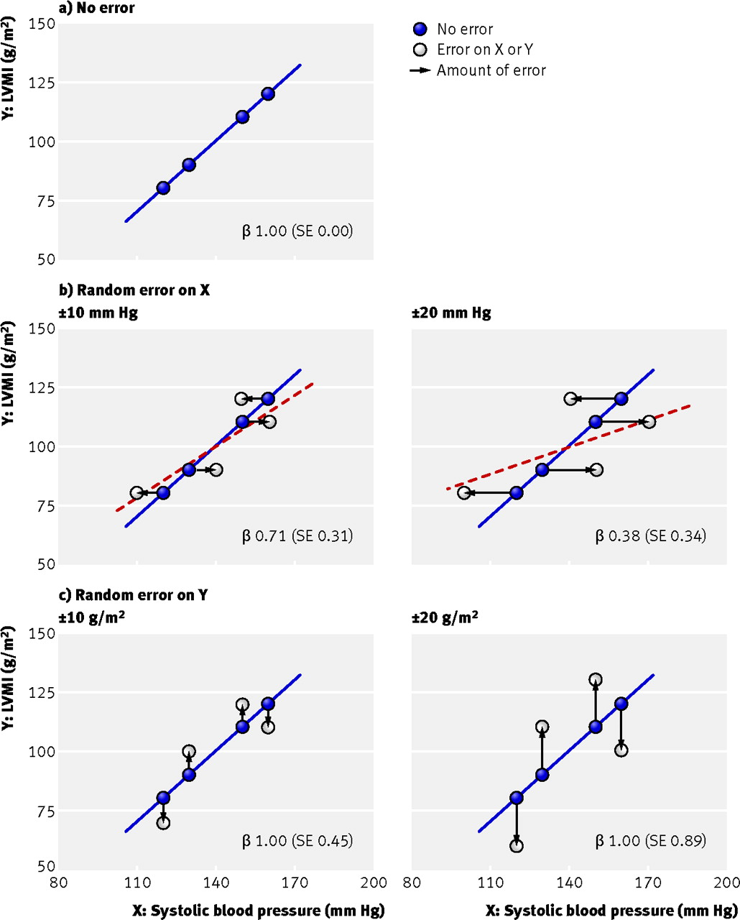
Attenuation bias for scalar linear regression
Slope is underpredicted by OLS with error in x
True slope vs. predicted slope via OLS:
Hutcheon, Chiolero, and Hanley, BMJ, 2010

Slide 11
Error-in-variable (EiV) models for standard regression
Given,
Find
Tools are narrowly tailored
Deming regression and total least-squares – variance/covariance must be known
Thesis with review of EiV models: Zwanzig, Estimation in nonlinear functional error-in-variables models, 1997

Slide 12
Generalization of attenuation bias to discrete linear operators
Given
Let be finite dimensional and be linear
Assume enough data such that the sample statistics converge
The optimum of the OLS problem,
is
With norm upperbound,

Slide 13
EiV model for operator regression
Error model,
Use maximum likelihood estimation (MLE)
Assume is a smooth function and introduce a filter

Slide 14
Smoothness prior
Use a smooth spectral filter,
Use a Beta distribution for prior (approximation to ),
Maximum a posteriori estimation (MAP),
are hyperparameters

Slide 15
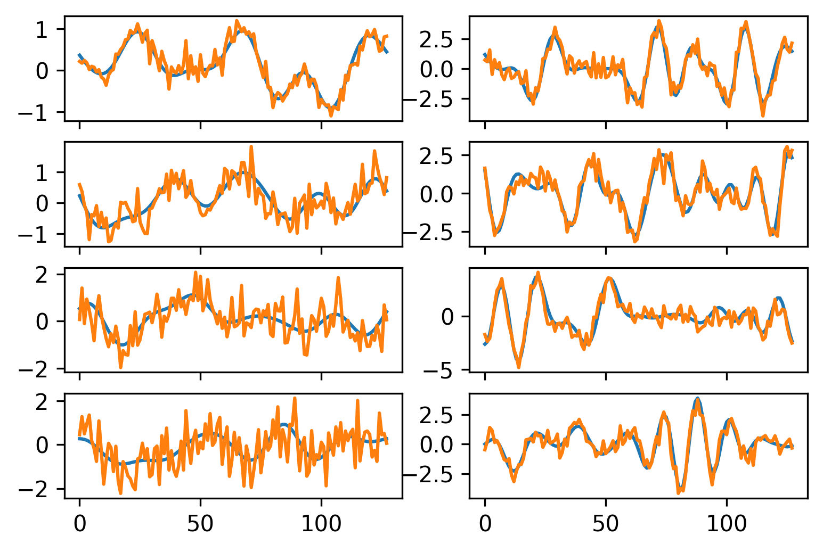
Learning the Burgers operator with noisy input
Data
Recover Burgers operator,

Slide 16
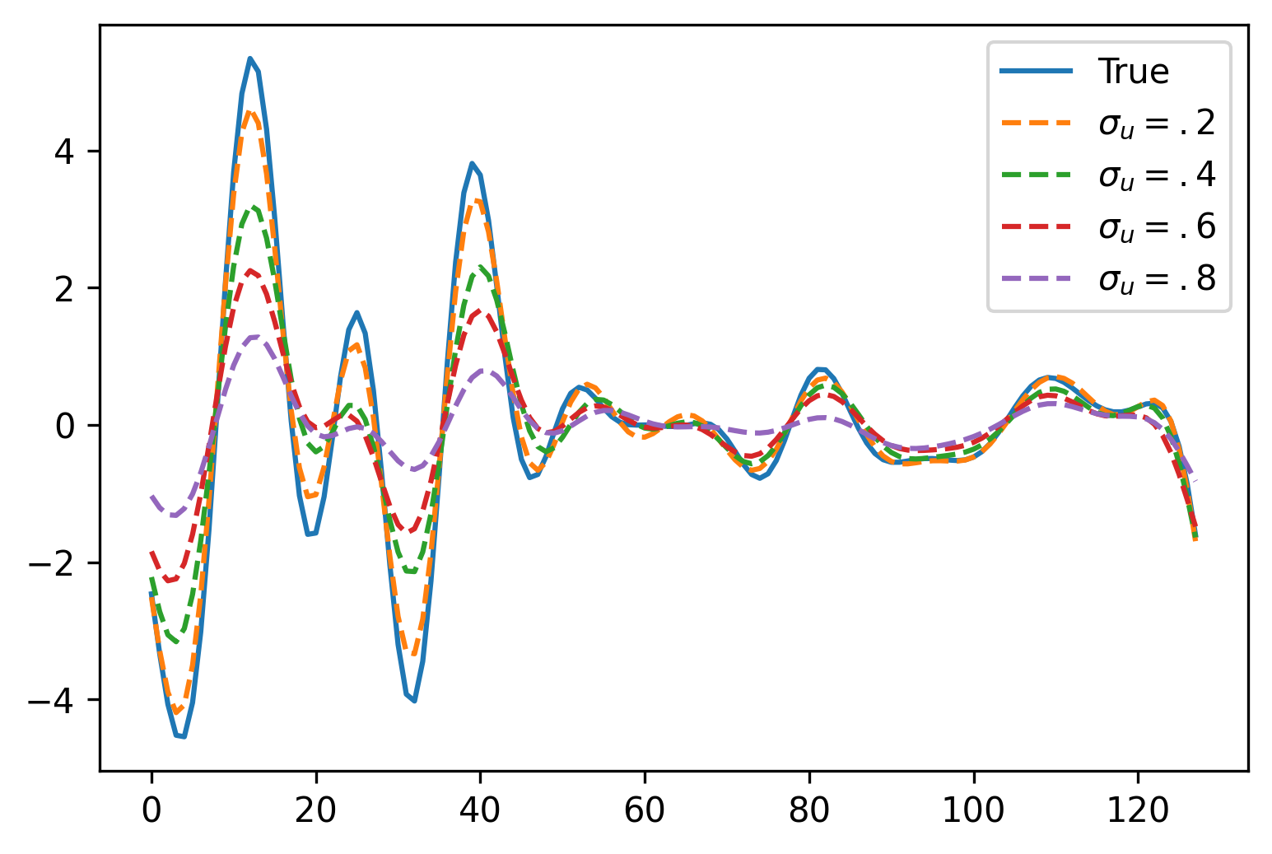
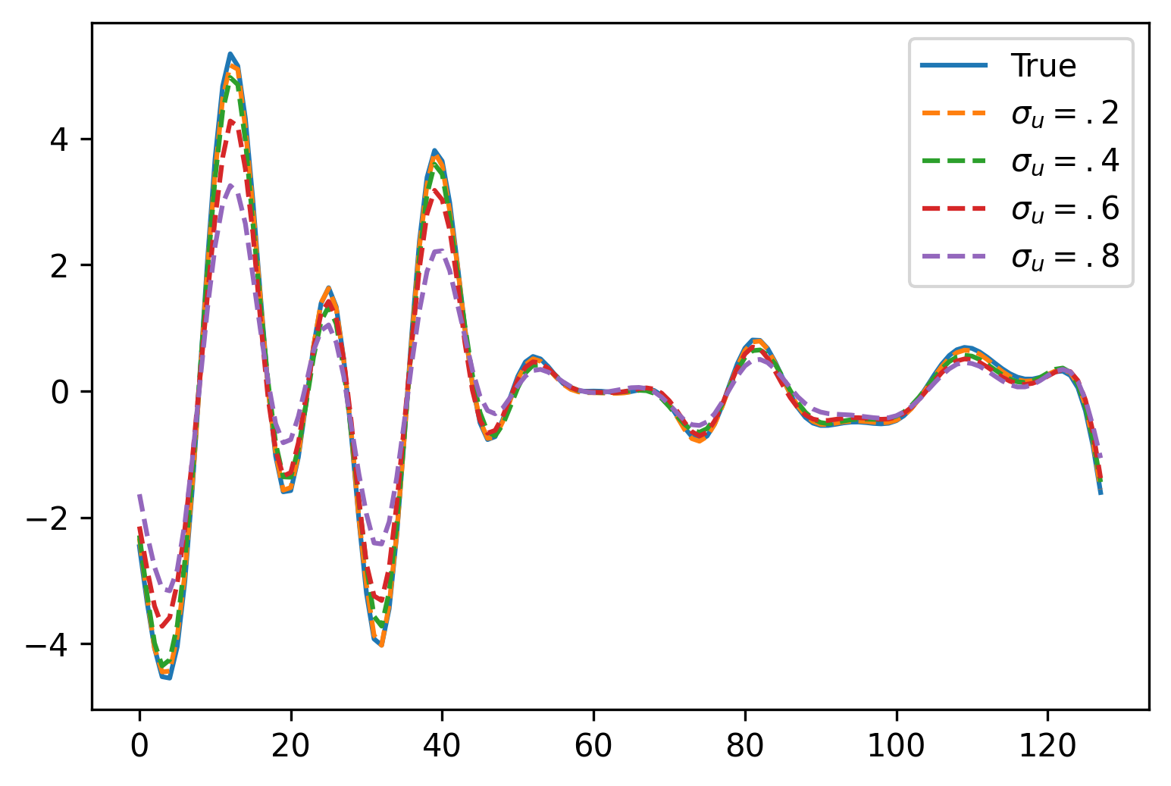
EiV model reduces attenuation bias in learning the Burgers operator – MOR-Physics
Action of OLS operator on clean u
Action of EiV operator on clean u
Increasing noise
Increasing noise

Slide 17
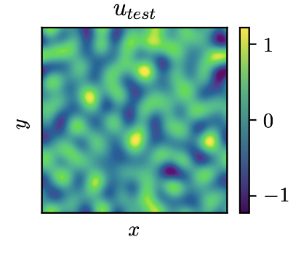
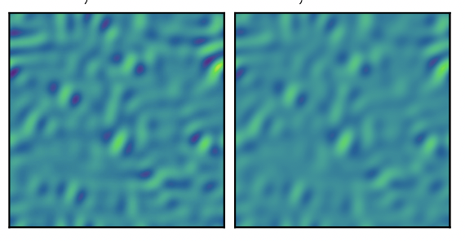
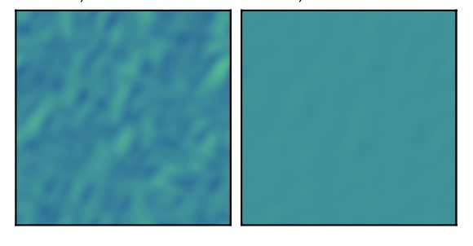
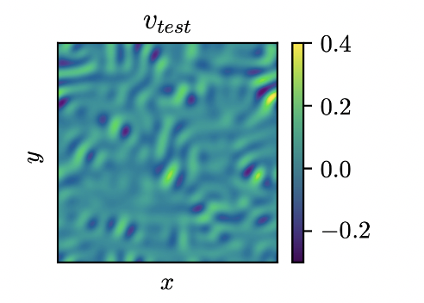
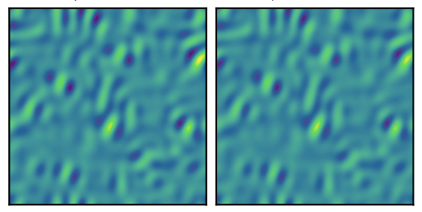
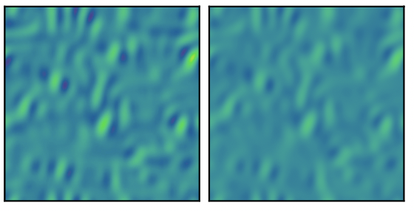
EiV model reduces attenuation bias in learning the 2D Burgers operator – MOR-Physics
Increasing Signal to noise (SNR) in training data
Noise free test function
OLS learned model applied to
EiV learned model applied to
True operator’s action

Slide 18
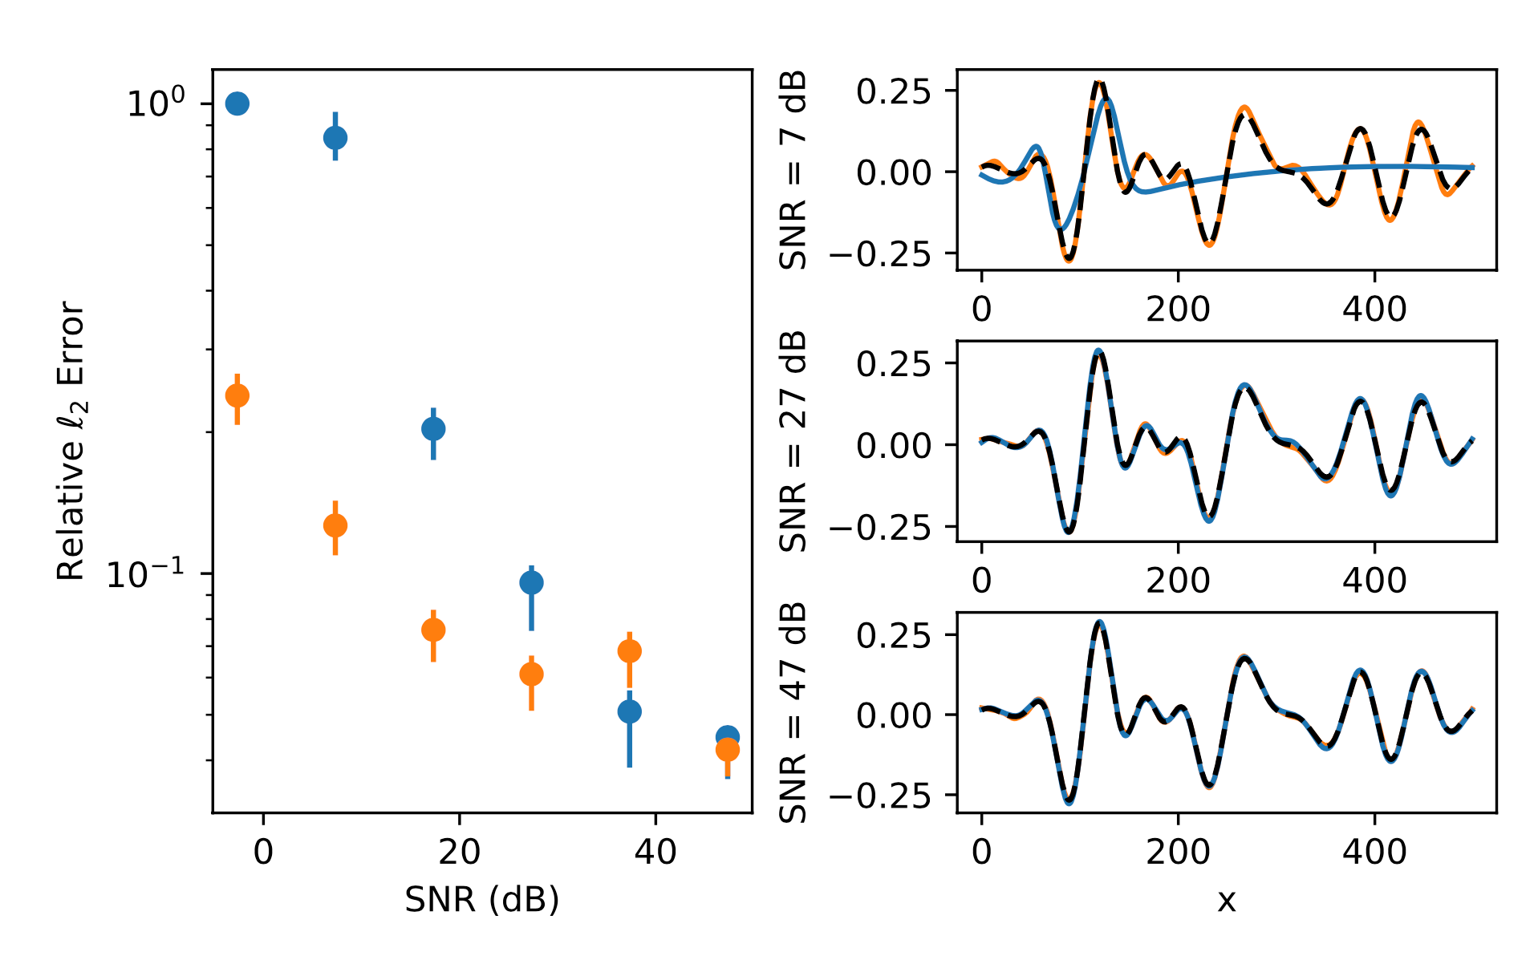
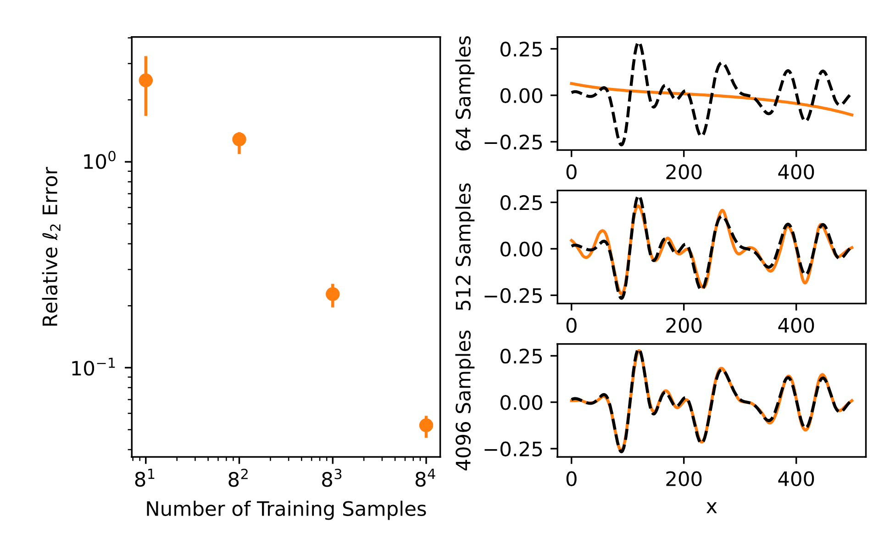
Statistics on learning the Burgers operator with EiV vs. OLS – DeepONets
OLS ( ) and EiV ( ) training error vs. SNR
EiV ( ) training error vs. number of samples

Slide 19
Conclusion
Failure to account for error in the independent variables leads to biased estimates for operator regression
Developed an error-in-variables model to correct for bias
Demonstrated this error model with MOR-Physics and DeepONet
Future work
  Explore the full posterior distribution of operators
    Besides the MAP, how do other plausible operators behave?
    UQ - The action of operators sampled from the posterior will give error bars
  Other error models, e.g. multiplicative noise
  Relax smoothness assumption
  Manuscript,
  Patel et al., arXiv:2204.10909, 2022

