Slide 1
Safety for Learning-based Differentiable Predictive Control
Wenceslao Shaw Cortez, Data Scientist
w.shawcortez@pnnl.gov
Jan Drgona, Aaron Tuor, Mahantesh Halappanavar, Draguna Vrabie

Slide 2
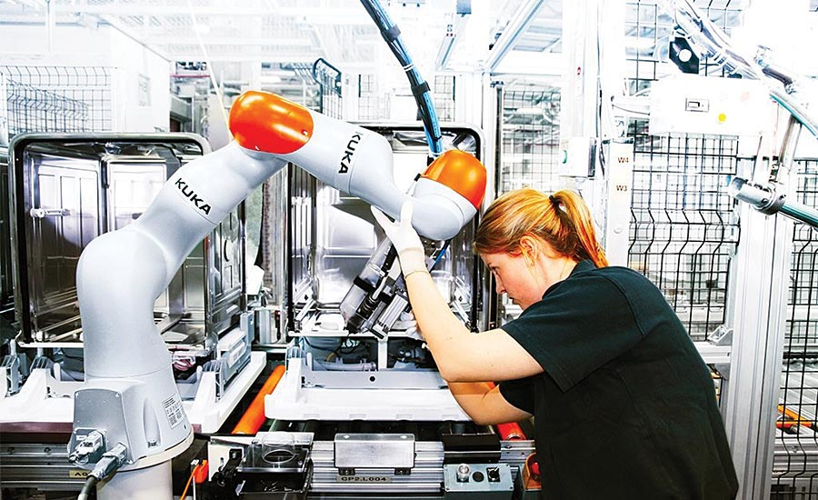
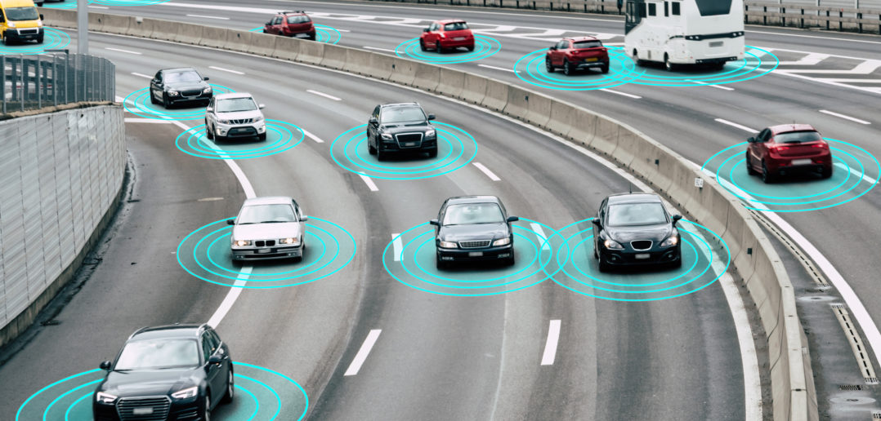
Motivation: Safety-Critical Control
Increased automation in human environments
  Robots
  Automated vehicles
Prevent system damage
Task specifications (not just stability)
Safety is Critical

Slide 3
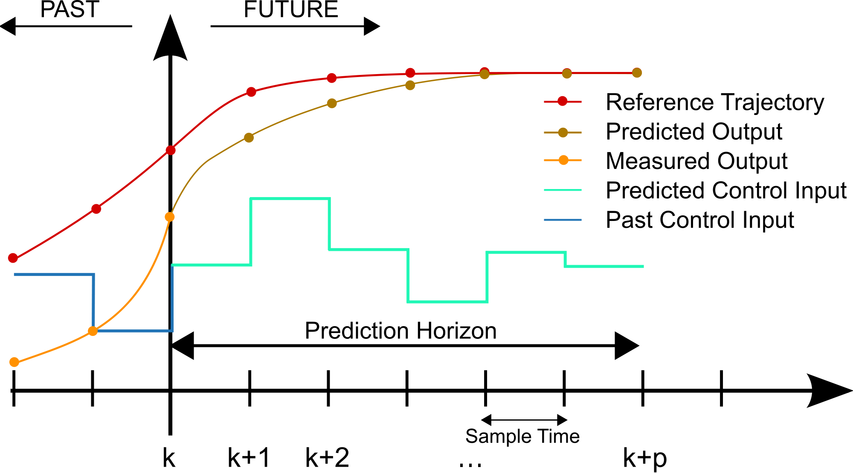
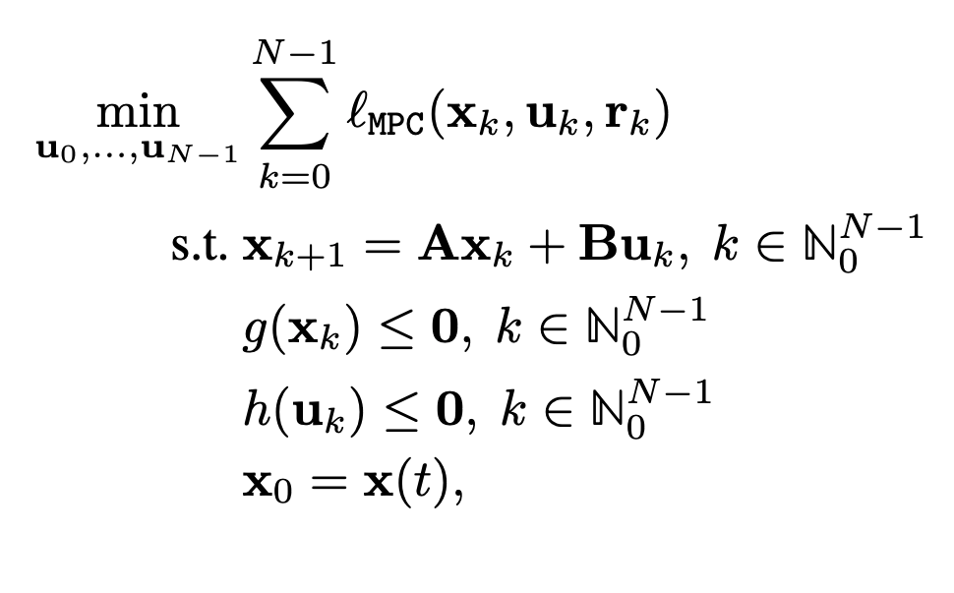
Model Predictive Control (MPC)
Cost:
Model Predictive Control
Advanced optimal control
First devised for process control in 1970’s
Handles constraints and optimality
Computationally expensive
Model:
Constraints:

Slide 4
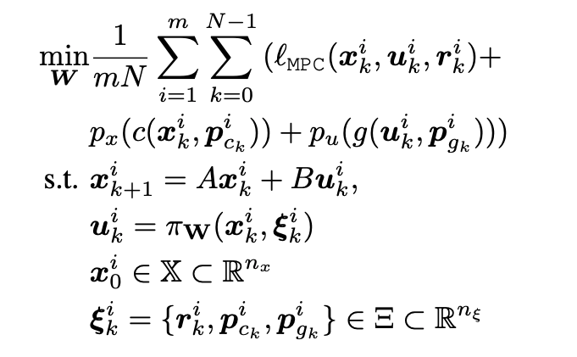
Differentiable Predictive Control (DPC)
From data to optimized control policy
MPC
DPC
Handles constraints and optimality
Computationally expensive
  Theoretical connection with MPC
  Offline computation, no online optimization
  Time-varying reference/constraints
Drgona, Jan, Karol Kis, Aaron Tuor, Draguna Vrabie, and Martin Klauco. “Deep Learning Alternative to Explicit Model Predictive Control for Unknown Nonlinear Systems.” 2021. http://arxiv.org/abs/2011.03699.

Slide 5
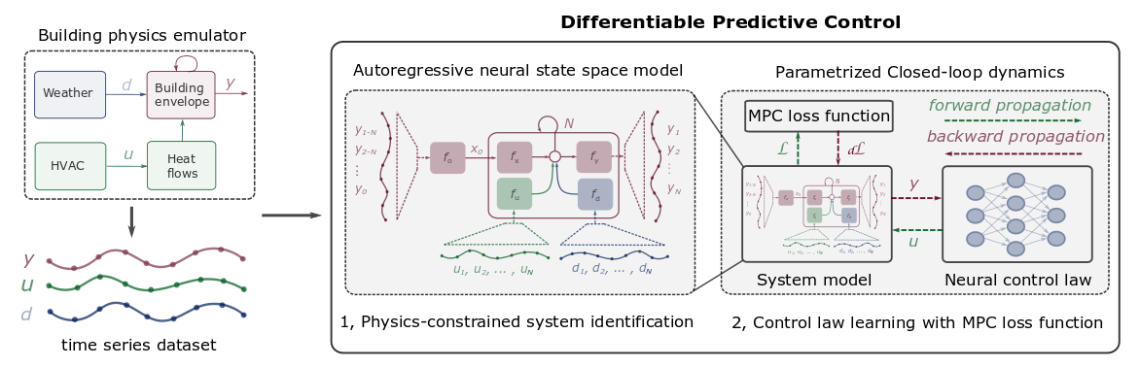
Differentiable Predictive Control (DPC)
From data to optimized control policy
  Limited guarantees of stability/constraint satisfaction
  No robustness to perturbations (e.g. model uncertainty)
  Theoretical connection with MPC
  Offline computation, no online optimization
  Time-varying reference/constraints
Drgona, Jan, Karol Kis, Aaron Tuor, Draguna Vrabie, and Martin Klauco. “Deep Learning Alternative to Explicit Model Predictive Control for Unknown Nonlinear Systems.” 2021. http://arxiv.org/abs/2011.03699.

Slide 6
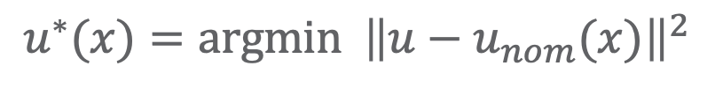


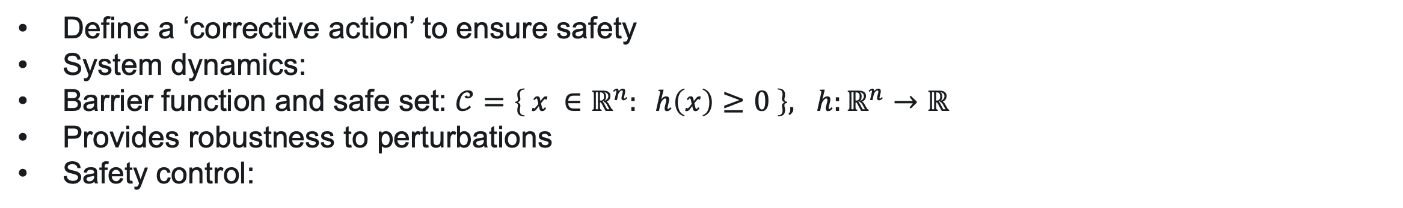
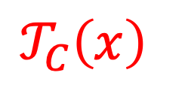

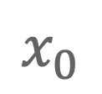
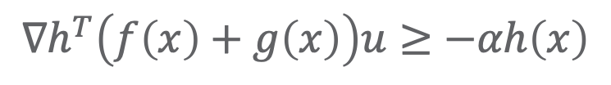
Zeroing Control Barrier Functions (ZCBFs)
Define a ‘corrective action’ to ensure safety
System dynamics:
Barrier function and safe set: $𝒞=\left\{ x ∈ℝ^{n}: h\left(x\right)≥0 \right\}, h:ℝ^{n}→ℝ$
Provides robustness to perturbations
Safety control:
$$\dot{x}=f\left(x\right)+g\left(x\right)u$$
$$u^{∗}(x)=argmin {\left\|u−u_{nom}(x)\right\|}^{2}$$
$$u∈𝒰$$
subject to:
$$x_{0}$$
$$𝒯_{C}\left(x\right)$$
$$∇h^{T}\left(f\left(x\right)+g\left(x\right)\right)u≥−αh\left(x\right)$$
Aim: Combine with DPC for guaranteed safety
$$𝒞$$
Ames, A.D., X. Xu, J.W. Grizzle, and P. Tabuada. “Control Barrier Function Based Quadratic Programs for Safety Critical Systems.” IEEE Transactions on Automatic Control 62, no. 8 (2017): 3861–76.

Slide 7
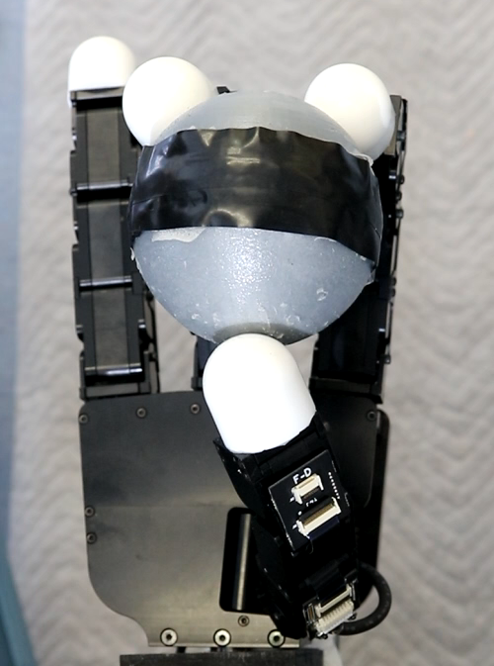
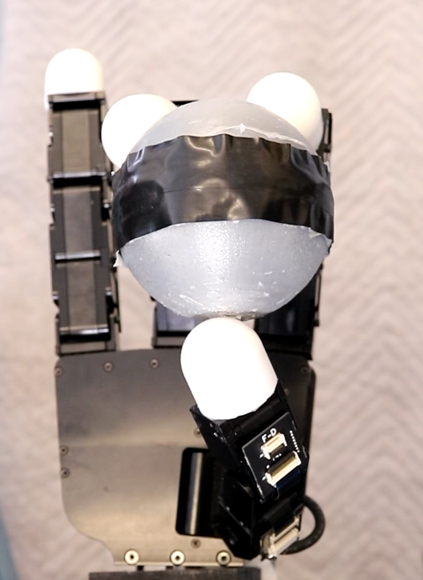



ZCBF Implementation
Nominal Control
Nominal + Proposed Control
  Barrier function implementation
  QP-based controller
  Allows any desired control to be implemented
$$u^{∗}(x)=argmin {\left\|u−u_{nom}(x)\right\|}^{2}$$
$$u∈𝒰$$
subject to:
$$∇h^{T}\left(f\left(x\right)+g\left(x\right)\right)u≥−αh\left(x\right)$$
Extension:
Time-varying constraints
Sampled-data systems
Minimally invasive for reduced computation

Slide 8

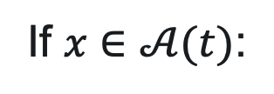

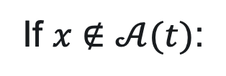
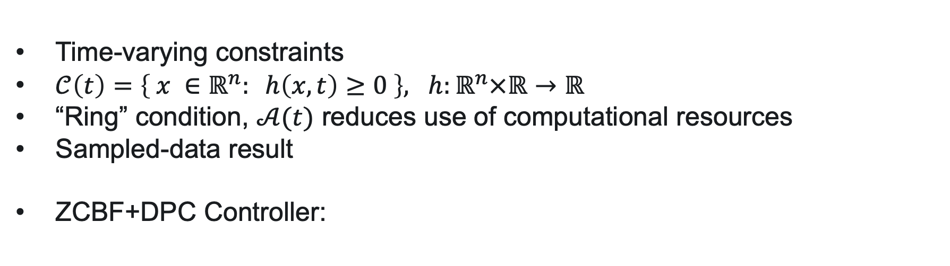
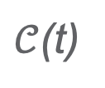


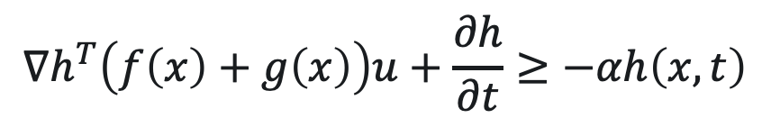


Modified ZCBFs+DPC
Time-varying constraints
$𝒞\left(t\right)=\left\{ x ∈ℝ^{n}: h\left(x,t\right)≥0 \right\}, h:ℝ^{n}×ℝ→ℝ$
“Ring” condition, $𝒜(t)$ reduces use of computational resources
Sampled-data result
ZCBF+DPC Controller:
Time slice
$$𝒜(t)$$
If $x∉𝒜(t)$:
$$u^{∗}(x)=π_{DPC}$$
*if DPC is trained ‘properly’, the ZCBF never interferes
If $x∈𝒜(t)$:
$$u^{∗}(x)=argmin {\left\|u−π_{DPC}\right\|}^{2}$$
$$u∈𝒰$$
*Ensures robustness and safety
$$x_{0}$$
subject to:
$$∇h^{T}\left(f\left(x\right)+g\left(x\right)\right)u+\frac{∂h}{∂t}≥−αh\left(x,t\right)$$
$𝒞$(t)

Slide 9


DPC: Training with Barriers
DPC
Barrier Condition:
$$\dot{h}≥−α\left(h\right)$$
Finite-difference approximation:
$$c_{h}(x_{k}^{i}, x_{k+1}^{i},k, k + 1)= h(x_{k+1}^{i}, k + 1) − h(x_{k}^{i}, k)+ α(h(x_{k}^{i}, k)) − d$$
  Software products:
  https://github.com/pnnl/neuromancer
  https://github.com/pnnl/slim

Slide 10
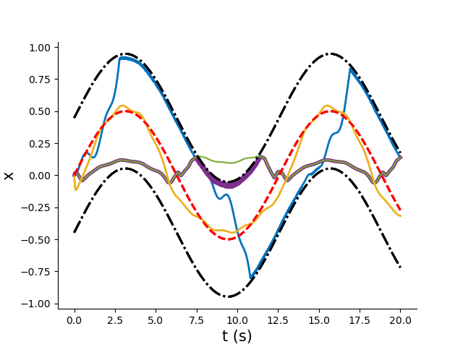
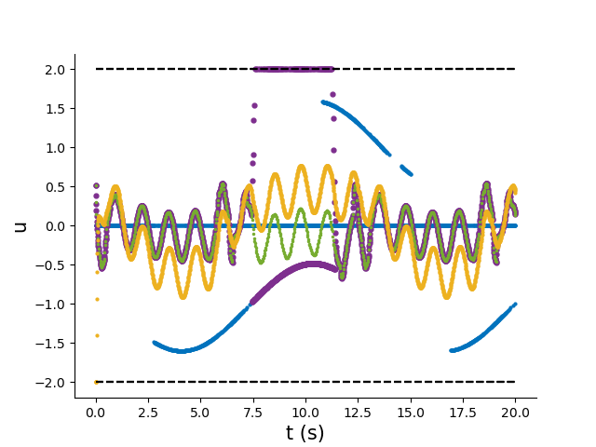

ZCBF and DPC Implementation
Barrier only
DPC only (poorly trained)
ZCBF+DPC (poorly trained)
ZCBF+DPC (ideally trained)
$$\dot{x} = Ax + u + w\left(t\right)$$
$$h\left(x, t\right):= ε − ∥x − x_{r} \left(t\right)∥_{2}^{2}$$

Slide 11

Future Directions
Extend to more general systems, higher order: $\dot{x}=f(x,u)$
Synthesize ZCBFs via learning methods with guarantees
Certify safety for learning-based controllers

Slide 12
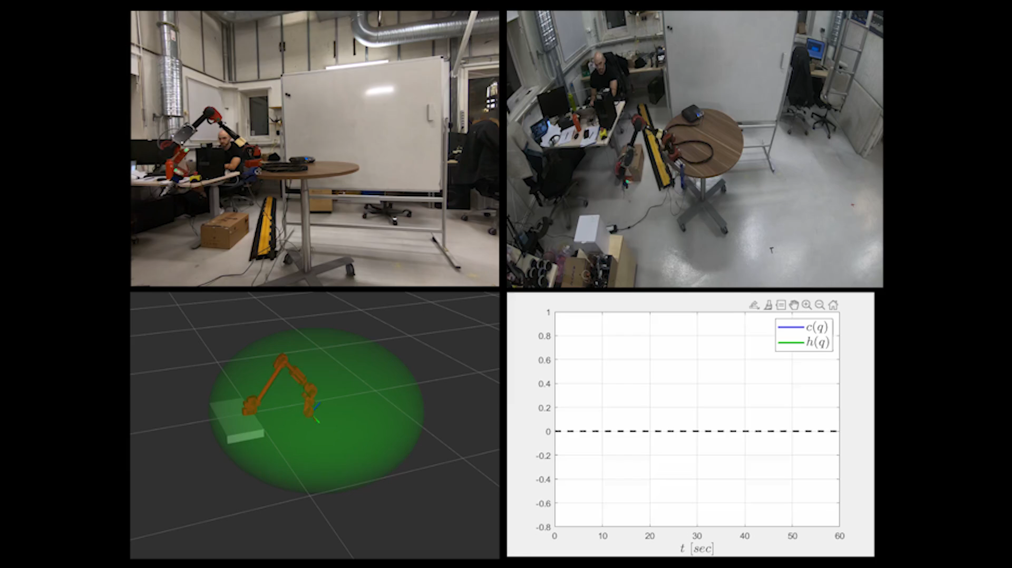
Implementation
Demonstration 1: Nominal Control Only

Slide 13
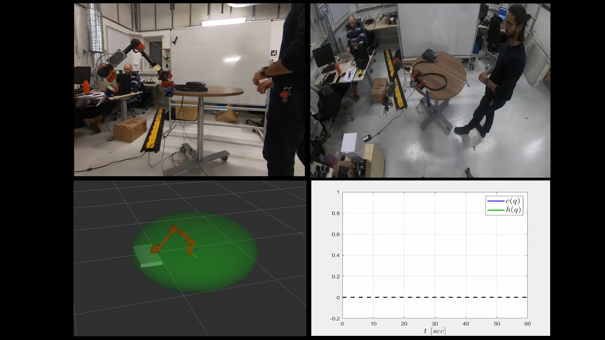
Demonstration 2: Proposed Control Law

