Slide 1
Decision Science for Machine Learning (DeSciML)
Rich Field / 5553
Michael Darling / 8732, J.D. Doak / 8765, James Headen / 6754, Mark Smith / 5493
J. Eric Bickel / UTA, Jason Boada / UTA, Zack Smith / UTA
LDRD Project 222397
SAND2022-9199 C

Slide 2
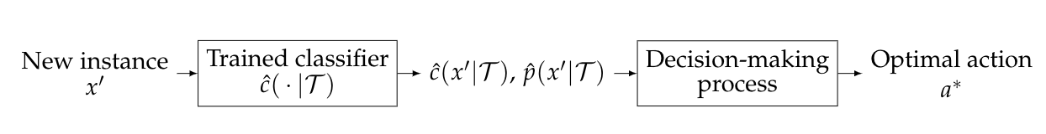
Overview of the Problem
Objective: Use outputs from a ML classifier for decision-making
  Make decisions for individual instances (high consequence applications)
  Account for uncertainty in ML model outputs
ML classification is not the same as decision-making
Cost-sensitive ML is limited
  Minimizes costs averaged over a population instead of optimizing individual decisions
  Cost may not be the only objective
Decision theory can be used
  Account for cost / consequences of each decision
  Can consider multiple objectives (cost, risk, security, etc.)
  Standard DT must be modified to handle uncertainty in ML model outputs
Example application: URL classification

Slide 3
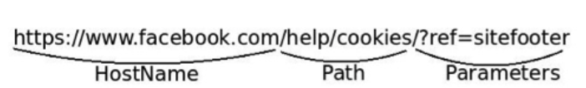
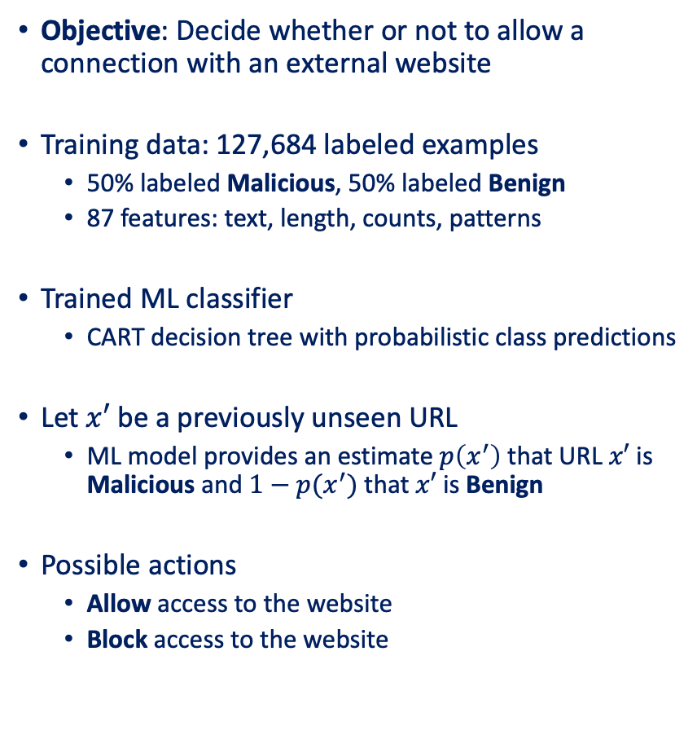

Motivating Example: URL Classification
Objective: Decide whether or not to allow a connection with an external website
Training data: 127,684 labeled examples
  50% labeled Malicious, 50% labeled Benign
  87 features: text, length, counts, patterns
Trained ML classifier
  CART decision tree with probabilistic class predictions
Let $x′$ be a previously unseen URL
  ML model provides an estimate $p\left(x^{′}\right)$ that URL $x′$ is Malicious and $1−p(x^{′})$ that $x′$ is Benign
Possible actions
  Allow access to the website
  Block access to the website
What action should we take on $x′$?

Slide 4
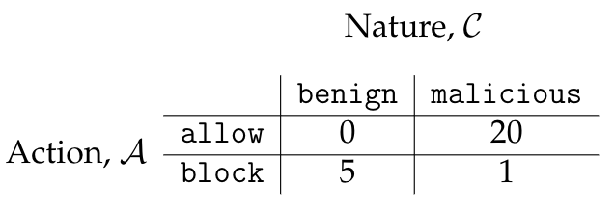
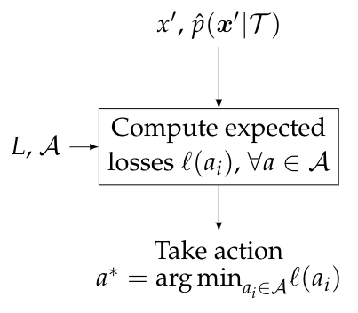
Decision Theory Applied to ML Classification
A decision problem has 4 ingredients:
The collection of possible actions to take
The collection of possible states of nature (the true labels)
A loss function
  Quantifies the consequences of taking an action given the true label
The optimal action
  Choose the action with the minimum expected loss
Decision-Making Process
Notes:
\mathcal{A} = \{ \text{all candidate actions} \} = \{ a_i \} = \{ \texttt{Allow}, \texttt{Block} \}
\mathcal{C} = \{ \text{all possible labels} \} = \{ C_i \} = \{ \texttt{Benign}, \texttt{Malicious} \}
L \colon \mathcal{A} \times \mathcal{C} \to [0, \infty)
\ell(a_i) &= \mathbb{E} [ L(a_i, \mathcal{C}) ] = \sum_{j=1}^{\kappa} L(a_i, C_j) \hat{p}_j(x')

Slide 5
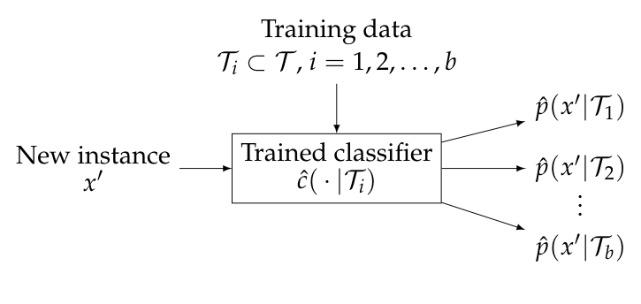
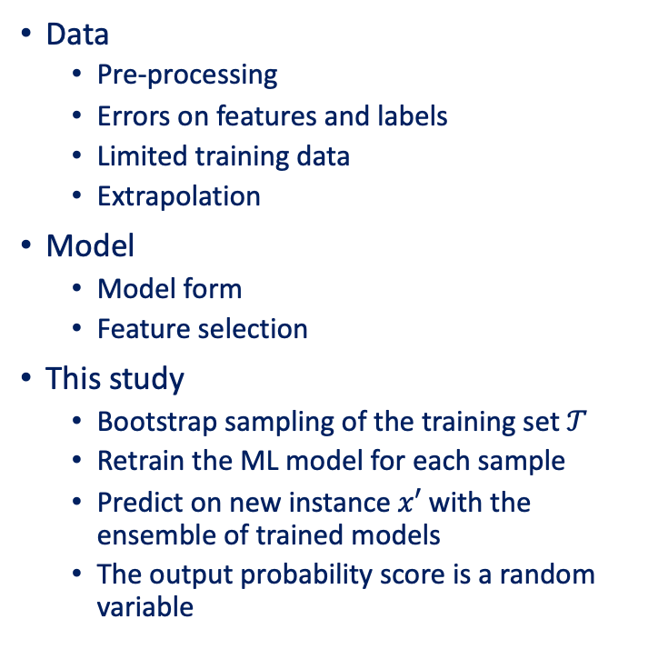
Uncertainty in ML Models
Data
  Pre-processing
  Errors on features and labels
  Limited training data
  Extrapolation
Model
  Model form
  Feature selection
This study
  Bootstrap sampling of the training set $𝒯$
  Retrain the ML model for each sample
  Predict on new instance $x′$ with the ensemble of trained models
  The output probability score is a random variable
Output from 1,000 ML models for one instance

Slide 6
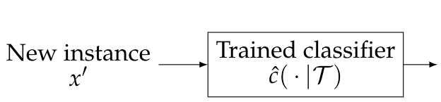
Modify the Expected Loss
The optimal action minimizes the expected loss
But the probability is now a random variable How do we handle this?
  We could use the mean, majority voting, etc., but that doesn’t utilize all information
Notes:
\hat{p}(x') &= \Pr(x' \text{ is \texttt{Malicious}}) \\
\hat{c}(x') &=
\begin{cases}
\texttt{Benign} & \text{if } p(x') \leq t \\
\texttt{Malicious} & \text{if } p(x') > t\\
\end{cases}
& \text{Random variable} \\
& ~~~~~~~~Q(x’)
\Pr(\hat{c}(x') = \texttt{Benign}) &= \Pr(Q(x') \leq t)\\
&= F(t)\\
\Pr(\hat{c}(x') = \texttt{Malicious}) &= \Pr(Q(x') > t)\\
&= 1 - F(t)\\

Slide 7
Examples
Assume the ensemble of outputs follows a beta distribution
Or a mixture of 2 Gaussian variables
PDF
CDF
The result is the same as the mean value only if the PDF is symmetric and t = 1/2
PDF
CDF
Notes:
\Pr(\hat{c}(x') = \texttt{Benign}) &= 0.8\\
\Pr(\hat{c}(x') = \texttt{Malicious}) &= 0.2\\
\text{Mean} &= 0.5
\Pr(\hat{c}(x') = \texttt{Benign}) &= 0.3\\
\Pr(\hat{c}(x') = \texttt{Malicious}) &= 0.7\\
\text{Mean} &= 0.58

Slide 8
Comparing 4 Methods for Analysis
Traditional method
  Decision = model output
  Uncertainty ignored
Cost-sensitive ML
  Consequences included in training (using loss function); averaged over the population
  Decision = model output
  Uncertainty ignored
Decision theory
  Consequence per instance quantified using a trained model
  Decision = action that minimizes expected loss
  Uncertainty ignored
Decision theory with uncertainty
  Consequence per instance quantified using a trained model
  Decision = action that minimizes expected loss
  Uncertainty accounted for

Slide 9
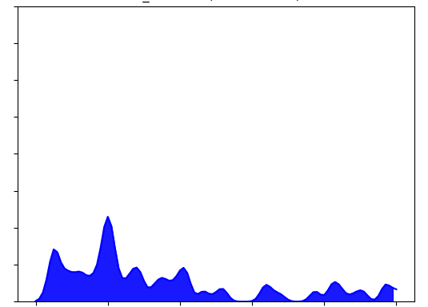
Results for URL Classification
True label = Malicious
PDF estimate from ensemble of ML models is at right
  Traditional approach would call this Benign and therefore decide to Allow
We apply decision-theoretic approach
  Asymmetric loss function
  Decision is to Block
When we consider all test URLs in the dataset
0 0.2 0.4 0.6 0.8 1.0
Approach | Accuracy | # Malicious URLs Allowed | # Benign URLs Blocked | Total loss
Traditional approach | 90.6% | 1,221 | 666 | $62,275
Cost-sensitive ML | 79.4% | 185 | 4,102 | $18,815
Decision theory | 84.4% | 309 | 2,834 | $8,155
Decision theory with uncertainty | 98.5% | 249 | 61 | $4,615

Slide 10
Summary
Objective: Integrate machine learning, uncertainty, and decision making
  We are particularly interested in high-consequence decisions
  ML output (prediction) is not the same as a decision
We applied a decision-theoretic (DT) approach
  Make the best decision you can for each instance, and not on average (e.g., cost-sensitive ML)
  Traditional DT requires a deterministic input; we had to modify the formulation
Additional work that we don’t have time to share
  Minimum prediction deviation (MPD)
  Generalized to more than two classes
  Multi-objective decisions
  Image classification

