Slide 1

Differentiable Optimization as Lingua Franca for Scientific Machine Learning
Workshop on Scientific Machine Learning: Foundations and Applications, Iowa State University
Ján Drgoňa
Collaborators: Aaron Tuor, Shrirang Abhyankar, Ethan King, Draguna Vrabie
Notes:
Image: Visualization of one years of Grid operation data with Gephi Graph Analytics

Slide 2
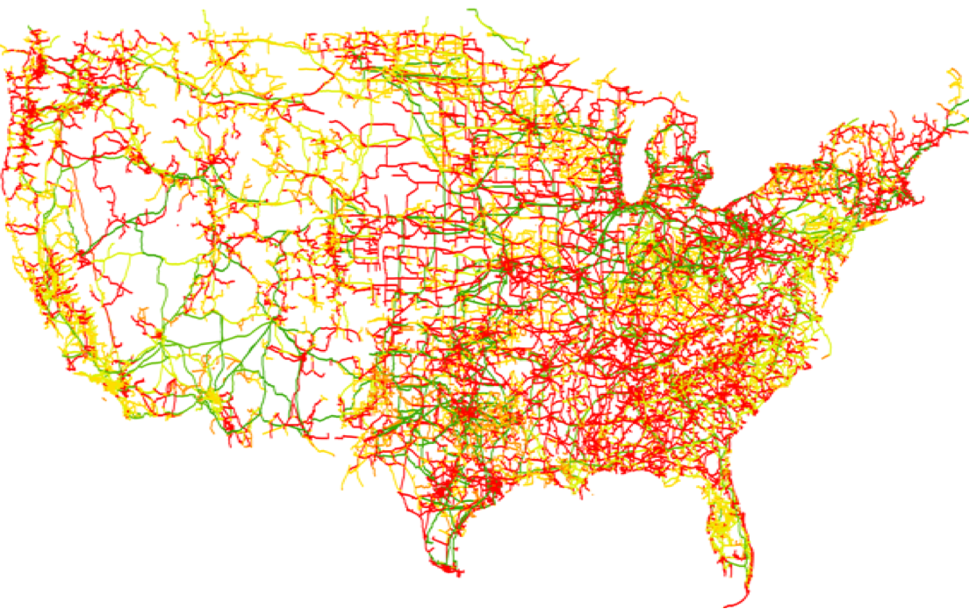
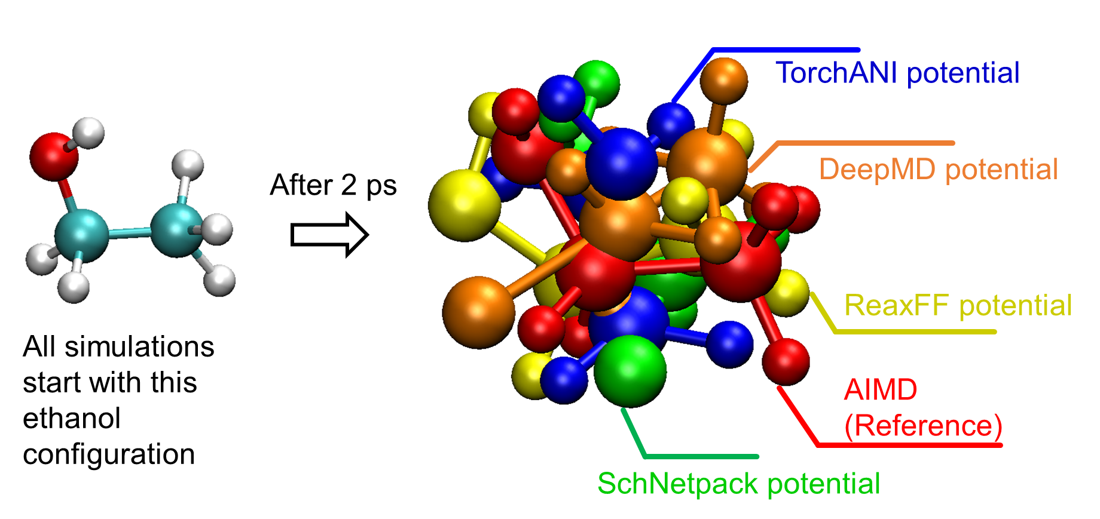
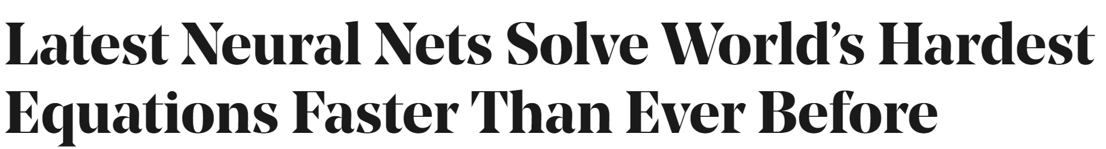

SciML Motivation and Aims
Simulations are crucial for many areas of decision-making and scientific discovery
Need: Improve computational efficiency and scalability for heterogenous scientific simulations
Objectives:
  Domain-agnostic software and algorithmic framework
  Scientific computing enhanced by data science
  Algorithmic speedups enhanced with HPC
Applications: Optimization, modeling and control of dynamical systems (ODE, PDE, DAE, Hybrid systems)

Slide 3
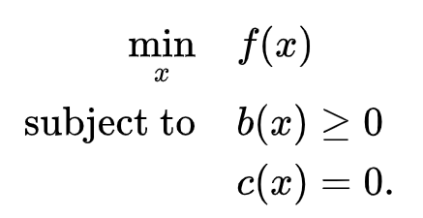

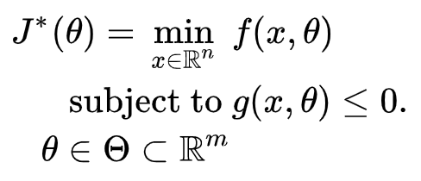
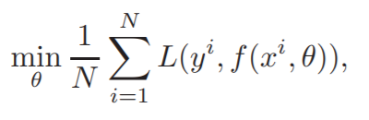
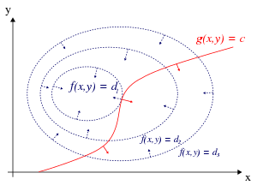
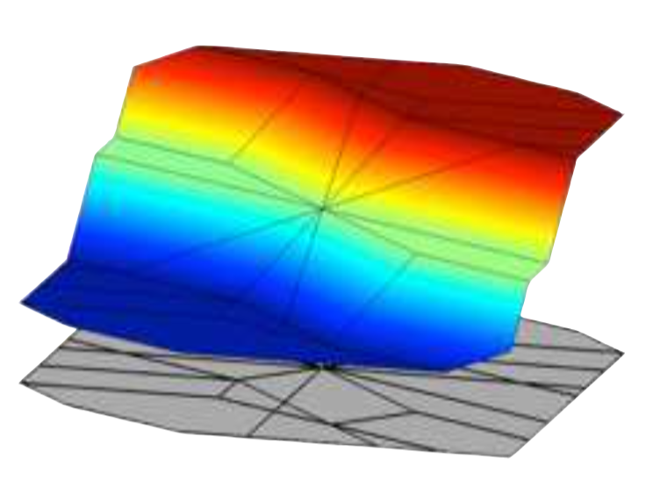
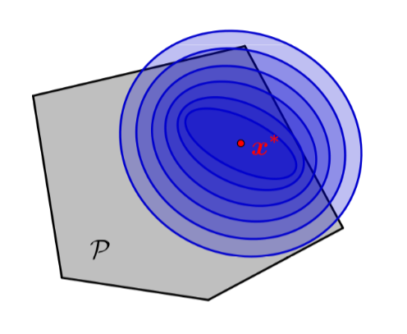
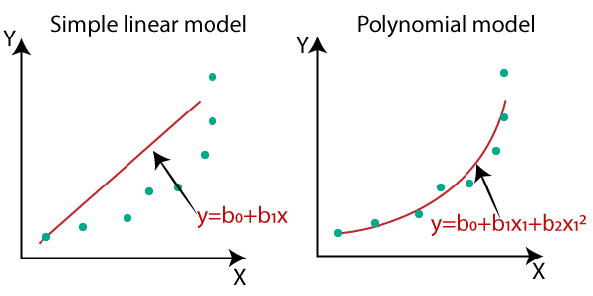
Differentiable Optimization as Lingua Franca for Scientific Computing
Standard form
Lagrangian form
Parametric programming
Machine learning
“online” optimization
single solution for
given parameter values
“online” optimization
using soft constraints
instead of hard constraints
“offline” optimization
obtains a solution map
for a set of parameters
classical methods lead to
exponential complexity!
“offline” optimization
obtains a model (map)
for a set of datapoints
scalable but classically
can’t handle constraints
Differentiable parametric programming (DPP): a unifying approach for data-driven parametric programming optimization with solutions based on automatic differentiation (AD)

Slide 4
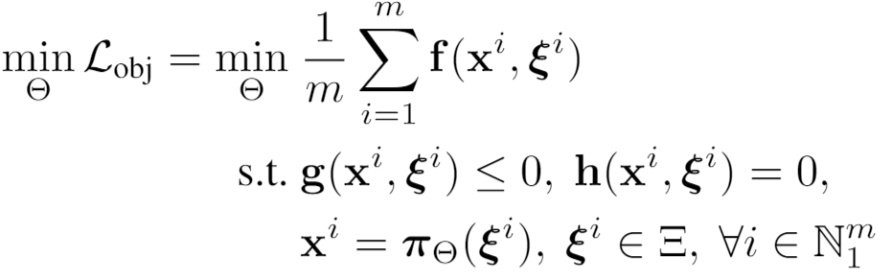
Differentiable Parametric Programming:
Generalization of PINNs
Objective function
Problem formulation:
Constraints
Primal optimizers
Scenarios
Solution map
Parameters

Slide 5
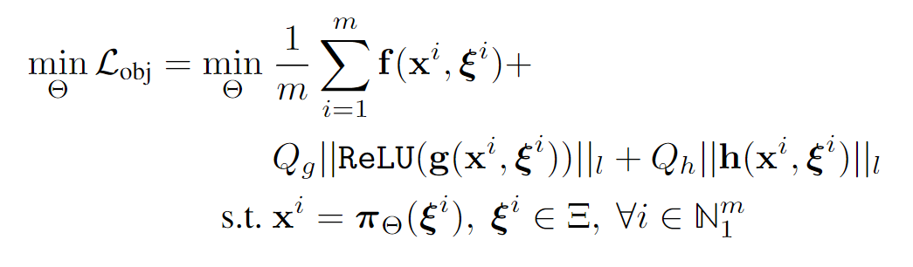
Differentiable Parametric Programming:
Generalization of PINNs
Objective function
Problem formulation:
Constraints
Primal optimizers
Scenarios
Solution map
Parameters
Lagrangian form:
Constraints penalties
Gradient-based optimization based on AD

Slide 6


NeuroMANCER Framework
Neural Modules with Adaptive Nonlinear Constraints and Efficient Regularizations
  Open-source scientific machine learning (SciML) framework in Python for integrating deep learning, constrained optimization, and physics-based modeling
Supported methods
  Physics-informed machine learning
  Differentiable constrained optimization
  Dynamical systems modeling
  Differentiable optimal control
Methods
  Parametric programming (Sensitivity Analysis)
  Differentiable programming (Automatic Differentiation)
https://github.com/pnnl/neuromancer

Slide 7
Part 1: Differentiable Constrained Optimization

Slide 8
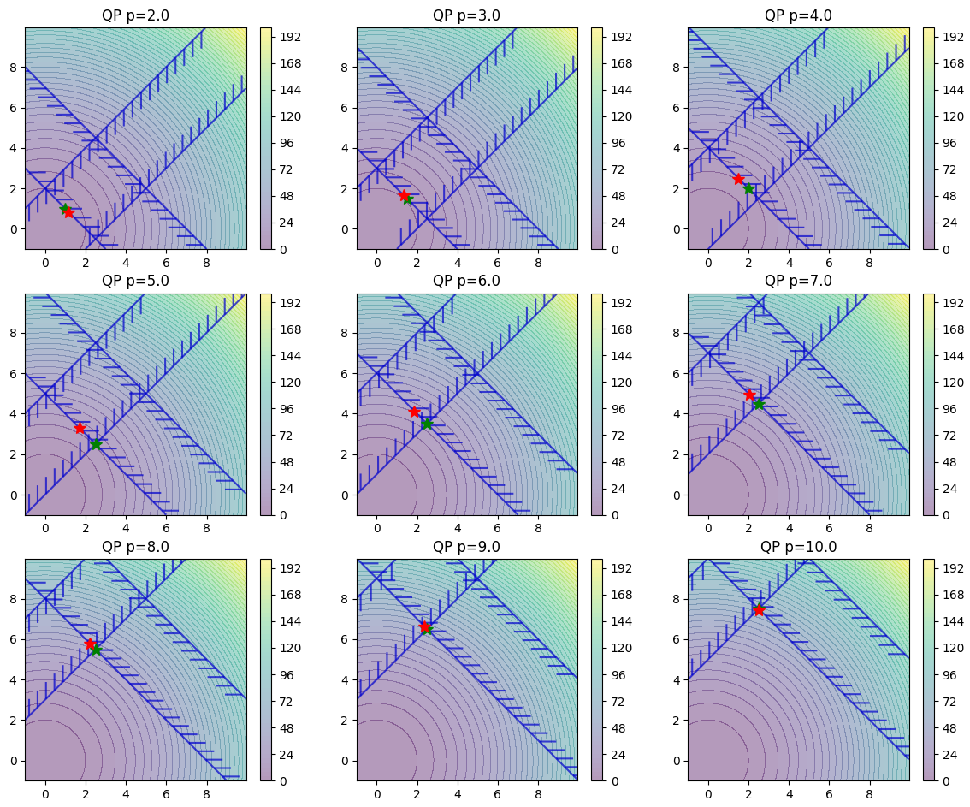
Differentiable Constrained Optimization
High abstraction level API in Neuromancer:
train_data, dev_data, test_data = get_dataloaders(samples)
x = Variable(‘x')
y = Variable('y')
p1 = Variable(‘p’)
map = nm.MLP(input_keys=['p’], output_keys=[‘x’,‘y’], name='map’)
f = x ** 2 + y ** 2
obj = f.minimize(weight=Q, name='obj’)
con_1 = Q_con*(-x - y + p1 <= 0)
con_2 = Q_con*(-x + y + p1 <= 0)
objectives = [obj]
Constraints = [con_1, con_2]
components = [map]
loss = PenaltyLoss(objectives, constraints, train_data)
problem = Problem(components, loss)
optimizer = torch.optim.AdamW(problem.parameters(), lr=args.lr)
trainer = Trainer(problem,train_data,dev_data,test_data,optimizer)
best_model = trainer.train()

Slide 9
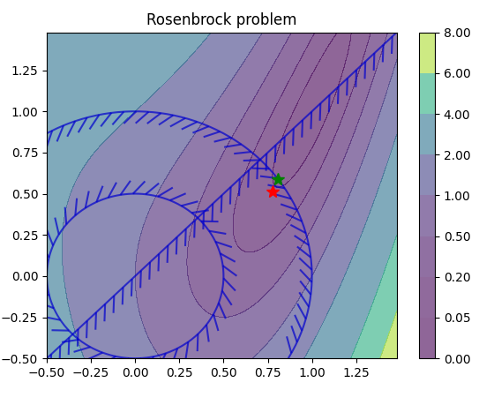
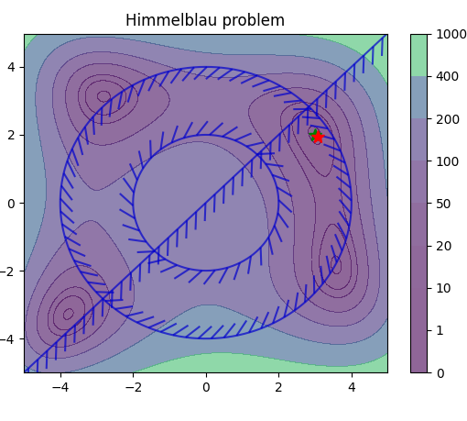
Differentiable Constrained Optimization in NeuroMANCER: Motivating Examples
Orders of magnitude faster online solution compared to online optimization solvers (e.g., IPOPT).

Slide 10
Part 2: Differentiable Control of Dynamical Systems

Slide 11
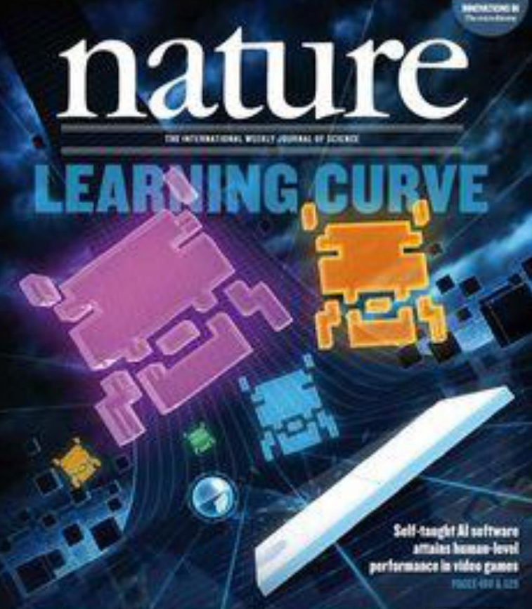
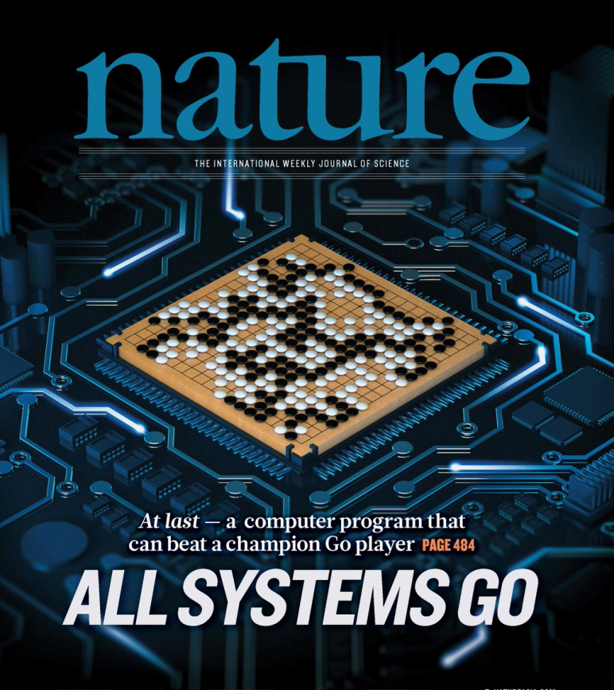
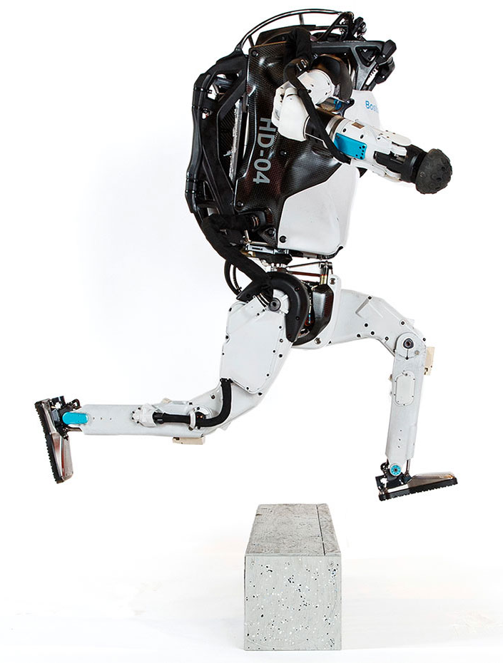
Model Predictive Control vs Deep Reinforcement Learning
MPC
RL
95% of the industrial control applications are PID loops & expert driven rule-based control (RBC).
The rest is model predictive control (MPC).
Everywhere where you have reliable digital environment model, mostly discrete action space, and you can use massive compute to solve the problem.
Drgona J., J. Arroyo, I.C. Figueroa, D. Blum, K. Arendt, D. Kim, and E.P. Olle, J. Oravec, M. Wetter, D. L. Vrabie, L. Helsen. 2020. "All You Need to Know About Model Predictive Control for Buildings." Annual Reviews in Control, September 29, 2020
G. Dulac-Arnold, D. J. Mankowitz, and T. Hester, “Challenges of real-world reinforcement learning,”, 2019.
http://arxiv.org/abs/1904.12901

Slide 12
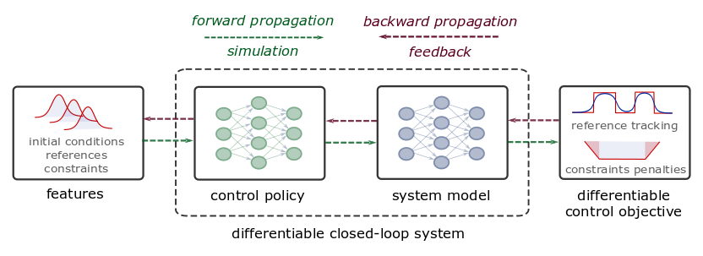
Differentiable Predictive Control
Constrained Model-based Policy Optimization for Parametric Optimal Control
Jan Drgona, Aaron Tuor, Draguna Vrabie, Learning Constrained Adaptive Differentiable Predictive Control Policies With Guarantees
https://arxiv.org/abs/2004.11184
Jan Drgona, et al., Differentiable Predictive Control: An MPC Alternative for Unknown Nonlinear Systems using Constrained Deep Learning https://arxiv.org/abs/2011.03699

Slide 13
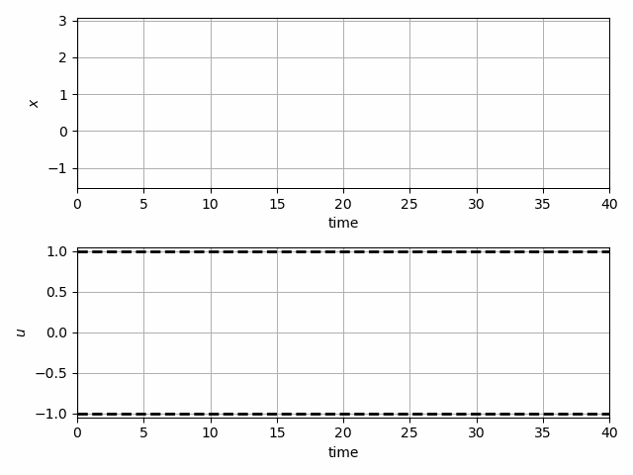
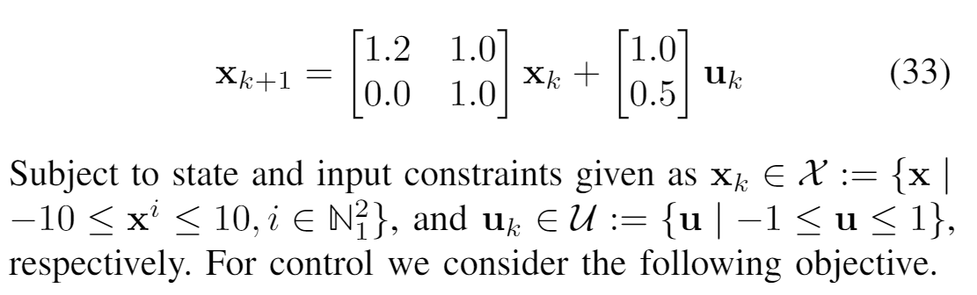

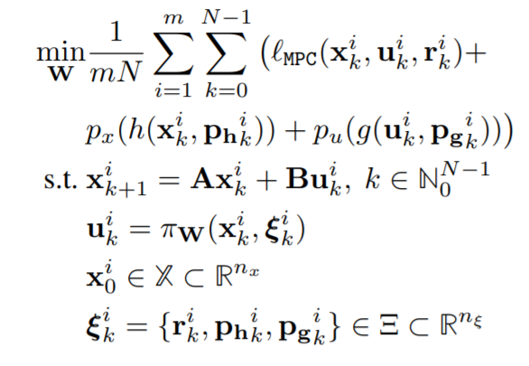
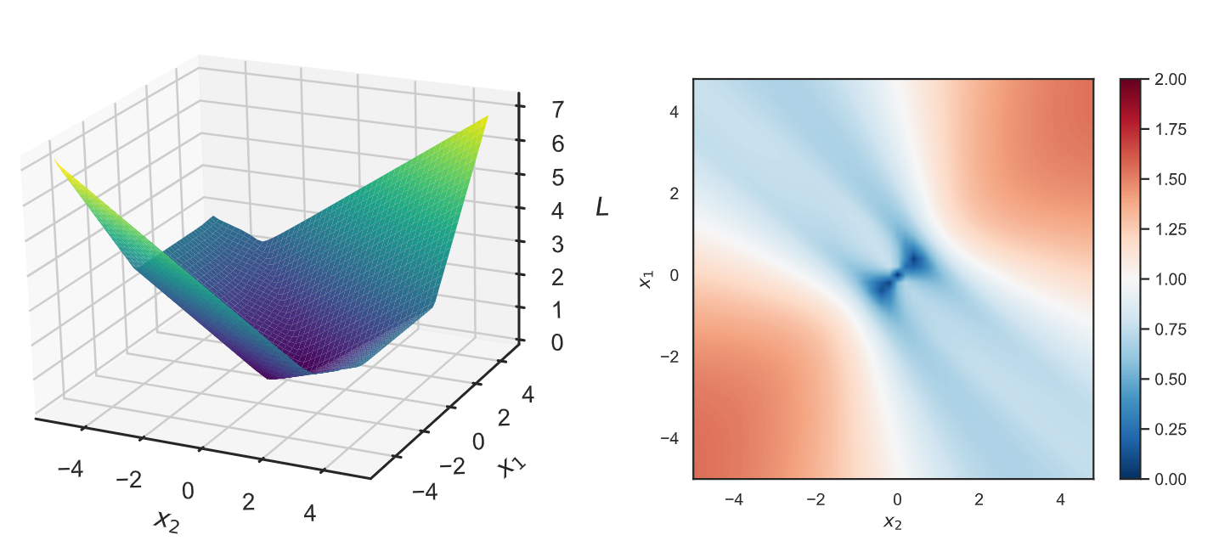
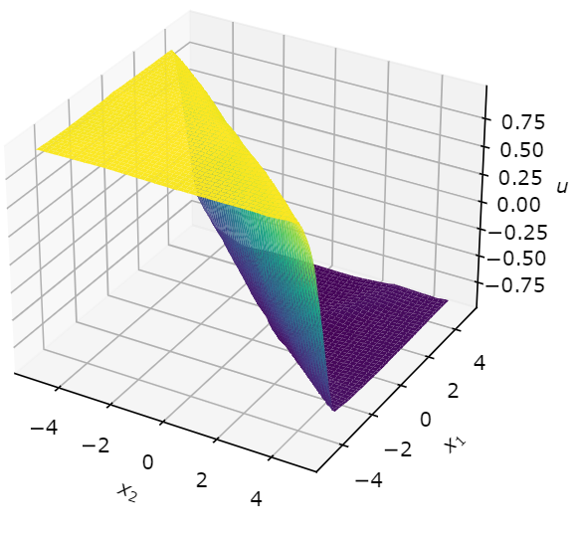
Learning to Stabilize Unstable System
Problem setup:
DPC formulation:
Jan Drgona, Aaron Tuor, Draguna Vrabie, Learning Constrained Adaptive Differentiable Predictive Control Policies With Guarantees, https://arxiv.org/abs/2004.11184

Slide 14
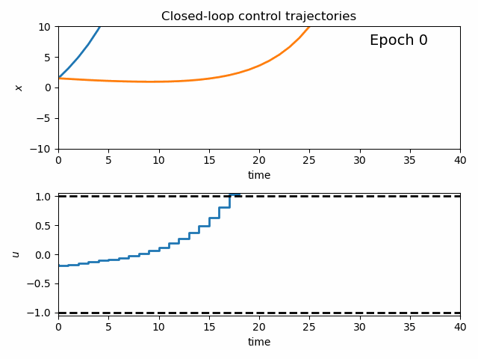
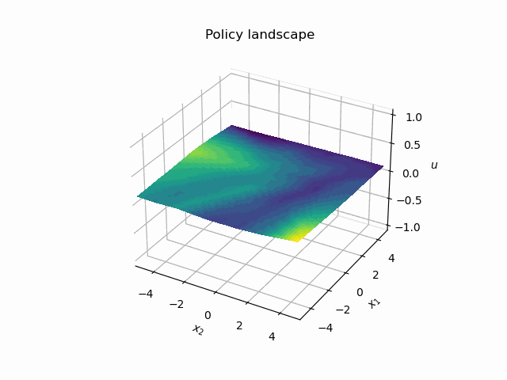
Dynamics of DPC Control Policy Learning
1341 learning parameters, 48.2 seconds offline training time on a CPU with 200 epochs.
Jan Drgona, Aaron Tuor, Draguna Vrabie, Learning Constrained Adaptive Differentiable Predictive Control Policies With Guarantees, https://arxiv.org/abs/2004.11184

Slide 15
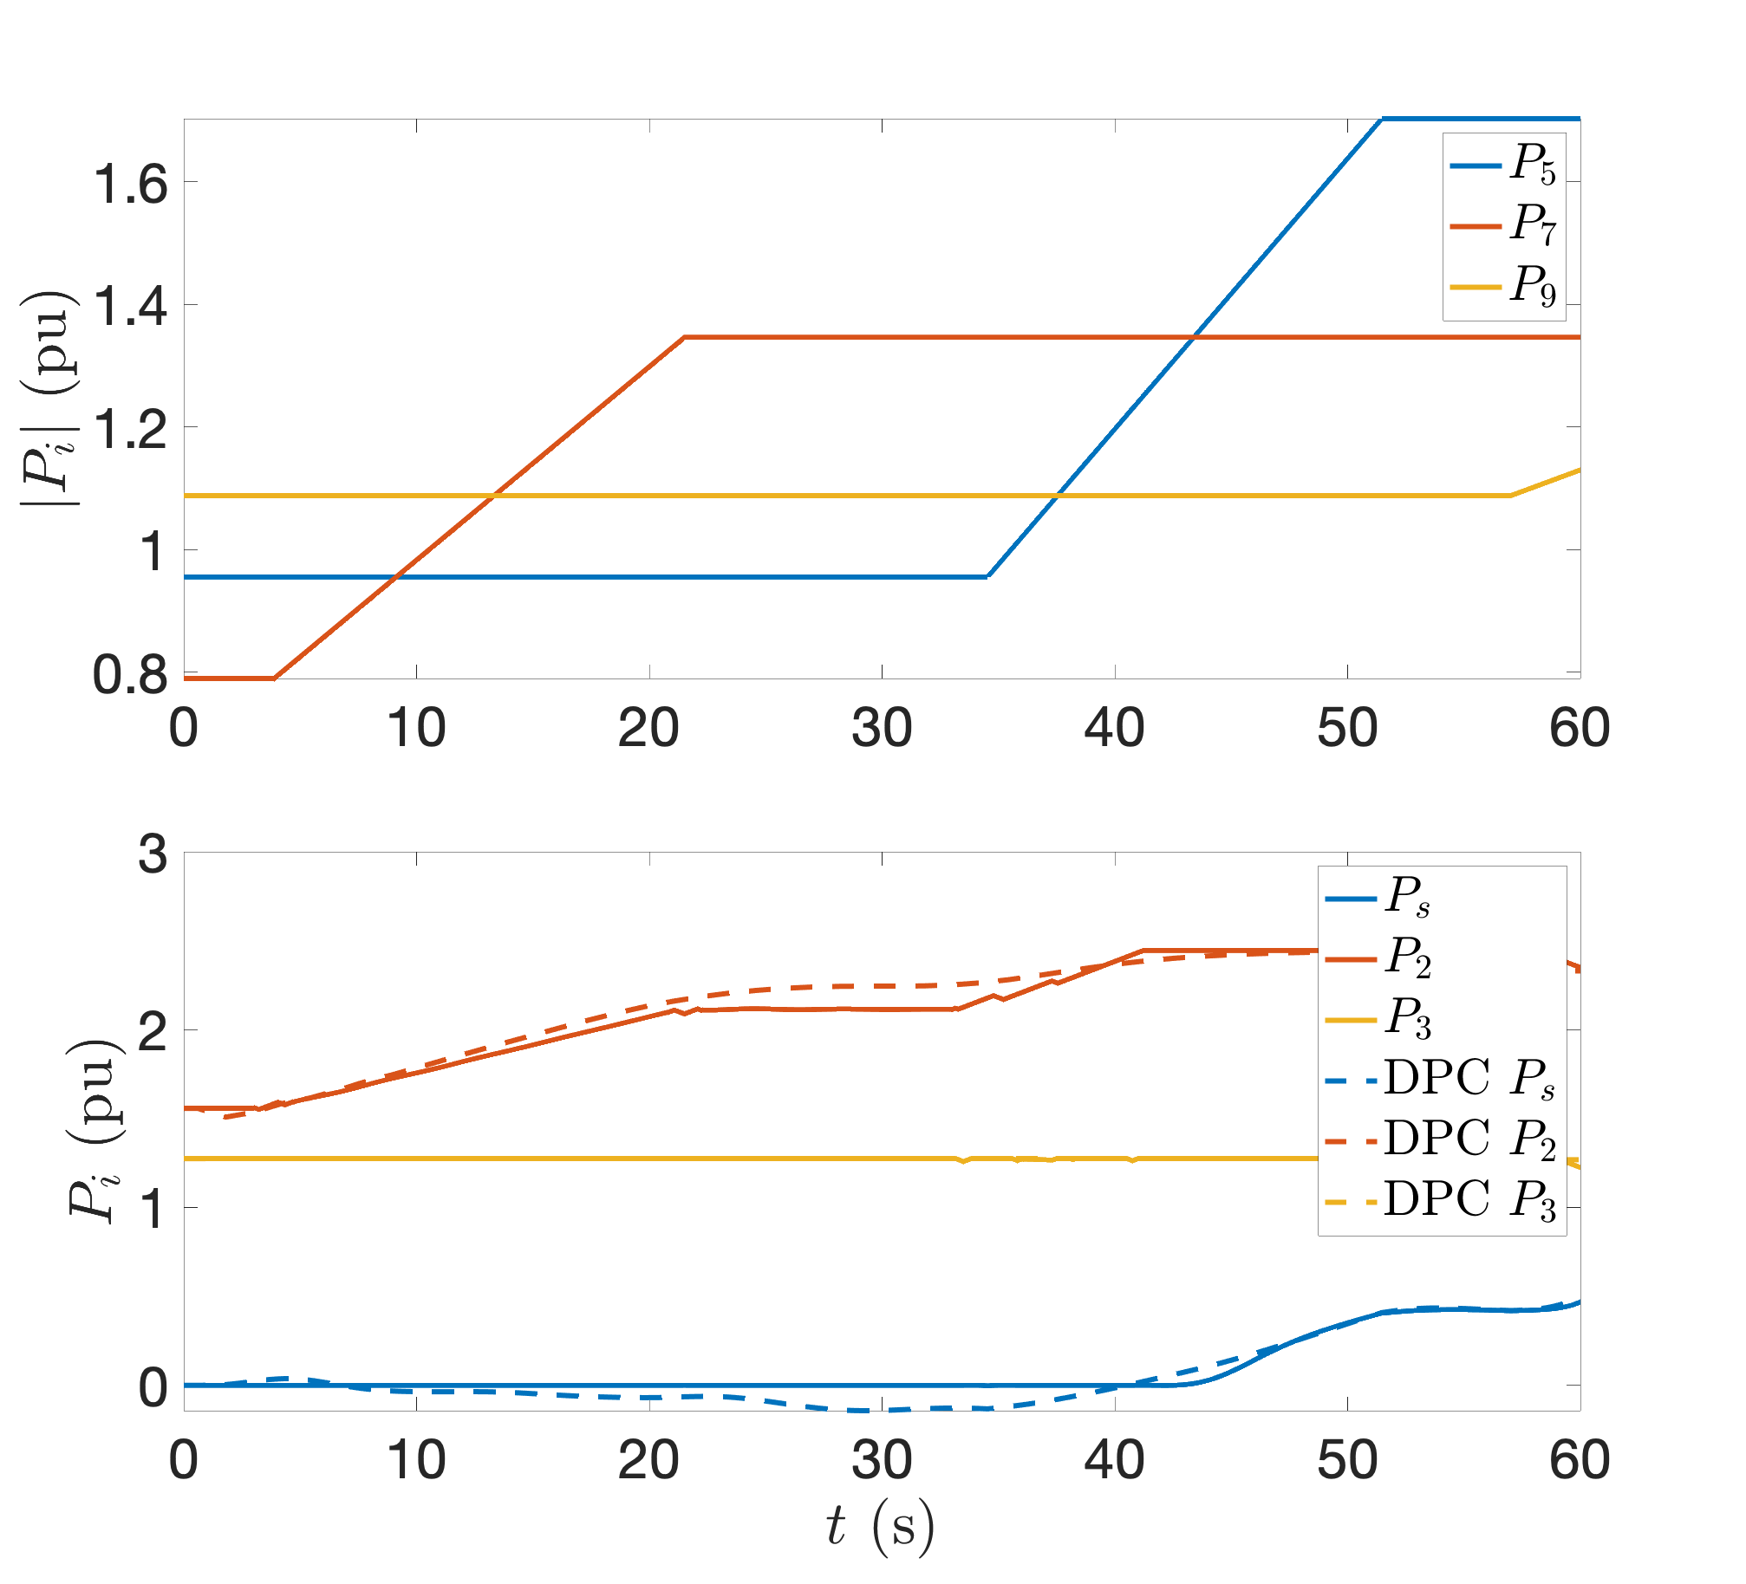
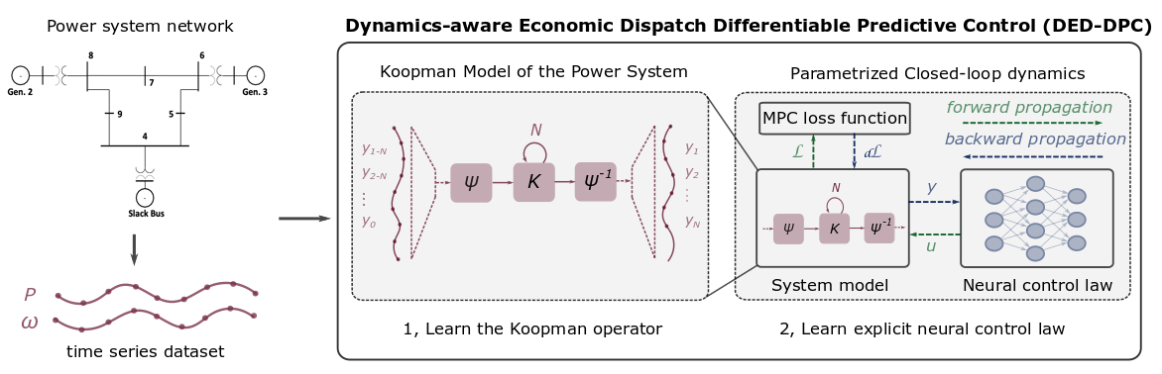
Dynamics-Aware Economic Redispatch via Differentiable Predictive Control
Problem: Current redispatch processes do not incorporate system dynamics concerns. Incorporating dynamics in redispatch is too complex and/or time-consuming
Architectures
Koopman dynamics model
CNN control policy
Solution: Machine-learning based dynamics-aware redispatch. Learn system dynamics for faster assessment.
Results
5 orders of magnitude speed-up
Minimal loss in solution quality
Ethan King, Ján Drgoňa, Aaron Tuor, Shrirang Abhyankar, Craig Bakker, Arnab Bhattacharya, Draguna Vrabie, Koopman-based Differentiable Predictive Control for the Dynamics-Aware Economic Dispatch Problem, The 2022 American Control Conference (accepted)
Notes:
Add waveform figure as a result – copy from previous slide
replace discretize linearize with one block as iterative method

Slide 16
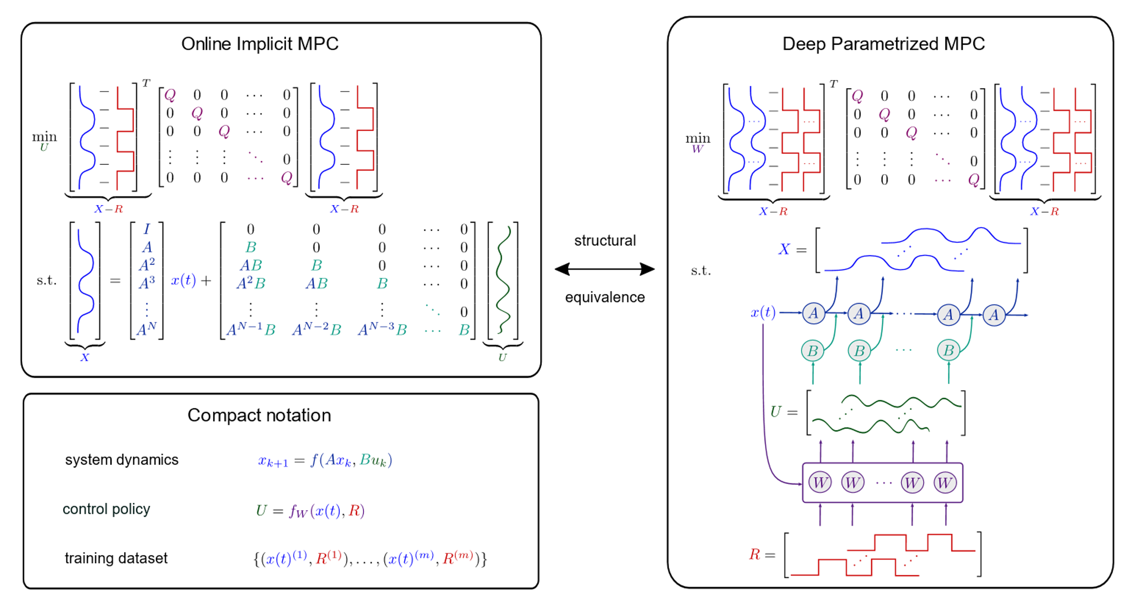
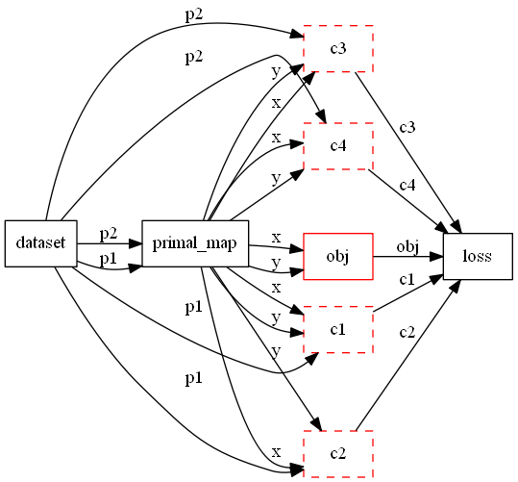
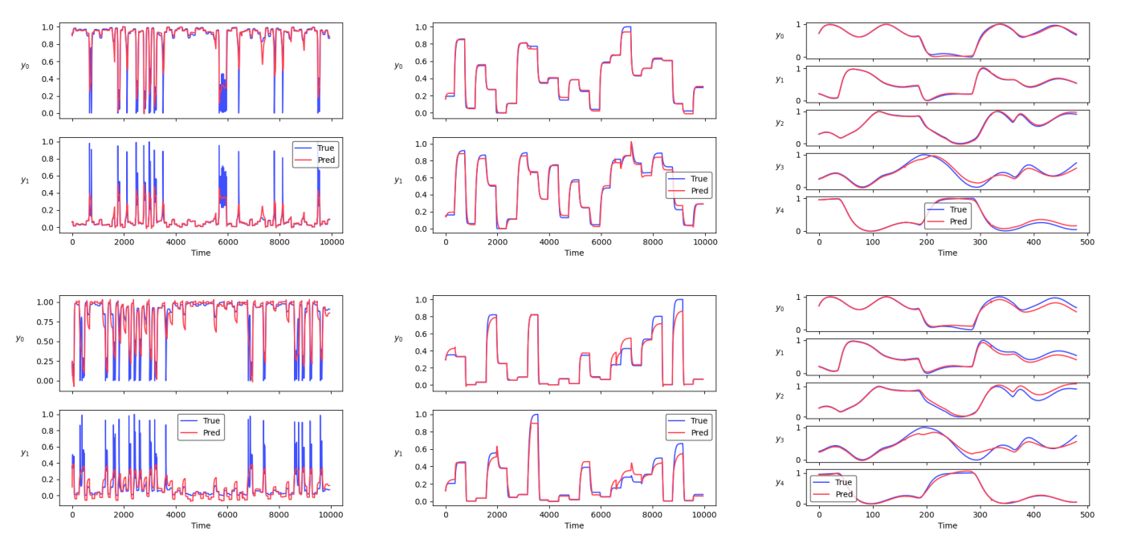
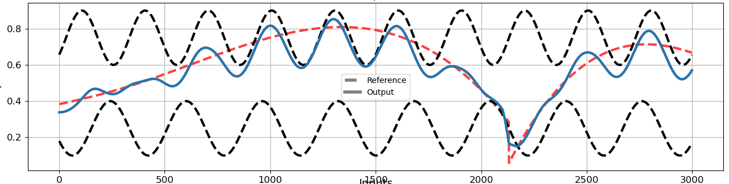
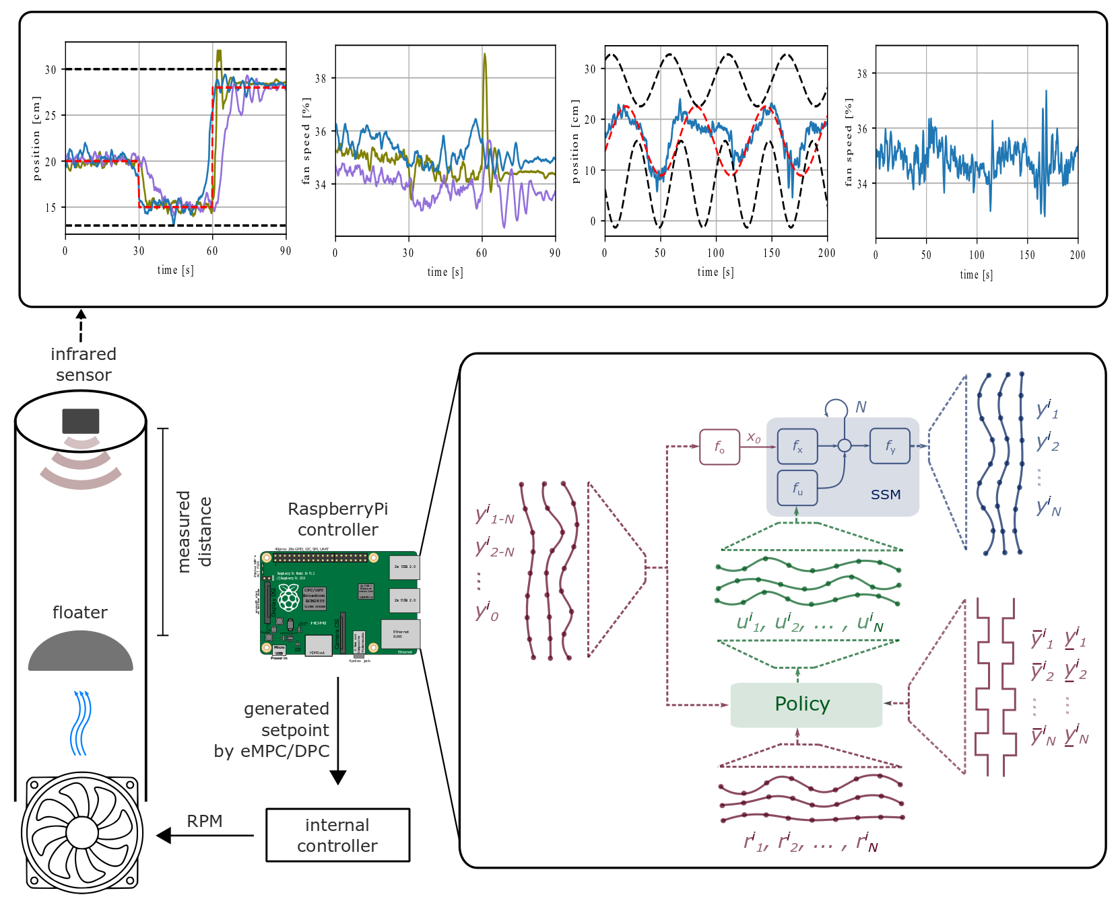
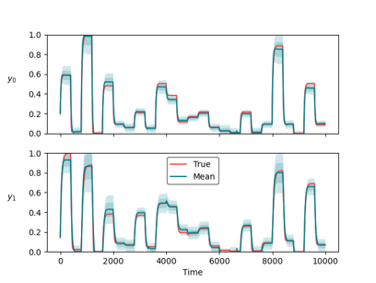
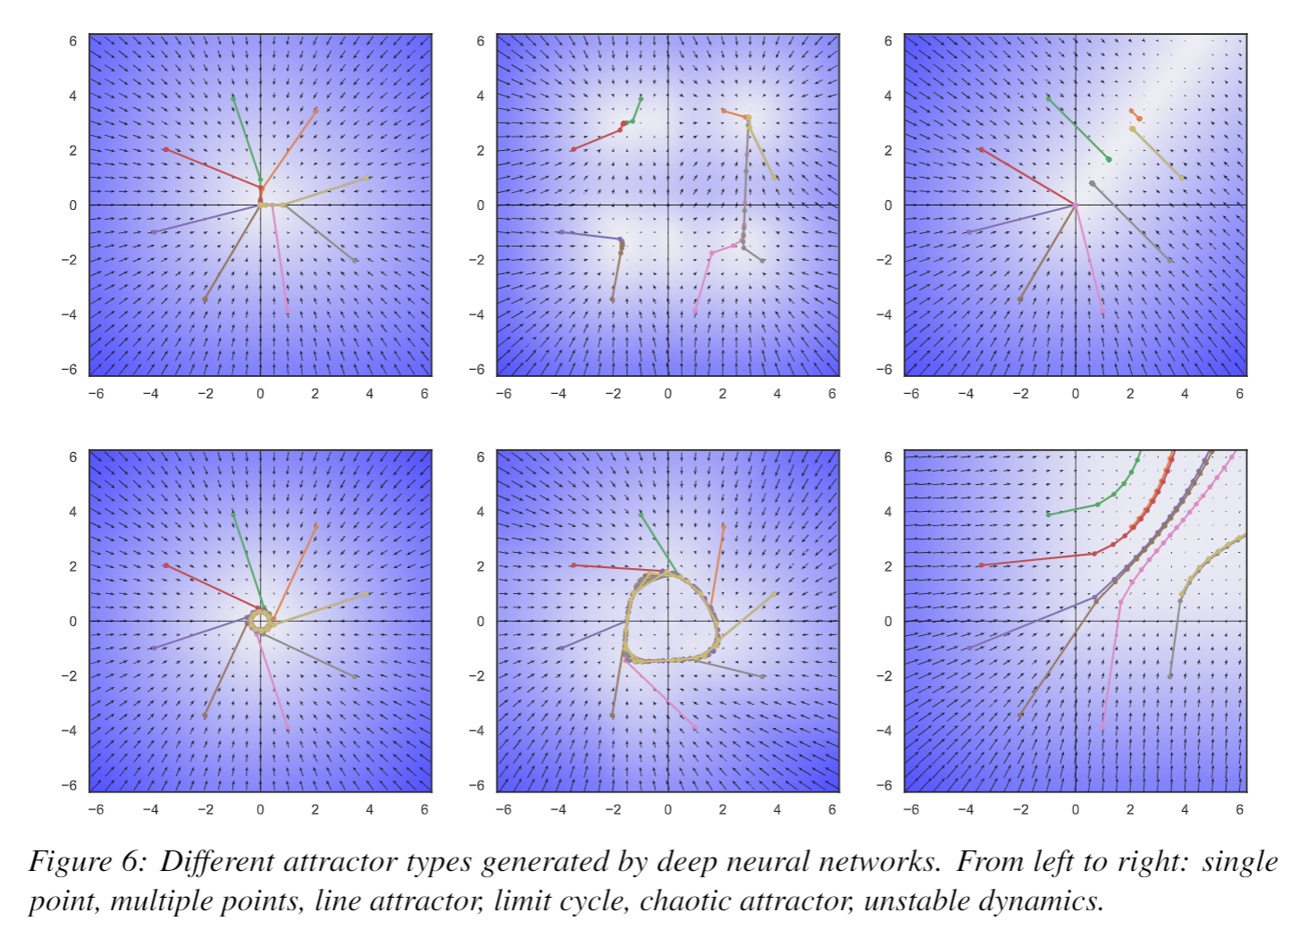
Conclusion
NeuroMANCER
  Differentiable programming
  Parametric programming
  Constrained optimization
  Dynamical modeling and control
Ongoing work
  Constrained optimization solvers
  Graph neural networks (GNNs)
  Mixed-integer programs (MIP)
  Uncertainty Quantification (UQ)
Long-Term Vision
  Causal discovery, dynamical coupling, sensitivity, structure, and stability analysis, machine reasoning
  Solving large-scale non-convex parametric constrained optimization problems
  https://github.com/pnnl/neuromancer
  https://github.com/pnnl/slim

