Slide 1
Widget Failure Analysis: A Tale of Two Features
Sarah Ackerman
Additional project members:
Meghan dailey, Leslie Munyao, Jaideep ray, cosmin safta
26 July 2022

Slide 2
Project Overview
Mission and Problem

Slide 3
Widget Manufacturing
Widgets are manufactured via a highly complex process:
Both manual and automated processes
Components manufactured at various facilities, where we have varied levels of influence
Thousands of measurable states, of which only some are measured
Different states measured by different equipment at different facilities
Widgets suffer from two primary failures:
Type 1 failures are easy to identify and catastrophic
Type 2 failures happen after repeated stress testing, and occur on a spectrum of Normal to Failed
Dataset is:
all manufacturing data: no results of destructive testing were included (except as class labels)
unbalanced: fewer than 10% of samples are examples of failures
wide: ~1500 features and ~6,000 samples
Component C
Widget
Component B
Component A

Slide 4
Research Questions
Project purpose: “Are there manufacturing predictors of failures that can be identified and controlled prior to the failure occurring?”
This is really three questions:
Are there manufacturing predictors?
Can they be identified?
Can they be controlled prior to failure?
Asked across multiple class splits:
3-Class: Normal vs. T1 Failure vs. T2 Failure
2-Class: Normal vs. Any Failure
2-Class: T1 vs. T2 Failures
2-Class: T1 vs. Other (Normal + T2)
2-Class: T2 vs. Other (Normal + T1)

Slide 5
Answering Question 1
Is this dataset predictive?

Slide 6
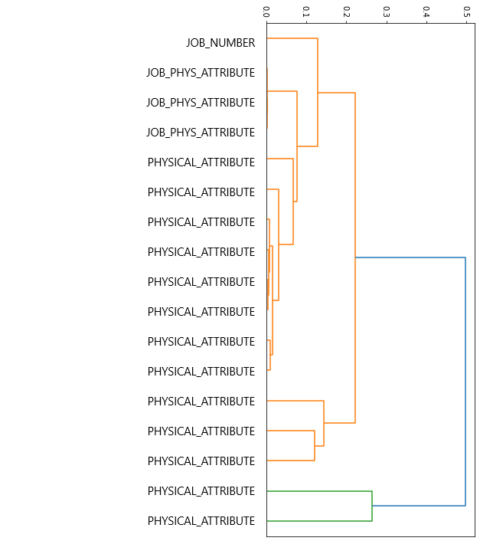
A Quick Look at the Features
Self-correlation of features correlated |corr| > 0.5 with Normal vs Any Failure class split
Job Attributes
Some label a group of parts moving together through production floor; set of parts encapsulated at same time
Some measurements are per-job, not per-part
Physical attributes: mass, height, diameter
These are all measured separately on fully assembled widgets.
Hypothesis: Near-perfect (or perfect) correlation of these measurements with one another may indicate a problem either in measurement or in data recording.
Potentially causal
One is interesting and may have causal relationship with norm/fail classification.
Still: why so tightly correlated (all features here are > 0.84 correlated with one another) with other measurements?
Hierarchical Clustering: Dendrogram

Slide 7
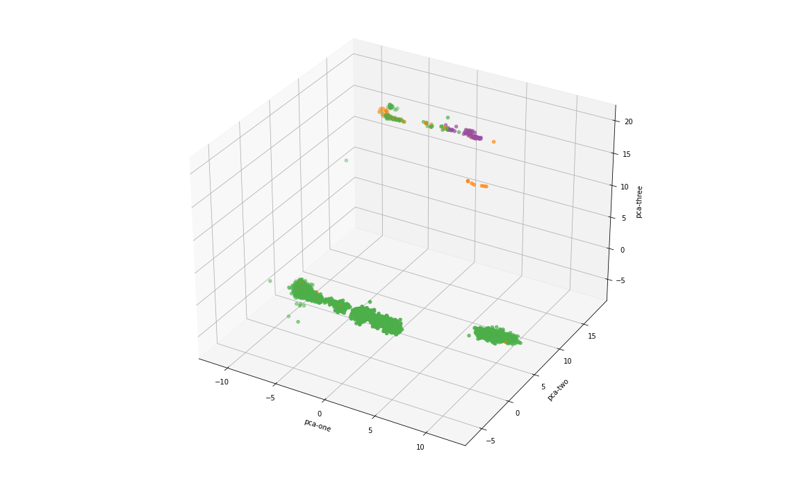
PCA: Normal vs Type 1 vs Type 2

Slide 8
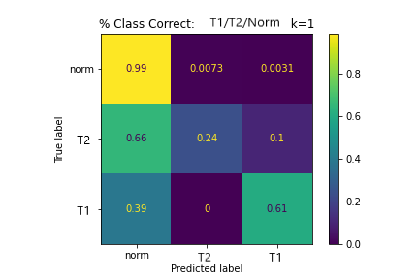
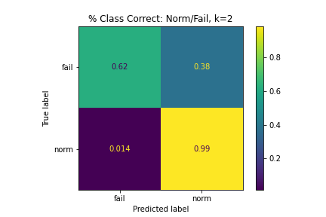
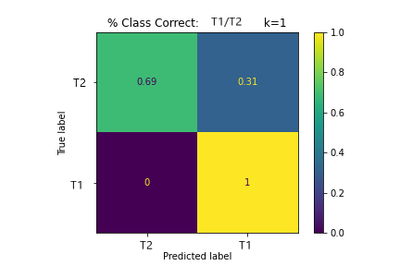
Clustering Results: k-Nearest Neighbors
[1899 8 7 ]
[ 19 6 2 ]
[ 7 0 10 ]
[ 25 15 ]
[ 26 1892 ]
[ 46 21 ]
[ 0 48 ]

Slide 9
Answering Q2 and Q3
Refocus on Type 1 Failures
Q2: Can predictors be identified?
Q3: Can they be controlled prior to failure?

Slide 10
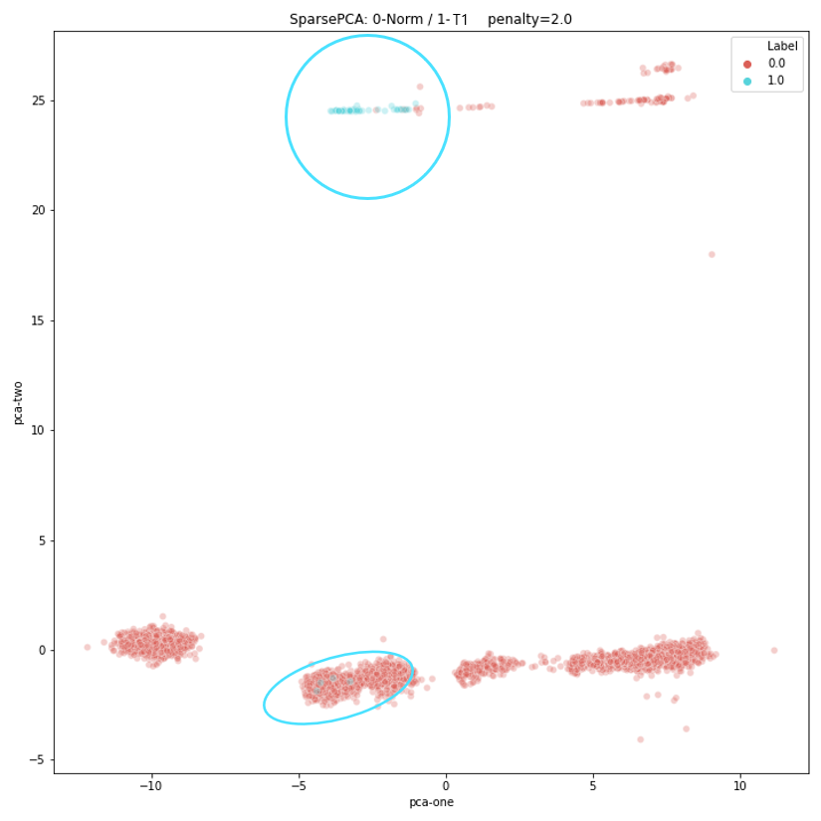
SparsePCA vs. SparserPCA
With increased sparsity, clusters are preserved, but dimensionality is reduced.
Replicated with Normal + T2 (aka “other”) vs. T1 to truly separate T1 failures.

Slide 11
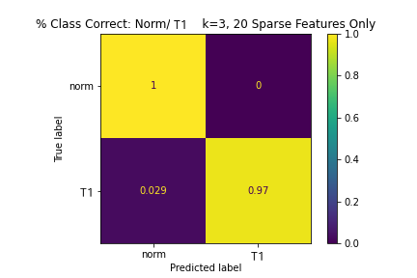
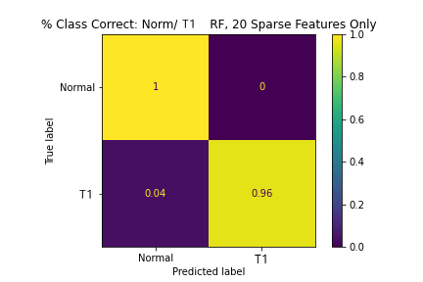
Top 20 SparsePCA Features
[2540 0]
[ 1 33]
k-NN F1 = 99%
[1906 0]
[ 1 24]
RF F1 = 99%

Slide 12
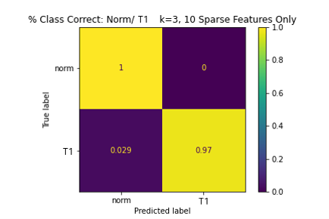
Top 10 SparsePCA Features
[2540 0]
[ 1 33]
k-NN F1 = 99%
[1906 0]
[ 1 24]
RF F1 = 99%

Slide 13
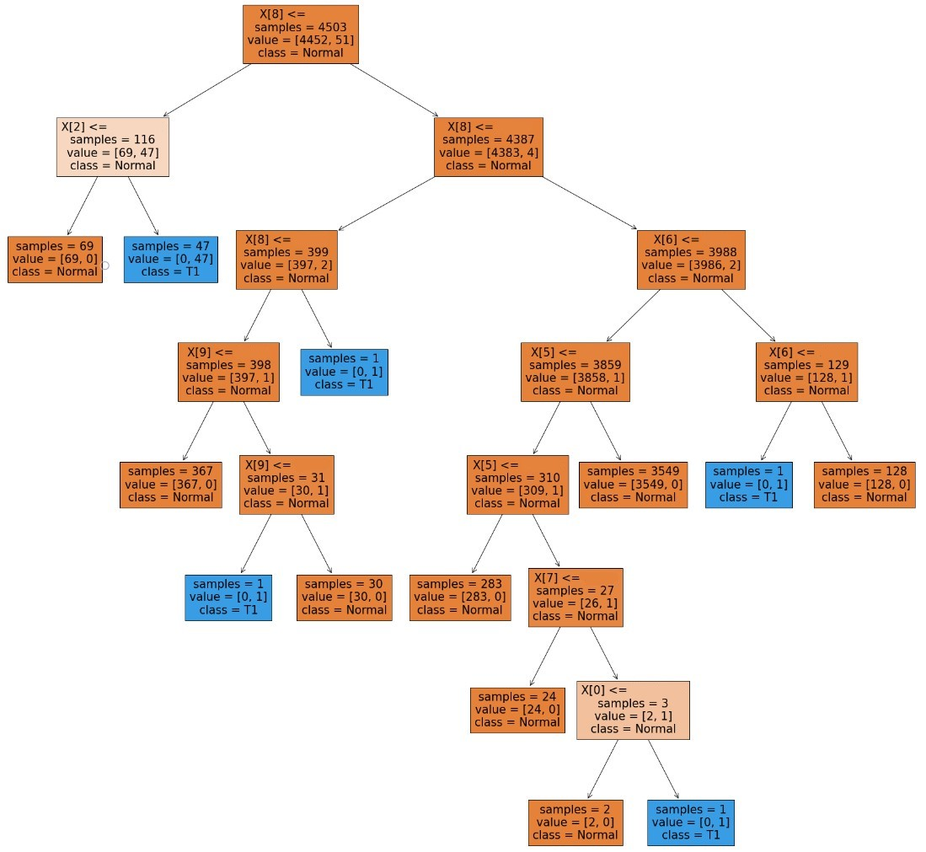
Let’s Look at One Tree from the Forest
51 total T1 samples
47 are correctly classified using only two features:
A job number
A measured physical attribute

Slide 14
Random Forest with Two Features
F1 = 98%
I should have been more suspicious before I reported these results.
Remember that hypothesis I had about the correlation study?
Hypothesis:
Near-perfect (or perfect) correlation of independent physical attributes with one another may indicate a problem either in measurement or in data recording.

Slide 15
A Tale of Two Features

Slide 16
Summary
2 Features sufficient for Normal vs. T1 Failure classification
This relationship is spurious
The SMEs knew something was up with our results, but didn’t know why
We aren’t collecting all the data we’re supposed to be collecting
It is critical that we use explainable, interpretable methods whenever possible
TODO:
Identify all “bogus” features in the dataset
Remove them and re-analyze the data (for all class splits)
Offer recommendations, including data gathering suggestions

