Slide 1
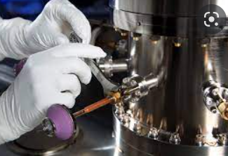
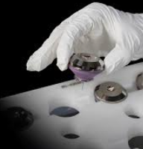
A novel approach to determine manufacturing processing parameters that are correlated to end-of-manufacturing test performance using multivariate analysis and iterative predictive modeling
R. Multari, L. Munyao, J. Howard, R. Ferrizz, and M. Dailey
Sandia National Laboratories
SAND2022-9063 C

Slide 2
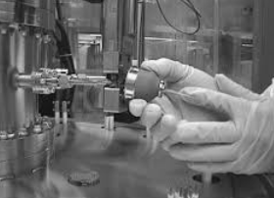
To be covered
Analysis Overview
Challenges and value
Method
Analysis Results

Slide 3
Analysis overview
Goal of the analysis is to determine which manufacturing process parameters contribute most to specific end-of-line testing failures
Data collected during the neutron generator (NG) manufacturing process is studied to determine which manufacturing operations contribute most two different types of end-of-line test failures
  High Voltage Breakdown (HVB)
    External to the NG (HVB wall)
    Internal to the NG (HVB vac)
The analysis methodology presented was developed using NG manufacturing data but can be applied to any manufacturing process

Slide 4
Challenges and value
Challenges
  Complexity manufacturing process
  Validity of hypothesis that the data collected during the manufacturing process for process control purposes contains signal that can be extracted by multivariate methods to predict which units will fail for specific reasons during post manufacturing quality testing
Value
  The ability to predict which units being manufactured will later fail for specific reasons using data collected during manufacturing enables
    operation specific optimization to reduce end-of-line material loss
    development of in-line scrapping criteria to eliminate further processing of material destined to fail

Slide 5
Multivariate modeling data
Modeling data for a unit consists of all data collected during manufacturing of the unit appended together to make a single 1Xn data array for each unit
Dimensions, Voltages Currents Fluxes Etc.
n=number of variables in the fingerprint
Manufacturing process data for unit 1
Manufacturing process data for unit 2
Manufacturing process data for unit 3
Analysis Array
Rows: fingerprint for each unit
Columns: manufacturing data
+ end-of-line test results
Fingerprint created from all manufacturing data

Slide 6
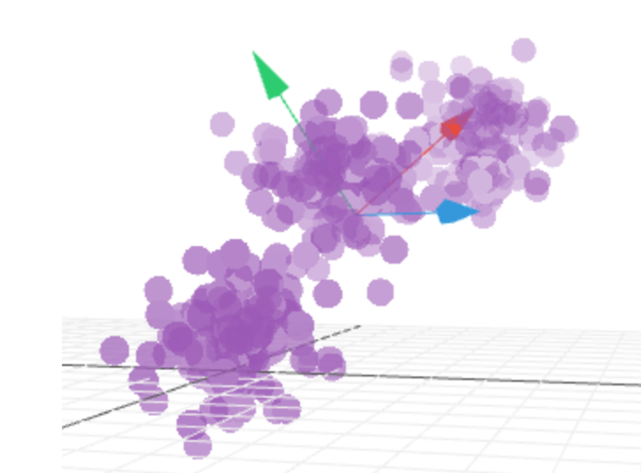
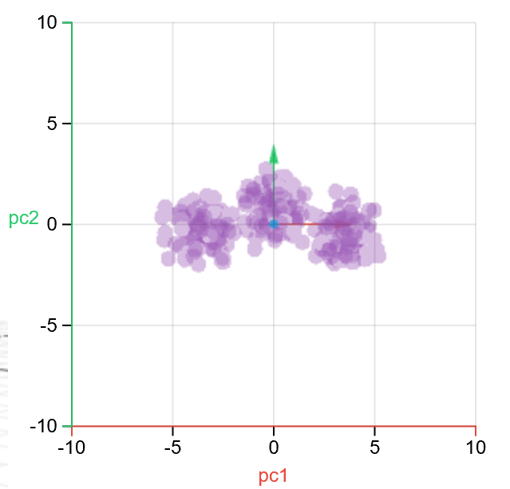
Multivariate modeling theory
Assumes a relationship exists between a set of measured variables and the properties of interest
Observation = Structure + Noise
  Variables X (set of observations)
  Response Y = F(X) (set of possible responses)
Finds the structure in the data representing the correlation between F(X) & X
Goal of the modeling is to extract the structure in the data that correlates to the observed responses while minimizing noise
Analysis is accomplished through successive transformations in which the data is projected onto axes or “Principal Components” (PC’s) representing the direction of maximum variation of the data
Each PC is orthogonal to the other PC’s and centered on the mean of the data and is aligned to the direction of the maximum variation of the data
With each successive transformation to a new PC, more of the variance in the data is explained and a smaller portion of the variance remains unexplained
Original Data
“Score” Space
Projection of original data onto PC1 & PC2

Slide 7
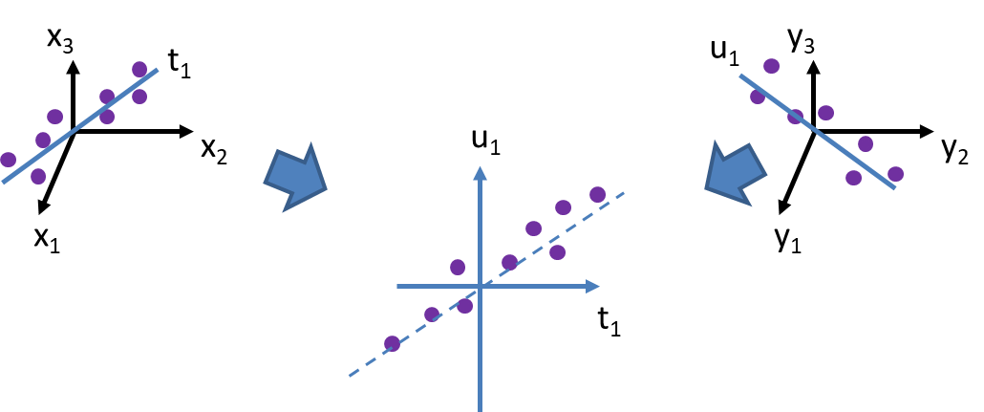
Partial Least Square Regression (PLSR)
Data is arranged in a NXn matrix for modeling
PC’s are calculated by modeling both the X and Y matrices (variables and responses) simultaneously using known data
  Uses PCA on the variables (X^{T}Y)
  Uses PCA on the responses (Y)
  Creates a transformation designed to maximize the covariance between X & Y
Each interactively calculated PC has a characteristic linear equation for the relationship of the response to the variables :
Y = b0 + b1x1 + b2x2 + b3x3 +….
  The loadings indicate the contribution of each variable to the PC calculation
Using an optimal number of PC’s, a “Prediction Value” (PV) is calculated by the PLS prediction model that indicates how well matched new input data is to one of the response groups in the modeling
PLS

Slide 8
Method
Create a manufacturing processing “fingerprint” for each unit by concatenating all the manufacturing process data for a unit
  1 X 1059 matrix for each manufactured unit
Build PLS* models to differentiate HVB data from normal data
  HVB wall vs. normal
  HVB vac vs. normal
Analyze the regression coefficients for the PC used to differentiate HVB wall (or vac) units from normal units to identify suspect operations responsible for the difference in performance
*PCA models were used for one product because data was insufficient for PLS Modeling
Prediction value:
Y = b0 + b1x1 + b2x2 + b3x3 +…. where regression coefficients b1, b2, etc. are the relative contributions of each variable (value from operation) to the total prediction value

Slide 9
Data
Manufacturing process data for NG’s determined to be normal, HVB wall, or HVB vacuum at end of line test
  Product-02
  Product-01*
  Product-00
Product | Normal | HVB | HVB wall | HVB Vacuum
-00 | 1186 | 32 | 0 | 32
-01* | 1179 | 3 | 0 | 3
-02 | 3300 | 86 | 71 | 14
*Not enough data for PLS HVB vac modeling, used PCA

Slide 10
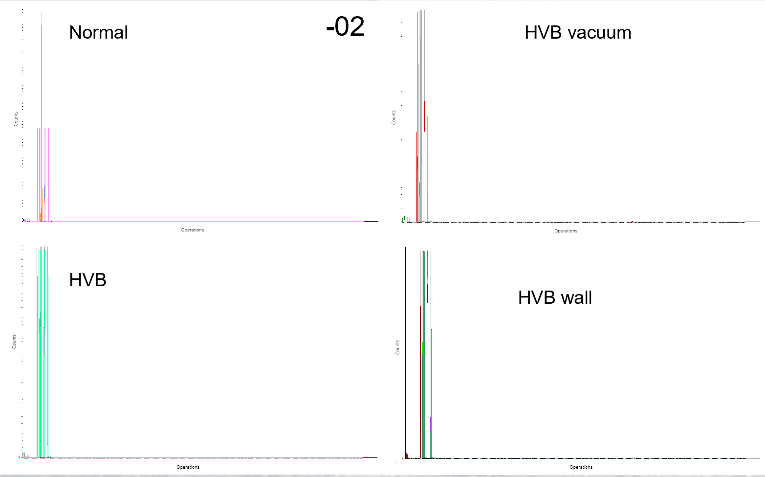
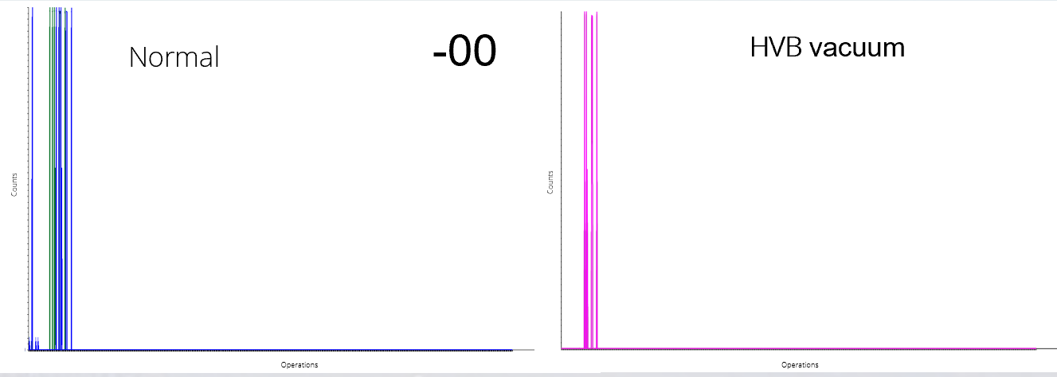
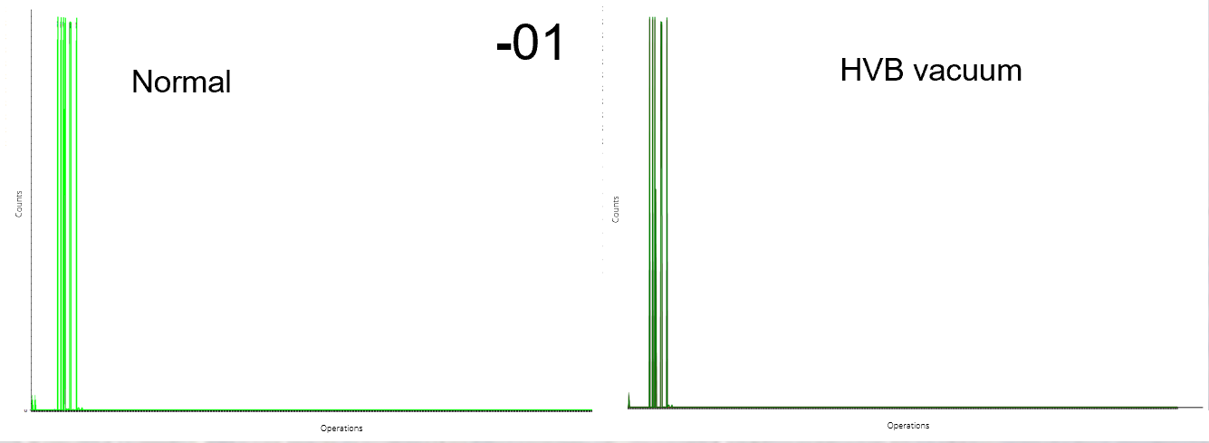
Data Fingerprints:
Not enough -01 data for PLS modeling, PCA was used instead
(only 3 HVB vac)

Slide 11
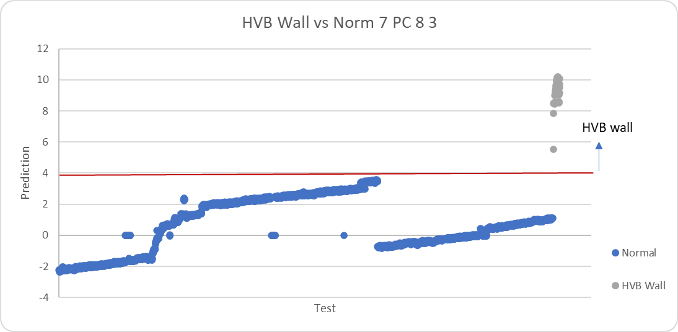
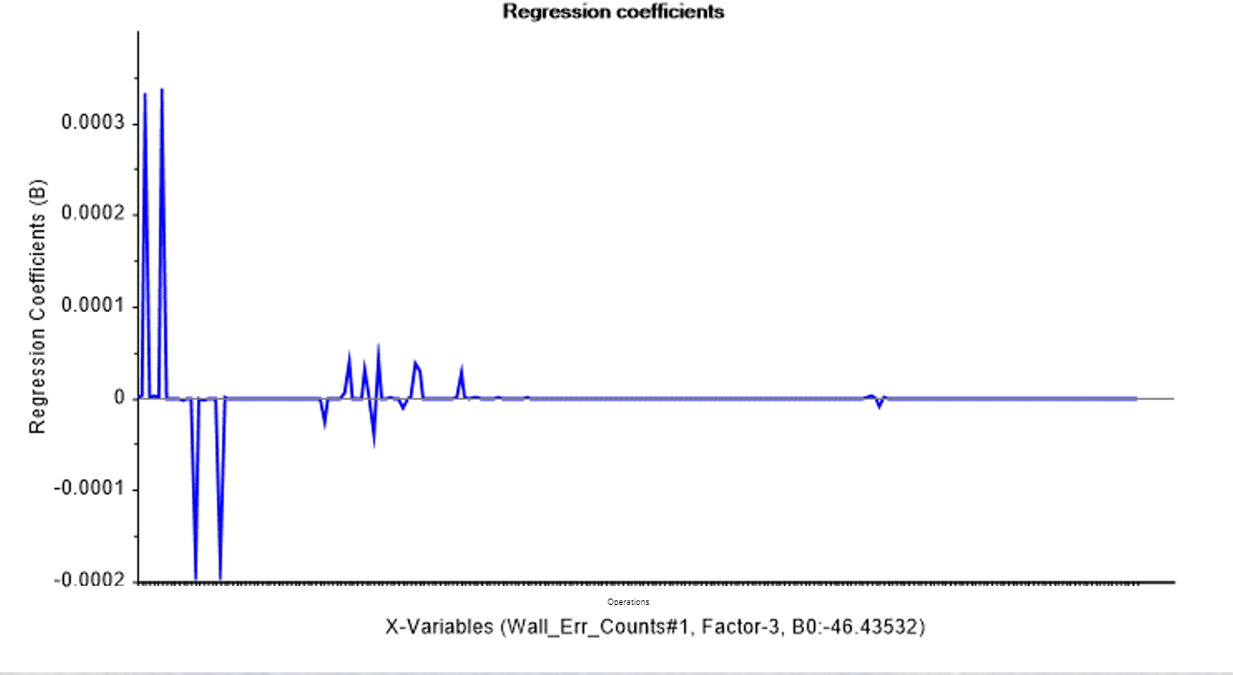
HVB wall vs Normal Analysis Results: -02
Tested on:
3246 Normal
43 HVB wall
Test data was not part of modeling data set
Iterative modeling: select data to model on, test model on new data, add failing test data back into the modeling data, repeat (until good prediction is obtained)

Slide 12
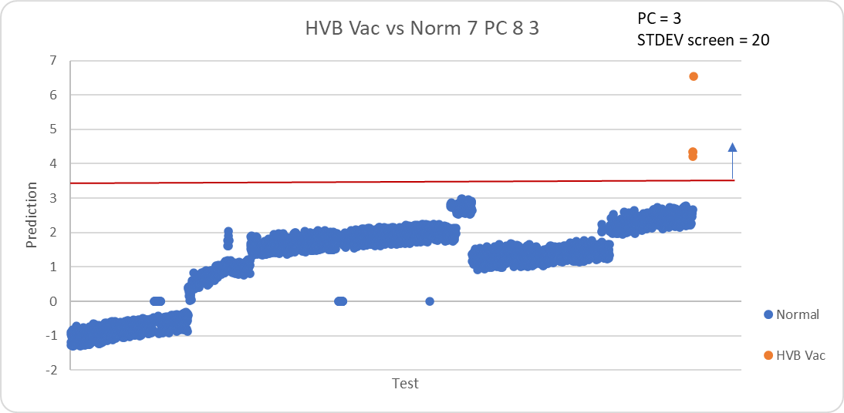
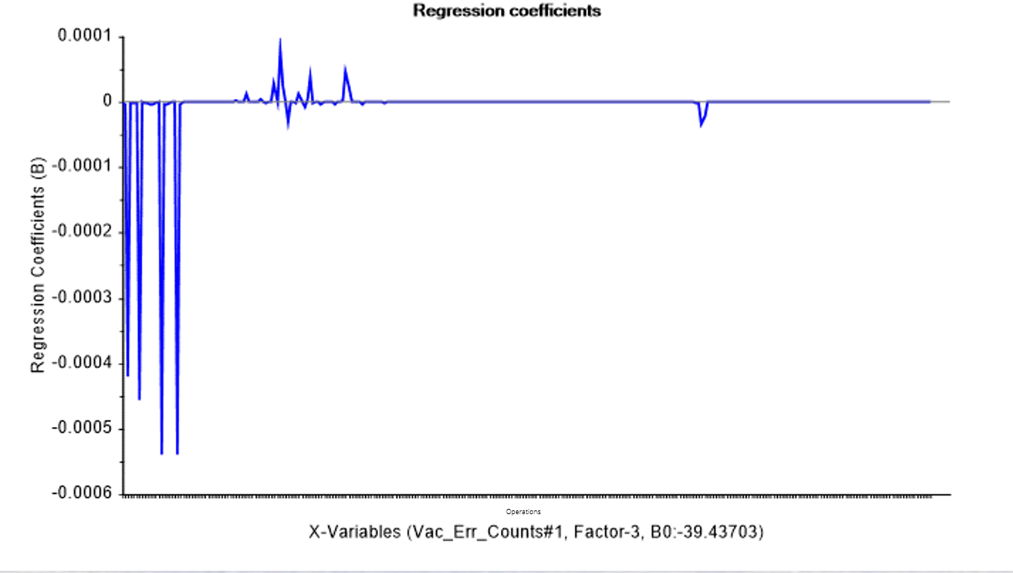
HVB vacuum vs Normal Analysis Results: -02
Tested on:
3246 Normal
4 HVB vac
Test data was not part of modeling data set
Iterative modeling: select data to model on, test model on new data, add failing test data back into the modeling data, repeat (until good prediction is obtained)

Slide 13
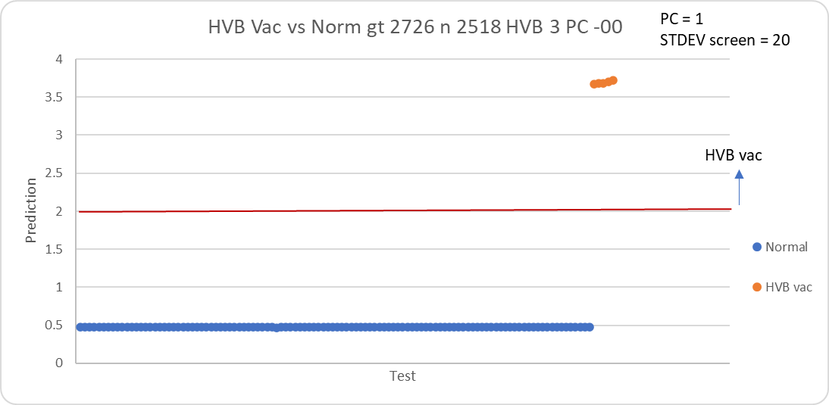
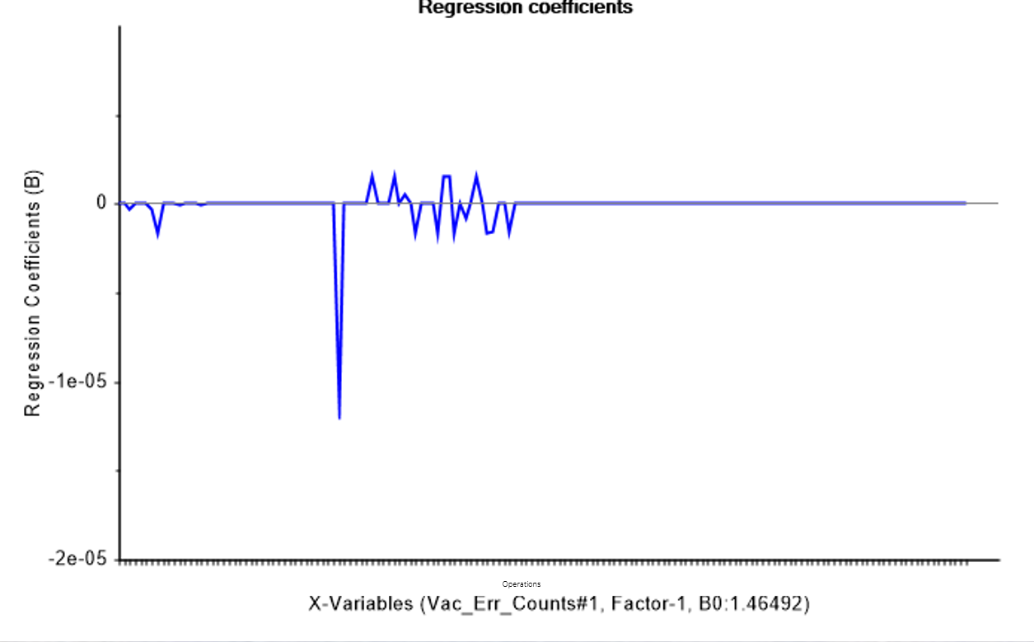
HVB vacuum vs Normal Analysis Results: -00
Tested on:
110 Normal
5 HVB vac
Test data was not part of modeling data set
Tested on:
110 Normal
5 HVB vac
Test data was not part of modeling data set
Iterative modeling: select data to model on, test model on new data, add failing test data back into the modeling data, repeat (until good prediction is obtained)

Slide 14
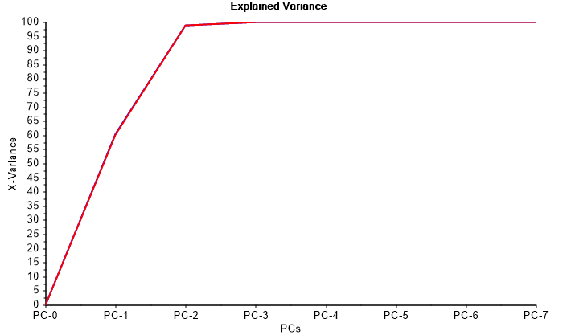
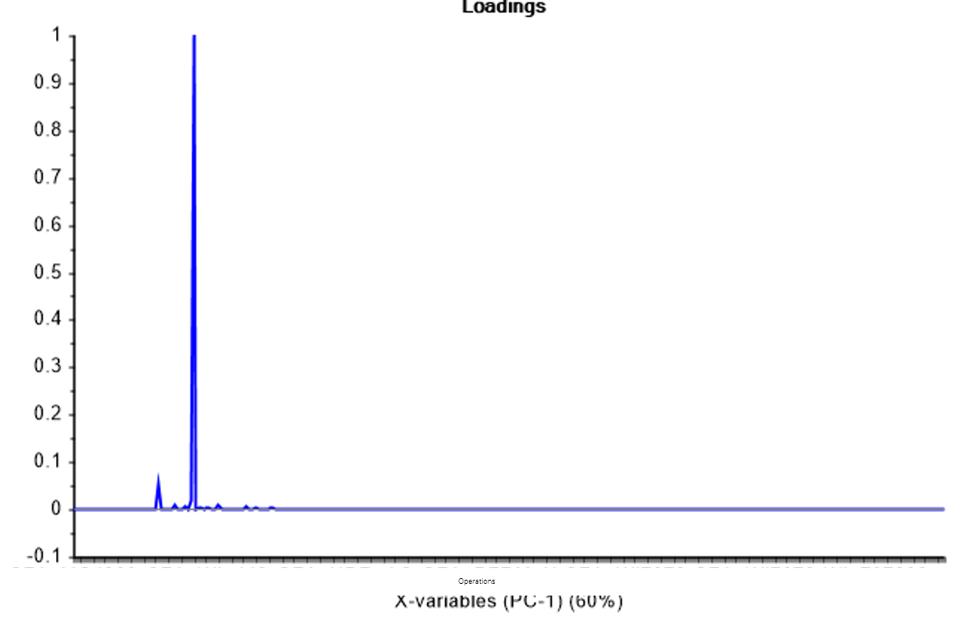
HVB vacuum vs Normal Analysis Results: -01
PCA Modeling on:
1179 Normal
3 HVB vac
Tested on:
110 Normal
5 HVB vac
Test data was not part of modeling data set
Results less sure:
Only 3 HVB vac fails in modeling

Slide 15
Important operations
Compare operations important for differentiating
HVB from normal (Yellow)
HVB wall from HVB vac (Blue)

Slide 16
Funding
Sandia National Laboratories is a multimission laboratory managed and operated by National Technology & Engineering Solutions of Sandia, LLC, a wholly owned subsidiary of Honeywell International Inc., for the U.S. Department of Energy’s National Nuclear Security Administration under contract DE-NA0003525.

