Slide 1
Identifying and Explaining Anomalous Activity in Surveillance Video with Compression Algorithms
Renee Gooding/SNL
Jonathan Bisila/SNL, Mike Smith/SNL, Christina Ting/SNL
LDRD

Slide 2
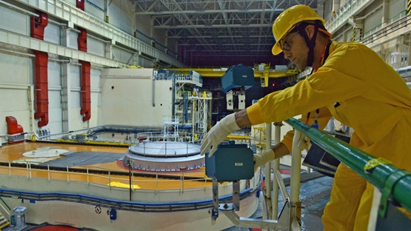
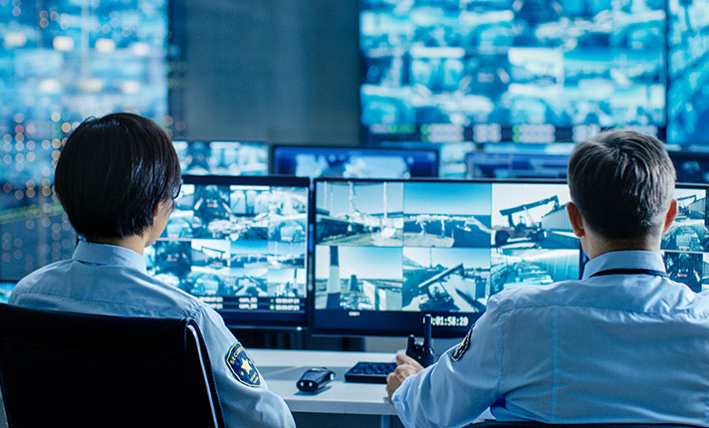
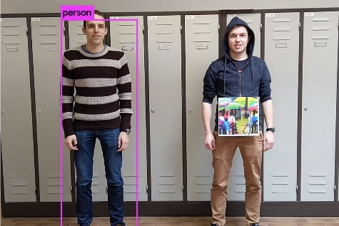
Anomaly detection in surveillance videos
Our goal is to improve the quality and efficacy of video surveillance in identifying anomalies
Current approaches:
Manual review
Basic review capabilities
Deep learning (state-of-the-art)
Notes:
Video surveillance is an important part of many national security domains, because of this automated anomaly detection methods are increasingly needed. Our goal is to improve the quality and efficacy of anomaly detection in video surveillance. Current approaches for video anomaly detection include manual review, which requires qualified analysts and is expensive and error and fatigue prone. Basic review capabilities such as comparing one frame to the next are sensitive to minor changes and prone to false positive rates. Finally, because of its success in computer vision, many sate-of-the-art approaches use deep learning methods. Deep learning methods can improve the learning structure for basic review capabilities to reduce false positives; however, they susceptible to adversarial attacks.

Slide 3
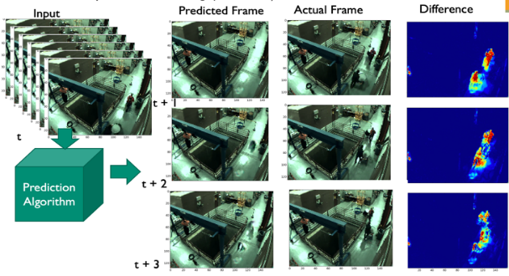
Deep learning methods
Approaches
Reconstruction Error
Future Frame Prediction
Classification-framed approaches
Distance based approaches
Challenges
Large quantities of labeled data
Tuning many parameters
Computationally expensive
Not interpretable
Easily fooled
Notes:
There are many approaches and variations of deep learning methods for video anomaly detection. Some of these approaches include,
Reconstruction error based methods such as autoencoders and CNNs. These approaches learn normal behavior and assume that anomalous data will have high reconstruction error however this is not always the case as the anomalous behavior may be correctly reconstructed.
Future frame prediction methods use many different DL architectures to predict the next frame in the sequence
Classification framed approaches such as multiple instance learning require labels for normal and anomalous data
And finally distance based approaches create models from a training partition and measure deviations from the model to determine anomaly scores.
While DL methods may offer performance improvements over other current tools, they still face considerable challenges including, requirements of large caches of training data, the models requiring fine tuning of many parameters which puts them at risk for overfitting and not being generalizable to new scenarios, and high computational cost. In addition, because of their “deep” nature, the models are not interpretable. Explainability methods have been developed to make it easier for users to understand how a decision was made, but these explanations are not always useful. Finally, as previously mentioned, DL models are easily fooled.
For some current customers such as the IAEA for nuclear safeguards, their mission is to ensure that the parameters of international treaties are upheld. They have strict requirements that no false positives are observed as any deviation of nuclear material could be catastrophic. This means that having an interpretable method that can be verified is extremely important. Additionally, most inspectors only have laptops and other non-supercomputer resources so being able to run these algorithms efficiently is extremely important.

Slide 4
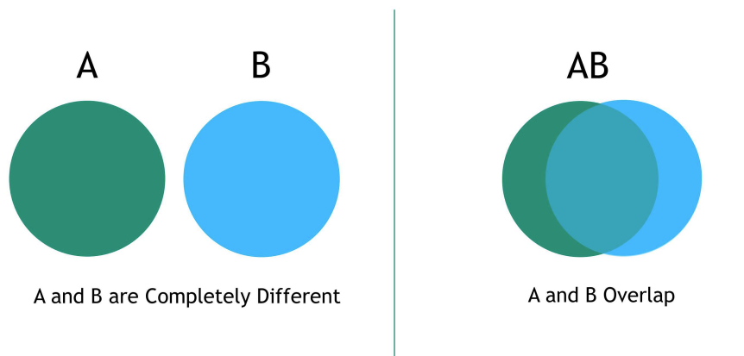
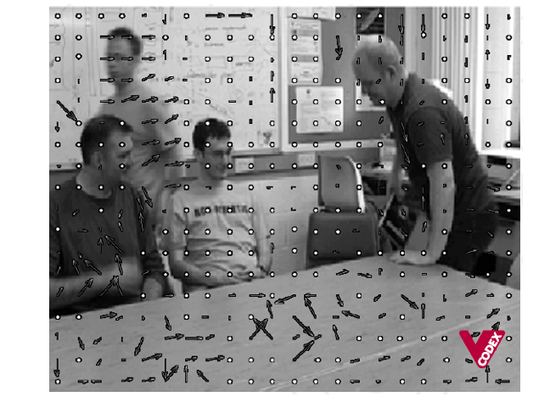
Our approach: compression
Video Compression for data reduction
Compression Analytics for anomaly detection
Information between video frames is largely redundant. To compress the information, a data compression model can be learned to express frames in terms of motion vectors with respect to one or more reference frames.
Apply the data compression model trained on normal videos to compress (test) a new video. Compressed size of new video is an indication of anomaly or normal.
Anomaly:
Motion vectors in video A cannot compress video B
Normal:
Motion vectors in video A can mostly compress video B
Advantages/Impact
Requires less training data
Few to no parameters to tune → more generalizable
Lower computational cost
Model results are interpretable probabilities of rare pixel sequences and/or motion vectors
Output is a timeseries → Time-series algorithms can be applied to discover longer-time dependent relationships and periodicity.
Li, Ming, et al. "The similarity metric." IEEE transactions on Information Theory 50.12 (2004): 3250-3264.
Notes:
To address many of the challenges facing the deep learning methods, we are investigating an alternative approach that uses compression in two ways, (1) first we use video compression methods to reduce the data dimensionality and improve computation cost. As you might imagine, in surveillance video with a fixed camera a large majority of the pixel values remain unchanged from frame to frame.. Taking advantage of this, video compression methods extract macroblock motion vectors that describe the change in motion from the current frame to a reference frame. Next, we use compression analytics to compute a similarity score. Compression analytics is the application of compression algorithms for ML tasks. Compression algorithms operate directly on raw byte files (like a video file), and finds predictable, repeatable patterns in a single data file with the goal of compressing the file. Compression analytics leverages this idea, but looks across multiple data files with the goal of finding predictable, repeatable patterns for ML tasks. For example, if you 1) compare two data files you can compute similarities, 2) have training data of multiple, labeled files you can do classification, or 3) have a set of ‘normal’ data files you can do anomaly detection using compression analytics
As shown in the Ven Diagram on the right, if we have two data sequences we want to compare, we can measure similarity using compression analytics. Specifically, if we can encode sequence B with the information in sequence A with using bits, then the two sequences share similar information. If A and B do not share similar information, then a compressor learned on A will not be able to encode B.
When compressing repeated data, we learn how similar our data is across space or time, and this process can be used to understand what’s “normal”. By developing models of what normal data looks like, we also develop the capability to recognize when our data is off-normal. This is the anomaly detection aspect of the work.
Some of the advantages of using compression analytics is that they require less training data for anomaly detection and have few to no parameters to tune making it easier to generalize our method to multiple cameras, multiple facilities, and multiple domains.
A significant advantage of compression analytics over deep learning is the interpretability. In our method, we operate on features from compressed video such as motion vectors, while DL methods operate on raw features that do not have semantic meaning and are not human interpretable. Because the compression is a function directly of the data, the outputs of the model are probability tables of their pixels or motion vectors, and can inherently be interpreted by a user. Finally, the output of our method is a timeseries allowing us to leverage time series algorithsm that can be used to discover longer-time dependent relationships and peridocity.

Slide 5
Video compression
Use video compression methods to extract macroblock motion vectors
Frame 1
Frame n
Pixel
Macroblock
Notes:
In our first compression technique, we leverage video compression methods to pre-process our data by extract macroblock motion vectors from each frame. A macroblock is a block of pixels and the associated motion vector describes the change in motion from the reference frame. In video compression, the reference frame gets reset regularly and the macroblock granularity is configurable. Reducing the resolution of images is a technique that DL methods often use to reduce the number of parameters. In our work, we can control the resolution with the size of the macroblock used in the video compression.

Slide 6
Video compression
Use video compression methods to extract macroblock motion vectors
Calculate motion vector angles and magnitudes
Frame 1
a m
Frame n
a m
$$a_{n_{0}}$$ $$m_{n_{0}}$$
Pixel
Macroblock
$A_{i}={a_{1}}_{i}, {a_{2}}_{i},…, a_{n_{i }}$
$$M_{i}={m_{1}}_{i}, {m_{2}}_{i},…, {m_{n}}_{i}$$
Notes:
Once we have our macroblock motion vectors, we calculate either the motion vector magnitude or angle and create 1D sequences for each macroblock across time. Compression analytics are commonly used on 1 dimensional sequences such as text. Our problem has the added challenge of being 3D. By constructing our 1D sequences in this way, we map our 3D problem us to many independent 1D problems. Additionally, we can use the temporal component to discover longer-time dependent relationships and periodicity.

Slide 7
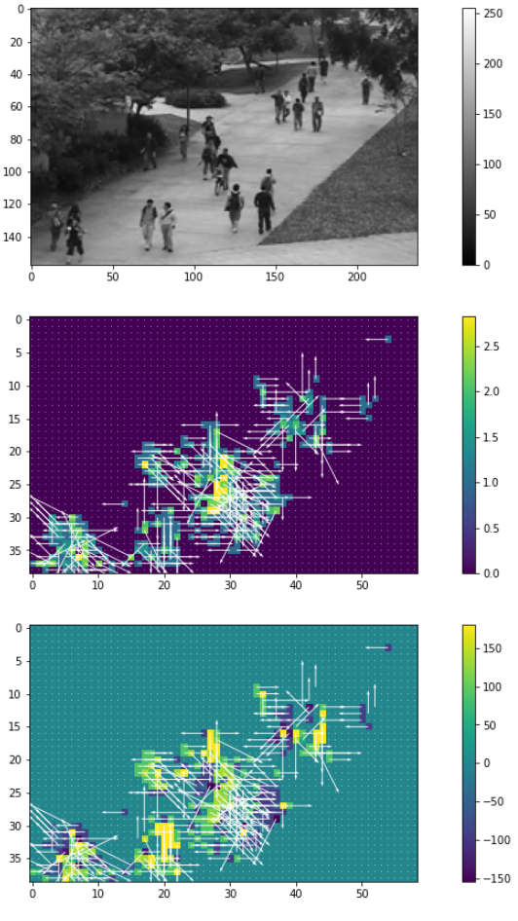
Video compression
Use video compression methods to extract macroblock motion vectors
Calculate motion vector angles and magnitudes
Frame 1
a m
Frame n
a m
$$a_{n_{0}}$$ $$m_{n_{0}}$$
Pixel
Macroblock
$A_{i}={a_{1}}_{i}, {a_{2}}_{i},…, a_{n_{i }}$
$$M_{i}={m_{1}}_{i}, {m_{2}}_{i},…, {m_{n}}_{i}$$
Top: Single frame at pixel level
Middle: Motion vectors and magnitudes
Bottom: Motion vectors and angles
Notes:
Processing videos at the pixel level is computationally expensive, by preprocessing our videos using methods from video compression, we reduce the computational cost. The figure on the right shows a single frame from a video and its associated macroblock motion vectors and magnitues and angles, respectively. By using video compression, we can reduce the size of the data without loss of information.

Slide 8
Compression analytic
NGramPPM[1]
Compression without the compression
Based on Prediction by Partial Matching (PPM)
Scores sequences based on similarities in statistical distribution compared to training data
Apply the data compression model trained on normal videos to compress (test) a new video. Compressed size of new video is an indication of anomaly or normal.
Anomaly:
Motion vectors in video A cannot compress video B
Normal:
Motion vectors in video A can mostly compress video B
[1] Bauer, Travis. “NgramPPM: Compression Analytics without Compression”. Sandia National Laboratories. SAND2021-11185
Notes:
Once our macroblock sequences have been created we use the Sandia developed algorithm, NGramPPM, to build local compression models. NGramPPM is based on the popular compression algorithm PPM. PPM is a compression algorithm that builds up a table of context probabilities. This is the probablily of a byte occurring given some preceding bytes or ‘context’. The context probabilities are used for compression, where the more probable bytes are better compressed. NGramPPM skips the compression step and just uses the probability tables to develop a statistical model of the training data. It uses the statistical model to score some test data based on how well the model describes the test data. The better the model describes the data, the more similar it is; a small score indicates the data is more similar while a larger score indicates dissimilarity, or an anomaly.

Slide 9
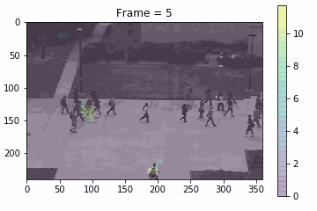
Compression analytic
Train
Test
Train local NGramPPM models
Model per macroblock
Score macroblock sequences according to model
We assign scores at pixel level
Pixels with large scores are more anomalous
$$m_{n_{0}}$$
$$m_{n_{0}}$$
$$m_{n_{0}}$$
$$m_{n_{0}}$$
$$m_{n_{0}}$$
$$m_{n_{0}}$$
M₀
M₁
$$…$$
M_{n}
Scores
$$s_{n_{0}}$$ | $$s_{n_{0}}$$ | $$s_{n_{1}}$$ | $$s_{n_{1}}$$
$$s_{n_{0}}$$ | $$s_{n_{0}}$$ | $$s_{n_{1}}$$ | $$s_{n_{1}}$$
 |  |  |  | $$s_{n_{k}}$$ | $$s_{n_{k}}$$
 |  |  |  | $$s_{n_{k}}$$ | $$s_{n_{k}}$$
$$s_{n_{0}}$$ | $$s_{n_{0}}$$ | $$s_{n_{1}}$$ | $$s_{n_{1}}$$
$$s_{n_{0}}$$ | $$s_{n_{0}}$$ | $$s_{n_{1}}$$ | $$s_{n_{1}}$$
 |  |  |  | $$s_{n_{k}}$$ | $$s_{n_{k}}$$
 |  |  |  | $$s_{n_{k}}$$ | $$s_{n_{k}}$$
$$s_{n_{0}}$$ | $$s_{n_{0}}$$ | $$s_{n_{1}}$$ | $$s_{n_{1}}$$
$$s_{n_{0}}$$ | $$s_{n_{0}}$$ | $$s_{n_{1}}$$ | $$s_{n_{1}}$$
 |  |  |  | $$s_{n_{k}}$$ | $$s_{n_{k}}$$
 |  |  |  | $$s_{n_{k}}$$ | $$s_{n_{k}}$$
Notes:
We train an NGramPPM model per macroblock using either the angle or magnitude sequences extracted from our training data. During this training phase, each macroblock model learns the normal behavior is for its location. In the testing phase, the trained model provides a score indicating how similar the test data is compared to what was observed in the training data. Using small windows of frames, each macroblock sequence in our set of test videos get scored according to the trained model. By mapping the macroblock scores to the pixel level, we can visualize the results. In the video on the right, we have overlaid the ngram scores on the original video. Here, brighter pixels correspond to higher ngram scores. Because our feature representation only takes into account motion, anomalies will show up as pixels with unpredictable changes in motion either in magnitude or in direction.

Slide 10
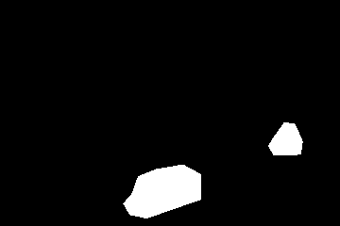
Data
UCSD Anomaly Detection Dataset
Video sequences of pedestrians walking around UCSD (UCSD-peds2 dataset)
Common anomalies:
Bikers, skaters, small cars, people walking across walkways or across grass.
Ground truth
Each video includes a binary ground truth flag for each frame
A subset of videos includes pixel-level binary masks identifying anomalies
Notes:
For our experiments, we use video surveillance data from the UCSD Anomaly Detection Dataset. This includes video sequences of pedestrians walking around the UCSD campus recorded by stationary cameras mounted overlooking pedestrian walkways. Normal videos contain only pedestrians and anomalous videos contain bikers, skaters, small cars, and people walking across walkways or on grass. Each video has an associated ground truth file that includes a binary flag per frame indicating whether an anomaly is present. Additionally, pixel-level ground truth is provided for a subset of the videos.
Although this is the only data we currently have results for, we plan to apply our method to other datasets that are widely used in the literature.
[Benchmark data sets sponsor data]

Slide 11
Anomaly detection performance
Comparing to the literature is difficult, but we’re working on it!
Evaluation | AUC
Frame-level with 40% pixel overlap | 69.0%
Frame level with maximum NGramPPM score | 82.0%
Pixel-level | 97.0%
Train on 9 videos
Total time to train: 21.4s
Test on 12 videos
Testing done in parallel
Total time to test: 43.8s
Our method,
Requires very few parameters
Uses commodity hardware (CPUs)
Is computationally inexpensive
Leverages feature representation already used in video compression
Notes:
Comparing performance apples to apples with the literature is difficult. While many performance measures are reported, details describing how they are calculated is often lacking. We examine ROC curves and report an AUC values suing using three methods to calculate anomaly detection performance, two of which appear to be widely-used in the literature. Using a frame level metric that requires a pixel level Ngram threshold and 40% ground truth overlap per frame, we achieve 69% AUC. Using only the maximum Ngram score for each frame, we improve our frame level AUC bringing it up to 82%. Finally, simply using the pixel level ngram scores we achieve 97% AUC.
Using compression, we are able to localize anomalies with relatively little training data and no overhead costs associated with calculating gradients or comparing predicted to actual frames like many of the deep learning methods. Our novel approach to video anomaly detection yields good results with very few parameters, uses commodity hardware, is computationally inexpensive, and leverages feature representation already developed for video compression.

Slide 12
Continued & future work
Local Compression models
Frame level ROC/AUC improvement
Improved computation time
Fuse scores for angles, magnitudes, color, etc.
Matrix Profiling
Can be used on univariate or multivariate timeseries to find
Repeated patterns (motifs)
Anomalies (discords)
Specific patterns (including different length patterns)
Seasonality
Is modified to be used on differences between videos; now utilizes
Pixel level, macroblock motion vectors
Normalized compression distance
Extract user friendly explainability
Notes:
Currently, are working on improving our frame level ROC/AUC performance. We are also working on improving computation time with different approaches of parallelization in our training phase. Finally, we are exploring the idea of fusing scores for models built on different features such as angles, magnitudes and color.
Next, we want to explore traditional timeseries analysis to try to capture long term time dependencies such as seasonality and repeated patterns. Specifically we are interested in exploring Matrix Profiling, this is a tool for timeseries data mining that helps discover repeated patterns and anomalies. We believe we can modify matrix profiling to use differences between frames or videos using pixel or macroblock information as well as possibly the normalized compression distance.
As mentioned on previous slides, compression analytics lend itself to user friendly explainability. Methods for examining sub-sequences with high or low predictability have been developed for NGramPPM and we plan to explore ways to leverage this to add interpretability to detected anomalies.

Slide 13
Thank you!
Questions?
Contact: wg-emonda@sandia.gov

