Slide 1
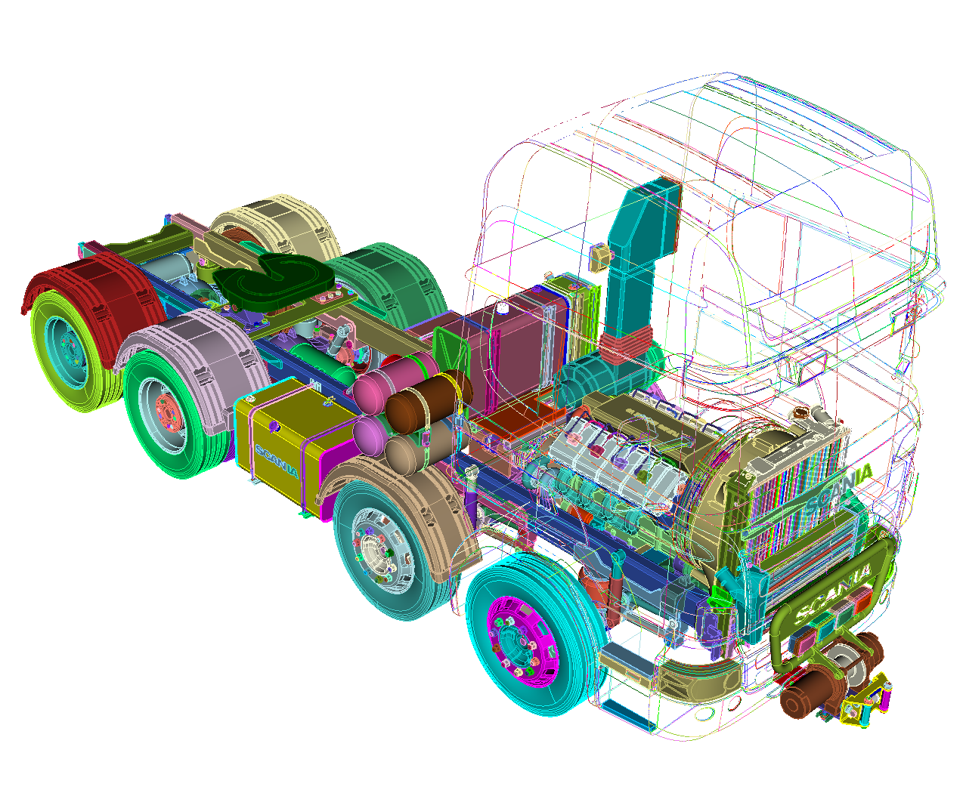
Machine Learning Applications for Defeaturing and Model Preparation
Steven Owen, Tim Shead, Shawn Martin, Armida Carbajal
July 25, 2022
Sandia Machine Learning, Deep Learning Workshop
July 25-28, 2022
Albuquerque, NM
SAND2021-8928 C

Slide 2
Rapid CAD to Simulation with Machine Learning
Commercial Truck CAD Model
3545 volumes
81,283 surfaces
208,203 curves
133,461 vertices
Example workflow
Break into subsystems for teaming and/or avoid large model size
Remove parts that are irrelevant and not normally modeled for a specific physics
Fix bad geometry
Remove small features
Remove gaps, overlaps, misalignments
Tet mesh
Identify and prepare specific categories of mechanisms (Bolts, Springs, Bearings, etc.)
Compute preloads on bolts, springs, etc.
Prepare input deck
2

Slide 3
Rapid CAD to Simulation with Machine Learning
Commercial Truck CAD Model
3545 volumes
81,283 surfaces
208,203 curves
133,461 vertices
Machine Learning for Analysis Preparation:
Reduce/Eliminate most tedious tasks
Guide user to next step
Present user with smart options
User validates ML-solutions
Standardization between analysts
3

Slide 4
Rapid CAD to Simulation with Machine Learning
Commercial Truck CAD Model
3545 volumes
81,283 surfaces
208,203 curves
133,461 vertices
Example workflow
Break into subsystems for teaming and/or avoid large model size
Remove parts that are irrelevant and not normally modeled for a specific physics
Fix bad geometry
Remove small features
Remove gaps, overlaps, misalignments
Tet mesh
Identify and prepare specific categories of mechanisms (Bolts, Springs, Bearings, etc.)
Compute preloads on bolts, springs, etc.
Prepare input deck
1
Defeaturing for Meshing
2
Classification and Reduction
4

Slide 5
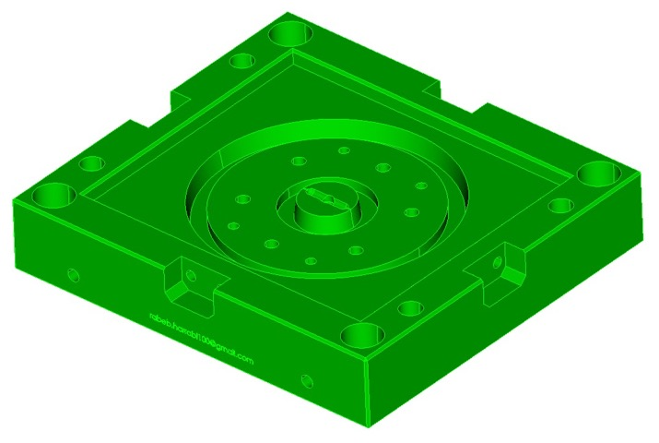
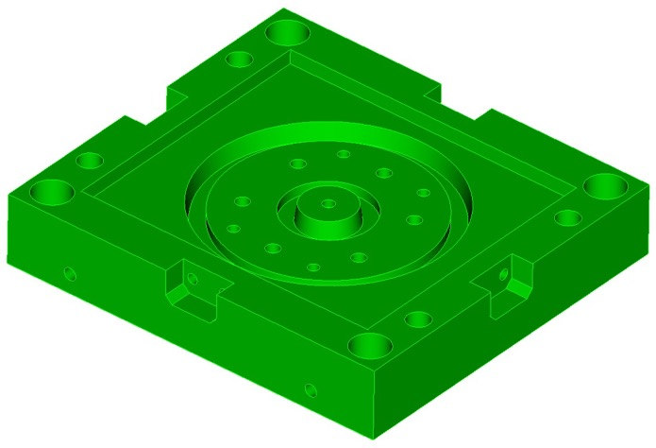
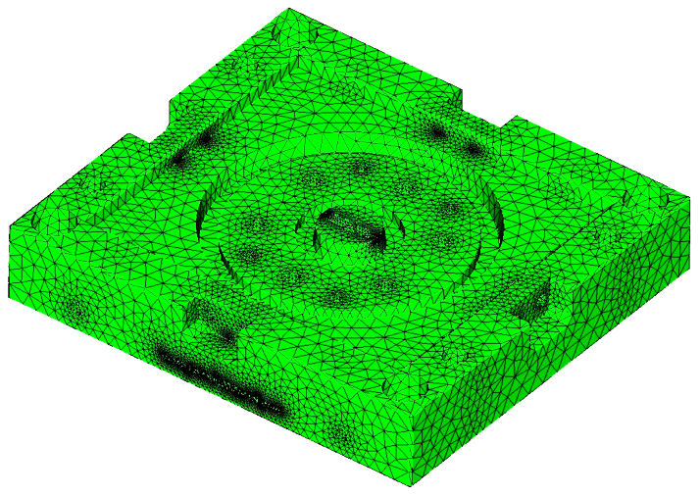
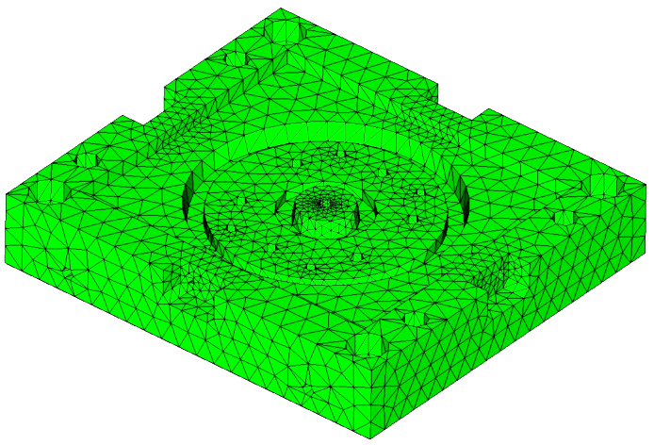
Defeaturing
CAD part for simulation
CAD part from designer
Defeaturing
595 surfaces
1506 curves
994 vertices
90 CAD operations performed in Cubit by "expert" user
397,258 tets
32,559 tets
5

Slide 6
Machine Learning driven Defeaturing
1
Find the most problematic features in the CAD Model
For a given local topology
Small Curve
Small Surface
Sharp Angle at Vertex
Predict local mesh quality
Scaled Jacobian
In-Radius
Deviation
2
Find solution that yields best mesh quality
For a given local geometry operation
Collapse Curve
Remove Surface
Blunt Tangency
Etc..
Predict local mesh quality after operation
Scaled Jacobian
In-Radius
Deviation
6

Slide 7
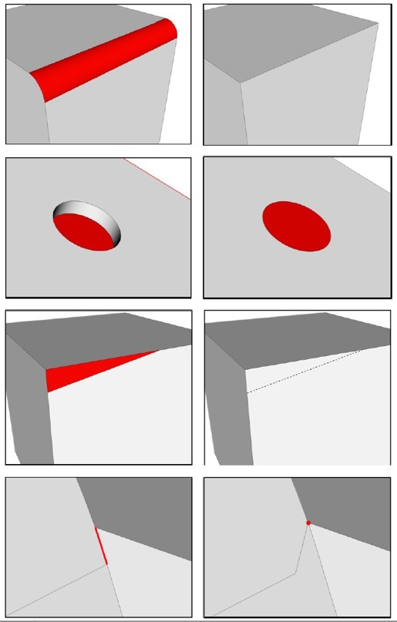
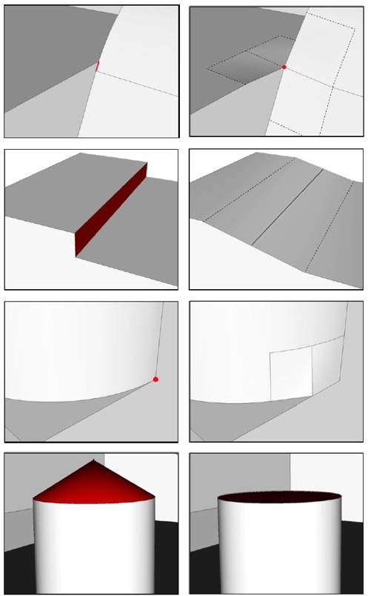
Example defeaturing operations
begin state
end state
begin state
end state
remove surface
tweak remove topology curve
tweak replace surface
tweak remove topology surface
composite surfaces
blunt tangency
collapse curve
remove cone
7

Slide 8
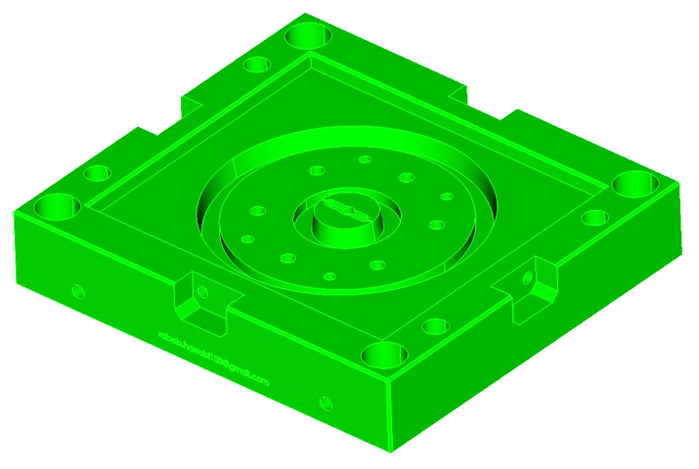
Machine Learning for Defeaturing
Machine Learning
$$y=f(x)$$
32,559 tets
Output: Mesh
quality metrics
“labels”
Input: CAD Model
Local geometry/topology
“features”
8

Slide 9
Machine Learning for Defeaturing
$$x,y$$
$$f$$
$$y=f(x)$$
Machine Learning Methods
Training Data
Machine Learning
Models
.csv file
Characterize problems
Features
Labels
Python Script + Cubit
Train many CAD models
Diverse problems
One row in .csv per problem
Non-runtime
scikit-learn
Python open source
Machine Learning libraries
Ensembles of Decsion Trees (EDT)
Make predictions
Small Binary
Used Run-time in C++ Code
Access via C-Python interface
9

Slide 10
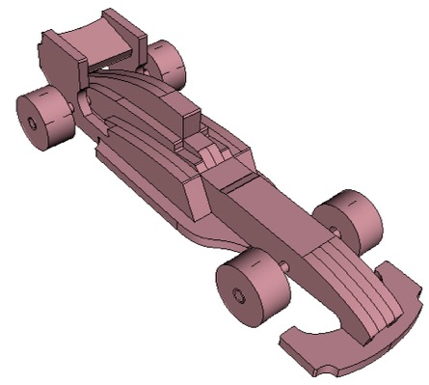
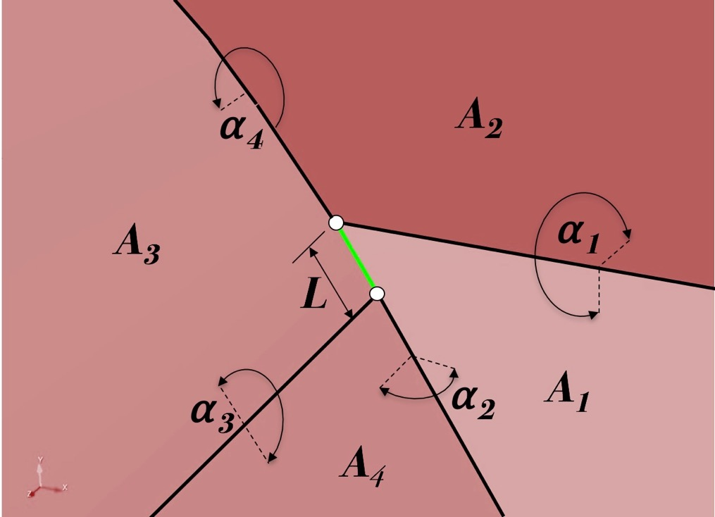
Training Data Features
Curve Length
Surface Area
Angle at vertex
Angle at curves
Valence at vertex
Number of loops
Hydraulic Radius
Etc…
Topology-Based Features
10

Slide 11
Training Data Labels
geometry
triangle/quad
r
deviation
Scaled Jacobian
In-Radius Ratio
Deviation
Function of angles at vertices
Scaled -1.0 to 1.0
Independent of mesh size
Ratio with equilateral tet with target edge length
Scaled 0.0 to 1.0
Sensitive to mesh size
Distance from triangle centroid to closest point on geometry
Scaled by target mesh size
Ensure mesh "matches" geometry
11

Slide 12
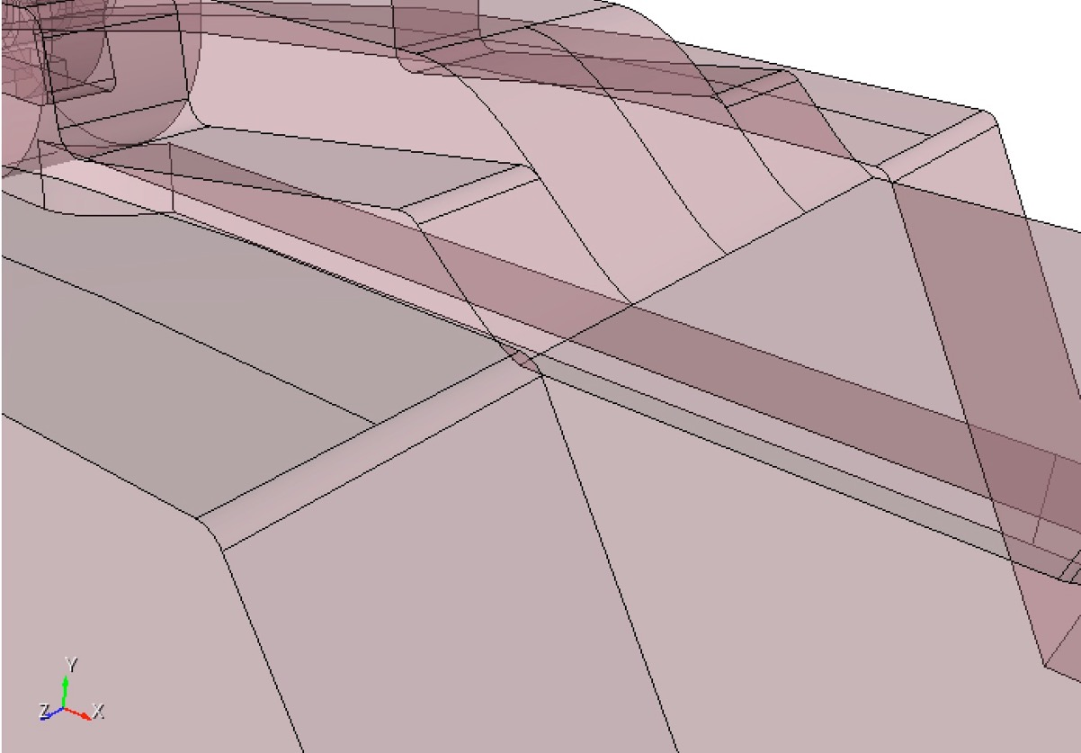
Training Data Labels
Small Curve
12

Slide 13
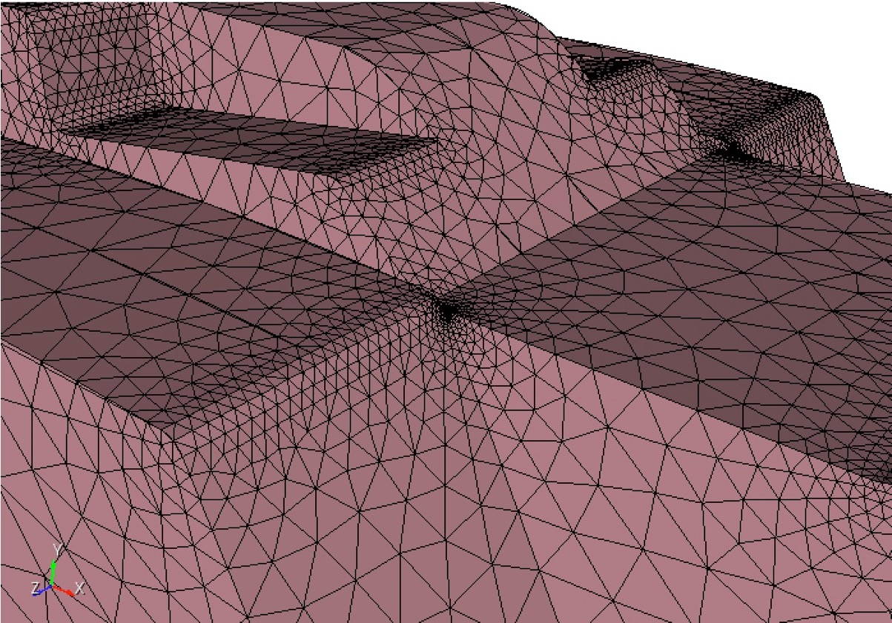
Training Data Labels
Small Curve
13

Slide 14
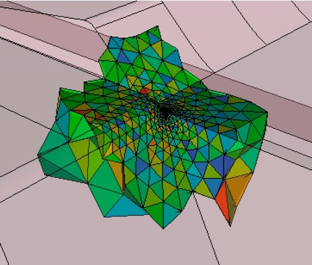
Training Data Labels
Local Tets at Geometric Curve
Small Curve
Topology
14

Slide 15
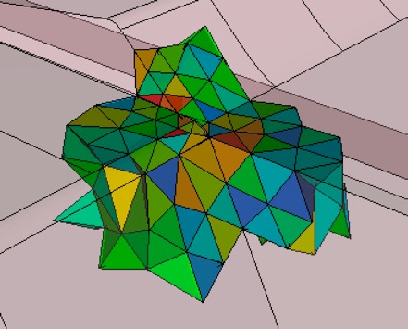
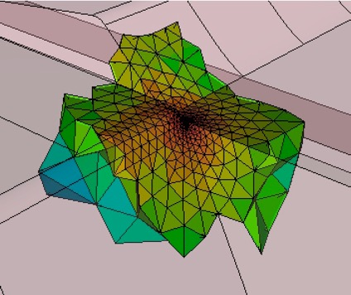
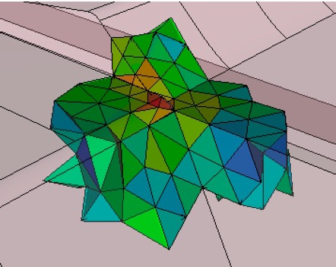
Training Data Labels
Collapse Curve
Before
After
Collapse Curve
Scaled Jacobian
Before
After
Min SJ = 0.250
Min SJ = 0.227
In-radius
Min IR = 0.027
Min IR = 0.267
15

Slide 16
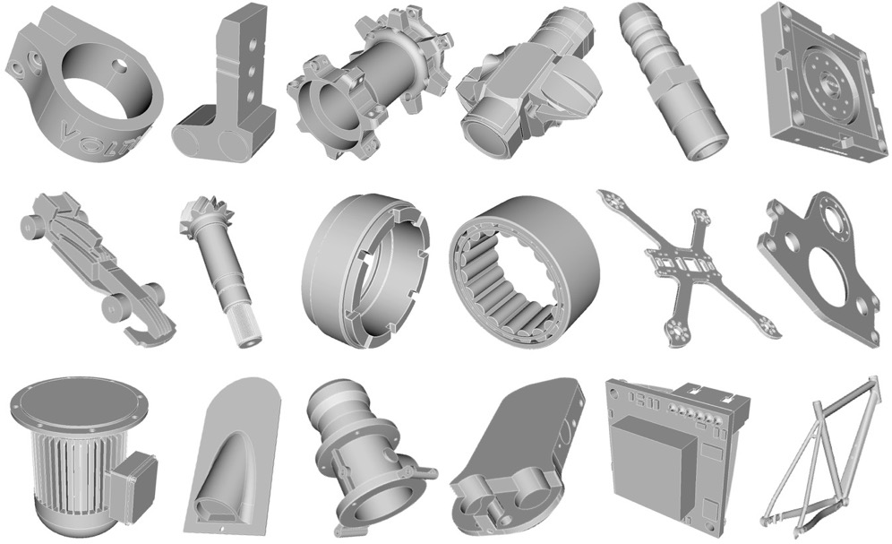
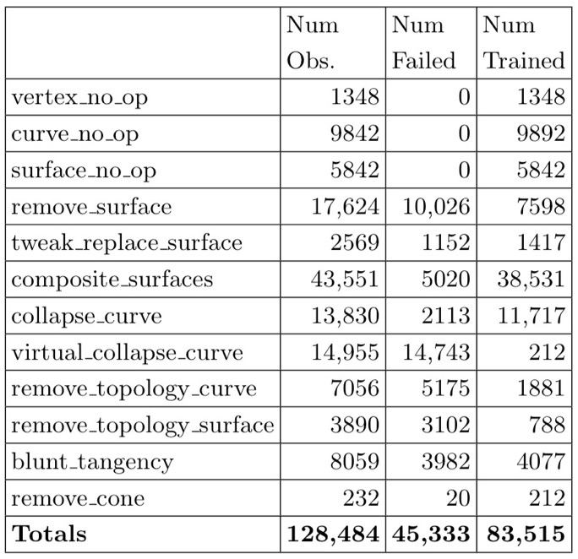
Machine Learning Study
94 single-part CAD models
Owen, Steven; Shead, Timothy M.; Martin, Shawn , “CAD Defeaturing Using Machine Learning”, 28th International Meshing Roundtable (IMR), Buffalo, New York, USA, October 14-17, 2019
Patent Granted March 2022
16

Slide 17
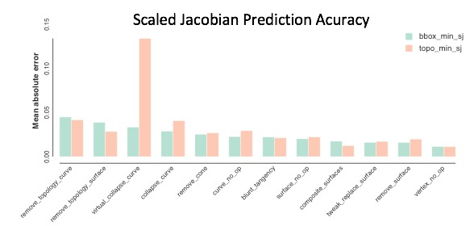
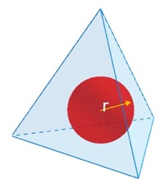
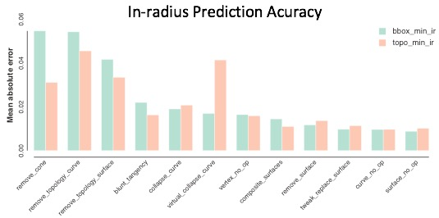
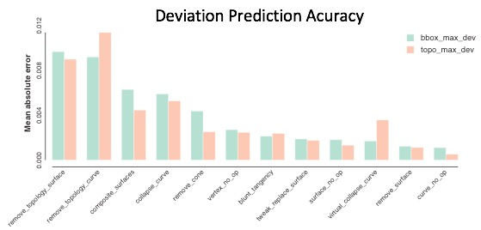
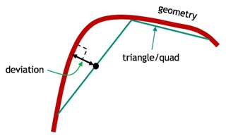
Machine Learning Study – EDT (Ensembles of Decision Trees)
Mean Absolute Error (MAE)
Scaled Jacobian
$$MAE≈0.02$$
Scaled In-radius
$$MAE≈0.02$$
Scaled Deviation
$$MAE≈0.003$$
17

Slide 18
Defeaturing for Meshing Example
18

Slide 19
Rapid CAD to Simulation with Machine Learning
Commercial Truck CAD Model
3545 volumes
81,283 surfaces
208,203 curves
133,461 vertices
Machine Learning for Analysis Preparation:
Defeaturing
Predicts potential problems in mesh
Predicts tools that will best improve
Allows user to select and validate
Part Classification
Identifies common mechanism types
Tools to quickly reduce to analysis-ready
In-situ training on user-defined categories
19

