Slide 1
What is the Best Model? A Statistical Approach to Compression Analytics
CIS LDRD 225949 (Year 1 of 2)
Alex Foss (PI, 5573), Justin Newcomer (PM, 5570)
Sandia Team: Christina Ting (5554), Kurtis Shuler (5573), Rich Field (5553), Travis Bauer (5554)
UIUC AA: Eddie Cardenas-Torres, Dave Zhao
SAND2022-9696 C

Slide 2
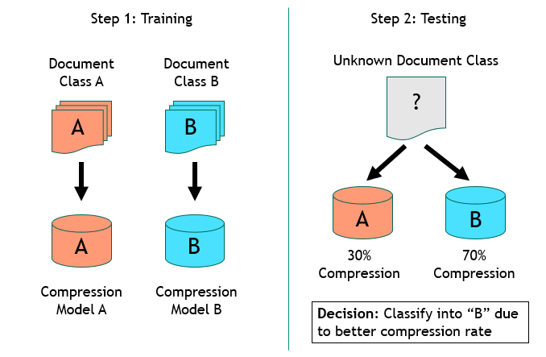
PROJECT BACKGROUND
Definition: Compression analytics (CA) is the use of compression algorithms for machine learning (ML)
Wide range of applications: Text, raw binaries, seismic measurements, genomics, cyber log data
Problem:
Lack of formal statistical models for CA limit principled extensions
Unclear how to select best CA model
Lack of rigorous ways to optimize misclassification rate
Goals:
Develop novel statistical framework for CA
Statistical model selection
Optimal classification rules
Use framework to create novel CA techniques
Develop nonlocal CA
Goal: Develop novel statistical and nonlocal CA algorithms for ML

Slide 3
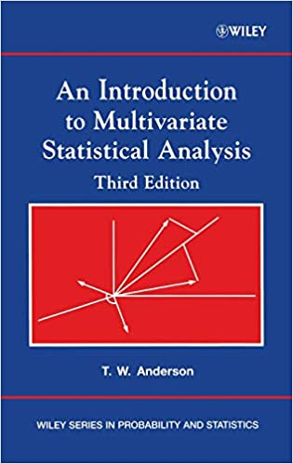
Background: Minimizing the Expected Cost of Misclassification
Theorem for deriving theoretically optimal classification rules:
Theorem: For a $K$-class classification problem, the regions $R_{1},R_{2},…, R_{K}$ that minimize the expected cost of misclassification are given by
$x$ is a scalar or vector of observed covariates
$P\left(x\right| class=i)$ is the PMF/PDF of the random variable $X$ evaluated at $x$ within class $i$
$π_{i}$ is the prior probability of observing class $i$
$cost(j|i)$ gives the cost of (mis)classifying into class $j$ given true class $i$
Can be adapted for minimax classification, maximizing accuracy/F₁/etc.
T.W. Anderson. An Introduction to Multivariate Statistical Analysis, 3rd Ed, Hoboken, NJ: Wiley.

Slide 4
Result 1: Minimizing the Expected Cost of Misclassification with CA
Consider that
$−\log_{2}P_{\vec{X}}(\vec{x})=I_{\vec{X}}(\vec{x})$, and
$I_{\vec{X}}\left(\vec{x}\right)≈C\left(\vec{x} \right| 𝕏)$
where
$I_{\vec{X}}(\vec{x})$ denotes the information content in the observation $\vec{X}=\vec{x}$
$C\left(\vec{x} \right|$ $𝕏$) denotes the compressed length of $x$ given by a compression model $C$ trained on $𝕏$, a sufficiently large sample from the random variable $X$
This allows the approximation of optimal classification rules as
where the approximation error is determined by the approximation of $−\log_{2}P_{\vec{X}}(\vec{x})$ with $C\left(\vec{x} \right| 𝕏)$.
$$∑π_{i}2^{C\left(x | 𝕏_{i}\right)}cost(k|i)$$
Novel application of optimal classification rules to compression analytics classifiers.

Slide 5
Background: Prediction by Partial Matching (PPM) and Model Order
PPM is a commonly used compression algorithm (e.g. RAR, 7-zip)
$$C_{PPM\left(K\right)}\left(\vec{x} \right|𝕏)≈\prod_{i=1}^{n}{P\left(x_{i} \right| x_{i−K}, x_{i−K+1}, …, x_{i−1})}$$
$$≈P\left(x_{1}, x_{2},…, x_{n}\right)$$
Complete PPM algorithm not shown here (See Cleary & Witten and Bauer 2021)
$\vec{x}$ is a vector of observed symbols drawn from a vector of random variables $\vec{X}$
$𝕏$ is a sufficiently large sample drawn from $\vec{X}$ used to estimate the required probabilities
Main idea: PPM attempts to estimate a variable order markov model (VMM)
Requires choosing a maximum context length (order) $K$
Includes a recursive method for defaulting to context length $K−1$ for an unobserved context $K$
Many PPM variants exist
Cleary, J.G. and Witten, I.H. (1984) Data Compression Using Adaptive Coding and Partial String Matching. IEEE Transactions on Communications, 32, 396-402.
Bauer, T. (2021) Ngram PPM: Compression Analytics without Compression. Sandia Report, SAND2021-11185.

Slide 6
Background: Model Selection with AIC/BIC
A statistical model $P_{X}(x ;θ)$ with parameters $θ$ has likelihood
$$L\left(θ;\vec{x}\right)=\prod_{i=1}^{n}{P_{X}(x_{i};θ)}$$
We can evaluate model quality via AIC (Akaike’s Information Criterion):
$$AIC\left(\hat{θ}\right)=2\left|\hat{θ}\right|−2\ln{(L\left(\hat{θ};\vec{x}\right))}$$
$$BIC\left(\hat{θ}\right)=ln⁡(n)\left|\hat{θ}\right|−2\ln{(L\left(\hat{θ};\vec{x}\right))}$$
$$↓AIC/BIC ⇒ ↑Model Quality$$
where $\hat{θ}$ is an estimator of $θ$, and $|\hat{θ}|$ is the dimensionality of $\hat{θ}$.
AIC/BIC are principled methods for selecting parsimonious statistical models.

Slide 7
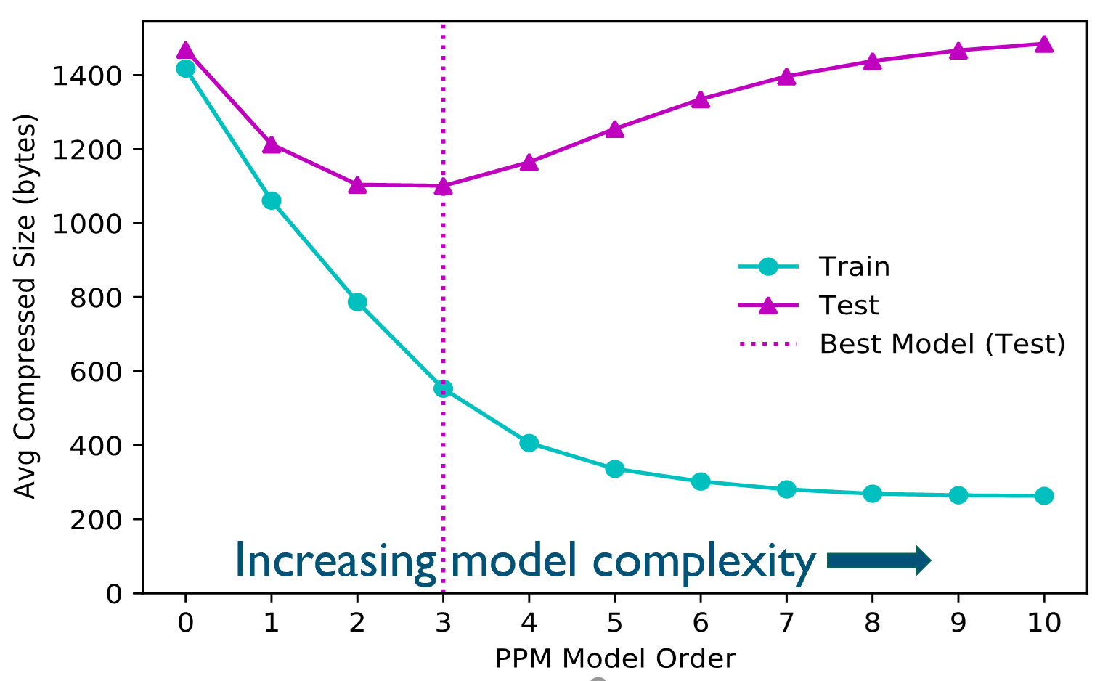
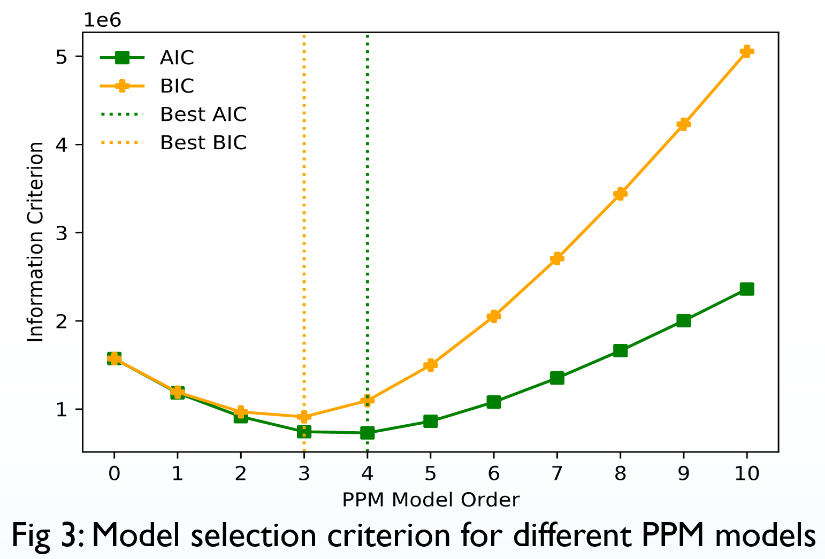
Result 2: Choosing PPM Model Order with AIC/BIC
For PPM encoding, AIC/BIC can be used to select model order $k$
$|θ|$ can be calculated as the number of estimated probabilities
Likelihood can be approximated using the compressed length of $x$
Sample results on 20-Newsgroups data:
k=3: Best observed out-of-sample performance
AIC/BIC detect best k ($±$1) using only in-sample data
Model Fit
(lower=better)
Model Selection Criterion (lower=better)
k
k
Novel AIC/BIC implementation gives principled technique for model selection with PPM

Slide 8
Conclusions
Compression Analytics (CA) involves using compression algorithms for machine learning (ML)
Statistical interpretation of CA offers a path forward for novel method development
Result 1: Optimal classification rules adapted to general compression algorithms
Result 2: Statistical model selection for choosing context length in PPM
Future directions:
Nonlocal compression for extending context length (order)
Adapting latent variable methods for unsupervised CA
Thanks for listening!

