Slide 1
Probabilistic Performance-Assessment Modeling of the Mixed Waste Landfill at Sandia National Laboratories
Clifford K. Ho, Timothy J. Goering,
Jerry L. Peace, and Mark L. Miller
Sandia National Laboratories
Albuquerque, NM 87185
(505) 844-2384
ckho@sandia.gov

Slide 2
Summary
Probabilistic fate and transport models showed several potential exceedances that merit “triggers” for long-term monitoring
  Tritium dose via air pathway
  Surface flux of radon-222 gas
  PCE concentration in groundwater
Key Assumptions
  Receptor located at MWL (continuous inhalation exposure)
  Sealed sources of radium-226 (which produces radon-222) allowed to degrade completely
  Cover allowed to erode completely
  Waste inventory treated as uncertain
Report can be downloaded from www.sandia.gov/caps

Slide 3
Overview
Background
Modeling Approach
Modeling Results
Recommended Triggers

Slide 4
Background
New Mexico Environment Department request for Corrective Measures Implementation Plan (May 2005)
  Include comprehensive model to assess the fate and transport of contaminants from the Mixed Waste Landfill
  Identify monitoring results that will trigger additional testing or remedies
Similar recommendations provided in 2003 WERC independent technical peer review
Developed probabilistic performance assessment to address these recommendations
  Conduct comprehensive fate and transport analysis for contaminants of concern; compare to regulatory metrics
  Quantify uncertainties
  Perform sensitivity analyses; understand failure modes
  Identify triggers for long-term monitoring
Notes:
From Final WERC Report: “Independent Technical Peer Review of the U.S. Department of Energy Sandia National Laboratories’ “Working Draft” Corrective Measures Study dated November 2002 Mixed Waste Landfill,” January 31, 2003, Performed by WERC:
A Consortium for Environmental Education and Technology Development
p. vi Executive Summary:
“4. The Panel strongly recommends the development of an integral numerical "fate
and transport" model for the simulation of the MWL. It is regrettable that such a
model was not yet developed to take advantage of sophisticated software that are
available in academia, national laboratories, and private industry. This software
should be calibrated with existing MWL data and fine tuned with the results of
future monitoring and fundamental developments. The results of the numerical
modeling should be used as inputs to the risk assessment model, and to probe into
the sensitivity of different MWL options.”
Our recent probabilistic performance-assessment model includes detailed fate-and-transport models for contaminants of concerns and relevant performance metrics. Simulated results were compared to existing data, when available, to calibrate and build confidence in the models.
p. 29:
“The Risk Assessment lacks modeling of the fate and transport of tritium in the subsurface
in the gas and liquid phases. The migration/release of tritium (and other COCs) needs to
be modeled to failure; i.e., when in time or at what level of source concentration will the
COCs reach the groundwater. This sort of modeling work will allow SNL to establish the
proper trigger levels described above.”
We have simulated the fate and transport of tritium in the subsurface in both the gas and liquid phases. Results show that tritium can reach the groundwater (when gas-phase transport is included), but the concentrations and groundwater dose remain below regulatory standards. Simulated dose due to tritium transport upward to the atmosphere resulted in some exceedances relative to the regulatory standard of 10 mrem/year via the air pathway. For all scenarios, the system was evaluated for possible “failure modes,” and appropriate triggers were recommended.
p. 30:
“Page I-26 – Section V: Fate and transport assessment does not include a model for
the fate of tritium or organics with time and space. SNL needs to run tritium
diffusion and tritium water migration, calibrated with the historical data from
sampling over time, to the point of contact with the groundwater. In this manner SNL
can determine where the contaminants migrate, how long it takes to reach a given
boundary condition, and what the concentrations/source energies are at that location
and time.”
We have included models of both tritium and organics (PCE), and simulations were compared to historical data to ensure consistency.

Slide 5
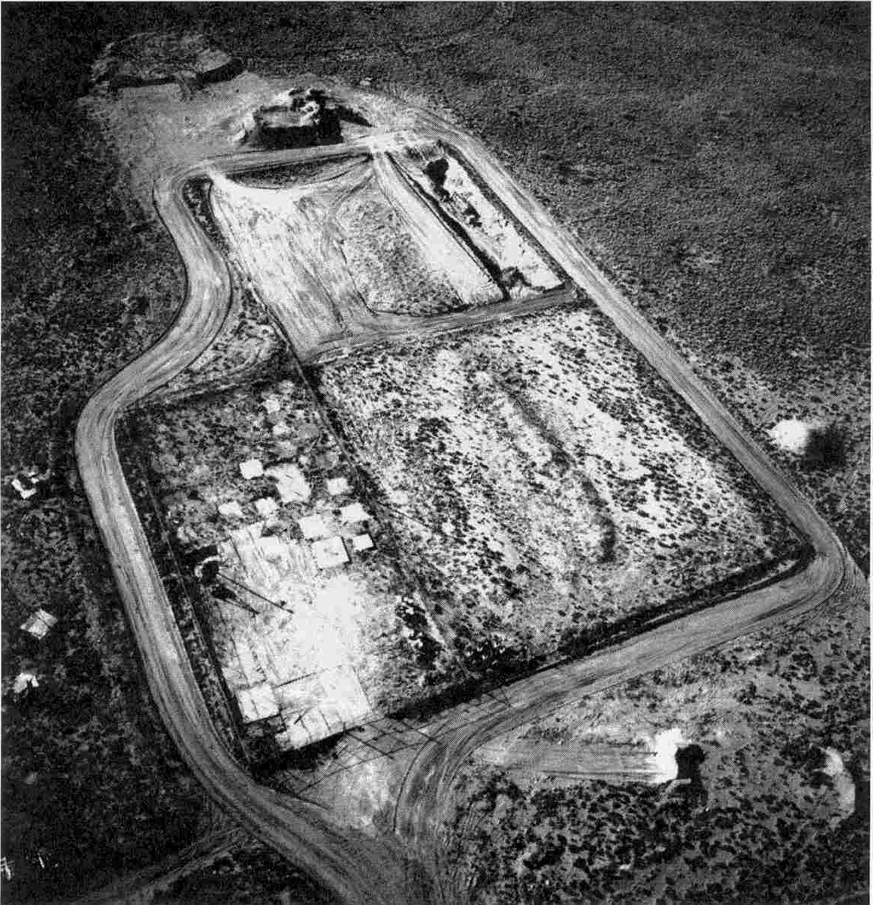
Mixed Waste Landfill
Received mixed waste from 1959 to 1988
  100,000 cubic feet
  6,300 Curies
Semi-arid climate
  Average precip. ~ 9 in/yr
Thick vadose zone
  Nearly 500 feet
Proposed 3-foot-thick vegetated soil cover
  1-foot-thick biointrusion barrier
100 ft
Looking Southwest, 1987

Slide 6
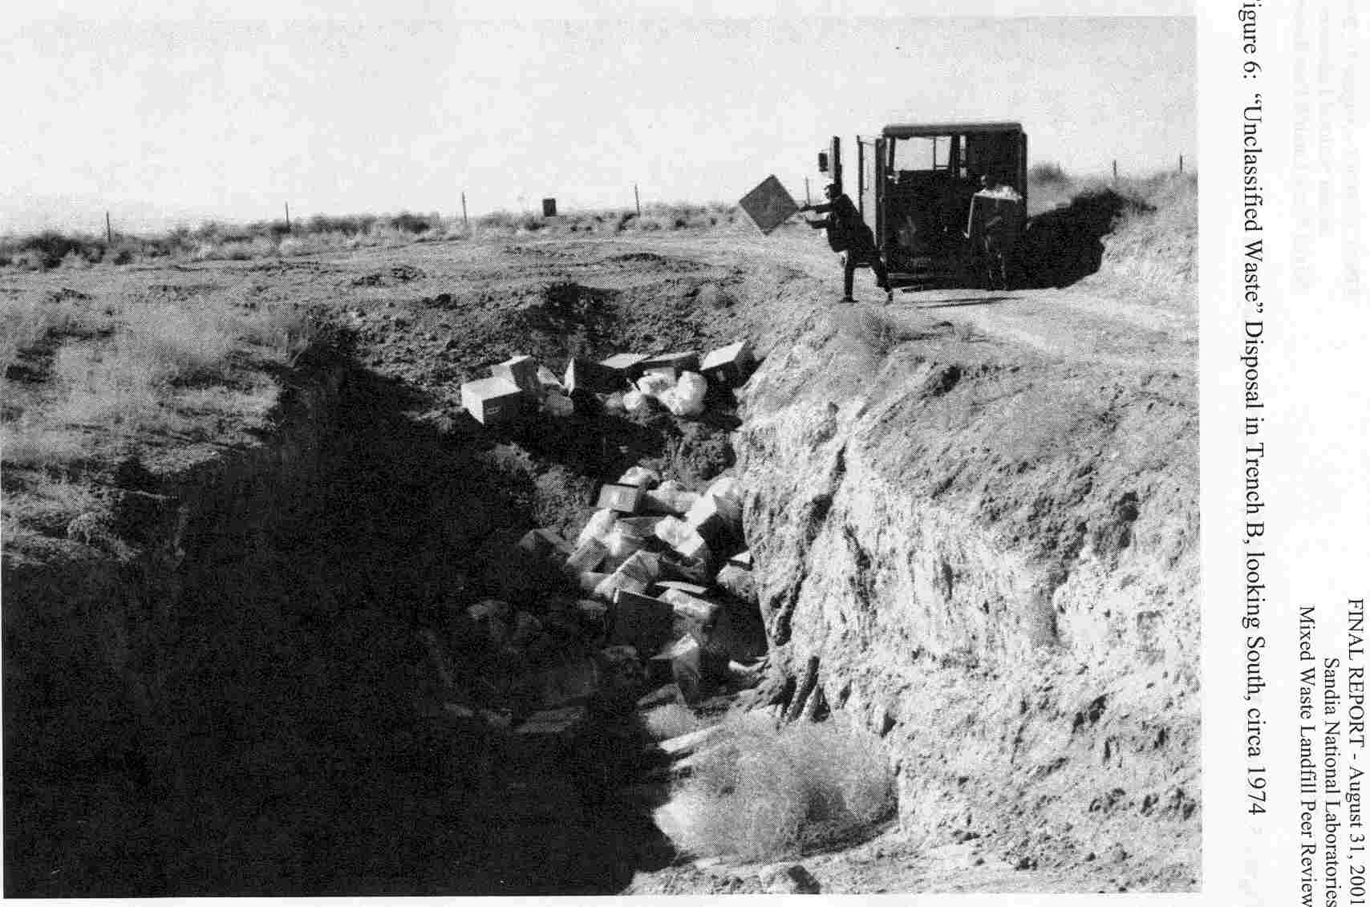
Trench B
Looking South, 1974

Slide 7
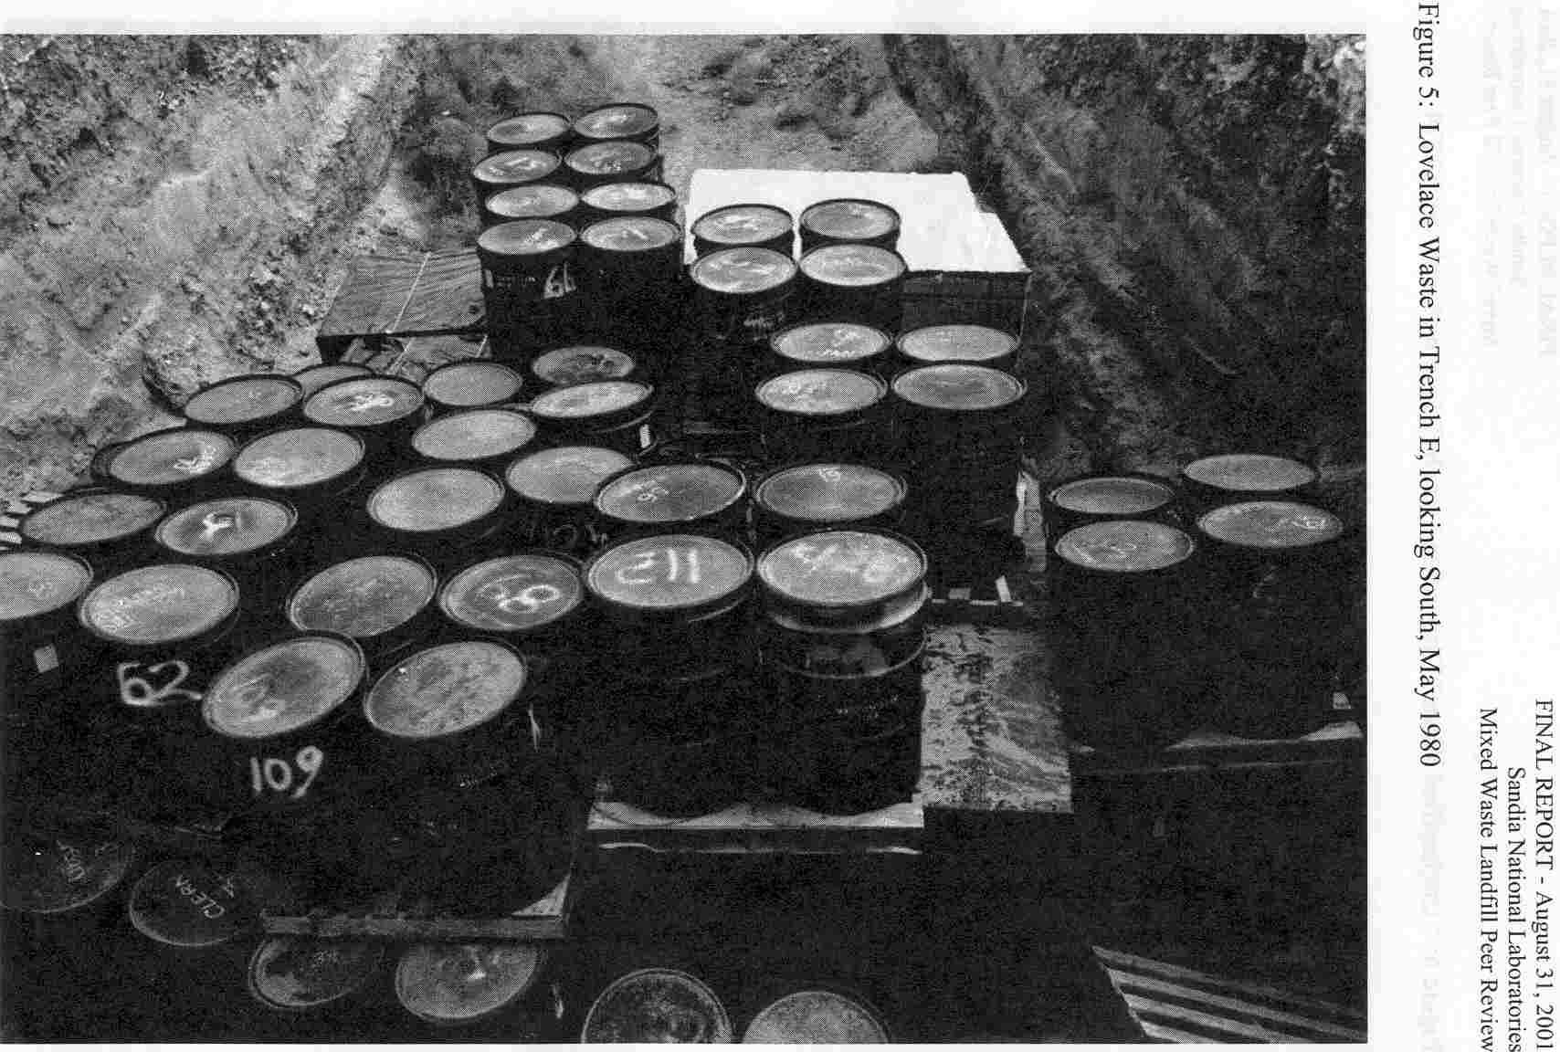
Trench E
Looking South, May 1980

Slide 8
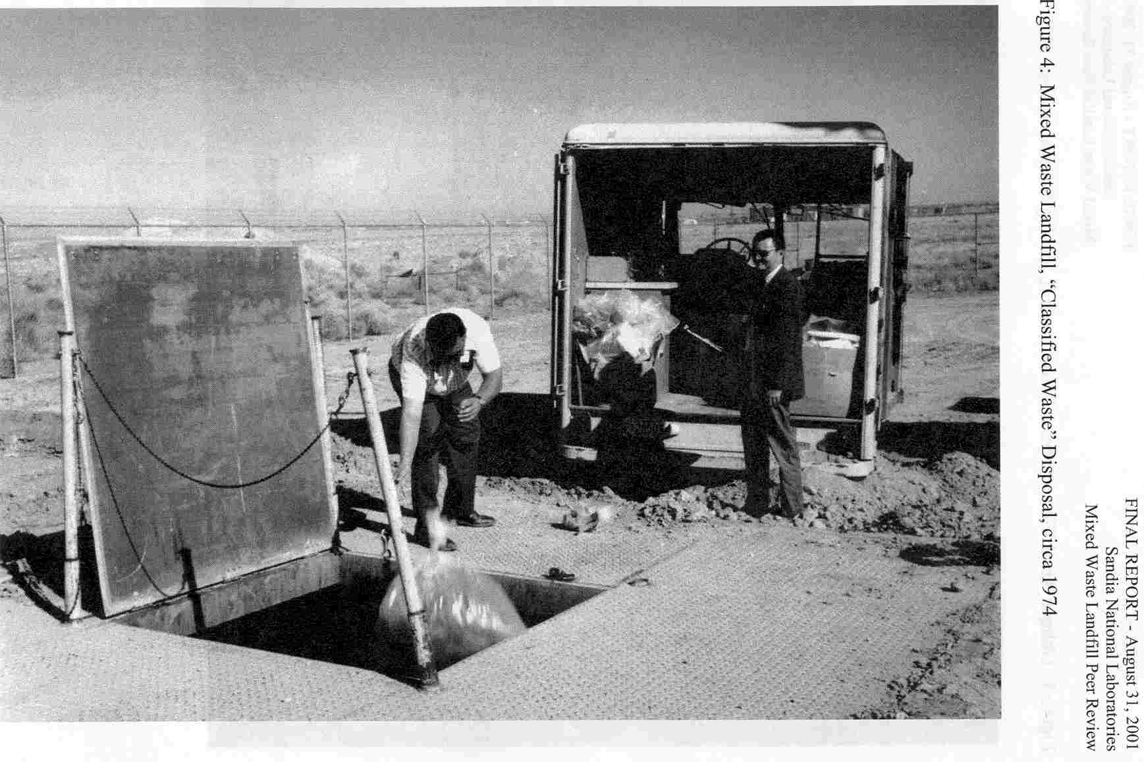
Classified Waste Pit Disposal
1974

Slide 9
Contaminants of Concern
Radionuclides
  Am-241, Cs-137, Co-60, Pu-238, Pu-239, Ra-226, Rn-222, Sr-90, Th-232, H3, U-238
Heavy Metals
  Lead
  Cadmium
Volatile Organic Compounds
  PCE (proxy for other VOCs; highest potential for vapor transport and exceedance of regulatory standard)

Slide 10
Overview
Background
Modeling Approach
Modeling Results
Recommended Triggers

Slide 11
Probabilistic Performance Assessment Process
Uncertainty Analysis
Sensitivity Analysis
Alternative Designs
Monitoring Requirements
Evaluate Design Options
Notes:
First identify regulatory requirements to screen scenarios and various design options to choose from.
When talking about models, mention that they can be integrated into a common framework using FRAMES or GoldSim.
Mention that an example of this method was given at the 2001 Midyear Review, and this year we will focus on how uncertainty, sensitivity, and alternative-design analyses can be performed and how they can benefit the end user.

Slide 12
Scenarios
Water percolates through the cover
  Consideration of wetter future climates
Transport of radionuclides
  Radionuclides leach to groundwater
  Gas-phase radionuclides (radon and tritium) diffuse to the surface and groundwater
Transport of heavy metals
  Lead and cadmium leach to groundwater
Transport of volatile organic compounds
  PCE diffuses/leaches to surface and groundwater
Notes:
Exclusion of bio-intrusion scenario:
The crushed-rock bio-intrusion barrier is intended to mitigate plant and animal intrusion and subsequent uptake of the buried contaminants.
There are an infinite number of scenarios that one can consider in a performance assessment. We considered what we believed to be the most important pathways and constituents of concern, including transport of radionuclides, heavy metals, and VOCs both to the surface and to the groundwater via gas and liquid-phase transport. Plant-root uptake and animal intrusion and displacement of these contaminants were not considered in these prioritized scenarios.

Slide 13
Models
Water Percolation through Cover
  UNSAT-H (unsaturated flow, evaporation, transpiration)
Leaching and Transport of Radionuclides & Heavy Metals to Groundwater
  FRAMES/MEPAS (probabilistic modeling of fate and transport of multiple radionuclides (with progeny), heavy metals, and chemicals)
Gas and Liquid-Phase Transport of Tritium, Radon, and PCE to Surface and Groundwater
  Transient tritium and PCE transport: Jury et al. (1983, 1990)
  Steady radon transport: Ho (2005)
  Probabilistic Monte Carlo analysis in Mathcad®

Slide 14

Probabilistic Modeling
At least 100 realizations were simulated in a Monte Carlo analysis for each transport model
  FRAMES/MEPAS used Latin Hypercube Sampling
Distributions were created for uncertain input variables
  Conservative or bounding values were used when site data were unavailable
Each realization can be thought of as a different (but equally probable) transport path through the system

Slide 15
Uncertain Variables
Waste Inventory and Size
Thickness of Cover and Vadose Zone
Transport Parameters
  Infiltration
  Adsorption coefficient
  Saturated conductivity
  Moisture content
  Tortuosity coefficients
  Boundary-layer thickness

Slide 16
Uncertainty Analysis
Multiple computer “realizations” are simulated using a range of input values for uncertain parameters
Ensemble of realizations yields probability distribution for “performance metric”
Stochastic Inputs
(Latin Hypercube Sampling)
Multiple Computer Simulations
(Fate & Transport Model)
Distribution of Results
(Multiple Simulations)

Slide 17
Sensitivity Analysis
Quantifies the most important parameters and processes that impact the simulated performance metric
  Linear stepwise rank regression
Important parameters can be used as triggers for long-term monitoring or to prioritize site characterization

Slide 18
Overview
Background
Modeling Approach
Modeling Results
Recommended Triggers

Slide 19
Modeling Results
Water percolation through cover
Fate and Transport
  Tritium
  Radon
  Other non-volatile radionuclides
  Heavy metals
  PCE
Comparison to field data
Comparison to performance metrics
Sensitivity analysis

Slide 20
Water Percolation
Peace and Goering (2005)
  Simulated net annual percolation through the cover was less than the regulatory metric of 10⁻⁷ cm/s for alternative scenarios and conditions
Predicted average infiltration rates through the MWL cover range from 1.18 X 10⁻⁹ cm/s for present conditions to 6.12 X 10⁻⁹ cm/s for wetter future conditions

Slide 21
Tritium Fate and Transport
Gas and Liquid-Phase Transport to Groundwater and Surface

Slide 22
Tritium Surface Flux
Comparison to Field Data

Slide 23
Tritium Surface Concentrations
Comparison to Field Data
Concentrations also compared at depths of 15 and 115 feet

Slide 24
Tritium Aquifer Concentrations

Slide 25
Tritium Dose via Groundwater

Slide 26
Tritium Dose via Air Pathway
Mean of the Peak Doses = 1.7 mrem/year
Using the mean of the peak doses to compare against the regulatory metric is based on NRC’s recommendation (NUREG-1573)

Slide 27
Tritium Sensitivity Analysis

Slide 28
Tritium Key Results
Simulations showed no exceedances in groundwater concentration or dose
A small percentage (2%) of the simulated peak dose due to tritium via the air pathway exceeded the regulatory metric of 10 mrem/year
  However, the average of the peak doses (1.7 mrem/yr) is less than the regulatory metric (as prescribed in NUREG-1573)
Key assumptions
  Continuous receptor inhalation and exposure above landfill
  Maximum inventory set equal to twice estimated value
  Allowance of complete erosion of cover
  Use of bounding tortuosity factors that maximized tritium diffusion

Slide 29
Radon Fate and Transport
Gas and Liquid-Phase Transport to Groundwater and Surface

Slide 30
Radon Calibration
Calibration based on “Emanation Factor” of sealed radium sources
  Governs how much radon-222 gas emanates from radium-226 source
  Ranges from 0 (complete containment) to 1 (no containment)
  Minimum value (10⁻⁶) calibrated to yield values of measured surface radon fluxes in 1997
  Maximum value assumed to range between 0.01 to 1 to accommodate container degradation

Slide 31
Radon Surface Flux
(average of peak fluxes = 2 pCi/m²/s)
40 CFR 192 states that the average Rn-222 surface flux shall not exceed 20 pCi/m²/s
(average of peak fluxes = 128 pCi/m²/s)

Slide 32
Radon Sensitivity Analysis

Slide 33
Radon Key Results
Average simulated surface flux is greater than regulatory metric of 20 pCi/m²/s if maximum emanation factor is 1 (up to 100% of radium-226 containers fail)
Releases of radon to groundwater were negligible
Key Assumptions
  Up to 100% of radium-226 sealed sources allowed to fail in 1000 years
  1-D model: maximizes gas transport to surface

Slide 34
Fate and Transport of Other Radionuclides (Leaching to Groundwater)
Am-241, Cs-137, Co-60, Pu-238, Pu-239, Ra-226, Rn-222, Sr-90, Th-232, H3, U-238

Slide 35
Key Results
Leaching of Radionuclides to Groundwater
None of the simulated radionuclides reached the groundwater within 1,000 years for all realizations.
Only uranium-238 (and some of its decay products) were predicted to reach the water table for extended periods (>10,000 years). All peak aquifer concentrations were still less than the EPA regulatory metric of 30 µg/L.
Infiltration rate was found to be the most significant parameter impacting the variability in the simulated groundwater concentrations and dose via groundwater
  Simulated uranium groundwater concentrations exceeded the regulatory metric of 30 μg/L if the Darcy infiltration increased two orders of magnitude above the maximum stochastic value to 6.12x10⁻⁹ m/s.

Slide 36
Heavy Metal Fate and Transport
(Leaching to Groundwater)
Lead and Cadmium

Slide 37
Key Results
Leaching of Lead and Cadmium to Groundwater
Simulations showed that neither lead nor cadmium reached the groundwater in 1,000 years (or extended periods past 10,000 years)
Additional increases in infiltration (3-4 orders of magnitude over expected maximum infiltration rates) allowed cadmium and lead to reach the groundwater in 1,000 years
Notes:
With a 3 order of magnitude increase in infiltration, cadmium was found to exceed regulatory metric of 5 micrograms/L. With a 4 order of magnitude increase in infiltration, lead reached the groundwater but did not exceed metric of 15 micrograms/L.

Slide 38
VOC Fate and Transport
Tetrachloroethylene (PCE)
Gas and Liquid-Phase Transport to Groundwater and Surface

Slide 39
PCE Soil Gas Concentrations
Comparison to Field Data
Notes:
Similar results to comparisons with data at 10 feet as well.

Slide 40
PCE Groundwater Concentrations
100 Realizations

Slide 41
PCE Peak Groundwater Concentrations
Average of Peak Concentrations = 0.87 μg/L

Slide 42
PCE Sensitivity Analysis

Slide 43
PCE Key Results
1% of the realizations yielded peak PCE concentrations in the groundwater that exceeded the regulatory metric of 5 μg/L
  The majority of the realizations showed that the peak PCE groundwater concentration occurred within 100 years
Key Assumptions:
  1-D model: maximizes transport to groundwater

Slide 44
Overview
Background
Modeling Approach
Modeling Results
Recommended Triggers

Slide 45
Recommended Triggers
Surface emissions of tritium and radon
Water percolation through the vadose zone
Concentrations of uranium in groundwater
Concentrations of VOCs in groundwater

Slide 46
Surface Emissions of Tritium and Radon
Trigger
  20,000 pCi/L of tritium in soil moisture at environmental monitoring locations along MWL perimeter
  4 pCi/L of Rn-222 (measured by Track-Etch radon detectors) along MWL perimeter
Performance Objective
  Dose to the public via the air pathway shall be less than 10 mrem/yr (excludes radon)
  Average flux of radon-222 gas shall be less than 20 pCi/m²/s
Notes:
Tritium soil concentration was on the order of 10^9 to 10^10 pCi/L for the few realizations that yielded doses via the air pathway that exceeded 10 mrem/yr.
Radon soil gas concentrations were greater than 10,000 pCi/L for realizations that yielded surface fluxes greater than 20 pCi/m^2/s

Slide 47
Water Percolation Through the Vadose Zone
Trigger
  Increases in moisture content above 25% as measured by neutron probes 10-100 ft beneath MWL
Performance Objective
  Percolation through the cover shall be less than the EPA-prescribed technical equivalence criterion of 31.5 mm/yr [10⁻⁷ cm/s]
  Large increases in percolation were shown to pose increased risks for groundwater contamination
Notes:
Characteristic curves for soils at site show that 25% volumetric moisture content corresponds to a percolation flux of 10^(-7) cm/s

Slide 48
Concentrations of Uranium in Groundwater
Trigger
  15 μg/L in groundwater (half the EPA MCL)
Performance Objective
  Uranium concentrations in groundwater shall not exceed the EPA MCL of 30 μg/L.

Slide 49
Concentrations of VOCs in Groundwater
Trigger
  10 VOCs will be monitored in the groundwater and the trigger will be half the MCL for each constituent
    1,1,1-Trichloroethane(1,1,1-TCA); 1,1-Dichloroethene; Benzene; Ethyl benzene; Methylene chloride; Styrene; PCE; Toluene; TCE; Xylenes (total)
Performance Objective
  VOC concentrations in groundwater shall be less than EPA MCLs

Slide 50
Trigger Evaluation Process

Slide 51
Summary
Probabilistic fate and transport models showed several potential exceedances that merit “triggers” for long-term monitoring
  Tritium dose via air pathway
  Surface flux of radon-222 gas
  PCE concentration in groundwater
Recommended Triggers
  Surface emissions of tritium and radon
  Water percolation through the vadose zone
  Concentrations of uranium in groundwater
  Concentrations of VOCs in groundwater

Slide 52
Summary (continued)
Key Assumptions
  Receptor located at MWL (continuous inhalation exposure)
  Diffusion of tritium and PCE were maximized
  Sealed sources of radium-226 allowed to degrade in 1000 years
  Cover allowed to erode completely
  Maximum waste inventory set equal to twice estimated value
  Use of 1-D models (maximizes transport to surface and groundwater)
Report can be downloaded from www.sandia.gov/caps

