Slide 1
A Next-Generation
Model-Based Enterprise Maturity Index
- A driver to achieve successful action
Curtis Brown
Principal Mechanical Engineer, Kansas City National Security Campus (KCNSC)
Sarah Hale
Senior Mechanical Engineer, Sandia National Laboratories (SNL)
Jeffrey Winter
Consultant to National Nuclear Security Administration (NNSA)
Sandia National Laboratories is a multimission laboratory managed and operated by National Technology and Engineering Solutions of Sandia, LLC, a wholly owned subsidiary of Honeywell International, Inc., for the U.S. Department of Energy’s National Nuclear Security Administration under contract DE-NA0003525.
NSC-614-3759 dated August/2021
Unclassified Unlimited Release
The Department of Energy’s Kansas City National Security Campus is operated and managed by Honeywell Federal Manufacturing & Technologies, LLC under contract number DE-NA0002839

Slide 2
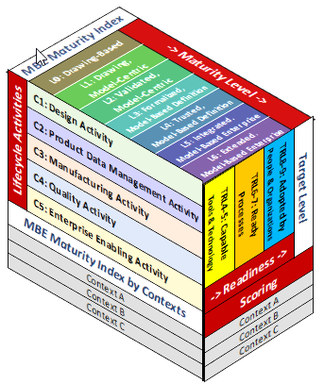
Agenda
Current Product Realization Situation
  Who we are
  Challenges
  Systemic Issues
MBE Proposition
  What is MBE?
MBE Maturity Index
  What is it?
  Why is it important?
  How can I use it?
  Where do I get it?

Slide 3
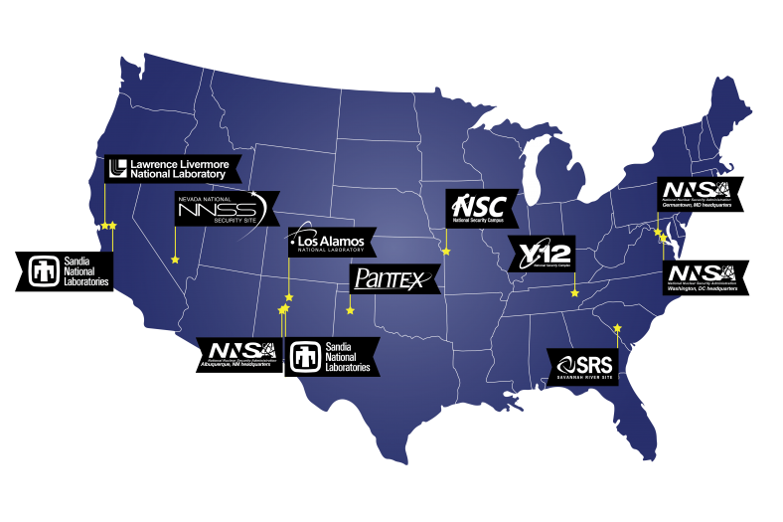
NNSA’s Nuclear Security Enterprise (NSE)
NNSA is a semi-autonomous agency within the U.S. Department of Energy.
  National Nuclear Security Administration (NNSA)
  Maintains/enhances safety, security, and effectiveness of the U.S. nuclear weapons stockpile (+more).
National Security Enterprise (NSE)
  NNSA HQ
  Design Agencies & Production Agencies
  Sandia National Laboratories (SNL)
    M&O by National Technology &
    Engineering Solutions of Sandia
  Kansas City National Security Campus (KCNSC)
    M&O by Honeywell Federal Manufacturing & Technology
  Others
Kansas City

Slide 4
Current Product Realization Situation
Challenges
World is Changing
  Industry moving towards a Digital
  Workforce and Culture: Attract & Retain
  US Competitors are developing faster
Customer Demands
  Compressed Development Timelines
  Increased Responsiveness to Product Change; while Adverse to Risk and Process Change
  Keep Pace with Industry and Culture
Systemic Issues
Document-Centric, 2D Drawing-Based Business (70+ years)
Drawing Model-Centric (30+ years)
Decisions from Disconnected Data
  Duplicate, unstructured data in multiple disconnected systems == (untrusted data)
  Requires human intervention, high cognitive load, resulting in inconsistent solutions
  Files are configuration managed, but not as digital objects and disconnected from models
Notes:
Syn-chro-nic-i-ty: the simultaneous occurrence of events which appear significantly related but have no discernible casual connection.

Slide 5
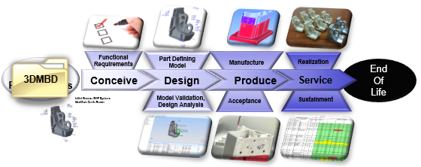
Digital Product Realization Proposition
Proposed Solution
  Become a Digital, Part-Centric, Model-Based Enterprise
  Uses digital threads for all product realization activities
  Faster cycle times, more responsive to change, and promotes innovation
  Trusted Models become the root of the digital thread
  Part configuration management, with as-needed access to product & process definitions
MBE Paradigm
  Digital Enterprise: An organization that uses a digital thread to conduct business activities.
  Digital Thread: The logical and physical infrastructure that links data from authoritative sources for interconnecting a digital enterprise.
Model Based Enterprise (MBE) -- An digital enterprise that uses digital models and associated datasets as the foundation for the product lifecycle.

Slide 6

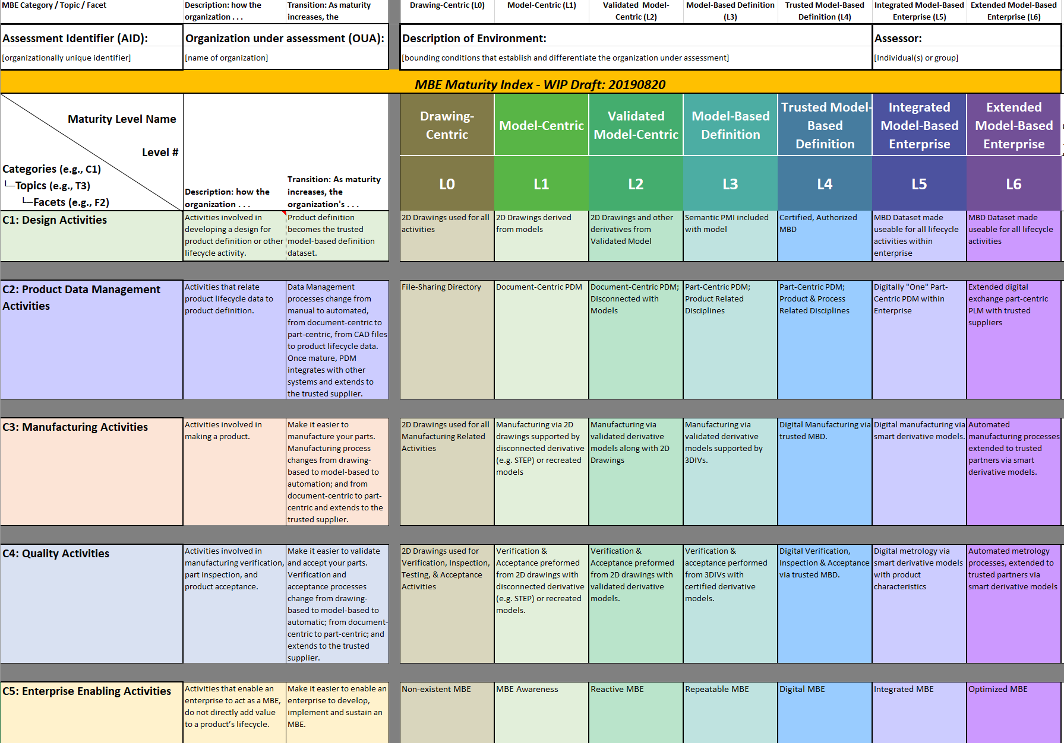
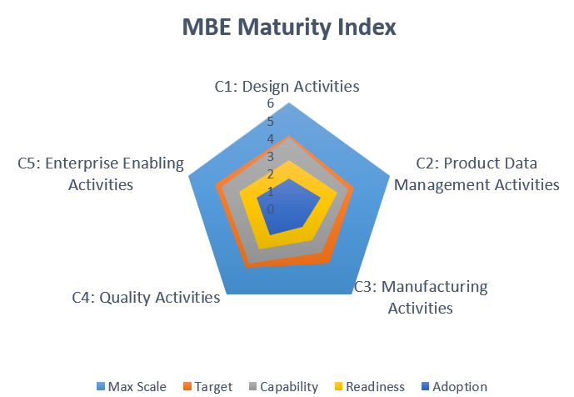
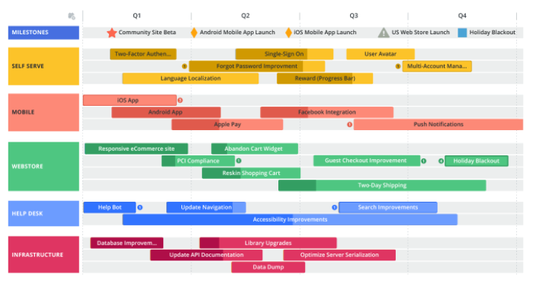
To successfully become an MBE, an organization needs a …
Enables your organization
to get started
Helps your organization find an actionable path for success
VISION
Identifies MBE capability/readiness/adoption/target gaps within your organization
MATURITY INDEX
Provides focus for your organization to developing an MBE implementation plan
ASSESSMENT
Allows organizations to tailor a MBE roadmap
ROADMAP
Notes:
MBE Index is Central to Broader Planning Context
Outcomes from a MBE Maturity Index assessment:
Identifies MBE capability/readiness/adoption gaps
Allows your organization to tailor a MBE roadmap
from where your organization currently is and
where it wants to be at some future date or event.
Provides focus for developing an MBE implementation plan.

Slide 7
The Multiple Dimensions of the NSE’s MBE Maturity Index
Maturity Levels (top)
Lifecycle Activities (front)
Scoring Readiness/Target (side)
  Capable (Tools are available)
  Ready (Processes are ready)
  Adopt (People are using)
  Target (Adoption goal)
Contexts (bases)

Slide 8
A Next Generation MBE Maturity Index
Describes Levels of Maturation by Categories
  L1: Probably where many are at right now
  L2: Validates the models being used
  L3: Begins to achieve an MBE state
  L4: Represents a complete MBE
  L5: Best practice
  L6: Extends capabilities
Level Name | Drawing-Centric | Drawing Model-Centric | Validated Model-Centric | Formalized Model-Based Definition | Trusted Model-Based Definition | Integrated Model-Based Enterprise | Extended Model-Based Enterprise
Level Identifier | L0 | L1 | L2 | L3 | L4 | L5 | L6
Level Theme | 2D Drawings Only; Disconnected | 2D Drawings & STEP Derived from 3D Models; Drawings Managed, Disconnected from Models | 2D Drawings & Equivalent Derivatives from Validated 3D Models; Drawings Managed, Disconnected from Models | 3D Models with Semantic PMI Added; Producing 3D Interactive Viewable (3DIV) Managed as Part-Centric | Digital Model-Based Definition (MBD) , Certified & Authorized; Managed & Sourced as Part-Centric | Enterprise Integrated from Trusted Digital Product Definition Dataset; Process Data Managed with Part-Centric | Enterprise Extended with Optimized Capabilities and Extended Partners
Authorized Definition | 2D Drawing | 2D Drawing | 2D Drawings w/ Support Models | Drawings w/ Support MBD | 3D MBD w/ Support Drawing | 3D MBD Dataset | 3D MBD Dataset
Artifact Management | File-Sharing | Document-Centric PDM | Document-Centric PDM | Part-Centric PDM | Part-Centric Lifecycle PLM | Enterprise Part-Centric PLM | Extended Part-Centric PLM
As-Is Adoption Levels
Complete MBE Practice
Interim
MBD State
Best MBE Practice
Categories w/Topics; w/Facets
Design Activities
Product Data Management Activities
Manufacturing Activities
Quality Activities
Enterprise Enabling Activities
Notes:
Currently the much of industry adoption level as a L1; ROI Goal is L4 (Demonstrated with MAPR-4Ds pilot); Demonstrating Goal L3 (Selected PRTs); A longer term achievable goal is L5; The transition from L3 to L4 changes the paradigm from human-readable definition to machine-readable definition.

Slide 9
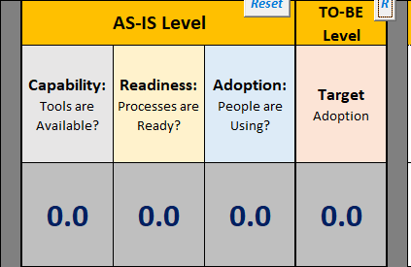
NSE’s MBE Maturity Index
Allows teams / organizations to assess & facilitate their
digital transformation as a model-based enterprise
      Capability (Tools/Technology are vetted and available )
      Readiness (Processes are ready)
      Adoption (People/Organizations are using)
      Target (Adoption goal at Event/Date)
4.6
2.9
1.2
3.1
Allows for an organization to option out (NA) of any category, topic, and/or facet.
Shows an incremental progression towards becoming more digital, better integrated, better informed, and more automated.
Provides a point of reference (MBE Lexicon) for communication, planning, & execution.
Identifies distinctive successes along an organization’s MBE transition.
Built for the NSE, but normalized for any Digital Product Realization Enterprise
MBE Maturity Index - A rubric tool that an organization uses to assess itself as, and facilitate transition to, a model-based enterprise.

Slide 10
Structure of the NSE’s MBE Maturity Index
Maturity Levels on Columns
Context is Organization Under Assessment (OUA)
Assess against a target date
Scoring Area
Activities on rows
Establish bounding conditions for OUA
Assertions at intersections

Slide 11
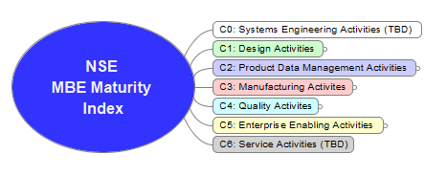

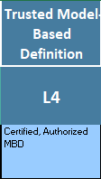
Taxonomy of the Index
Levels (L#), Conveys a consistent theme of maturity
Categories (C#), As-is and Target scores
Topics (C#), As-is and Target scores
Facets (F#), Assess As-is assertions and
describes a progression toward
a more mature state
Reference Example: C1:T1:F1:L4

Slide 12
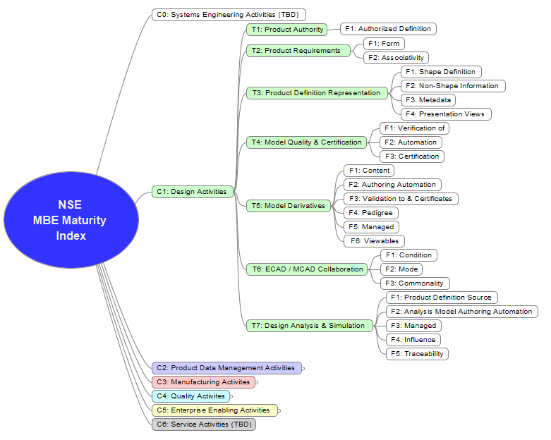
C1: Design Activity
C1: Design
Activities involved in designing a product.
Topics:
T1: Product Authority
T2: Product Requirements
T3: Product Definition Representation
T4: Model Quality & Certification
T5: Model Derivatives
T6: ECAD/MCAD Collaboration
T7: Design Analysis & Simulations

Slide 13
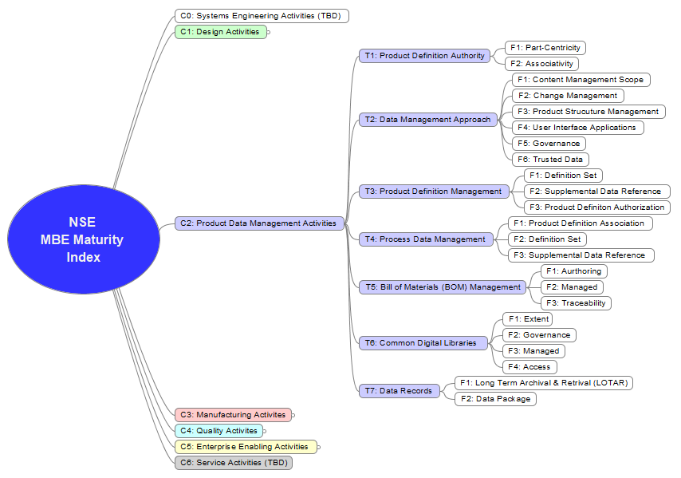
C2: Product Data Management Activity
C2: Product Data Management
Activities that interrelate product data.
Topics:
T1: Product Definition Authority
T2: Data Management Approach
T3: Product Definition Management
T4: Process Definition Management
T5: Bill of Materials Management
T6: Common Digital Libraries
T7: Data Records

Slide 14

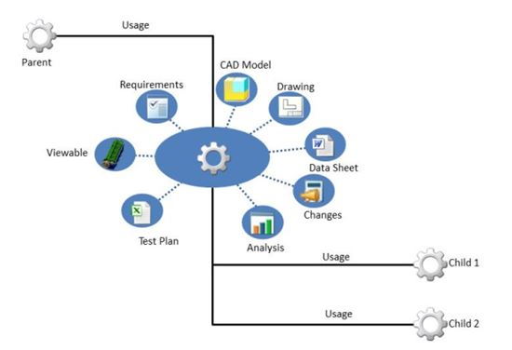
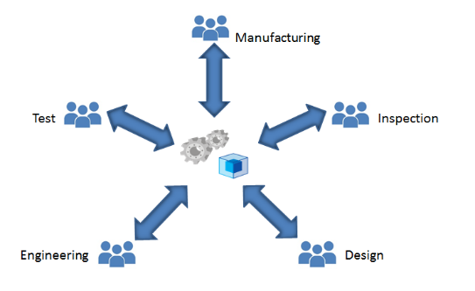
Part-Centric
An organizing principle that enables product data management to relate all product lifecycle data to a single point of reference.
The Critical Enabler for MBE Success and Business Sustainment
Product, Part-Centric
(L3)
Lifecycle, Part-Centric
(L4)
Enterprise,
Part-Centric
(L5)
XR
NSE
SA
LL
SL
LA
KC
A critical enabler for MBE success and business sustainment

Slide 15
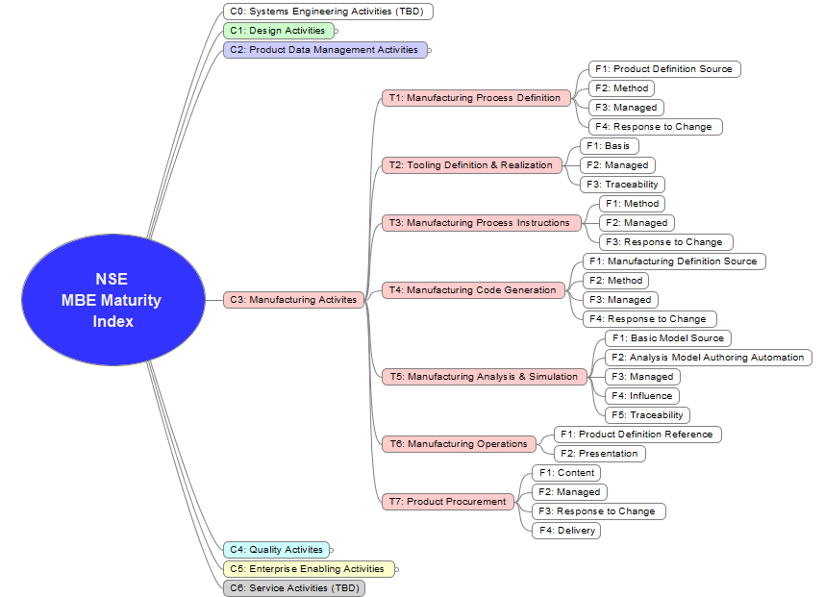
C3: Manufacturing Activity
C3: Manufacturing
Activities involved in realizing a product.
Topic:
T1: Manufacturing Process Definition
T2: Tooling Definition & Realization
T3: Manufacturing Process Instructions
T4: Manufacturing Code Generation
T5: Manufacturing Analysis & Simulation
T6: Manufacturing Operations
T7: Product Procurement

Slide 16
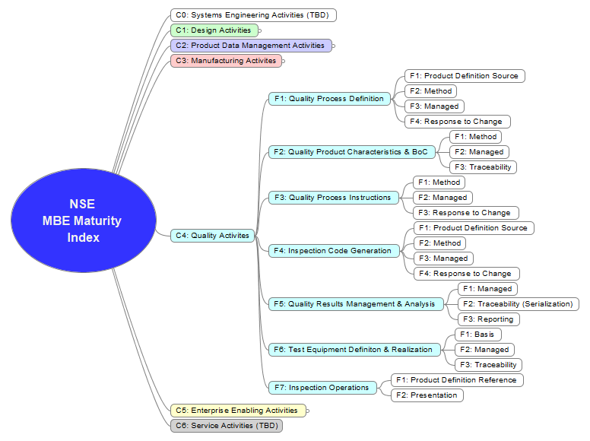
C4: Quality Activity
C4: Quality
Activities involved in manufacturing verification, testing, inspection, and product acceptance.
Topic:
T1: Quality Process Definition
T2: Quality Product Characteristics & BoC
T3: Quality Process Instructions
T4: Inspection Code Generation
T5: Quality Results Management & Analysis
T6: Test Equipment Definition & Realization
T7: Inspection Operations

Slide 17
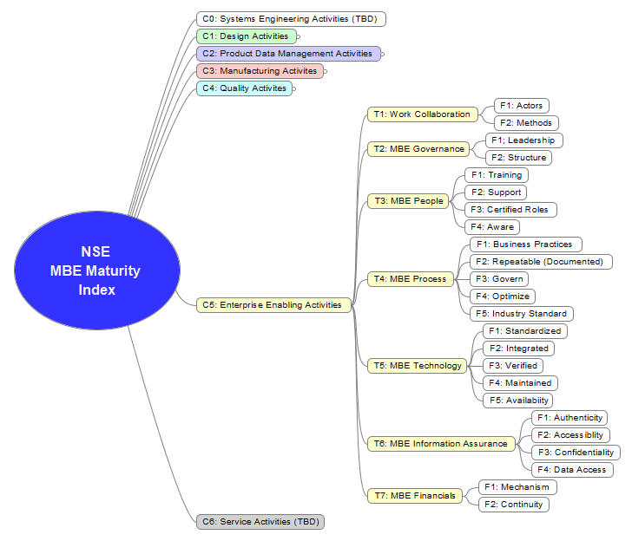
C5: Enterprise Enabling Activity
C5: Enterprise Enabling
Activities that enable an organization to act as a MBE, but do not directly add value to a product.
Topic:
T1: Work Collaboration
T2: MBE Governance
T3: MBE People
T4: MBE Process
T5: MBE Technology
T6: MBE Information Assurance
T7: MBE Financials

Slide 18
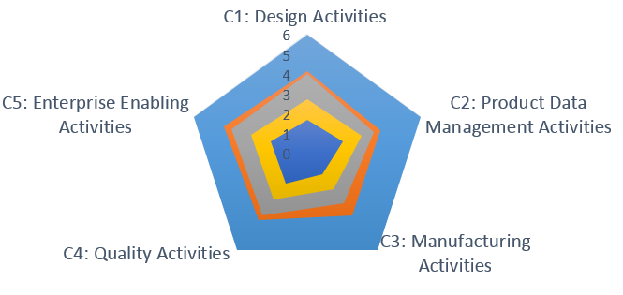
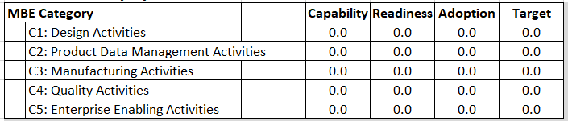
How to View the Results from the Assessment
Scores are shown graphically in ‘RADAR’ charts.
  High-level showing all categories
  One for each category, showing topics
Identifies MBE Target/Capability/Readiness/Adoption gaps
Informs and provides focus for your organization’s MBE roadmap or action plan.
Drives Action!

Slide 19
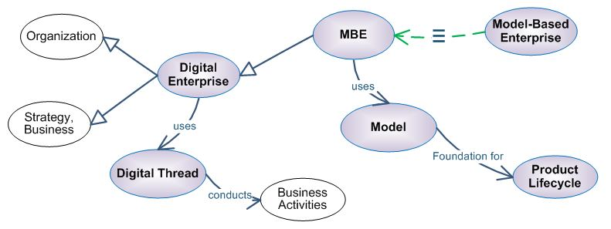

MBE Maturity Index includes a Controlled MBE Lexicon
MBE practitioners need a reliable lexicon
  Common vocabulary of terms and phrases used in a domain
  Validated terms and concepts in context
  Managed with Thesaurus
…for collaboration …
  Precision (remove ambiguity)
  Ease (I understand you)
… as a foundation for developing MBE practices…
  More confidently (no more meandering)
  More rapidly (less paralysis and contention resolution)
  More collaboratively (move forward together)
…that are
  More assuredly integrated
  Achieve common goals

Slide 20

NSE’s MBE Trust Framework
Trusted | Regarded with confidence, and concurrently being certified, authorized, and authenticated.
Certified | Guaranteed to conform to protocols.
Authorized | Approved by an authority for use in a lifecycle activity.
Authenticated | Proven to be genuine as issued by its originator.

Slide 21
NSE’s MBE Trust Framework
Trusted: Regarded with confidence, and concurrently being certified, authorized, and authenticated.
    Authenticated: Proven to be genuine as issued by its originator.
    Signed: Authenticity of originator cannot be repudiated.
    Traceable: The ability to find the authoritative source of a given fact
  Authorized: Approved by an authority for use in a lifecycle activity.
    Certified: Guaranteed to conform to protocols.
      Validated: Assured to satisfy intent.
      Verified: Assured to satisfy requirements.
      Versioned: Successive revisions are stored and sequentially identified.
Factors that increased confidence:
Required: Mandated by some authority.
Specified: Defined to minimally-sufficient detail.
Recorded: Permanently documented for future reference.
Certified
Authenticated
Authorized
Trusted

Slide 22
What is a Digital Twin? A normalized definition
Digital twins are virtual representations that serve as real-time digital counterparts of physical products or processes. Digital twin of the design focuses on digitally connecting all of the designs, analyses, and processes required to realize a physical product.
Digital Twin: A virtual representation of a physical product which is updated with information about a particular physical counterpart and elucidates the current state and Makes predictions about future states to inform decision making.
A Digital Twin is a digital representation of a physical object that includes the model of the physical object, data from the object, a unique one-to-one correspondence to the object, the ability to measure and monitor the object, and the ability to predict future states based on past history.
From the MBE Maturity Index’s MBE Lexicon
Digital Twin
A model, digitally connected with its realization(s)
Whereas: Model is a digital representation of a thing.
Digital twins were first developed in the industrial manufacturing sector, using the term to describe digital representations that are linked to physical machines. Digital twins differ from previous modeling technologies (like CAD), as they require sensors or videos and images to tie the virtual model to its physical counterpart.
A digital twin is a virtual model continuously linked to a physical object, allowing you to
fore see issues before they occur, monitor performance and simulate future
A digital twin is a virtual representation that serves as the real-time digital counterpart of a physical object or process. The concept, which had a few different names, was subsequently called the "digital twin" by John Vickers of NASA in a 2010 Roadmap Report. The digital twin concept consists of three distinct parts: the physical product, the digital/virtual product, and connections between the two products.
A virtual representation of a physical product which is updated with information about a particular physical counterpart and elucidates the current state and makes predictions about future states to inform decision making.
“A digital twin is a virtual representation of an object or system that spans its lifecycle, is updated from real-time data, and uses simulation, machine learning and reasoning to help decision-making.” In plain English, this just means creating a highly complex virtual model that is the exact counterpart (or twin) of a physical thing. The ‘thing’ could be a car, a building, a bridge, or a jet engine. Connected sensors on the physical asset collect data that can be mapped onto the virtual model. Anyone looking at the digital twin can now see crucial information about how the physical thing is doing out there in the real world.
Digital Twins are virtual counterparts, or “Twins”, of real objects that can predict future outcomes with information from current and past states.

Slide 23


References to the Digital Twin within the MBE Maturity Index

Slide 24
Status and Way-forward
Released as Revision A, but Work in Progress. (Revision B expected by early Fall 2021)
Continue to solicit peer review and to obtain focus area validation & improvements.
Testing: Conduct real and simulated assessments to confirm the content.
Prepare training curriculum.
Publish for NNSA, US Industry, and other government reuses.
Consider additional categories:
  C0: System Engineering Activity and
  C6: Service Activity
Expand functional areas for electrical design (ECAD) and production.
Continue to update as needed.
Consider more useable format for the assessment.

Slide 25
Where can you get the latest NSE MBE Maturity Index?
NSE_MBE_Maturity_Index_(UUR)_A.2.xlsm
KCNSC’s Web Exchange File Manager
https://fmt.kcnsc.doe.gov/kcpfm/kcpfm_short.cgi?box=/.Dst9EMRmxucstVHi&path=/&cmd=list
Or via TinyURL
https://tinyurl.com/NSE-MBE-Maturity-Index

Slide 26
Thanks
Foundational work
  MBE Maturity Capability Levels
    DOD - Army ManTech – 2010; Roy Wittenburg, Mark Nielsen, Raphael Nascimento
  MBE Level Assessment Worksheet (aka NIST Index)
    DOD – OST ManTech; Roy Wittenburg, Rich Eckenrode, RECON-Services, now with Elysium
Group Thanks
  NNSA’s MBIT MBE Committee (multiple sites)
  KCNSC’s Digital Product Realization Enterprise (DPRE) Team
  Industry Peer Reviewers including:
    Rolls Royce
    US Army
    TechAzul
Special Thanks to:
  Brian Scott: Lead Architect, Sandia National Laboratories (SNL)
Notes:
Of course some others to thank, and a special shout out to . . .
That concludes my presentation. Thank you for joining today. Back to you Xxxxxx.

Slide 27
Backup

Slide 28
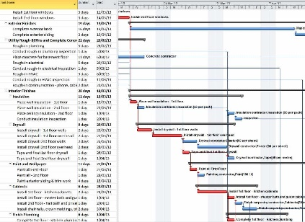
Tailored MBE Implementation Path for Success
MATERITY INDEX
GAP ANALYSIS
Cast a Vision
Conduct a MBE Assessment via MBE Maturity Index
  Overall Organization
    As-Is Capability Assessment
    As-Is Readiness Assessment
  Individual Sub-Organization
    As-Is Adoption Assessment
    To-Be Adoption Targets
Identify Gaps
  Readiness to Capabilities
  Adoption to Readiness
  Targets to Adoption
Assess Opportunities (Impact vs Effort)
Determine Roadmap
Create Tailored Implementation Plan
VISION
ASSESS
TAILORED PLAN
ROADMAP
Notes:
Drives for a Tailored Actionable Path for Success

