Slide 2
Taming the Beast:
System designs to address
cell-level safety concerns
Instructor: Jim McDowall

Slide 3
Learning objectives
Understand the influence of safety incidents on the evolution of ESS system design and safety standards
Learn how ESS vendors are approaching system safety and compliance with codes and standards
Please ask questions as we go…

Slide 4
Trends in ESS design
Mitigating cell-level safety issues – battery management systems
Influence of codes and standards on ESS design
System design
  Early systems
  Enclosure development
  Thermal management
  Safety systems
Cell design
  Chemistry
  Format
  Capacity

Slide 5
BMS functionality and limitations
BMS functions
  Verify battery operation within limits for voltage, current, and temperature
    Open a current-rated switch if limits are exceeded
  Report battery operating parameters to higher-level controllers
    Direct measurements for V, I, and T
    Calculated values for state of charge and state of health
  Actively balance cell states of charge
  Provide overcurrent protection
BMS limitations
  No active current control
  Cannot prevent internal cell failures or external failures such as arcing ground faults

Slide 6
UL 1642
UL 1973 Ed.1
Ed.2
Ed.3
UL 9540 Ed.1
Ed.2
Ed.3
UL 9540A Ed.1, 2, 3, 4
Ed.5
Ed.6
NFPA 70 Art.706
2017
2020
2023
2026
NFPA 855
2020
2023
2026
2008
2010
2012
2014
2016
2018
2020
2022
2024
2026
First Li-ion
container
system
Kahuku
First major
ESS fire
(lead-acid)
S. Korean
fires
NY State
fires
McMicken
Moss Landing

Slide 7
Grandfathering or retroactivity?
What happens with existing ESS as codes and standards are constantly changing?
NFPA 855 does not apply to ESS that existed or were approved for construction or installation prior to the effective date of the standard
HOWEVER,
The authority having jurisdiction (AHJ) can require a site-specific hazard mitigation analysis
If the AHJ determines that an unacceptable degree of risk exists, they can apply any portion of the standard retroactively

Slide 8
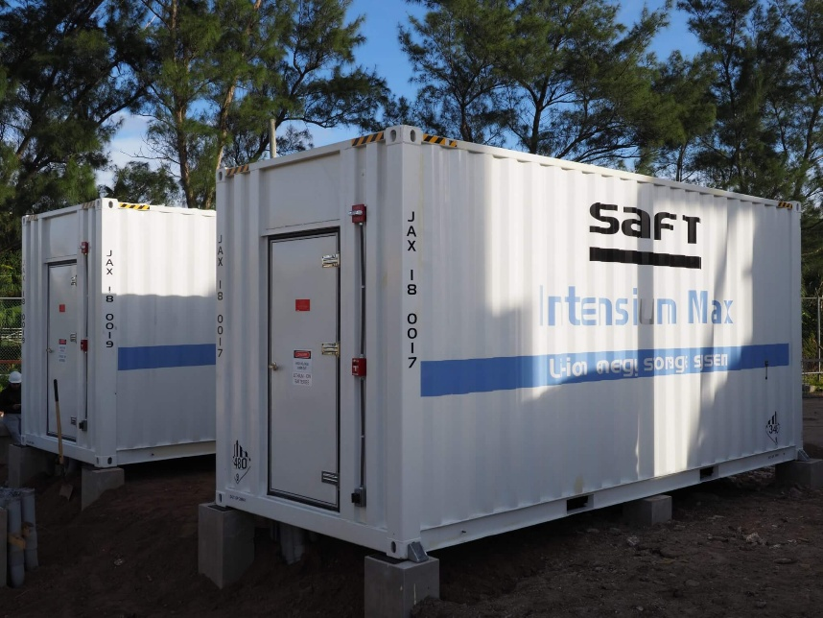
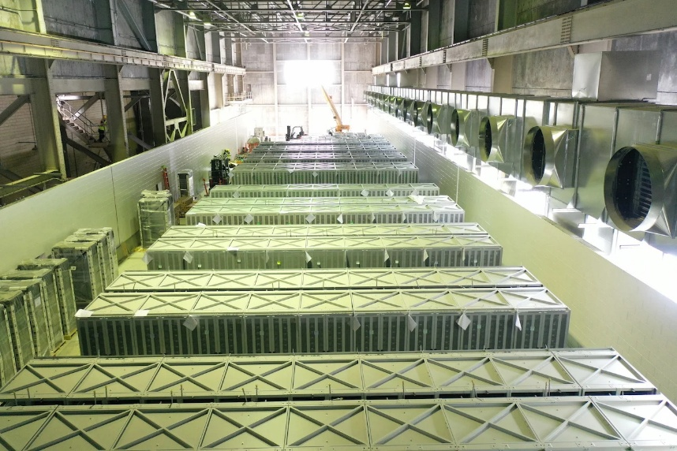
Early systems
Covering the period 2008 to around 2019
Systems were mainly walk-in ISO containers
(many 53-foot) and building-based
A123 Systems had early success with LFP;
others used NCA or NMC
Fire suppression was standard
  Sprinklers in buildings
  Clean agents or aerosols in containers
BELCO, Bermuda and Moss Landing, CA

Slide 9
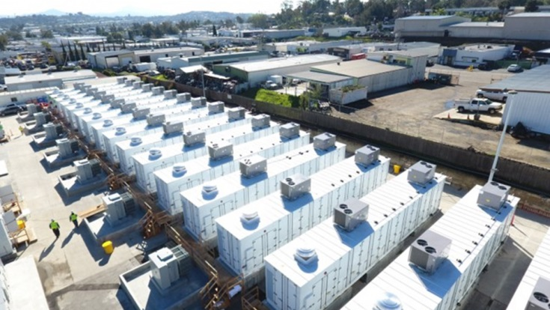
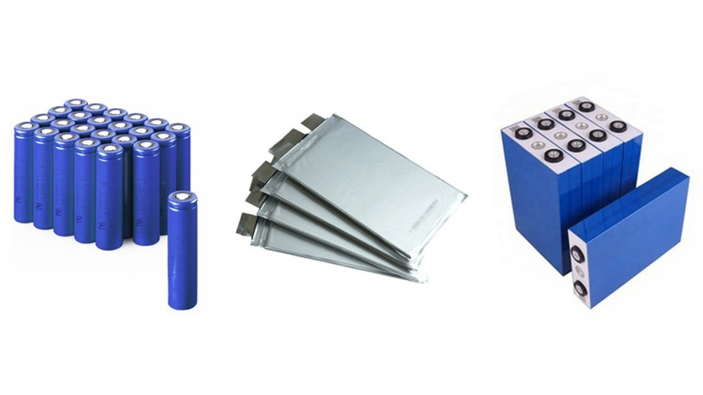
Evolutions
Building-based systems no longer in
fashion
  Prominent fires at Gateway and
  Moss Landing
Containers shifted to outside access
(both sides)
  Higher energy
  Less stringent code requirements for non-walk-in units
NMC chemistry yielded to LFP
  Less expensive and improved safety
  But not as easy to manage
Cell formats changed from cylindrical
and pouch to prismatic
Escondido, CA
Source: Marco Righi
LinkedIn

Slide 10
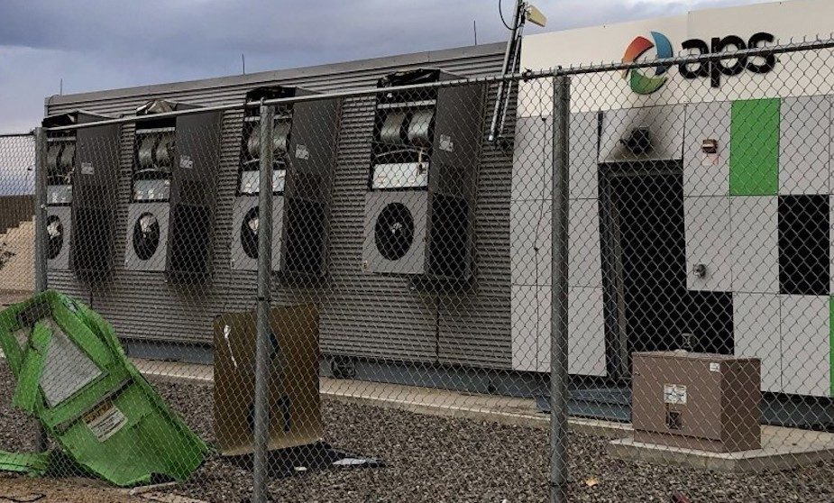
Evolutions (cont.)
New thinking on fire suppression
  Sprinklers can cause or worsen fires
  Clean agents, if successful in suppressing fires, can create an explosion hazard
Elimination of 40- and 53-foot containers
  20-foot containers or custom enclosures shipped fully assembled
  Road transport weight limits
  Now single-side access for higher site density
Move from HVAC to liquid cooling
  Cooling plate directly under cells
  More effective cooling with lower aux power use
  Better temperature uniformity within strings
  May still have a small HVAC for humidity control
Surprise, AZ

Slide 11
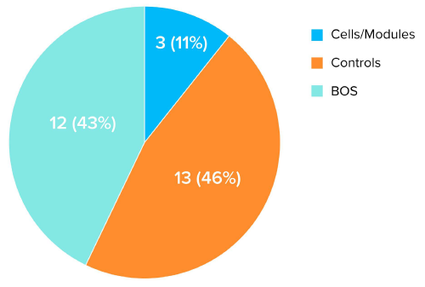
Evolutions (cont.)
Development of ‘big data’ approach with battery analytics
Upload BMS data to cloud-based database for trending with AI
  Provided that ESS vendor allows this
Service offered by some ESS vendors and third parties
Service providers claim to be able to spot impending cell failures for proactive response
  But bear in mind that balance-of-plant failures are more common
  than cell/module failures
EPRI: Insights from EPRI’s Battery Energy Storage Systems (BESS) Failure Incident Database
Analysis of Failure Root Cause

Slide 12
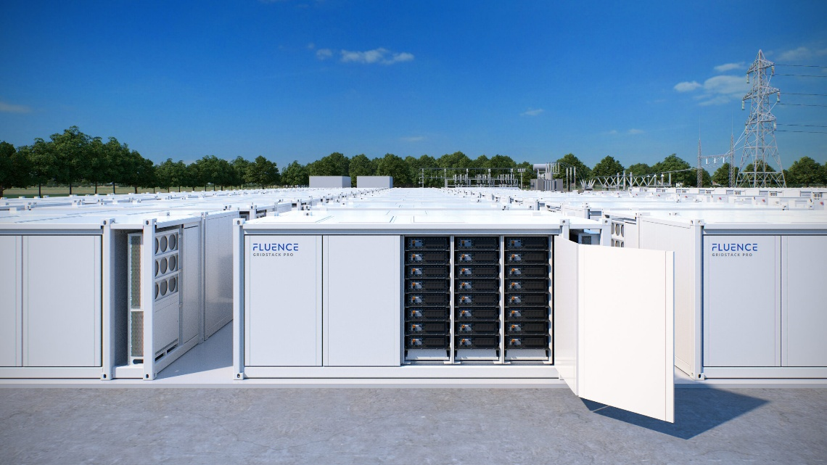
Today’s systems – DC blocks
DC system
  Often based on 20 ft. ISO container footprint
  Battery strings and associated BMS
  May have string-level DC-DC converters
  Managing multiple strings on a common DC bus can be challenging
Separate DC-to-AC power conversion
  May be matched with a medium-voltage power station (inverter, transformer, and switchgear)
DC block can only be certified to UL 1973
  Full system must be UL 9540 listed
  May require field certification
Source: Fluence

Slide 13
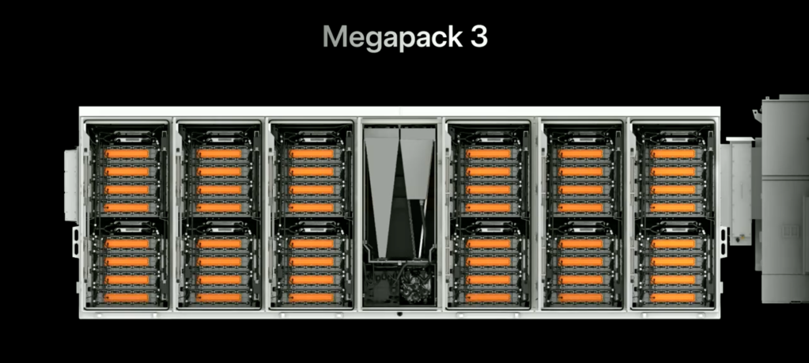
Today’s systems – AC blocks
AC blocks incorporate power conversion into the battery enclosure
  May have string-level PCS and common AC bus or a separate PCS compartment
UL 9540 system certification performed by the factory
Source: Tesla

Slide 14
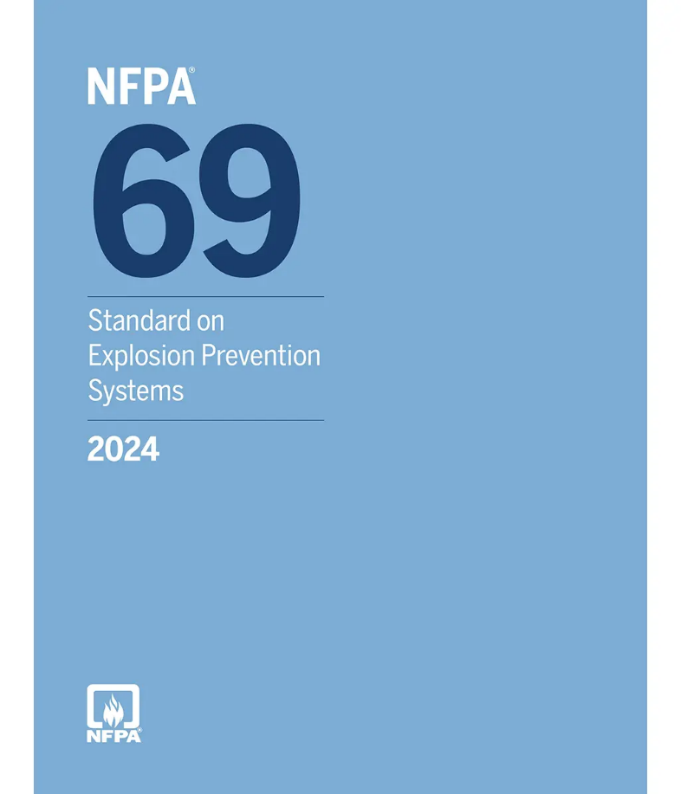
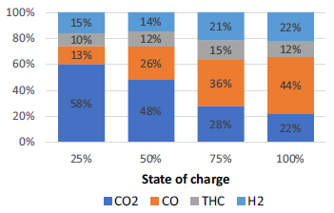
Critical safety systems
Similar safety systems for AC and DC blocks
NFPA 855 requirements for Li-ion outdoor facilities
  Smoke and fire detection in accordance with NFPA 72
  Explosion control and prevention
    Securely powered combustible concentration reduction (CCR) system mandated in accordance with NFPA 69
    Maintain average concentration of flammable gas below 25% of the lower flammable limit
    CCR system required to function up to the point where fire occurs
    Partial-volume deflagration analysis also required in accordance with NFPA 68
  Engineered explosion control systems allowed as an alternative to NFPA 69
    Controlled deflagration systems (sparkers), typically in combination with deflagration venting
Journal of Energy Storage 68 (2023) 107785
https://doi.org/10.1016/j.est.2023.107785

Slide 15
Maintenance considerations
Critical safety systems are subject to mandatory inspection, testing, and recordkeeping requirements
  NFPA 69: initially inspected and tested at 3-month intervals
  Changes to schedule must be approved by the system designer and the AHJ
NFPA 69 CCR systems require routine airflow measurements to verify design assumptions
Secure powering systems (NFPA 110 or 111) have their own inspection and testing requirements

Slide 16
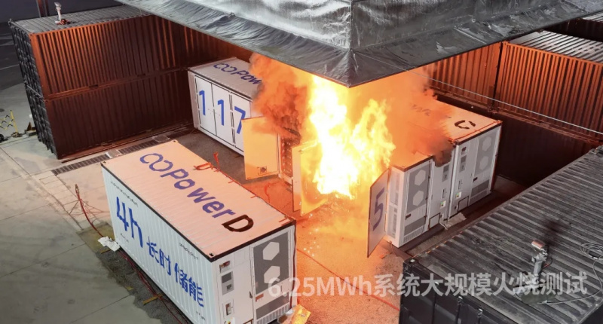
Large-scale fire testing
Problem: systems passed UL 9540A propagation testing (up to 5th edition) with flying colors – and still suffered from fires
Solution: require a full burn of an ESS enclosure and verify that propagation does not occur to adjacent enclosures at the spacing recommended by the manufacturer
LSFT added in 2026 edition of NFPA 855
  Included in CSA C800-25 and 6th edition of
  UL 9540A (March 2026)
Source: Hithium

Slide 17
Future evolutions
LFP cell capacities have been increasing
  Many systems today use 314 Ah cells
  Some Chinese manufacturers have announced systems with cells of
  565 Ah, 1,175 Ah, and even 2,710 Ah
  Compliance with NFPA 69 is questionable for these systems
    Thermal runaway vent gas volume scales with capacity
Emergence of sodium-ion technology
  Includes multiple chemistries, as with Li-ion
  Beware of statements that these batteries are ‘safe’
  Cells have similar electrolytes to Li-ion and hard carbon negatives that form a solid-electrolyte interphase, and will vent if abused
  Advantage of Na-ion is that, unlike Li-ion, they can be transported and stored fully discharged

Slide 18
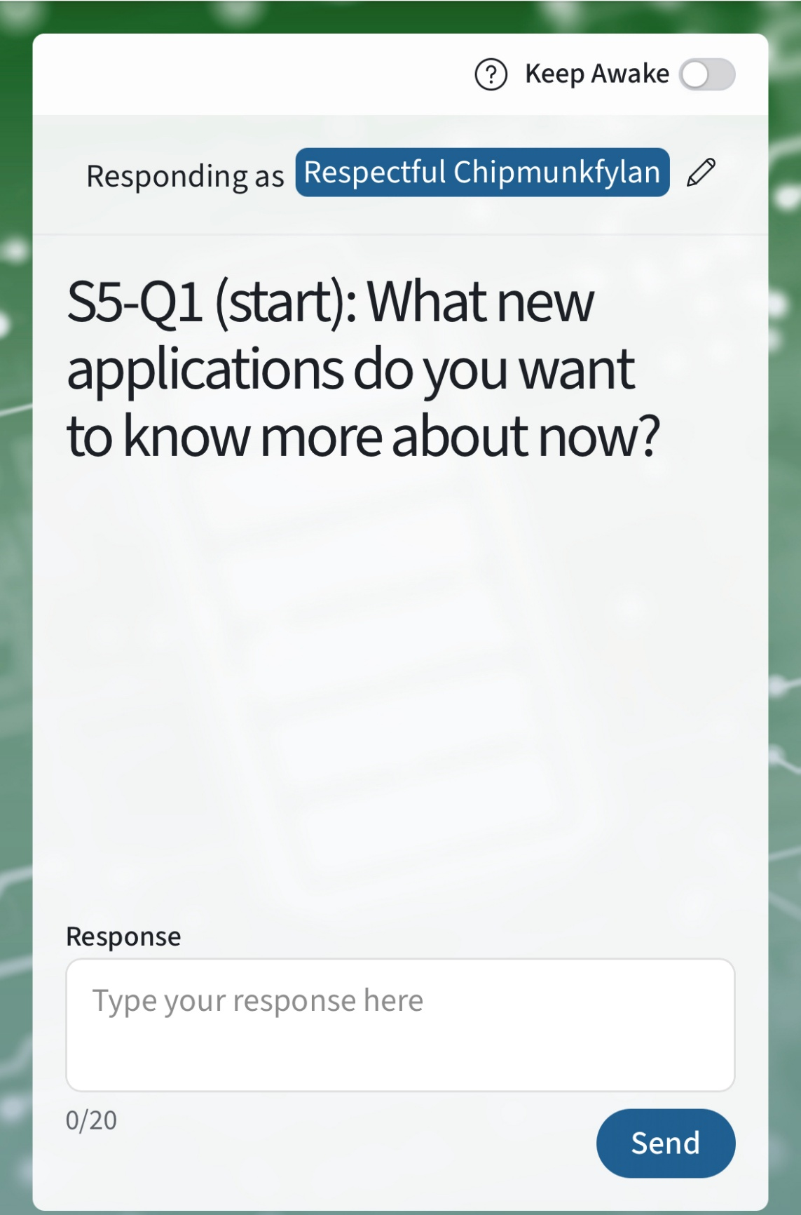


Poll Questions
Please visit Poll Everywhere via the QR code below (mobile) or at pe.app/essrf (laptop). If you would like to add your name, please update with the “pencil” icon. If not, feel free to remain anonymous

Slide 19
Poll:
A BMS can control current in a battery string
  True
  False

Slide 20
Poll:
ESS enclosures are equipped with fire suppression
as standard
  True
  False

Slide 21
THANK YOU
jim@mcdowalladvisorsllc.com

