Slide 2
What Causes Thermal Runaway and What Are the Materials Processes Involved?
A foundational exploration of battery failure science, covering microscopic mechanisms, triggers, and safety implications for energy storage systems.
Instructors: Nathan B. Johnson, and Loraine Torres-Castro
SAND2026-21830C

Slide 3
JUNE 2, 2026
AGENDA
Introduction to Thermal Runaway
Battery Components and Materials
Thermal Runaway Mechanism
Initiation Methods
Critical evaluation of “Safe” Chemistries
Scaling Up Safety
Closing Remarks

Slide 4
Learning Objectives
By the end of this tutorial, we will be able to:
Define what thermal runaway is and what its hazards are.
Identify which reactions contribute to thermal runaway.
Identity thermal runaway initiation methods.
Determine differences in hazards dependent on battery chemistry.
Critically assess claims of safety for new chemistries.
Determine thermal runaway hazards associated with system scale-up.

Slide 5
JUNE 2, 2026
AGENDA
Introduction to Thermal Runaway
Battery Components and Materials
Thermal Runaway Mechanism
Initiation Methods
Critical evaluation of “Safe” Chemistries
Scaling Up Safety
Closing Remarks

Slide 6
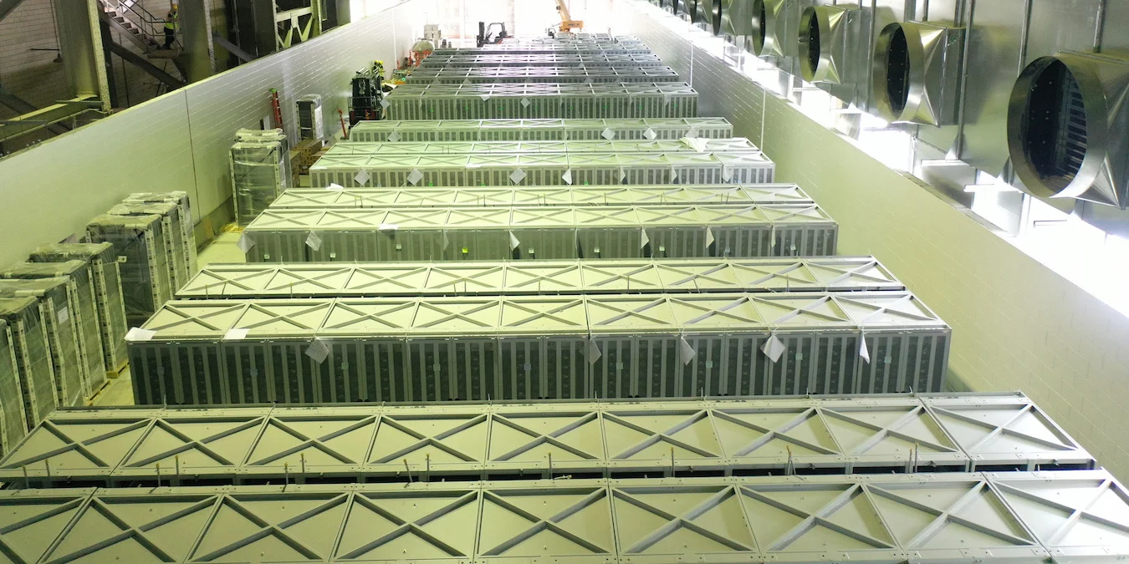


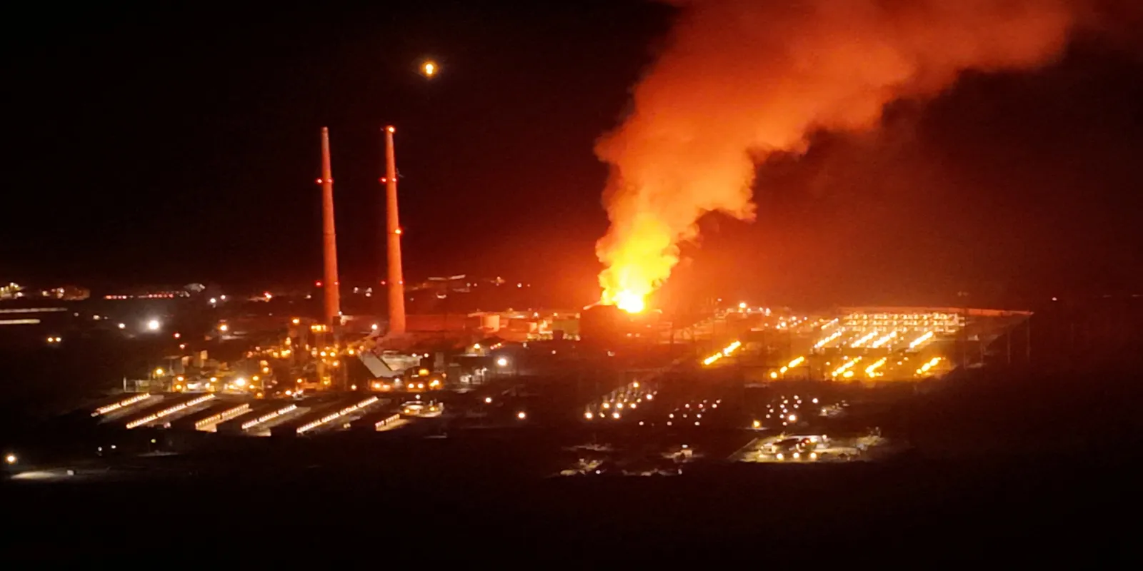

Battery Storage Is Growing Fast —
And the Safety Science Needs to Keep Up
Modern grid-scale ESS installations: Scaling brings new safety challenges.
Global Scaling
Grid-scale and distributed ESS are expanding rapidly worldwide.
Amplify Consequences
Larger deployments mean single-cell failures can have system-wide impacts.
https://www.energy-storage.news/moss-landing-worlds-biggest-battery-storage-project-is-now-3gwh-capacity/
Foundational Safety
Understanding cell-level science is not optional—it is the foundational requirement for every informed safety decision
https://eticaag.com/moss-landing-fire-lessons-for-bess-safety/

Slide 7







Energy Storage Systems Face Several Hazard Types —
Thermal Runaway Drives the Most Severe Outcomes
Electrical
Mechanical
Chemical
Thermal
Arc flash, short circuits, high-voltage DC risks.
Internal pressure, structural failure, vibrations.
Electrolyte leaks, coolant exposure, toxicity.
Thermal runaway: self-propagating.
Why is Thermal Runaway distinctive?
Self-Amplifying: Batteries contain both oxidant and reductant, making it uniquely difficult to interrupt.
Escalating Consequences: Can spread to neighboring cells (propagation), scaling with deployment size.
Diverse Hazards: Can produce fire, toxic gas, and overpressure simultaneously.

Slide 8






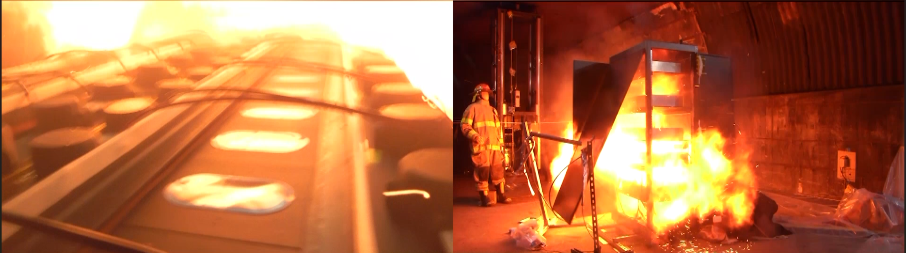

Thermal Runaway Is a Self-Accelerating Process —
Fire Is One Possible Outcome, Not the Definition
The Heat Balance Failure
Possible Outcomes
A condition where a cell generates heat faster than it can release it to its surroundings - Accumulation.
Generation > Dissipation
Venting & Gas Release
Swelling & Deformation
Self-Reinforcing Cycle
STEP 1
STEP 2
STEP 3
Fire & Combustion
Rising
Temperature
Exothermic
Reactions
More Heat
Generated
Overpressure & Explosion
Toxic Vapor Cloud
*Outcomes depend on cell chemistry, state of charge, and environmental conditions.

Slide 9
JUNE 2, 2026
AGENDA
Introduction to Thermal Runaway
Battery Components and Materials
Thermal Runaway Mechanism
Initiation Methods
Critical evaluation of “Safe” Chemistries
Scaling Up Safety
Closing Remarks

Slide 10




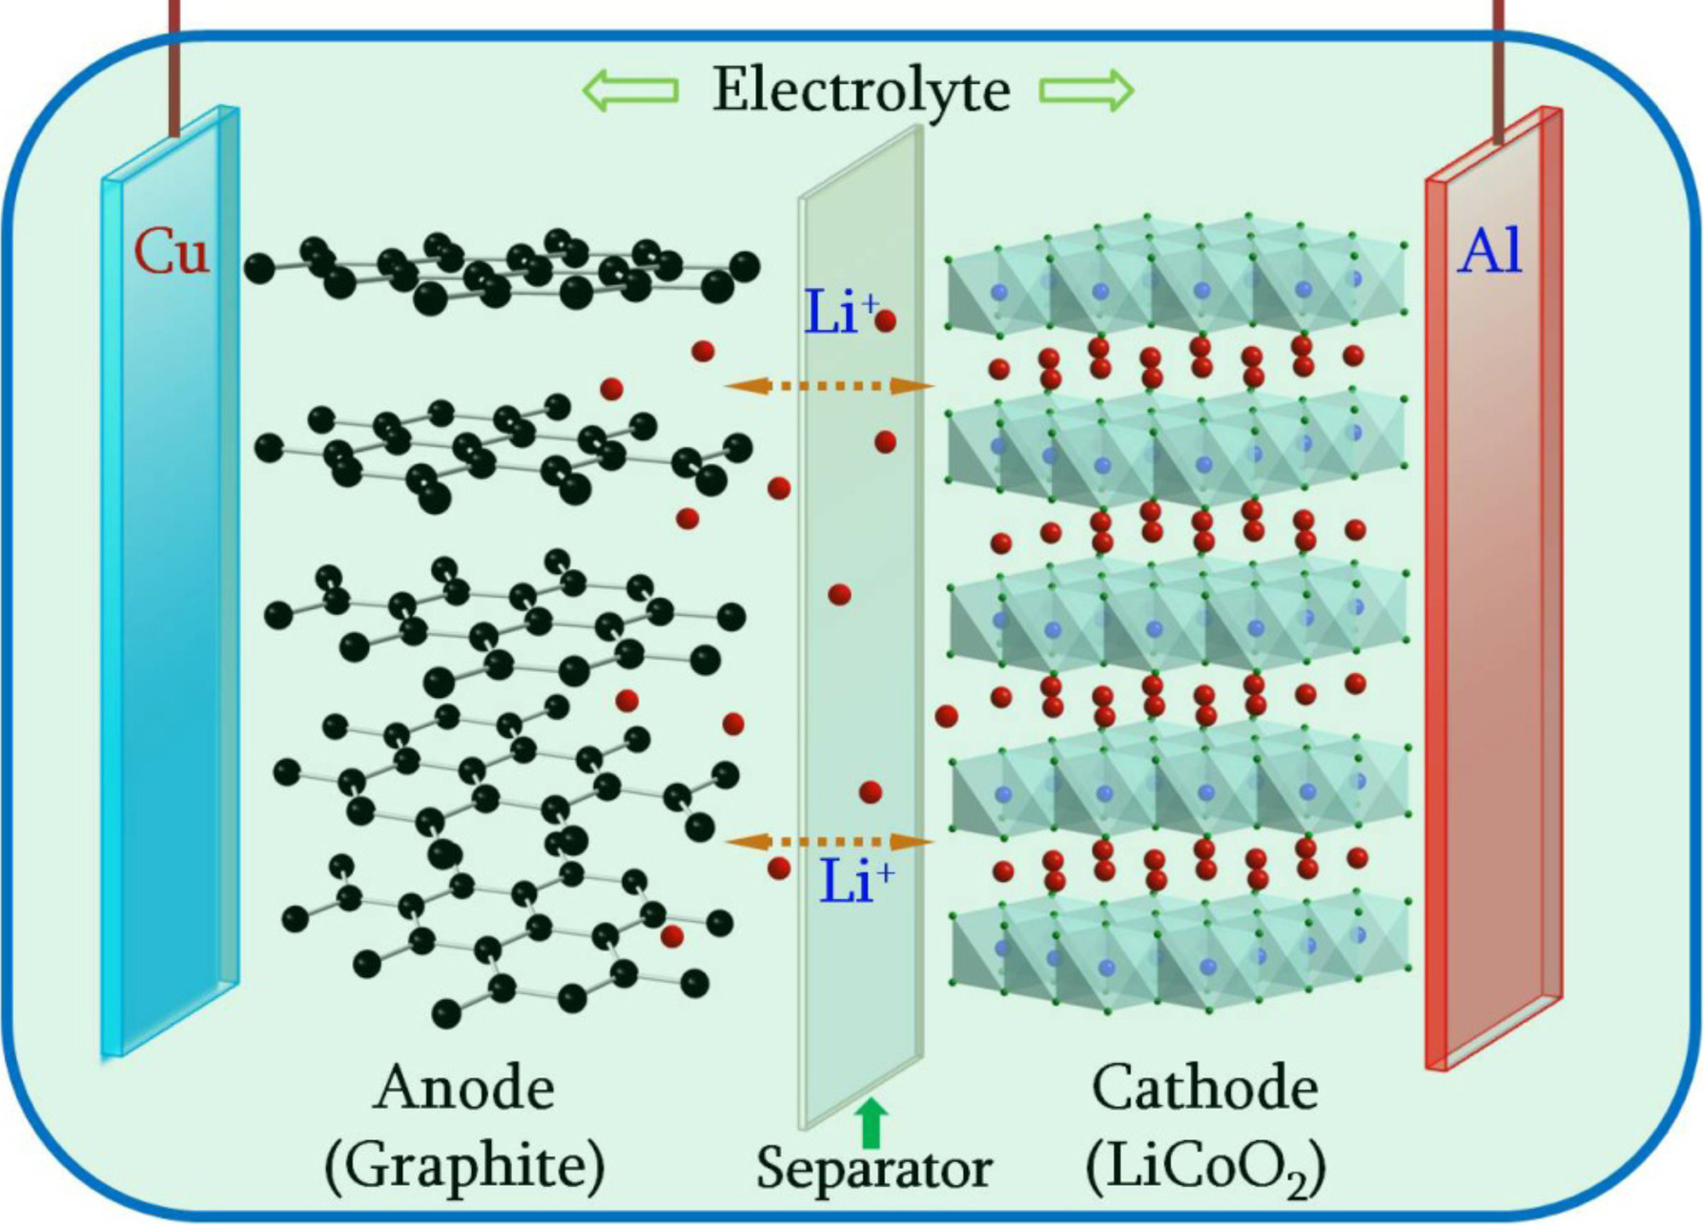









Cell Architecture: What We Are Working With
Control depends on maintaining the separation of reactive materials.
e⁻
charge
discharge
Electrolyte
Separator
Organic liquid solvent (carbon-based)
Facilitates ion flow between electrodes
Flammable under runaway conditions
Porous plastic/ceramic membrane (~20μm)
Prevents physical contact (shorts circuit)
Melts/shrinks at 120–150°C
Anode (Negative)
Cathode (Positive)
Typically composed of graphite layers
Hosts lithium ions in charged state
High reactivity when SEI layer fails
Metal oxide or phosphate structures
Hosts lithium ions in discharged state
Can release oxygen at high heat
Energy storage is fundamentally the separation of highly reactive materials.
Liu, C. et al. Mater. Today (2016) 19(2), 109-123

Slide 11
JUNE 2, 2026
AGENDA
Introduction to Thermal Runaway
Battery Components and Materials
Thermal Runaway Mechanism
Initiation Methods
Critical evaluation of “Safe” Chemistries
Scaling Up Safety
Closing Remarks

Slide 12


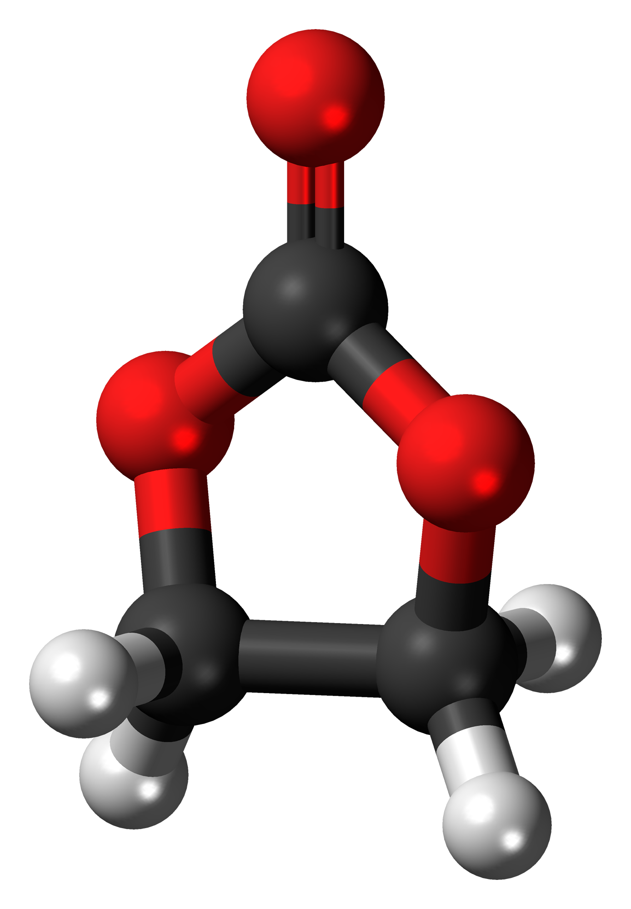






The SEI: The Cell's Built-In But Fragile First Layer of Protection
Normal Operation
T > ~80-120°C
Selective Membrane
Formed naturally on the anode; permits lithium ions while blocking electrolyte decomposition.
Thermal Sensitivity
SEI INTACT
SEI DECOMPOSING
Metastable layer; decomposition typically begins between ~80°C and 120°C.
REACTIVE
GRAPHITE ANODE
REACTIVE
GRAPHITE ANODE
Exothermic Breakdown
The process releases heat and exposes the reactive anode surface to the electrolyte.
Interface is stable & protected
Self-heating begins
Stage 1 of the Cascade
Often the triggering chemical event for cells with graphite anodes.
Note: Thresholds are approximate and design-dependent

Slide 13












When the Separator Fails, the Electrodes Make Contact —
Releasing Stored Energy Rapidly
Material Breakdown
Stage: Intact Separator
Normal operation. Electrodes are physically isolated.
Polymer films (PE/PP) have defined melting points.
Heat causes the separator to shrink, melt, or fail.
Threshold: Thermal Instability
Approximate and design-dependent temperature reach.
Loss of physical barrier allows direct electrode contact.
Stored electrical energy converts to intense localized heat.
Event: Internal Short Circuit
Rapid electrical discharge. Cascade acceleration.
*Ceramic coatings can significantly alter these thresholds.

Slide 14

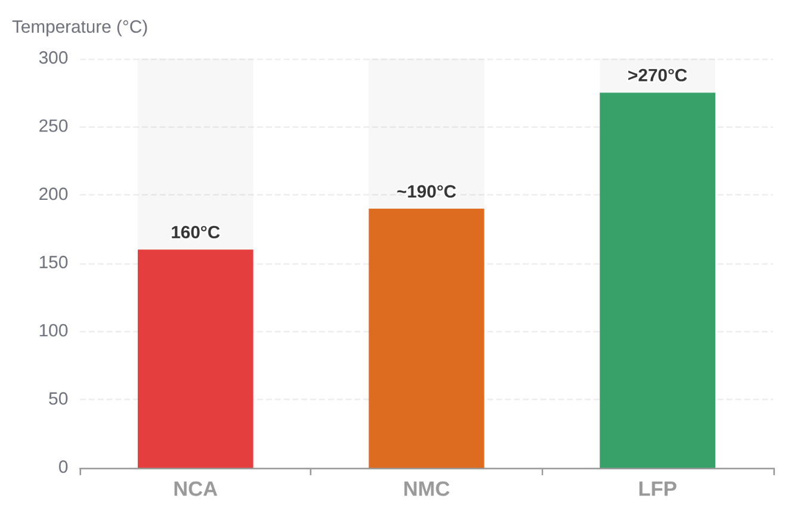



At High Temperatures, Some Cathode Materials Release Oxygen — Which Can React With the Hot Electrolyte
Thermal Runaway Onset Temperature
Cathodes are lithium metal oxides; oxygen is part of their crystal structure.
Heat causes structural instability, releasing lattice oxygen as a gas.
Released oxygen drives highly exothermic reactions with the organic electrolyte.
Safer
Release severity depends heavily on the specific cathode chemistry.
*Relative comparisons only. Specific thresholds vary by design, state of charge, and heating rate.
NCA and NMC are more prone to combustion than LFP due to lower oxygen release thresholds.

Slide 15








The Cascade of Material Breakdown
Thermal runaway is a sequential series of exothermic failures. Each stage releases heat that triggers the next, creating a self-sustaining feedback loop.
STAGE 1
STAGE 2
STAGE 3
STAGE 4
SEI Decomposition
Separator Failure
Cathode Breakdown
Full Combustion
80°C – 120°C
120°C – 150°C
150°C – 200°C+
Peak Runaway
Protective film breaks down
Exothermic heat release
Anode surface exposed
Plastic membrane melts/shrinks
Direct Anode-Cathode contact
Internal short circuit
Oxide structure collapses
Oxygen release occurs
Rapid heat acceleration
Electrolyte oxidation
Venting and pressure rise
Toxic gas & fire hazard
POINT OF NO RETURN: Typically reached during Stage 2/3 transition

Slide 16
JUNE 2, 2026
AGENDA
Introduction to Thermal Runaway
Battery Components and Materials
Thermal Runaway Mechanism
Initiation Methods
Critical evaluation of “Safe” Chemistries
Scaling Up Safety
Closing Remarks

Slide 17







Thermal Abuse Triggers Internal Thermochemical Cascade
Exposing cells to temperatures beyond
safe operating limits.
COMMON EXTERNAL SOURCES
External heat initiates SEI decomposition,
activating internal reactions.
Nearby Fire
Cooling Failure
Once internal reactions dominate, the
cell becomes self-heating.
This is the primary mechanism for
runaway propagation between cells.
Neighboring
Cell Runaway
Extreme
Ambient Heat

Slide 18
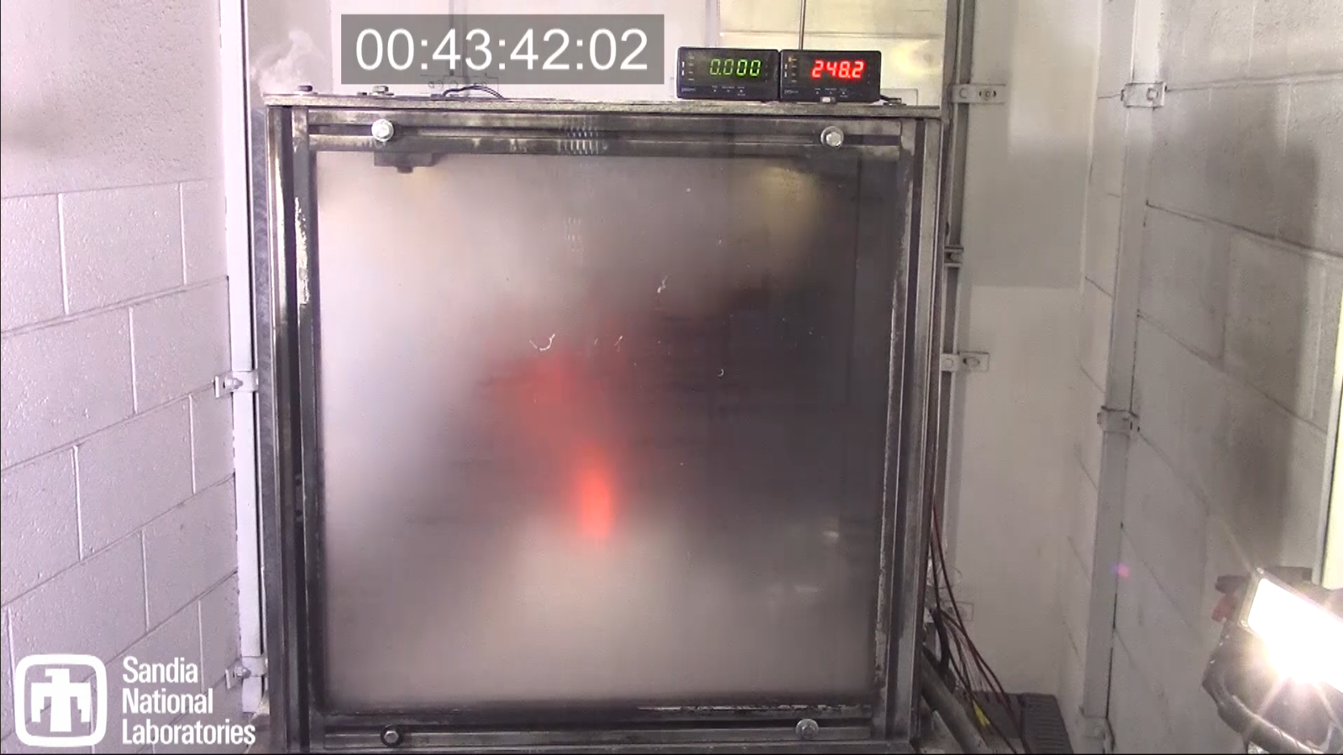
Thermal Ramp

Slide 19
Electrical Abuse Triggers Chemical Instability and Structural Failure
Exceeding voltage limits forces materials into reactive states that bypass normal safety margins.
Over-discharge Risks
Overcharge Hazards
Overdischarge Hazards
Excess Li forms reactive metallic layers on the anode surface.
Dendrites (metallic "needles“) can pierce the separator, causing internal shorts.
Over-delithiation lowers the oxygen release temperature threshold.
Deep discharge causes the anode current collector to dissolve into electrolyte.
Dissolved copper redeposits during recharge, creating conductive bridges (copper dendrites).
Short circuit often triggers during subsequent charging cycles.
The Battery Management System (BMS) is a foundational safety component, not just a performance tool.
TUTORIAL PAGE 10

Slide 20
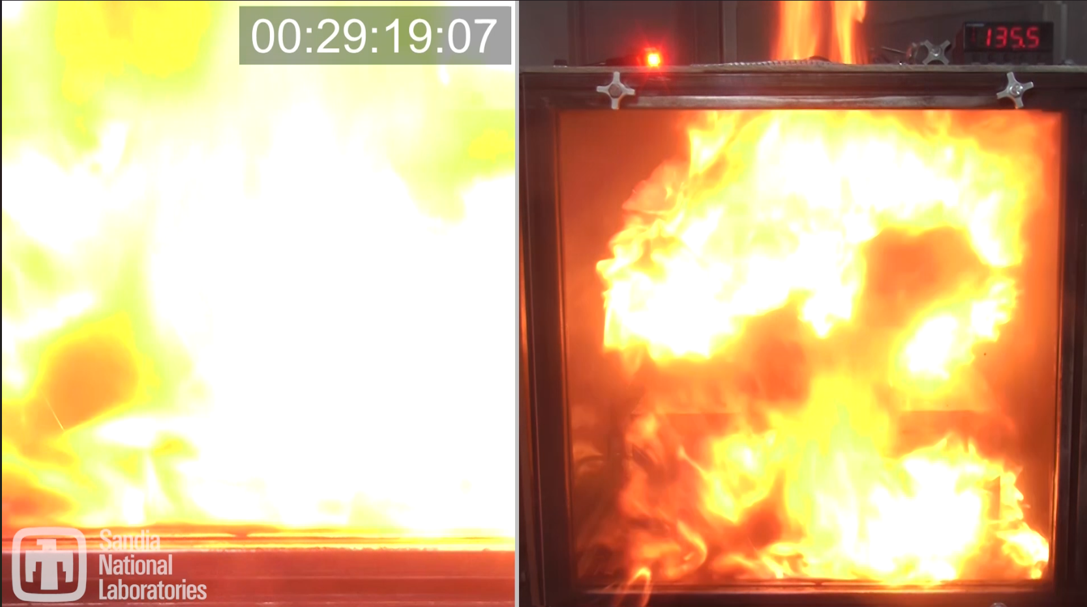
Overcharge

Slide 21
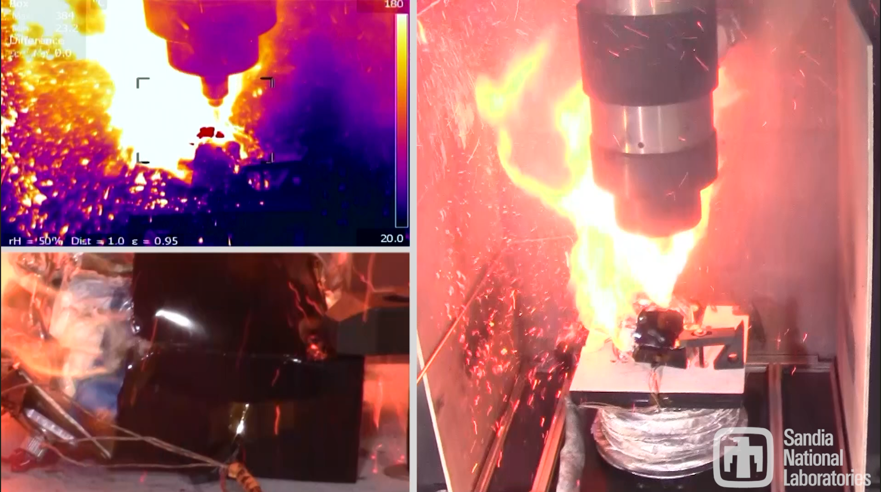
Nail Penetration

Slide 22














Mechanical Deformation Triggers Instant Energy Release
Structural Collapse
Physical deformation—crushing, bending, or penetration—forces the anode and cathode into direct contact by destroying the separator.
COMMON FAILURE SCENARIOS
Vehicular Accidents & Impacts
Instant Internal Short Circuit
Improper Installation/Handling
At high State of Charge (SOC), the stored chemical energy is converted to heat (Joule heating) almost instantaneously at the point of contact.
Seismic or Structural Events
Manufacturing Defects
Localized Thermal Initiation
Intense localized heating can bypass early-stage instabilities (like SEI breakdown), triggering immediate cathode decomposition.
"Mechanical abuse is unique because it forces the cascade to jump directly to the most energetic stage."

Slide 23





All Abuse Modes Converge into a Unified Internal Failure Cascade
Thermal Abuse
Electrical Abuse
Mechanical Abuse
External heat drives internal temperature directly to the SEI decomposition threshold (~80°C).
Overcharge/discharge causes lithium plating or copper dendrites, leading to internal shorts.
Physical crush or penetration collapses internal layers, causing instantaneous energy release.
THE CONVERGENCE POINT
POINT OF NO RETURN
Self-Accelerating Heat Generation exceeds Dissipation
The Unified Thermal Runaway Cascade
SHARED MATERIAL BREAKDOWN
SAFETY IMPLICATION
SEI Layer Disintegration
Separator Melting & Massive Internal Short
Cathode Decomposition & Oxygen Release
Regardless of the initiating event, the cell's internal chemistry dictates the final hazard severity. Mitigation must address the cascade itself."

Slide 24
JUNE 2, 2026
AGENDA
Introduction to Thermal Runaway
Battery Components and Materials
Thermal Runaway Mechanism
Initiation Methods
Critical evaluation of “Safe” Chemistries
Scaling Up Safety
Closing Remarks

Slide 25

LFP Chemistry: Improved Stability is Not Total Immunity
Enhanced Stability (LFP)
Persistent Hazards
The phosphate bond holds oxygen more tightly than metal oxides.
Higher thermal onset temperatures for cathode decomposition.
Lower peak heat release rate during failure events.
Reduced tendency for self-sustained oxygen release.
Still contains flammable organic electrolyte solvents.
Stores significant chemical and electrical energy.
Can still vent, produce toxic or flammable gases, or ignite under abuse.
"More stable" does not equal "stable under all conditions."
Safety Assessment Reality Check
LFP reduces the likelihood of a self-sustained fire, but the hazard of toxic gas release and overpressure remains significant for indoor ESS installations.

Slide 26
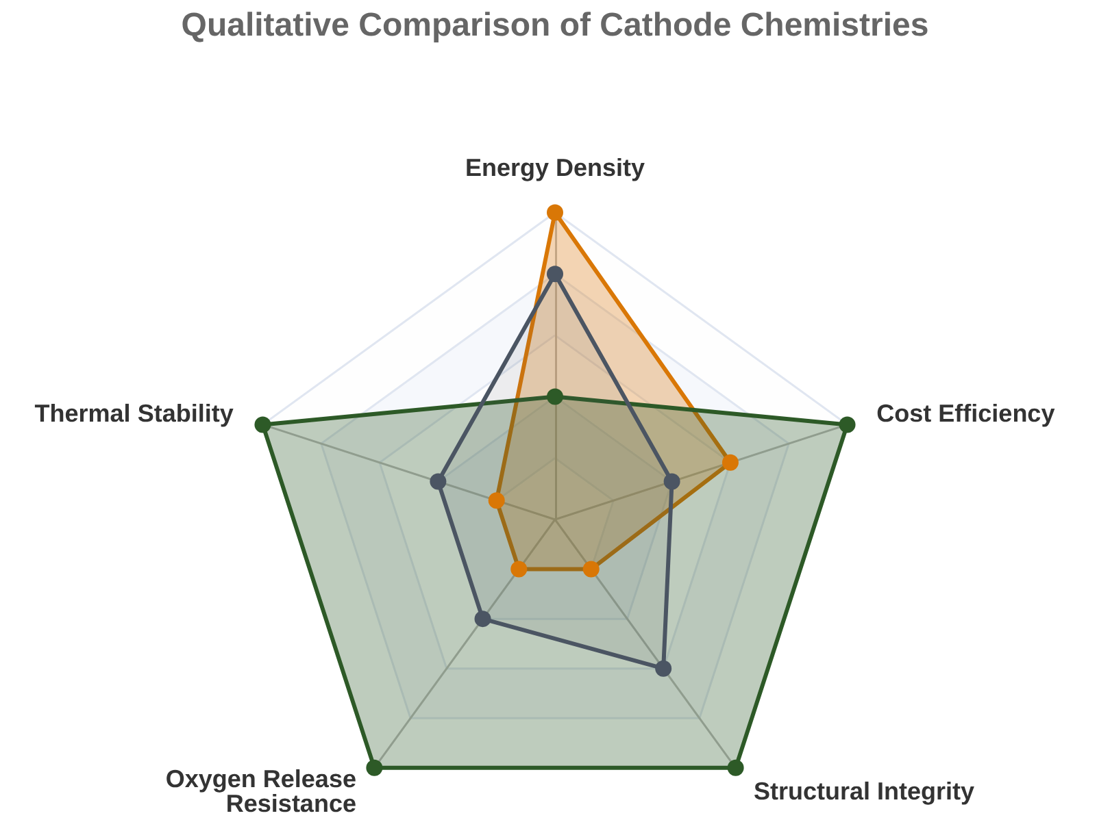






Beyond LFP: Every Chemistry Has a Profile
Balancing energy density with inherent thermal stability
NMC
NCA / High-Ni NMC
• Highest energy density for long-range applications
• Lower structural stability at high temperatures
• Higher tendency for lattice oxygen release
NCA
LFP
LFP (Lithium Iron Phosphate)
• Exceptional thermal and structural stability
• Phosphate bonds hold oxygen tightly
• Tradeoff: Lower specific energy/density
The Engineering Reality
"Safer" does not mean "immune." All chemistries require robust system-level management to mitigate thermal runaway risks.

Slide 27

What About Sodium-Ion?
Lithium-ion and Sodium-ion have analogous materials
Lithium-ion
Sodium-ion
Cathodes:
Layered Metal Oxide (NMC, NCA)
Iron Phosphate (LFP)
Cathodes:
Layered Metal Oxide (NMF, NCO)
Iron Phosphate (NFPP)
Separator
Polypropylene
Polyethylene
Separator
Polypropylene
Polyethylene
Electrolyte
LiPF₆
Carbonate and Ether Solvents
Electrolyte
NaPF₆
Carbonate and Ether Solvents
Anodes
Graphite
Silicon
Anodes
Hard Carbon
Tin

Slide 28
Sodium-Ion Has The Same Thermal Runaway Mechanism
Vent
Thermal Runaway
Binder Decomposition
Self-Heating
Electrolyte Combustion
Layered Metal Oxide Cathode Decomposition
Short Circuit
Separator Melting/Shrinking
Electrolyte Vaporization and Decomposition
Electrolyte/Anode Reaction
SEI Decomposition
50
100
150
200
250
300
350
400
450
>500
°C

Slide 29


Scrutinizing Safety Claims: Beyond "Non-Flammable" Labels
Not all safety data is created equal—context and methodology are critical.
Specific Testing Conditions
Standardized Protocols
Full-Cell Performance
Evaluate the environment of the claim. Was the material tested in isolation or within a high-energy density environment?
Claims must be backed by recognized industry standards (e.g., UL, IEC) rather than proprietary internal methods.
Verify that "stable" components do not introduce new failure modes (e.g., gas generation) when integrated into a complete cell.
Temperature ranges
Pressure variables
Repeatable metrics
Peer-reviewed data
System interaction
Real-world cycling
Scientific Caution: Be wary of absolute terms like "fireproof" or "intrinsically safe." Safety is a function of design, chemistry, and rigorous testing conditions.

Slide 30
JUNE 2, 2026
AGENDA
Introduction to Thermal Runaway
Battery Components and Materials
Thermal Runaway Mechanism
Initiation Methods
Critical evaluation of “Safe” Chemistries
Scaling Up Safety
Closing Remarks

Slide 31














Vented Gases Create Toxic and Explosive Risks
Even Without Visible Fire
H₂
FLAMMABLE
CO
TOXIC & FLAMMABLE
Venting Mechanism
Hydrogen
Carbon Oxide
Cell pressure rises until the vent or seal fails, releasing high-velocity gas and vapor.
High buoyancy, wide explosive range
Asphyxiant, often produced in high volumes.
Hidden Toxicity
Gases like HF are toxic and corrosive, posing immediate hazards to first responders.
ENVIRONMENTAL
HF
HIGHLY TOXIC
Vapors
Hydrogen Fluoride
Explosion Potential
H₂ and CO can build up in enclosures and trigger delayed deflagrations if ignited.
Corrosive, penetrates skin, attacks bone.
Flammable mist, contributes to fire spread.
Critical Safety Insight
No flames does not mean the area is safe; gas hazards can persist, especially with poor ventilation.

Slide 32

The Hazard Is Bigger Than the Flame
Thermal runaway produces multiple hazard domains requiring unique mitigation.
Fire
Smoke & Particulates
Visible combustion of electrolyte and gases. High radiant heat can drive propagation to neighboring cells.
Reduces visibility for responders and can leave conductive soot deposits on sensitive electronics.
Toxic & Flammable Gas
Overpressure
Venting can occur without fire. Gases may be toxic (HF, CO) or form explosive mixtures in enclosed spaces.
Rapid gas generation in sealed enclosures can cause structural failure or violent "projectiles" if not vented.
Safety design must address ALL domains: Suppression is not the same as gas management.

Slide 33









Material Mitigation Strategies: Engineering Out the Risk
Advanced Separators
Stable Electrolytes
Cathode Engineering
Ceramic Coatings: Prevents physical contact between electrodes at high temperatures.
Flame Retardants: Organic phosphorous additives reduce the flammability of solvents.
Surface Coatings: Nanometer-thin metal oxide layers inhibit oxygen release.
SEI Stabilizers: Additives that create a more robust protective layer on the anode.
Doping: Modifying the crystal structure to improve lattice stability during heating.
Thermal Shutdown: Pores close automatically to stop ion flow when heat thresholds are reached.
Non-Flammable Salts: Transitioning to salt systems with higher thermal decomposition points.
LFP Transition: Utilizing iron-phosphate chemistries for inherently lower oxygen release.
Shrinkage Resistance: Maintains structural integrity up to ~200°C.

Slide 34




From Cell Materials to ESS System Safety
Material-level insights drive robust engineering controls and system protections.
BMS Controls
Physical Spacing
Suppression
Prevents electrical abuse (overcharge)
Monitors thermal thresholds (SEI stability)
Acts as a primary safety component
Mitigates thermal abuse propagation
Prevents "domino effect" between cells
Engineered thermal isolation barriers
Manages the hazard domains (fire/gas)
Cools adjacent cells to stop cascade
Advanced detection of venting gases
The Safety Bridge: We cannot engineer system safety without knowing the material thresholds of the cells inside. System-level protection is the final layer of defense for the cell's internal chemistry.

Slide 35
JUNE 2, 2026
AGENDA
Introduction to Thermal Runaway
Battery Components and Materials
Thermal Runaway Mechanism
Initiation Methods
Critical evaluation of “Safe” Chemistries
Scaling Up Safety
Closing Remarks

Slide 36
Safety Starts with Science: Thermal Runaway Fundamentals
The Core Mechanism
The Material Cascade
Thermal runaway is a self-accelerating heat balance failure. It is a positive feedback loop where internal heat generation exceeds dissipation capacity.
Failure is a predictable sequence: SEI decomposition (80-120°C) → Separator failure → Cathode oxygen release → Electrolyte combustion.
Diverse Triggers, One Path
Material-to-System Safety
Thermal, Electrical, and Mechanical abuse modes differ in initiation but converge on the same internal exothermic chemical breakdown.
System resilience depends on cell chemistry (e.g., LFP vs Oxide) and engineering barriers to prevent cell-to-cell propagation.

Slide 37



Poll Questions
Please visit Poll Everywhere via the QR code below (mobile) or at pe.app/essrf (laptop). If you would like to add your name, please update with the “pencil” icon. If not, feel free to remain anonymous

Slide 38

Polling Questions
A cell can go into thermal runaway without catching fire.
  True
  False
Heat generation primarily comes from reaction between the cathode and the electrolyte (i.e. electrolyte combustion).
  True
  False
Which event initiates self-heating?
  Electrolyte reacting with the anode
  SEI decomposition
  Electrolyte decomposition
  Oxygen evolution from the cathode
Which cell chemistries are inherently safe?
  LFP
  Na-ion
  Non-flammable electrolytes
  All of the above
  None of the above
Which of the following is not a common thermal runaway initiation method?
  Optical
  Mechanical
  Electrical
  Thermal
Safety can be engineered at which level:
  Materials
  System
  Both a and b
  Neither a nor b

Slide 39
JUNE 2, 2026
THANK YOU

